Slide 1
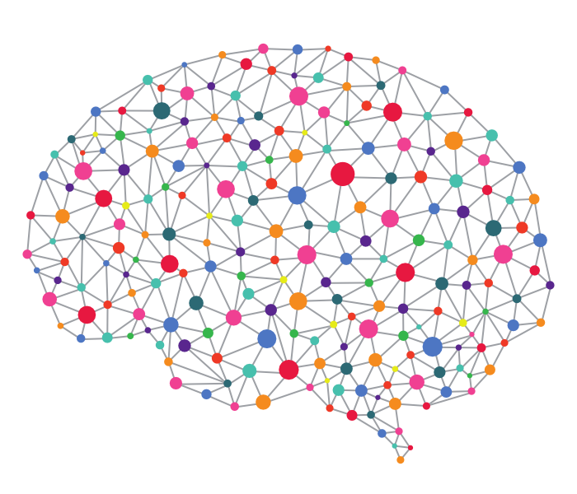
LG-KAIST AI [ Deep Reinforcement Learning 실습 3] Code Review & Experiment: Generative Adversarial Imitation Learning Algorithm
TA: Haanvid Lee, HyeongJoo Hwang, Shinhyung Kim
Advisor: Kee-Eung Kim
KAIST AIPR Lab
[ Contact Info. ]
Haanvid Lee: hvlee@ai.kaist.ac.kr HyeongJoo Hwang: hjhwang@ai.kaist.ac.kr
Shinhyung Kim: shkim@ai.kaist.ac.kr
KeeEung Kim: kekim@cs.kaist.ac.kr

Slide 2
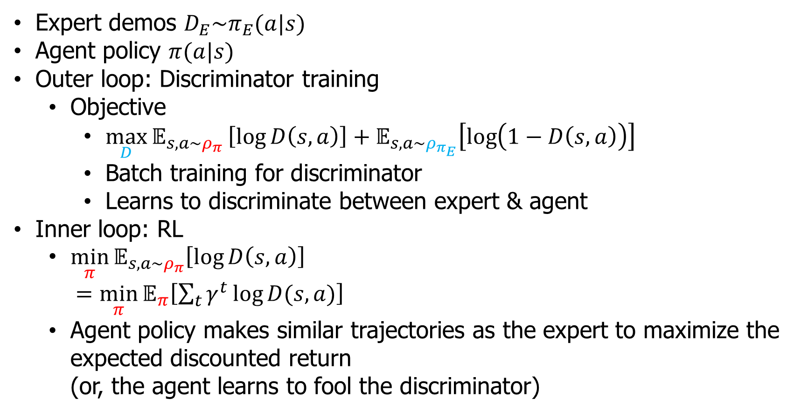
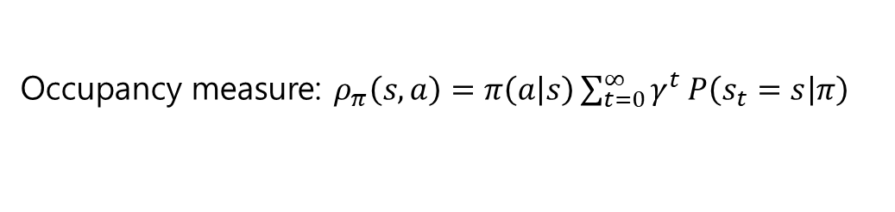
GAIL
Occupancy measure: $ρ_{π}\left(s,a\right)=π\left(a | s\right)\sum_{t=0}^{∞}{γ^{t}}P\left(s_{t}=s | π\right)$
Expert demos $D_{E}\sim π_{E}(a|s)$
Agent policy $π(a|s)$
Outer loop: Discriminator training
Objective
${\max_{D}{𝔼}}_{s,a\sim ρ_{π}}\left[\log{D\left(s,a\right)}\right]+𝔼_{s,a\sim ρ_{π_{E}}}\left[\log\left(1−D\left(s,a\right)\right)\right]$
Batch training for discriminator
Learns to discriminate between expert & agent
Inner loop: RL
$\min_{π}{𝔼_{s,a\sim ρ_{π}}\left[\log{D\left(s,a\right)}\right]}$ $=\min_{π}{𝔼_{π}\left[\sum_{t}{γ^{t}\log{D(s,a)}}\right]}$
Agent policy makes similar trajectories as the expert to maximize the expected discounted return (or, the agent learns to fool the discriminator)
D=0 when the discriminator think if it is from the expert
Ho et al. (NIPS 2016). “Generative Adversarial Imitation learning “
Notes:
On-policy: 다른 policy에서 sampl된 trajectory 또는 episode들을 사용할 수 없다.

Slide 3
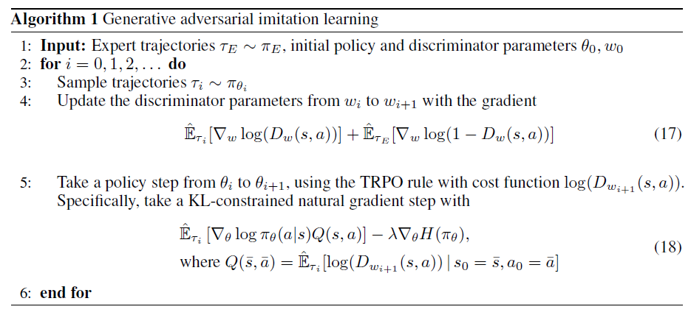
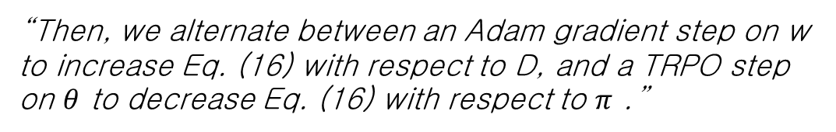
In the paper:
“Then, we alternate between an Adam gradient step on w to increase Eq. (16) with respect to D, and a TRPO step on $θ$ to decrease Eq. (16) with respect to $π$ .”
Ho et al. (NIPS 2016). “Generative Adversarial Imitation learning “
Notes:
On-policy: 다른 policy에서 sampl된 trajectory 또는 episode들을 사용할 수 없다.

Slide 4
Next, we review the author’s code & run the code

