Slide 1
ecalj course menu
Monday 15:40~17:40,17:50~19:20
LECTURE1: PMT method
How to solve one-body problem? →PMT= LAPW+LMTO
LECTURE2: Quasiparticle self-consistent GW method
theory and results until now.
Some kinds of numerical techniques.
Get Started!
Install ecalj, and go through “ecalj tutorial”.
Observe how it works.
-------------------------------------------------------------------------
Tuesday: 9:00~17:20, Wednesday 9:00~11:00 (or to 12:10).
ctrl file and output.
Numerical technique and GWinput.
Read output (console output, data).
Check points (How to get reliable results?)

Slide 2
The PMT method: a new linearized method Takao Kotani (tottori-u)
PMT =APW + MTO
Muffin-tin
Key point:
1. Iteration cycle.
2. eigenfunctions are expanded with
APWs(augmented plane wave)
and MTOs(muffin-tin orbital)
Notes:
I thank to organizers prof.Ebert, diemo, and Ogura-san for the invitation to this meeting.
My talk is about a new linearlized method, the PMT method.
…
PMT means APW+MTO.
APW is the augmented plane wave.
MTO is the muffin-tin orbital, which is the atomic-centered augmented wave.
As this name stand for, the PMT method is a mixed basis linearized method,
which uses both of the augmented wave together.
My talk is as follows.
At the next page, my motivation. I explain why I started the PMT.
Then I will remind you what is the linearized method, APW, and MTO.
Then you will see why the PMT method can be important..
The I will give a few key points in its theoretical formulation.
Then I will show recent results on the homonuclear diatomic molecules in the PBE exchange-correlation calculations.

Slide 3
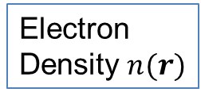
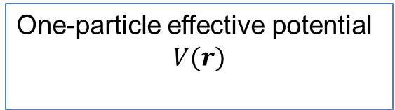
Independent particle picture and total energy
These can be obtained by the density functional theory (DFT) in LDA.
Electron
Density $n(r)$
DFT in LDA
One-particle effective potential
$$V(r)$$
Fill up to Fermi energy
iteration
cycle
This iteration cycle until converged = total energy minimization

Slide 4
How to represent density and so on in computer?
How to solve it numerically?
Lists of the Full-potential methods
KKR
Pseudopotential method
PAW
LMTO
LAPW
Linearized xxx methods
(why do we call them ” linearized” method?
→from the view of “exact ” APW method)
Notes:
…
Until now
I expect such a method should be

Slide 5
Finite basis set
Basis set (finite number of basis)
→ We assume eigenfunctions are given as:
Finite dimension problem(as the same as LCAO/Gaussian)
Notes:
Let us remind the framework of the linear method.
In the method two key quantities are
→Minimize the total energy with respect to alpha_p^I
If we fix psi_p, minimization is done with respect to this coefficient alpha.
Note that F_j can changes when we move atoms.

Slide 6
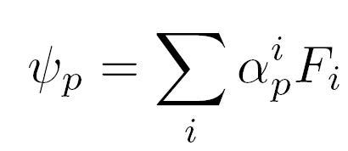
iteration cycle
previous iteration
Next iteration
Notes:
This is the flow chart of the linearized method to attain the total energy minimization.
Augmented wave can be determined with the knowledge of V(r).
Augmentation can be independent of V(r)
Or are set up from MT part of the potential.

Slide 7
How to choose the good basis?
APW (augmented plane wave)
MTO ( muffin-tin orbital)
are the names of the basis functions.
Both of them are made by “augmentation”.
My conclusion:
To overcome shortcomings in APW basis and MTO basis, we should use both of APW and MTO together. →this means the PMT method
But wait…
What is the APW and MTO?→ next page.
Notes:
Faster is better.
Improvement as for

Slide 8
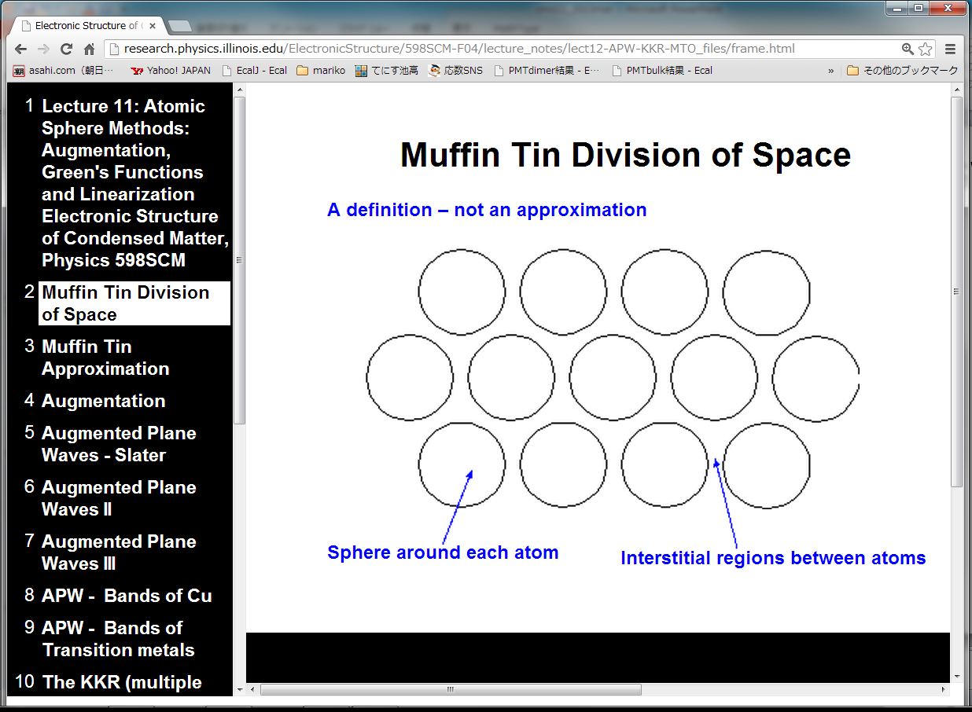
MT regions
Interstitial region
http://research.physics.illinois.edu/ElectronicStructure/598SCM-F04/lecture_notes/

Slide 9
Envelope function = PlaneWave(PW)
ＡＰＷ
PW in MT
MT region
MT region
3-components
PW ＋ Atomic-like part － Counter part:
PW within MT
0th 1st 2nd
Good for Na(3s), high energy bands.
Not so good for Cu(3d), O(2p)
Systematic
Notes:
This is a schematic view of APW.
APW
Atomic-like functions consist of linear combination of two atomiic-like waves for each lm channel,
The linear combination is so that they are continiously connected to the envelope functions as for value and slope.
Schematic view of APW

Slide 10
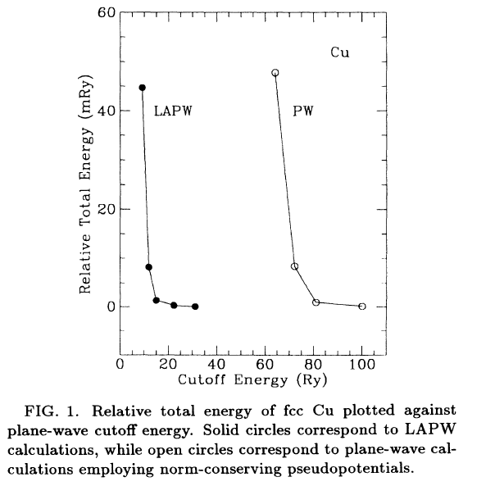
Linearized APW
fcc Cu
plane wave is not
so efficient for 3d
15Ry or more for
~1mRy convergence
D.Singh et al PRB49,17424
Notes:
~15Ry or more is required for ~1mRy convergence
This too large cutoff is only used to describe shape of eigenfunction around atom.
Why do we need such large cutoff? → This is because of the nature of PW.

Slide 11
ＭＴＯ
Atom-centered Hankel function, e.g,
Smooth Hakel function
MT region
MT region
3-components
Hankel ＋ Atomic-like part － counter part of Hankel
0th 1st 2nd
Good for localized orbitals such as Cu(3d), O(2p)
Ｎot so good for extended states, surface.
Not systematic
Notes:
To treat conduction bands for Si or so, we need empty sphere.
It will be very difficult to treat atoms on surface and so on
Atom-centered Hankel function. (in practice we use smoothed Hankel function)..
Hankel is a solution of a flat potential.
Smooth charge can not → we use smoothed Hankel function

Slide 12
PMT =APW + MTO
T.K and M.van Schilfgaarde
arXiv:0808.1604
Phys. Rev. B 81, 125117 (2010)
T.K and H. Kino
Supercell calculations from H2 through Kr2.
Almost automatic setting of MTOs with APWs
(Energy cutoff 3~4Ry) .
Journal of the Physical Society of Japan,
vol. 82, no. 12, p. 124714, (2013).
Notes:
So, some year ago, I got conclusion that I have to develop this method.
Use MTO and APW together..
As we explained, the eigenfuncitons in solids can look like APW or MTO,
So the method fits to the eigenfunctions in real materials.
These are results for solids, MTOs are not controlled well,
formulation is unclear..
Such dimers are not so easily treated in these methods.

Slide 13
Basis function
Envelope function
PW or smHankel
Atomic-like parts
for
Counter part
for
Augmentation parts
Cutoff:
Radial-part expansion
Electron density $n\left(r\right)$ and potential $V(r)$ are expanded in a similar manner.
Notes:
A basis consists of the three components.
For simplicity, consider the case with an atom in a cell with periodic boundary condition.
Spin index is now shown explicitly.
Augmentation procedure can be dependent on the basis set.
Expanded in the spherical Harmonics.
J is the index for a basis function
Envelope function PW or Hankel functions.
True part within MT site a.
This parenthes means a set of functions for MTs.

Slide 14
Local orbitals(lo): basis functions which are Non-zero only wihtin MTs.
e.g, see http://www.wien2k.at/lapw/index.html
This is also used together.

Slide 15
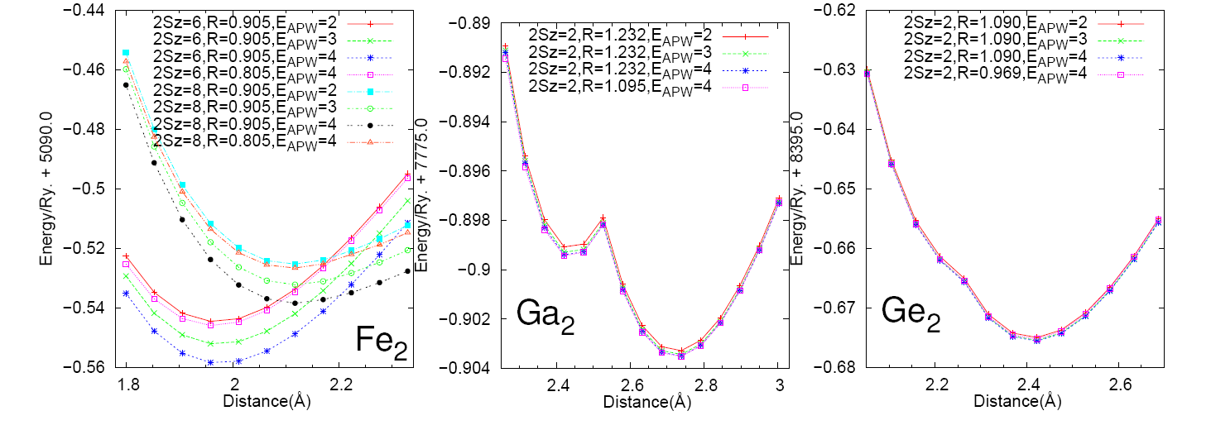
N_{basis}=1081+36×2, 1973+36×２, 3025+36×２

Slide 16
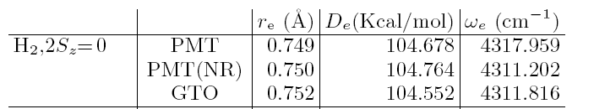
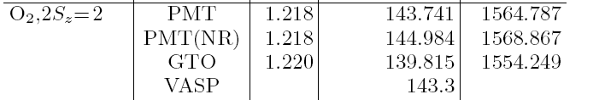
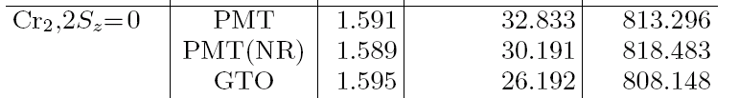


Comparison with Gaussian
ＮＲ：non relativistic ＧＴＯ：6-311+G(d,p)

Slide 17
Quasiparticle self-consistent GW
Takao kotani(tottori university)
Mean field theory.
What the eigenvalue means?
GW, and QSGW method
Minimum and previous results.

Slide 18
Mean field theory gives independent-particle picture
Hartree-Fock theory
Density functional theory

Slide 19
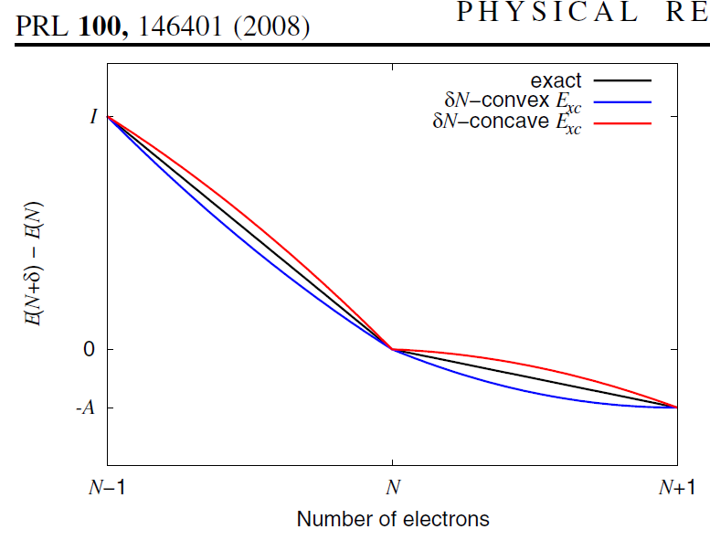
Ionization energy of an atom
A.J.Cohen, P. Mori-Sanchez, W.Yang, Science321,792(2008)
Vacuum level
LUMO
LUMO
HOMO
HOMO
HF LDA
How about solid (infinite system)?→

Slide 20
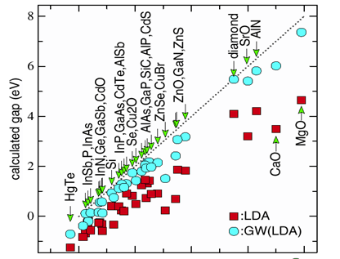
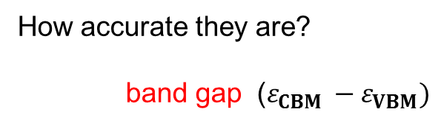
Conduction band
How accurate they are?
band gap ($ε_{CBM }−ε_{VBM})$
Band gap
Valence band
LDA gives too small
HF(not shown) gives too large
Experimental gap (eV)

Slide 21
GW method and QSGW method

Slide 22
Why ＱＳＧＷ？
We need good independent particle picture in order to calculate linear responses (magnetic optical, transport…).
H0 (eigenvalue and eigenfunctions) are required.
＊ Band gap, Effective mass
＊Relative position of levels.
ＬＵＭＯ－ＨＯＭＯ, Fermi energy…
Metal
Molecule
ＬＵＭＯ
Molecule on
top of metal.
Fermi energy
ＨＯＭＯ

Slide 23
(preparation) What is Green’s function?
Example: Laplace eq.
→
(note boundary condition)
Note: G₀ = G₀electron + G₀hole

Slide 24
Many-body perturbation theory(picture)
The many-body Hamiltonian is decomposed to
H= H₀ ＋ Vee＋residual term
． H₀ is despribed by G_{0.}
Many electrons are interacting each other. Add electrons and holes,
and observe this afterwards.
Time axis

Slide 25
polarization
External field

Slide 26
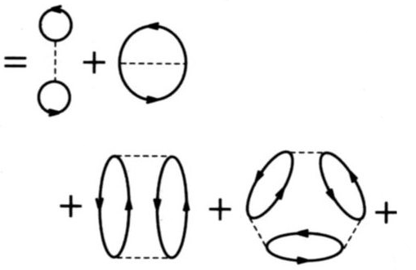
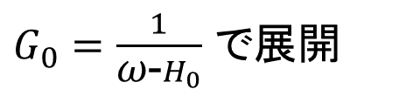
GW is based on the “RPA total energy”
$G_{0}=\frac{1}{\text{ω}\text{−}H_{0}}$ で展開
…
This is one-shot GW
Notes:
Let me explain minimum on the GW approximaiton.
RPA total energy.
This is a key point to interpret the meanings of GW approximation for localized orbitals.
I may say many researchers do not care about this, and apply GW in a wrong manner.
Historical reason, there is consusion about what Ei means...

Slide 27
How to determine better H₀ ?
→
An average procedure
(not shown here)

Slide 28
Non-local potential term (as Fock exchange term) is important.
I. Localized electrons ← LDA+U type effect
(Onsite non-locality. self-interaction included).
It can break time-reversal symmetry → No orbital moment.
II. Extended electrons ← GW type effect for semiconductor.
Important to describe band gap. Off-site non-locality.
(required to distinguish “bonding orbital”
and “anti-bonding” orbitals. ) →next page
Notes:
So, I want to emphasise importance of Non-locality in GW approximaiton.
This is missing in LDA/GGA calculations.
Roughly speaking, its effects are devided into these two. Effects.
You may say this is LDA+U type effect.

Slide 29
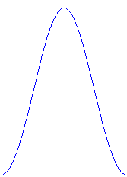
Schematic explanation on off-site exchange
If
Bonding ＨＯＭＯ
Anti-Bonding, ＬＵＭＯ,
square of them are the same.
Local potential can not distinguish
LUMO and HOMO.
Notes:
No

Slide 30
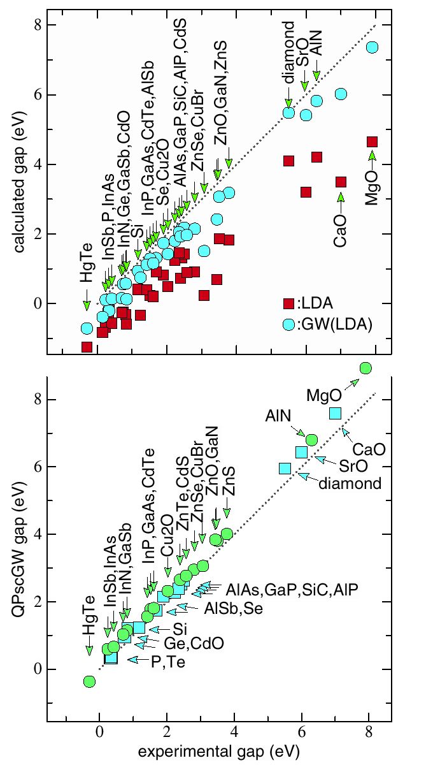
BAND GAP
LDA, one-shot GW
Calculated(eV)
QSGW
(we see systematic
over estimation).
Experimental Band gap (eV)

Slide 31
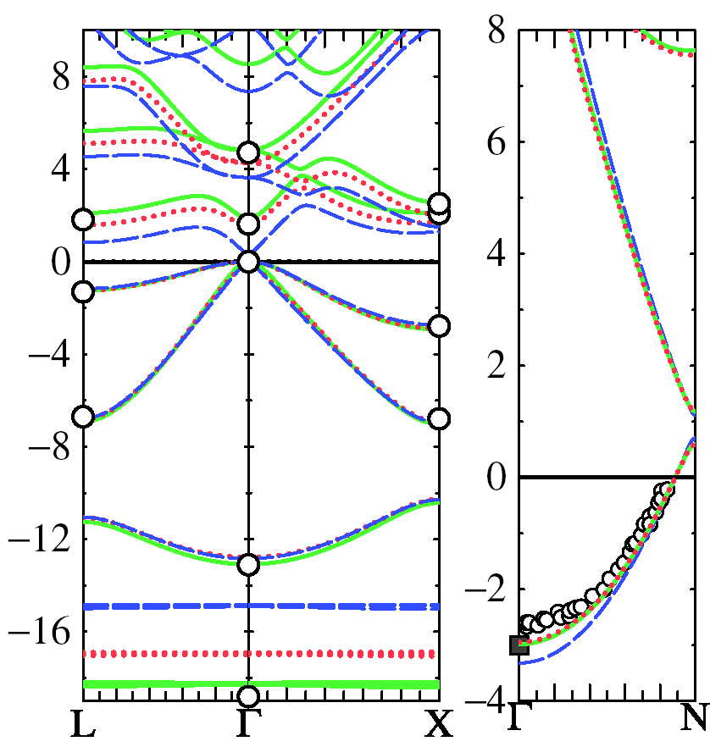
sp bonded systems
LDA: broken blue
QSGW: green
G^{LDA}W^{LDA}: Dotted red
O: Experiment
m* (QSGW) = 0.073
m* (LDA) = 0.022
m* (expt) = 0.067
Na
GaAs
Gap too large by ~0.3 eV
Band dispersions ~0.1 eV
Na bandwidth reduced by 15%
Ga d level well described

Slide 32
ZnO
Black:QSGW 3.87eV
Red:LDA 0.71eV
Green:G^{LDA}W^{LDA} (Z=1,Offdiagonal included) 3.00eV
Blue：e-only self-consistency 3.64eV
Experiment(+correction) 3.60eV
Kotani et al PRB76,165106(2007)
Notes:
Our main result is by the black line shown here.
>Red LDA.
Green one-shot (including off-diagonla part)
E-olny (disentanglement problem).

Slide 33
d systems
“No Pushing down 3d-band’’ in GW.
Notes:
As for Cu case, we did not see “pushing down effect of 3d level”.
Especially NiO and MnAs, we have good agreement with experiment.
It was poor in LDA.

Slide 34
NiO
Black:QSGW Red:LDA Blue: e-only
Notes:
E-only poor. Valence part is changed little from LDA.

Slide 35
NiO MnO dos
Black:t2g Red:eg
Red(bottom): expt
Notes:
As for Cu case, we did not see “pushing down effect of 3d level”.
Especially NiO and MnAs, we have good agreement with experiment.
It was poor in LDA.

Slide 36
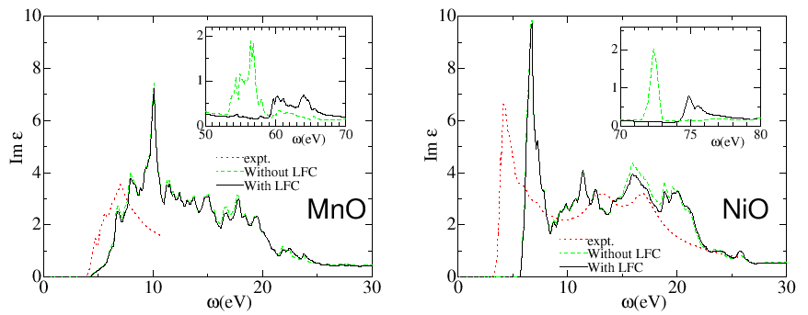
NiO MnO dielectric
Black:Im eps with LFC Red:expt
Notes:
As for Cu case, we did not see “pushing down effect of 3d level”.
Especially NiO and MnAs, we have good agreement with experiment.
It was poor in LDA.

Slide 37
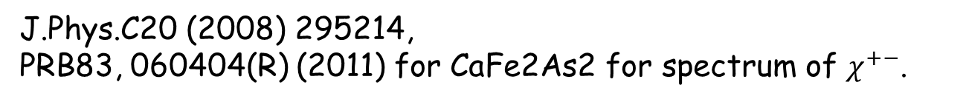
Spin wave dispersion based on QSGW

Slide 38
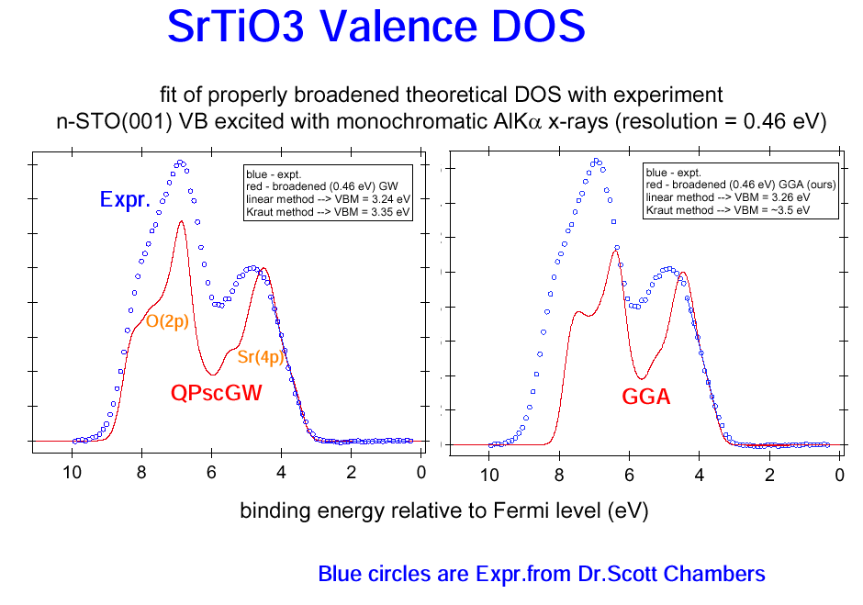
srtio3
QSGW
S. A. Chambers et al, Surface Sci 554,81-89 (2004)
Notes:
To determine the Fermi energy.

Slide 39
Large d(x²-y²) - ｄ（z²) separation.
SW.Jang,MJ.Han,H.Kino,K.Kuroki,TK in preparation

Slide 40
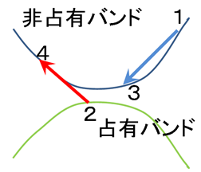
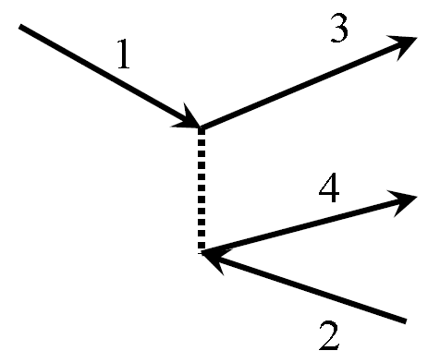
Impact ionization rate(auger process)
Fermi’s Golden rult → transition rate. Sum up for all final states. Matrix element of transition is
＜1,3｜electron-electron interaction｜4,2＞
（Energy conservation and Momentum conservation）
Unoccupied band
Occupied band
Notes:
エネルギーと運動量保存がある．
エネルギー

Slide 41
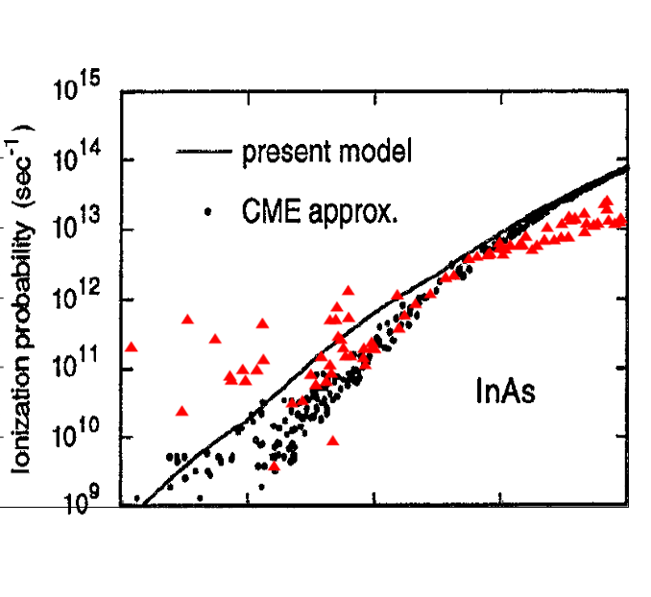
InAs impact ionization rate (=auger process = high energy electron lose energy with e-h pair)
direct gap 0.38eV
2 3 4 5
eV
Present model: Sano and Yoshii JAP77 2020 (1995)
Notes:
Impact ionization rare is the life time of electrons caused by electron-electron scattering.
It is calculated from the imaginary part
of the self-energy.
Auger effect.

Slide 42
YH3(fcc structure 6x6x6)
GGA
QSGW
L Γ X
L Γ X

Slide 43
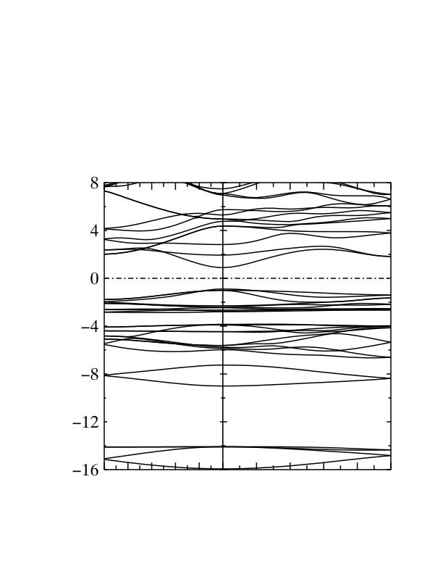
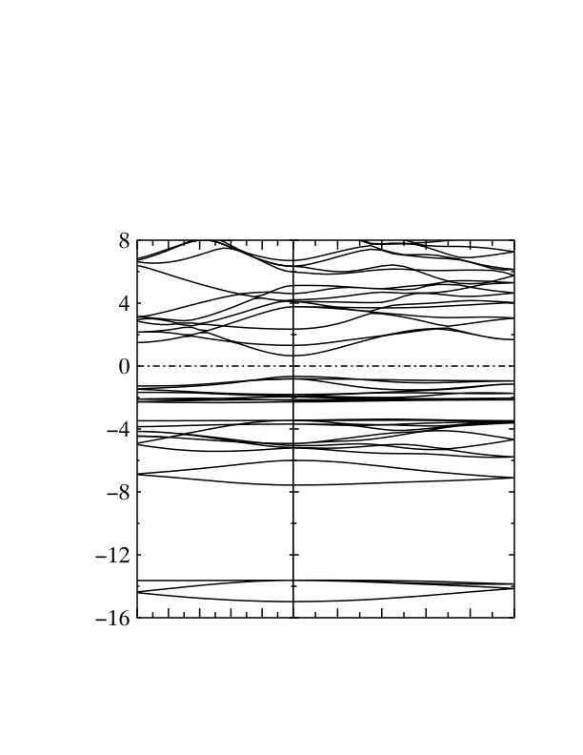
CuGaSe2 (eight atoms in cell, 2x2x2. ~3hours per iteration by single core)
1shotGW
QSGW
T
Γ
N
T
Γ
N
Band gap GGA:0.4eV, GW(1shot noZ) 1.37 eV, QSGW(1.79eV) Exper. 1.63, 1.67, 1.73eV
Notes:
実験のバンドギャップは1.63, 1.67, 1.73eVといったところのようで、1.67eVのH¥"{o}rigらの論文(W. H¥"{o}rig, H. Neumann, B. Schumann, and G. K¥"{u}hn, phys. stat. sol. 85 (1978) K75 )が引かれることが多いようです。 計算ではGGAでは0.399eV, GWの1shotで1.37 eV, self-consistentに回した計算で 1.79 eVなんだと思います。lmf の結果のband gapの所を見たのですがこれでよいでしょうか？ バンドプロットの全体的な様相としてはどれもそれほどは変わりませんが、バンドギャップのところと、Cu-3d と Se-3p の混成でできているバンドの 分裂がGGAに比べて大きく出ていることと、それからGa-SeのボンドがつくるバンドがGGAに比べて押し下げられているいるのが顕著なように 思います。 Ga-SeのバンドはPhotoemissionの実験ではvalenceのトップから 7.35eVのところにあると見積もられていて(M. Turowski, G. Margaritondo, M. K. Kelly and R. D. Tomlinson, Phys. Rev. B 31 (1985) 1022) 計算の結果はGGAを改善する方向に動いていて、この値に近いと いえると思います。

Slide 44
CuInS₂ band gap（eV)
Band gap for CuAB₂ （eV)
A B | S | Se
Al | 3.62 (3.49) | 2.91 (2.67)
Ga | 2.83 (2.43) | 1.69 (1.68)
In | 1.22(u=0.22)1.48(u=0.23) (1.53) | ---- (1.04)
0.22 0.23 u
Experiments in (…)
J.Vidal, PRL 104, 056401 (2010)
3x3x3 calculation(need check)
Notes:
We usually expect
Internal parameter problem?
CuGaSe (1.4eV)?

Slide 45
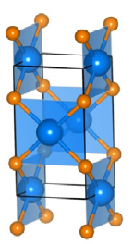
PdO(tetragonal , four atoms per cell 3x3x2 calculation , 1hour per iteration )
GGA
QSGW
Γ X M Γ Z R A Z
Γ X M Γ Z R A Z
Band gap about 0.7 eV

Slide 46
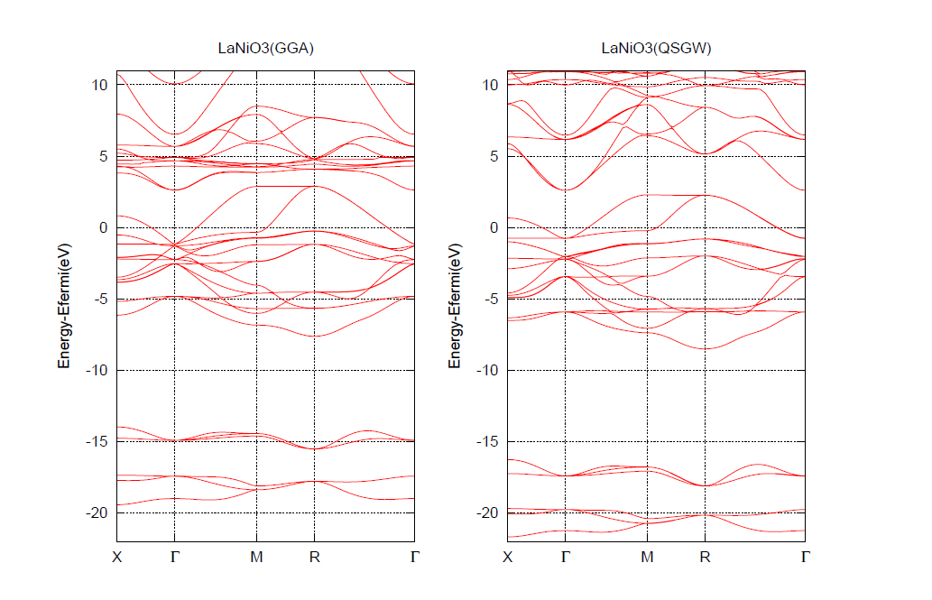
LaNiO3
M.J.Han, H.Kino, T.K (arXiv:1402.4915)
Notes:
LaNiO3/LaAlO3

Slide 47
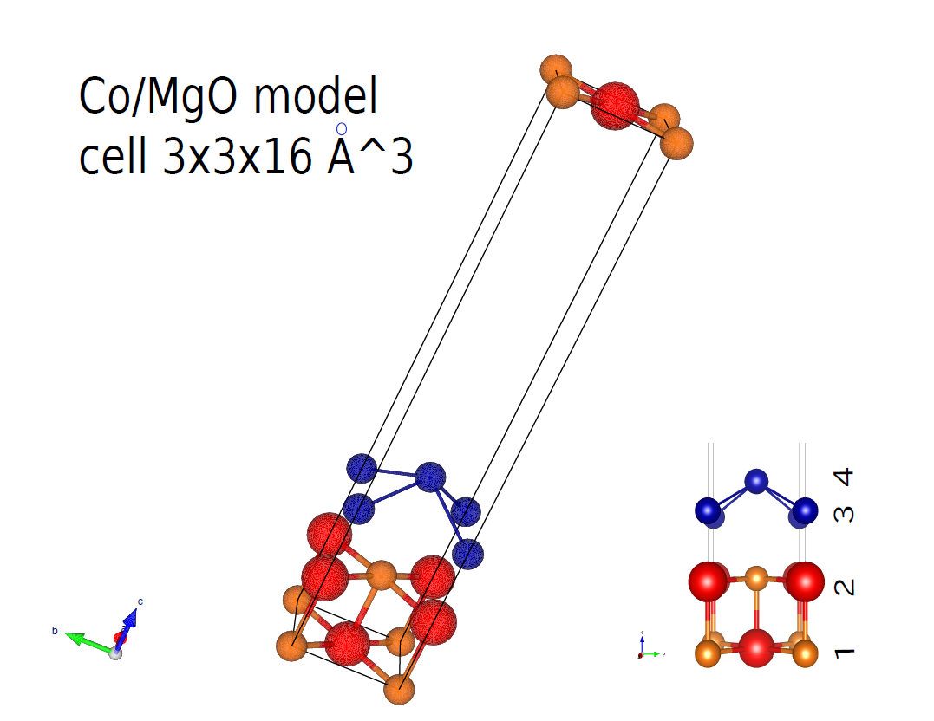

Slide 48
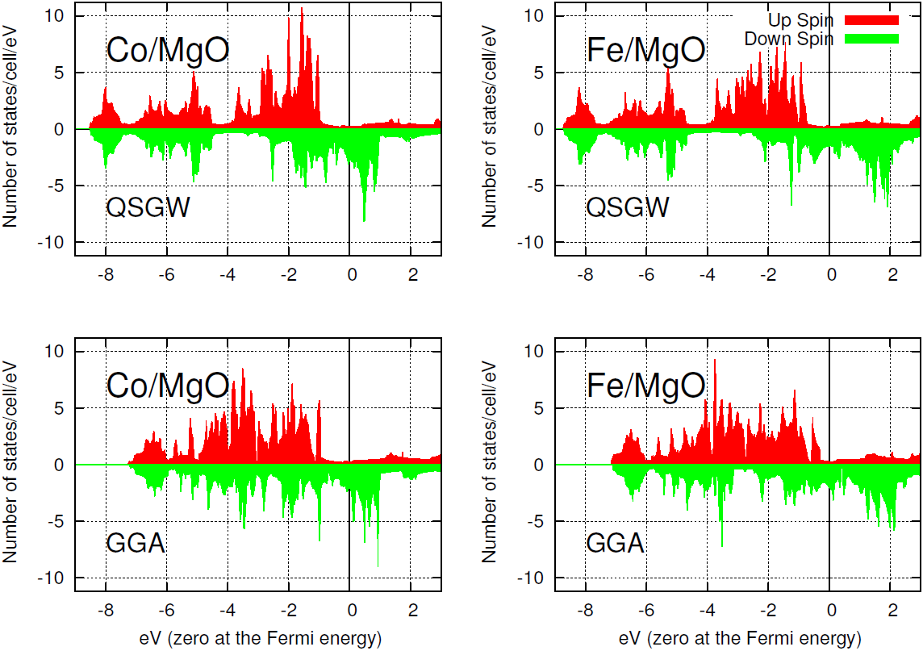

Slide 49
summary
Mean field theory and excitation energy
LDA, Hartree-Fock and QSGW
Janak theorem, finite vs.infinite system
RPA total energy
QSGW method
Some Results
Band gap, GaAs and Na, Cu
NiO, Spin Wave, ZnO, LaMnO3,
InAs (impact ionization), YH3, CuGaSe2,PdO
How QSGW works for atoms and molecules?
See F.Bruneval J.Chem.Phys 136,194107(2012)

