Slide 1


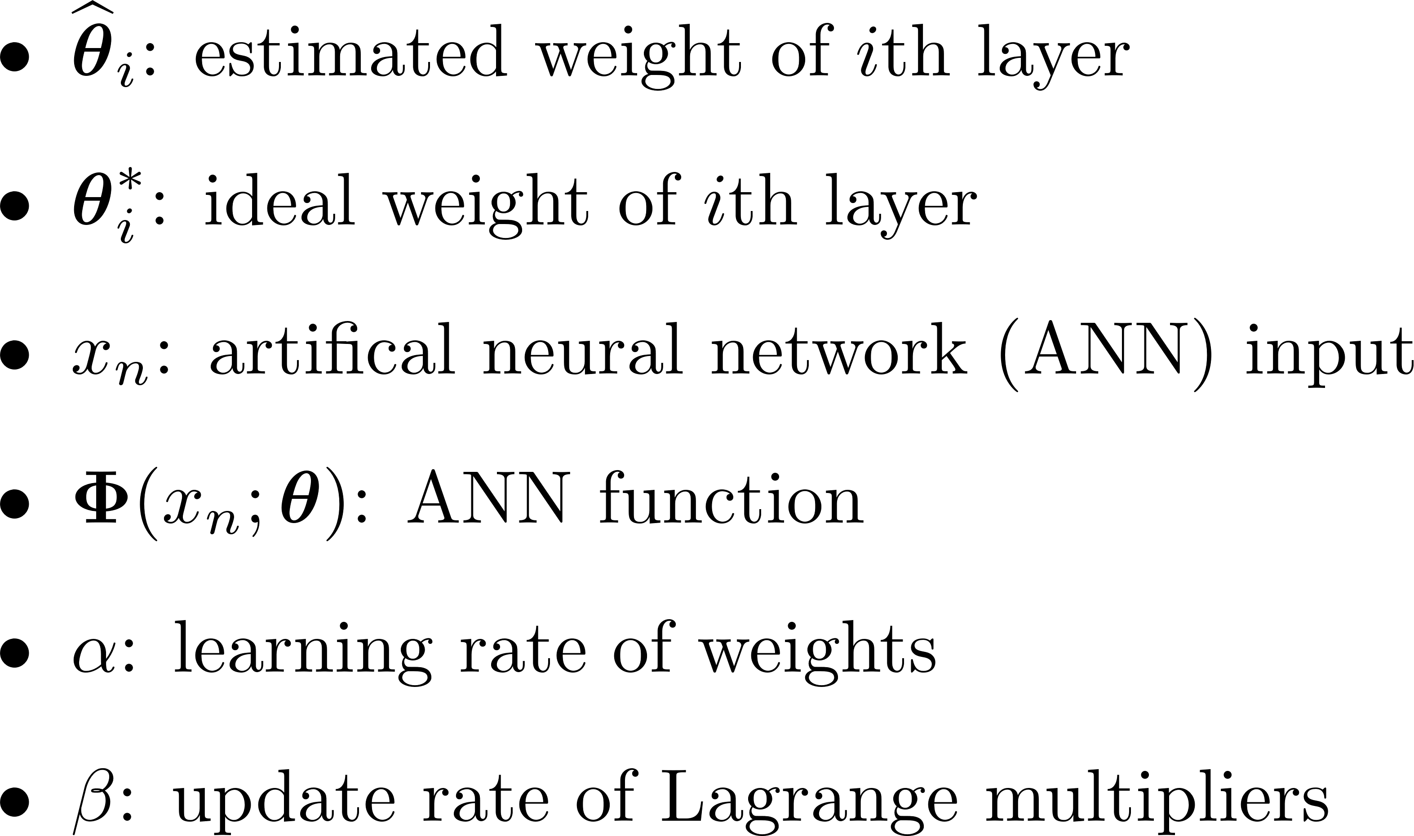
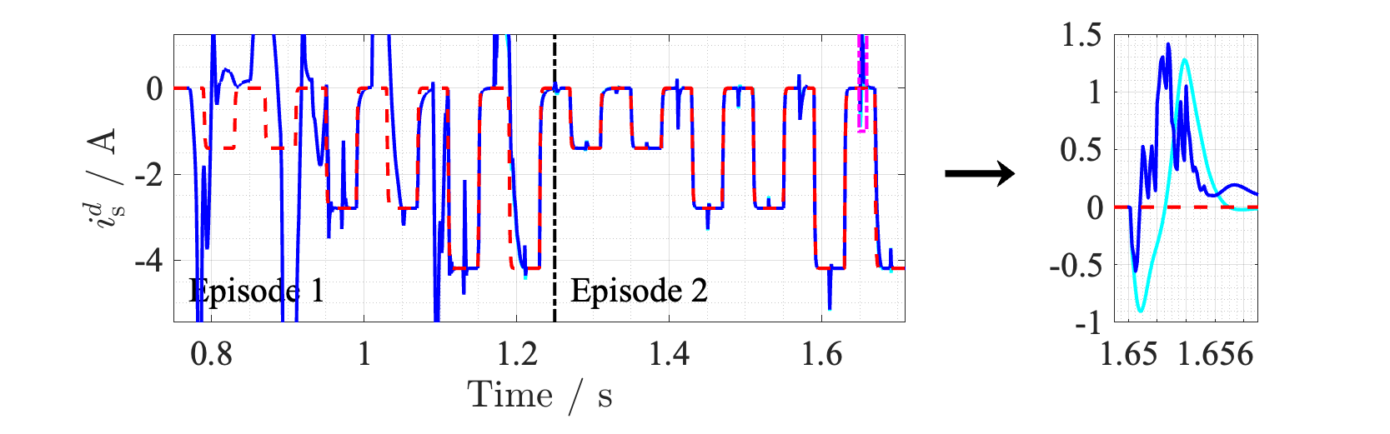
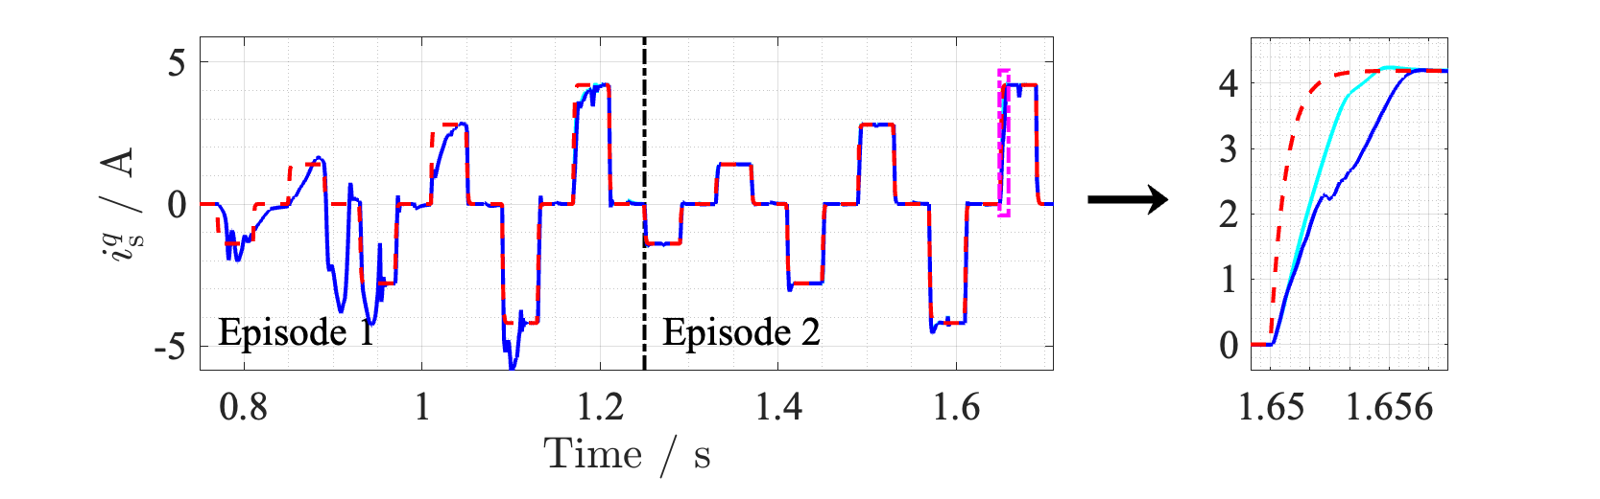
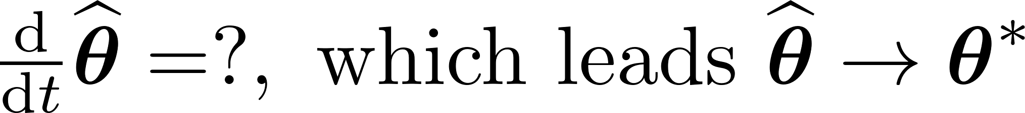
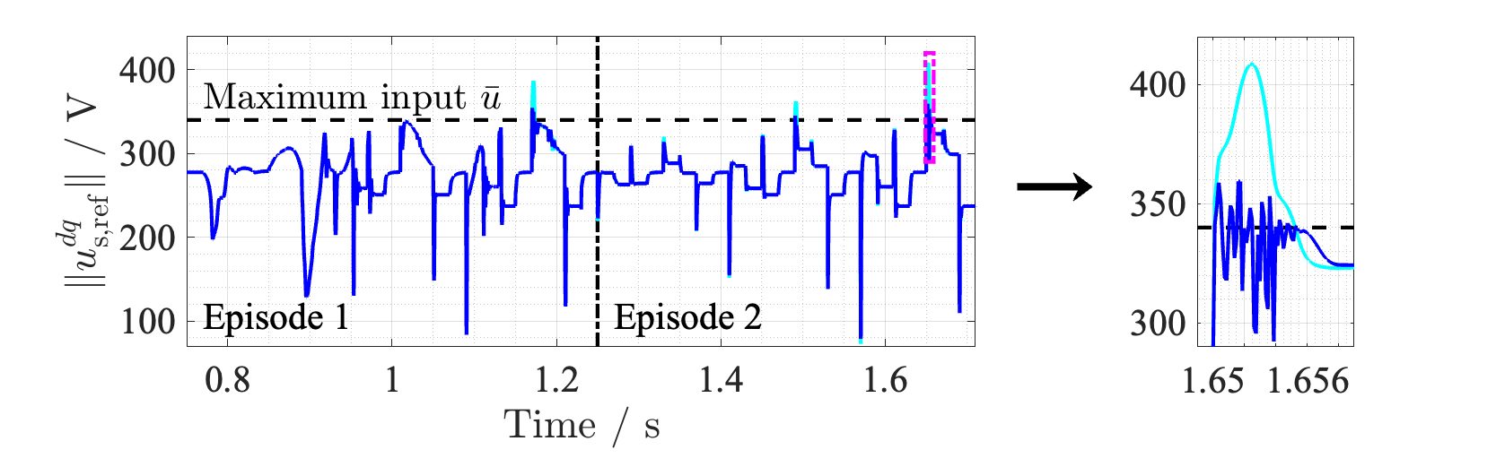
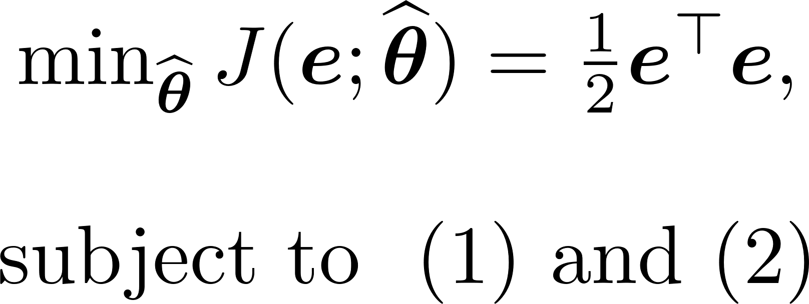
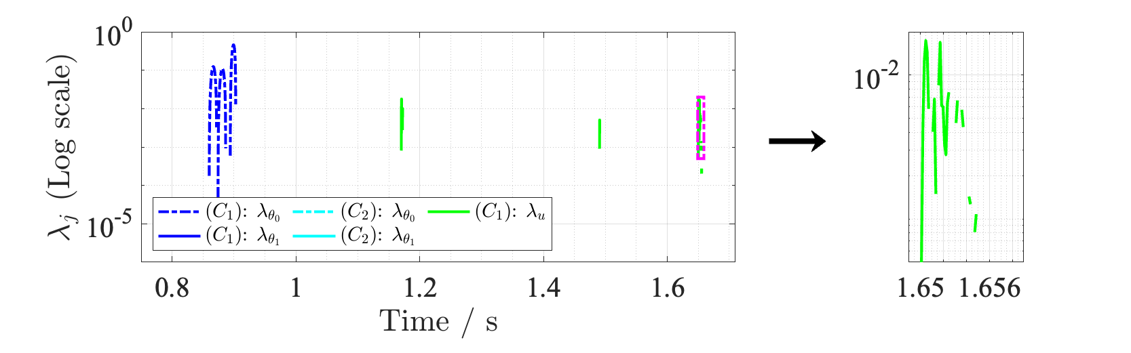
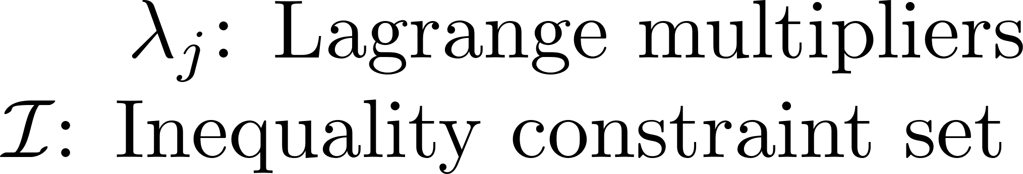
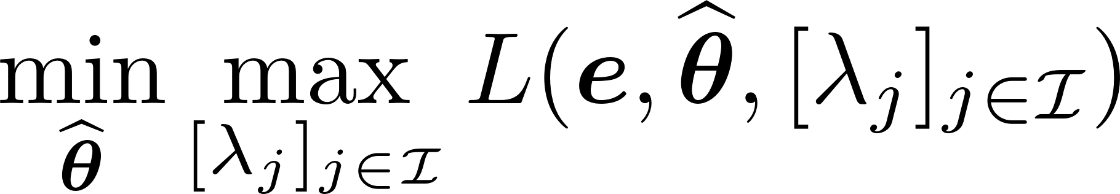
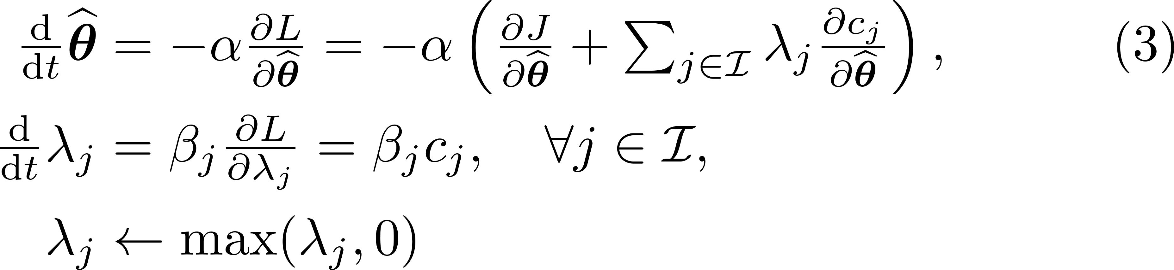
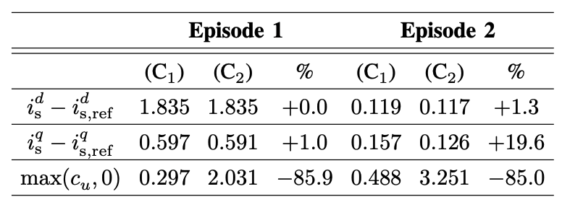
Constrained Optimization-Based Neuro-Adaptive Control (CONAC) for Synchronous Machine Drives Under Voltage Constraints (ID: 1360)
Myeongseok Ryu*, Niklas Monzen**, Pascal Seitter**, Kyunghwan Choi* and Christoph M. Hackl**
(*) CCS Graduate School of Mobility, KAIST, Republic of Korea and (**) LMRES, Hochschule Műnchen, Germany
Background
Nomenclature
Nomenclature
Motivation 1:
Exact system knowledge is required, e.g., resistances and flux linkages
Motivation 2:
Input saturation by
voltage source inverter (VSI)
Proposed Method (CONAC)
Numerical Validation
.
SM drive modeling
(C1) CONAC with input constraint
(C2) CONAC without input constraint
Reference current
Saturation (VSI)
Resistances
Flux linkages
Control input (voltage)
State (current)
Unknown terms
Tracking Performance
Both controllers demonstrated satisfactory performance
Performance was improved in Episode 2, ≅ -84%
(C2) achieved slightly higher performance
However, it neglected costs that come from saturation
Controller design objectives
Design current tracking controller
Utilize ANN to approximate unknown ideal input (Motivation 1)
Derive ANN weight adaptation law ensuring stability (weight and error boundedness) and preventing input saturation (Motivation 2)
Ideal unknown control input
Actual input (ANN output)
Constraints formulation
Fig 1. Current tracking results
Constraint 1: Weight boundedness (1 hidden layer)
Constraint 2: Input saturation
Input Saturation
Input saturation of (C1) was suppressed
(C2) exceeded the input limit, ≅ +85%
Constrained optimization problem
Quadratic objective function $J(⋅)$ of tracking error $e≔i_{s}−i_{s,ref}$
Fig 2. Norm of control input (voltage)
Constraint Handling
Lagrange multipliers increase to adjust adaptation, see eq. (3)
Lagrangian function
Adaptation law derivation
Fig 3. Lagrange multipliers in logarithmic scale
Gradient descent/ascent methods (dual problem)
Table 1. Quantitative comparison of performances’ $L_{2}$ norm
Lagrange multipliers adjust adaption direction
Contributions
Conclusion
No prior system information is required
Adaptation laws are derived based on constrained optimization
Stability is guaranteed using Lyapunov theory, see Thm. 1 in Paper
CONAC was proposed for SM drives with input voltage saturation
Stability and constraint satisfaction were ensured via Lyapuonv theory
As future work, the following subjects will be investigated
The parameter dependencies of CONAC
Real-time implementation to validate the effectiveness and feasibility
This work was supported in part by GIST-IREF from Gwangju Institute of Science and Technology (GIST), was supported in part by the National Research Foundation of Korea (NRF) grant funded by the Korea government (MSIT) (RS-2025-00554087)

