Slide 1

ORAL SESSION
Paper ID: 1360
Paper Title: Constrained Optimization-Based Neuro-Adaptive Control (CONAC) for Synchronous Machine Drives Under Voltage Constraints
Author’s Name: Myeongseok Ryu*, Niklas Monzen**, Pascal Seitter**, Kyunghwan Choi* and Christoph M. Hackl**
Department, Affiliation, Country: (*) CCS Graduate School of Mobility, KAIST, Republic of Korea and (**) LMRES, Hochshule Műnchen, Germany

Slide 2
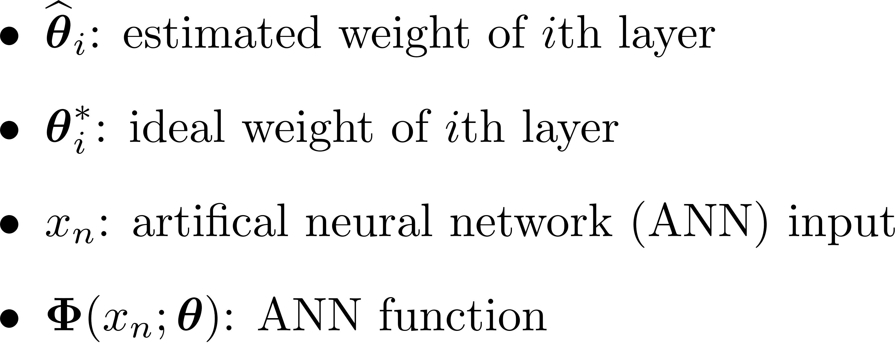
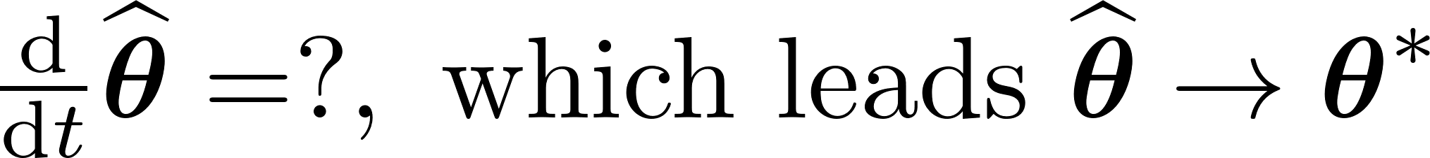
Background
Resistances
Flux linkages
Saturation (VSI)
Control input (voltage)
State (current)
Unknown terms
Motivation 1:
Exact system knowledge is required,
e.g., resistance and flux linkage
Motivation 2:
Input saturation due to
voltage source inverter (VSI)
Controller design objectives
Design current tracking controller
Utilize ANN to approximate unknown ideal input (Motivation 1)
Derive ANN weight adaptation law ensuring stability (weight and error boundedness) and preventing input saturation using constrained optimization theory (Motivation 2)
Unknown ideal control input
Actual input (ANN output)

Slide 3
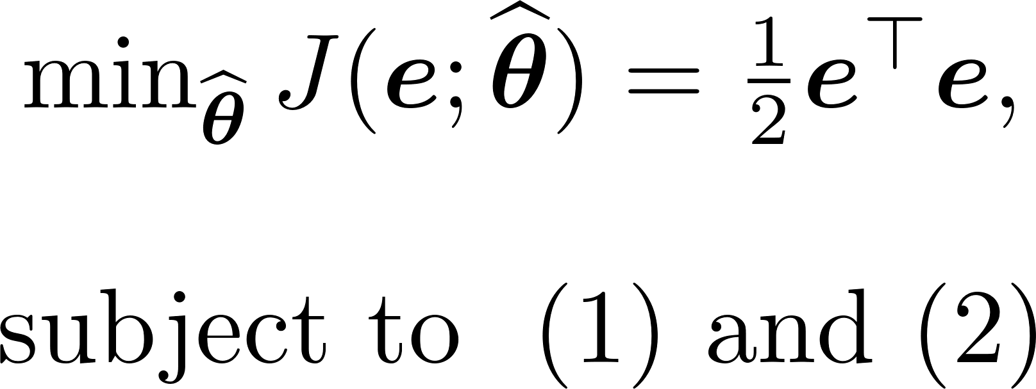
Constraint formulation
Constraints are formulated to ensure…
Constraint 1: Stability of adaptation process (weight boundedness)
Constraint 2: Input saturation satisfaction
Constrained optimization problem
Quadratic objective function $J(⋅)$ of tracking error $e≔i_{s}−i_{s,ref}$
By solving the constrained optimization problem, we can obtain estimated ideal control input while satisfying constraints

Slide 4
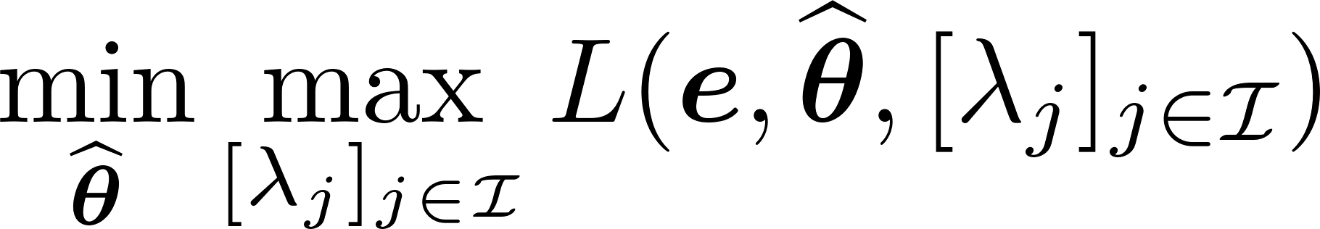
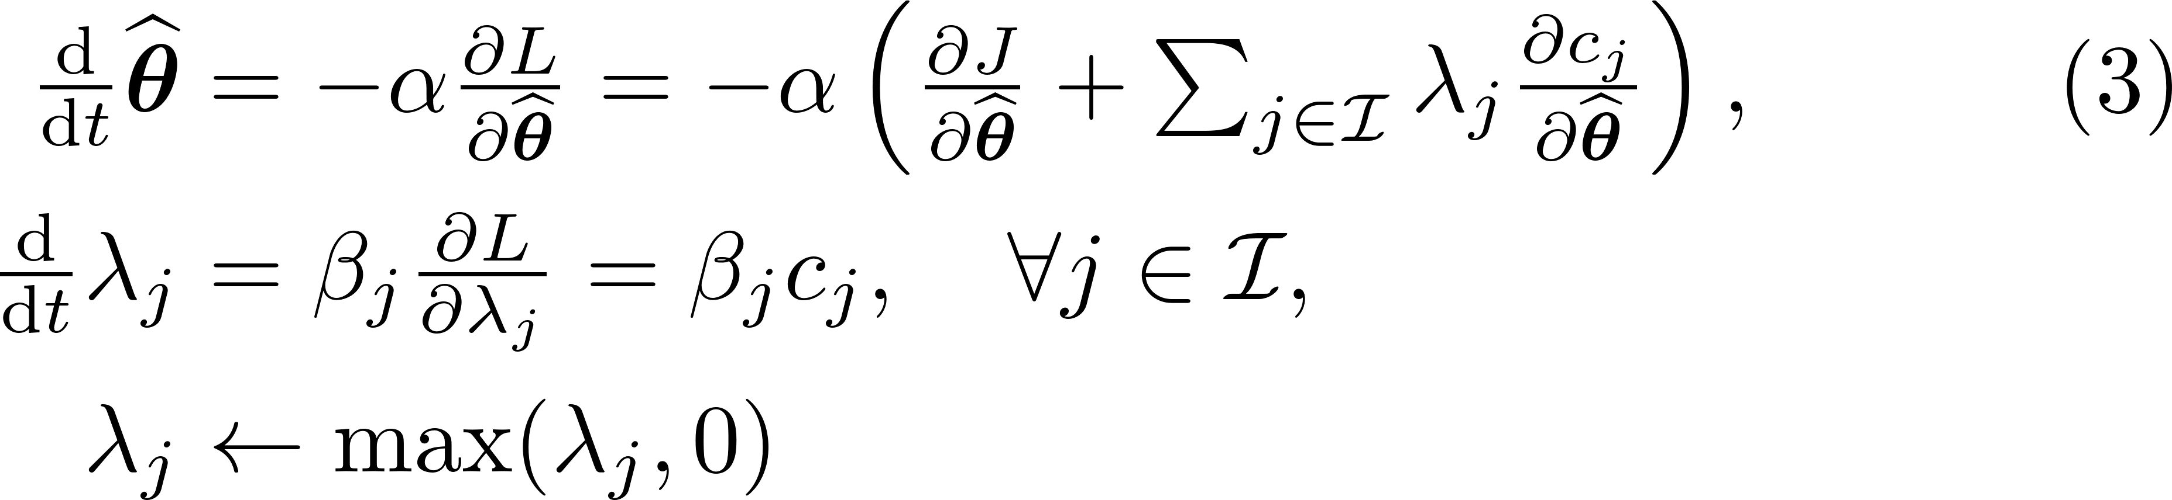
Adaptation law derivation
Find Lagrangian
dual problem
Gradient descent/ascent methods are used
Contributions
No prior system information is required
Adaptation laws are derived based on constrained optimization
Stability is guaranteed using Lyapunov theory, see Thm. 1 in Paper

Slide 5
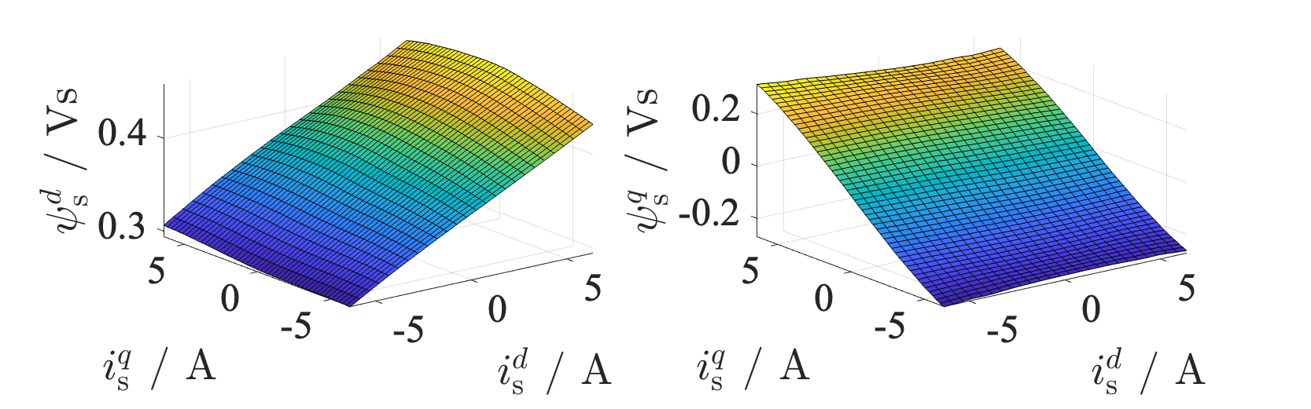
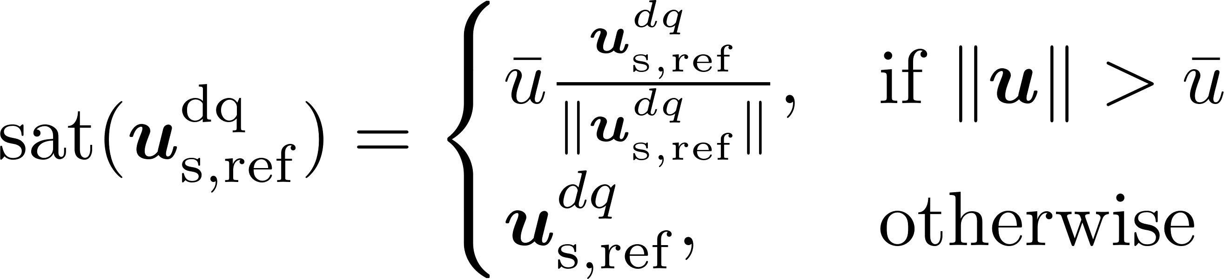
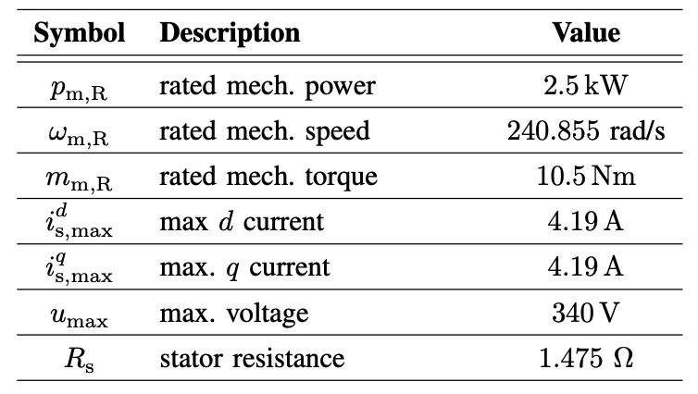

Numerical Validation
MATLAB/SIMULINK R2024b
Interior permanent magnet SM’s (IPMSM’s) flux linkage maps were used
Identified from a real machine in laboratory
IPMSM was operated at the rated mechanical speed
Saturation function is defined as
Fig 1. Stator flux linkages of IPMSM
at the rated mechanical speed $ω_{m,R}=240.855$rad/s
Table 1. IPMSM parameters
Comparative study
(C1) CONAC with input constraint
(C2) CONAC without input constraint

Slide 6
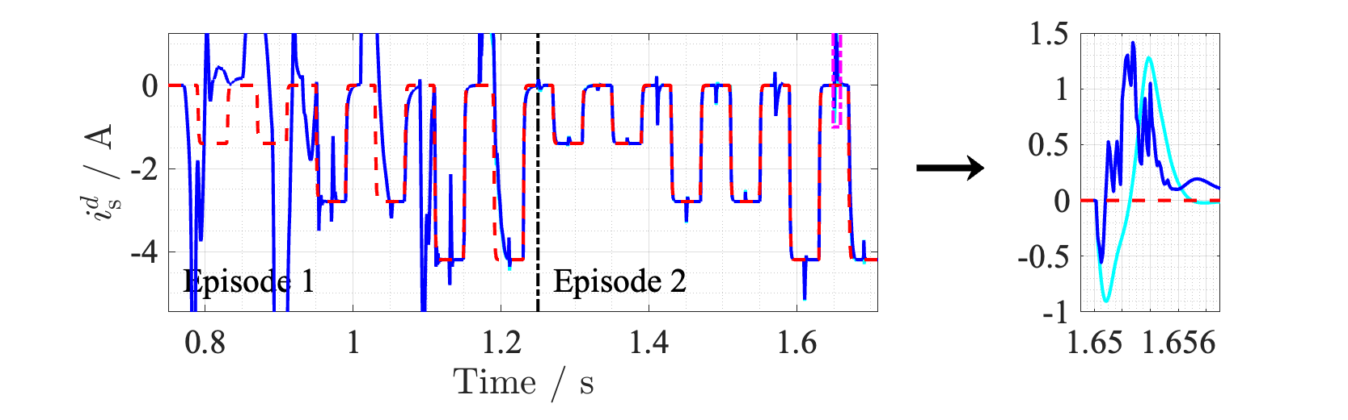
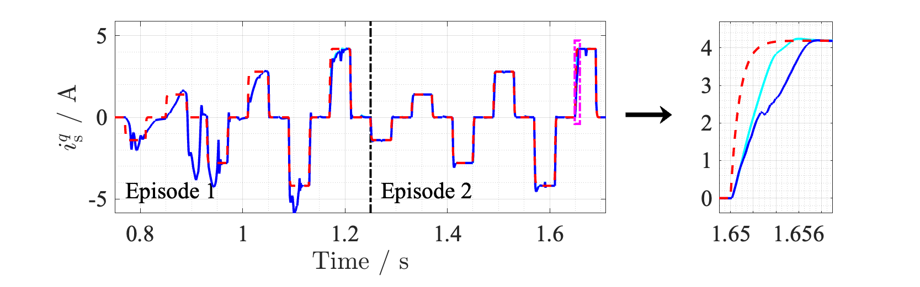
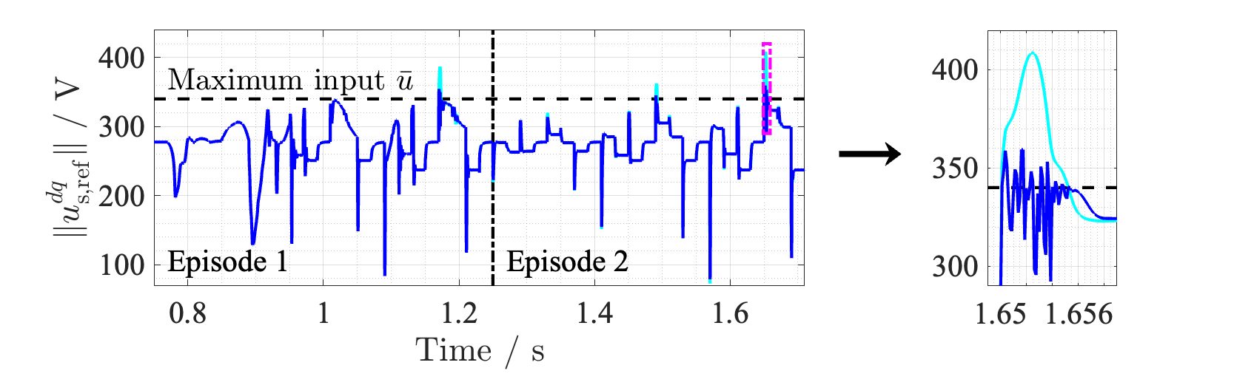
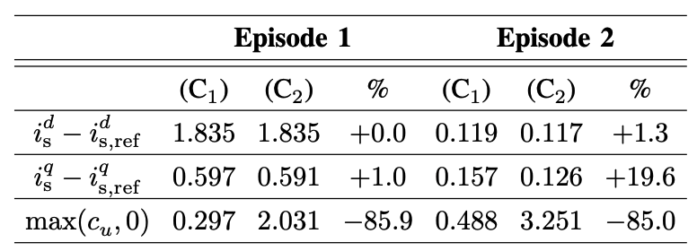

(C1) CONAC with input constraint
(C2) CONAC without input constraint
Reference current
Numerical Validation (Tracking Performance)
Tracking Performance
Both controllers demonstrated satisfactory performance
Performance was improved in Episode 2, ≅ -84%
(C2) achieved slightly higher performance
However, it neglected costs that come from saturation
Fig 2. Current tracking results
Table 2. Quantitative comparison
of performances’ $L_{2}$ norm
Fig 3. Norm of control input (voltage)

Slide 7
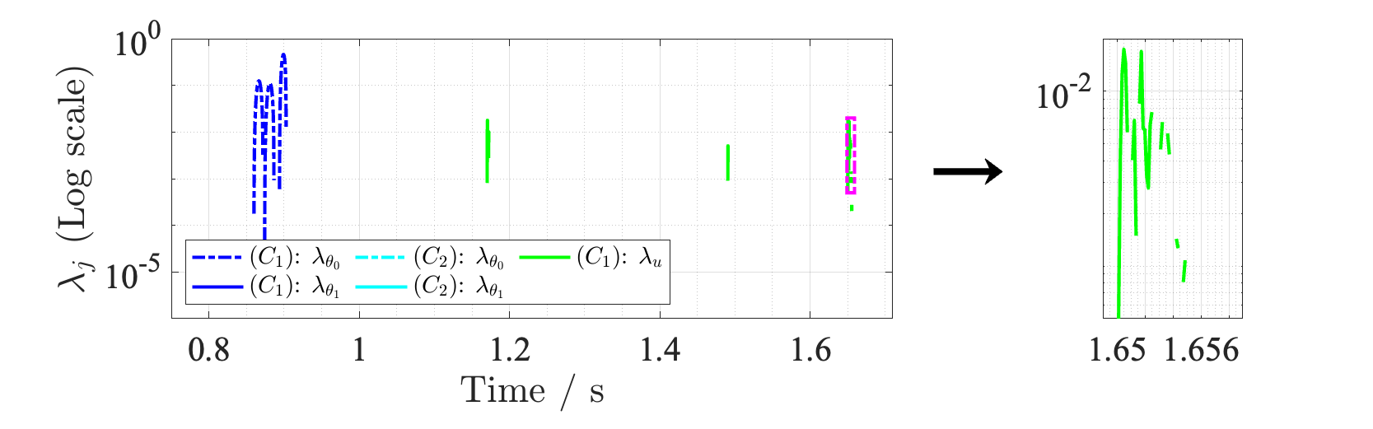
(C1) CONAC with input constraint
(C2) CONAC without input constraint
Numerical Validation (Constraint Handling)
Input Saturation
Input saturation of (C1) was suppressed
(C2) exceeded the input limit, ≅ +85%
Constraint Handling
Lagrange multipliers increase to adjust adaptation, see eq. (3)
Fig 3. Norm of control input (voltage)
Fig 4. Lagrangian multipliers in logarithmic scale

Slide 8
Conclusion
CONAC was proposed for SM drives with input voltage saturation
Stability and constraint satisfaction were ensured via Lyapuonv theory
As future work, the following subjects will be investigated
The parameter dependencies of CONAC
Real-time implementation to validate the effectiveness and feasibility

