Slide 1

total intensity
linear polarization
circular polarization
(horizontal/vertical)
(diagonal/antidiagonal)
CodType.POLAR3
CodType.SCALAR
CodType.POLAR2
CodType.POLAR4

Slide 2
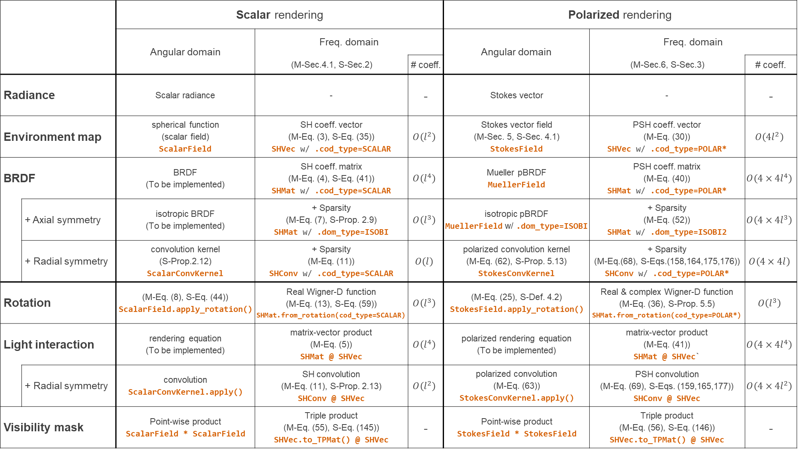
 |  | Scalar rendering |  |  | Polarized rendering
 |  | Angular domain | Freq. domain |  | Angular domain | Freq. domain
 |  |  | (M-Sec.4.1, S-Sec.2) | # coeff. |  | (M-Sec.6, S-Sec.3) | # coeff.
Radiance |  | Scalar radiance | - | - | Stokes vector | - | -
Environment map |  | spherical function (scalar field) ScalarField | SH coeff. vector (M-Eq. (3), S-Eq. (35)) SHVec w/ .cod_type=SCALAR | $$O\left(l^{2}\right)$$ | Stokes vector field (M-Sec. 5, S-Sec. 4.1) StokesField | PSH coeff. vector (M-Eq. (30)) SHVec w/ .cod_type=POLAR* | $$O\left(4l^{2}\right)$$
BRDF |  | BRDF (To be implemented) | SH coeff. matrix (M-Eq. (4), S-Eq. (41)) SHMat w/ .cod_type=SCALAR | $$O\left(l^{4}\right)$$ | Mueller pBRDF MuellerField | PSH coeff. matrix (M-Eq. (40)) SHMat w/ .cod_type=POLAR* | $$O\left(4×4l^{4}\right)$$
 | + Axial symmetry | isotropic BRDF (To be implemented) | + Sparsity (M-Eq. (7), S-Prop. 2.9) SHMat w/ .dom_type=ISOBI | $$O\left(l^{3}\right)$$ | isotropic pBRDF MuellerField w/ .dom_type=ISOBI | + Sparsity (M-Eq. (52)) SHMat w/ .dom_type=ISOBI2 | $$O\left(4×4l^{3}\right)$$
 | + Radial symmetry | convolution kernel (S-Prop.2.12) ScalarConvKernel | + Sparsity (M-Eq. (11)) SHConv w/ .cod_type=SCALAR | $$O\left(l\right)$$ | polarized convolution kernel (M-Eq. (62), S-Prop. 5.13) StokesConvKernel | + Sparsity (M-Eq.(68), S-Eqs.(158,164,175,176)) SHConv w/ .cod_type=POLAR* | $$O\left(4×4l\right)$$
Rotation |  | (M-Eq. (8), S-Eq. (44)) ScalarField.apply_rotation() | Real Wigner-D function (M-Eq. (13), S-Eq. (59)) SHMat.from_rotation(cod_type=SCALAR) | $$O\left(l^{3}\right)$$ | (M-Eq. (25), S-Def. 4.2) StokesField.apply_rotation() | Real & complex Wigner-D function (M-Eq. (36), S-Prop. 5.5) SHMat.from_rotation(cod_type=POLAR*) | $$O\left(l^{3}\right)$$
Light interaction |  | rendering equation (To be implemented) | matrix-vector product (M-Eq. (5)) SHMat @ SHVec | $$O\left(l^{4}\right)$$ | polarized rendering equation (To be implemented) | matrix-vector product (M-Eq. (41)) SHMat @ SHVec` | $$O\left({4×4l}^{4}\right)$$
 | + Radial symmetry | convolution ScalarConvKernel.apply() | SH convolution (M-Eq. (11), S-Prop. 2.13) SHConv @ SHVec | $$O\left(l^{2}\right)$$ | polarized convolution (M-Eq. (63)) StokesConvKernel.apply() | PSH convolution (M-Eq. (69), S-Eqs. (159,165,177)) SHConv @ SHVec | $$O\left(4×4l^{2}\right)$$
Visibility mask |  | Point-wise product ScalarField * ScalarField | Triple product (M-Eq. (55), S-Eq. (145)) SHVec.to_TPMat() @ SHVec | - | Point-wise product StokesField * StokesField | Triple product (M-Eq. (56), S-Eq. (146)) SHVec.to_TPMat() @ SHVec | -

Slide 3
`.SHCoeff()`
`.from_SHCoeff()`

Slide 4
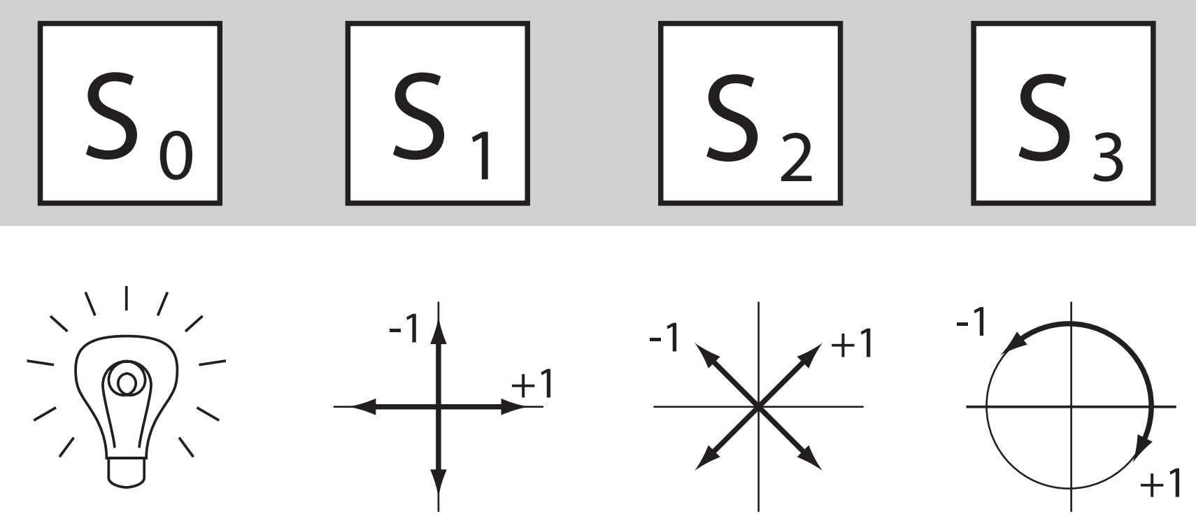
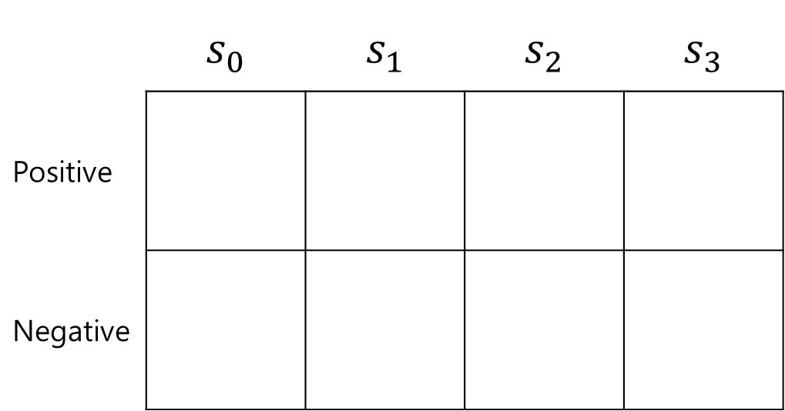
 | $$s_{0}$$ | $$s_{1}$$ | $$s_{2}$$ | $$s_{3}$$
Positive
Negative

Slide 5
