Slide 1
Auto-Labeling
기술연구소 / 인턴 / 김시연

Slide 2
1. Auto-Labeling 소개 2. 사용한 Auto-Labeling 기법 3. Prediction Uncertainty 4. 4월 Plan
Content

Slide 3
Auto-Labeling

Slide 4




Supervised Learning
Loss
Input
Data
Model
Prediction
Label

Slide 5

Labeling
Unlabeled
Data
Labeled
Data
Human
$
Cost

Slide 6
Auto Labeling
Unlabeled
Data
Model
Labeled
Data

Slide 7
Semi-Supervised Learning
Labeled
Data
Unlabeled
Data
Labeling

Slide 8
Meta Pseudo Labels
Updated Teacher
Teacher
Update!
Labeled
Data
Unlabeled
Data
Update!
Student
Updated Student

Slide 9
Meta Pseudo Labels
Updated Teacher
Teacher
④
Update!
Labeled
Data
Unlabeled
Data
①
③
②
Update!
Student
Updated Student

Slide 10
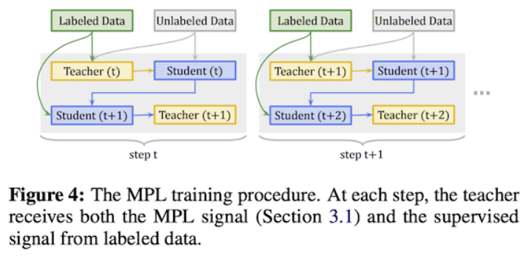
Meta Pseudo Labels

Slide 11
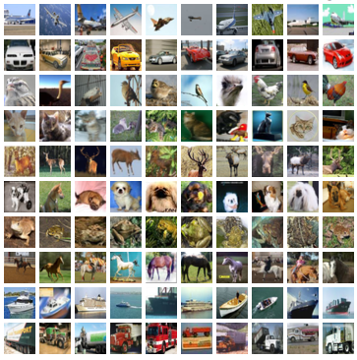
Meta Pseudo Labels
CIFAR-10
50000 train dataset
4000 labeled data (8%)
46000 unlabeled data
10000 test dataset
WideResNet
300000 iteration
Acc: 94.46%

Slide 12
This is a dog…but I’m not sure…
?
Prediction: [0.55 : 0.45]
[dog : cat]

Slide 13


Slide 14
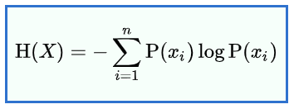
Uncertainty
Entropy

Slide 15
Entropy
Data x: [A, B, C],
Data 1: [0.90, 0.05, 0.05]
Data 2: [0.30, 0.50, 0.20]
Entropy: 0.171
Entropy: 0.447
Entropy
=
Uncertainty

Slide 16
Ex) class {A, B, C}
Data x: [a, b, c], X, entropy
Data 1: [0.90, 0.05, 0.05], A, 0.171
Data 2: [0.30, 0.50, 0.20], B, 0.447
…

Slide 17
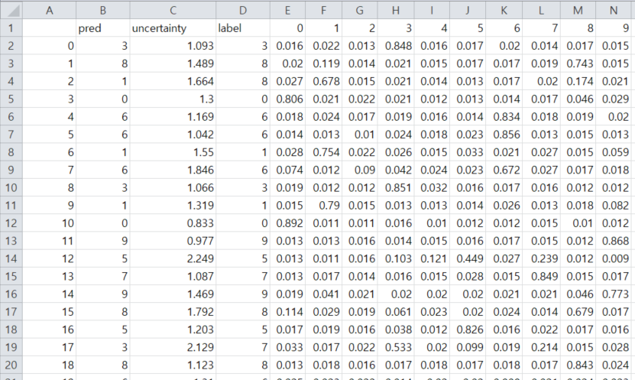
Acc: 86.35%

Slide 18
4월 계획
T3Q 플랫폼 사용해보기 (익히기)
T3Q 플랫폼에 올리기
Entropy, batch-size, model, iteration….

