Slide 1
Auto-Labeling
2021.04.30
기술연구소 / 인턴 / 김시연

Slide 2
1. Issue #1 Purpose 2. Issue #2 Uncertainty 3. T3Q Platform 4. 5월 Plan
Content

Slide 3
Issue #1

Slide 4


Online Training
Unlabeled
Data
Input for Training
Labeled
Data
Auto Labeling
Model
Real
Model

Slide 5
Online Training
Unlabeled
Data
Labeled
Data
Auto Labeling
Model

Slide 6

Day 1
Unlabeled data
Unlabeled data
Labeled data
Pseudo Labeled data
MPL
Error
New unlabeled data
Day 2
MPL
…
Day ~ 5
No Work
Day 11

Slide 7

Day 1
Unlabeled data
Unlabeled data
Labeling
Labeled data
Pseudo Labeled data
MPL
Error
Find error & fix
Day 2
New unlabeled data
MPL
Find error & fix
1. Model Accuracy (Test Data)
…
2. Finding Mislabeled Data
Day 11

Slide 8
Issue #2

Slide 9
Meta Pseudo Labels를 통해 labeling 한 결과 중에서 Mislabeled 된 case를 uncertainty로 판단해보자!
Ex) class {A, B, C}
Data x: [a, b, c], X, entropy
Data 1: [0.90, 0.05, 0.05], A, 0.171
Data 2: [0.30, 0.50, 0.20], B, 0.447
…
+ Margin

Slide 10
Entropy of Correctly Labeled Data
Entropy of Mislabeled Data
Margin of Correctly Labeled Data
Margin of Mislabeled Data
Accuracy : 92%

Slide 11
T3Q Platform

Slide 12
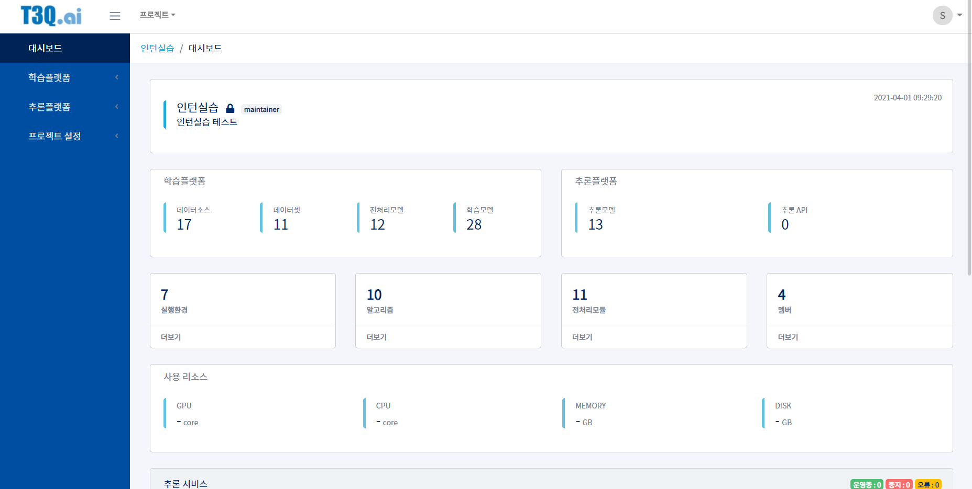

Slide 13
Dataset 등록
전처리
학습
추론

Slide 14
Dataset 등록 & 전처리
Labeled data
Unlabeled data
Class 1
Class 2
Class 3
.zip
학습
Output
Auto_labeled.zip
Class 1
Class 2
Class 3

Slide 15
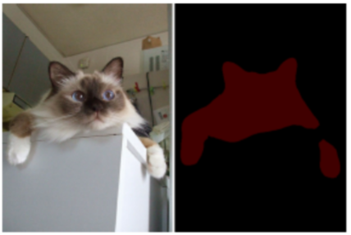
Meta Pseudo Labels
Image Classification
Cat
Semantic Segmentation

Slide 16
5월 Plan
Classification MPL code 정리
Mislabeled case
Accuracy

