Slide 1
AUTOMATION OF DEPARTMENTAL STORE MANAGEMENT SYSTEM
K.T.L.KALAIVANI-16IT041
K.MEENADEVI-16IT052
S.MUKILA-16IT056
S.SALAI PRIYA SELVI-16IT087

Slide 2
Problem Statement
1) Automation of departmental stores management
store management system is discussed in our
project.
2) Customers are able to purchase the product from their home and also having the option of cash on delivery and online payment option also.
Therefore , they can save their time to travel

Slide 3
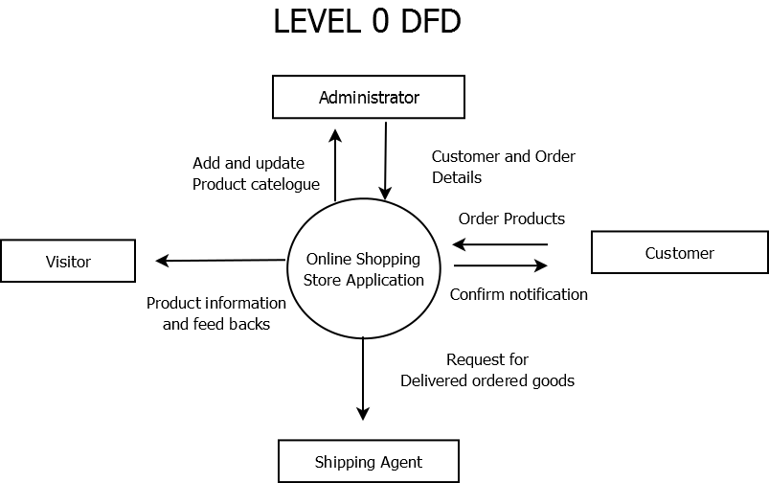
Product Features

Slide 4
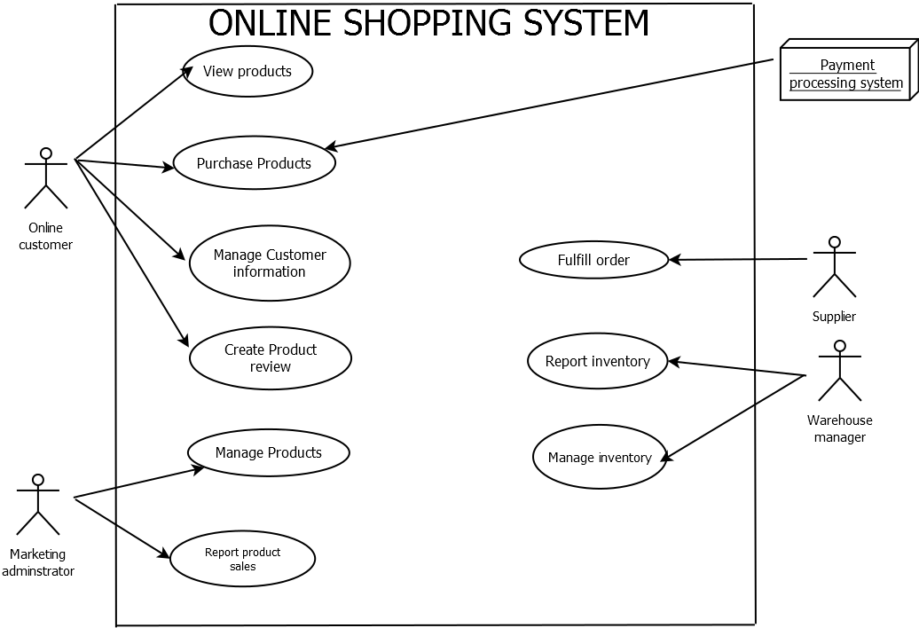
USE CASE

Slide 5
Modules
Requirement Description | Module Name | Module designed by
Customers able to purchase their products. | PRODUCT PURCHASING SECTION | K.MEENADEVI
Employee attendance maintenance and salary calculation is needed | EMPLOYEE MANAGEMENT | K.T.L.KALAIVANI and S.MUKILA
The purchased products need to be delivered. | SHIPPING | TEAM MEMBERS
To update the product details. | STOCK MAINTENANCE | S.SALAI PRIYA SELVI
To analyze the overall performance.. | FEEDBACK | K.T.L.KALAIVANI

Slide 6
Modules
Module Name | Data Structure Concept(s) used | Justification
SHIPPING | QUEUE USING ARRAY | The Customers who are all purchased,their Id will be enqued in the file.While dequeueing ,it will be displayed with the delivery information.

Slide 7
Modules
Module Name | C++ Concept(s) used | Justification
PRODUCT PURCHASING SECTION | Multiple inheritance, Exception handling | 1)We used more than one classes. So Inheritance is required. 2)To avoid unusual conditions.
EMPLOYEE MANAGEMENT | Single inheritane, Exception handling Function overriding Function overloading | 1)To use the function in derived class which is declared in base class . 2)To use the same function with different arguments
STOCK MAINTENANCE | Inline Function, Exception handling, Function overloading | 1) To avoid the cost of calling of small function .
FEEDBACK | Templates | 1)The same template is used for both character and integer datatypes
DATABASE | Files | To store and retrive the data from the file.

Slide 8
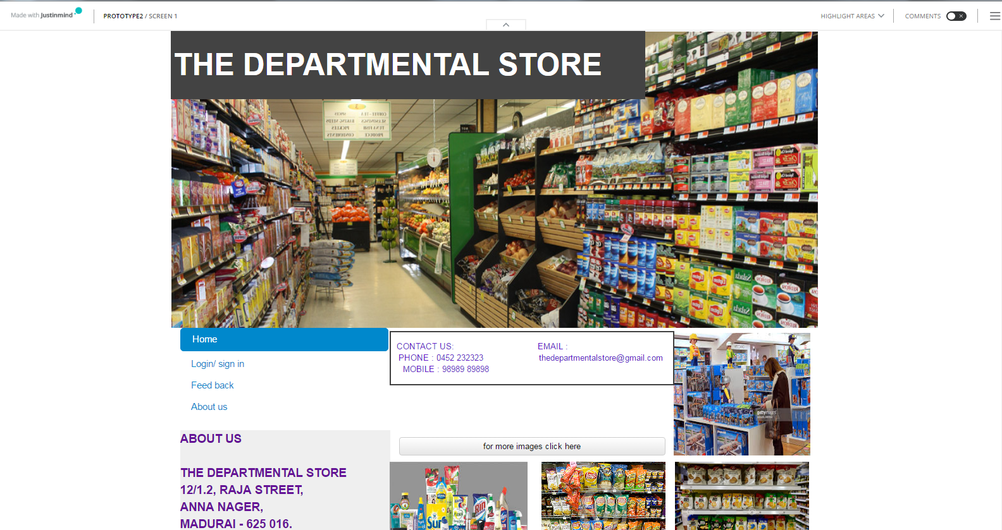
FRONT PAGE…

Slide 9
.
User Interface Design Framework

Slide 10
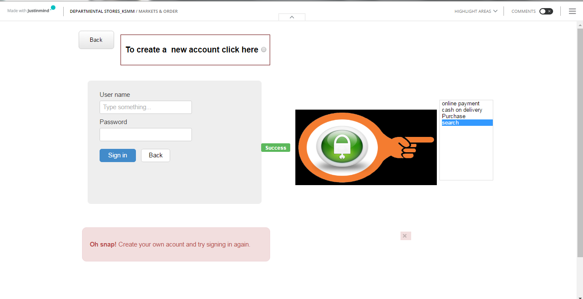
LOGIN PAGE…

Slide 11
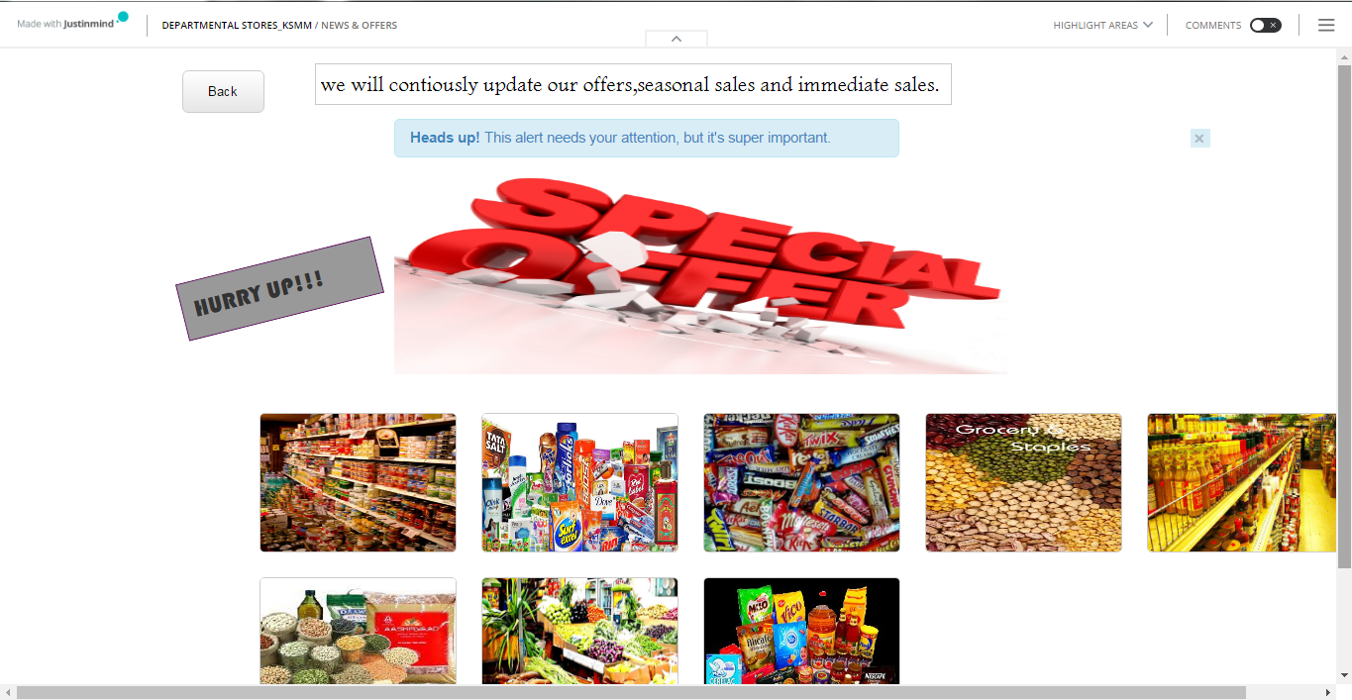
OFFER DETAILS…

Slide 12
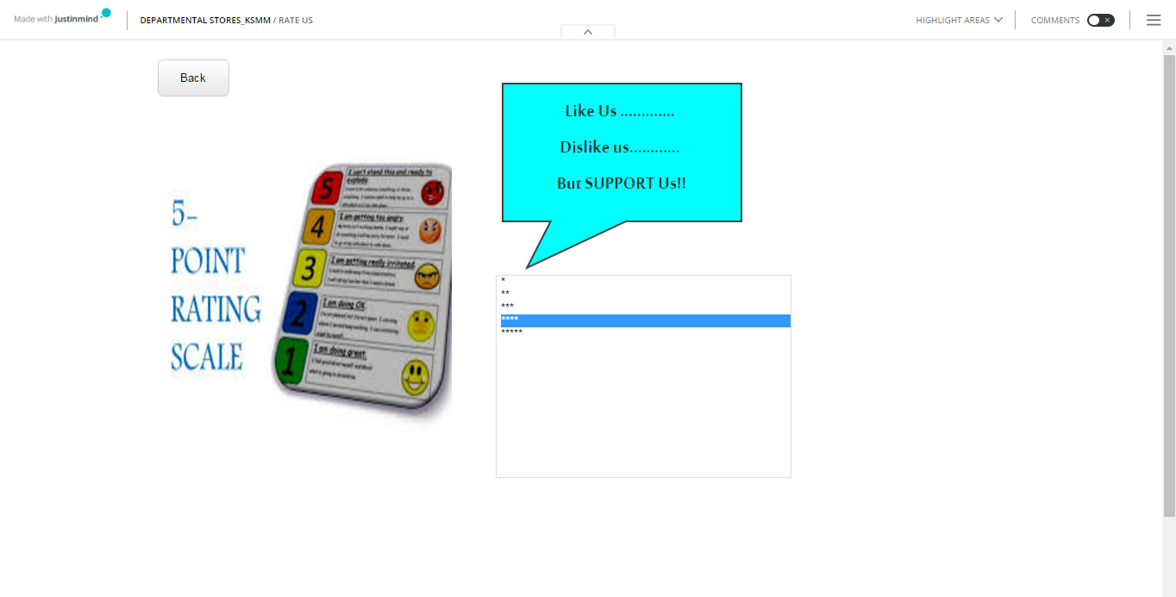
RATING…

Slide 13
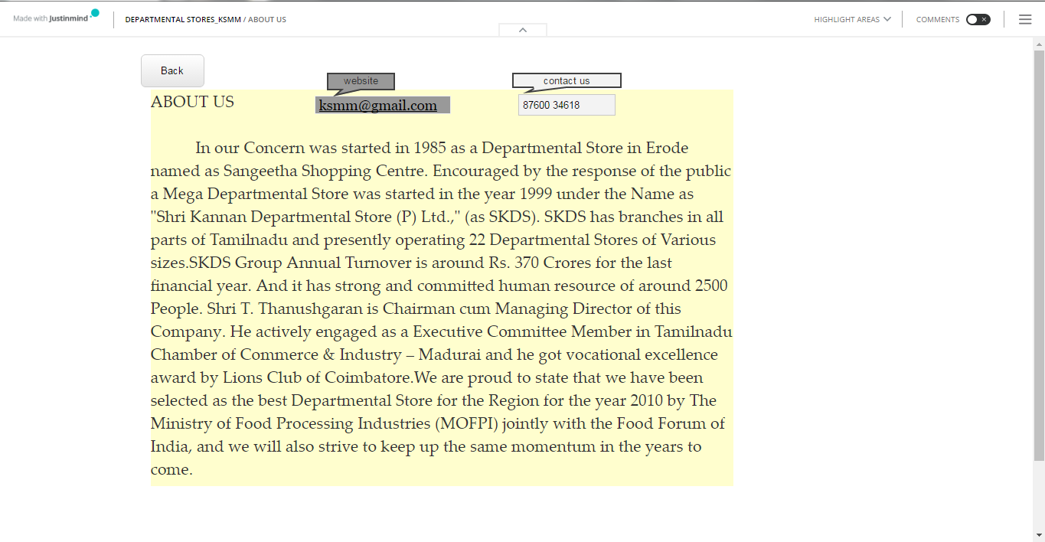
ABOUT US…

Slide 14
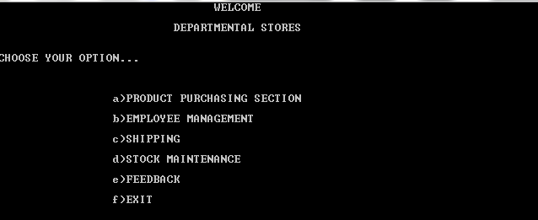
Demo - Screenshot 1

Slide 15
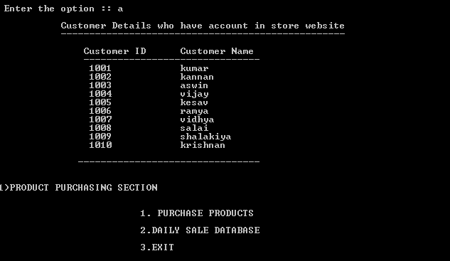
Demo - Screenshot 2

Slide 16
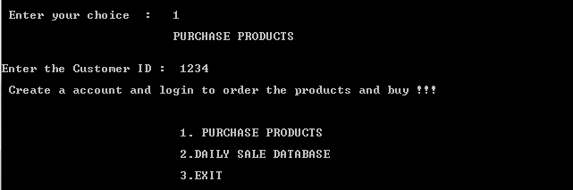
Demo - Screenshot 3

Slide 17
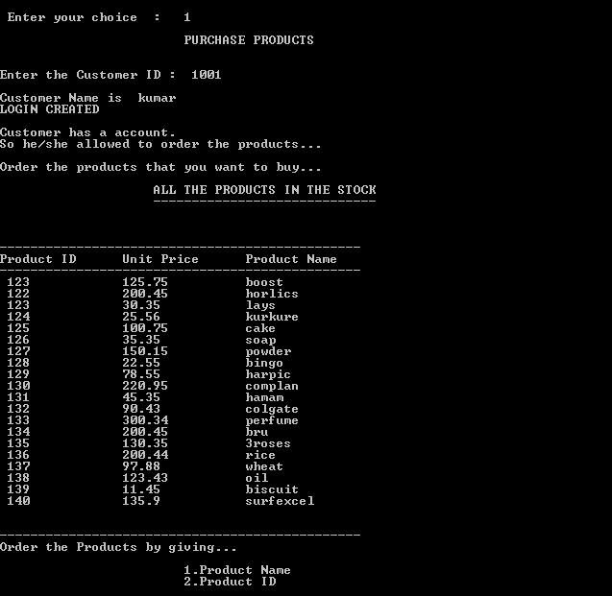
Demo - Screenshot 4

Slide 18
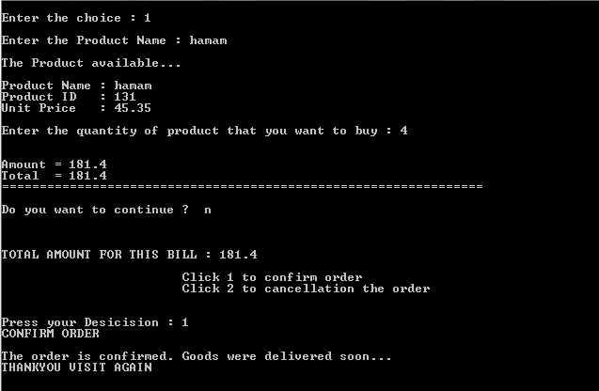
Demo - Screenshot 5

Slide 19
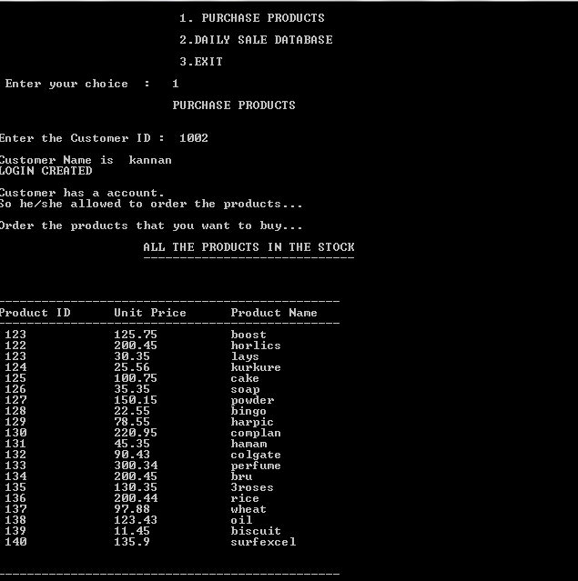
Demo - Screenshot 6

Slide 20
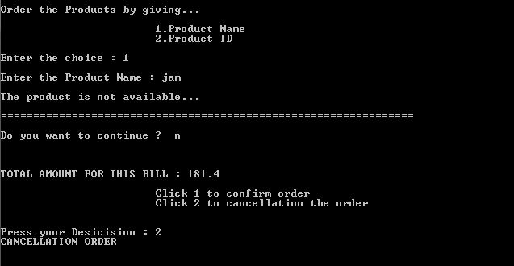
Demo - Screenshot 7

Slide 21

Demo - Screenshot 8

Slide 22
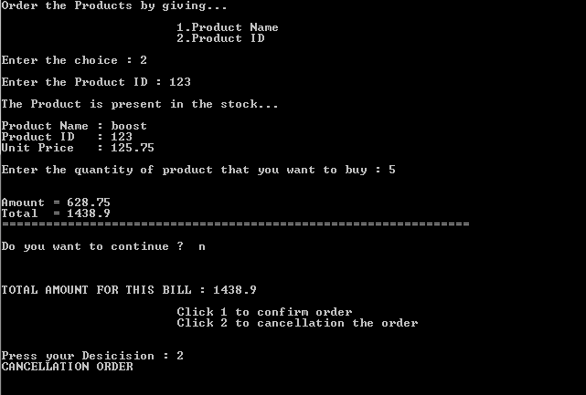
Demo - Screenshot 9

Slide 23
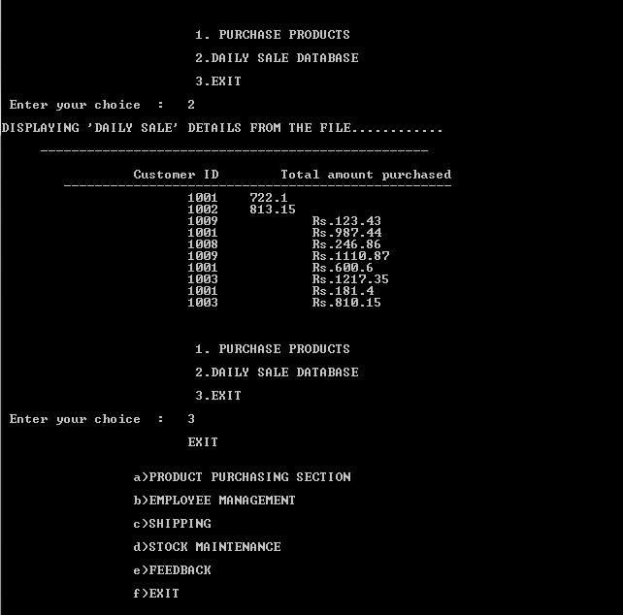
Demo - Screenshot 10

Slide 24
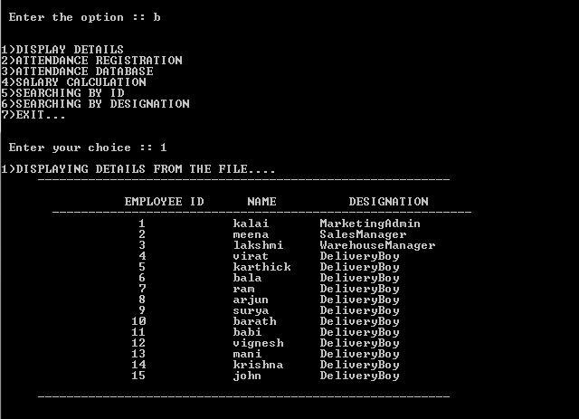
Demo - Screenshot 11

Slide 25
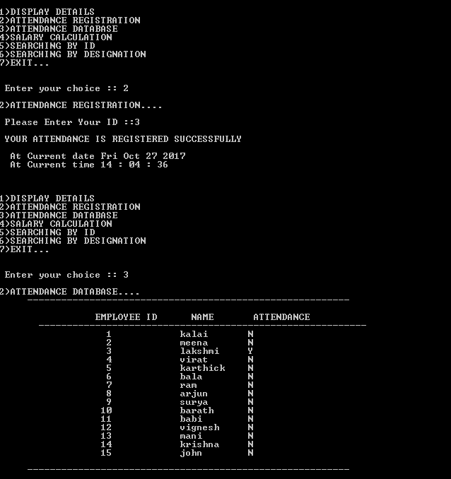
Demo - Screenshot 12

Slide 26
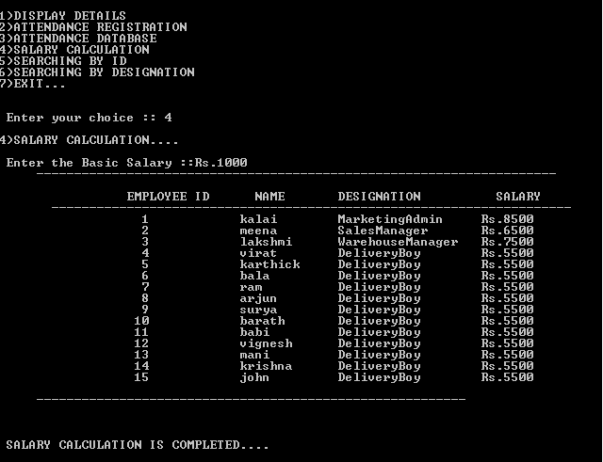
Demo - Screenshot 13

Slide 27
Demo - Screenshot 13

Slide 28
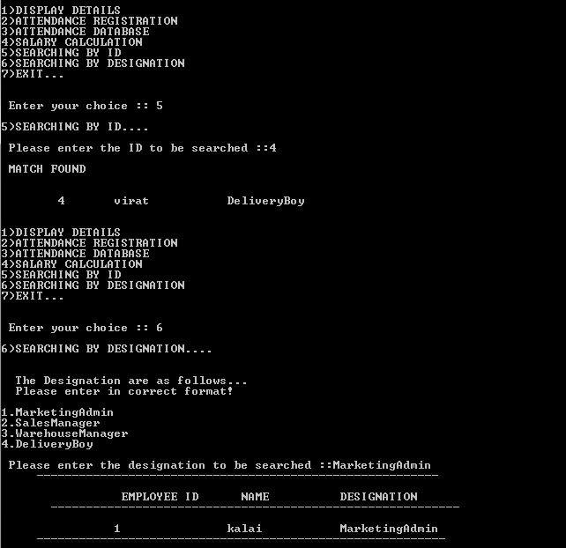
Demo - Screenshot 14

Slide 29
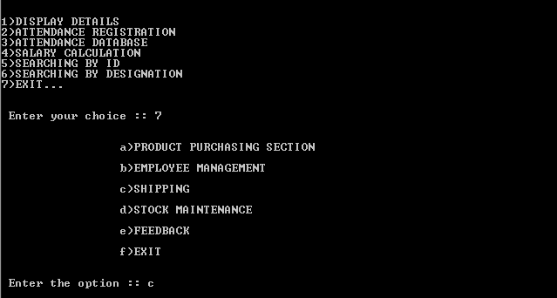
Demo - Screenshot 15

Slide 30
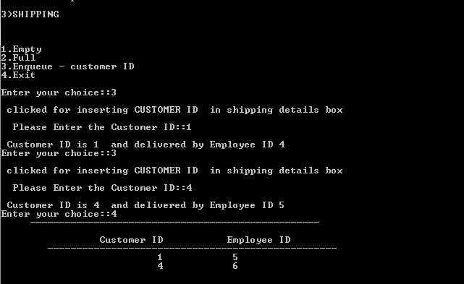
Demo - Screenshot 16

Slide 31
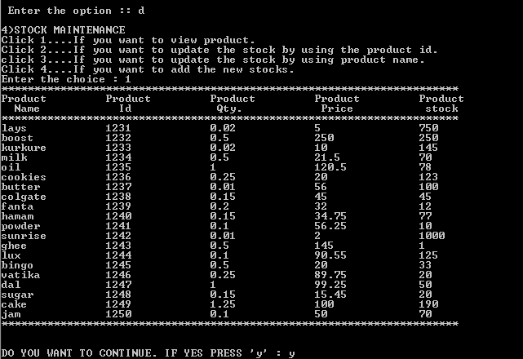
Demo - Screenshot 17

Slide 32
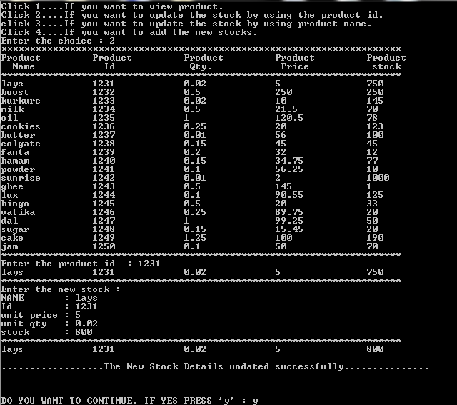
Demo - Screenshot 18

Slide 33
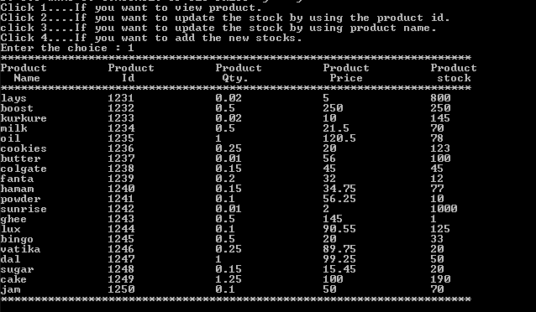
Demo - Screenshot 19

Slide 34
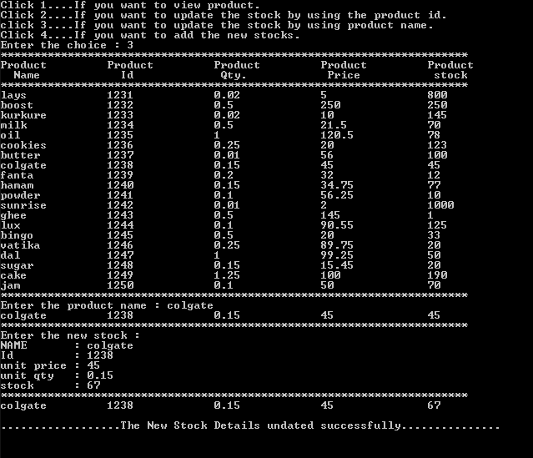
Demo - Screenshot 20

Slide 35
Challenges
Integrating all individual module into a single integrated module.
Analyzing the suitable data structures concept in our project.
Gathering both employee and customer details.

Slide 36
Lessons Learnt
From this experience, we have developed our team co-ordination skills.
We have learnt to complete our work within the due date.
We have developed our skills in programming.

Slide 37
Thank You !!

