Slide 1
Building a Handwritten Multi-Digit Recognition
t Kalaiyarasan
Github link

Slide 2
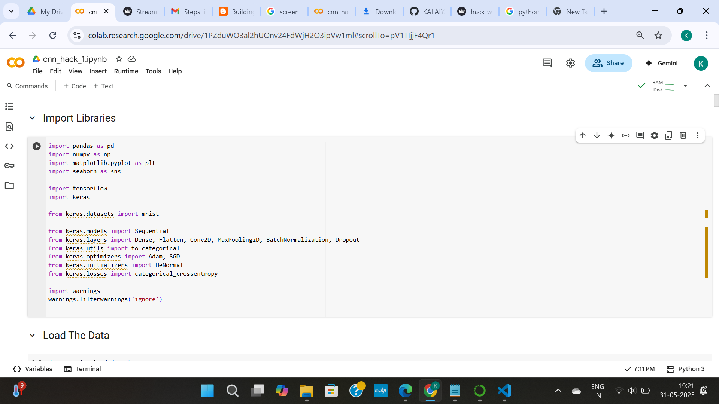
jjjjjj
IMPORT LIBRARIES

Slide 3
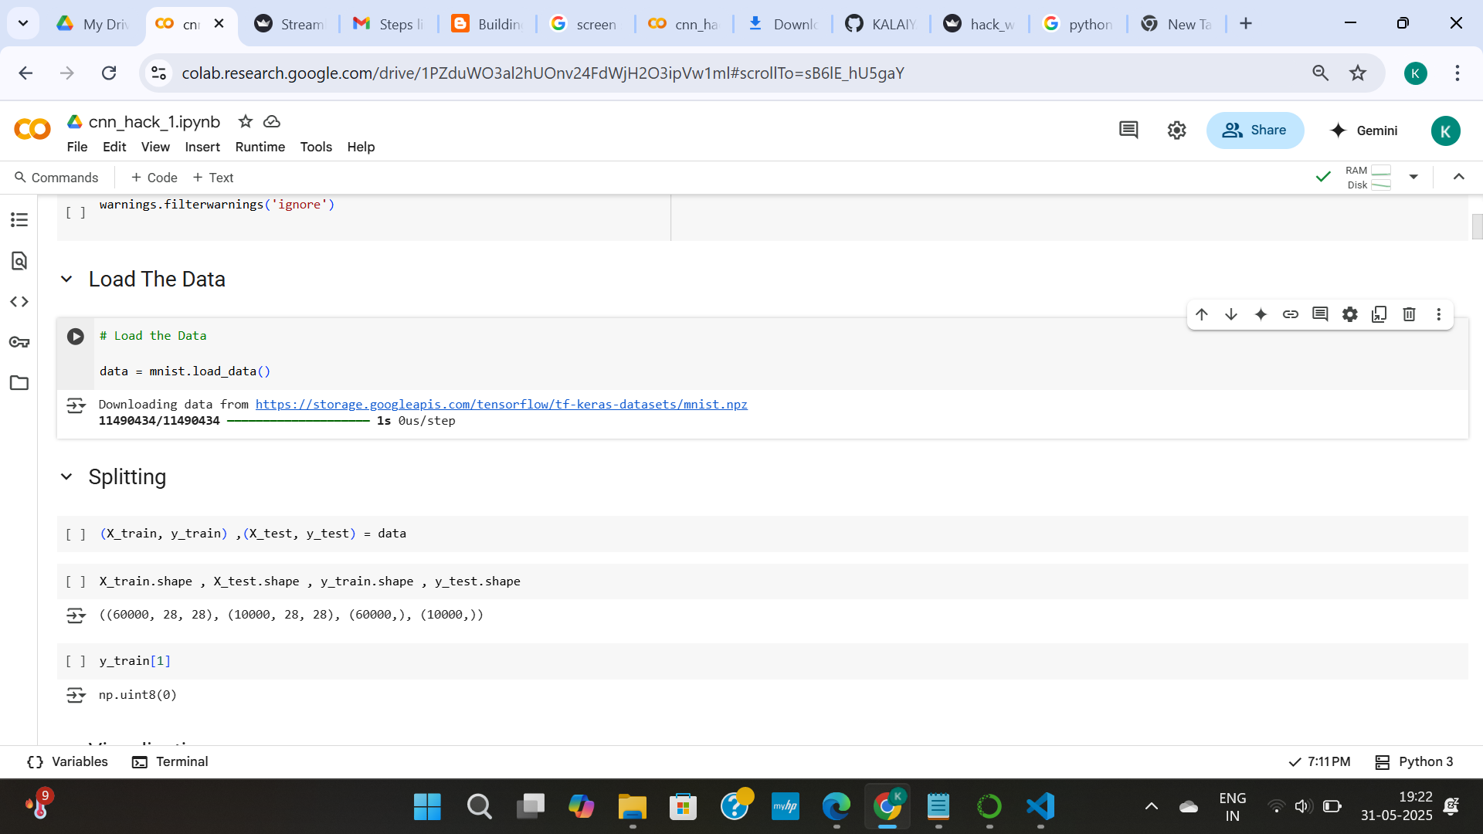
LOAD THE DATA
SPLIT THE DATA

Slide 4
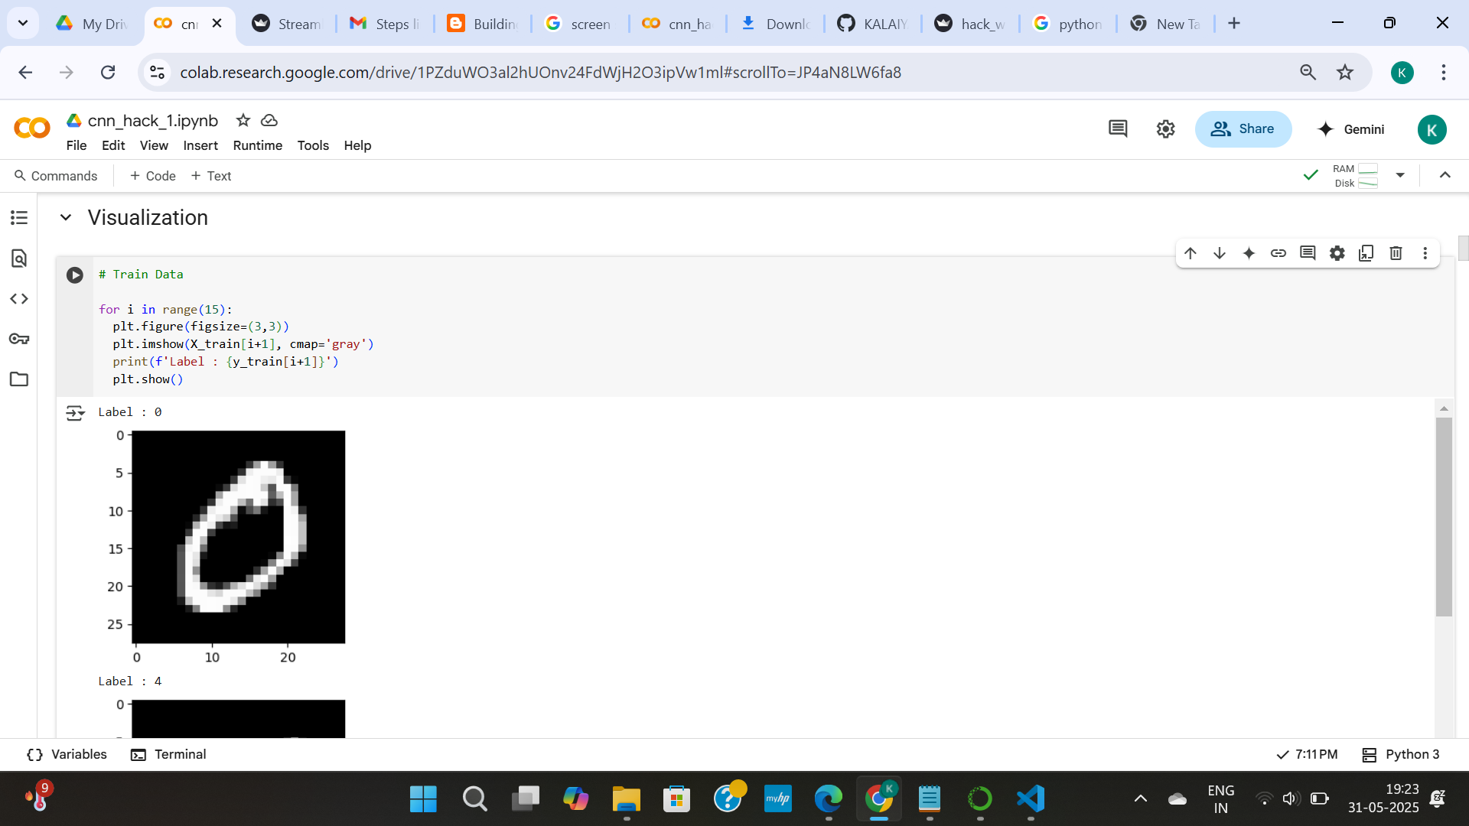
Visualize The Image

Slide 5
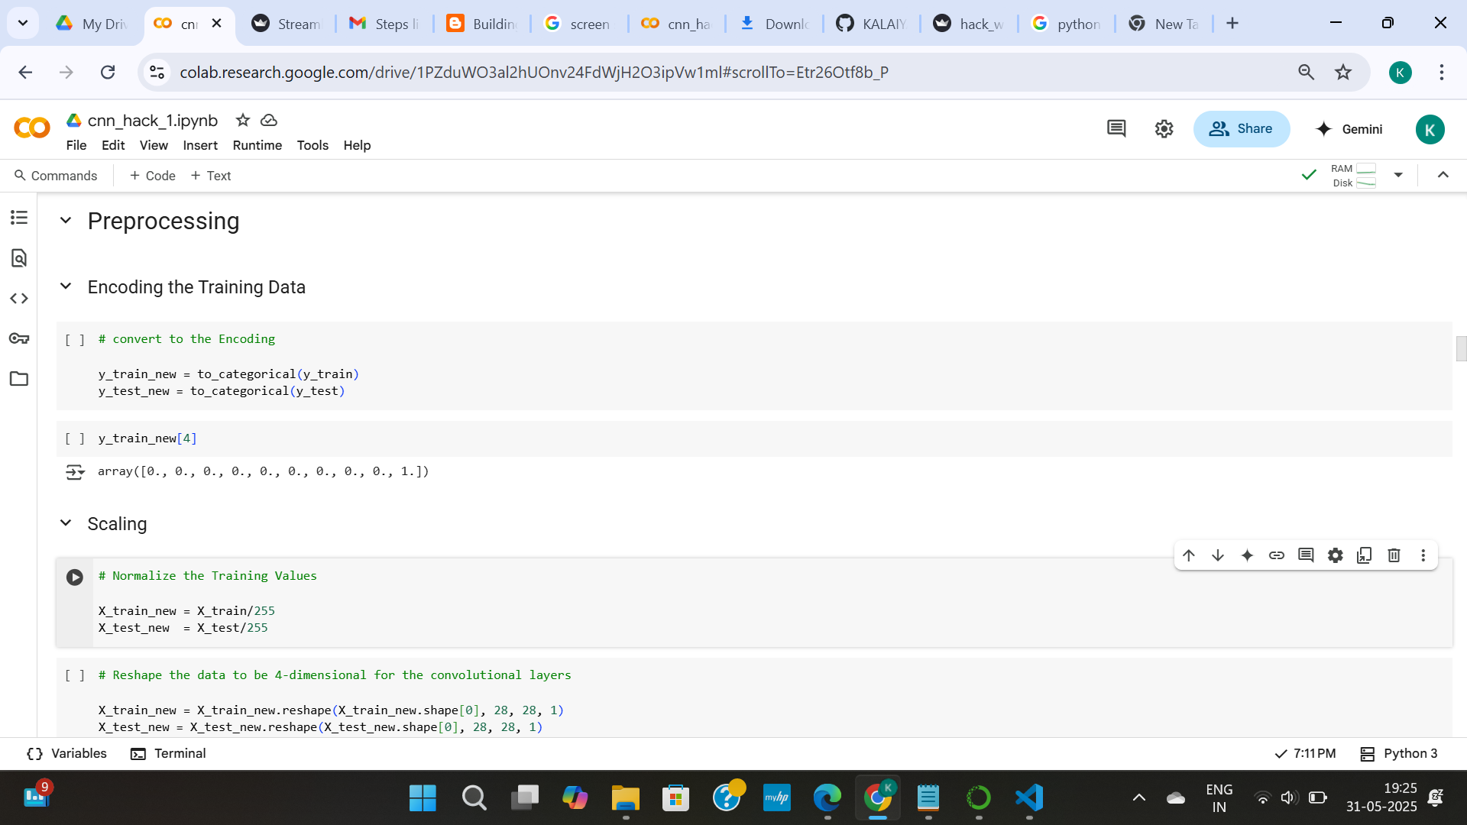
Preprocessing

Slide 6
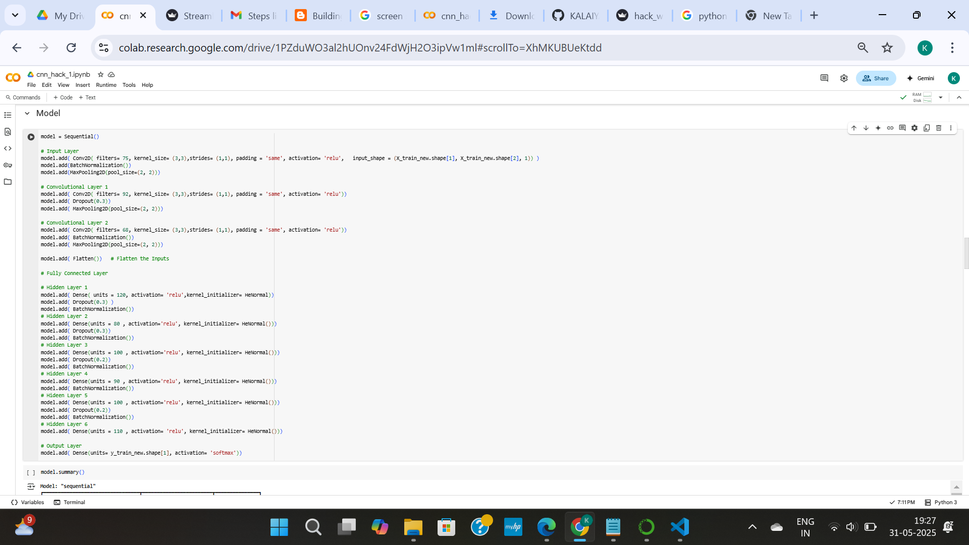
Create model architecture

Slide 7
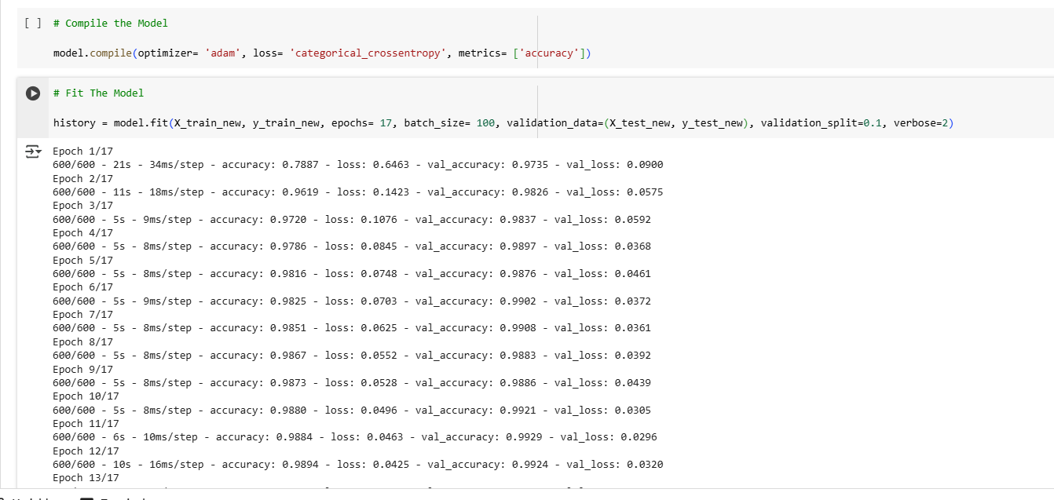
Model compile & Fit

Slide 8
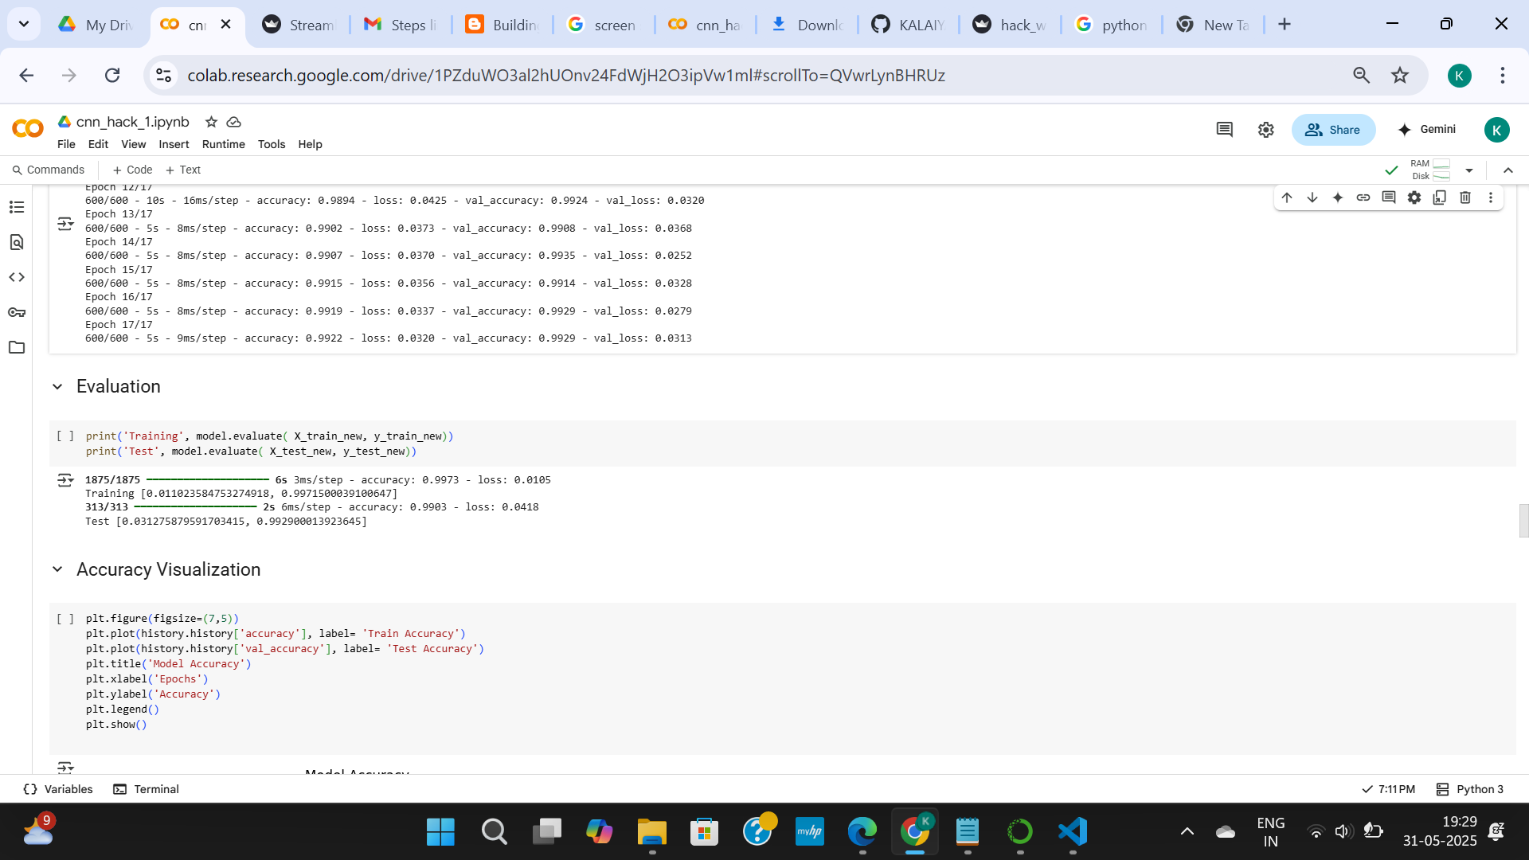
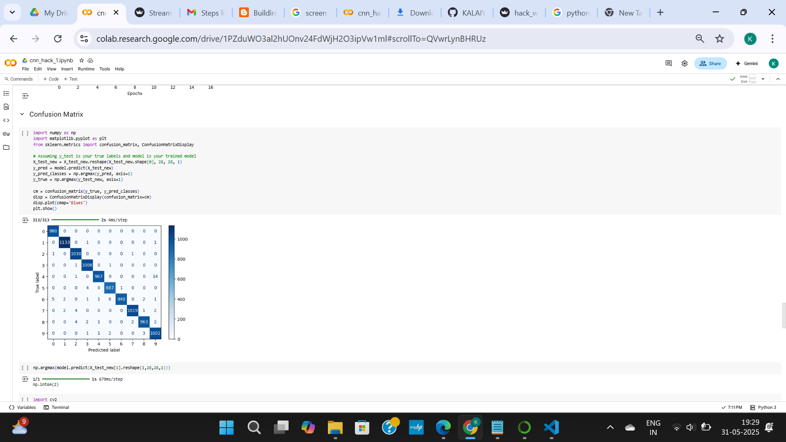
evaluation
CONFUSION MATRIX

Slide 9
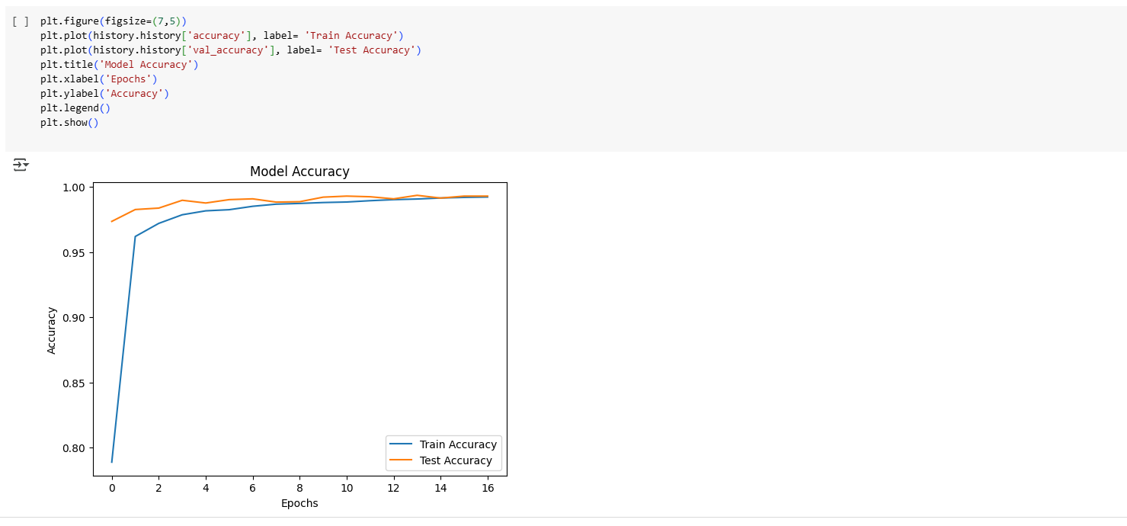
Accuracy comparing

Slide 10
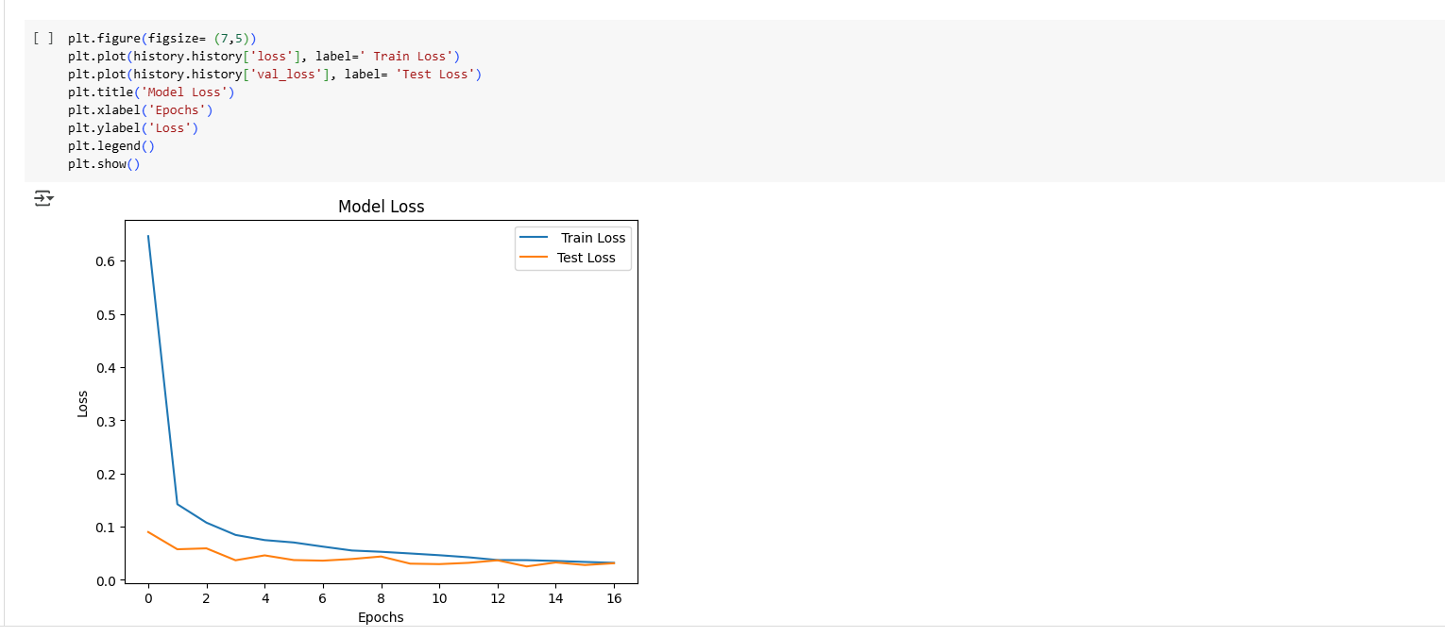
Loss comparing

Slide 11
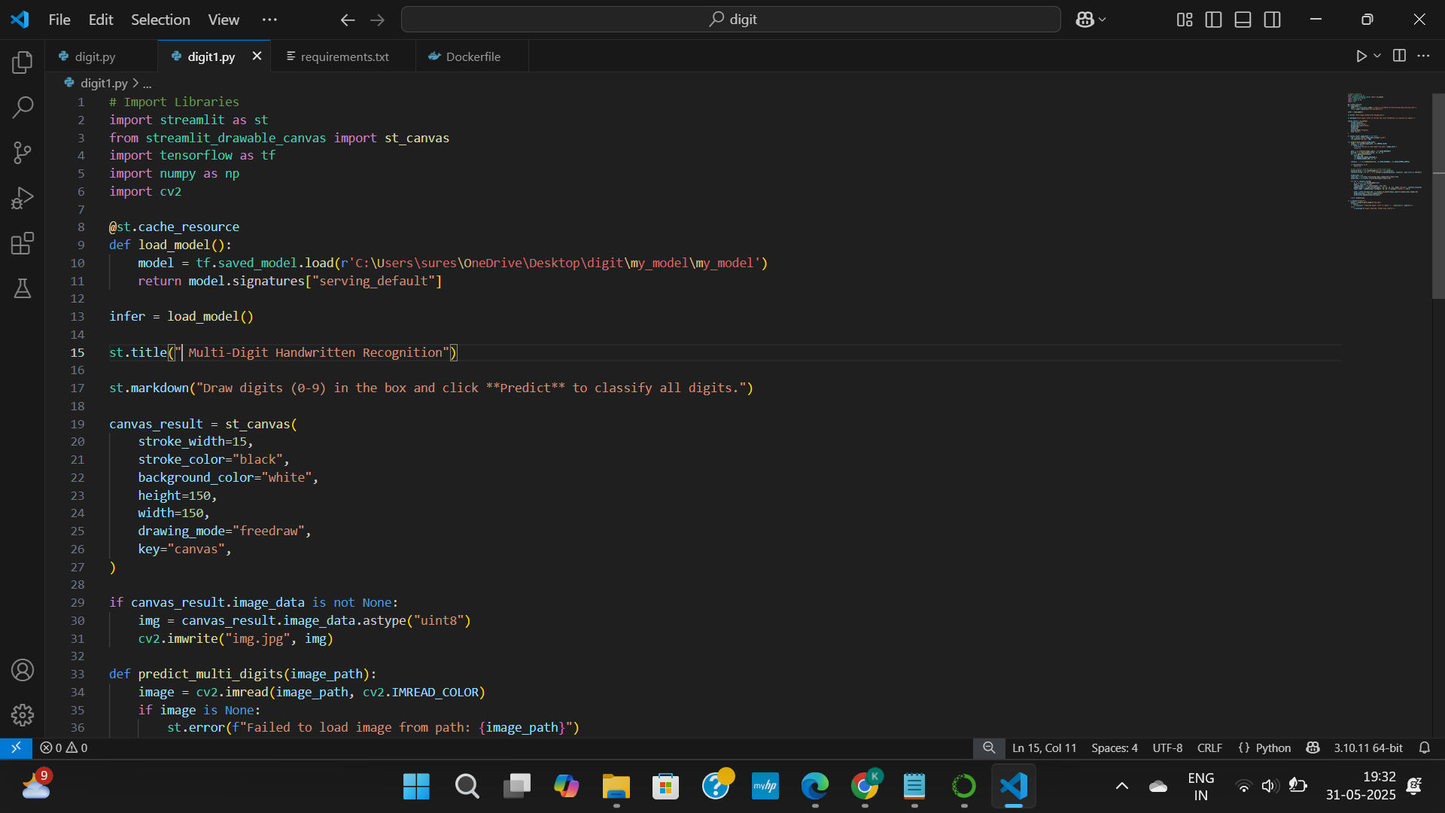
STREAMLIT UI

Slide 12
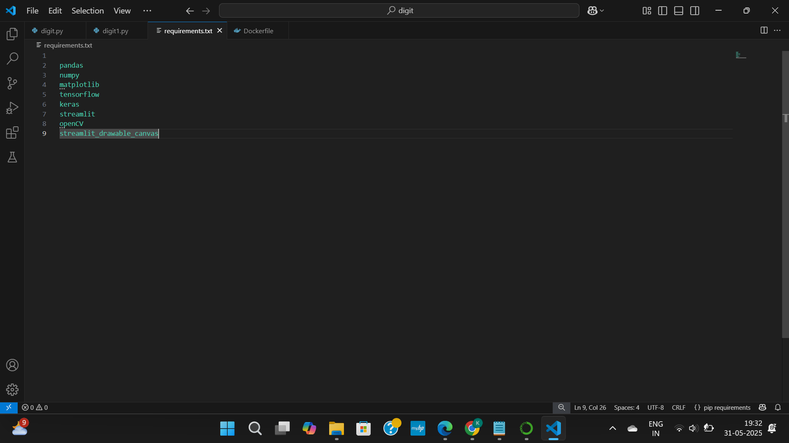
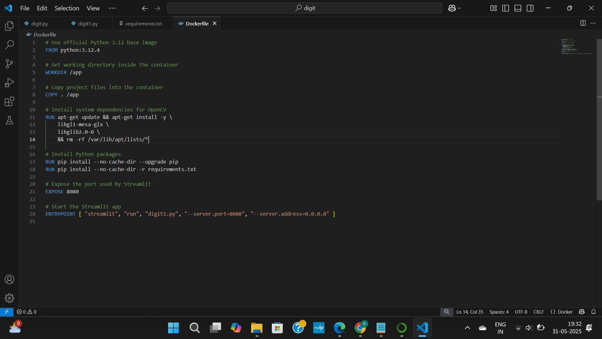
Requirement
DOCKER FILE

Slide 13
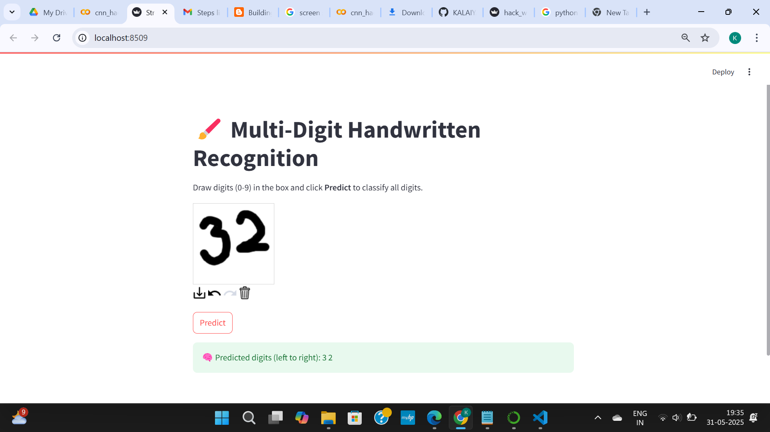
testing

