Slide 1

CoviNet
A responsive, minimalist Site That helps you amidst this pandemic !

Slide 2
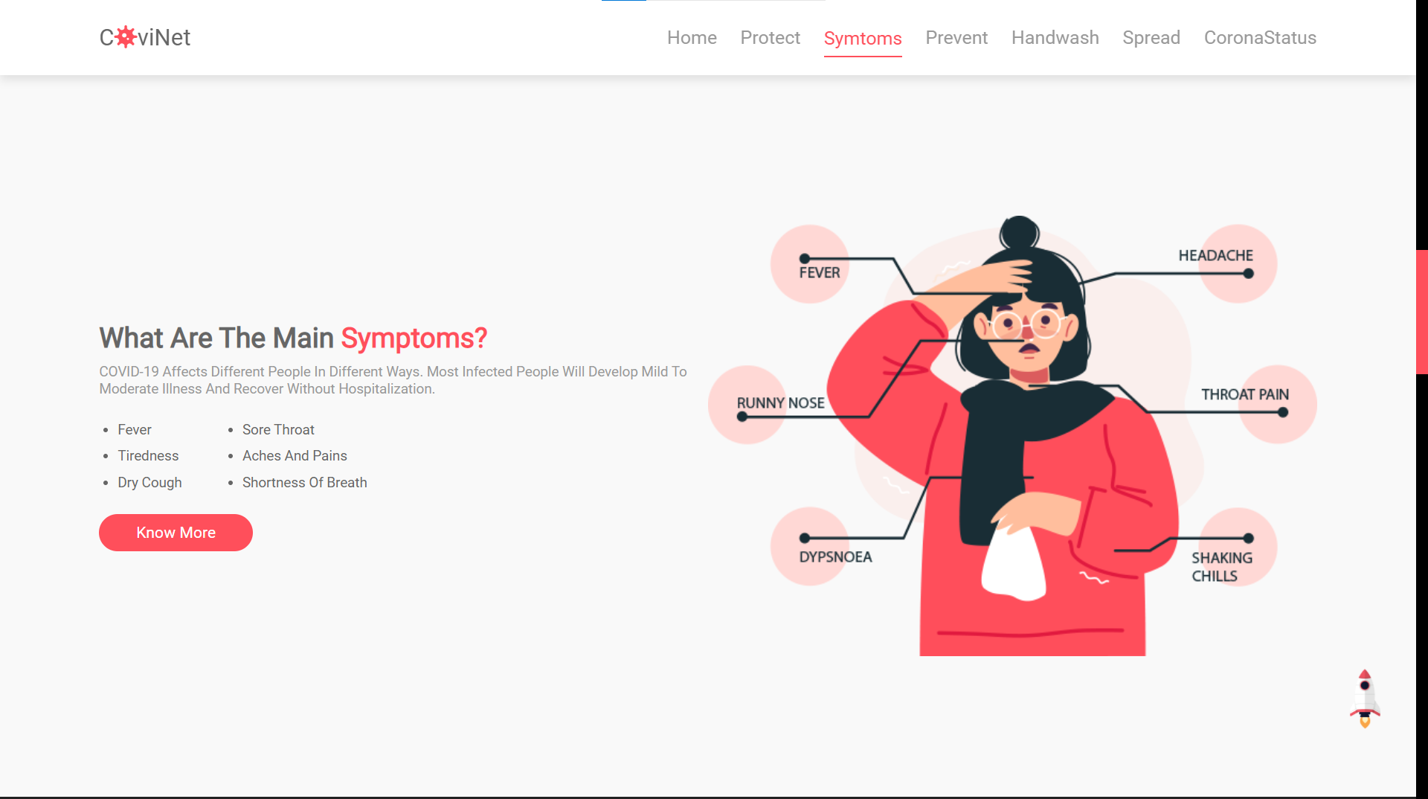
Provides Background Info
We have added all the basic measure, symptoms and preventions for you to be safe amidst this pandemic.

Slide 3
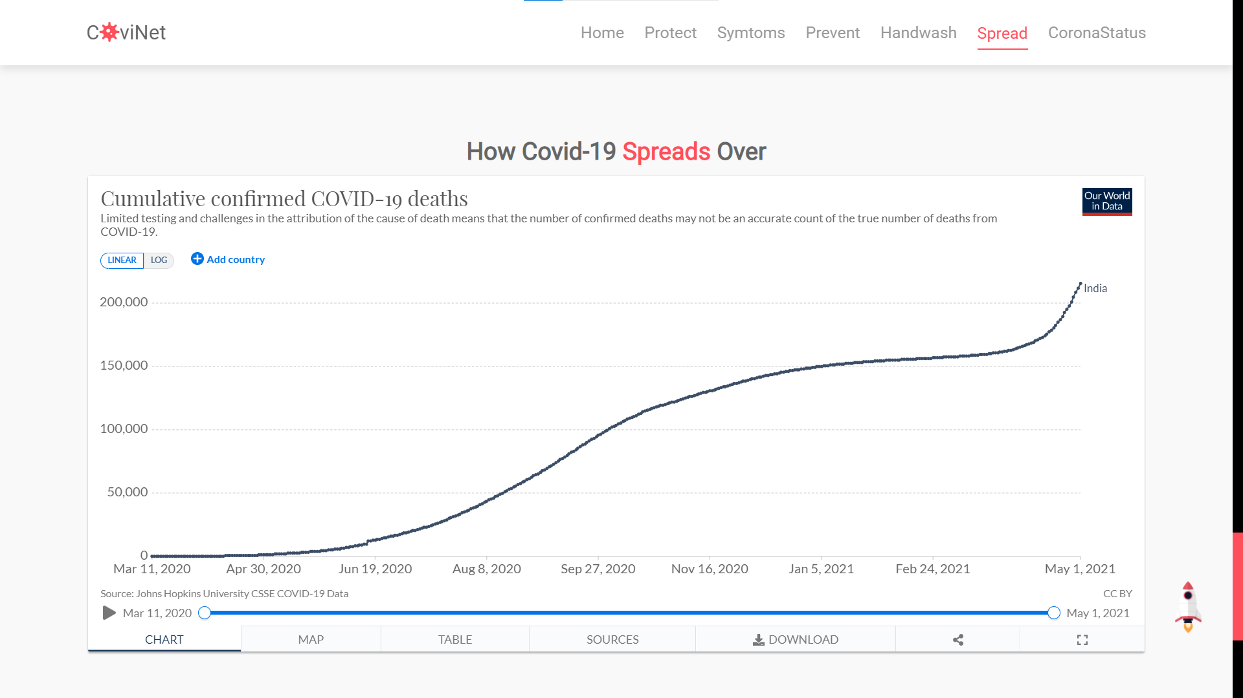
Stats for India and More...
The spread section shows the cumulative number of deaths by this pandemic.
The stats also have sub sections of world-map and country-wise listed table.

Slide 4
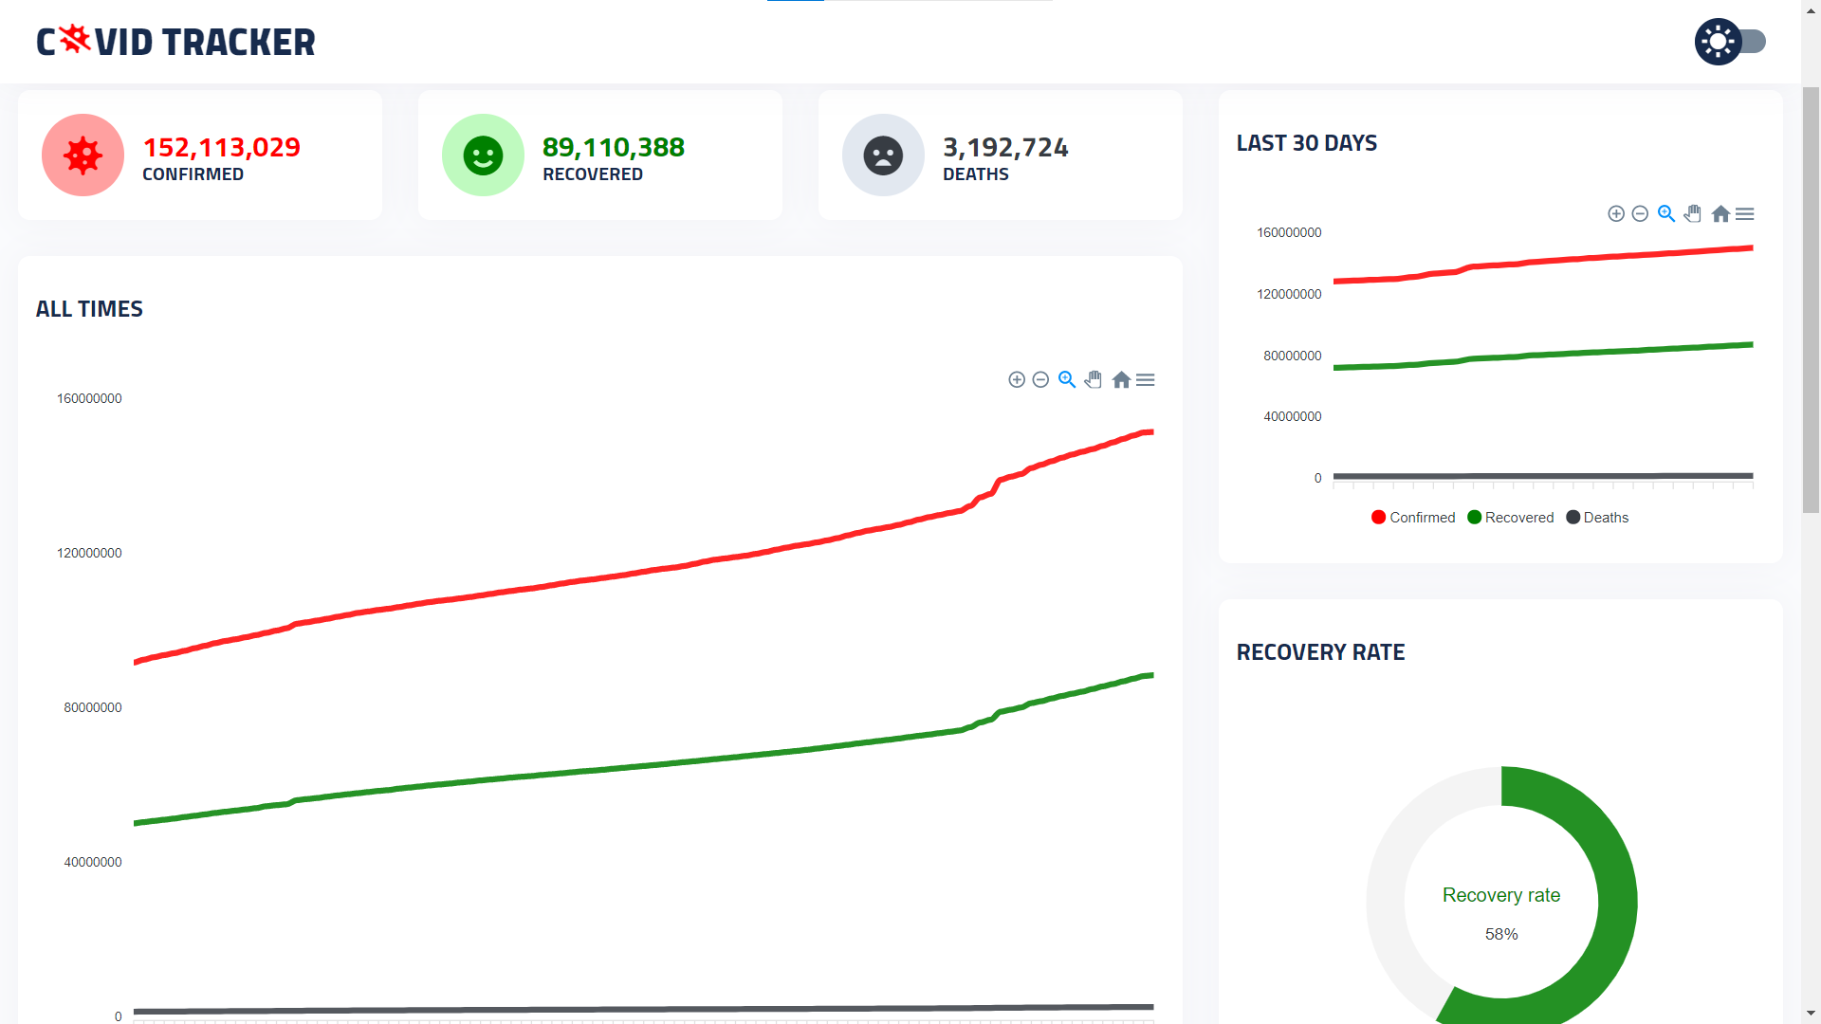
CORONA Tracker
Adding to the stats we have a dedicated page for checking out the detailed pandemic stats in around the world.
They are updated as well !

Slide 5

RESPONSIVE !!!
The site can be easily accessed from your smartphones.
This makes it much easier to get the important information, in urgency.

Slide 6

LOCATIONS !!!
All the important data about hospital beds and O₂ beds can be accessed for the respective major cities/states from the footer panel ,which is not too far away (the designing was kept in mid !).
Each link redirects to the OFFICIAL government sites which has accurate record about vacant beds and other stuff.

Slide 7
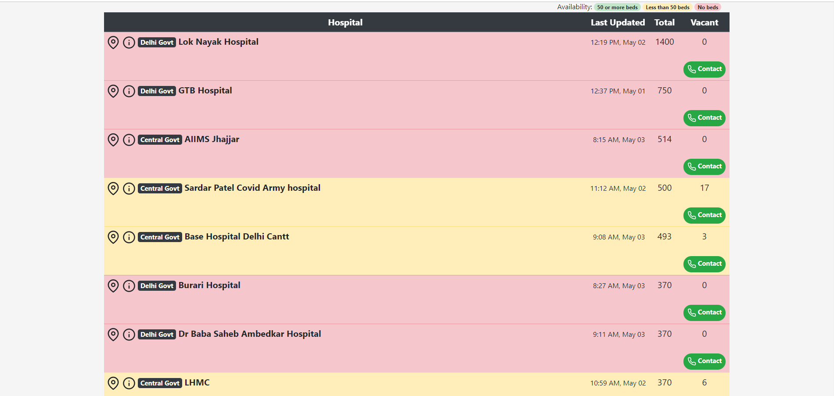
Official websites with updated data
We have added official webite links for the vacant beds/O₂ beds data.

