Slide 1


Maratha Vidya Prasarak Samaj’s K.R.T. Arts, B.H. Commerce & A.M. Science (KTHM) College, Nashik. ​ ​
Department of Statistics
Affiliated to Savitribai Phule Pune University. (SPPU)
A RESEARCH PAPER PRESENTATION
Presented By
Nikumbh Kalpesh Sanjay
Khairnar Krishnai Chandrakant
Bhamare rutuja nanaji
Under The Guidance Of
Prof. Mansi Hiray Mam
Prof. Priya Patil Mam
Prof. Nutan Khangar Mam

Slide 2
Project Title :
Thyroid Disease Detection Using Machine Learning Technology

Slide 3
Objective
To highlight the increasing rate of thyroid gland diseases
To propose the use of ML algorithms for the analysis of thyroid dataset and prediction of accuracy in diagnosis.
To evaluate the effectiveness of different Machine Learning classifiers, namely Logistic Regression, KNN, SVM, Decision Tree Classifier, PCA, and XGBoost in predicting thyroid disease accurately.
To use ML techniques as a tool for simplifying prediction, pattern recognition, and classification in the diagnosis of thyroid disease.

Slide 4
Data Collection
We collected secondary data ( Thyroid dataset & Thyroid attribute names ) from the UCI repository.
Dataset consists of 29 attribute values such as age, sex, on thyroxine, query on thyroxine, on antithyroid medication, sick, etc
Thyroid disease records supplied by the Garavan Institute and J. Ross; Quinlan, New South Wales Institute, Sydney, Australia. 1987.

Slide 5
Research Paper 1
THYROID CANCER DETECTION USING MACHINE LEARNING TECHNIQUES

Slide 6
Introduction
Hyperthyroidism affects about 2% of individuals while hypothyroidism affects about 1% of individuals.
Both of these disorders can be caused by thyroid gland dysfunction, pituitary gland failure, or hypothalamic malfunction.
Machine learning is a set of tools that can be used for prediction, pattern recognition, and classification.
The study in the article uses six machine learning classifiers, including Naïve Bayes, KNN, SVM, Decision Tree Classifier, ANN, and AdaBoost.

Slide 7
Objective
To highlight the increasing rate of thyroid gland diseases
To emphasize the importance of early detection and accurate diagnosis of thyroid cancer.
To propose the use of ML algorithms for the analysis of thyroid dataset and prediction of accuracy in diagnosis.
To evaluate the effectiveness of six different Machine Learning classifiers, namely Naive Bayes, KNN, SVM, Decision Tree Classifier, ANN, and AdaBoost, in predicting thyroid cancer accurately.
To compare the accuracy of Logistic Regression and SVM classifier.
To use ML techniques as a tool for simplifying prediction, pattern recognition, and classification in the diagnosis of thyroid cancer.

Slide 8
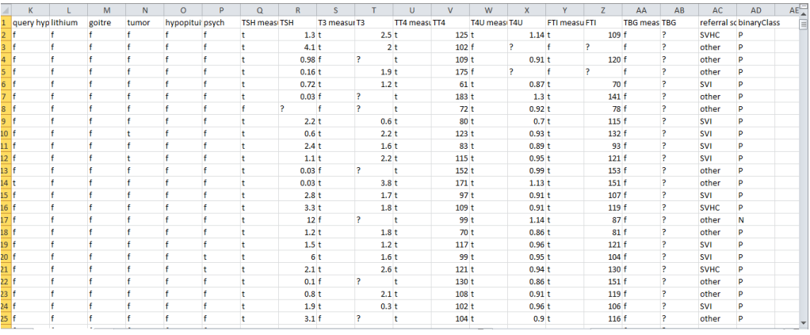
Data

Slide 9
Methodology
Dataset
Data Pre-Processing
Dataset divided into two datasets
All features
Without Query Thyroxine and Query Hyperthyroid and query hyperthyroid
ML Algorithm
(DT,SVM,RF,NB,LR,KNN,NLP)
Classified Accuracy Result

Slide 10
Machine Learning Techniques
Artificial Neural Network
Support Vector Machine
Decision Tree
K- Nearest Neighbour
Naive Bayes
AdaBoost

Slide 11
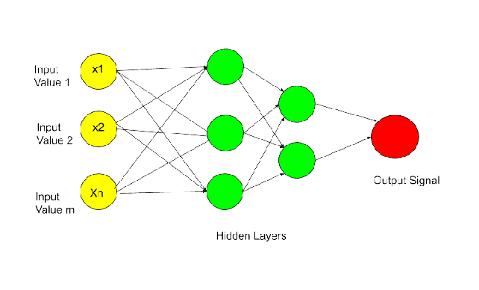
Machine Learning Techniques
Artificial Neural Network
ANN is defined as an information processing model that is inspired by the way biological nervous system such as brain, process information.
ANN is composed of large number of highly interconnected processing units called as neurons used to solve specific problems.
ANN is configured for a specific application such as face recognition, pattern recognition, etc.
Support Vector Machine
Decision Tree
K- Nearest Neighbour
Naive Bayes
AdaBoost

Slide 12
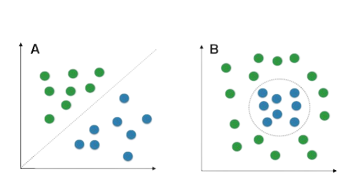
Machine Learning Techniques
Support Vector Machine
Artificial Neural Network
SVM works by mapping data to a high dimensional feature space so that data points can be categorized, even when the data are not linearly separable.
The boundary which divides the classes in the most effective manner is known as the hyperplane.
SVM has two types Linear SVM and Nonlinear SVM.
Decision Tree
K- Nearest Neighbour
Naive Bayes
AdaBoost

Slide 13

Machine Learning Techniques
Decision Tree
Artificial Neural Network
Decision tree is a tree-structured classifier.
In a decision tree, internal nodes represent features of the dataset, Branches represent the decision rules and each leaf node represents the outcome.
Support Vector Machine
K- Nearest Neighbour
Naive Bayes
AdaBoost

Slide 14
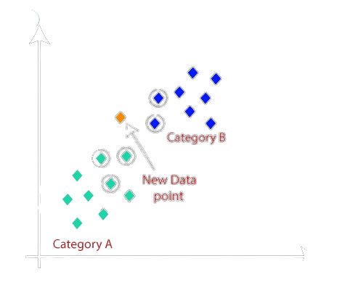
Machine Learning Techniques
K- Nearest Neighbour
Artificial Neural Network
Support Vector Machine
KNN assumes the similarity between new data and available data and puts the new data into the category that is most similar to available categories.
Decision Tree
Naive Bayes
AdaBoost

Slide 15
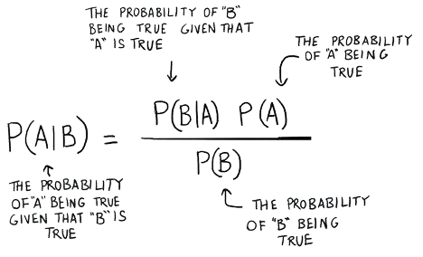
Machine Learning Techniques
Naive Bayes
Artificial Neural Network
Naïve Bayes is the most effective classification algorithm which helps in building fast ML models.
It depends on Baye’s theorem.
Support Vector Machine
Decision Tree
K- Nearest Neighbour
AdaBoost

Slide 16
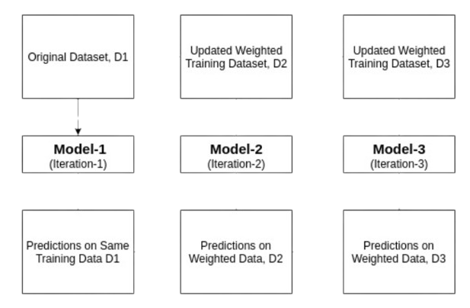
Machine Learning Techniques
AdaBoost
Artificial Neural Network
Adaboost works on the principle of learners growing sequentially.
In simple words, weak learners are converted into strong learners.
Support Vector Machine
Decision Tree
K- Nearest Neighbour
Naive Bayes

Slide 17
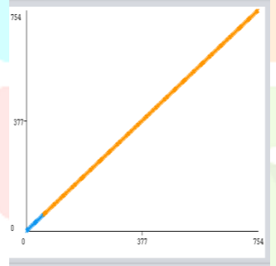
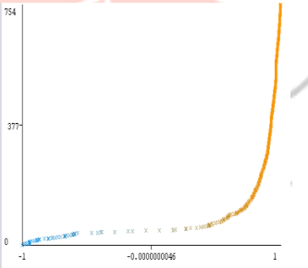
Result
SVM
Logistic Regression
No. | Algorithm | Accuracy
1 | SVM | 92.53
2 | Logistic Regression | 91.73
3 | Decision Tree | 90.13

Slide 18
Conclusion
The article discusses using Machine Learning classification algorithms to identify thyroid difficulties and reduce noisy patient evidence.
The study evaluates KNN, Naïve Bayes, and Support Vector Machine algorithms on accuracy and prototype performance.
SVM has the best prediction performance with an accuracy of 92.53%, followed by logistic regression at 91.73% and decision tree at 90.13%.
As the dataset size increases, the computational cost of SVM will rise.
Effective data classification can help find the best treatment for thyroid patients with improved charge and management.

Slide 19
Research Paper 2
THYROID DETECTION USING MACHINE LEARNING

Slide 20
Introduction
The article discusses the use of computational biology in healthcare for disease prediction, specifically using machine learning algorithms.
The thyroid gland, which regulates metabolism and energy in the body, is a focus for disease prediction.
Thyroid disorders are increasing in India, affecting approximately 1 in 10 adults.
The prediction process for thyroid disorders can be tedious and lead to negative outcomes.
Machine learning can assist doctors in accurately diagnosing thyroid disorders and reducing their burden.
It is important to select features from different datasets to accurately classify healthy patients and avoid misclassification that can lead to unnecessary treatment.

Slide 21
Objective
The main objective is to develop a system that can predict the type of thyroid disease that the patient is affected by.
To predict thyroid disease with the usage of a minimum number of parameters.
To predict all possible types of Thyroid diseases

Slide 22
Methodology
Dataset
Training data
Test data
Classifier/Prediction algorithm
Feature extraction and selection
Test data
Prediction Algorithm
Output label of Disease

Slide 23
Machine Learning Techniques
Artificial Neural Network
Support Vector Machine
Decision Tree
K- Nearest Neighbour
Heat Map
Logistic Regression

Slide 24
Machine Learning Techniques
Artificial Neural Network
ANN is defined as an information processing model that is inspired by the way biological nervous system such as brain, the Processing units called as neurons.
ANN is configured for a specific application such as face recognition, pattern recognition, etc.
ANN algorithm has been implemented with the help of sklearn library and 75.38% accuracy score is obtained
Support Vector Machine
Decision Tree
K- Nearest Neighbour
Heat Map
Logistic Regression

Slide 25
Machine Learning Techniques
Support Vector Machine
SVM works by mapping data to a high dimensional feature space so that data points can be categorized, even when the data are not linearly separable.
The boundary which divides the classes in the most effective manner is known as the hyperplane.
SVM algorithm has been implemented with the help of sklearn library and 95.38% accuracy score is obtained
SVM has two types Linear SVM and Nonlinear SVM.
Artificial Neural Network
Decision Tree
K- Nearest Neighbour
Heat Map
Logistic Regression

Slide 26
Machine Learning Techniques
Decision Tree
Decision tree is a tree-structured classifier.
In a decision tree, internal nodes represent features of the dataset, Branches represent the decision rules and each leaf node represents the outcome.
DT algorithm has been implemented with the help of sklearn library and 92.3% accuracy score is obtained
Artificial Neural Network
Support Vector Machine
K- Nearest Neighbour
Heat Map
Logistic Regression

Slide 27
Machine Learning Techniques
K- Nearest Neighbour
Artificial Neural Network
KNN assumes the similarity between new data and available data and puts the new data into the category that is most similar to available categories.
KNN algorithm has been implemented with the help of sklearn library and 93.84% accuracy score is obtained.
Support Vector Machine
Decision Tree
Heat Map
Logistic Regression

Slide 28
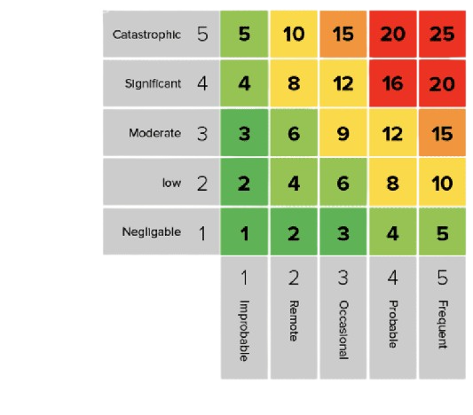
Machine Learning Techniques
Heat Map
Artificial Neural Network
A heatmap is a graphical representation of data where values are depicted by colour.
They are essential in detecting what does or doesn’t work on a website.
Support Vector Machine
Decision Tree
K- Nearest Neighbour
Logistic Regression

Slide 29
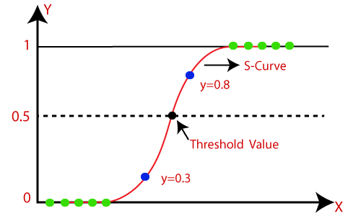
Machine Learning Techniques
Logistic Regression
Artificial Neural Network
Logistic regression is used for predicting categorical dependent variables using a given set of independent variables.
In logistic regression, instead of fitting a regression line, we fit an “S” shaped logistic function which predicts two values 0 and 1.
Logistic Regression has been implemented and 96.92% accuracy score is obtained.
Support Vector Machine
Decision Tree
K- Nearest Neighbour
Heat Map

Slide 30
Conclusion
1. The project uses machine learning to predict thyroid disease using the logistic regression algorithm.
2. Users input their data into a web app, which is then processed by the model, and the result is displayed on the screen.
3. The project aims to provide society with an efficient and accurate machine-learning model that can be used in disease detection applications.
4. Image processing of ultrasonic scanning of thyroid images can be used to predict thyroid nodules and cancer, which cannot be recognized in blood test reports.
5. Combining the results of both approaches could potentially cover all thyroid-related diseases.
No. | Algorithm | Accuracy
1 | Logistic Regression | 96.92
2 | Decision Tree | 95.38
3 | SVM | 93.84

Slide 31
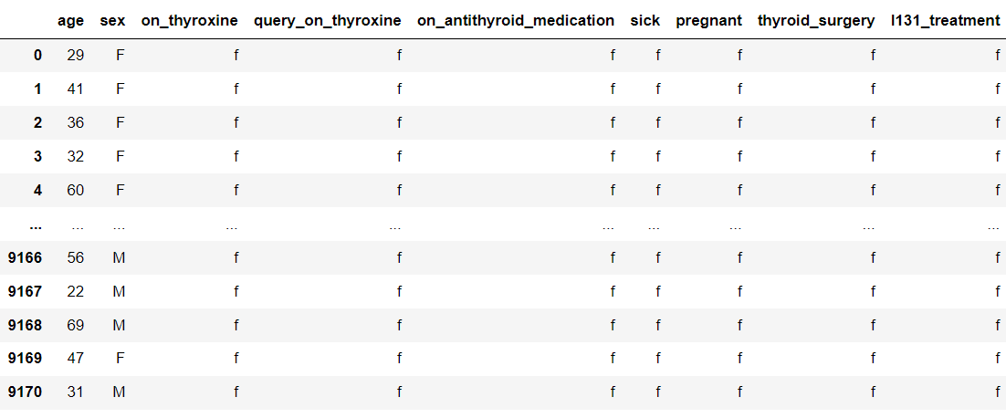
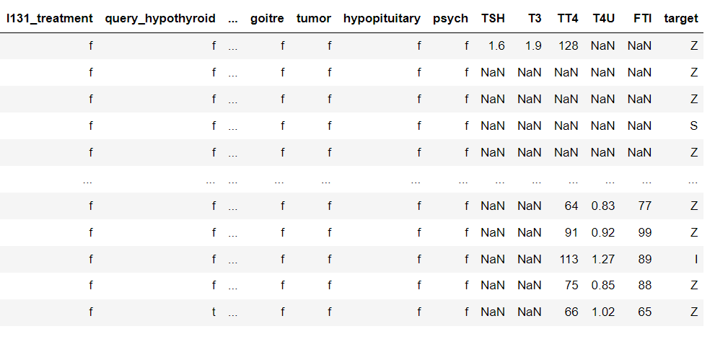
Data

Slide 32
How we are using these research papers in our project?
we can utilize these Research papers to gain insights, select features, choose algorithms, develop models, and evaluate the performance of our project.
We can use some Machine Learning techniques as follows.
Logistic regression
SVM
KNN
Decision Tree
Random Forest
XGBoost
PCA

Slide 33
References
Research Paper 1
[1]. Lewiński A, Sewerynek E, Karbownik M: 2006. Aging processes and the thyroid gland. In Aging and Age-Related Diseases: The Basics. Edited by: Karasek M. New York: Nova Science Publishers, Inc;131–172.Google Scholar.
[2]. Faggiano A, Del Prete M, Marciello F, 2018. Marotta V, Ramundo V, Colao A: Thyroid diseases in elderly. Minerva Endocrinol 2011, 36: 211–231.PubMedGoogle Scholar International Journal of Computer Sciences and Engineering Vol.6(1), Jan 2018, EISSN: 2347-2693 ©, IJCSE All Rights Reserved 331.
[3]. Papaleontiou M, Haymart MR: 2012. Approach to and treatment of thyroid disorders in the Elderly. Med Clin North Am, 96: 297–310. 10.1016/j.mcna.2012.01.013.
Research Paper 2
[1]Ankita Tyagi and Ritika Mehra. (2018).“Interactive Thyroid Disease Prediction System using Machine Learning Techniques” published on ResearchGate.
[2] YongFeng Wang,(2020). “Comparison Study of Radiomics and Deep-Learning Based Methods for Thyroid Nodules Classification using Ultrasound Images” published on IEEEAccess.
[3] Sunila Godara,(2018). “Prediction of Thyroid Disease Using Machine Learning Techniques” published on IJEE.

Slide 34
Thank you.

