Slide 1



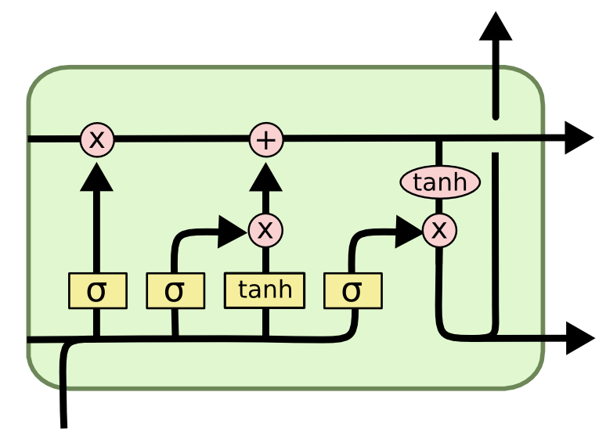
Forecasting Financial Futures:
LSTM Approach to Tech, Gold & Bitcoin
Prateek Kalra / Lars Henske / Janice Kohrs / Da Yeon Kang
Abstract & Introduction
Which stocks did we analyze?
Results
Conclusion
In this project, we aim to predict short-term price changes for the top 10 US tech stocks, Gold, and Bitcoin. We use a deep learning model called LSTM, which is good at working with time-based data like stock prices. To improve our predictions, we also include news headlines to understand market sentiment. We used data from August 18, 2023, to March 18, 2024. Our results show that combining price data with news sentiment gives better predictions than using price data alone.
Top 10 Tech Stocks in the US - Apple (AAPL) - Microsoft (MSFT) - Amazon (AMZN) - Alphabet (GOOGL) - Nvidia (NVDA) - Tesla (TSLA) - Palantir (PLTR) - Meta (META) - Uber Technologies (UBER) - Robinhood Markets (HOOD)
Bitcoin & Gold
Add your information, graphs and images to this section.
Add your information, graphs and images to this section.
What is LSTM?
LSTM (Long Short-Term Memory) is a type of neural network that’s good at learning patterns in time-series data, like stock prices. Unlike regular models, LSTM can remember important information from the past and forget what's not useful, using special gates. This makes it ideal for predicting future values based on historical trends.
Methodology
Inspired by a study on the Vietnamese stock market (Phuoc et al., 2024), our architecture includes:
Input Features: 214 days rolling window of closing prices, trading volume, and technical indicators
(RSI, MACD, SMA)
Layers:
- LSTM Layer 1: 30 units, ReLU, Dropout(0.1)
- LSTM Layer 2: 40 units, ReLU, Dropout(0.1)
- Dense Layer: Output prediction for next-day closing price
Training:
- Epochs: 1000
- Early stopping: Patience = 8
Tools:
- Python (Keras/TensorFlow)
- Yahoo Finance for data
- Scikit-learn for preprocessing
Recommendations
Add your information, graphs and images to this section.
Research Question
Can a deep learning model based on Long Short-Term Memory (LSTM) networks consistently predict short-term price trends in US large-cap stocks better than traditional technical indicators?
Acknowledgements
Add your information, graphs and images to this section.

