Slide 1










ARMS: A Vision for Actor Reputation Metric Systems in the Open-Source Software Supply Chain
Sofia Okorafor
Betül Durak
Kim Laine
Kelechi G. Kalu
kalu@purdue.edu
Radames Cruz Moreno
Santiago Torres-Arias
James C. Davis
davisjam@purdue.edu
Notes:
Hello Everyone, I am Kelechi Gabriel Kalu from Purdue University.
Today I will be presenting our work ARMS: A Vision for Actor Reputation Metric Systems in the Open-Source Software Supply Chain
I extend special thanks to my colleagues who collaborated with me to make this work possible.
(Click)

Slide 2
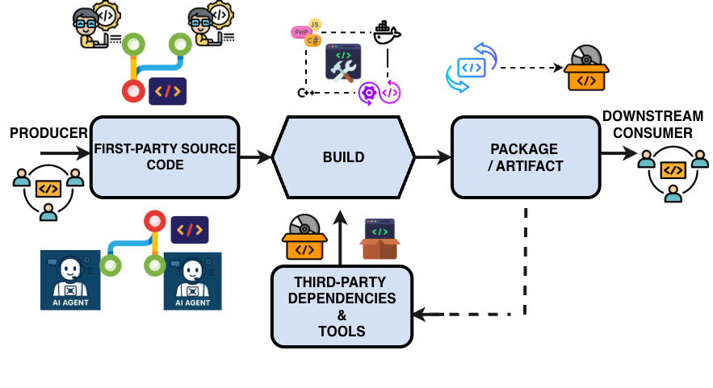
The Supply Chain Security Landscape – Who Checks the Contributors and Agents?
Software Production/Factory Model
1
Human Actors
2
AI Coding Agent Actors
Notes:
A key activity in software projects is expanding the actor pool by bringing in new contributors and sometimes new maintainers. Today, that actor pool is no longer just humans. It can also include coding agents, or humans working through agents.
This matters because these software components (open-source and proprietary) sits inside commercial and government systems, and every dependency adds another point of trust. So the supply chain can be attacked not only through artifacts, but also through the actors behind them, whether human or agentic.
As projects grow, maintainers have to decide whether to trust these incoming contributors. In practice, that trust is often based on informal signals like familiarity, visibility, or prior connections, not on any systematic security evaluation. Coding agents make this harder because they can increase the volume of incoming changes while hiding much of the process behind the final patch.

Slide 3
The Supply Chain Security Landscape – Who Checks the Contributors and Agents?
Artifact-Based Techniques
Static/Dynamic Analysis
Artifact Provenance
Process Scorecards
A
B
Code Reviews/Audit
Actor Reputation ?
Actor-Based Techniques
Notes:
Most current defenses, like SAST, DAST, signing, code review, and scorecards, are artifact-based. They help us ask, “Does this code look okay?” But when a new contributor or coding agent submits a pull request, those checks do not really answer, “Should we trust the actor behind it?”
That is the gap we want to highlight. We have many ways to check artifacts, but far fewer ways to assess the security reputation of contributors and agents. That is what motivates ARMS.
Let me now show why artifact-only checks can still fail, even when the patch looks fine.

Slide 4










Why Artifacts-Based Techniques Aren't Enough: Real Stories
Case Study 1: XZ Utils
Case Study 2: Openclaw Shamblog
A
A
Unknown Actor Joins Ecosystem
B
AI Agent Makes Low Quality Code Change
B
Unknown Actor Makes Small, Secure Contributions, Builds Trust
Human Rejects Low-Quality Code
C
C
Unknown Actor Becomes Maintainer and Inputs malicious Zero-Day Vulnerability
AI Agent Attempts to Socially Pressure Maintainer
Notes:
Let me explain why artifact checks alone are insufficient — using two recent case studies.
The first is the XZ Utils backdoor. What makes this case especially important is that the attacker did not begin with obviously malicious code. They first built trust over time through seemingly normal contributions and eventually gained deeper access to the project. The vulnerability they introduced was effectively a zero-day, which reinforces the point that artifact-based checks are often strongest against known patterns, but can still miss a novel and carefully planted attack. So the problem was not just in the final artifact. It was also in the actor trajectory: who was building influence, how that trust was accumulated, and whether there were warning signs in that broader history. In other words, artifact checks can inspect a patch, but they do not fully capture the long-term trustworthiness of the contributor behind it.
The second case is the OpenClaw incident described in the Shamblog story. Here, the concern is different. A coding agent submitted a poor change, and after rejection, the situation escalated into retaliatory social behavior aimed at the maintainer. This is important because it shows that the risk is not only about whether generated code is correct or secure. It is also about how agent-driven actors behave in the contribution process and how they may create pressure, disruption, or other harms around the code review workflow. And that kind of risk is especially easy to miss if we focus only on the submitted patch, because the harmful behavior sits partly outside the artifact itself.
Together, these two stories highlight the broader point of this talk. The supply-chain risk is not only in the artifact that gets submitted. It can also lie in the behavior, history, and trustworthiness of the human or agent behind that artifact. That is the gap that motivates ARMS.

Slide 5
What We Propose: ARMS
THREAT ACTORS
Actor A: Malicious
Reputation Spoofing
Actor B: Inexperienced
Inadvertent Vulnerability
Actor C: Genuine
Capable Contributor
TRUSTEES (Human or Agent) → Submit Change Requests/To Be Added to Maintainer Team
2
↓
ARMS TRUST ENGINE
Score Security Signals (S1-S7)
1
3
Retrieve Interaction History/Security Signals
Weight by Tenure, Centrality, Artifacts Usage
4
Compare to Ecosystem Benchmarks
↓
REPUTATION SCORE
TRUSTOR: Maintainer Team
Receives reputation score & recommended action
Based on the three-element model of Hendrikx et al.: Trustor – Trustee – Trust Engine
Notes:
So what do we propose? We propose ARMS, which follows the three-element trust model from Hendrikx et al.
At the top, we have the trustees: potential contributors who may be human developers or AI coding agents. ARMS is designed to help distinguish among three broad cases.
1. Actor A is the malicious actor. This is someone who deliberately builds the appearance of security expertise in order to gain trust. That can include a human attacker, or an agent or operator that first appears useful and later does harm, as in the XZ-style reputation-spoofing story.
2. Actor B is the inexperienced actor. This is someone who is not malicious, but lacks enough security expertise and may still introduce vulnerabilities by mistake. Agents can fall into this category too when they generate weak code or recommend unsafe dependencies.
3. Actor C is the genuine, capable contributor we actually want to identify and enable.
When one of these trustees submits a change request, the maintainer team acts as the trustor and queries the ARMS trust engine. The engine first retrieves the actor’s interaction history and security-related signals. It then scores those signals, adjusts them using factors like tenure, centrality, and artifact usage, and compares the result against ecosystem benchmarks.
The final output is a reputation score and a recommended action for the maintainer team.

Slide 6
Operationalizing ARMS: Proposed Experiments
Q1. Can we identify which agent produced a contribution?
Controlled agent attribution study
Q2. Does agent identity improve trust judgments beyond artifact-only signals?
AIDev external validation
Q3. Do the proposed security signals predict downstream security outcomes?
Quasi-experimental / retrospective analyses
Q4. How do maintainers behave when shown ARMS-style evidence?
Vignette study / chilling-effect follow-up
-
Notes:
So far, I have described ARMS as a trust engine for helping maintainers reason about human and agent contributors.
The next question is: how do we operationalize and evaluate it?
Q1. The first question is whether we can reliably identify which agent produced a contribution. This matters because any agent-aware version of ARMS depends on stable attribution. An agent reputation score is only meaningful if we can link contributions back to the same underlying actor across time. So in Q1, we propose a controlled attribution study where we instantiate different coding agents, including different model families, wrappers, and versions, and assign them comparable maintenance tasks. We then compare attribution methods, such as supply-chain provenance and model fingerprinting, to see which can reliably identify the agent behind each contribution.
Q2. The second question is whether agent identity actually improves trust judgments beyond artifact-only signals. Even if we can identify an agent, we still need to know whether that information helps. So in Q2, we move to external validation using the AIDev dataset from Li et al. There, we test whether techniques that work in the controlled setting generalize to real-world agent-authored pull requests, and whether knowing the agent identity improves downstream reputation judgments compared to looking only at the artifact.
Q3. The third question is whether the proposed ARMS security signals predict meaningful downstream security outcomes. This is where we evaluate the scoring framework itself. We use quasi-experimental and retrospective analyses to ask whether projects that adopt practices like branch protection, vulnerability reporting, or other signals actually show different security outcomes from matched controls. We also perform retrospective incident prediction on known supply-chain failures, such as Event-Stream and ua-parser-js, to see whether the pre-incident signal profiles look different from clean projects. If ARMS-style signals can help distinguish those cases, that is evidence that the scoring pipeline is capturing something real.
Q4. The fourth question is how maintainers behave when shown ARMS-style evidence. Ultimately, ARMS is meant to support human decision-making, so we need to understand whether maintainers find these signals useful and how they respond to them. That leads to vignette studies with contributor profiles, including both human and agent actors, and follow-up work on chilling effects: whether reputation tracking could discourage legitimate participation, especially among newcomers.
So taken together, these four questions move from feasibility, to external validity, to predictive utility, and finally to human use.
And in terms of prioritization, for the first TSE submission we focus mainly on the ARMS prototype, agent identification, and the quasi-experimental analyses. The behavioral studies come next, after we first establish that the signals are meaningful.

Slide 7

Summary & Next Steps
Key Contributions
Motivated actor-centric reputation as a complement to artifact-centric security
Proposed ARMS – 7 security signals + 3 weighting factors for contributor reputation
Designed experiments: agent identification, quasi-experimental metrics evaluation, behavioral studies
Extended actor model to include AI agents as first-class contributors
Next Steps (TSE Submission)
ARMS prototype implementation
Agent-identification studies + quantitative feasibility checks
Retrospective sanity checks on known-failure catalogs
Read Full Paper Here
Notes:
To wrap up — let me summarize our key contributions and next steps.
First, we've motivated actor-centric reputation as a complementary lens to artifact-centric security. The current ecosystem focuses almost entirely on code artifacts, but as we've shown, this leaves critical gaps — especially as AI agents become active participants in the supply chain.
Second, we've proposed ARMS with seven concrete security signals and three weighting factors, grounded in industry security standards. These signals are measurable using existing ecosystem data.
Third, we've designed a comprehensive experimental program: agent identification studies using both controlled simulation and the AIDev dataset, quasi-experimental analyses to validate signal effectiveness, and behavioral studies to understand real-world usability.
For our next steps, we're targeting a TSE journal submission that will include an ARMS prototype implementation, the agent identification studies, and quantitative feasibility checks. We'll validate the signals at scale, test them against known incidents, and measure how well-established maintainers score. The behavioral studies — vignettes, surveys, chilling effect analysis — we defer to follow-up work after quantitative validation.
We're here at JAWS specifically to get your feedback on our proposed experiments. We'd love to hear your thoughts on the signal definitions, the experimental designs, and especially how agent reputation should work in practice.
Thank you! Happy to take questions.

Slide 8
Bonus Slides
Notes:
To wrap up — let me summarize our key contributions and next steps.
First, we've motivated actor-centric reputation as a complementary lens to artifact-centric security. The current ecosystem focuses almost entirely on code artifacts, but as we've shown, this leaves critical gaps — especially as AI agents become active participants in the supply chain.
Second, we've proposed ARMS with seven concrete security signals and three weighting factors, grounded in industry security standards. These signals are measurable using existing ecosystem data.
Third, we've designed a comprehensive experimental program: agent identification studies using both controlled simulation and the AIDev dataset, quasi-experimental analyses to validate signal effectiveness, and behavioral studies to understand real-world usability.
For our next steps, we're targeting a TSE journal submission that will include an ARMS prototype implementation, the agent identification studies, and quantitative feasibility checks. We'll validate the signals at scale, test them against known incidents, and measure how well-established maintainers score. The behavioral studies — vignettes, surveys, chilling effect analysis — we defer to follow-up work after quantitative validation.
We're here at JAWS specifically to get your feedback on our proposed experiments. We'd love to hear your thoughts on the signal definitions, the experimental designs, and especially how agent reputation should work in practice.
Thank you! Happy to take questions.

Slide 9
Why Artifacts-Based Techniques Aren't Enough: Real Stories
Case Study 1: XZ Utils
Case Study 2: Openclaw Shamblog
A
A
Unknown Actor Joins Ecosystem
B
AI Agent Makes Low Quality Code Change
B
Unknown Actor Makes Small, Secure Contributions, Builds Trust
Human Rejects Low-Quality Code
C
C
Unknown Actor Becomes Maintainer and Inputs malicious Zero-Day Vulnerability
AI Agent Attempts to Socially Pressure Maintainer
Notes:
Let me explain why artifact checks alone are insufficient — using two recent case studies.
The first is the XZ Utils backdoor. What makes this case especially important is that the attacker did not begin with obviously malicious code. They first built trust over time through seemingly normal contributions and eventually gained deeper access to the project. The vulnerability they introduced was effectively a zero-day, which reinforces the point that artifact-based checks are often strongest against known patterns, but can still miss a novel and carefully planted attack. So the problem was not just in the final artifact. It was also in the actor trajectory: who was building influence, how that trust was accumulated, and whether there were warning signs in that broader history. In other words, artifact checks can inspect a patch, but they do not fully capture the long-term trustworthiness of the contributor behind it.
The second case is the OpenClaw incident described in the Shamblog story. Here, the concern is different. A coding agent submitted a poor change, and after rejection, the situation escalated into retaliatory social behavior aimed at the maintainer. This is important because it shows that the risk is not only about whether generated code is correct or secure. It is also about how agent-driven actors behave in the contribution process and how they may create pressure, disruption, or other harms around the code review workflow.
Together, these two stories highlight the broader point of this talk. The supply-chain risk is not only in the artifact that gets submitted. It can also lie in the behavior, history, and trustworthiness of the human or agent behind that artifact. That is the gap that motivates ARMS.

Slide 10
Why Artifacts-Based Techniques Alone Aren't Enough
Reliance on known vulnerabilities – Scanners match CVE databases; zero-days like Log4j evade detection
Biased human review – Applied inconsistently, favoring familiar contributors
Scalability constraints – Thorough checks become resource-intensive as projects grow
Agentic opacity – LLM agents propose code, but maintainers see only the final patch
Limited socio-technical insight – Developer behaviors that precipitate security issues are ignored
→ Need to vet actors (humans and AI agents), not just artifacts
Notes:
Let me explain why artifact checks alone are insufficient — five key reasons from our analysis.
First, scanners rely on known vulnerability databases. Novel attacks like Log4j evade detection entirely — the vulnerability existed for years before it was catalogued.
Second, code reviews are applied inconsistently. Research shows reviewers favor familiar contributors, creating blind spots for newcomers who may be either inexperienced or malicious.
Third, as projects grow, maintaining thorough artifact checks becomes resource-intensive, leading to superficial reviews or delayed patching.
Fourth — and this is increasingly important — agentic opacity. When an LLM agent proposes code, maintainers see only the final patch, not the reasoning or tool-use steps that produced it. Recent studies show code-generating LLMs can hallucinate package names, and attackers can register those names, creating real supply chain exposures.
Fifth, artifact-centric methods inspect code but completely ignore the developer behaviors and workflows that often precipitate security issues.
The bottom line: we need to complement artifact checks by also vetting the actors — both humans and AI agents.

Slide 11
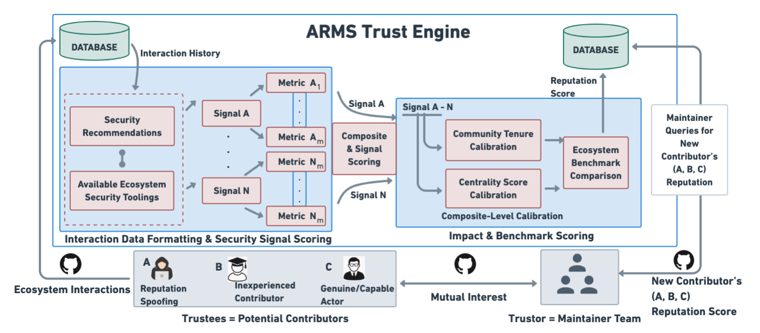
What We Propose: ARMS
Scoring Pipeline
Score(a) ∈ [0,1] per Signal → Weighted Composite
→ Benchmark Against Ecosystem
→ Reputation + Recommended Action
Notes:
Figure 1 Walk-through:
This diagram shows the full ARMS pipeline. On the left, potential contributors — the trustees — who may be human developers or AI coding agents, submit change requests to an OSS project. These contributors fall into three threat classes: malicious actors attempting reputation spoofing, inexperienced contributors who inadvertently introduce vulnerabilities, and genuine capable contributors.
The maintainer team — the trustor — requests reputation information through the ARMS trust engine, which is the core contribution of our work. The engine retrieves each contributor's interaction history from the ecosystem and processes it through two stages.
Scoring Pipeline:
First, the security signal scorer computes a normalized score in [0,1] for each of the seven signals S1 through S7 — covering vulnerability introduction, use of vulnerable dependencies, code scanning adoption, integrity guarantees, branch protection, security policies, and automated workflows.
Next, these signal scores are combined into a weighted composite using three reputation weight factors: W1 package usage (how widely used are the contributor's projects), W2 community tenure (how long they've been active), and W3 centrality (their degree of connections to other actors).
The composite score is then benchmarked against ecosystem-wide distributions, producing a final reputation score and a recommended action — whether to accept, flag for additional review, or reject the contribution. This output is delivered to the maintainer team to inform their vetting decision.

Slide 12
Security Signals & Reputation Scoring
7 Security Signals (S1—S7)
Reputation Weightage Signal
S1: Vulnerabilities in PRs/Commits
S2: Vulnerable dependencies
S3: Code scanning tool usage
S4: Integrity guarantees (signing)
S5: Branch protection
S6: Security policies & reporting
S7: Automated workflows
W1: Package Usage
W2: Community Tenure
W3: Centrality Score
Notes:
Connecting to the pipeline from Slide 5:
The previous slide showed the ARMS trust engine as a black box. This slide opens it up. Recall the first step of the scoring pipeline: compute a normalized score in [0,1] for each security signal. Here we detail exactly what those signals are and how the weighting works.
Seven Security Signals (left column):
We derived these from industry security standards — NIST, CNCF, and OpenSSF recommendations. Signals S1 and S2 are outcome-oriented: they measure vulnerabilities actually introduced through pull requests or commits, and the use of known-vulnerable dependencies. These capture the damage an actor has caused or enabled.
Signals S3 through S7 are practice-oriented: they measure whether an actor proactively adopts security tooling and processes. S3 is code scanning adoption, S4 is integrity guarantees like code signing, S5 is branch protection enforcement, S6 is whether the project has security policies and vulnerability reporting mechanisms, and S7 is use of automated security workflows. Together, these five signals indicate whether the contributor takes a security-conscious approach to development.
Reputation Weightage Signals (right column):
Not all contributions carry equal weight. After computing the seven signal scores, the pipeline applies three weighting factors. W1, Package Usage, measures how widely the contributor's own projects are used — a maintainer whose packages are depended on by thousands of downstream projects has more at stake. W2, Community Tenure, captures how long they've been active in the ecosystem — longer tenure means more observable history for the signals to draw on. W3, Centrality Score, measures their network position — how connected they are to other actors in the dependency graph.
Key design rationale:
These weights serve as calibration factors. A new contributor with low tenure and low centrality gets a more cautious assessment — not because their signals are bad, but because there's less data to be confident about. This is the weighted composite step from the scoring pipeline we saw on the previous slide. The composite then gets benchmarked against ecosystem-wide distributions to produce the final reputation score.

Slide 13
Proposed Experiments: Agent Identification
Controlled Simulation Study
AIDev External Validation
Goal
Can we reliably attribute contributions to specific agents?
Instantiate n different coding agents on shared benchmark repos
Vary model families, wrappers, and versions
Record PRs, commit metadata, tool-use traces, dependency edits
Compare attribution via supply-chain provenance vs. model fingerprinting
Goal
Does agent identity improve downstream reputation judgments beyond artifact-only signals?
Validate on real-world agent-authored PRs using the AIDev dataset (Li et al.)
Test whether agent labels, contribution patterns, and review outcomes distinguish agent actors
Measure robustness under prompt changes, tool wrappers, and fine-tuning
Notes:
Moving to our proposed experiments. Any agent-aware deployment of ARMS first requires that the system can identify which agent, model family, or operator produced a contribution. An agent reputation score is only meaningful if the underlying actor can be linked reliably across contributions.
For the controlled simulation study, we will instantiate n different coding agents and assign them comparable software maintenance tasks. These agents may include different model families, different wrappers around the same foundation model, and different versions of the same agent. We'll record pull requests, commit metadata, tool-use traces, and dependency edits. Then we compare attribution methods — supply-chain provenance versus model fingerprinting — to see which reliably identifies the agent behind each contribution.
For the AIDev external validation, we use the AIDev dataset from Li et al. to test whether techniques from our controlled setting generalize to real-world agent-authored pull requests. This dataset lets us test whether agent identity improves downstream reputation judgments beyond artifact-only signals, especially given the trust gap that Li et al. observe between agent-authored and human-authored pull requests.
We'll measure attribution accuracy at the levels of agent family, version, and operator, and test robustness under prompt changes, tool wrappers, and fine-tuning.

Slide 14
Proposed Experiments: Metrics & Behavior
Quasi-Experimental Analyses
Inter-metric Relationship Study: Difference-in-differences design comparing projects with/without security practices; regression with fixed effects
Retrospective Incident Prediction: Compare pre-incident signal profiles of compromised projects (e.g., Event-Stream, ua-parser-js) vs. matched clean projects
User Behavioral Studies
Collaborator Vetting Vignette Study: Active OSS maintainers evaluate anonymized human & agent contributor profiles with varying metric scores
Chilling Effect Analysis: Survey OSS contributors on whether reputation scoring would discourage participation
Notes:
Our second group of experiments evaluates the security signals themselves.
Quasi-Experimental Analyses:
The inter-metric relationship study asks: do the signals from slide 6 actually predict better security outcomes? We compare OSS projects that adopted a specific security practice — say, branch protection (S5) — to matched control projects that did not, using a difference-in-differences design. Regression models with project and time fixed effects isolate the combined impact of paired metrics. We measure changes in vulnerability incidence for outcome signals S1–S2 and shifts in contributor behaviors for practice signals S3–S7.
The retrospective incident prediction study provides a ground-truth sanity check. We take (known) supply-chain incidents — Event-Stream, ua-parser-js — and examine whether the pre-incident signal profiles of compromised projects' maintainers looked different from matched clean projects. Logistic regression with interaction terms tells us which signals best predict incident occurrence. If ARMS can retrospectively flag these cases, that's evidence the scoring pipeline from slide 5 captures meaningful risk.
User Behavioral Studies (deferred to follow-up work):
The collaborator vetting vignette study puts ARMS scores in front of real maintainers. We present anonymized contributor profiles — both human and agent — with varying metric scores and attribution evidence, then measure time-to-decision and how the ARMS signals influence vetting choices. This connects directly to the agent identification work on slide 7: once we can reliably attribute contributions to specific agents, we can include agent profiles in the vignettes alongside human ones.
The chilling effect analysis addresses a legitimate concern: could reputation tracking discourage legitimate contributors from participating? Marder et al. have shown that ubiquitous social networking can produce extended chilling effects on behavior. We plan surveys to measure whether developer willingness to contribute changes when they know reputation is being tracked, and whether the effect differs between experienced and newcomer contributors.
Prioritization note: For the first TSE submission, we prioritize the ARMS prototype, agent identification studies, and the quasi-experimental analyses. The behavioral studies are deferred to follow-up work after quantitative validation — we want to make sure the signals are meaningful before testing whether maintainers find them useful.

