Slide 1











Operationalizing Research Software for Supply Chain Security
Soham
Rattan
Taylor R. Schorlemmer
Kelechi G. Kalu
George K. Thiruvathukal
Jeffrey C. Carver
James C. Davis
Notes:
Good morning/afternoon everyone. I'm [NAME] from Purdue University, and today I'll be presenting our work on operationalizing research software for supply chain security. This is joint work with Soham Rattan, Taylor Schorlemmer, George Thiruvathukal from Loyola, Jeff Carver from Alabama, and James Davis from Purdue.

Slide 2
What is Research Software?
Software produced or adapted to support research activities and outcomes.
Instrument
control
Simulation
& modeling
Data & workflow
tooling
Reusable
libraries
Research-support
software
Lab devices, acquisition, HPC job scripts
Numerical codes, analysis notebooks
Pipelines, ETL, visualization
Packages, frameworks, research APIs
CI, packaging, build, deployment
Key point
RS is not just the final scientific application. It also includes the tools, packages, and workflows that make research code usable, reusable, and reproducible.
2
Notes:
When we say research software, we mean the software used to carry out computational and data-intensive research in the natural sciences, especially in university and national-laboratory settings.
That includes instrument-control software, simulation and modeling code, data and workflow tooling, reusable libraries and APIs, and the support software needed to build, package, run, and reproduce those workflows.
So the term does not just refer to the final scientific application.
It refers to the broader software stack that natural-science research depends on.
And that broader view is important, because once we define research software this way, we can start to see that it depends on many other pieces around it.

Slide 3
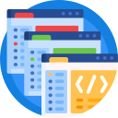



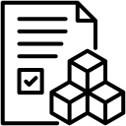
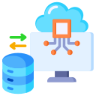
Research Software Forms a Supply Chain
Research Software rarely stands alone: upstream actors and artifacts shape how it is built, distributed, and used.
Example: ASTROPY — Core Packages for Astronomy Research
Researchers &
Research Software Engineers
Libraries + Dependencies E.g Other Astronomy Packages
ASTROPY
Source Repo
Distribution Infrastructure
Infrastructure &
Tools
Downstream Use
By Other Researchers & Research Software Engineers
Notes:
Let's make this concept a bit more concrete.
Astropy is a widely used open-source Python software project that provides core libraries for astronomy research.
In this example, the source repository is shaped by upstream contributors, infrastructure, tools, and dependent packages. It is then distributed through packaging and publishing infrastructure and reused downstream by other researchers and research software engineers.
This should familiar to anyone thinking about software supply chains!
Now, why should we worry about the security of this supply chain?

Slide 4
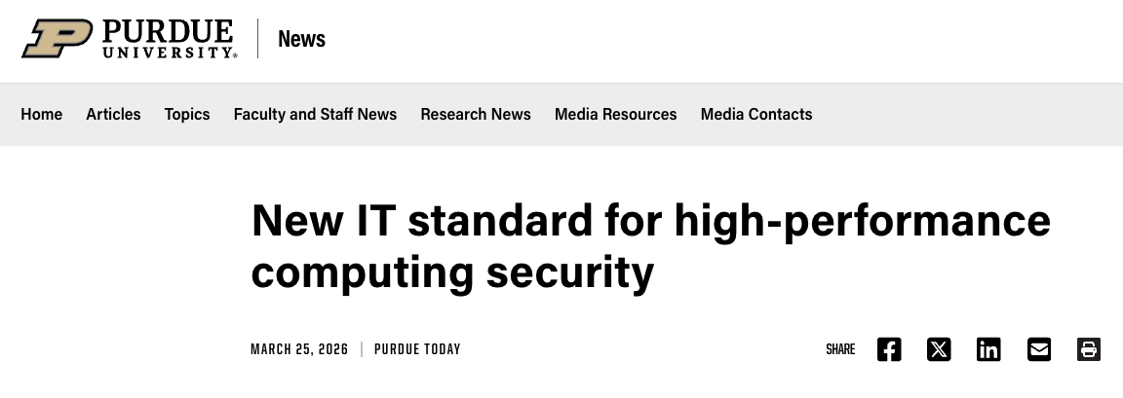
The RSSC Security Challenge
** If something upstream is compromised, a computing infrastructure, a dependency, a release process, or an account that risk can propagate downstream into research workflows and outputs. **
Institutions are beginning to formalize research-computing security expectations.
Notes:
If something upstream is compromised, whether that is computing infrastructure, a dependency, a release process, or an account, that risk can propagate downstream into research workflows, outputs and trust in shared research infrastructure.
The integrity and controlled IP of research activity depends on the integrity of the surrounding software and infrastructure that support it.
Institutions are beginning to formalize these concerns.
This Purdue example is one signal of that shift
Our IT recently announced a new standard for high-performance computing security.
This isn't unique to Purdue...driven by the US Federal Government, research-computing security is becoming more explicit as an institutional responsibility, not just an ad hoc technical concern.

Slide 5
The RSSC — Definitional Challenge
Current empirical studies often use different proxies for “research software.”
All Research Software
Differing Populations – scope boundaries, units of analysis, inclusion heuristics
Inconsistent definitions – publication linkage, funding, text classification
Non-comparable conclusions – different populations, same label
→ Policy guidance & Security efforts may target only narrow slices of the ecosystem
Study A
publication
Study C
text classif.
Study B
funding
⚠ Results are not comparable!
Notes:
Even if we agree that research software forms a supply chain and that its security matters, there is still a basic definitional problem: different empirical studies often mean different things when they say research software.
As this illustration shows, some studies identify research software through publication linkage, some through funding linkage, and others through text classification. These approaches may all point into the broader research software ecosystem, but they do not necessarily identify the same population.
That means the results are not directly comparable. The same label, research software, can refer to different populations depending on how the study defines and identifies it.
And that has practical consequences. If policy guidance or security efforts are built on top of these inconsistent definitions, they may end up targeting only narrow slices of the ecosystem.
That is the gap this paper addresses: making scope and operational boundaries explicit so that research software security studies can be interpreted and compared more consistently.

Slide 6
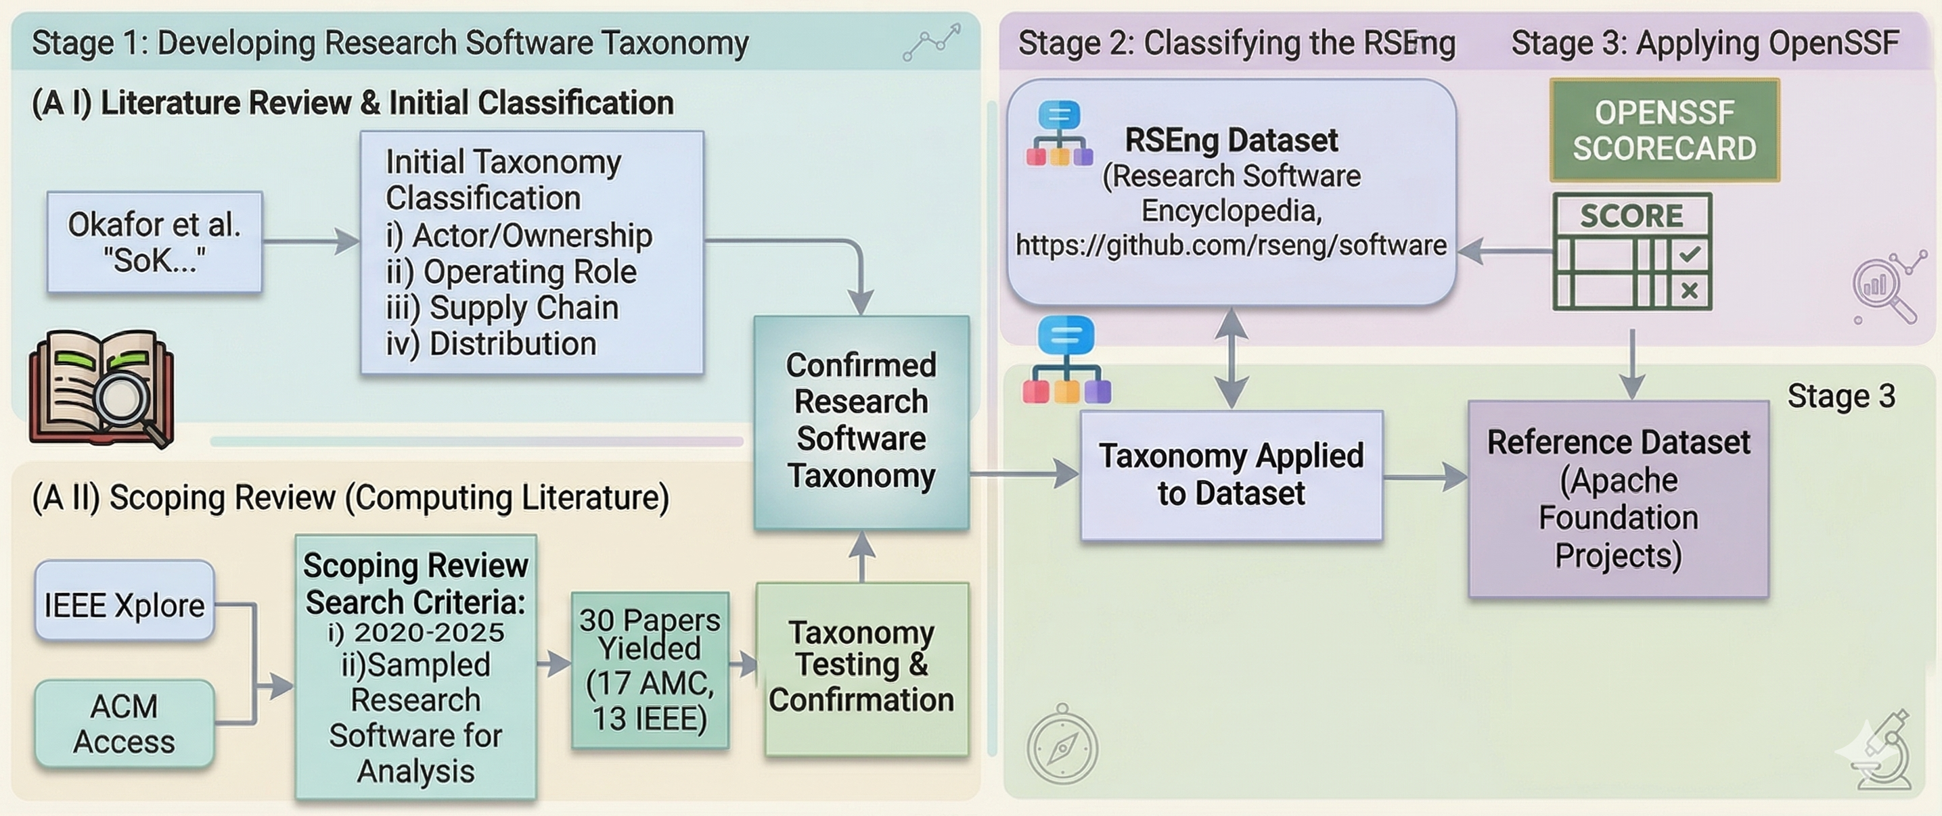
What We Built: An RSSC-Oriented Taxonomy
Derived from SSC framing [Okafor et al.]
• Validated via scoping review (2020–2025)
• Applied to 6,966 RSE entries
Actor Unit
Who maintains it?
Supply Chain Role
Where does it sit?
Research Role
What does it do?
Distribution Pathway
How is it delivered?
Individual maintainer
Research group / lab
Institution (univ, govt)
Community / foundation
Vendor / commercial
Application software
Dependency artifact
Infrastructure
Build & release
Direct research execution
Research-support tooling
Incidental / general-purpose
Package registry
Source repository
Installer / binary
Network service
Container
Notes:
To address the definitional challenge, we built an RSSC-oriented taxonomy and applied it through a three-stage pipeline.
First, we developed the taxonomy from prior software supply chain framing and validated it through a scoping review of recent literature. Second, we applied that taxonomy to the RSEng dataset, a corpus created and curated in prior work, using an LLM-based classifier on repository READMEs and project metadata. Third, we used the resulting labels to support a preliminary OpenSSF Scorecard analysis, with an Apache baseline for context.
The bottom half of the slide summarizes the four taxonomy dimensions we arrived at.
The first is Actor Unit, which asks who maintains the software, for example an individual maintainer, a research group or lab, an institution, a community or foundation, or a vendor.
The second is Supply Chain Role, which asks where the software sits in the supply chain, such as application software, a dependency artifact, infrastructure, or build-and-release tooling.
The third is Research Role, which asks what the software does in relation to research, such as direct research execution, research-support tooling, or more incidental or general-purpose use.
And the fourth is Distribution Pathway, which asks how the software is delivered, for example through a package registry, source repository, installer or binary, network service, or container.
So our contribution is not just a definition in words. It is a structured taxonomy grounded in prior supply chain thinking, validated through literature review, and operationalized on a large corpus for downstream security analysis.
Thus instead of relying on inconsistent implicit definitions, we make the relevant scope choices explicit and reusable in this work.

Slide 7
Applying the Taxonomy to the RSE Corpus
A
Top Labeled Taxonomy Categories
B
C
D
Notes:
Here, I move from the taxonomy itself to what the labeled corpus looks like once we apply it.
Starting with Actor Unit, the distribution is fairly balanced across three dominant groups: research groups or labs at 28.8%, individual maintainers at 28.4%, and institutions at 25.6%. Community or foundation-governed projects make up a smaller but still meaningful share at 10.0%.
For Supply Chain Role, the largest category is clearly application software, which accounts for 65.2% of the corpus. A substantial minority, 30.0%, are dependency software artifacts. That is important from a security perspective because dependencies may sit upstream of many downstream research applications.
For Research Role, most entries are used for direct research execution, at 63.3%, while 32.9% are research-support tooling. So this corpus is not just infrastructure around research, it is largely software used directly in the research process itself.
And for Distribution Pathway, nearly half of the entries, 49.1%, distribute through package registries, followed by source repositories at 24.1%, installers or binaries at 14.8%, and network services or containers at 7.1%.
So once we label the corpus explicitly, it becomes clear that research software is not a single uniform population. It is a structured ecosystem with meaningful differences in who maintains the software, where it sits in the supply chain, what role it plays in research, and how it is distributed.

Slide 8
Taxonomy-Aware Scorecard Analysis
Key Insights
A. The aggregate average (All RS) hides important governance differences.
B. Community-run projects score almost as well as top foundations, but solo-maintained software falls noticeably behind — averages alone miss this gap.
Notes:
Now for the payoff: why does this taxonomy matter for security measurement?
We applied OpenSSF Scorecard to 5,937 of the labeled entries in our corpus and compared them against a baseline of enterprise-backed open-source projects from the Apache Software Foundation.
If we look only at the aggregate, research software appears to score lower overall, with a median Scorecard score of 2.9 compared with Apache’s 3.9, a gap of about one point. But that aggregate view hides important differences.
Once we stratify by actor unit, the picture changes. Community- and foundation-governed research software comes closest to the Apache baseline, with a median score of 3.6 and only a 0.3 gap. Research-group-maintained software scores 3.1. By contrast, individual-maintainer projects lag the most, at 2.7, which is a 1.2-point gap from Apache.
So the key message is that research software is not one uniform security population. Governance structure matters. Community-run projects look much closer to well-resourced open-source foundations, while individually maintained projects fall noticeably behind.
That is why taxonomy-aware stratification matters: averages alone can obscure meaningful differences in governance and workflow maturity, and those differences matter for how we interpret security measurements and where we focus improvement efforts.

Slide 9


Contributions & Next Steps
RSSC-oriented taxonomy + harmonization mapping that makes scope choices explicit across 4 dimensions
Annotated RSE dataset + labeling codebook + reproducible pipeline applied to 6,966 entries
Taxonomy-aware Scorecard analysis with ASF baseline showing why stratification matters
What's Next
Expand data sources beyond conventional OSS security signals
Use taxonomy for stratified re-analysis of prior studies
We are hosting a Workshop on Research Software Supply Chain Security at IEEE eScience !!!
Full Artifacts Here
Read Full Paper Here
Supported by NSF Awards 2537308, 2537309, 2537310
Notes:
To conclude, we contribute an RSSC-oriented taxonomy, a labeled RSE dataset and reproducible pipeline, and a taxonomy-aware security analysis showing why stratification matters.
Looking ahead, we want to expand the evidence sources we use and continue refining the labeling pipeline.
The paper and artifacts are available through the QR codes here, and we are also hosting a related workshop at IEEE eScience.

Slide 10
Bonus Slides

Slide 11
Applying the Taxonomy to the RSE Corpus
Dimension | Top Categories | %
Actor Unit | Research group or lab | 28.8%
 | Individual maintainer | 28.4%
 | Institution (university, lab, govt research org) | 25.6%
 | Community or foundation | 10.0%
Supply Chain Role | Application software | 65.2%
 | Dependency software artifact | 30.0%
Research Role | Direct research execution | 63.3%
 | Research-support tooling | 32.9%
Distribution Pathway | Package registry | 49.1%
 | Source repository | 24.1%
 | Installer or binary | 14.8%
 | Network service / container | 7.1%
6,966 taxonomy-labeled entries from the Research Software Encyclopedia (RSE)
Notes:
Here's how the 6,966 entries in the RSE corpus break down across our taxonomy dimensions.
For Actor Unit, the distribution is fairly balanced across research groups at about 29%, individual maintainers also at 28%, and institutions at 26%. Community-governed projects make up about 10%.
For Supply Chain Role, the majority — 65% — are application software, with about 30% being dependency artifacts. This matters for security because compromise of a dependency can propagate widely to downstream applications.
For Research Role, about 63% of entries directly execute research, while 33% are research-support tooling.
And for Distribution Pathway, nearly half distribute through package registries like PyPI or CRAN, followed by source repositories at 24% and installers at about 15%.
The key insight here is that research software is not a monolith — it's a diverse ecosystem with distinct categories that matter for how we measure and interpret security.

Slide 12
The RSSC Security Challenge
All Research Software
RS has a supply chain – upstream artifacts and actors form the RSSC
Supply chains = attack vectors – RSSC inherits these risks with stakes for research integrity
Inconsistent definitions – publication linkage, funding, text classification
Non-comparable conclusions – different populations, same label
→ Policy guidance & Security efforts may target only narrow slices of the ecosystem
Study A
publication
Study C
text classif.
Study B
funding
"RS is secure"
"RS has gaps"
"RS is at risk"
⚠ Results are not comparable!
Notes:
Research software underpins virtually all of modern science and engineering. And like any software, research software doesn't exist in isolation — it depends on upstream libraries, tools, and contributors, forming what we call the Research Software Supply Chain, or RSSC.
We know software supply chains are a frequent vector for cyberattacks. The RSSC inherits these risks, and the stakes are particularly high because compromised research software can threaten the integrity and trust in research outputs.
Here's the core problem: when we look at empirical studies that try to measure research software security, they don't agree on what "research software" even means. Some studies link repos to publications, others use funding linkage, and others classify based on README content. These aren't just different methods — they're sampling fundamentally different populations under the same label.
The result is that security conclusions across studies are non-comparable, and policy guidance built on this fragmented evidence may only target narrow slices of the ecosystem.

Slide 13
Taxonomy-Aware Scorecard Analysis
Key Insight: Community/foundation RS nearly matches ASF (Δ=−0.3), while individual maintainers lag significantly (Δ=−1.2). Aggregate numbers obscure meaningful governance differences.
Notes:
Now for the payoff — why does this taxonomy matter for security measurement? We applied OpenSSF Scorecard to 5,937 of our labeled entries and compared against a baseline of enterprise-backed open source projects from the Apache Software Foundation.
Looking at the aggregate: research software has a median Scorecard score of 2.9 versus Apache's 3.9, a gap of about 1 point. But that aggregate number is misleading.
When we stratify by actor unit, the picture changes dramatically. Community and foundation-governed research software nearly matches Apache — median 3.6, only a 0.3 gap. Research groups score 3.1. But individual maintainers lag significantly at 2.7, a gap of 1.2 points.
Importantly, this gap isn't just because Scorecard can't evaluate these repos — missingness rates are comparable across groups. The difference reflects that practices like branch protection, code review, and dependency management automation are less frequently adopted by individual maintainers.
The takeaway is clear: treating research software as a single population obscures meaningful differences in governance and workflow maturity. Taxonomy-aware stratification is necessary for interpreting security measurements and for directing policy interventions where they're most needed.

Slide 14
Taxonomy-Aware Scorecard Analysis (Table Version)
Group | N | Median Score (IQR) | Missingness | Δ vs ASF
ASF Baseline | 2,575 | 3.9 (3.3–5.1) | 28% | —
RS: All Projects | 5,937 | 2.9 (2.5–3.6) | 22% | −1.0
RS: Community / Foundation | 531 | 3.6 (3.2–4.5) | 11% | −0.3
RS: Research Group / Lab | 1,679 | 3.1 (2.6–3.8) | 17% | −0.8
RS: Institution | 1,552 | 2.8 (2.5–3.5) | 28% | −1.1
RS: Individual Maintainer | 1,778 | 2.7 (2.3–3.2) | 28% | −1.2
RS: Vendor / Commercial | 291 | 3.0 (2.6–3.8) | 17% | −0.9
Key Insight: Community/foundation RS nearly matches ASF (Δ=−0.3), while individual maintainers lag significantly (Δ=−1.2). Aggregate numbers obscure meaningful governance differences.
Notes:
This table shows the detailed Scorecard comparison. The ASF baseline sits at a median of 3.9 with 28% missingness — meaning about 28% of Scorecard checks couldn't be evaluated from available repository evidence.
Looking across the RS actor types: community-governed projects come closest to Apache at 3.6, and they actually have lower missingness at just 11%, suggesting more standardized repository workflows and observable governance signals. Research groups score 3.1. Institutions are at 2.8, and individual maintainers show the largest gap at 2.7.
The missingness column is important context — a score of 0 means a practice was evaluated and failed, while a missing check means it couldn't be assessed. So the score gap for individual maintainers isn't driven by missing data — it reflects that practices like branch protection, code review, and dependency management are genuinely less adopted.
The bottom line: aggregate research software security numbers mask real differences tied to governance structure. Any policy or tooling intervention should account for these actor-unit differences rather than treating all research software the same.

