Slide 1
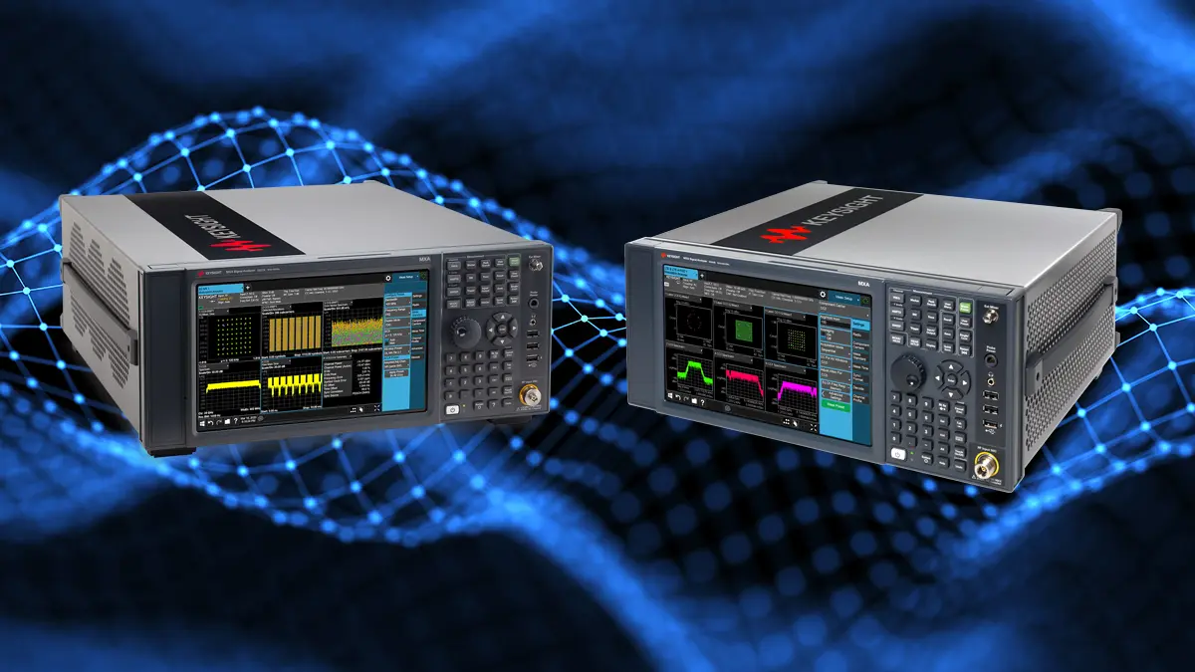
Basic Spectrum Analyser Settings

Slide 2
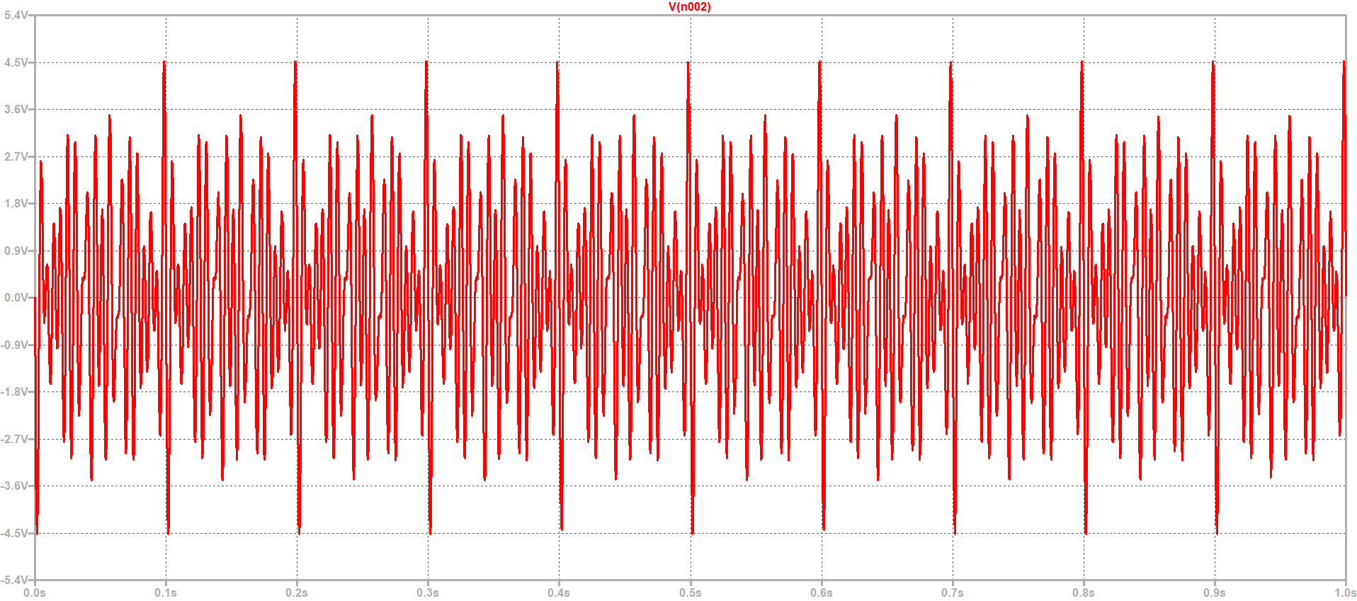
Guess the Wave form

Slide 3
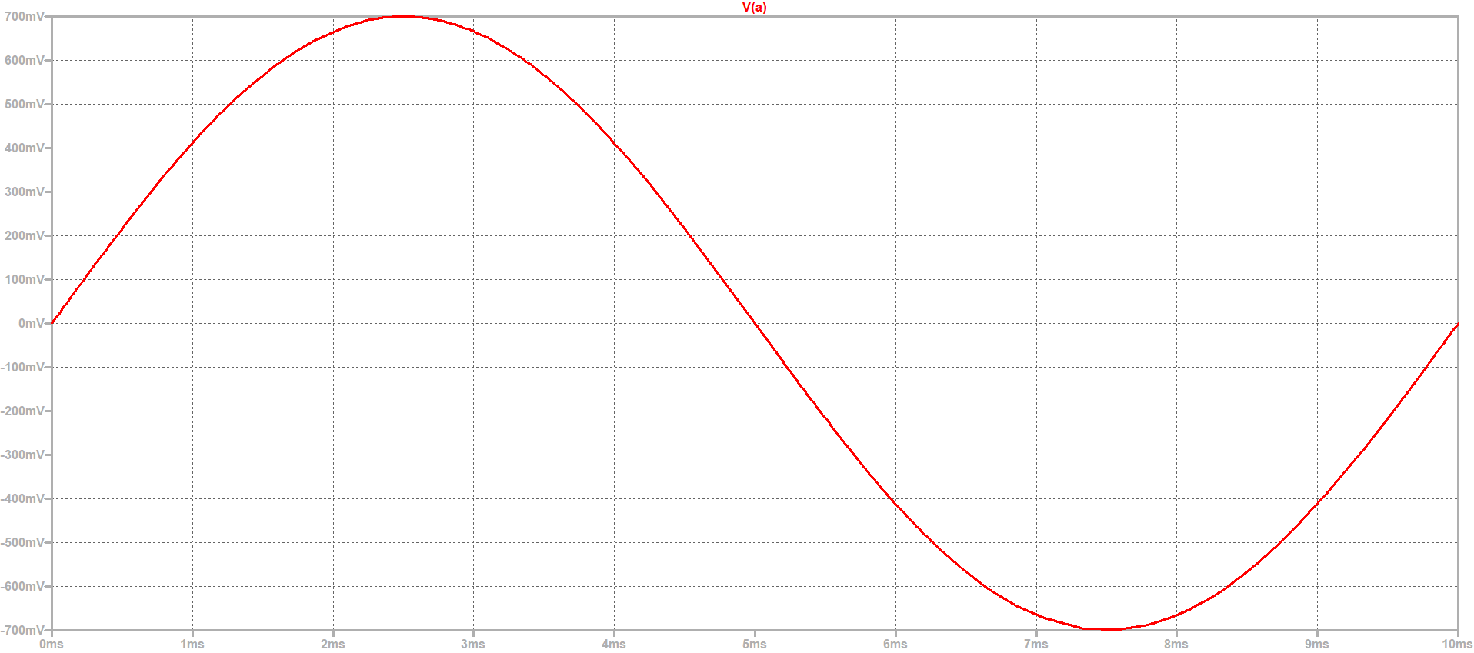
Guess the Wave form
Freq = 100 Hz
Amplitude = 0.7 V
VRMS = 0.495 V

Slide 4
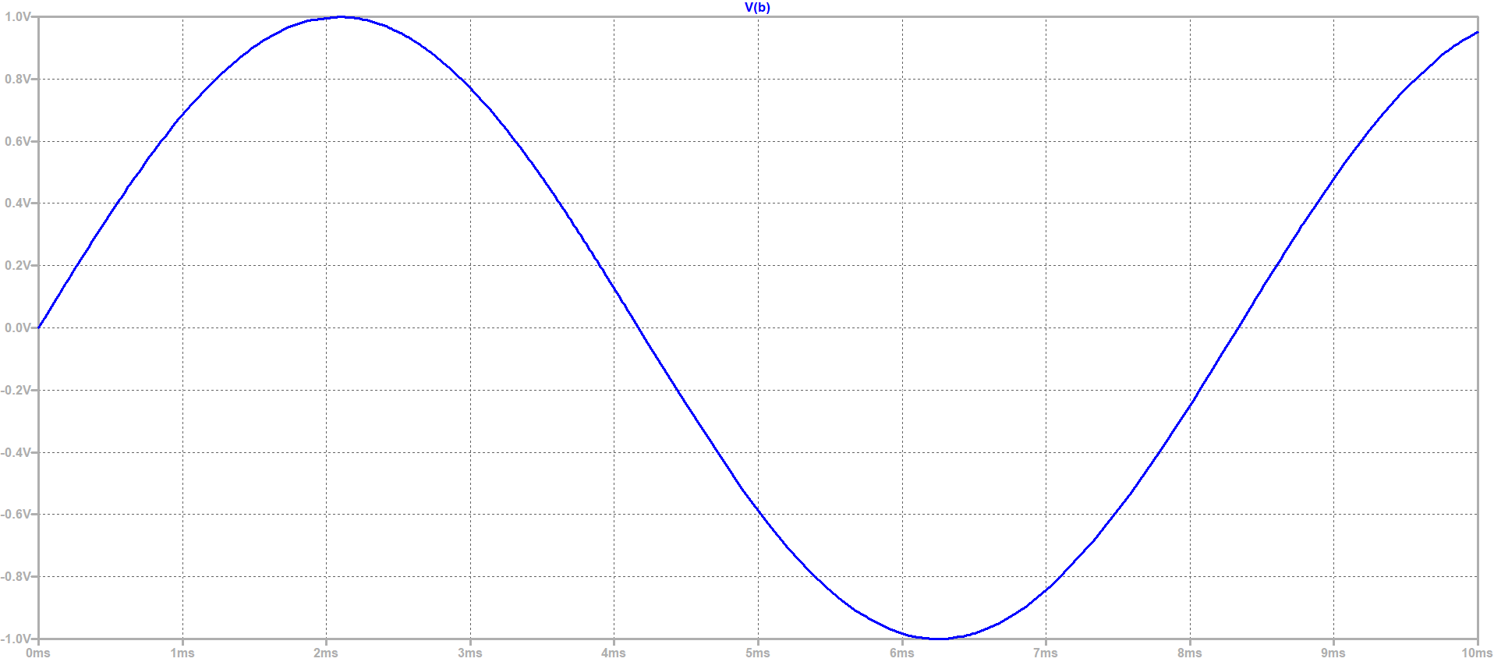
Guess the Wave form
Freq = 120 Hz
Amplitude = 1 V
VRMS = 0.7071 V

Slide 5
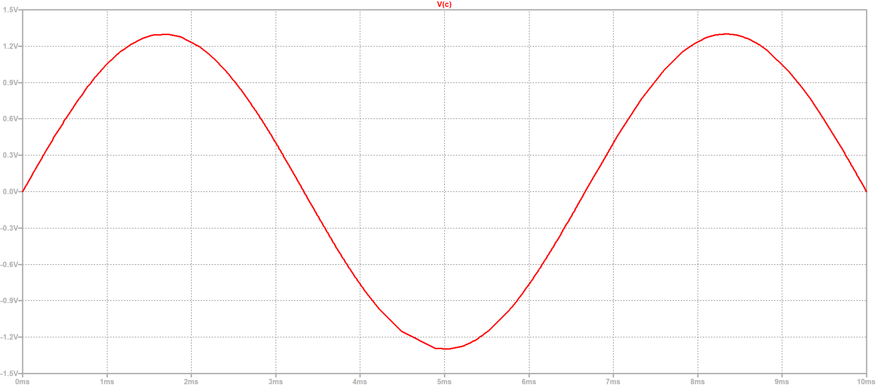
Guess the Wave form
Freq = 150 Hz
Amplitude = 1.3 V
VRMS = 0.495 V

Slide 6
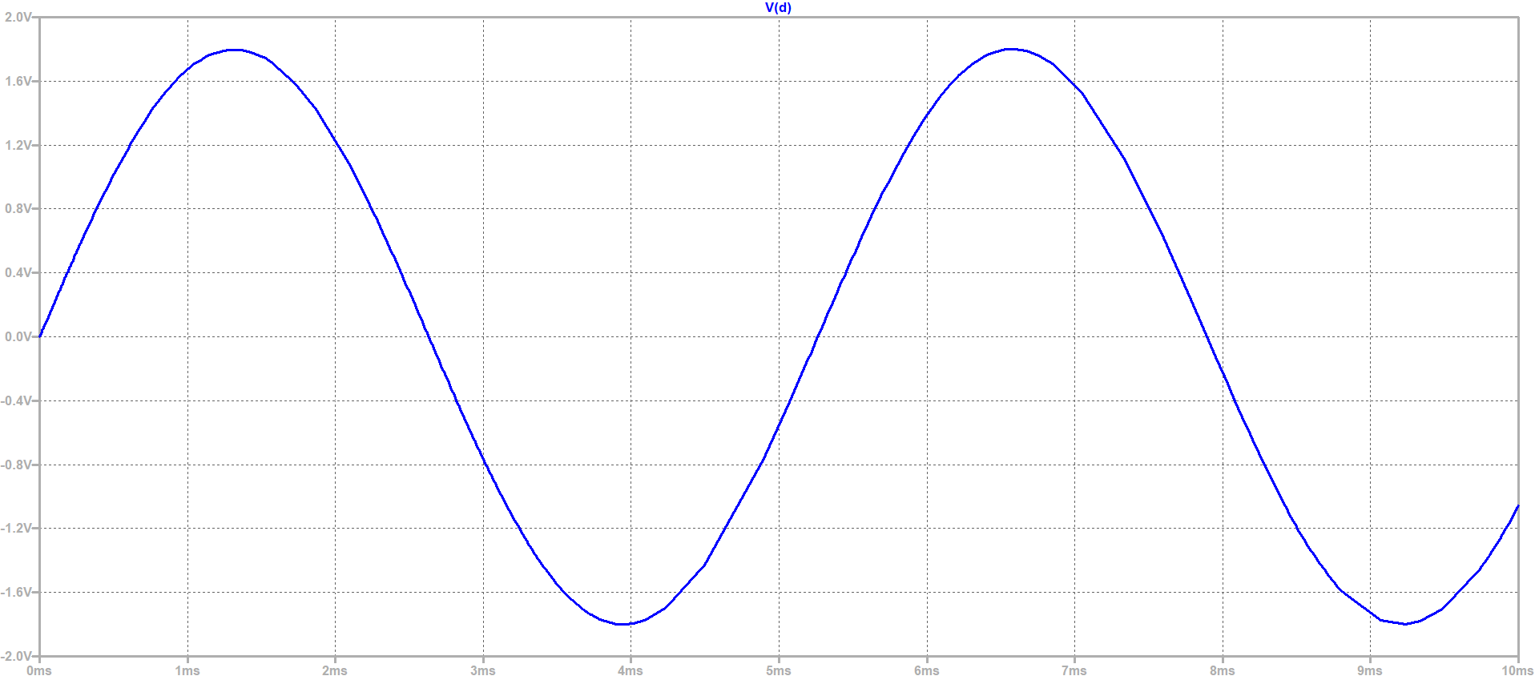
Guess the Wave form
Freq = 190 Hz
Amplitude = 1.8 V
VRMS = 1.273 V

Slide 7
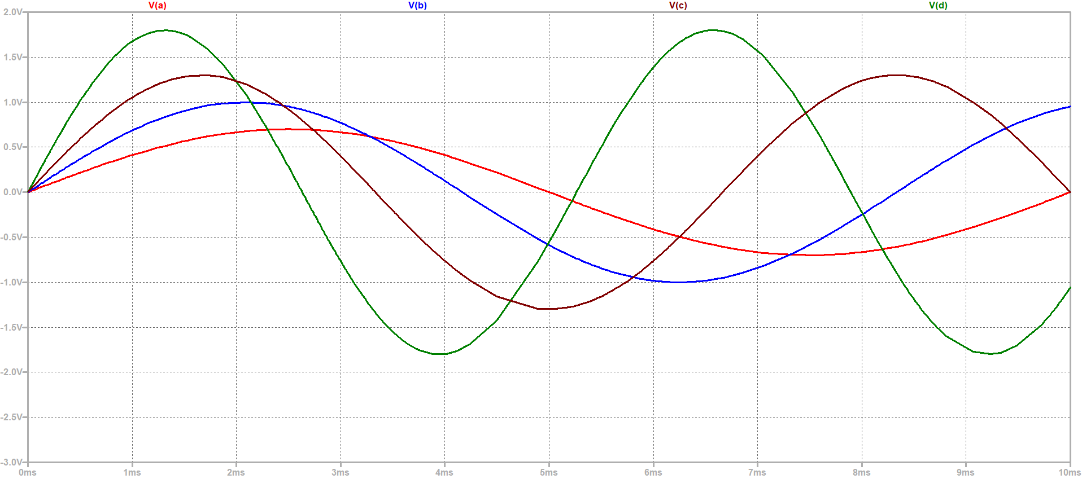
Sum of the all 4 wave

Slide 8
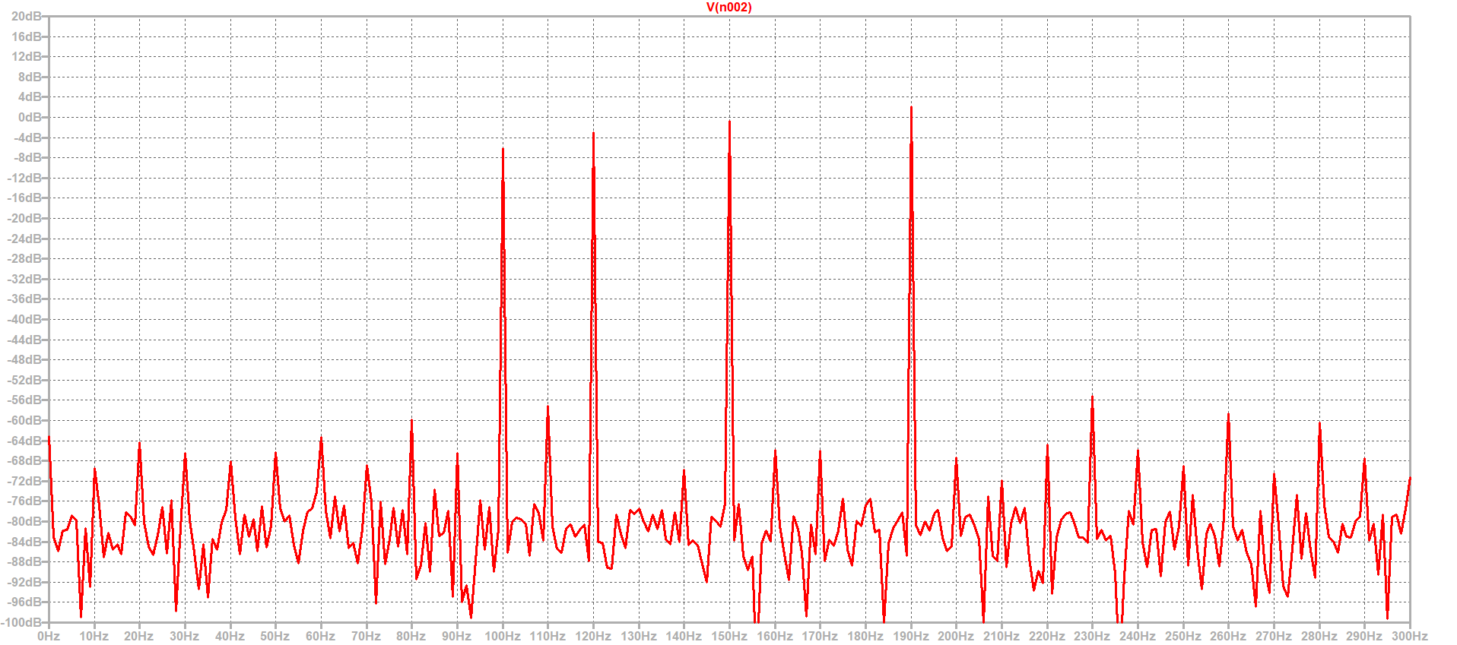
Sum of Sine waves
FFT Plot
Sine waves

Slide 9
Fast Fourier Transform Plot

Slide 10
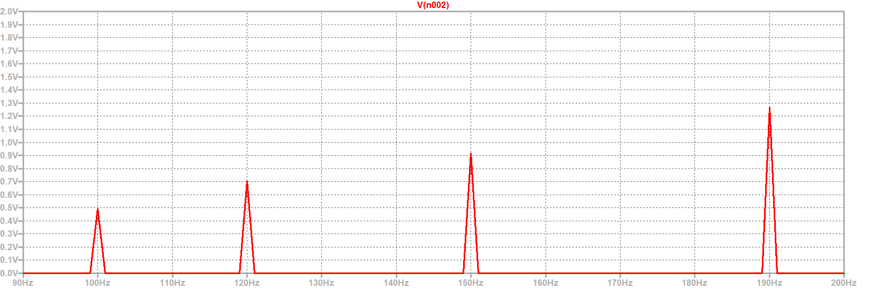
Fast Fourier Transform Plot in Voltage Scale

Slide 11
Spectrum analyser
A spectrum analyzer is used to measure and analyze the frequency spectrum of RF (Radio Frequency) signals.
It helps visualize signal amplitude versus frequency, making it essential for RF design, EMI/EMC testing, and debugging wireless communications.

Slide 12
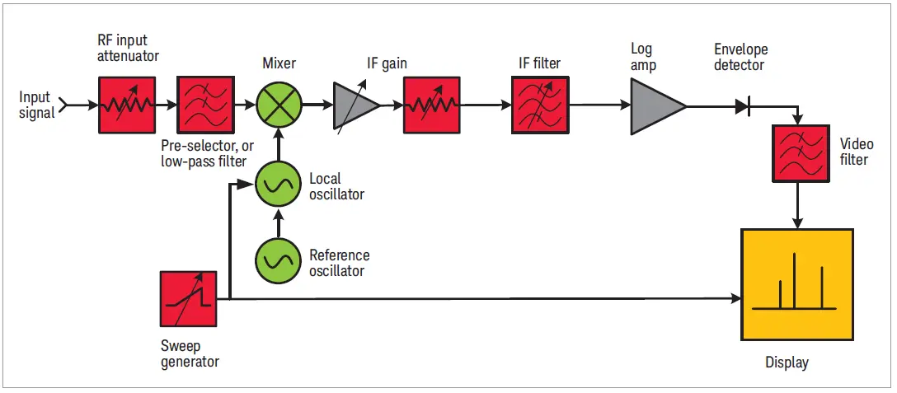
Block Diagram

Slide 13
General Alternative Names
Frequency Analyzer
RF Spectrum Analyzer
Signal Analyzer
Spectral Analyzer

Slide 14
Basic Settings
Set the Frequency Range
Adjust Amplitude Settings
Triggering & Sweep Settings

Slide 15
Frequency Range
Methods to Set Frequency Range
  Using Center Frequency & Span
  Using Start and Stop Frequencies

Slide 16
  Center Frequency & Span
Center Frequency: Set it to the signal’s expected frequency.
Span: Define how wide the spectrum should be around the center frequency.

Slide 17
  Using Start and Stop Frequencies
Start Frequency: The lowest frequency you want to observe (HIGH PASS FILTER).
Stop Frequency: The highest frequency you want to observe (LOW PASS FILTER).

Slide 18
Adjust Amplitude Settings
Reference Level: Set to avoid signal clipping or low visibility.
Attenuation: Adjust input attenuation to prevent overload.
Resolution Bandwidth (RBW): Defines frequency resolution (lower RBW = better detail but slower scanning).
Video Bandwidth (VBW): Smooths the display (should be ≤ RBW).

Slide 19
Resolution Bandwidth

Slide 20
Video Bandwidth

Slide 21
Zero Span

Slide 22
REFERENCE
Youtube (R&S): https://www.youtube.com/watch?v=P5gxNGckjLc
Simulation (LT Splice): https://github.com/KAMALESH-EEE/FFT
Web: https://www.keysight.com/blogs/en/tech/rfmw/2020/05/28/spectrum-analysis-basics-part-2-whats-in-a-spectrum-analyzer

Slide 23
Thank You

