Slide 1
Presentation of Internship Work
Kamaleshkumar Balamurugan
Embedded Intern (E&E)
Date: 17-06-2024
Notes:
Welcome everyone to my internship report presentation. In the next 30 minutes, I will be sharing the key projects I worked on and the achievements I accomplished during my internship.

Slide 2
Introduction
Name: KAMALESHKUMAR BALAMURUGAN
Internship Duration: January 2024 - June 2024
Purpose of Presentation: On completion of the internship period and in anticipation of conversion to a full-time employee role, I am using this presentation to showcase my contributions.

Slide 3
Table of Contents
Data Analysis Software with Python
Ride Based Analysis
Battery Analysis
Issues (Automating RCA with ChatGPT- OpenAI API)
Hardware in Loop (HIL) Setup for Vehicle Control Unit
Fingerprint Authentication in place of Key ignition
Current Deration Experiment with ESP32

Slide 4
BLE UUID creation for Android application
Over the Air (OTA) Updates for VCU
Command Centre( connectM- Lectrix EV)
DFMEA
Data Payload and Frequency Decision

Slide 5
1. Data Analysis
Performed daily data analysis including Battery analysis (added cycle count) and issue tracking (Root Cause Analysis - RCA).
Used Byte beam's data (Log and Km file) for each ride and analyzed it.
Now, we have 60 parameters analyzed, starting from Wh/km to distance traveled for each ride, and can be scaled up if needed.

Slide 6
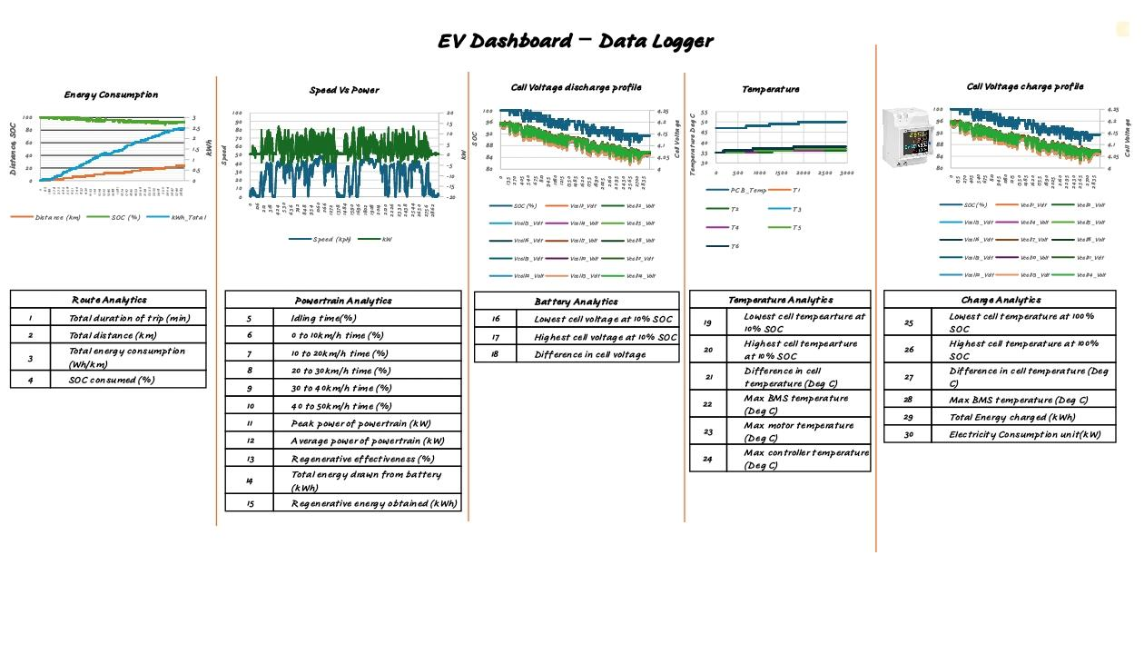
1. a. Ride Based Analysis

Slide 7
Data Input
Uses data from Byte beam or Influx log’s data.
Analysis and Storage
Results stored in both PPT and Excel formats:
PPT Format: Useful for presenting each ride's analysis.
Excel Format: Useful For monthly or total analysis.

Slide 8
Purpose
Analyzes approximately 60 parameters for each ride.
Generates graphs for detailed analysis and each ride’s graph will be stored in respective PPT’s.
Capable of adding more parameters as needed(as we started with 30 parameters and due to the requirement, now we are analyzing 60 parameters)

Slide 9
Example Outputs
Sample graphs of rides, PPT showing parameters like speed, SOC, etc.
Excel analysis showing improvements in energy consumption (Wh/km), peak speed, cruising speed, etc.
Insights
Identifying trends and anomalies.
Evaluating vehicle performance over time.

Slide 10
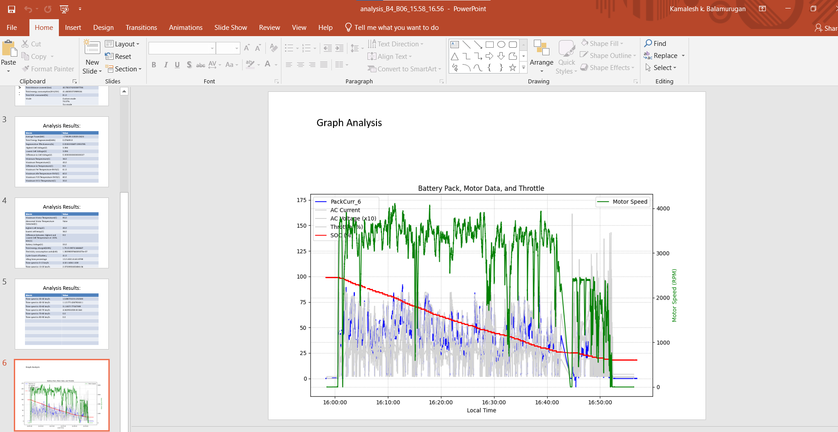
PPT Generated After Analysis

Slide 11
Other Parameters Added in analysis
Peak Speed.
Cruising Speed.
Energy consumption(Wh/km) in each Mode in a Ride.
Distance travelled in each Mode in a Ride.
And few more!

Slide 12
Accessories Made for Analysis(Python)
Code to crop out anomalies in the ride data
Code for merging Log and Km files
Code for splitting data by ride(if data contains multiple rides)
Code for merging each ride’s analysis and daily analysis into a single sheet for a complete overview
Automated dynamic graph generation

Slide 13
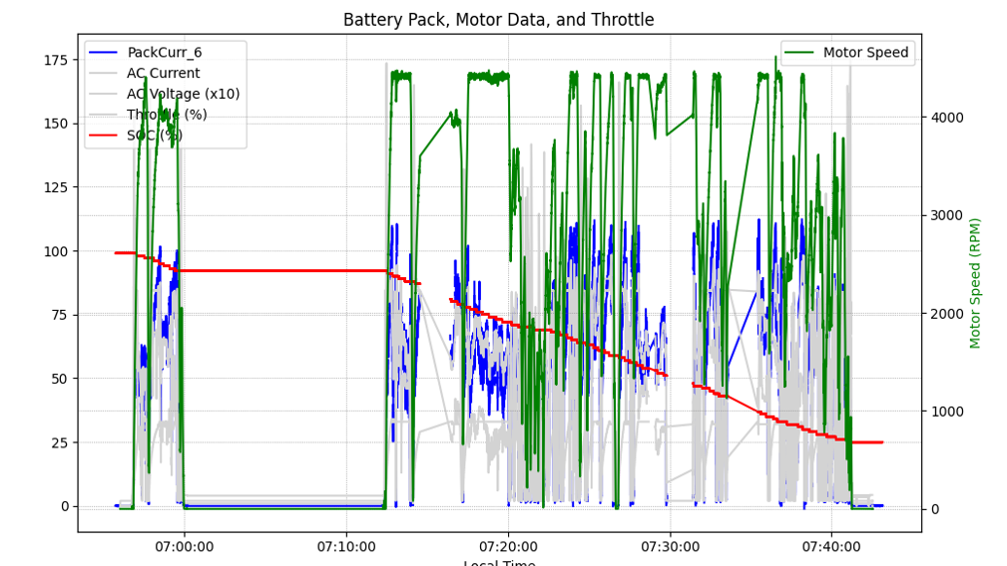
Crop out anomalies in the ride data

Slide 14
Anomaly Detection Problem
Purpose
Detect and remove anomalies in ride data.
Example Anomaly
Sudden, unrealistic increase in SOC during a ride.
Missing of data in between the ride.

Slide 15
Anomaly Handling Process
Detection
Identify anomalies through visual inspection of graphs.
Removal
User can specify time range to remove anomalous data.
Outcome
Clean and reliable data for accurate analysis.

Slide 16
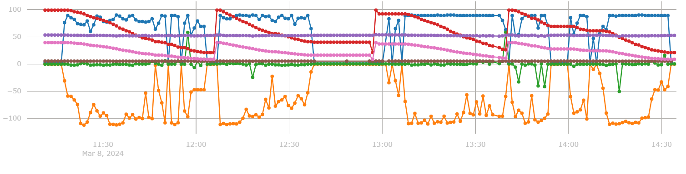
Code for splitting data by ride(if data contains multiple rides)

Slide 17
Cropping Ride Data Based on SOC Parameter
Need for Data Cropping
Isolates individual rides from continuous data logs.
Criterion
Use SOC (State of Charge) parameter to identify ride boundaries.

Slide 18
Cropping Process and Outcome
Process
Splits rides based on SOC difference threshold.
Threshold set to detect significant changes (e.g., >30% SOC).
Outcome
Clean, segmented ride data for accurate analysis

Slide 19
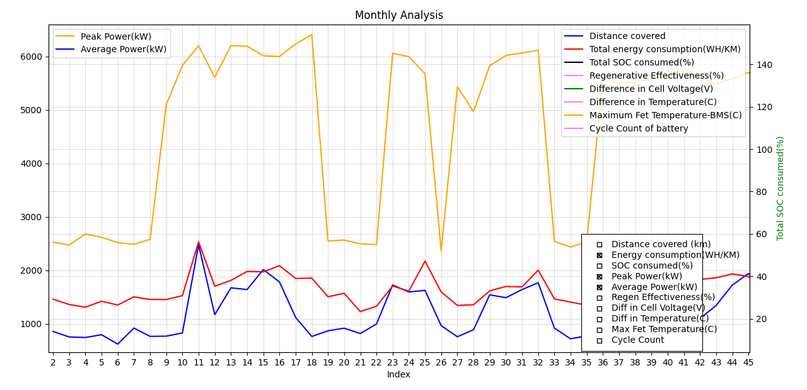
Automated Dynamic Graph Generation

Slide 20
Features of the Dynamic Graph
Checkbox: Easily select and view the desired parameters.
Cursor: Hover over the graph to see precise values.
Pan: Move the view horizontally or vertically to explore different parts of a larger image.
Zoom: Adjust the magnification to focus on specific areas of the graph.
These features enhance the usability and interactivity of the dynamic graph, making data visualization more efficient and user-friendly.

Slide 21
1. b. Battery Analysis
Parameters Added:
Cycle Count of the Battery(Used in the ride).
SOH of the Battery.
Battery ID not yet added in Bytebeam. Once added, we will add Battery ID as a parameter to be analysed in the analysis, it will differentiate which battery was used for each individual rides.

Slide 22
1. c. Issues (Automating RCA)
Introduction to Issue Analysis and Automation
Overview
Automated Root Cause Analysis (RCA) using ChatGPT API.
Aim: Create user-understandable explanations (Root cause) for various warnings.

Slide 23
Brainstorming and Identifying Issues
Collaborative Effort
Team brainstormed potential causes for various warnings.
Examples of Warnings
Cell under-voltage warning
Controller over-temperature warning.

Slide 24
Developing Conditional Statements
Creating If Cases
Multiple causes identified for each warning.
Example:
Controller Over Temperature: Temperature exceeds a specific threshold.
Further conditions explored: Why the temperature increases?

Slide 25
Using ChatGPT API
Automated the creation of root cause explanations.
Example Process
Input: Collected data such as temperature, voltage.
Processing: Conditional checks to identify potential causes.
Output: User-understandable explanations.

Slide 26
Results and Insights
Automated Explanations
Generated clear, understandable explanations for RCA(Root Cause Analysis).
Benefits
Improved diagnostic process.
Easier to report the RCA.

Slide 27
2. Hardware in Loop Setup (for VCU)
(a) Hardware: Developed the HIL made by Sanjith, Anil and simulated the connectM-VCU hardware setup.
(b) Software: Developed code for ESP32 to act as a HIL test setup.
(c) UI Interface: Designed and refined user interface for seamless interaction with the VCU. More flexible and scalable than the hardware HIL setup.

Slide 28
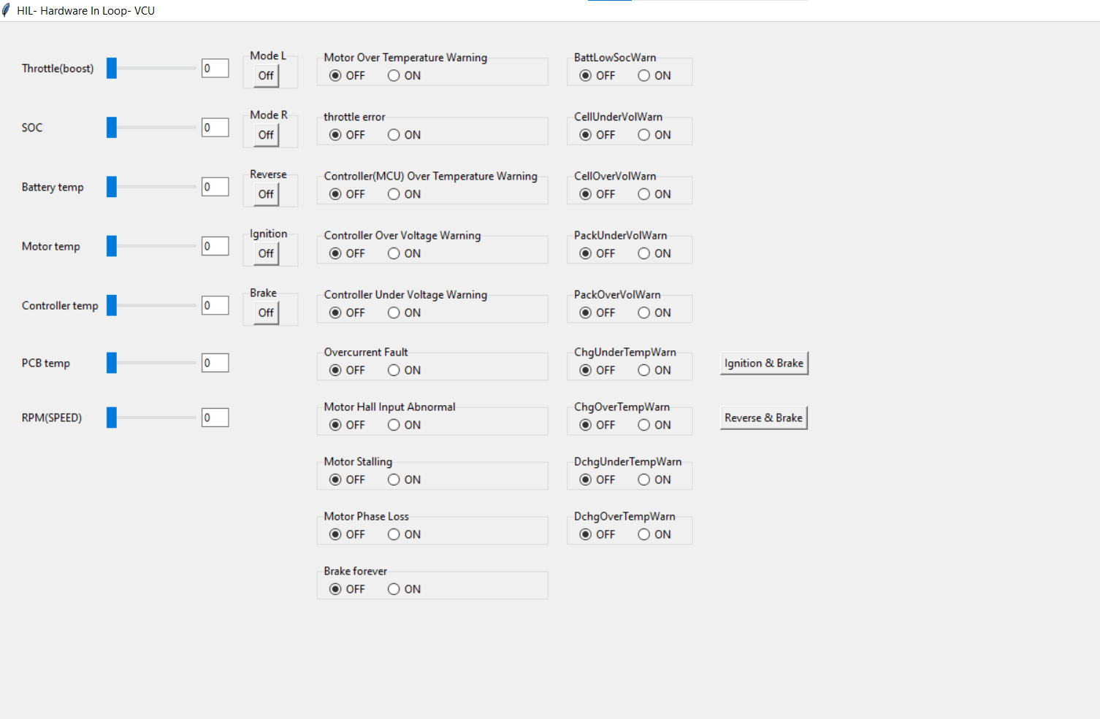
HIL (SOFTWARE)

Slide 29
Hardware Component
Hardware Enhancements
Added switches to existing HIL setup by Anil.
Simulated VCU from ConnectM with the HIL hardware setup.
Key Features
Integration of physical switches for controls (e.g., ignition, brake).

Slide 30
Software Development
ESP32 Programming
Developed code for ESP32 microcontroller to act as HIL test setup with the guidance of Sanjith.
Utilized TWAI (Twin Wire Automotive Interface) and CAN communication.
Functionality
ESP32 simulates signals transmitted from MCU to VCU.
Mimics real-world automotive communication protocols.

Slide 31
UI Interface Design
User Interface Development
Designed a user-friendly UI using Python (tkinter) with Annmon James.
Ensures seamless interaction with the VCU.
Components
Switches: Ignition, brake, etc.
Sliders: Throttle, SOC, etc.
Warnings: Display multiple warning indicators

Slide 32
Advantages of UI-based HIL Setup
Flexibility and Scalability
More flexible and scalable compared to hardware-only HIL setup.
Avoids the need for physical switches, reducing size and cost.
Automation and Control
Automated signal transmission via UART to ESP32.
Simplifies testing and debugging processes.

Slide 33
Receiving CAN Messages from VCU
Code Implementation
Enhanced ESP32 code to receive CAN messages from VCU.
Displays received messages on an OLED display.
Functionality
Verifies signal transmission integrity.
Example: If MCU sends "Motor On" to VCU, OLED displays "Motor On" confirmation.

Slide 34
OLED Display Integration
Display Features
Real-time feedback of signals received from VCU.
Confirms proper communication and response.
Example Display
Show a sample OLED display output indicating received messages (e.g., "Motor On").

Slide 35
Comprehensive HIL Setup
Combining hardware, software, and UI for VCU simulation.
Real-time CAN message verification through OLED display integration.
Readiness
With the OLED display integrated, the HIL setup is now ready for ConnectM VCU.
Scalability
The setup can also be scaled for MCU and other components due to the use of CAN communication.

Slide 36
3. Capacitive Fingerprint Sensor - SEN0359
Project Overview:
Integrated SEN0359 Fingerprint Sensor with Arduino NANO and ignition button functionality.
Goal: Enhance security and enable secure startup mechanism using biometric authentication.

Slide 37
Features Implemented:
Enrolment of up to 80 unique fingerprints.
Verification process for registered users.
Deletion of stored fingerprints.
Secure ignition control based on fingerprint authentication.

Slide 38
Power Supply: The system is powered by an auxiliary lithium-ion battery, providing a dedicated power source.
Ignition Control: A relay is connected to the ignition
path, allowing the system to control the vehicle's
ignition.
Secure Startup: The ignition is only enabled when a
registered fingerprint is verified, ensuring a secure
startup process.

Slide 39
Authentication Requirement
Implementation:
Authentication fingerprint stored during setup process.
Only authorized personnel can access registration or deletion modes.
Process:
User presents authentication fingerprint to initiate registration or deletion.
System verifies fingerprint against stored template for authorization.

Slide 40
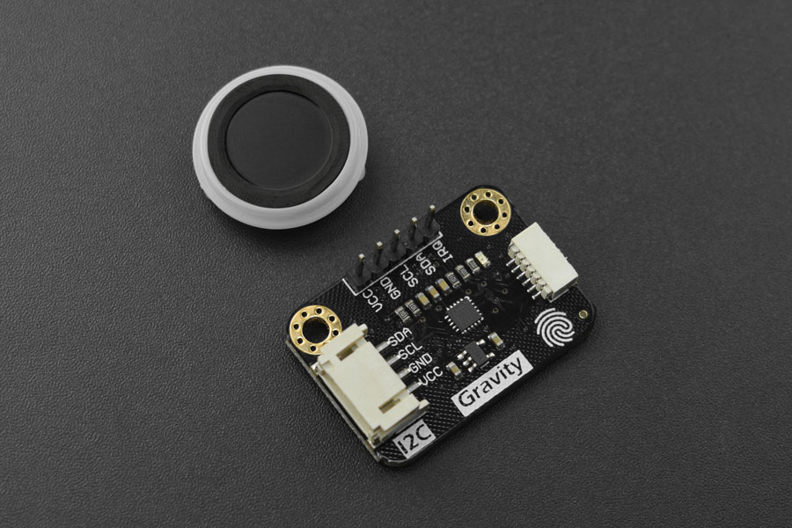
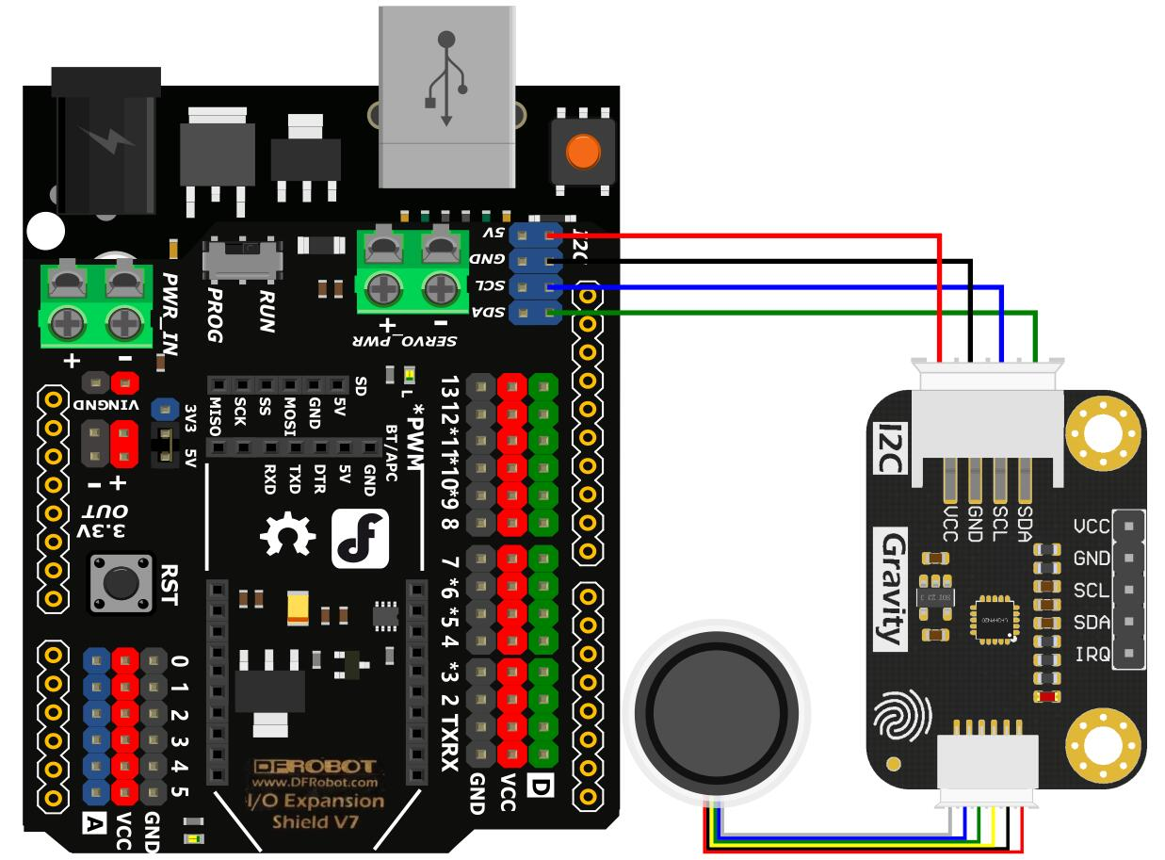
SEN0359

Slide 41
4. Current Deration Experiment with ESP32
Conducted current deration experiments using the ESP32 microcontroller.
Used ESP32 as a VCU and derated the current gradually. Once the current reached a particular point, I made the vehicle automatically switch to 'ECO mode' to avoid cut off that occurs in power mode.

Slide 42
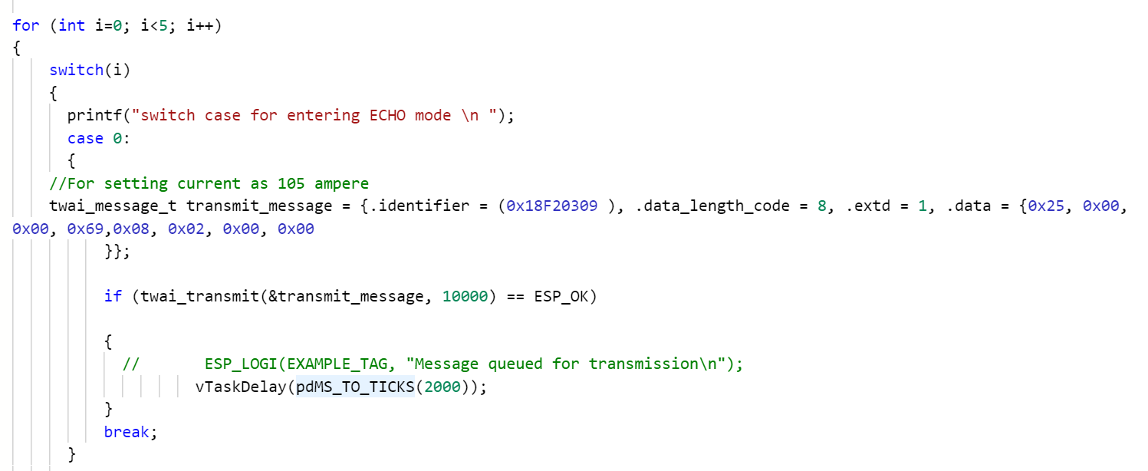

Slide 43
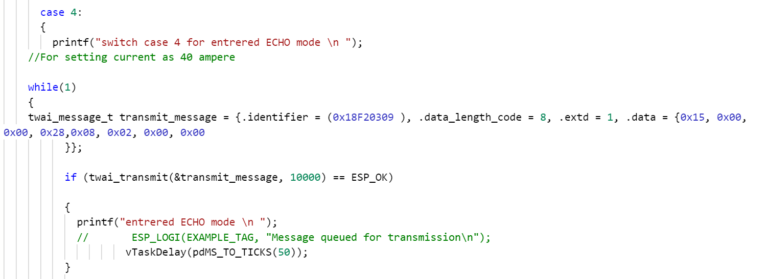
ECO mode(After derating the current)

Slide 44
5. BLE (UUID's Creation)
For the mobile application, added the BLE contract including the creation of service UUIDs for various parameters like temperature.
Used the nRF-Connect application to connect BLE with ESP32.
Used 16-bit UUIDs for BLE adopted services and labeled specific services based on documents from Assigned Numbers (bluetooth.com).

Slide 45
6. OTA(Over the Air- Update)
Performed firmware updates on the VCU via Over-the-Air (OTA) updates.
HIL(Hardware in Loop) setup with UI, which i developed, made the Process of OTA easier.

Slide 46
7. Command Centre( connectM- Lectrix EV)
Used the following features in Command Centre .
EV Live Parameter Report: Real-time monitoring of electric vehicle parameters.
Device Data Log: Historical data analysis for device performance.
Alert Dashboard: Monitoring and managing alerts for quick issue resolution.
OTA Update Dashboard: Tracking and managing over-the-air updates for devices.

Slide 47
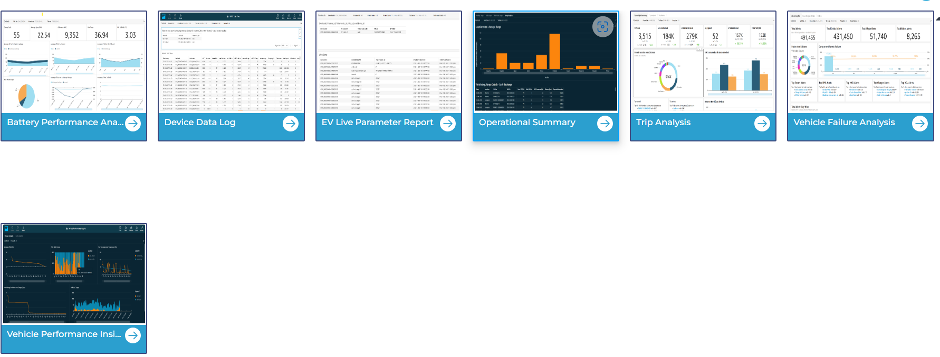
Command Centre

Slide 48
8. DFMEA
Developed Design Failure Mode and Effects Analysis (DFMEA) for the LX70 VCU and the Enduro segmented cluster.
Brainstormed causes behind failure modes and identified controls or actions needed to avoid those failures.

Slide 49
9. Data Payload and Frequency Decision
Optimized data payload and transmission frequency of data transmission to the cloud for efficient data management and transmission.
Played a major role in brainstorming sessions to find the best-optimized data payload.

Slide 50
Conclusion
Summary of Key Points:
Reviewed major projects and tasks completed
Highlighted skills and knowledge gained
I am grateful for the opportunity and look forward to contributing as a full-time employee.

Slide 51
Q&A

