Slide 1

Finora
Credit-Safe, Voice-Guided Payments
A new Finora feature bringing UPI and credit card payments to elderly users— protected by a credit-score check and a voice + face guided flow.
TARGET AUDIENCE
PROTECTS
POWERED BY
Elderly users
Credit score
Voice + Face

Slide 2



Why elderly users need a different kind of payment flow
Existing UPI and credit-card journeys were not built with them in mind.
Small text, many steps
Menus, PINs and confirmation screens are hard to navigate quickly, which causes hesitation and mistakes.
Credit card debt creeps up quietly
An EMI or a large purchase can push utilization past a safe limit before anyone notices.
Fear of getting it wrong
One bad tap can send money to the wrong person, so many avoid digital payments altogether.
Finora · Credit-safe voice payments
2

Slide 3




Feature 1 — Credit Score Guardrail
Every EMI, large purchase or credit card payment is checked against credit health before it goes through.
Before you pay
This payment affects your credit score
Checked automatically on EMIs and large loan-linked payments
Card utilization if you proceed
Flags when card utilization would cross the healthy 30% mark
42%
Plain-language alert, shown before money leaves the account
Safe zone is under 30%
Pay anyway
Review my budget instead
Finora · Credit-safe voice payments
3

Slide 4





Feature 2 — Voice + Face Guided UPI
A spoken command like "send 3000 to Suman" replaces menu-hunting — identity and PIN still confirm every payment.
1
2
3
Unlock the app
Say “UPI transfer”
Face scan
Open Finora as usual
Voice assistant opens Send Money
Confirms it is really you
4
5
6
“Send 3000 to Suman”
Speak or enter PIN
Payment done
Assistant reads back the request
Final safety check before sending
Confirmation spoken aloud
Finora · Credit-safe voice payments
4

Slide 5
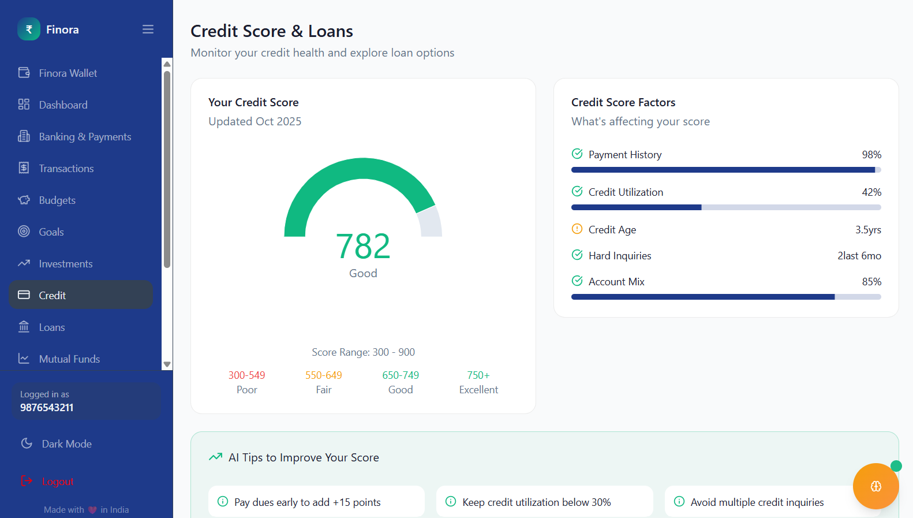
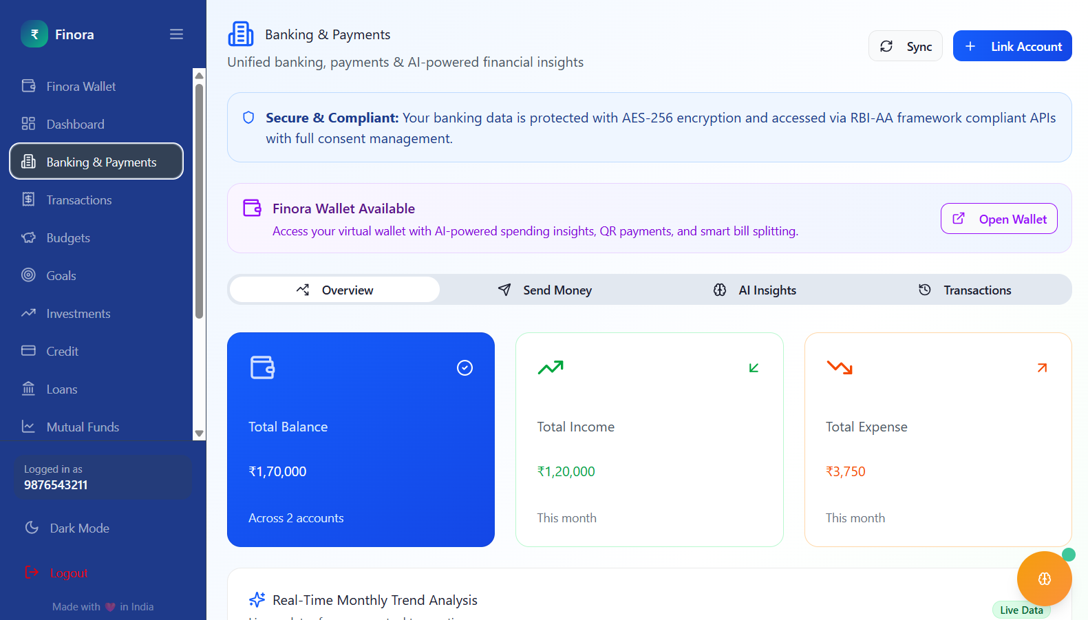
Built on top of Finora’s existing Banking & Credit screens
No new app to learn — the guardrail and voice flow extend screens users already have.
Credit screen → guardrail
Send Money → voice + face
Finora · Credit-safe voice payments
5

Slide 6

Why it matters
Safer spending
Simpler to use
Credit-damaging payments are flagged before they happen.
One spoken sentence replaces multiple screens.
Fewer mistakes
More independence
Face + PIN confirm every transfer before money moves.
Elderly users can pay confidently, without help.
Finora — finance that keeps up with everyone, at their own pace.

