Slide 1

Author's Hand
Autonomous AI Research Agent that summarises research papers — every claim traceable, linked to your ORCID, ResearchGate & Google Scholar
IIT Guwahati E&ICT Academy · Generative AI · Final Capstone Option 5 · LangChain · RAG · Agent · Streamlit + FastAPI · Windows app
Submitted by: Dr. Kameswari Jada
Notes:
Author's Hand is an autonomous research agent. It plans and runs the whole research workflow — find, read, summarise, verify, relate to my work, synthesise — and it is anchored to the researcher's own ORCID and ResearchGate identity.

Slide 2



Too many papers, and AI summaries can’t be trusted
THE PROBLEM
THE SOLUTION
Volume
An agent that knows your research
Millions of papers a year; reading enough to stay current or write a review takes hours per paper.
Plans from a plain-English goal and runs the full workflow
9-field structured summary with an evidence trail for every claim
Self-reflects: re-summarises when evidence support is weak
Links ORCID + ResearchGate → unified profile, themes, gaps, health audit
Chat with papers (RAG) and auto literature review
Free & offline by default; any LLM when available
Trust
Generic AI summarisers hallucinate numbers and give no way to check a claim against the source.
Context-blind
Tools ignore who you are — your ORCID record, themes, co-authors and gaps are never used.
Notes:
Three pains: volume, trust, and context-blindness. Author's Hand answers each: autonomy for volume, evidence grounding for trust, ORCID/ResearchGate linking for context.

Slide 3
What Author's Hand does that market tools don’t
Capability | Typical summarisers | Author's Hand
Structured summary (problem → future work) | Partial | 9 fields · 3 personas
Sentence-level evidence + faithfulness score | Rare | Every claim linked to its source
Self-reflection on weak summaries | No | Quality gate + strict retry
Linked to your ORCID & ResearchGate | No | Unified, de-duplicated profile
“How does this paper relate to my work?” | No | Relevance score + your closest papers
Theme momentum, gaps, next-paper ideas | No | From your own record
Profile-health audit with fixes | No | 8 checks, step-by-step
Runs free / offline / any LLM | Mostly paid | Local · Groq · Gemini · Ollama · Claude · OpenAI
Notes:
This is the novelty argument: identity-anchored personalisation plus verifiable summaries plus autonomy, free to run.

Slide 4
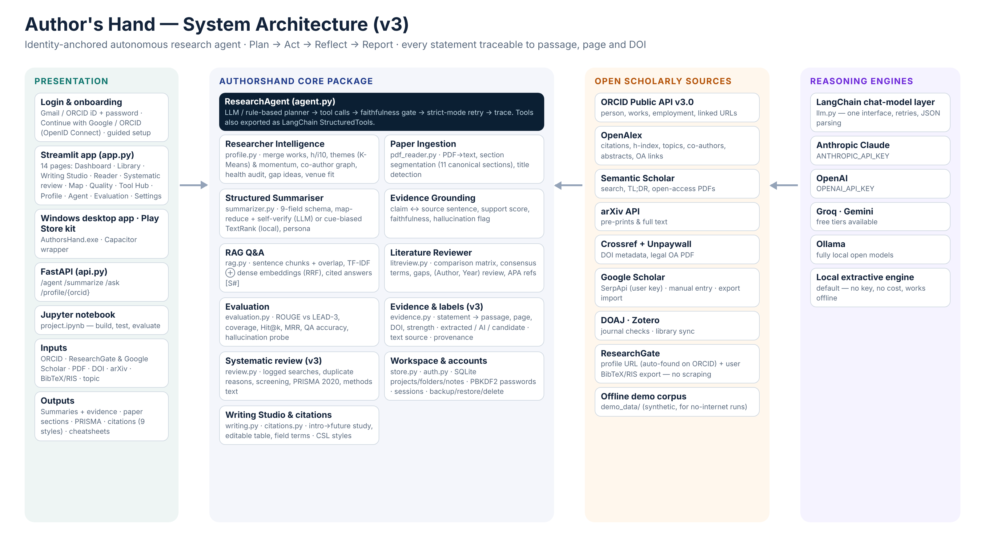
Architecture: four layers around one autonomous agent
Notes:
Presentation layer (Streamlit, FastAPI, notebook); core package with the ResearchAgent on top; open scholarly sources; pluggable reasoning engines behind one LangChain interface.

Slide 5
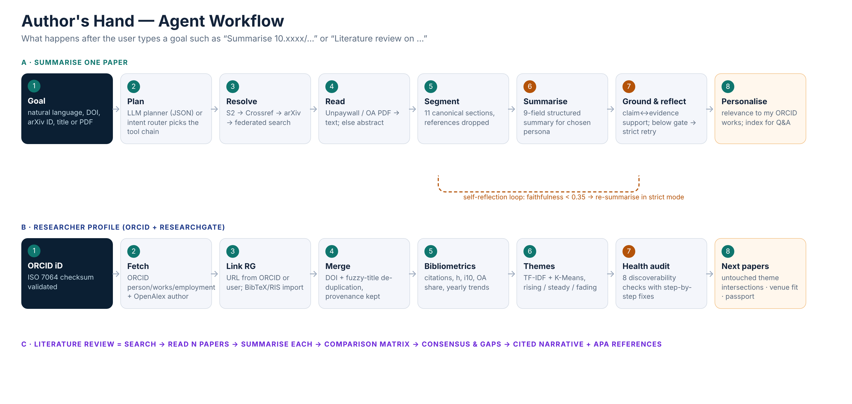
Workflow: from a goal to a verified, personalised answer

Slide 6
How the agent thinks: Plan → Act → Reflect → Report
1
2
3
4
Plan
Act
Reflect
Report
LLM planner returns a JSON intent + arguments; with no key a deterministic router does. Five intents: profile, summarise, review, venue, question.
Calls tools — search, resolve DOI/arXiv, read open-access PDF, segment, summarise, index — logging thought → tool → result → time.
Grounds every claim in a source sentence. Faithfulness below 0.35 triggers a strict-mode re-summary.
Structured output, evidence trail and full trace; exports Markdown, BibTeX, CSV and a Research Passport.
Tech stack
Python · LangChain (chat models + StructuredTools) · scikit-learn (TF-IDF, K-Means) · NetworkX (TextRank, co-author graph) · pypdf · rouge-score · optional sentence-transformers · Streamlit · FastAPI · pytest

Slide 7
Results on the synthetic demo corpus (pipeline check, not real-world quality)
0.506
ROUGE-1
LEAD-3: 0.432
100%
Retrieval Hit@3
10 QA pairs · MRR 0.87
100%
Field coverage
9 structured fields
0.03
Support for an invented claim
vs 1.00 genuine → flagged
⚠ Limitation: 5 synthetic papers written for testing — these numbers show the pipeline works, not quality on real literature. ROUGE-2 trails LEAD-3 (summary-like abstracts); local faithfulness is 1.0 by construction. Real-paper protocol + human ratings are built in (next slides). 33/33 unit tests pass.

Slide 8
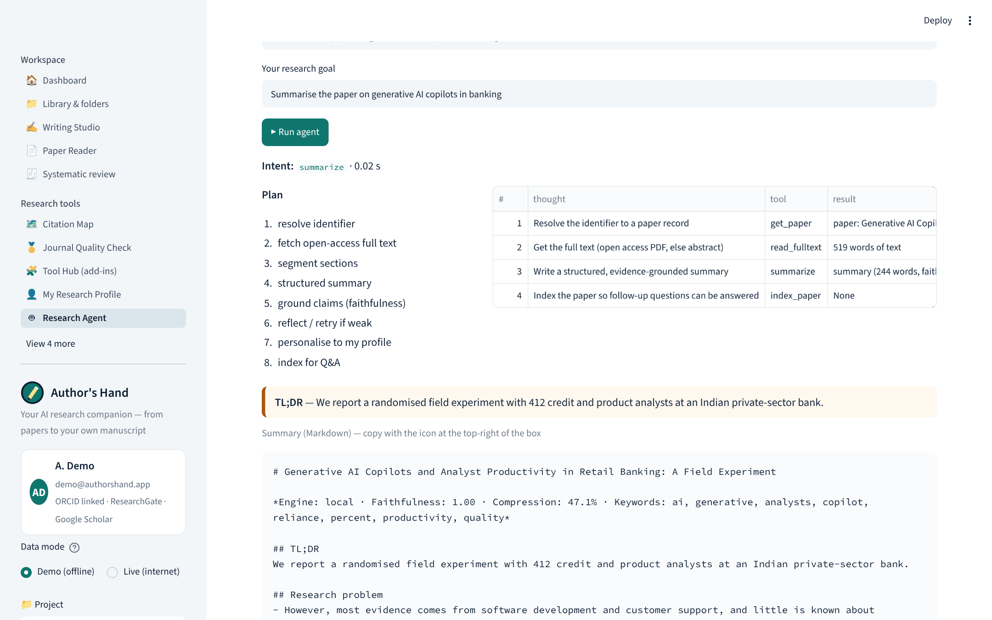
Research Agent: a plan and an auditable trace
Goal typed in plain English
Intent detected, plan shown before results
Each tool call logged with its reasoning, result and time
Output: structured summary with evidence

Slide 9
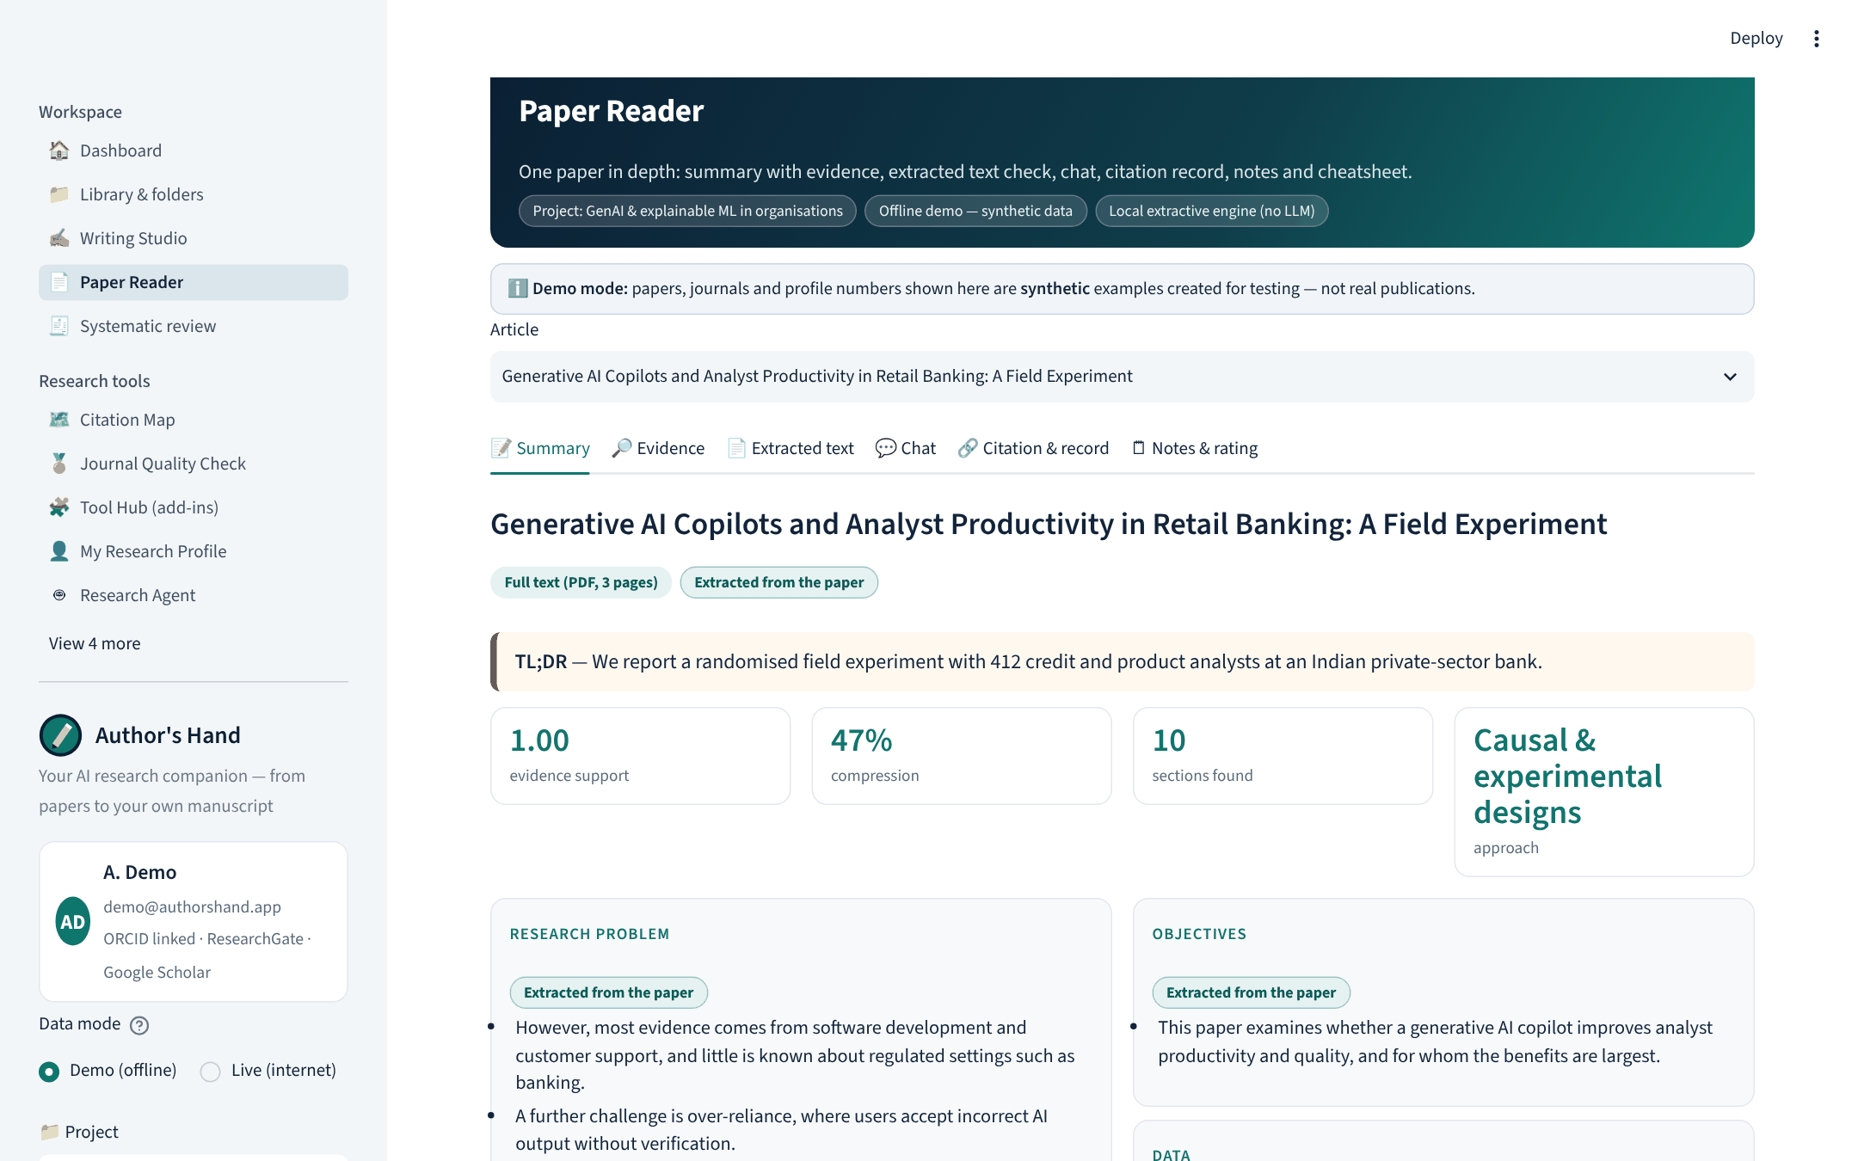
Paper Reader: structured summary with labels
Text-source chip: full text (PDF, 3 pages) vs abstract only
Every point labelled “Extracted from the paper”
Evidence support, compression, sections found
Tabs: evidence, extracted text, chat, citation record, notes & rating

Slide 10
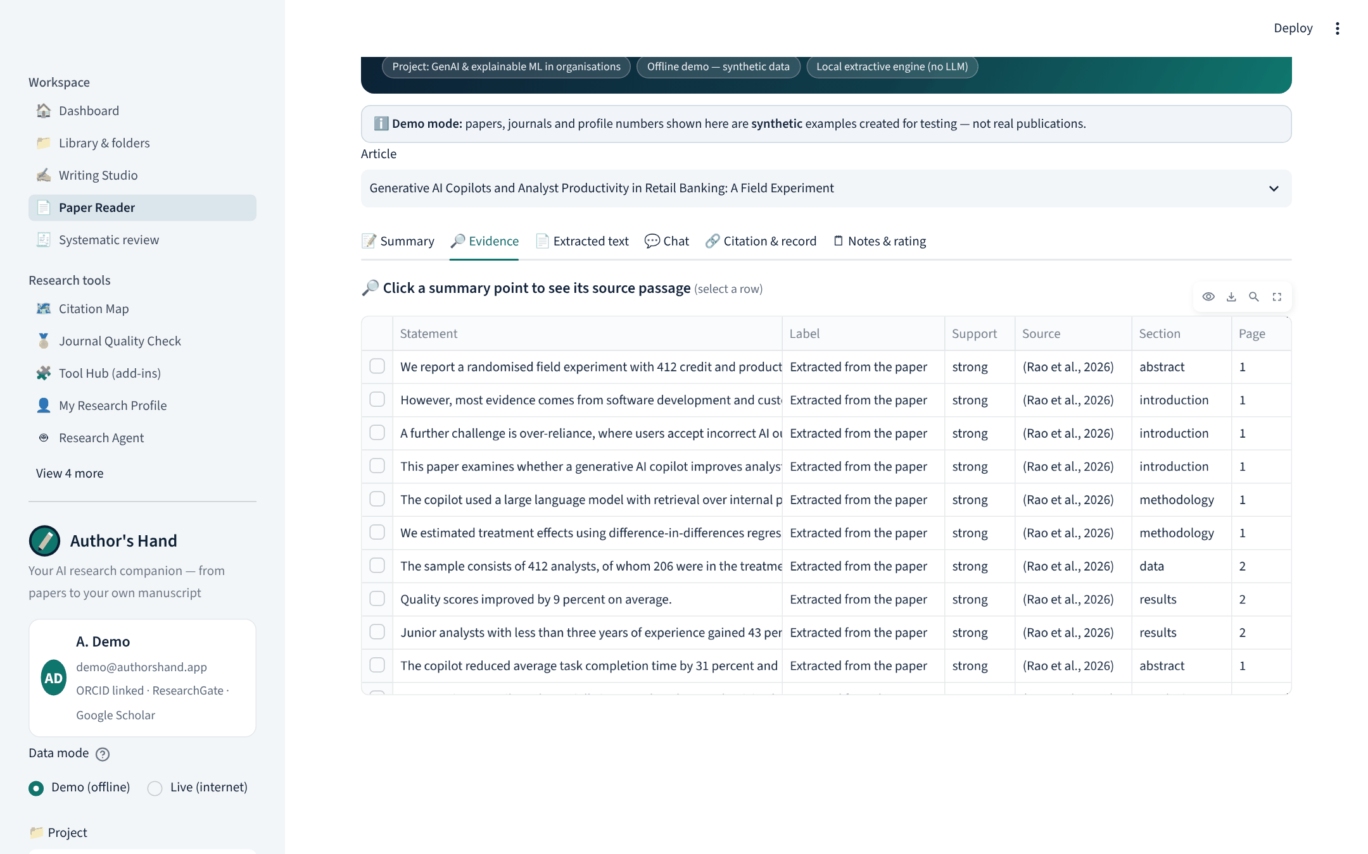
Evidence: click a statement → passage, section, page, DOI
Support strength: strong / moderate / weak
Source passage with surrounding context
Page number from the PDF and DOI link
Weak support is flagged, never hidden

Slide 11
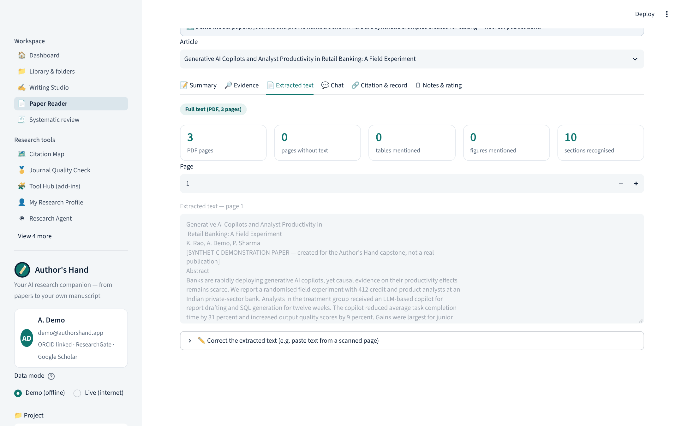
Extracted text you can check and correct
Page-by-page text viewer
Flags: empty / scanned pages, tables and figures mentioned
Optional OCR for scanned PDFs
Correct the text — summaries re-run on your version

Slide 12
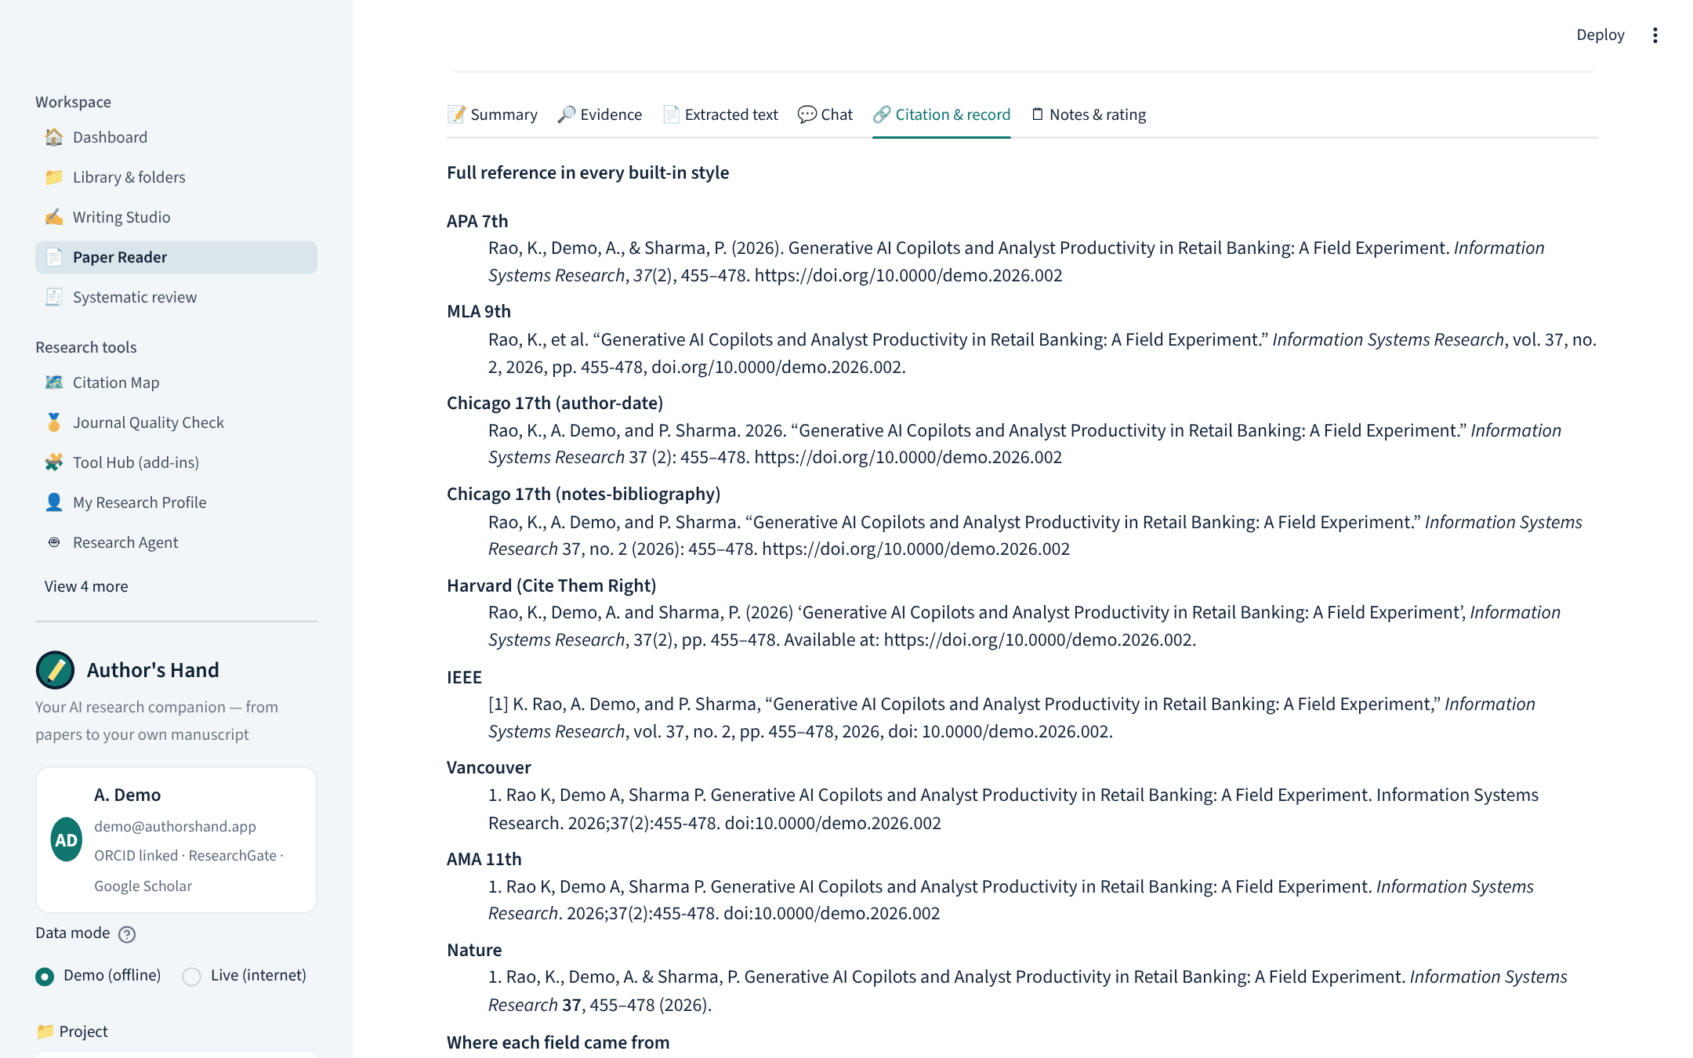
Citation record with field provenance
All 9 styles side by side
Where each field came from (Crossref, PDF, edited by you) and when
Edit any field; fill from DOI
Notes and tags carried into BibTeX / RIS exports

Slide 13
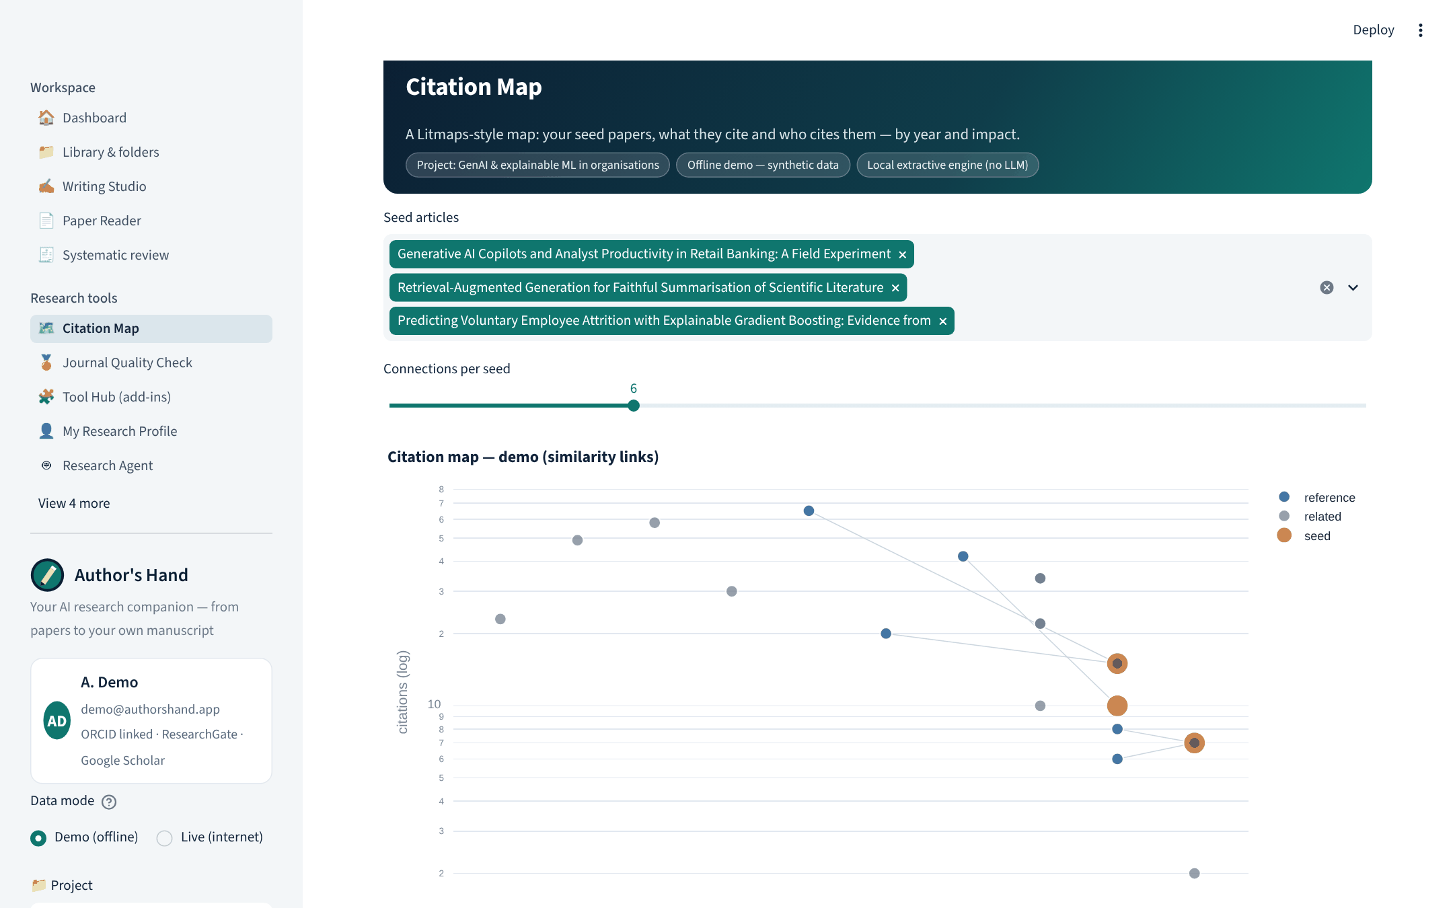
Citation map (Litmaps-style)
Seed papers, references and citing papers by year and impact
Export as BibTeX to Litmaps, ResearchRabbit, Zotero

Slide 14






From summariser to a full research workspace
One identity
Projects & folders
Auto-refresh
Writing Studio
E-mail = workspace; ORCID (found from your e-mail), ResearchGate and Zotero linked once.
Every project keeps its own folders, articles, citation style, add-ins and saved search.
New papers on your topic and papers citing your library arrive as alerts; citation counts update.
Pick 5 articles → overall summary + Intro, LR, Gap, Method, Model, RQs, Hypotheses, Future study.
Every citation style
Visual mode
Journal quality check
45 add-ins
Editors, edition, pages, publisher kept; 9 built-in styles + 10,000 CSL styles; copy with italics.
Funnels, timelines, gap heat-maps, white-space maps, conceptual-model diagrams.
DOAJ, OpenAlex, Crossref + your Scopus/ABDC/UGC-CARE lists + red flags → score.
Litmaps, SciSpace, JANE, Connected Papers, Zotero, Elicit, scite … per writing stage.
Notes:
Version 2 answers the request to link identities, manage multiple projects in folders, keep them refreshed, and support every stage of writing with visuals, citations and add-ins.

Slide 15
Writing Studio: ten tabs, one for each part of the paper
1
2
3
4
5
Summaries
Introduction
Literature review
Research gap
Methodology
Overall + per-article summary, cheatsheet PDF
Funnel + opening evidence
Timeline, themes, comparison matrix
Gap types, who-reports-what, white-space map
Methods & designs charts, checklist
6
7
8
9
10
Model development
Research questions
Hypotheses
Future study
References
Conceptual model diagram
RQ cards from gaps
Hypothesis path diagram + support
Directions by type
9 styles, Word/BibTeX/RIS/EndNote
Every tab: Visual mode on/off · copy-ready text box (copy icon) · the add-ins that fit that stage · drafts always cited; local drafts must be paraphrased before submission.

Slide 16
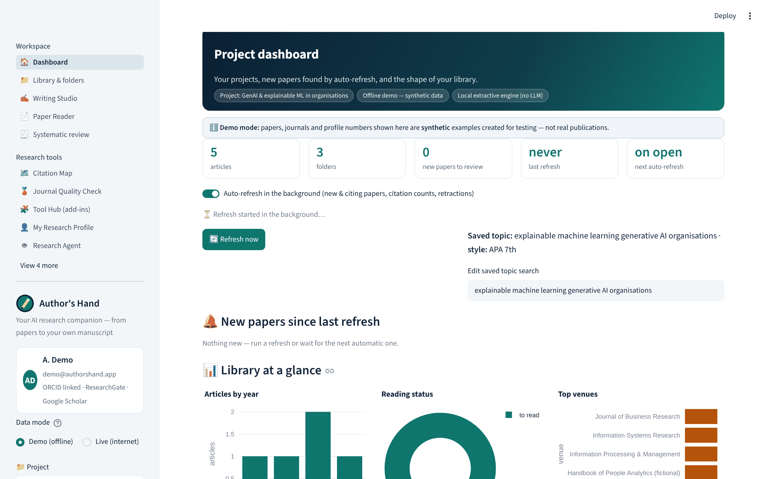
Project dashboard with background auto-refresh
Project KPIs, last and next refresh
Refresh runs in the background — the app stays responsive
New papers on the saved topic / citing your library → add to a folder
Library charts: years, reading status, venues

Slide 17
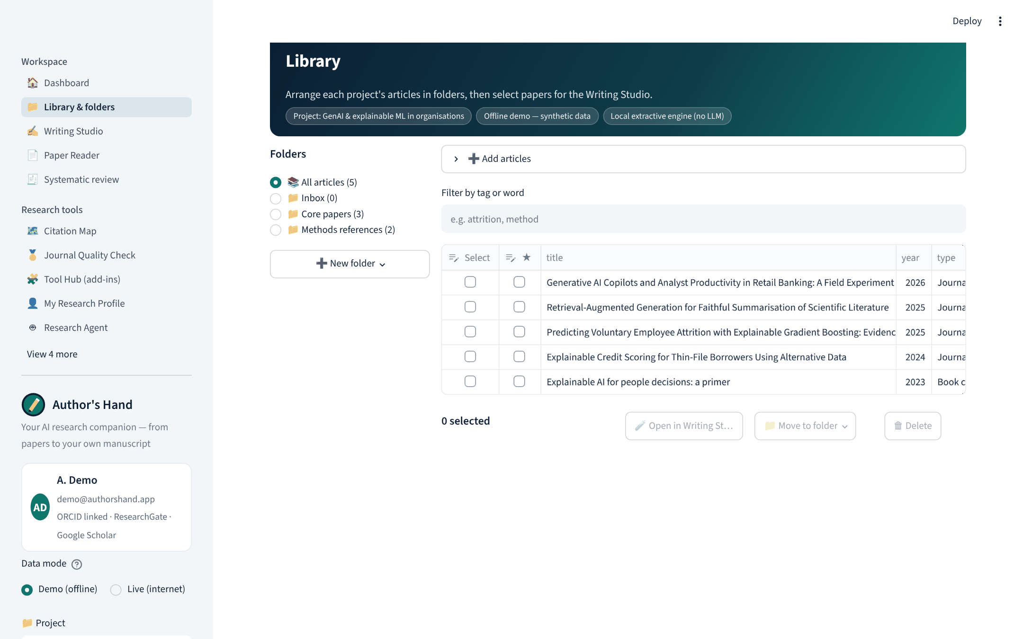
Library: projects → folders → articles
Search, DOI/arXiv, PDF upload, BibTeX/RIS import (Litmaps, ResearchRabbit, Zotero, Mendeley, ResearchGate) or your ORCID works
Type, text used, tags and notes columns (editable)
Filter by tag or word

Slide 18
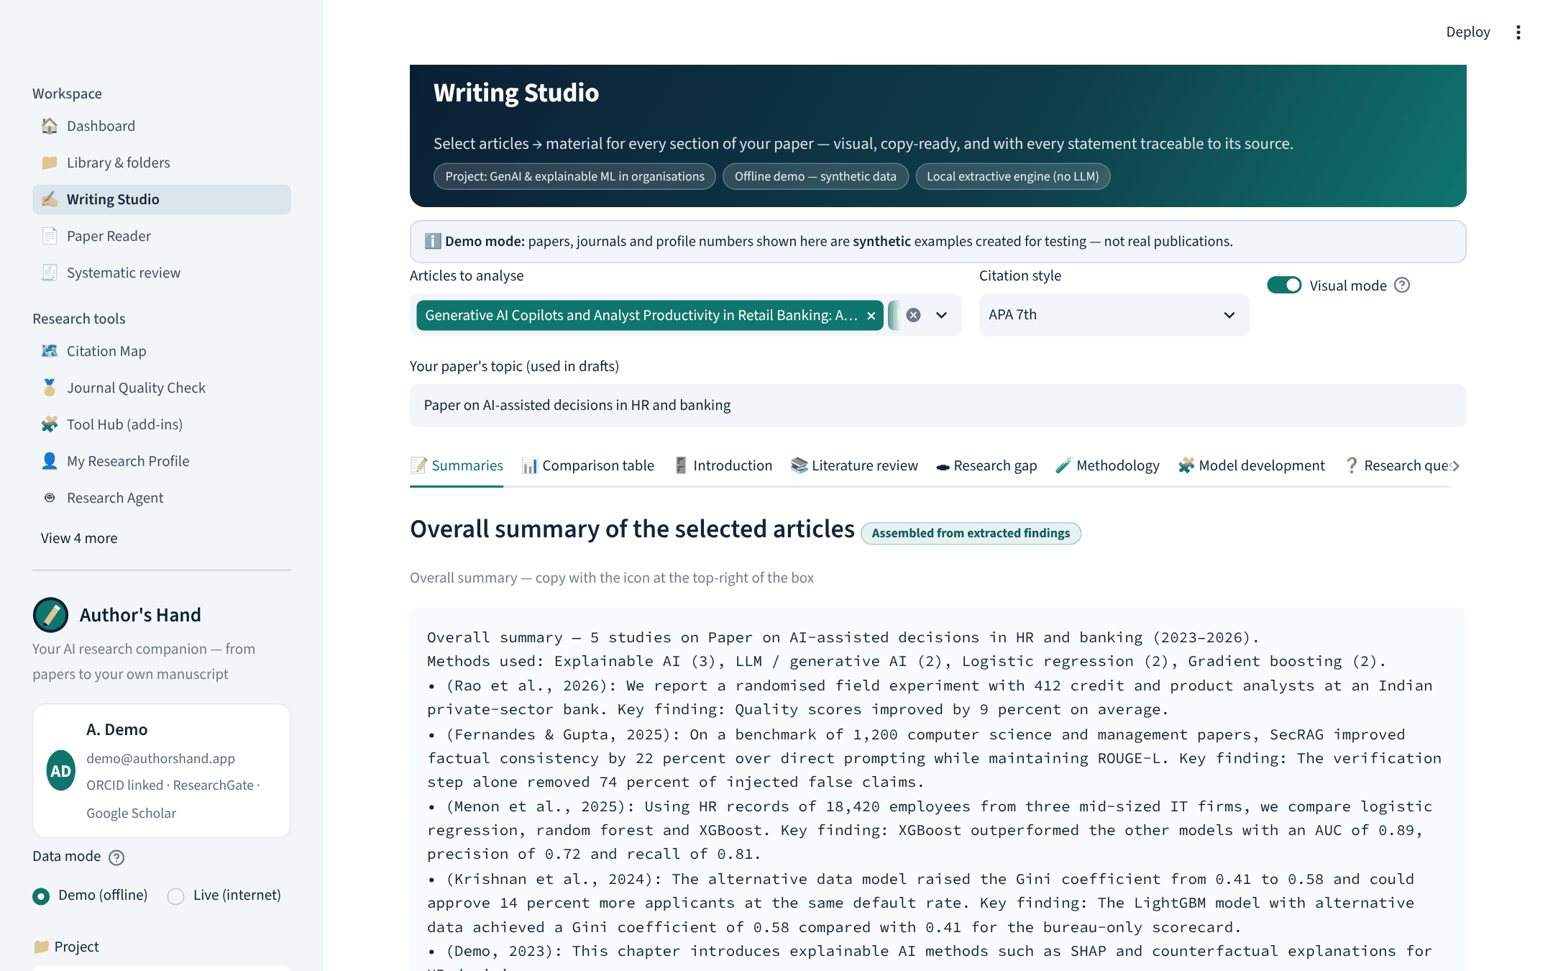
Overall summary of the selected articles — copy in one click
One overall summary across all selected papers
Badge: assembled from extracted findings
Per-article cards, evidence and cheatsheets
Warns when a paper is abstract-only

Slide 19
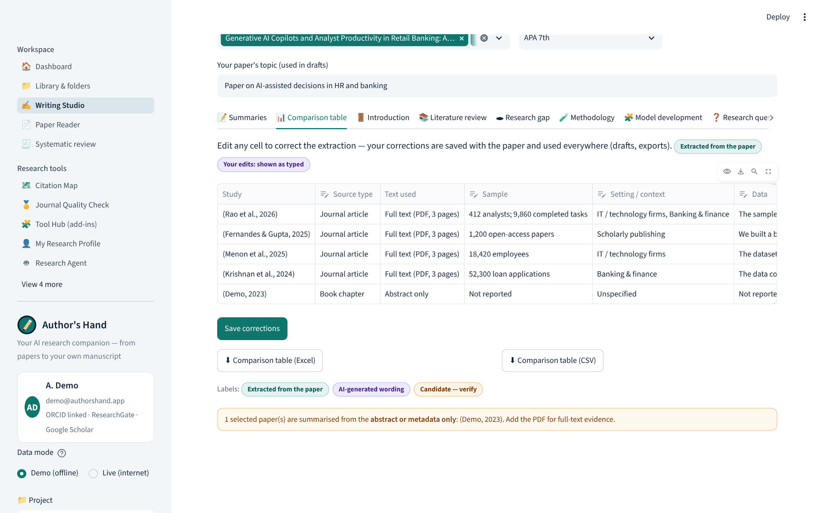
Comparison table you can correct and export
Source type, text used, sample, setting, data, method
Edit any cell → saved and reused in every draft
Excel / CSV export

Slide 20
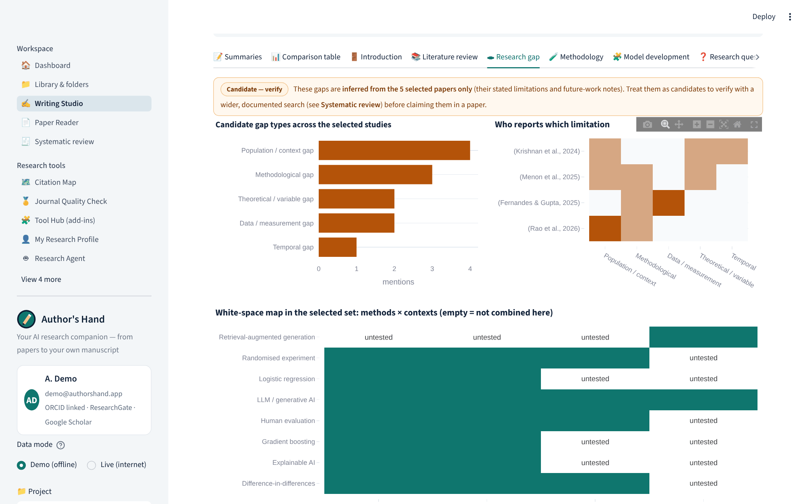
Research gap: candidates, clearly labelled
“Candidate — verify” label on every gap
Gap types across studies, who reports what
White-space map: method × context combinations not studied

Slide 21
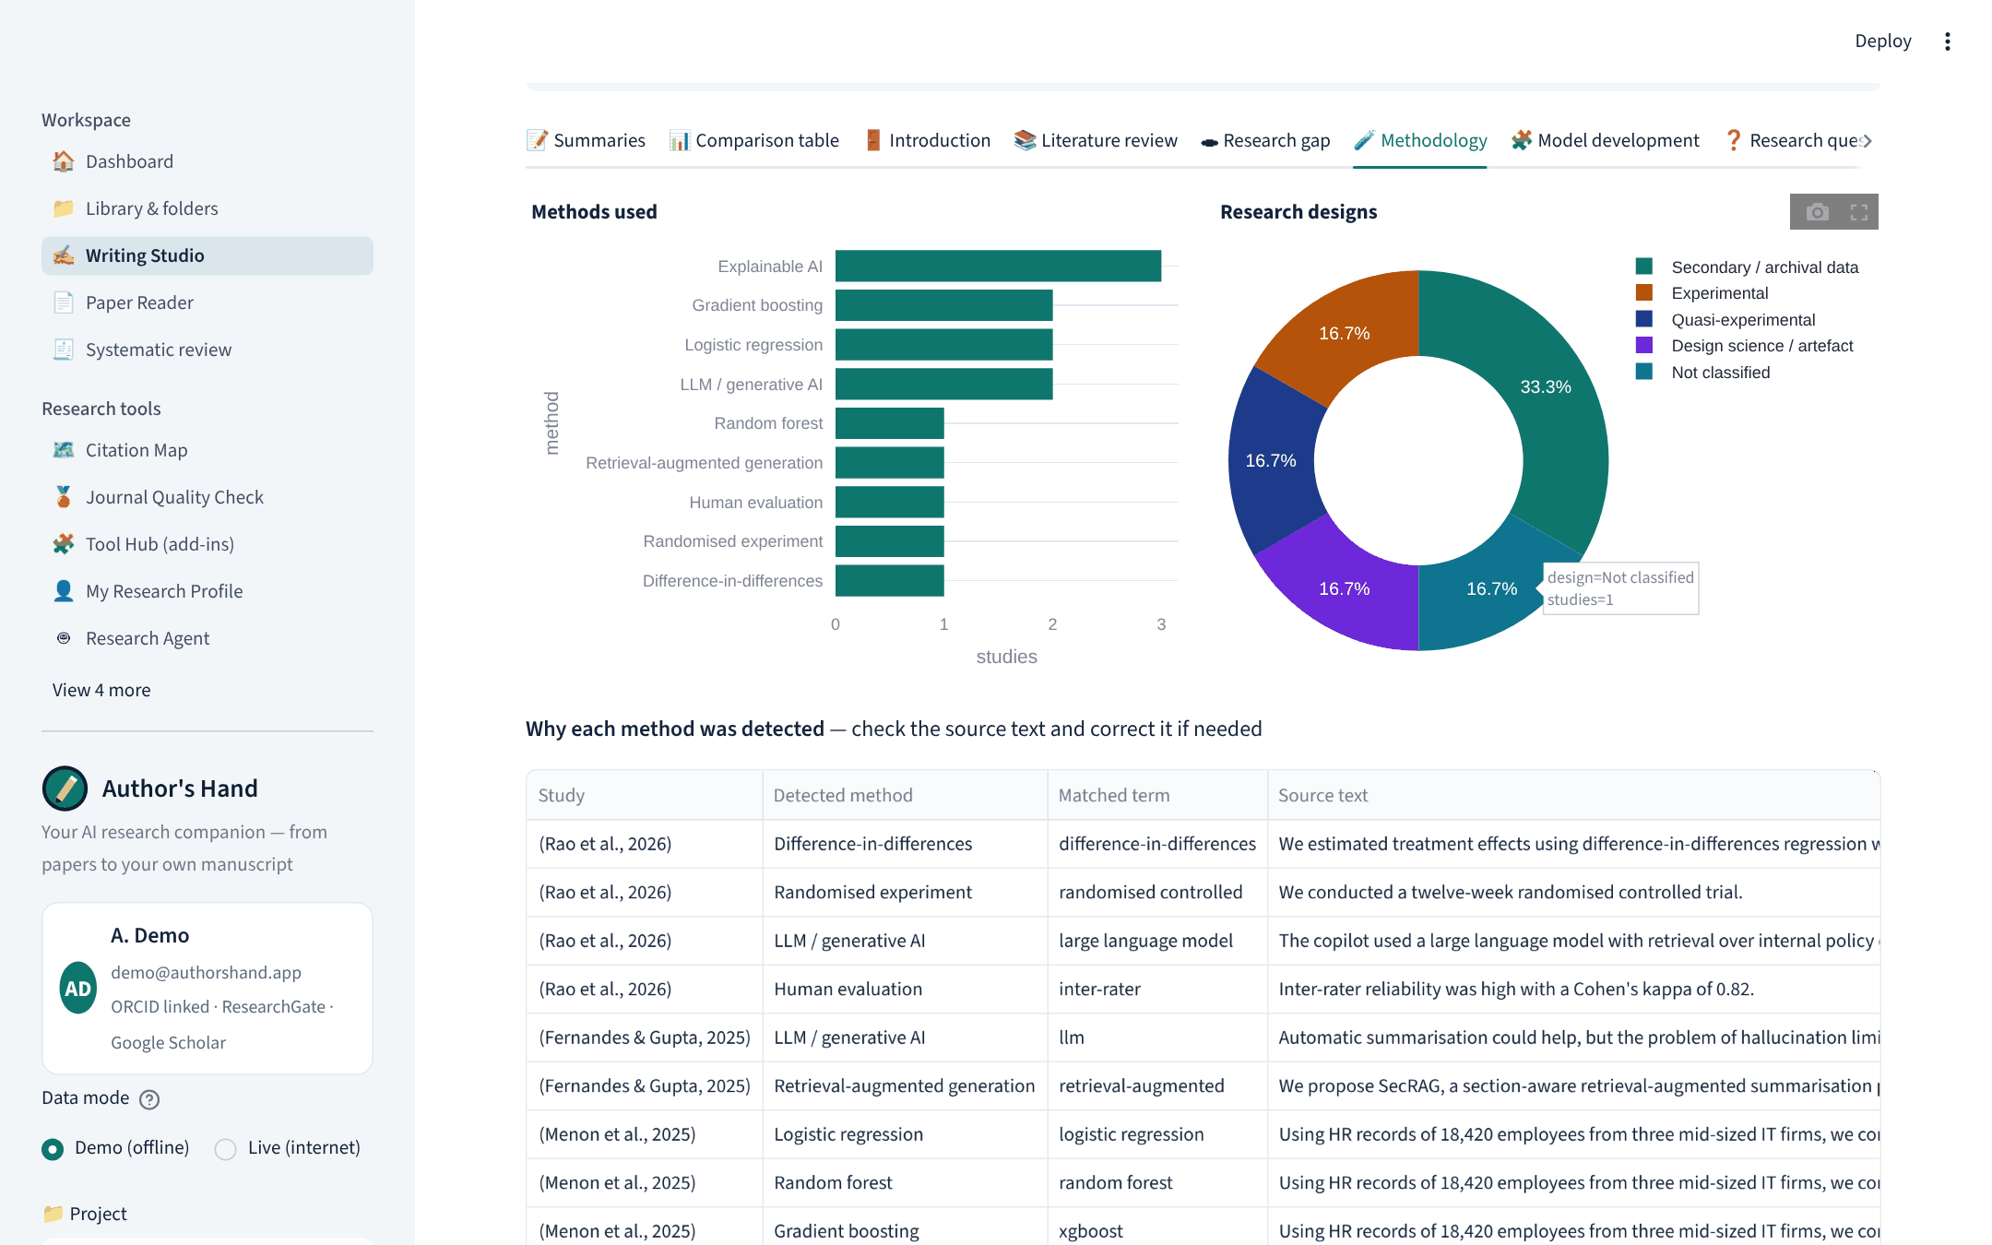
Methodology: why each method was detected
Methods and designs charts
Table: detected method, matched term, source sentence
Correct the classification; add your field’s own terms

Slide 22
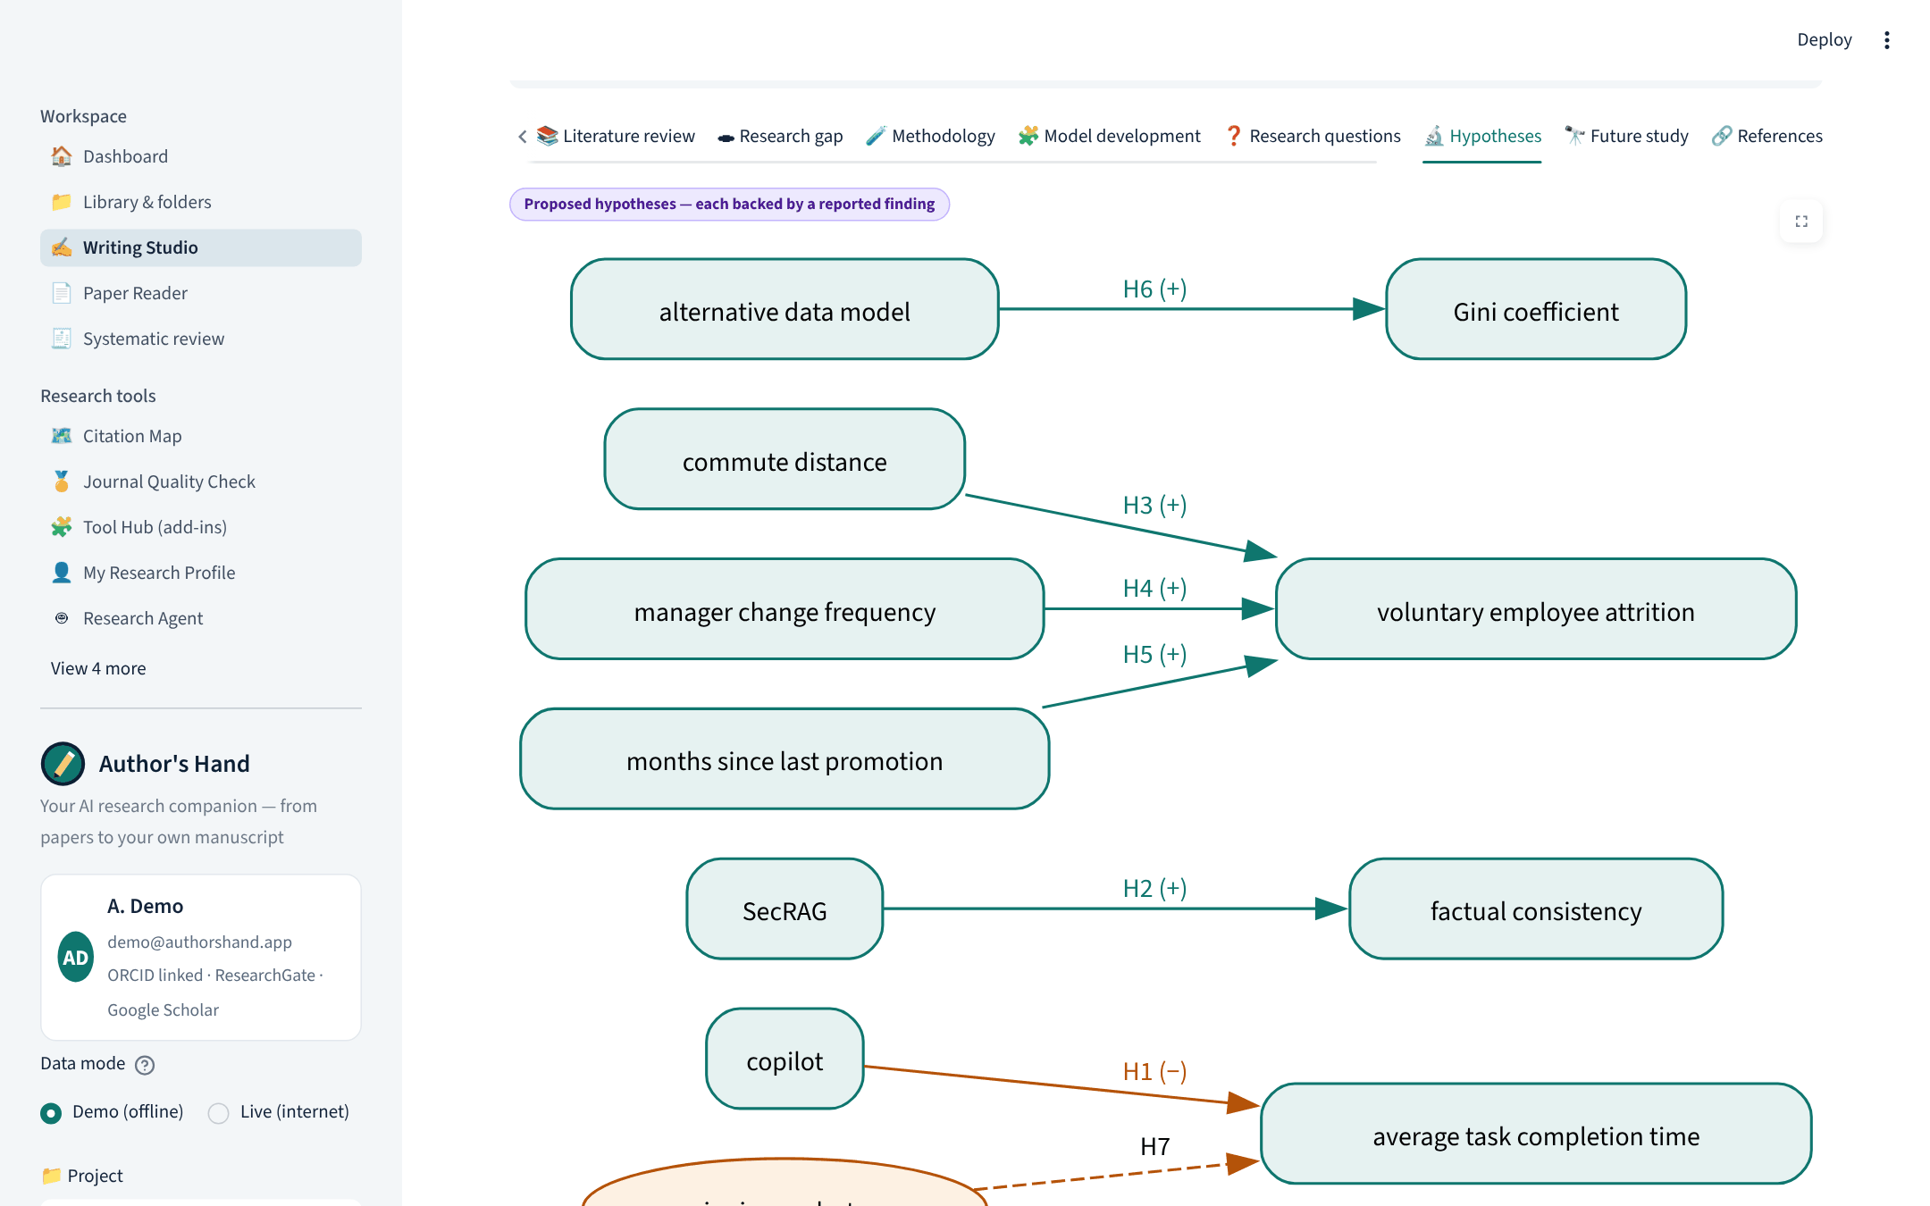
Model development & hypotheses
Relationships extracted from findings (X → Y, sign)
H1…Hn each backed by a cited finding
Hidden automatically for review-only goals

Slide 23
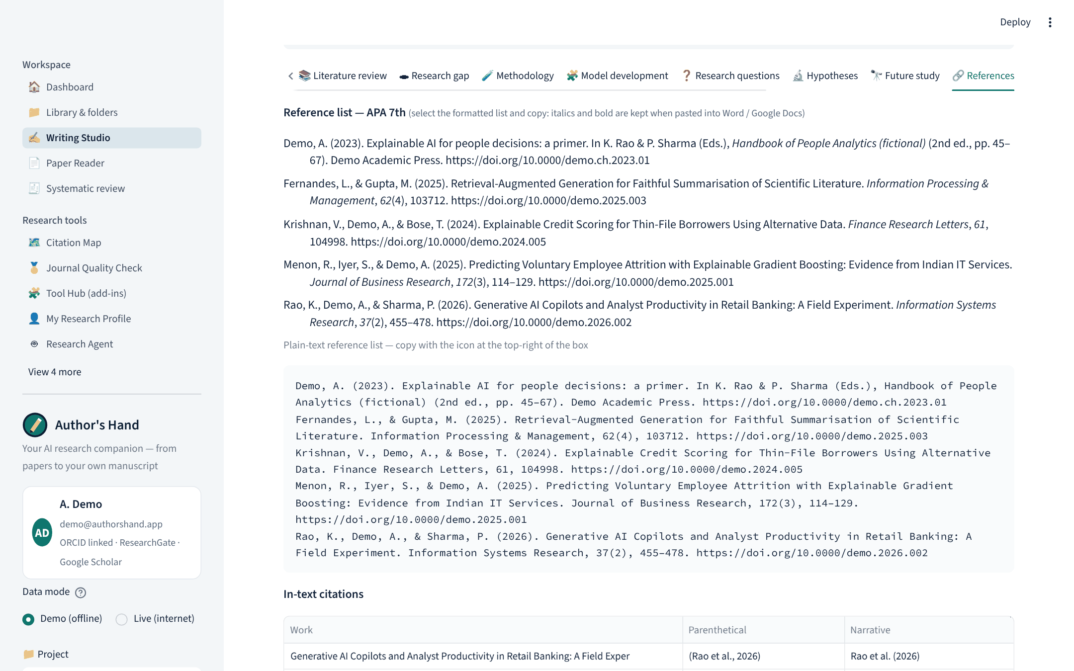
References: full citations in the style you need
Editors, edition, volume, issue, pages, publisher
APA, MLA, Chicago ×2, Harvard, IEEE, Vancouver, AMA, Nature + 10,000 CSL styles via DOI
Word (italics kept), BibTeX, RIS, EndNote

Slide 24
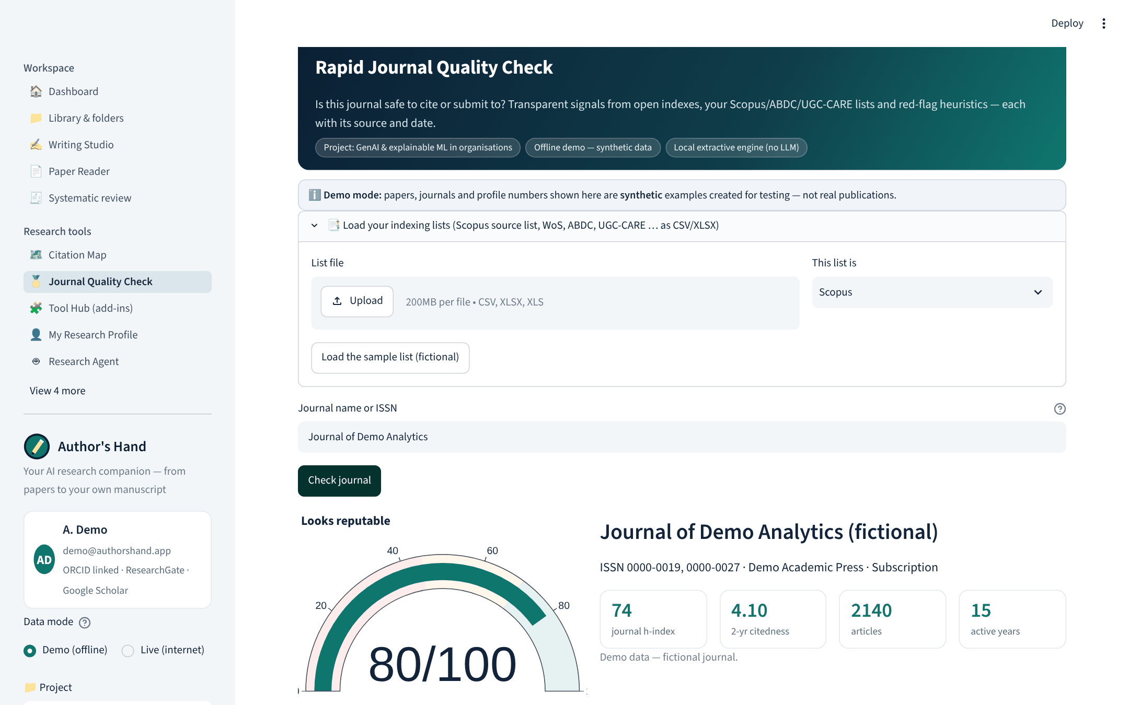
Rapid Journal Quality Check — a screening aid
Signals from DOAJ, OpenAlex, Crossref and your own indexing lists
Each signal shows its data source and the date checked
Explained as a screening aid, not a universal quality score

Slide 25
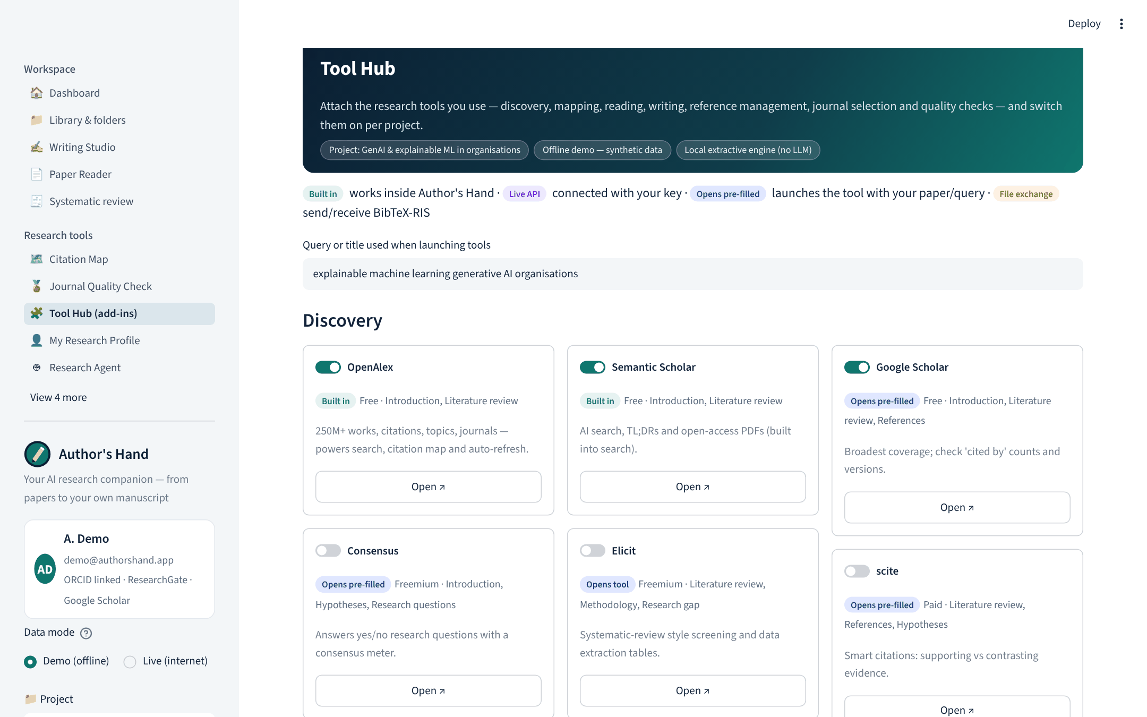
Tool Hub: 45 add-ins, honestly labelled
Built in · live API · opens pre-filled · file exchange
JANE, SciSpace, Litmaps, Elicit, scite, Zotero …
Enabled add-ins appear on the matching Writing Studio tab

Slide 26
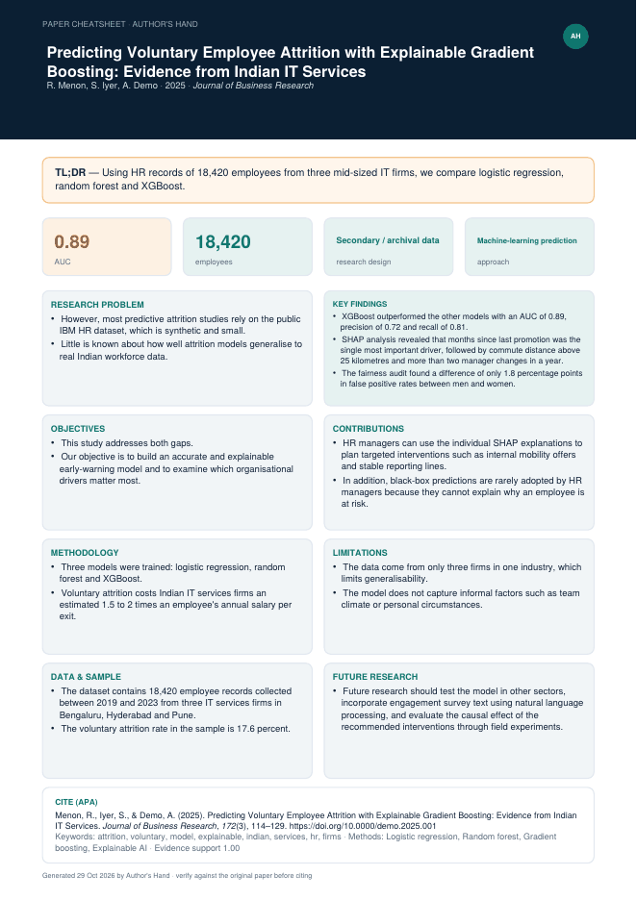
Cheatsheet, Windows app and Play Store
Install anywhere
1
Deploy
Streamlit Community Cloud (free) or Docker on Render / Cloud Run → public URL.
2
Add to Home screen
Any phone: open the URL → browser menu → Install app.
3
Play Store
mobile/ Capacitor wrapper → signed .aab in Android Studio → Google Play Console (US$25 once).
4
Windows desktop app
AuthorsHand.exe — first run installs everything automatically; opens in its own window with a Start-menu shortcut.
One-page cheatsheet per paper (left): headline numbers, design, approach, eight summary boxes and the formatted citation.

Slide 27
Version 3: review feedback → what changed
Requested (user · ChatGPT review · IIT G brief) | Delivered in Author's Hand v3
Login page; Gmail or ORCID iD; sign-up for new users | Login/sign-up page, recovery code, Continue with Google / ORCID (OpenID Connect), guided onboarding
Google Scholar profile with numbers and graph | Citations, h-index, i10 (all / since) and citations-per-year chart, with source and date
Trace every statement to its evidence | Click a statement → passage, context, section, page, DOI, support strength
Separate evidence from suggestions | Labels: Extracted from the paper · AI-generated wording · Candidate — verify
Reproducible literature review | Logged searches, duplicate reasons, editable screening, PRISMA 2020, methods paragraph, exports
PDF handling & corrections | Full text vs abstract label, page viewer, parse flags, OCR option, editable text, table and records
Privacy & control | What is stored/sent table, keys in memory only, unlink accounts, backup / restore / delete
Honest evaluation | Synthetic limitation stated; real-paper protocol, human ratings and failure cases built in
Notes:
Every request from the review is mapped to a concrete feature that can be shown live in the app.

Slide 28
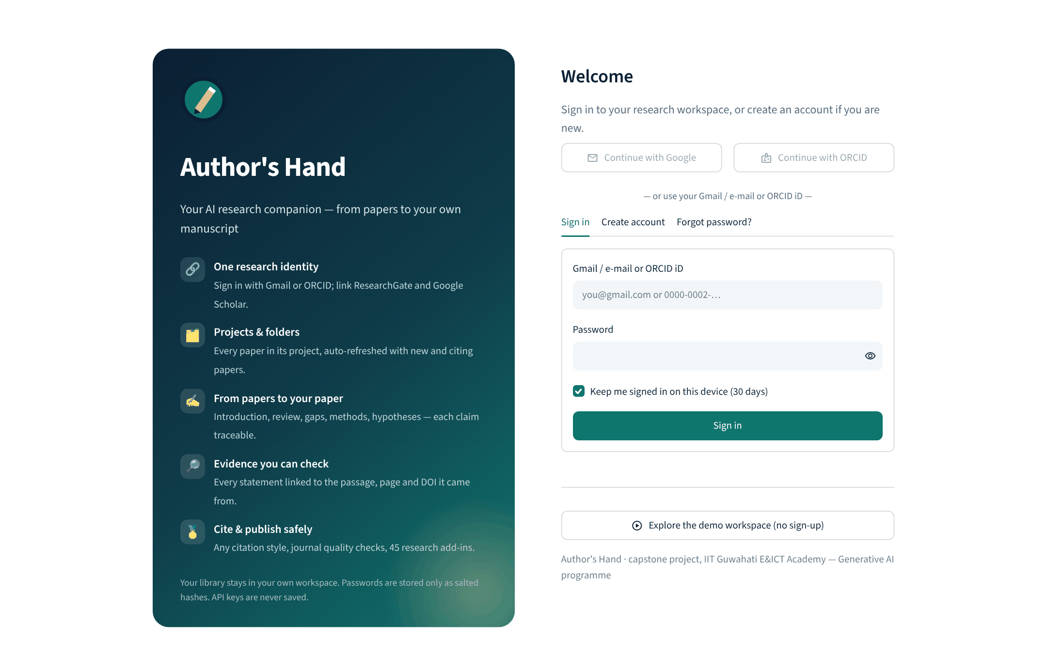
Login page: sign in, create account, or explore the demo
Gmail / e-mail or ORCID iD + password
Continue with Google / ORCID once client IDs are added (Settings → Sign-in providers)
Keep me signed in (30 days, hashed token)
Demo workspace without sign-up

Slide 29
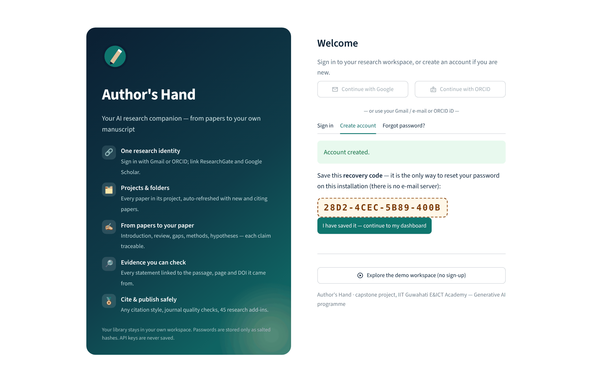
First-time users: account + recovery code
Name, Gmail, optional ORCID iD, password twice, privacy consent
Passwords stored only as salted PBKDF2-SHA256 hashes
One-time recovery code replaces e-mail reset
Then straight to guided setup

Slide 30
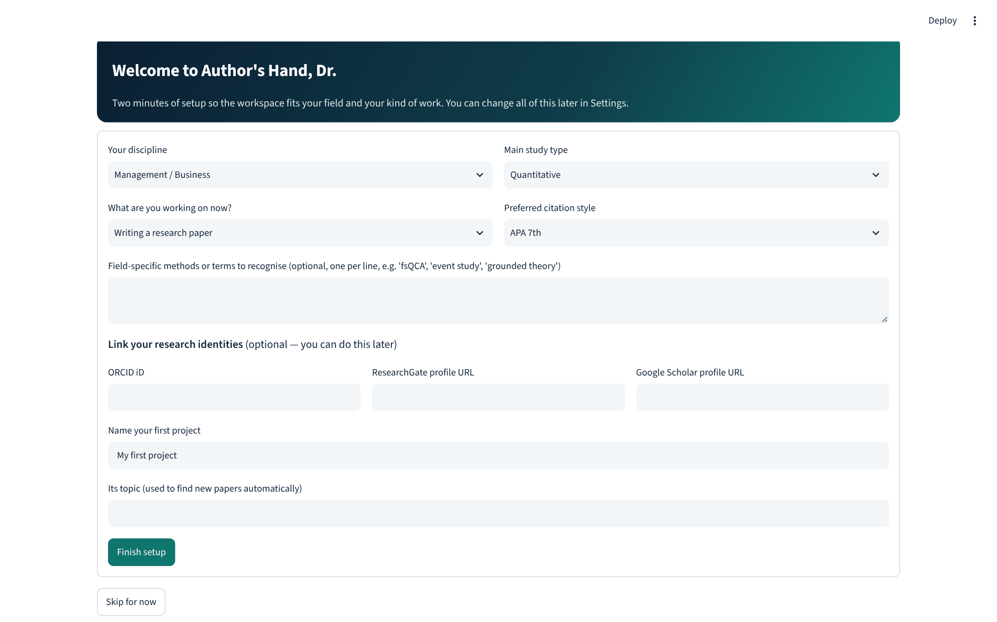
Guided setup: discipline, study type, goal, identities
Discipline, study type, current goal and citation style
Field-specific method terms
ORCID, ResearchGate and Google Scholar links (optional)
First project created → personal dashboard

Slide 31
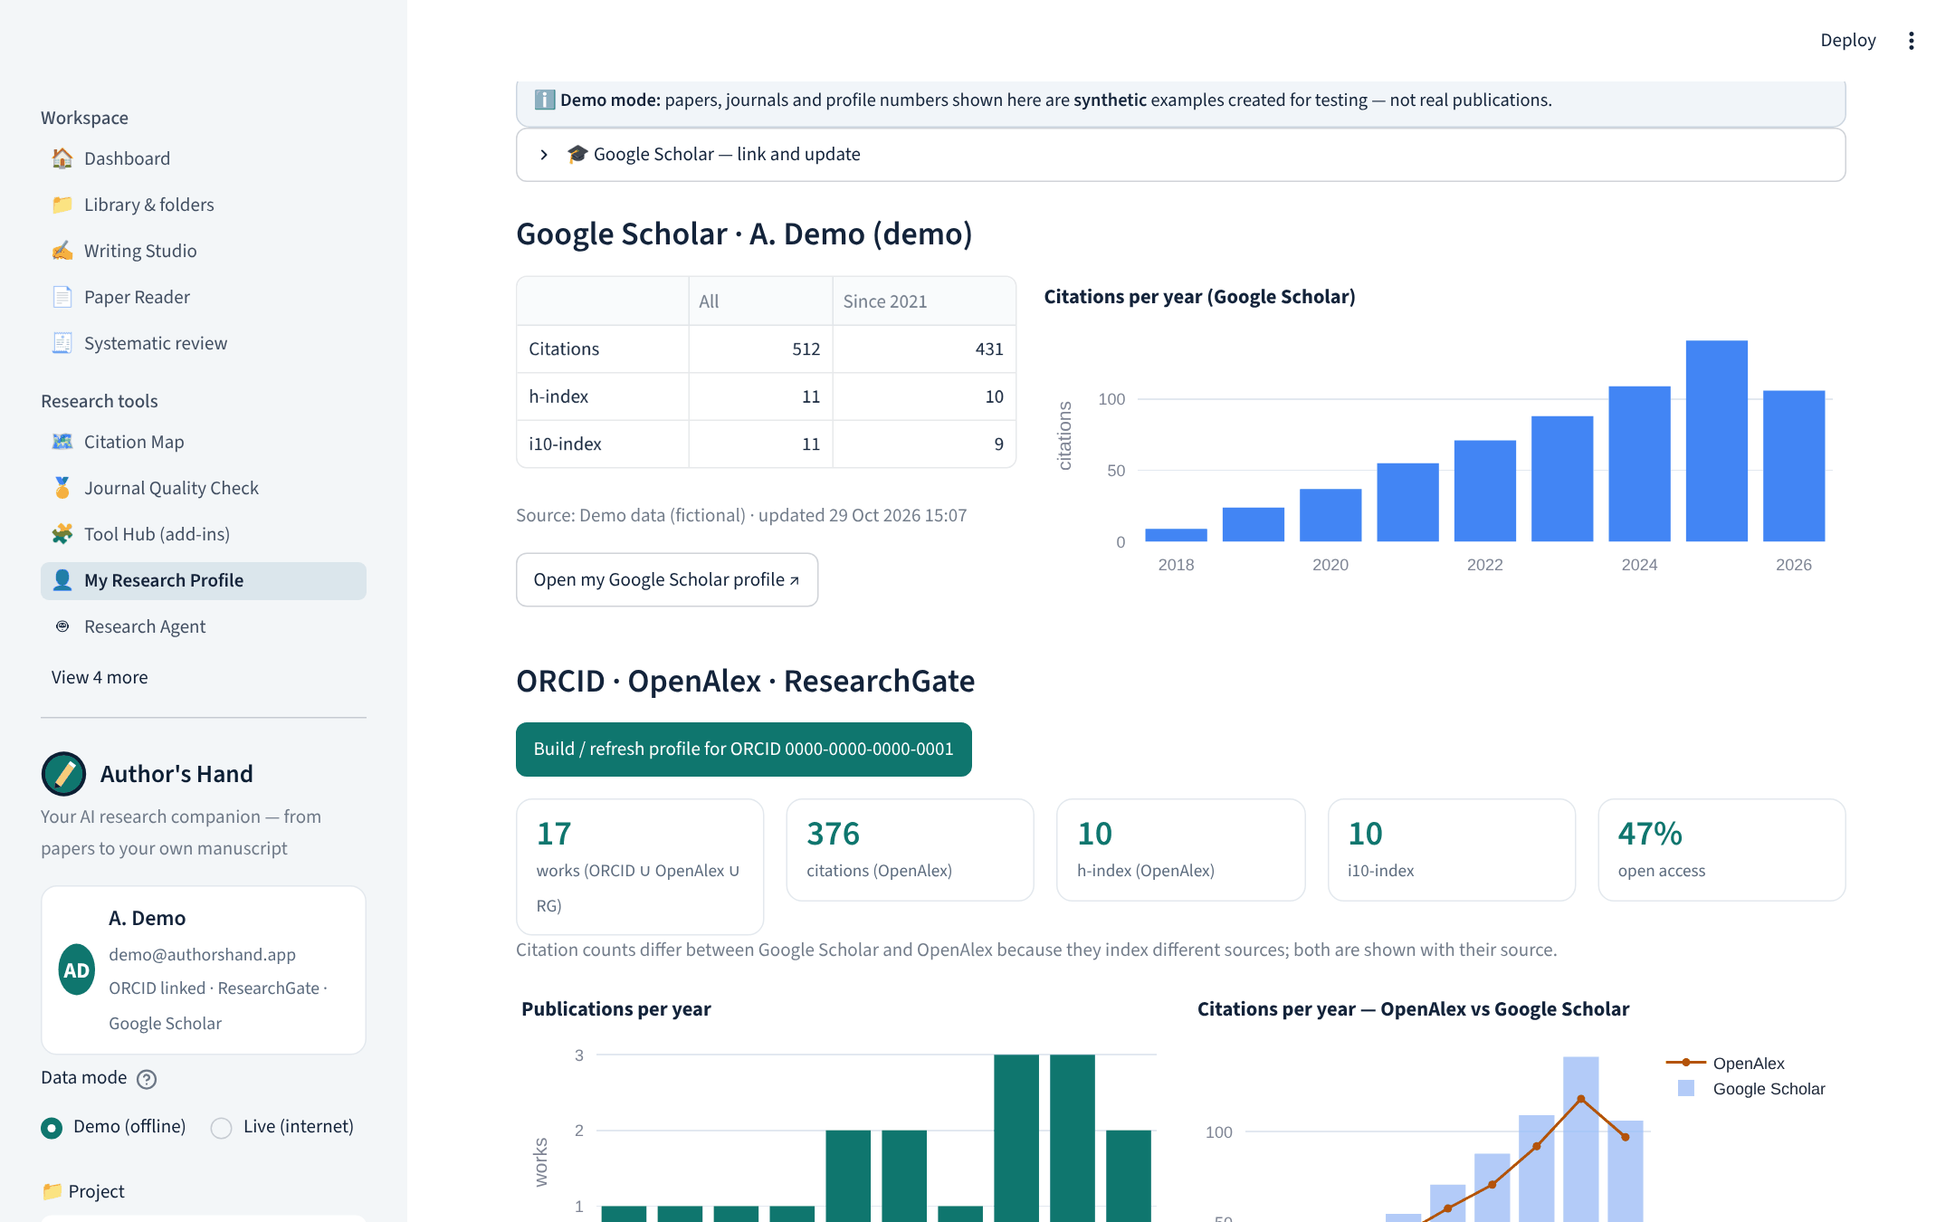
Google Scholar metrics and citation graph
Citations, h-index, i10 — all and since year
Citations per year chart
Three routes: SerpApi (own key), enter numbers, import export
Source and date always shown; no scraping

Slide 32
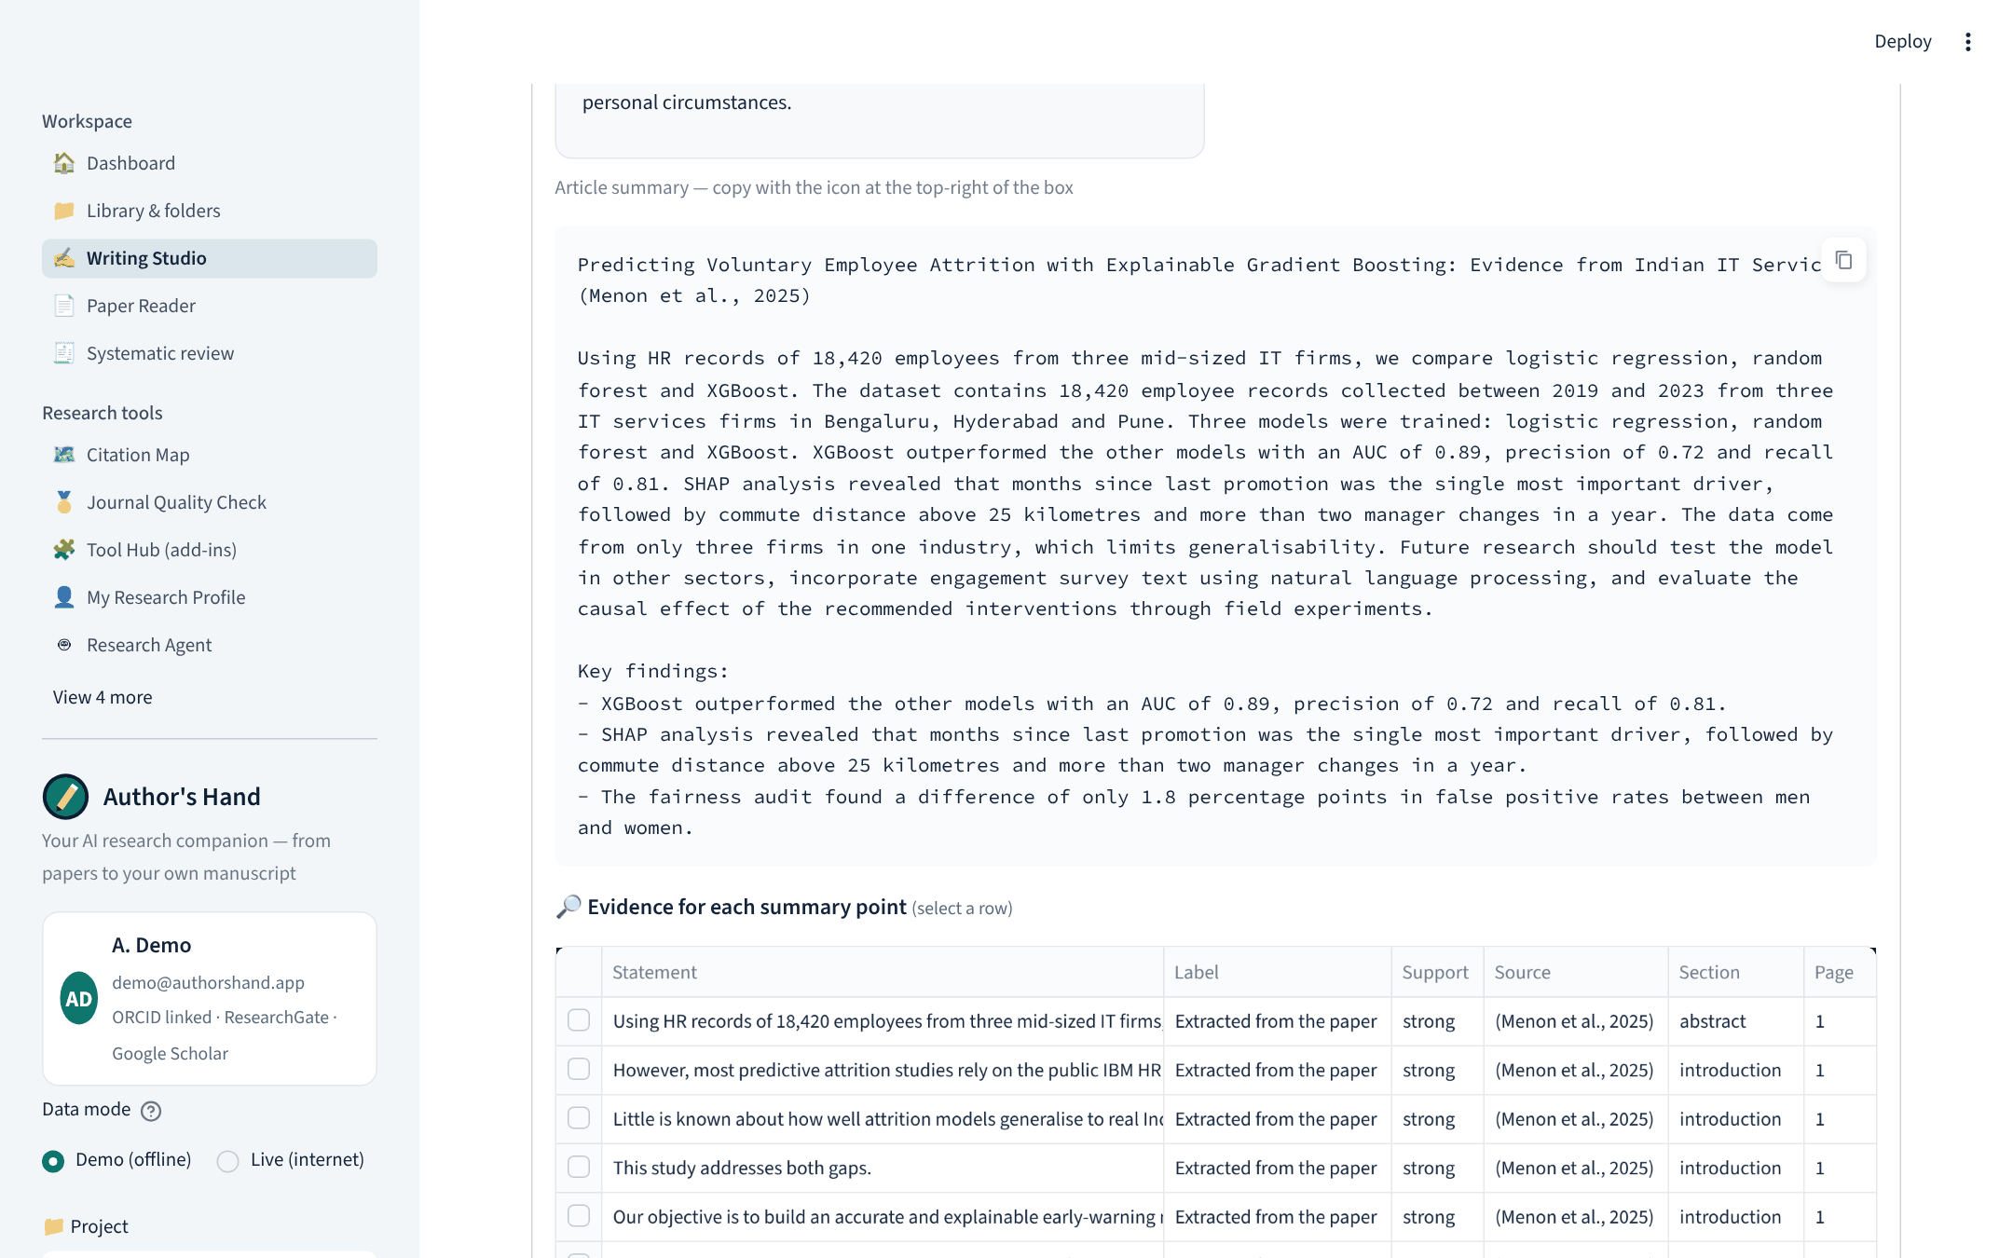
Writing Studio evidence: statements you can check
Every summary point in a selectable table
Label, support strength, source paper, section, page
Detail card with passage, context and DOI link

Slide 33
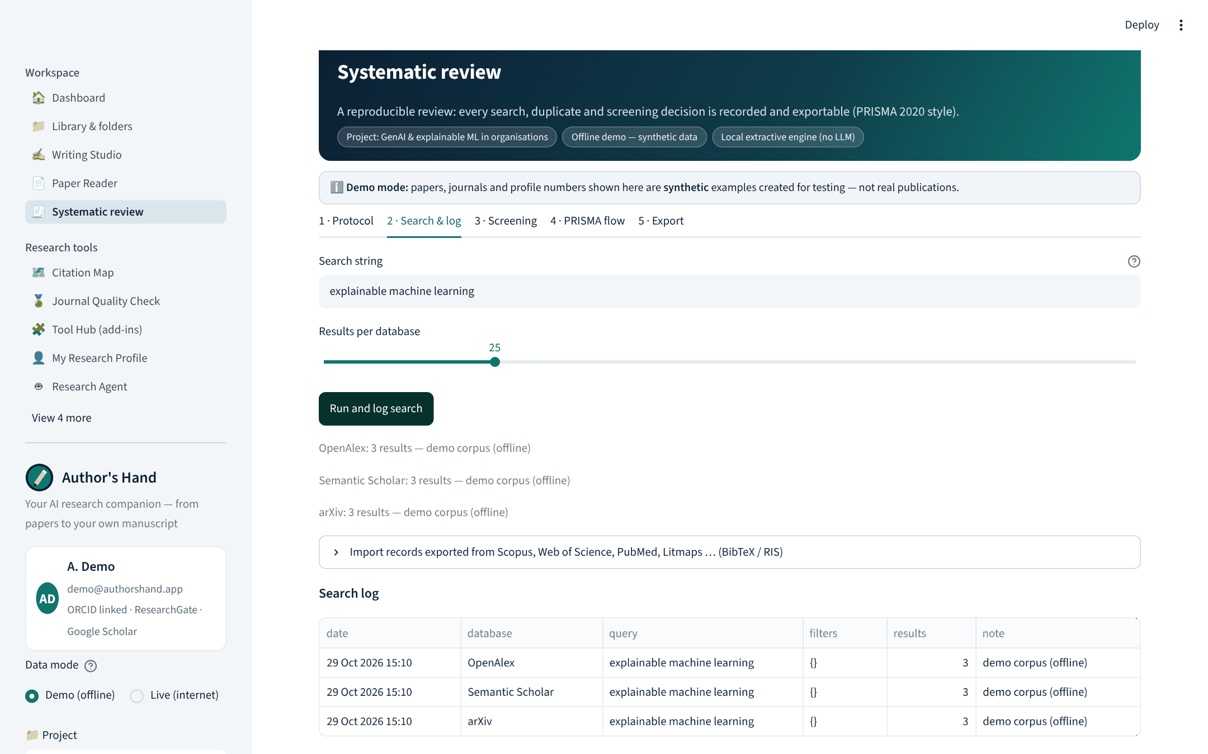
Systematic review: every search logged
Protocol: review type, question, inclusion & exclusion reasons
Search string, databases, date, filters, results per database
Import Scopus / WoS / PubMed exports as logged searches

Slide 34
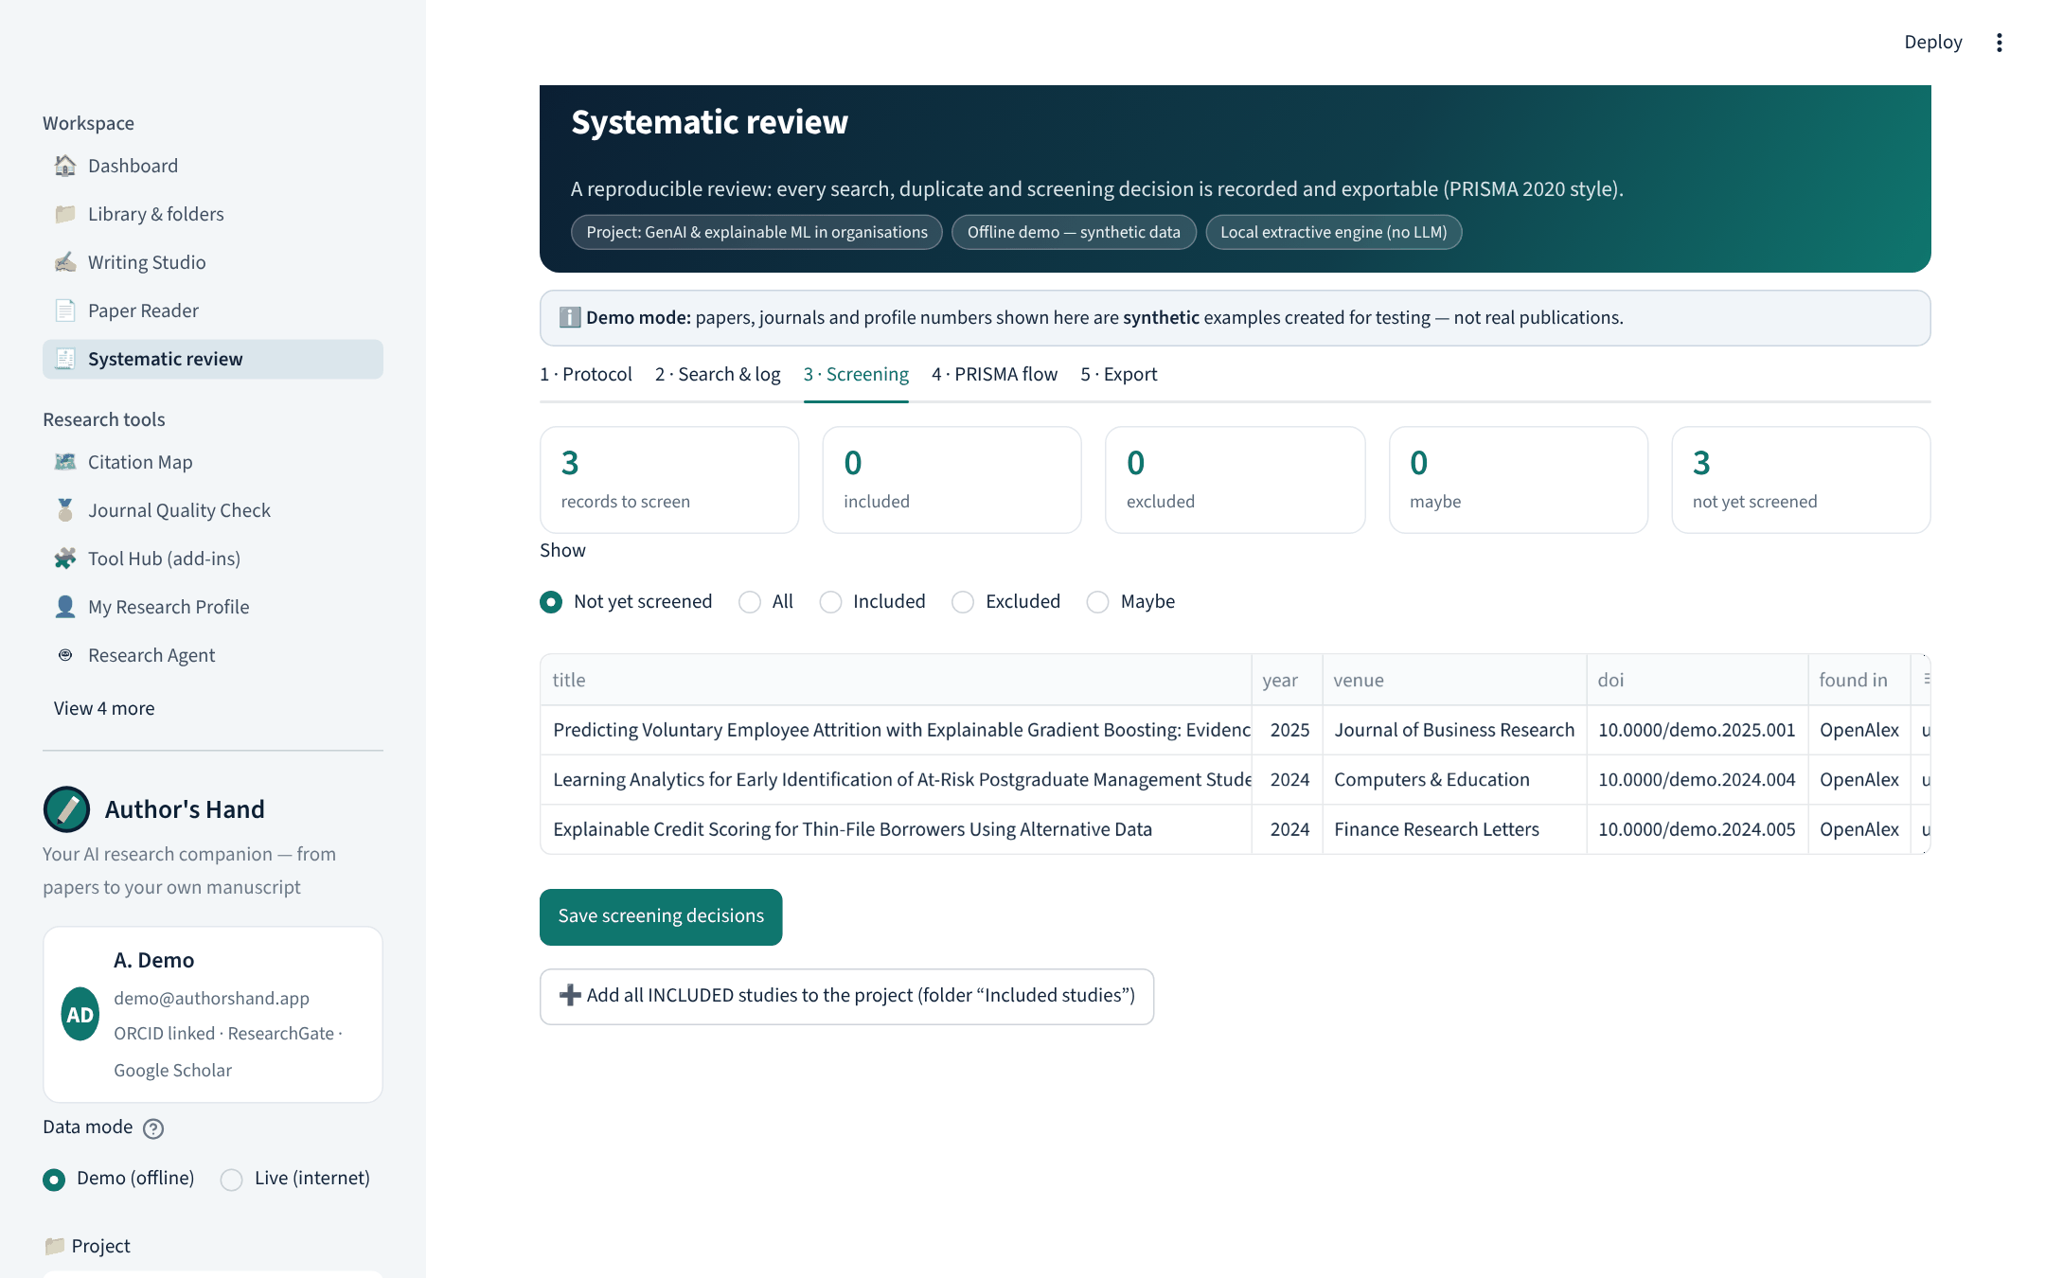
Screening with decisions and reasons
Include / exclude / maybe per record
Exclusion reason chosen from your protocol
Included studies move to a project folder

Slide 35
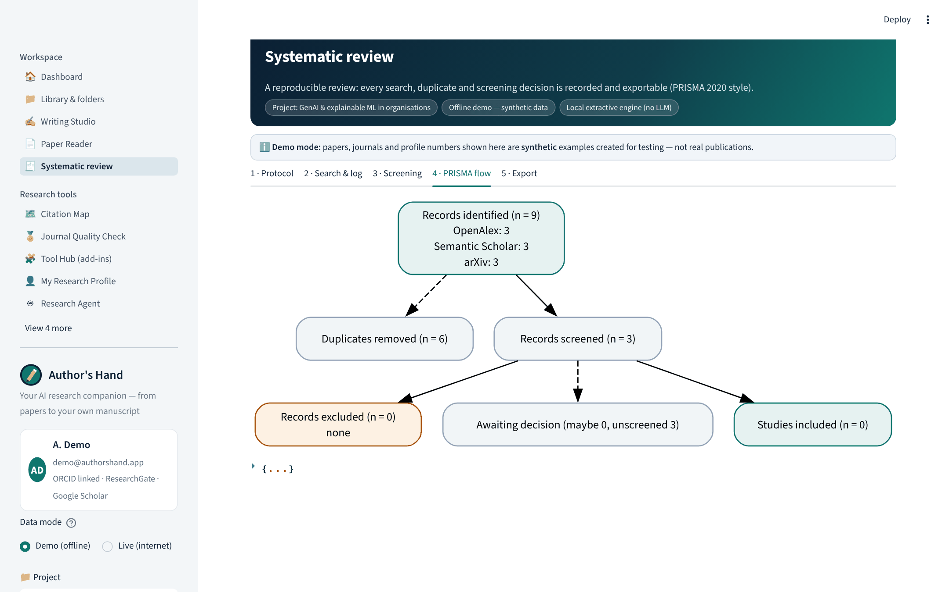
PRISMA 2020 flow — generated from the log
Records per database, duplicates removed with reasons
Screened, excluded (by reason), included
Updates as you screen

Slide 36
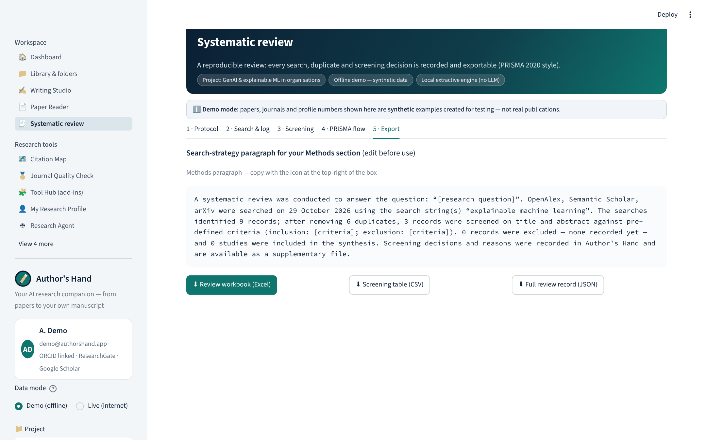
Review export: methods paragraph and full record
Copy-ready search-strategy paragraph
Excel workbook, screening CSV and JSON record
Supplementary file for journals

Slide 37
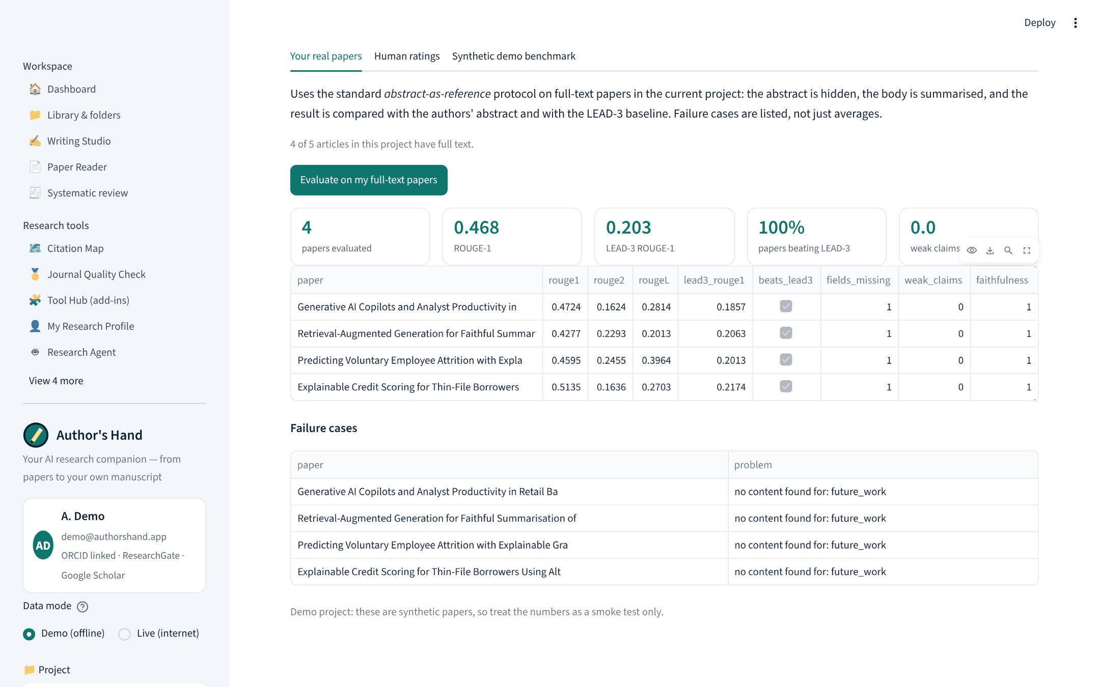
Evaluation on your own real papers
Abstract hidden, body summarised, compared with the authors’ abstract
LEAD-3 baseline per paper
Failure cases listed, not hidden
Human ratings tab: accuracy, usefulness, errors

Slide 38
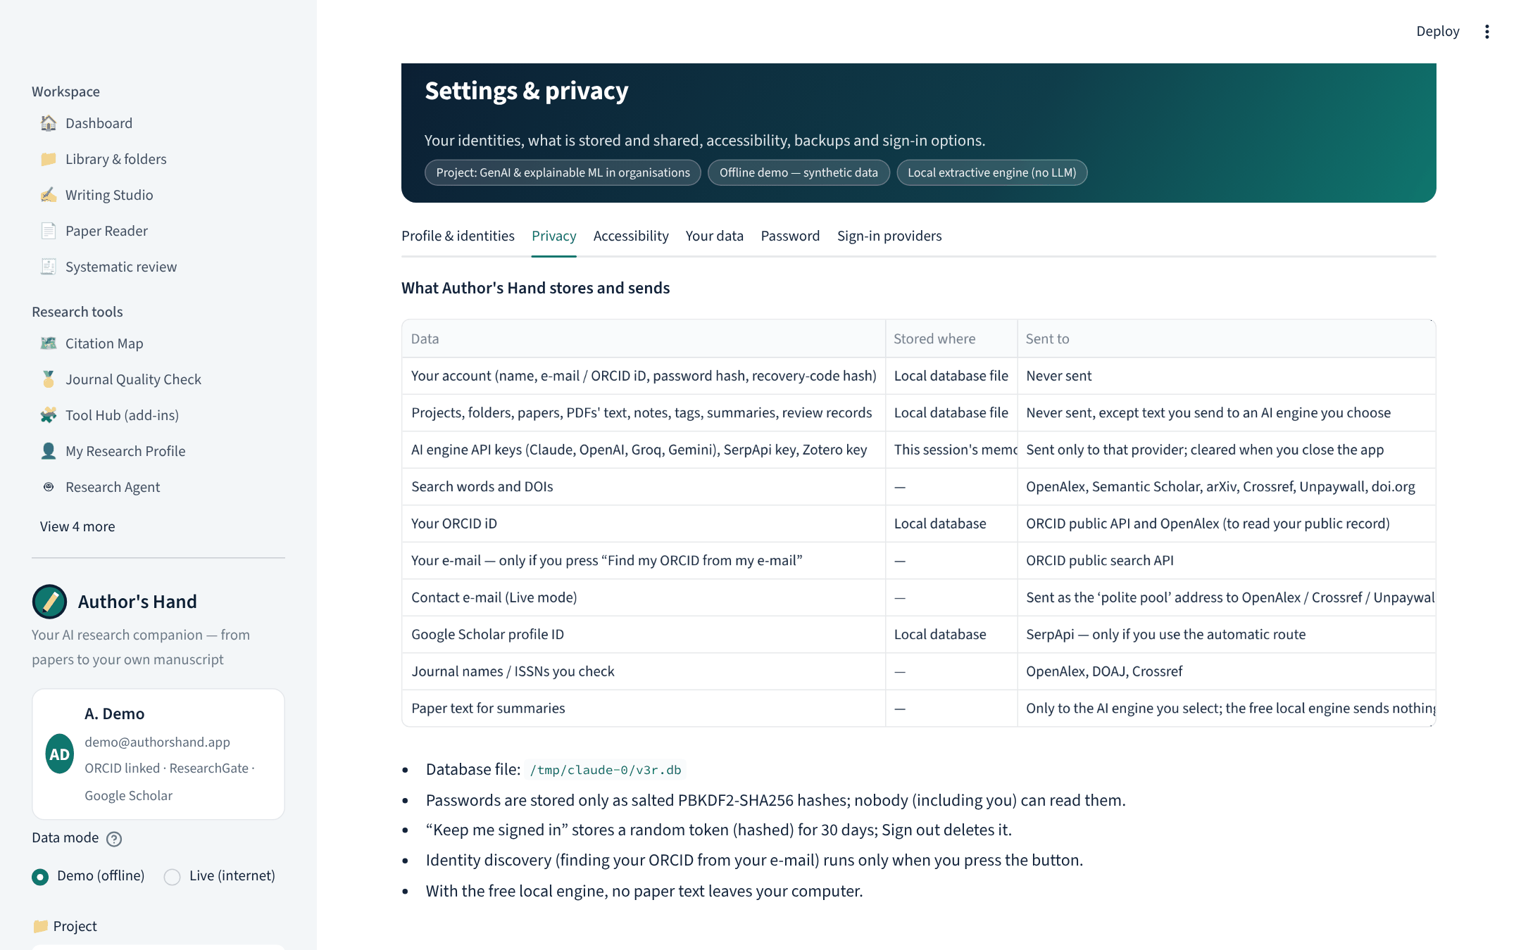
Privacy: what is stored and what is sent
Table of every data item, where it is stored and where it goes
API keys kept in session memory only
Identity discovery only on request
Free local engine sends no paper text

Slide 39
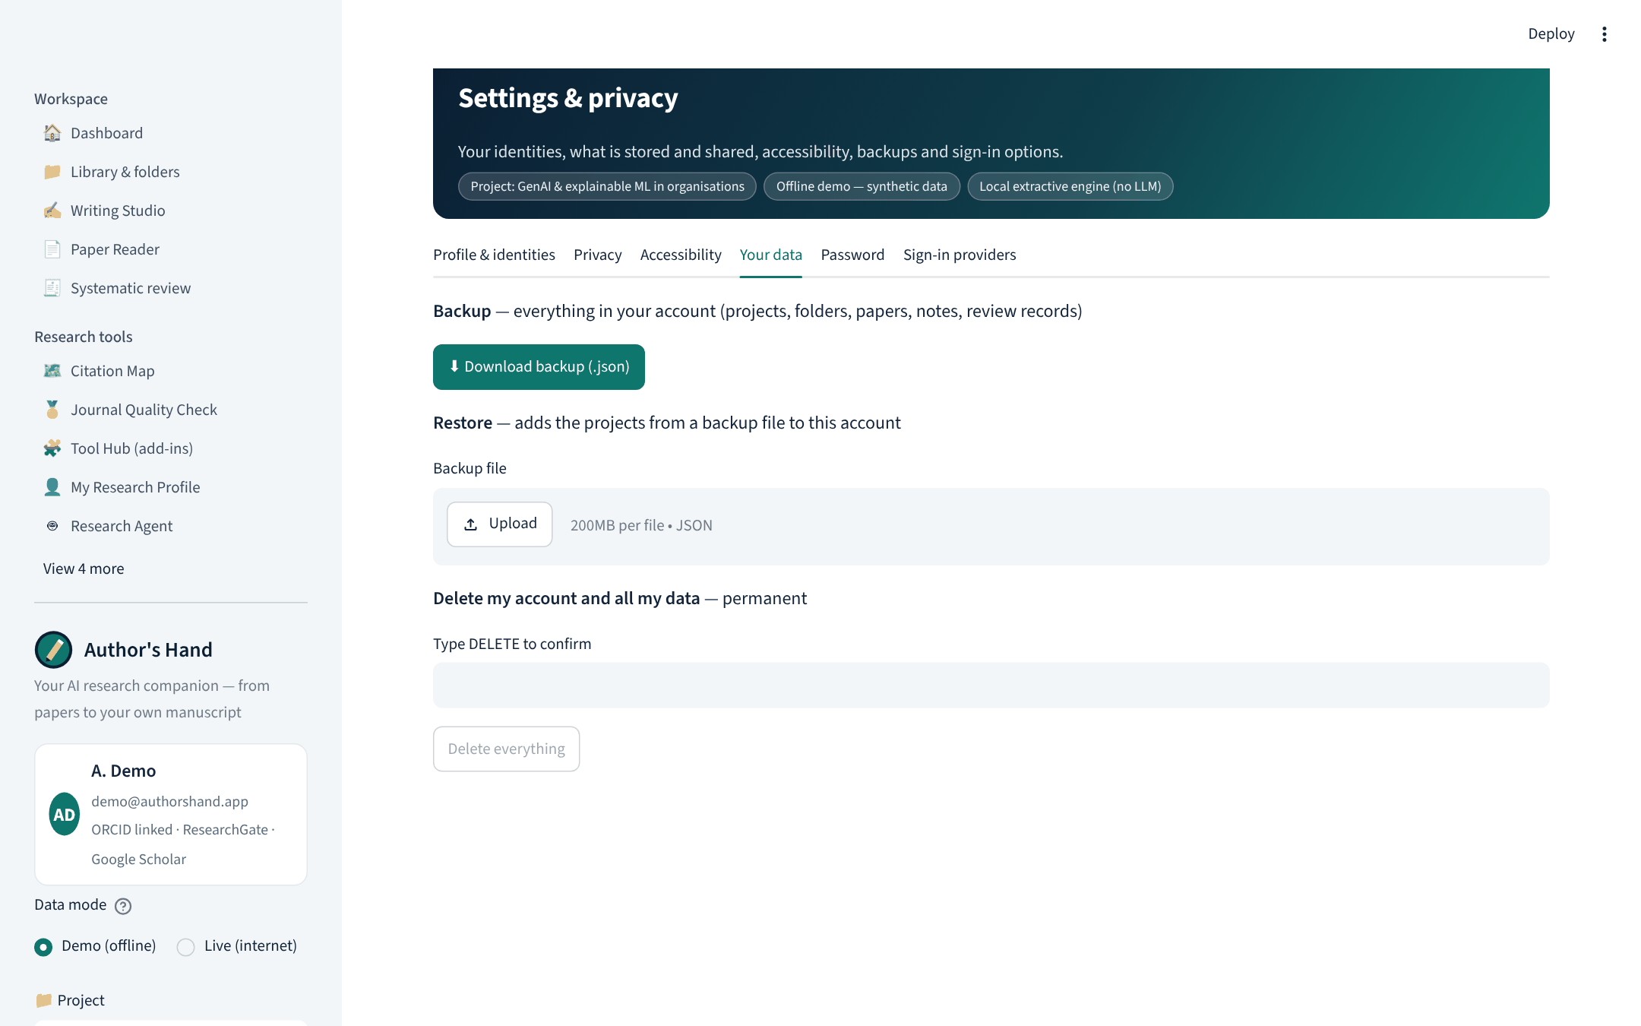
Your data: backup, restore, delete
Download the whole account as JSON
Restore into any installation
Delete account and all data (type DELETE)
Unlink ORCID, ResearchGate, Scholar, Zotero

Slide 40
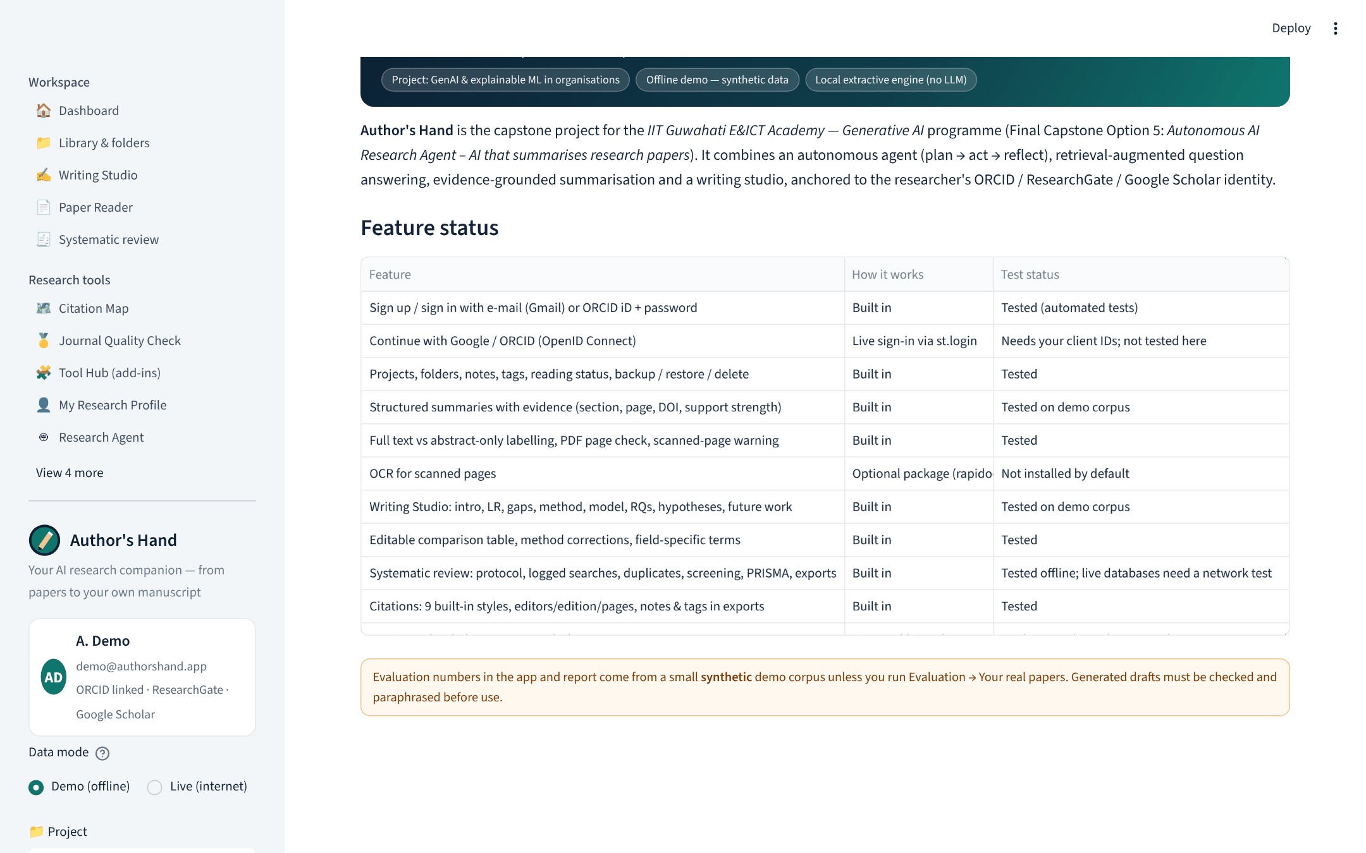
About: honest feature status
Each feature marked built-in, live API, link or file exchange
Test status for each
Synthetic-data warning repeated

Slide 41
Link to the Generative AI course, and my contribution
Prompting & structured output 9-field summaries, Writing Studio drafts, JSON parsing
MY CONTRIBUTION (student to complete)
LangChain one chat-model interface; tools exported as StructuredTools
Problem choice and requirements: [write here]
Design decisions I made: [write here]
Testing on my own papers and what I found: [write here]
Interpretation of results and limitations: [write here]
Embeddings & RAG TF-IDF ⊕ dense retrieval, cited answers, evidence grounding
Agents planner → tool calls → faithfulness gate → retry → trace
Evaluating generative output ROUGE vs LEAD-3, faithfulness, probes, human ratings
AI-assistance disclosure: parts of the code and text were drafted with an AI assistant, then reviewed, tested and edited by the student.
Deployment Streamlit, FastAPI, Docker, Windows app, Play Store kit

Slide 42

Challenges we hit, and how we solved them
ResearchGate has no public API
Hallucinated numbers in summaries
Scraping breaches its terms. We link the profile URL (auto-found on ORCID) and import the user’s own BibTeX/RIS export, then de-duplicate.
Claim-level grounding with a faithfulness score, a self-verification pass and a strict-mode retry loop.
Messy PDFs and inconsistent headings
Same work from many sources
Canonical section mapping (11 sections, 60+ heading variants), wrapped-title detection, de-hyphenation, unstructured fallback.
Merge by DOI, then fuzzy title (≥ 0.92); keep the richest fields and record provenance.
Cost and access to LLMs
Most AI tools have no public API
Local extractive engine by default; one LangChain layer for Claude, OpenAI, Groq, Gemini and Ollama.
Litmaps, SciSpace, JANE etc. are attached honestly: pre-filled launch links and BibTeX/RIS exchange; Zotero, ORCID, OpenAlex, DOAJ via real APIs.

Slide 43
Next: from capstone to research-office tool
Read tables & figures
Stronger verification
Citation snowballing
Multimodal parsing so numbers in tables are summarised and grounded too.
LLM-judge / NLI entailment in place of TF-IDF support; SciFact & arXiv benchmarks.
Expand reviews through references and citing papers automatically.
Shared team projects
Real-paper study
Multilingual papers
Co-author workspaces with roles and comments on top of the new accounts.
Run the built-in protocol on 30+ genuine PDFs with human ratings and report failures.
Summarise non-English literature with cross-lingual retrieval.
Deliverables: project.ipynb · app.py (Streamlit) · api.py (FastAPI) · report.pdf/.pptx · requirements.txt · README.md · Windows app · mobile/ Play Store kit · Dockerfile · 33 unit tests

