Slide 1



Ad Hoc Insights
PRESENTATION
By Kamna

Slide 2




About
Company
Atliq Hardware (imaginary company) is one of the leading computer hardware producers in India and well expanded in other countries too.
Problem Statement
Management need insights about their sales and financial analysis insights to make quick and smart data-informed decisions.

Slide 3
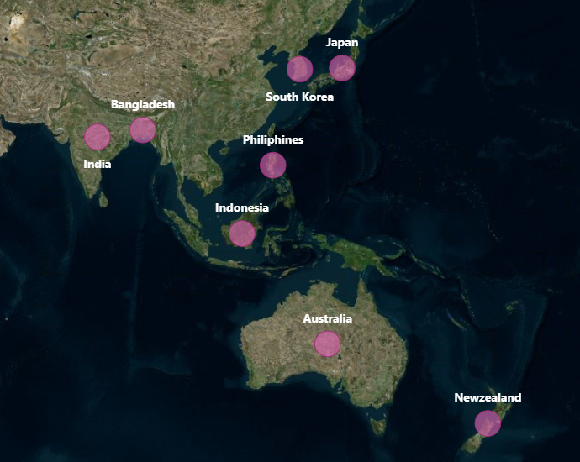
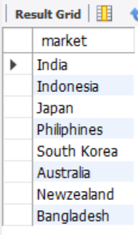
Ad Hoc Requests Insights
1. Provide the list of markets in which customer "Atliq Exclusive” operates its business in the APAC region

Slide 4
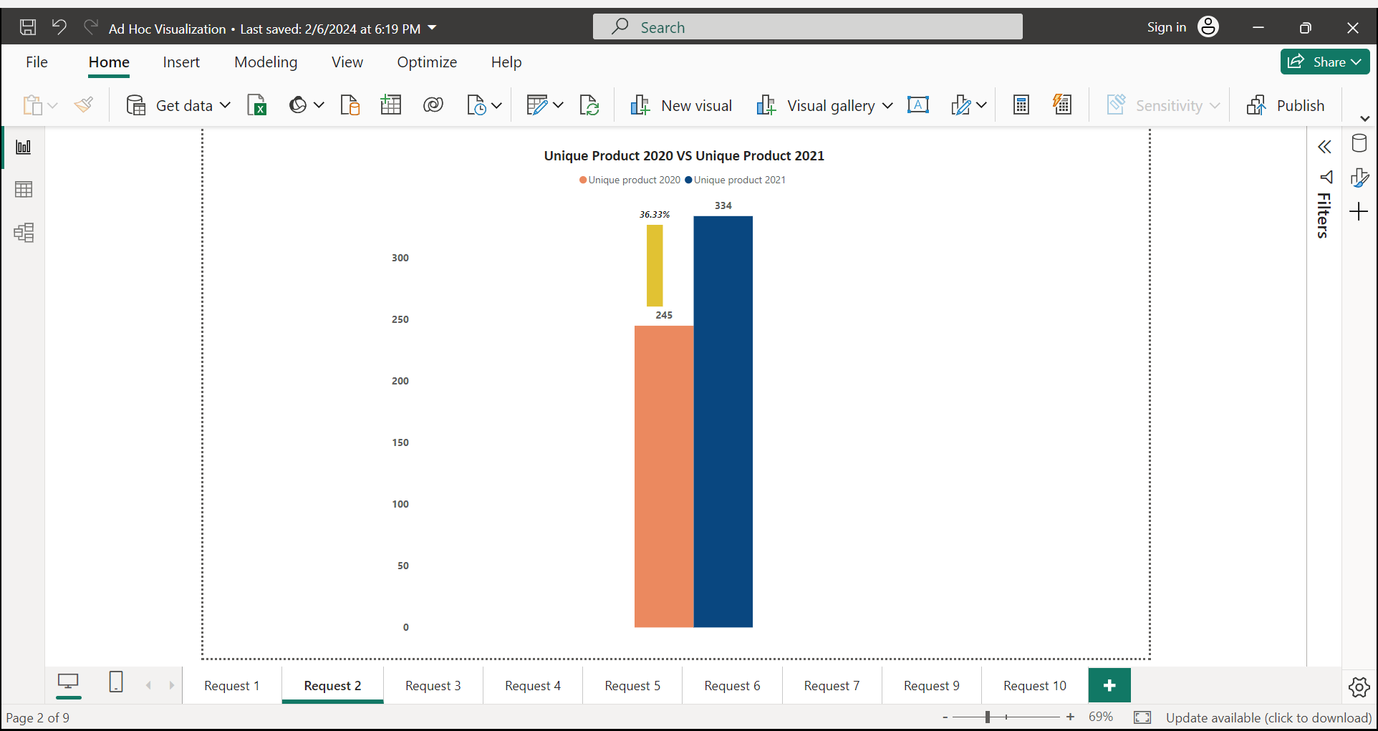

2. What is the percentage of unique product increase in 2021 vs 2020?
Insights
There is 36.33% growth in unique products in year 2021. Thus, demand and production of products is increased.

Slide 5
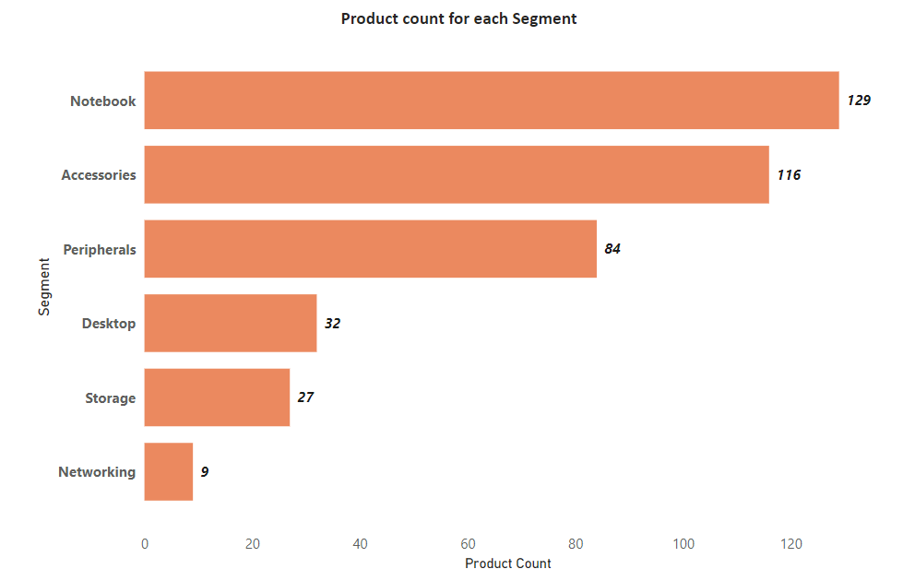
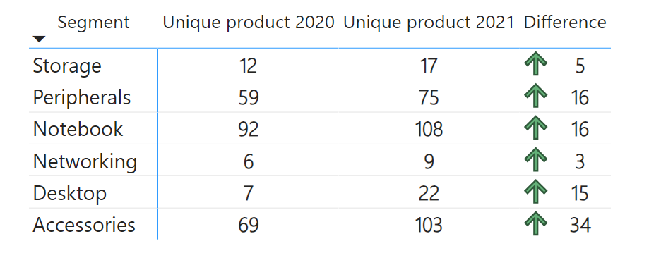
3. Provide a report with all the unique product counts for each segment and sort them in descending order
Top segments are Notebook and Accessories Storage and Networking segment are not performing well
4. Segment with most unique products in 2020 vs 2021
Every segment has significant growth in unique products in 2021

Slide 6


5. Get the products that have the highest and lowest manufacturing costs
AQ HOME Allin1 Gen 2
A6120110206
AQ Master wired x1 Ms
A2118150101
Highest Manufacturing Cost - $240.54
Lowest Manufacturing Cost - $0.89

Slide 7
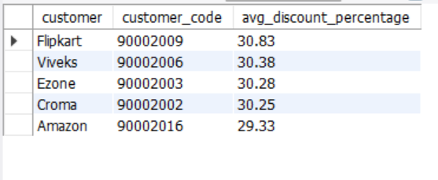
6. Generate a report which contains the top 5 customers who received an average high pre_invoice_discount_pct for the fiscal year 2021 and in the Indian market

Slide 8
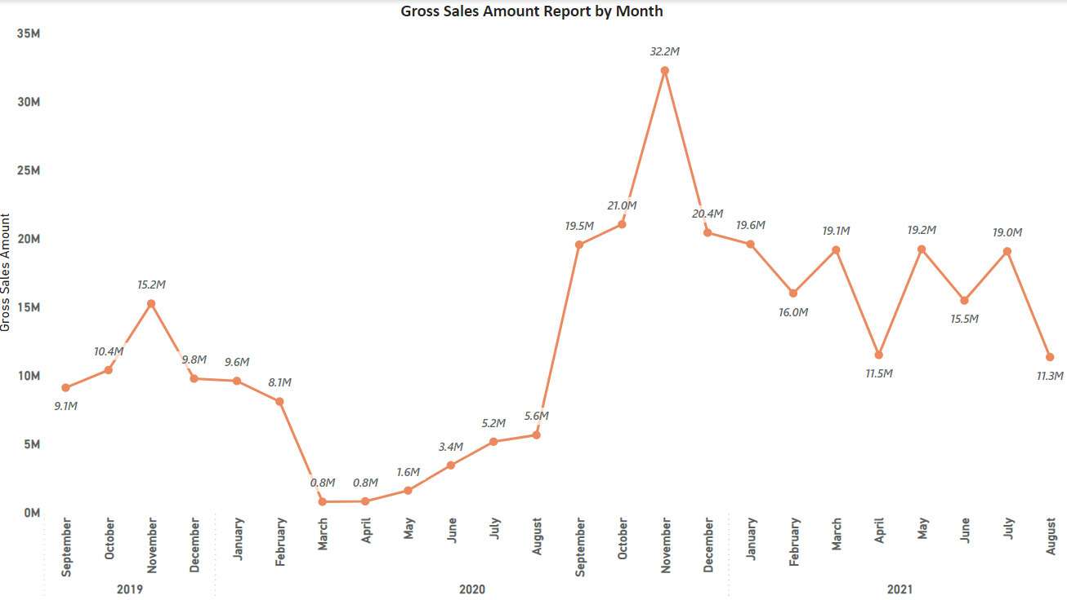
7. Get the complete report of the Gross sales amount for the customer “Atliq Exclusive” for each month
Gross Sales amount is lowest during March –April 2020 because of Covid
After pandemic gross sales amount increased
Highest gross sales amount in November 2022

Slide 9
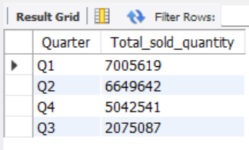
8. In which quarter of 2020, got the maximum total sold quantity
Q1 i.e., Quarter 1 of 2020 has the highest sold quantity
Q3 has the lowest sold quantity, it consist of months March, April and May
The main reason for Q3 decline is due Covid

Slide 10
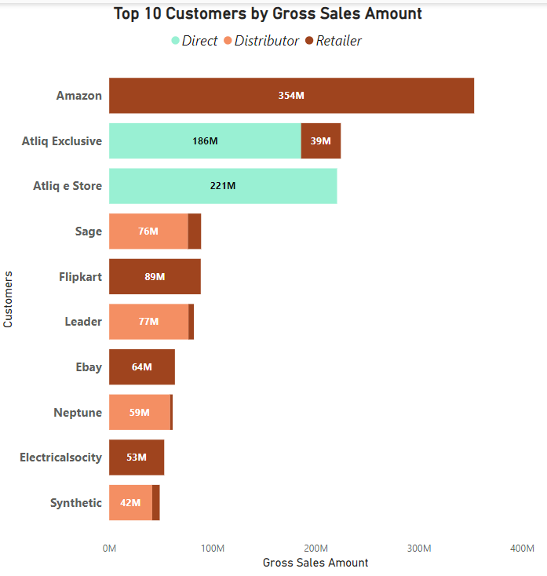
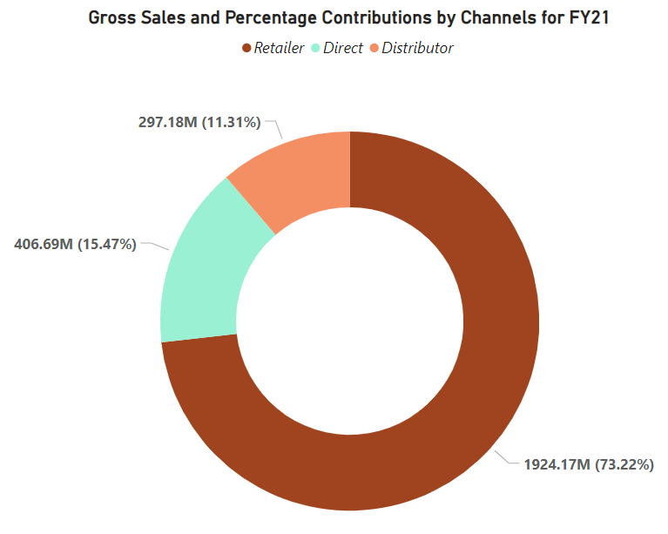
9. Which channel helped to bring more gross sales in the fiscal year 2021 and the percentage of contribution
Retailers contributed mostly in the business and has the highest gross sales

Slide 11
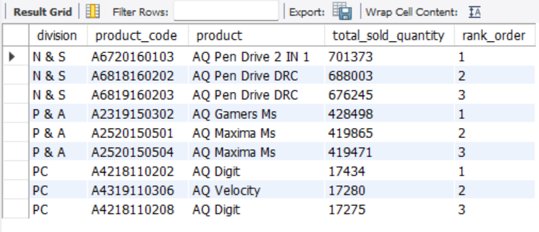
10. Get the Top 3 products in each division that have a high total sold quantity in the fiscal year 2021

Slide 12
Recommendations
2. Quantities sold in PC division is the lowest as compared to other divisions
Atliq hardware should put more efforts in understanding their consumers and expand product offerings to cater to a wider range of consumers needs
They can provide more product placement fees at physical stores so that their product is placed at prime location of the store
Invest in technological advancements to stay ahead of their competition
1.Networking & Storage segment has the lowest product count & slower growth
Atliq hardware can -
Research on current trends as well as needs and introduce some new products in Networking and Storage segments
Upgrade Discounts
Extended Warranty
Free Installation of product

Slide 13

THANK YOU

