Slide 1

PreSareeFinder – Budget-Based Saree Discovery Platform for Hyderabad
Student Name: Kamtam Priyanka
Student ID: 2520090001
Dept: CSIT
Section: 8
Under the Guidance
of
Supervisor Name: Dr Jayaram Boga & Balaiah Gudipudi
Assistant Professor
Department of CSIT

Slide 2
Abstract
PreSareeFinder is a platform that helps users explore saree collections from Hyderabad stores before visiting shopping malls. Customers can browse sarees based on budget and style such as silk, cotton, or designer sarees, save favourites, add items to cart, and view billing details. Store admins can add new sarees, update prices, and manage stock. The project combines Front-End Web Development and Data Structures & Algorithms, using HTML, CSS, JavaScript, and local Storage for the interface and data handling, while searching, sorting, and data structures are used to efficiently manage saree information.

Slide 3
Existing System
There is no single platform to compare sarees across multiple Hyderabad stores.
Customers must visit each store physically to check saree designs, prices, and availability.
Store owners mostly manage inventory manually without any digital system.
There is no proper separation between customer browsing and store admin management.
Existing e-commerce platforms are complex and require backend servers, which small stores cannot easily maintain.
Traditional systems do not use efficient data structures or algorithms to organize, search, or manage saree information.
Small local Hyderabad stores lack a simple online presence to showcase their collections.
10-03-2026

Slide 4
Proposed System
A single platform that displays sarees from multiple Hyderabad stores in one place.
Role-based login system providing separate access for customers and store admins.
Customers can search sarees by name and filter by price or category using efficient searching methods.
Users can save sarees to Wishlist and add items to Cart for easy selection.
Store admins can add, edit, delete sarees and update stock details efficiently.
Data is managed using local Storage and organized using data structures and algorithms for faster retrieval.
The system provides a simple and responsive interface that works smoothly on desktop browsers.

Slide 5
System Architecture
Every page first loads saree data from browser storage or data structures when it opens.
The system then checks the user role (Customer or Admin) after login.
If an unauthorized user tries to access a page, they are redirected back to the login page.
Customers can view saree cards, search, and browse collections, while admins see their store’s inventory management panel.
Any change made by an admin (add, update, delete sarees) is immediately updated in the system data.
Customers always see the latest saree information when they open or refresh the page.
Cart and Wishlist data are saved, so selected items remain available even after refreshing or reopening the application.

Slide 6
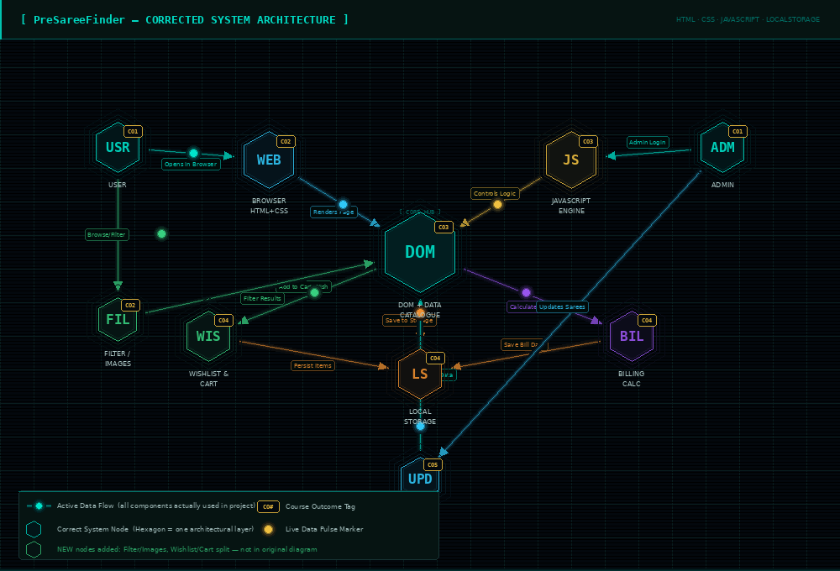
FWD System Architecture

Slide 7
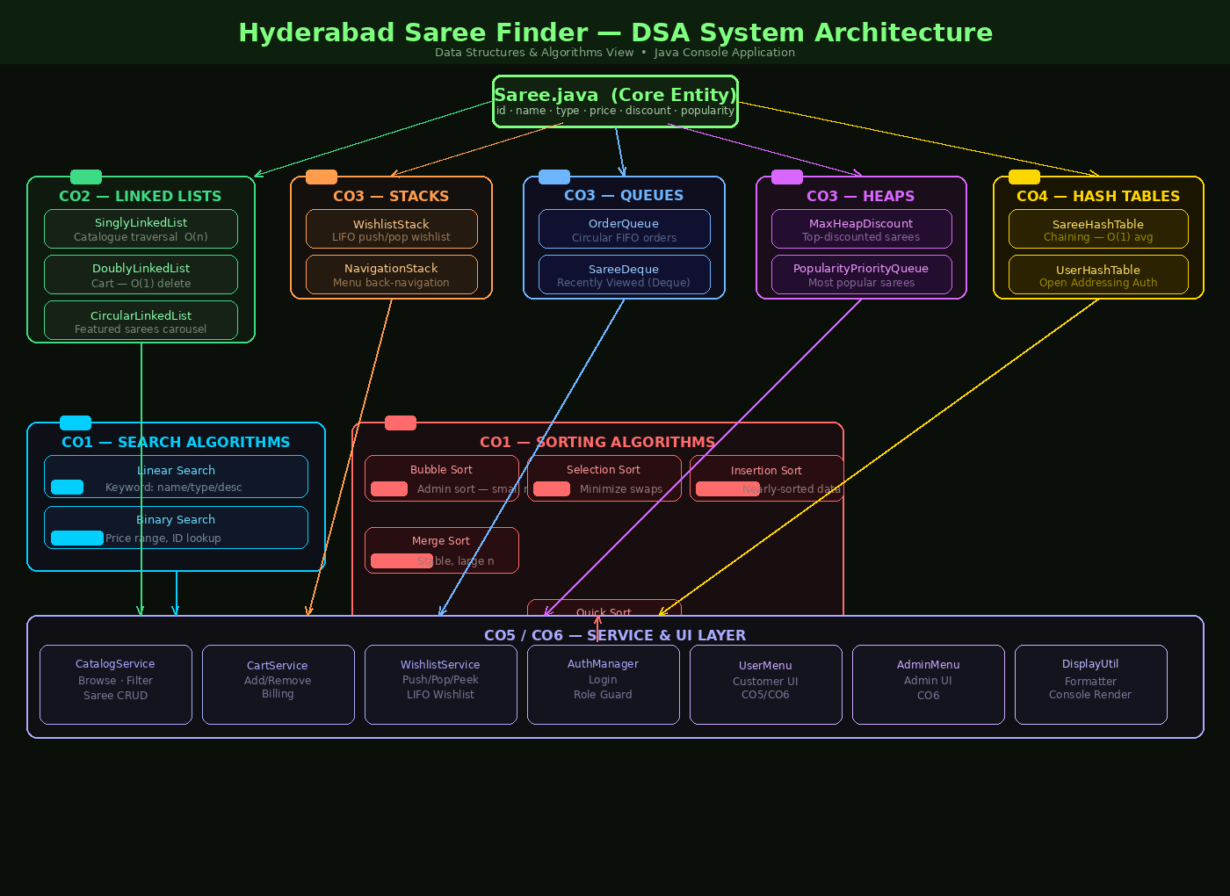
DSA System Architecture

Slide 8
Project Modules
User Authentication Module – Handles login and role-based access for customers and admins.
Saree Catalog Module – Displays saree collections with details like name, price, type, and store.
Search and Filter Module – Allows users to search sarees and filter by price or category.
Wishlist Module – Enables customers to save favourite sarees for later.
Cart Management Module – Allows users to add or remove sarees from the cart.
Billing Module – Calculates the total price of selected sarees.
Admin Management Module – Allows admins to add, update, or delete saree details.
Data Management Module – Stores and manages saree data (LocalStorage in FWD / Data Structures in DSA).

Slide 9
Objectives
Develop a single website that displays sarees from multiple Hyderabad stores in one place.
Provide separate login access for customers and admins.
Enable customers to search and filter sarees by name, price, and category.
Allow admins to manage store inventory by adding, editing, deleting sarees, and updating stock.
Maintain cart and wish-list data so it remains available even after refreshing the page.
Build a desktop-compatible web application that runs directly in the browser without installation.

Slide 10
Co’s Attainments - FWD
CO1: Developed a multi-page web application using HTML5, CSS3 and JavaScript
CO2: Implemented role-based login system for customers and store admins
CO3: Built saree browsing with search, filter and modal detail view
CO4: Implemented wish-list and cart using local Storage for persistence
CO5: Implemented admin CRUD operations with store-specific access control

Slide 11
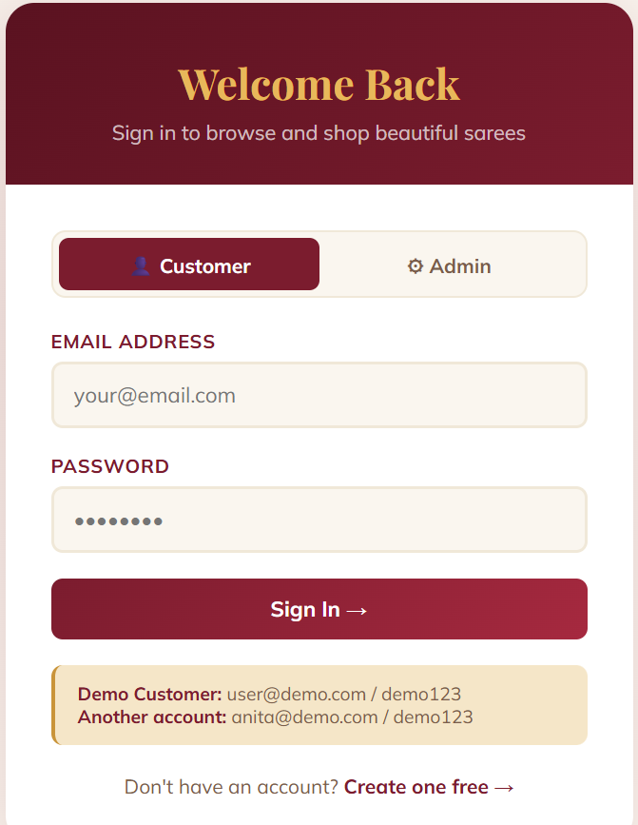
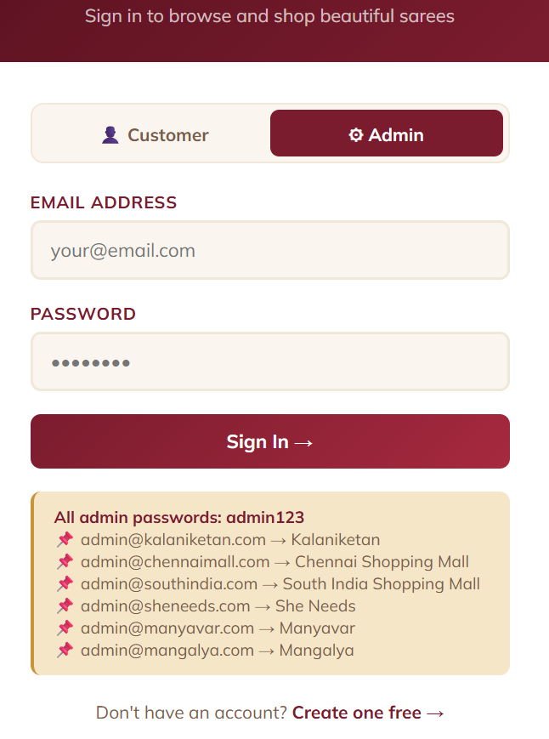
Login Page

Slide 12
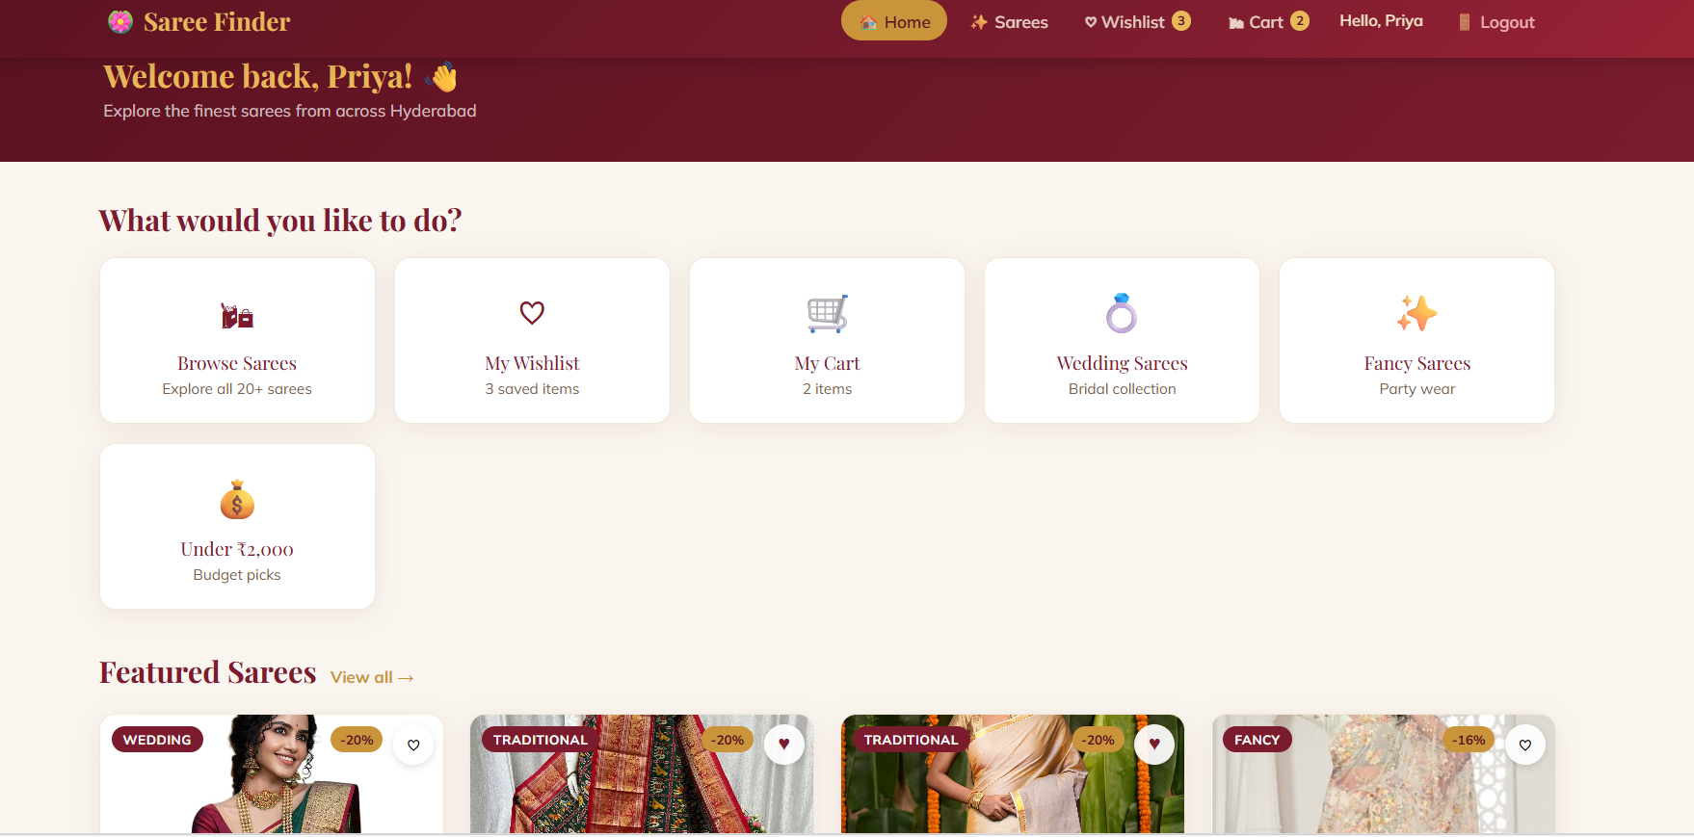
Welcome Page

Slide 13
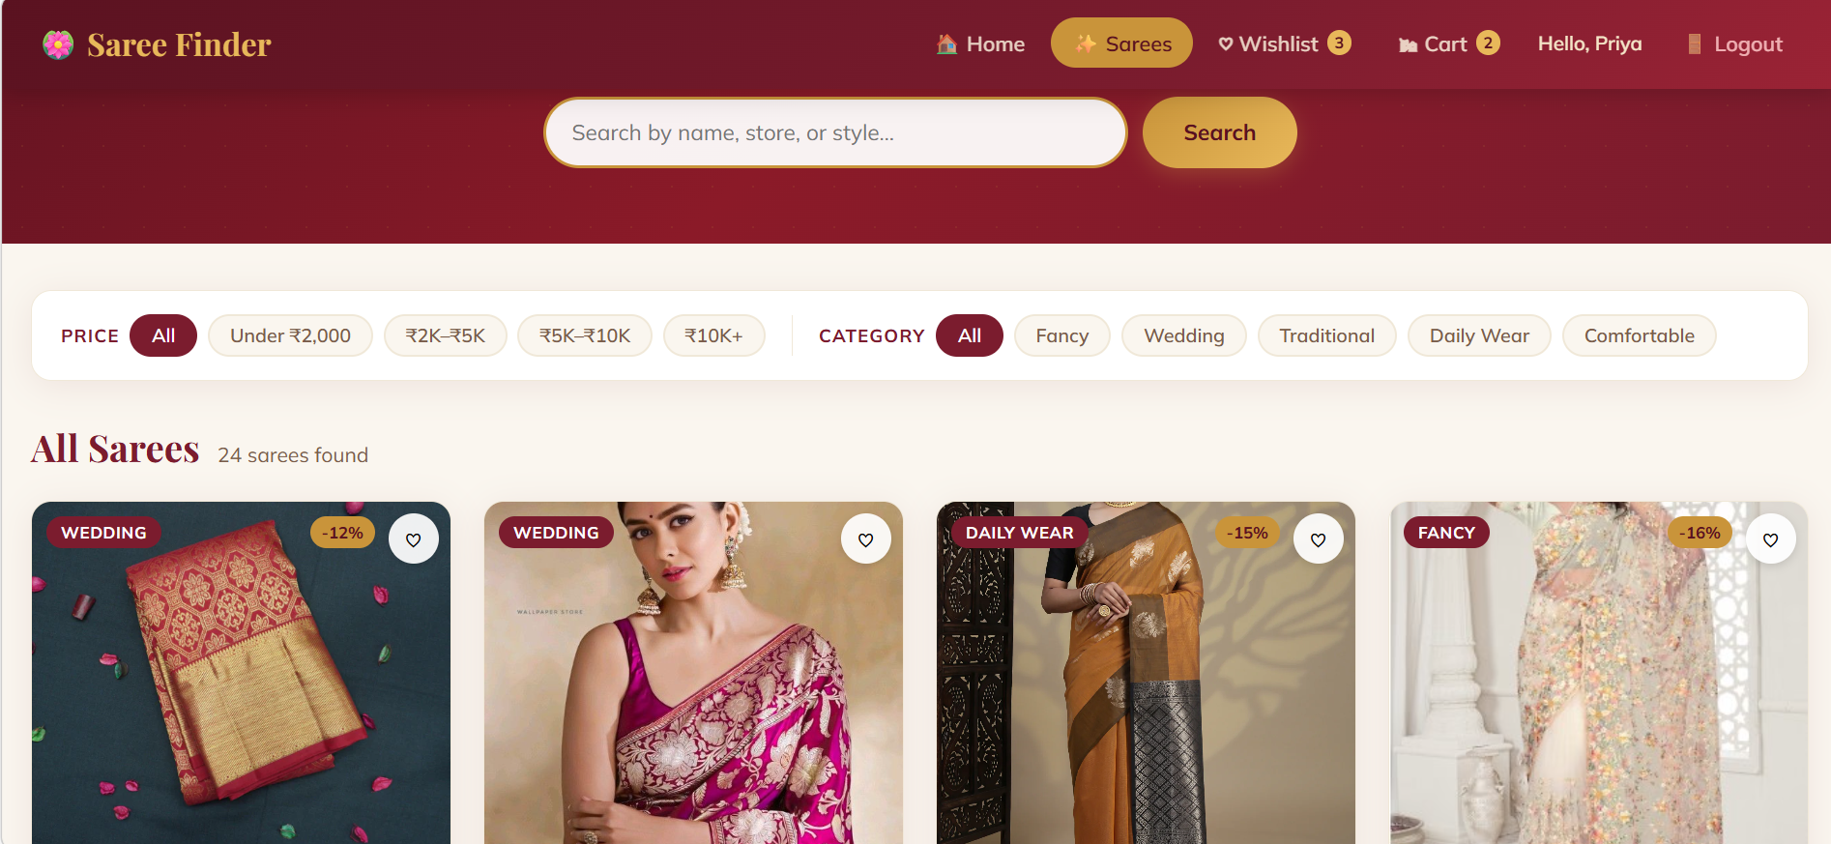
Search Page for Sarees

Slide 14
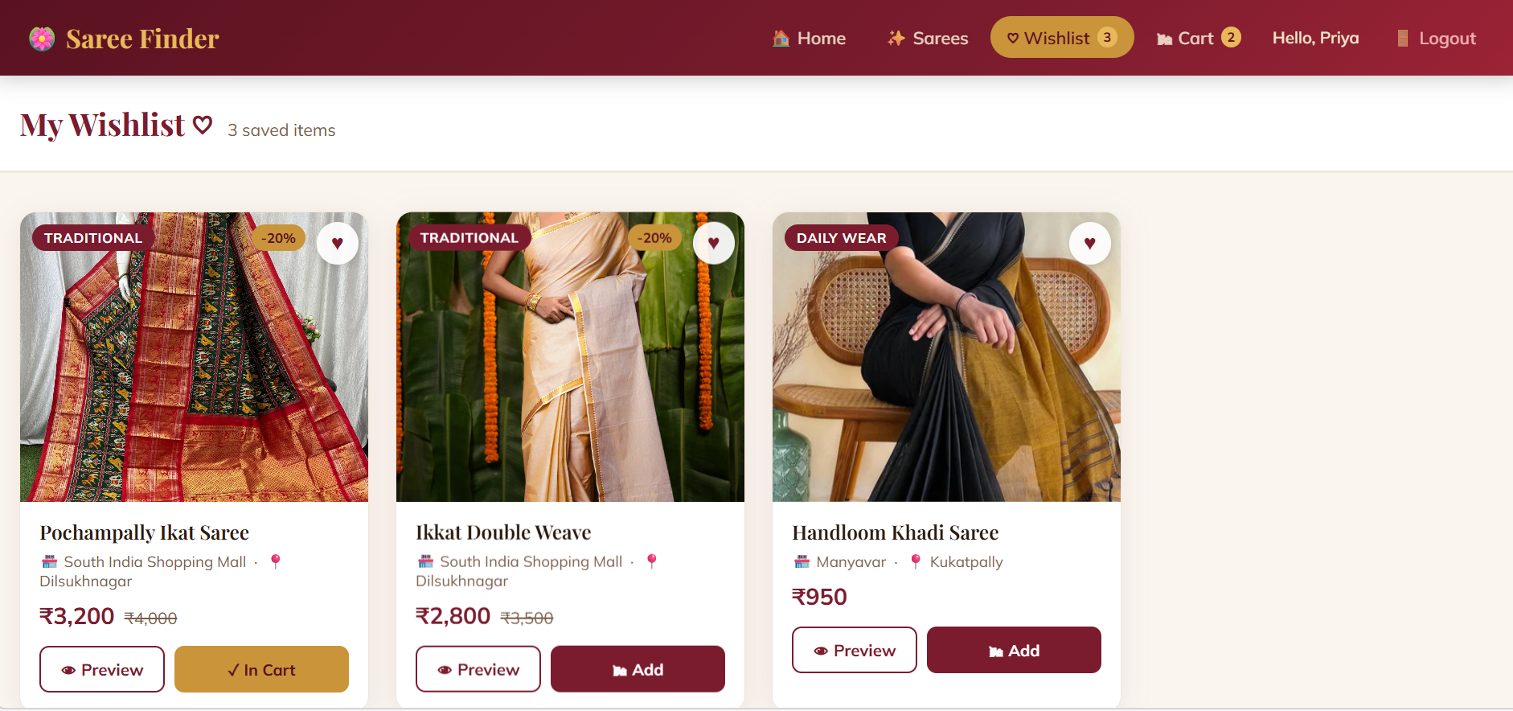

Wishlist Page

Slide 15
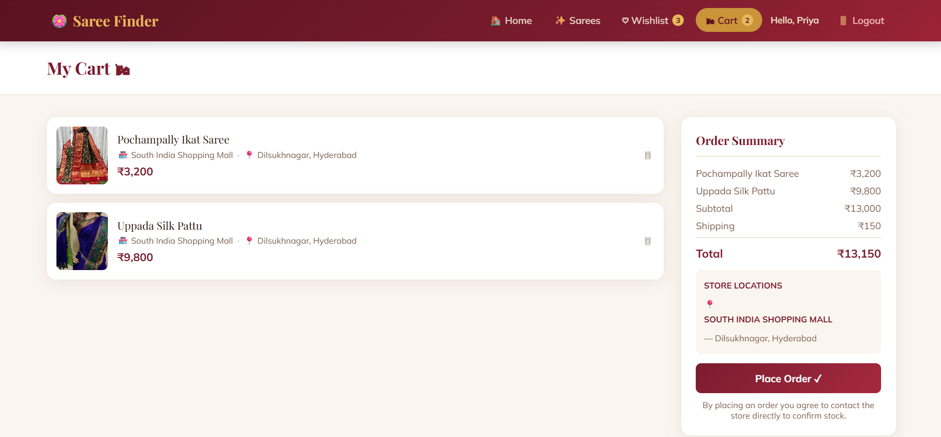
Cart

Slide 16
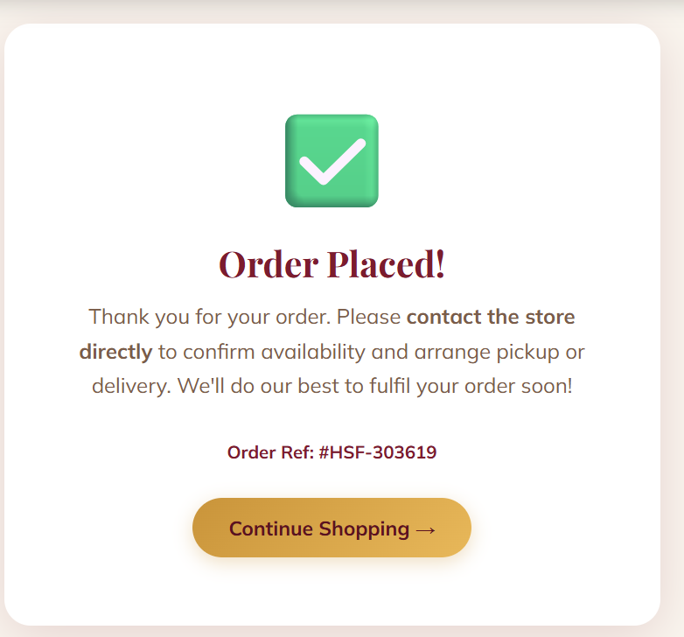
Advance Booking Process Status

Slide 17
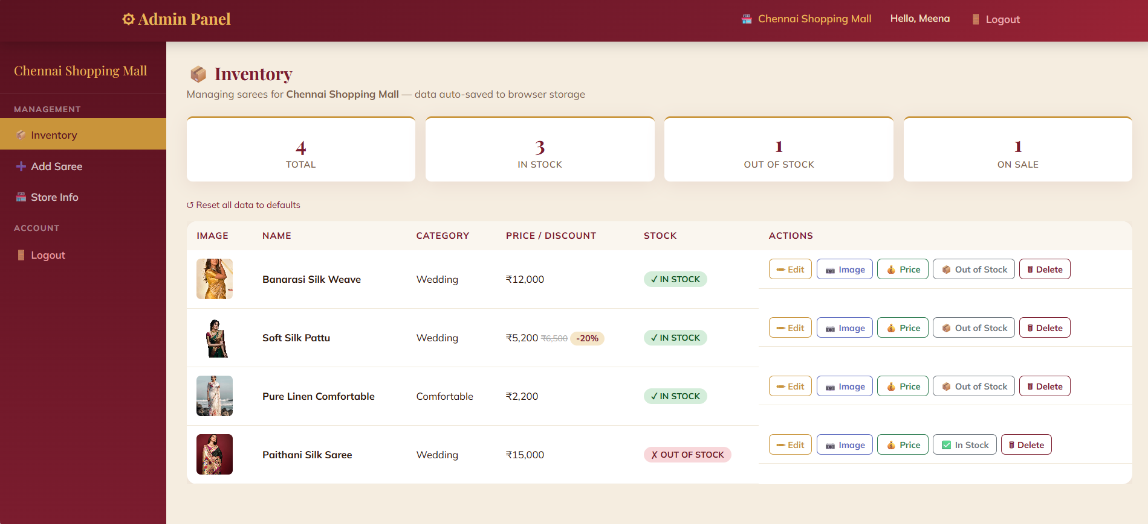
Admin Page

Slide 18
Co’s Attainments - DSA
CO1: Analysed problem statements and evaluated algorithm efficiency using Big-O notation and time complexity concepts.
CO2: Implemented searching and sorting algorithms (Linear Search, Binary Search, Bubble Sort, Selection Sort, Insertion Sort, Merge Sort, Quick Sort) to manage saree data efficiently.
CO3: Designed and implemented Abstract Data Types using arrays and linked lists to store and manipulate saree information.
CO4: Applied stacks and queues for functionalities like wishlist management and order processing.
CO5: Implemented hash-based data structures and priority queues to enable faster data retrieval and prioritized operations.

Slide 19
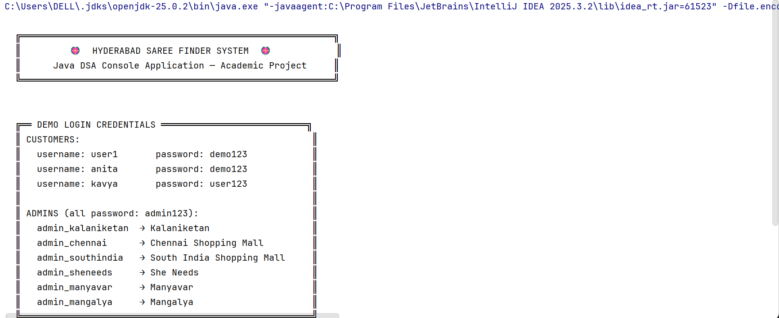
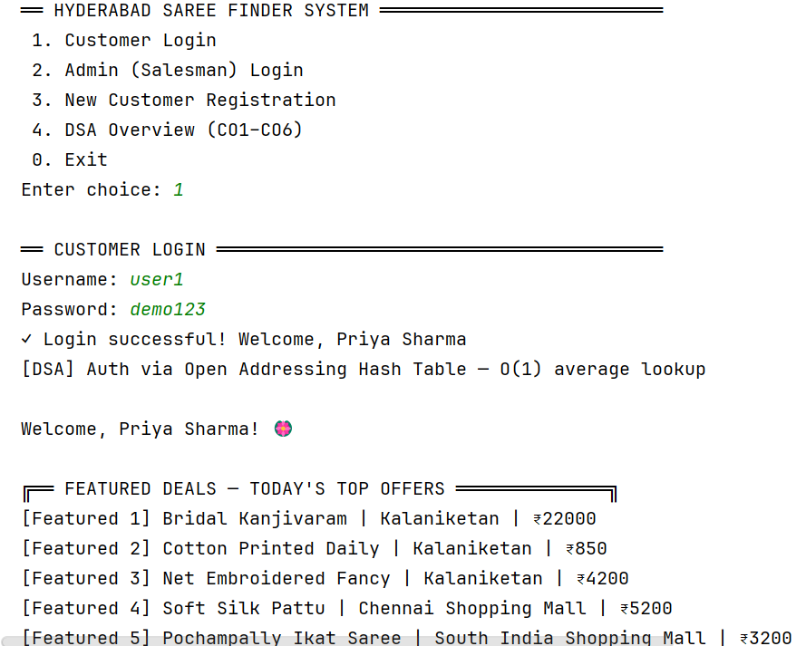
User Login

Slide 20
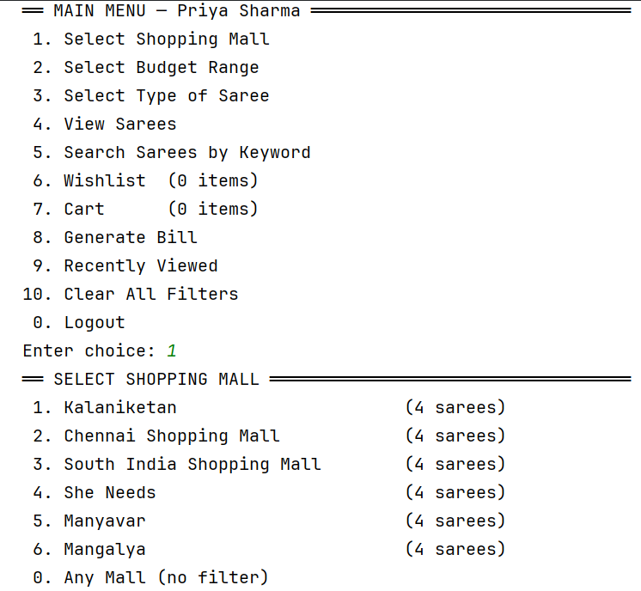
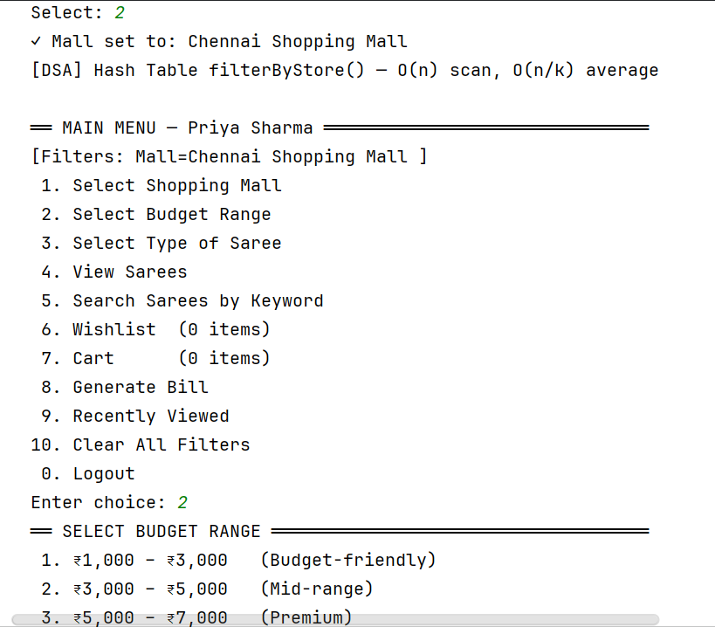
Mall And Budget Range Selection

Slide 21
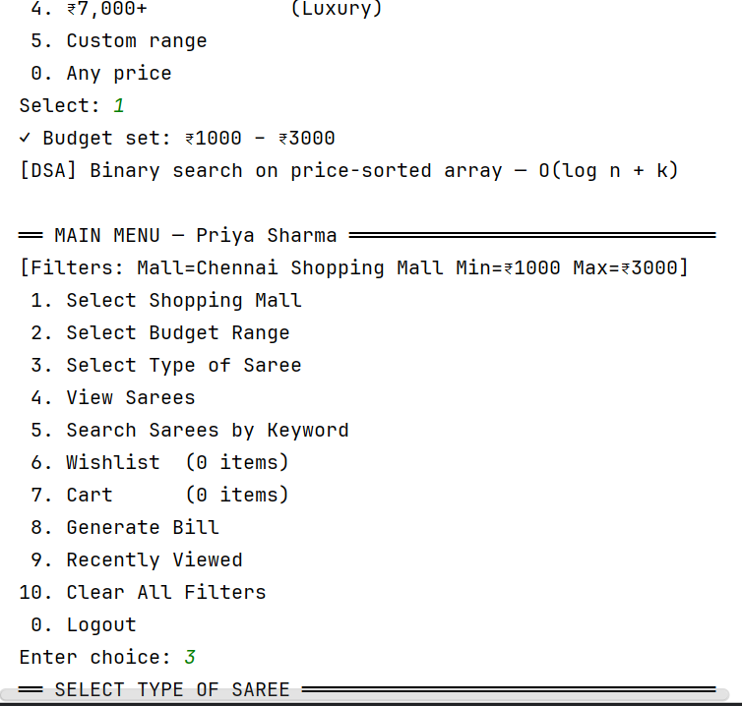
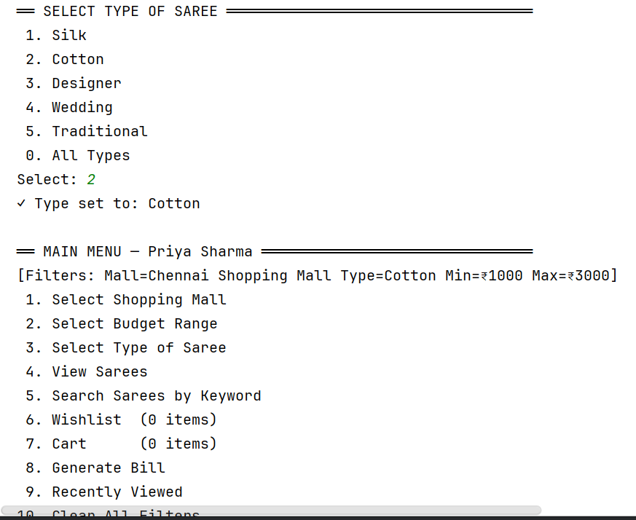
Type Of Saree

Slide 22
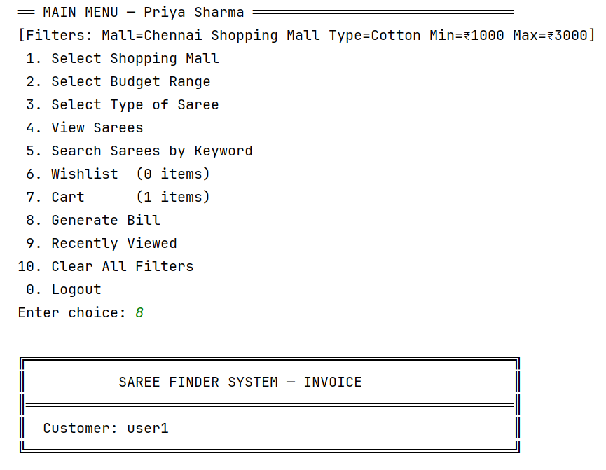
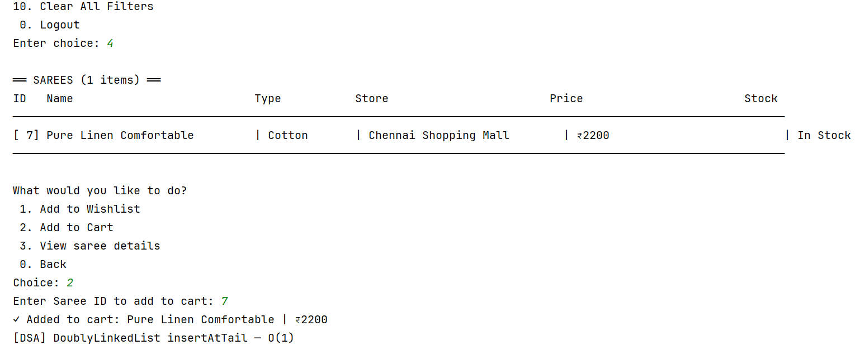
Option to add into Cart or Wishlist

Slide 23
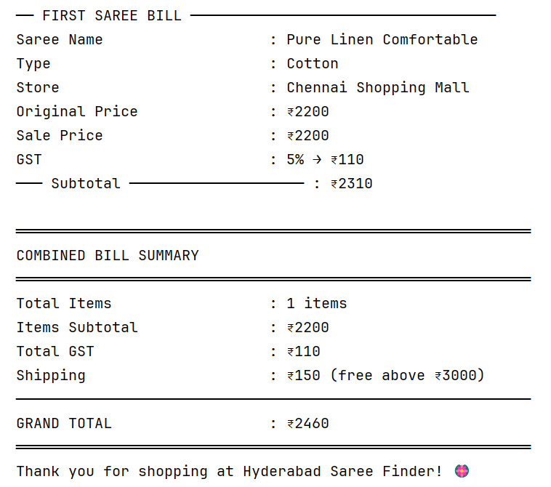
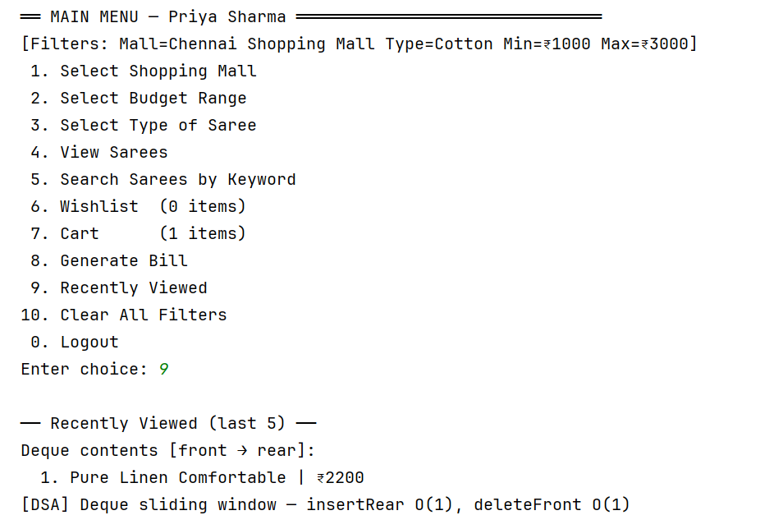
Display of Bill and Recently Viewed item

Slide 24
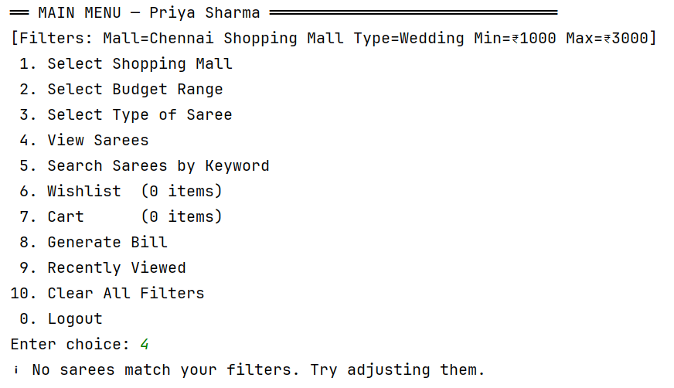
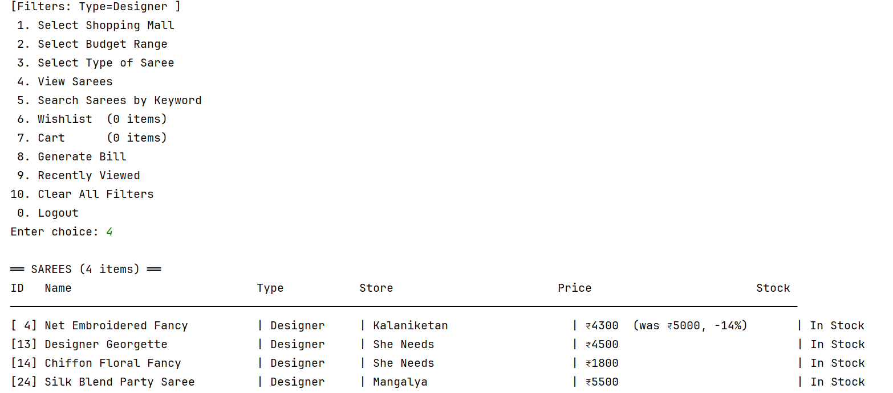
Some Sample Test Cases on Random raised questions:

Slide 25
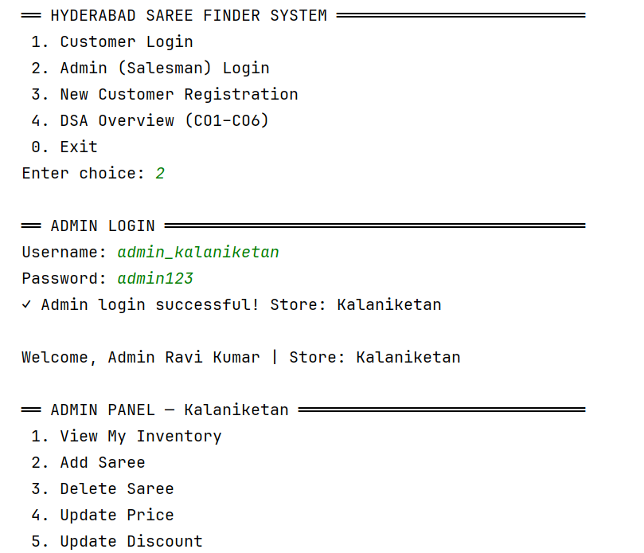
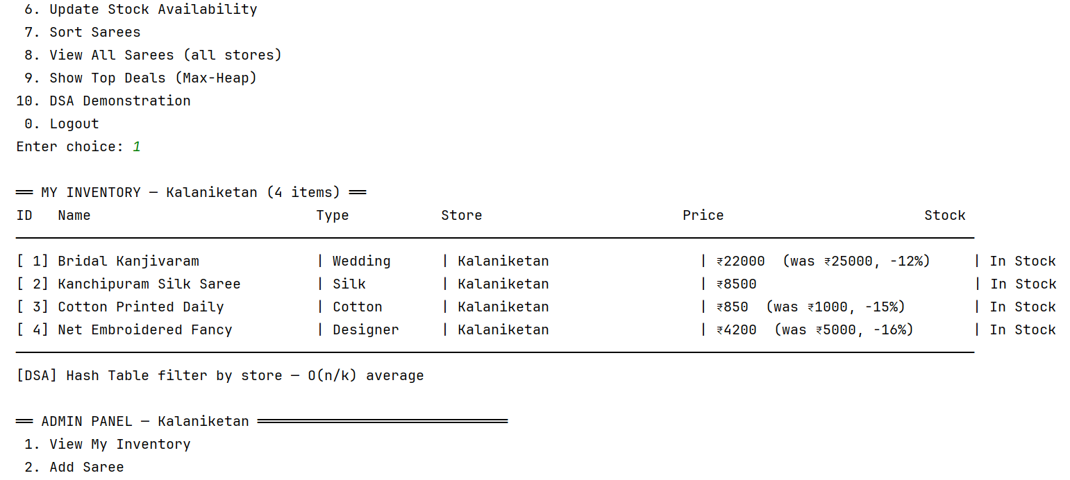
Admin Login and his Inventory

Slide 26
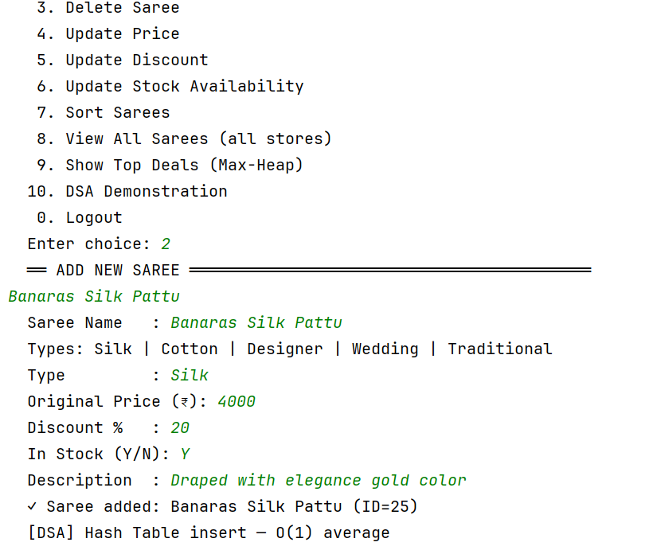
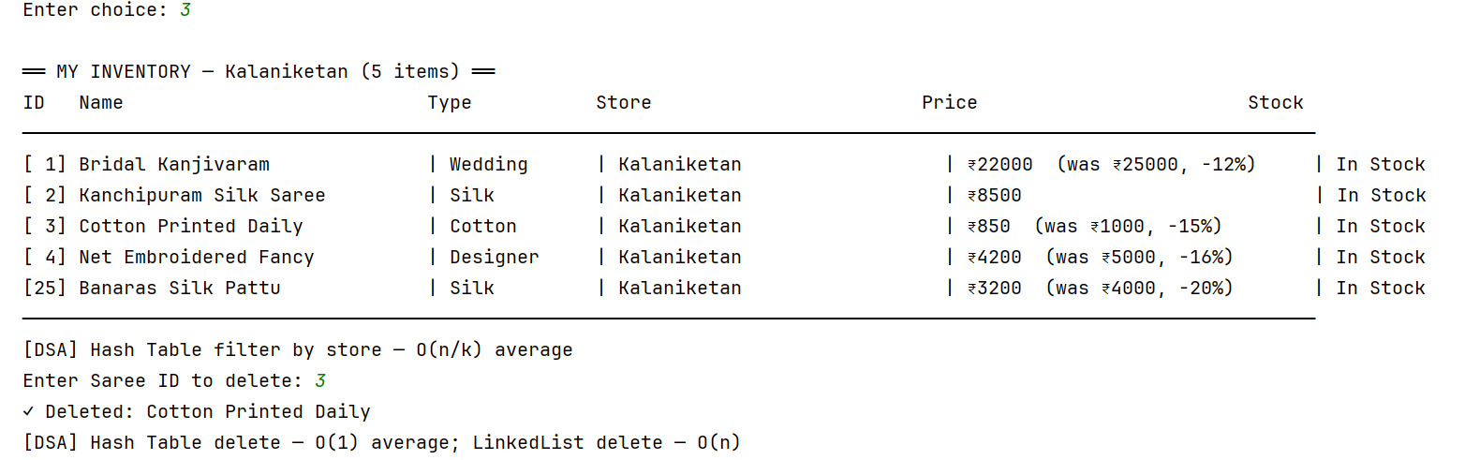
Addition of New Saree and Deletion

Slide 27
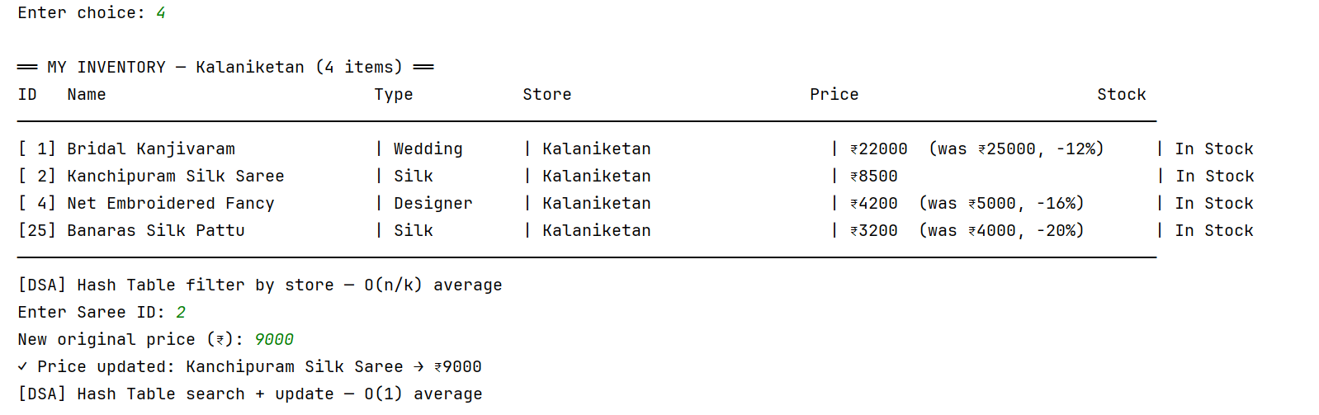
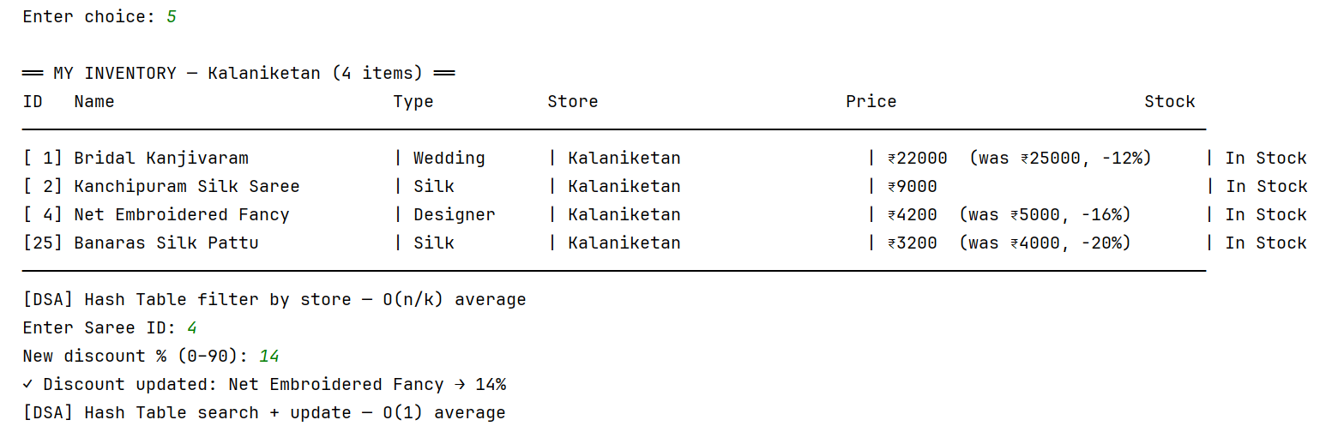
Updating Price and Discount

Slide 28
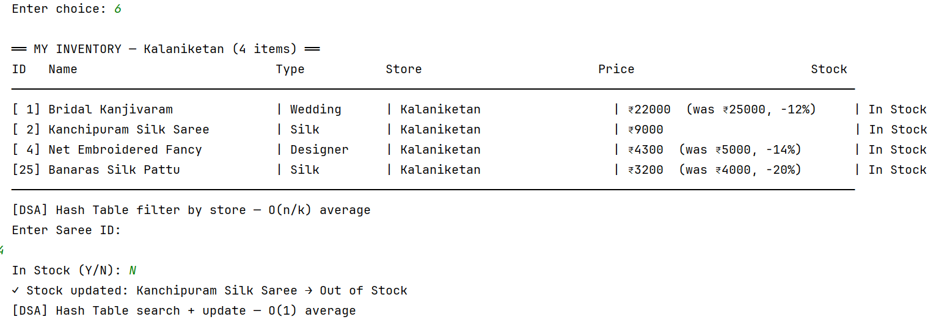
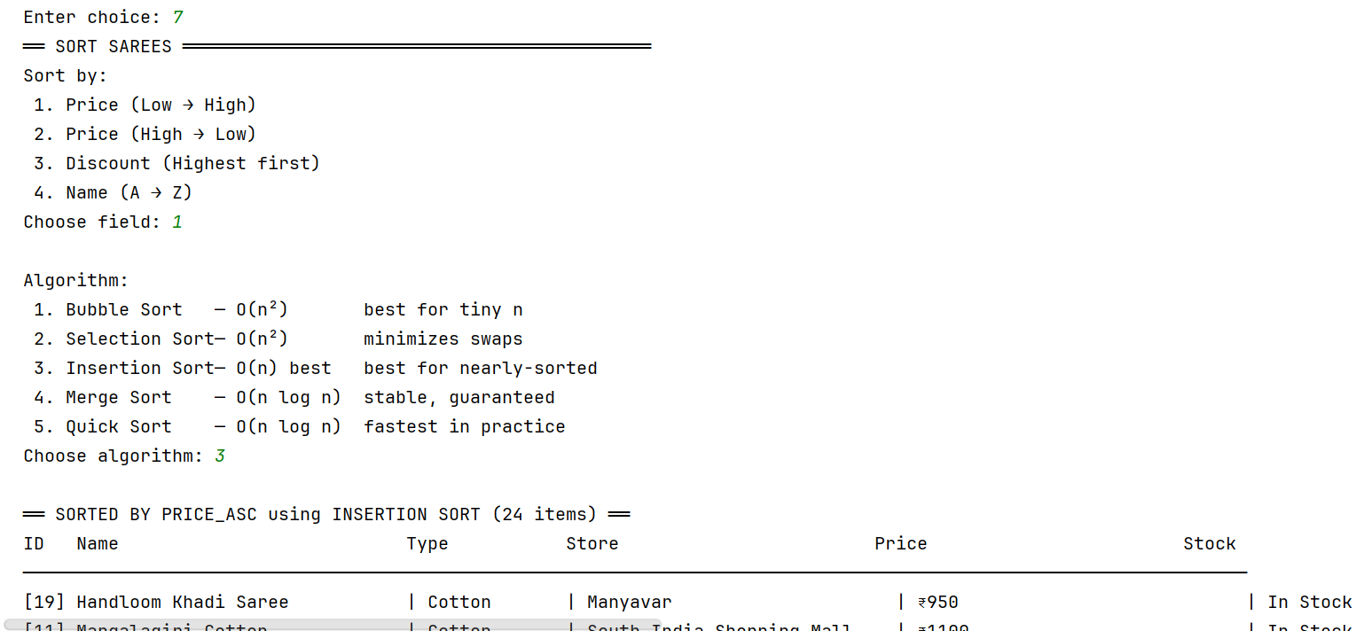
Stock Availability and Sorting Order

Slide 29
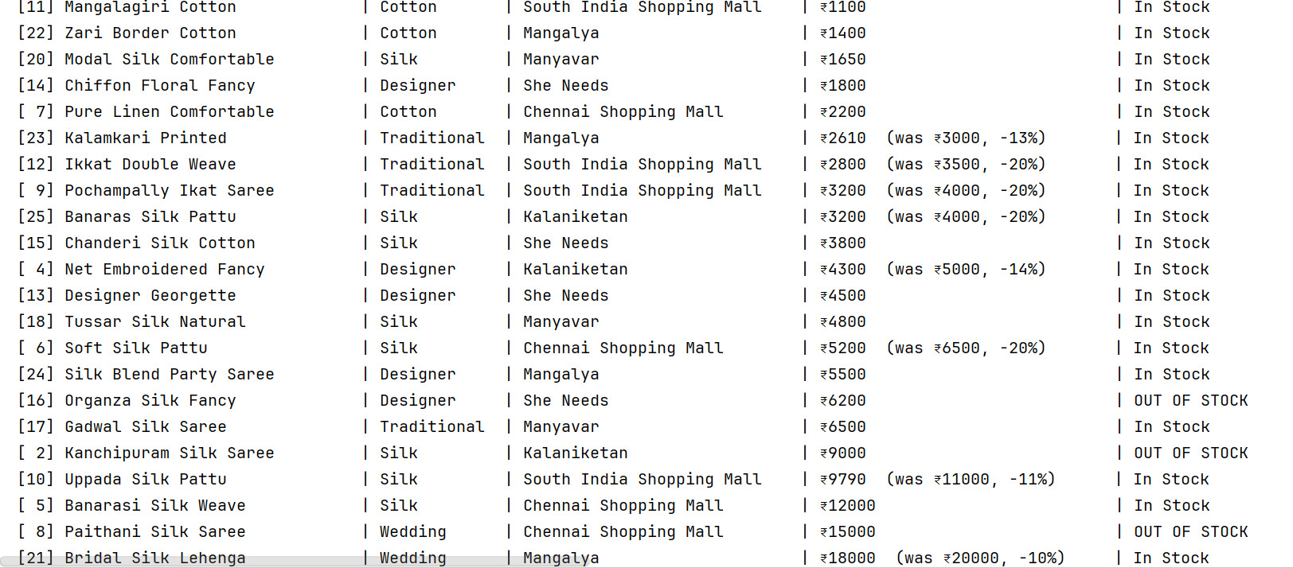
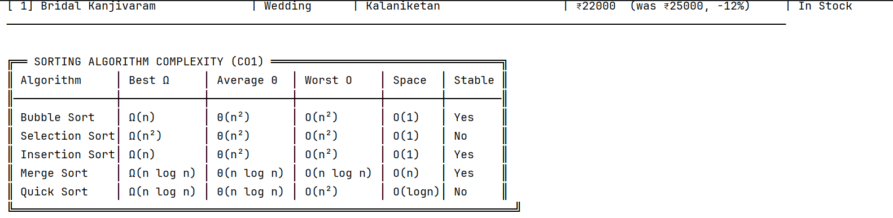

Slide 30
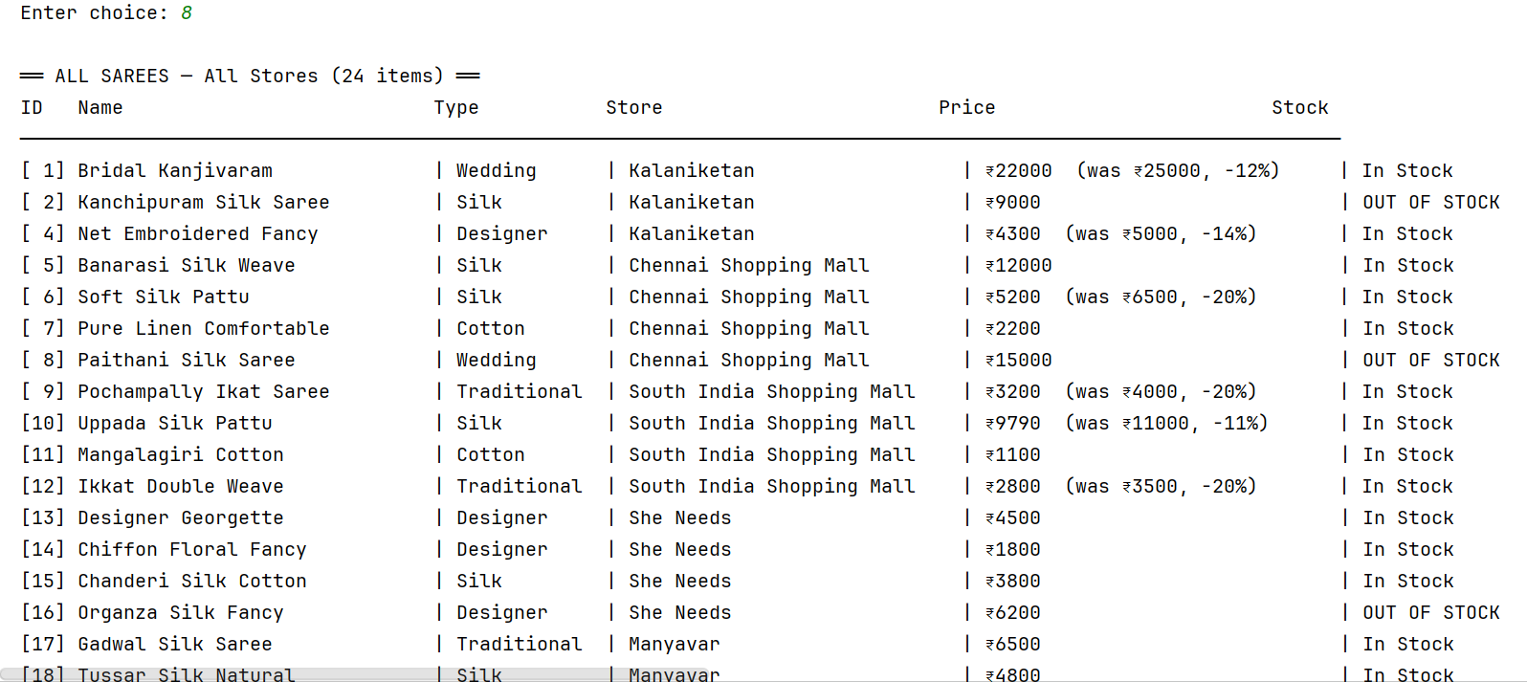
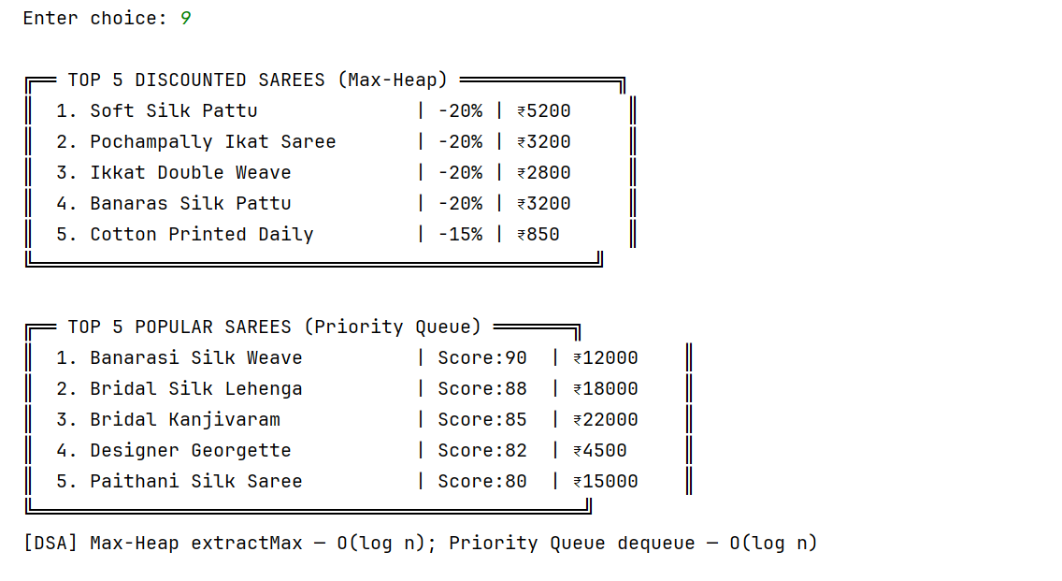
Display of All Sarees and Top 5 discounted and popular

Slide 31
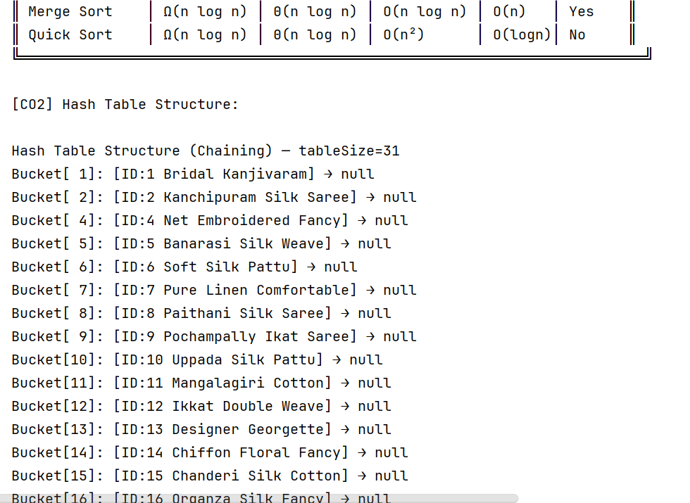
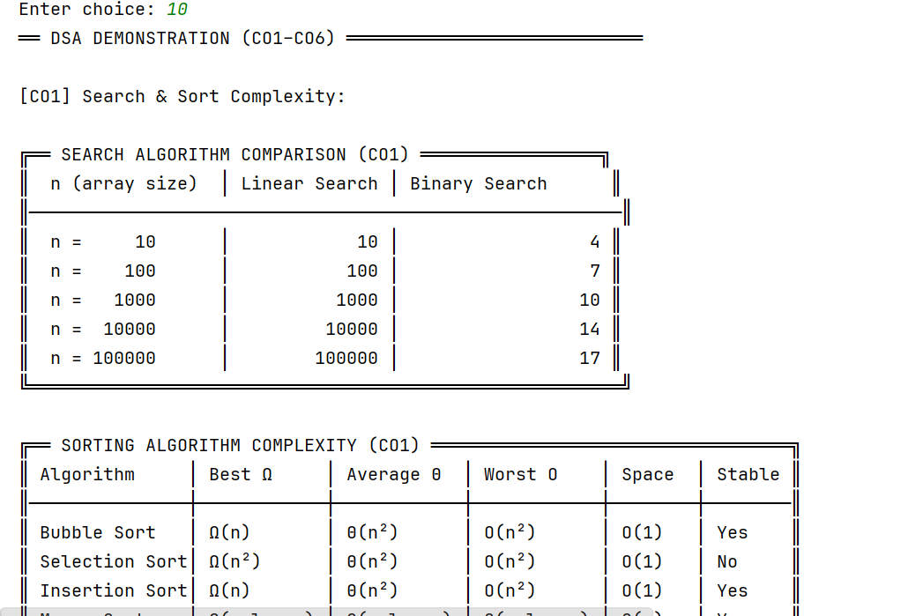
DSA Demonstration

Slide 32
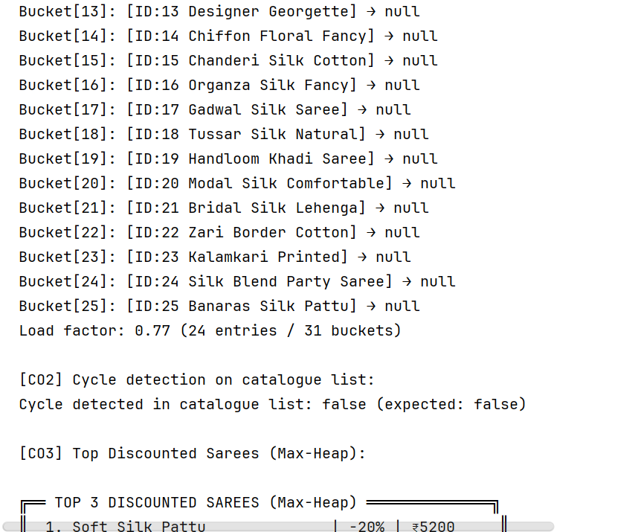
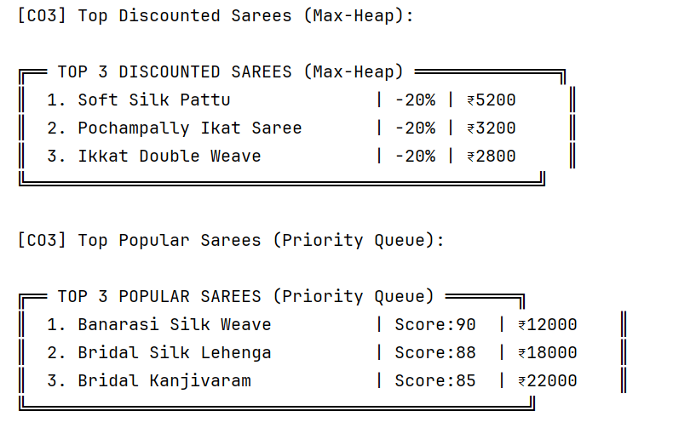

Slide 33
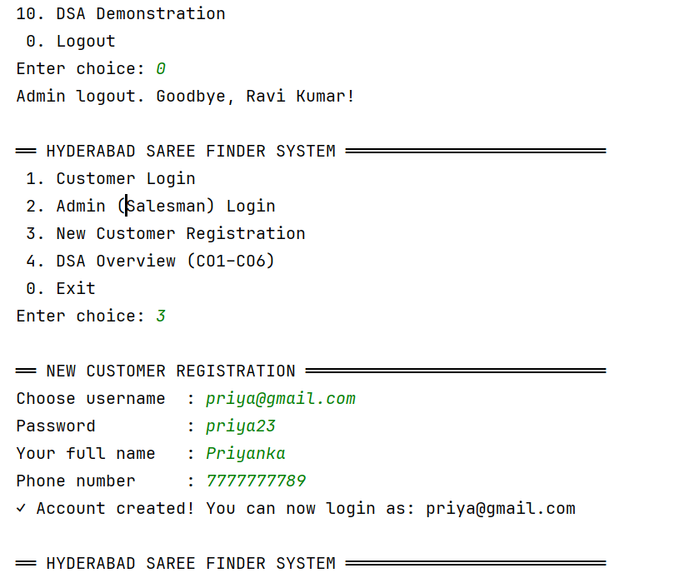
New Customer Registration

Slide 34
Conclusion
Developed a working saree browsing and management system using HTML, CSS, JavaScript and Data Structures concepts.
Customers can browse, search, save to wish-list, and add sarees to cart from multiple Hyderabad stores.
Admins can manage their store sarees by adding, editing, deleting items, and updating stock details.
Data is stored locally using browser local Storage and structured data handling without requiring a server or database.
Identified and fixed an issue where multiple admins could not view their store sarees correctly.
The system works smoothly on desktop browsers and demonstrates practical use of DSA for data management.

Slide 35
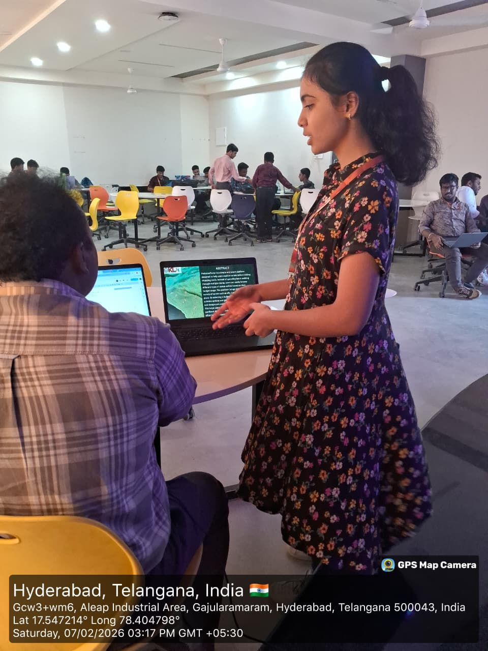
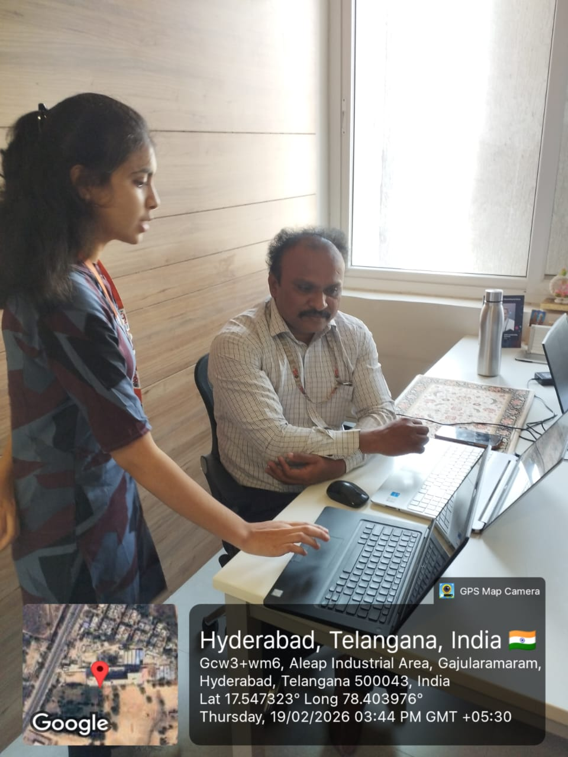
Geo Tag Photos

Slide 36
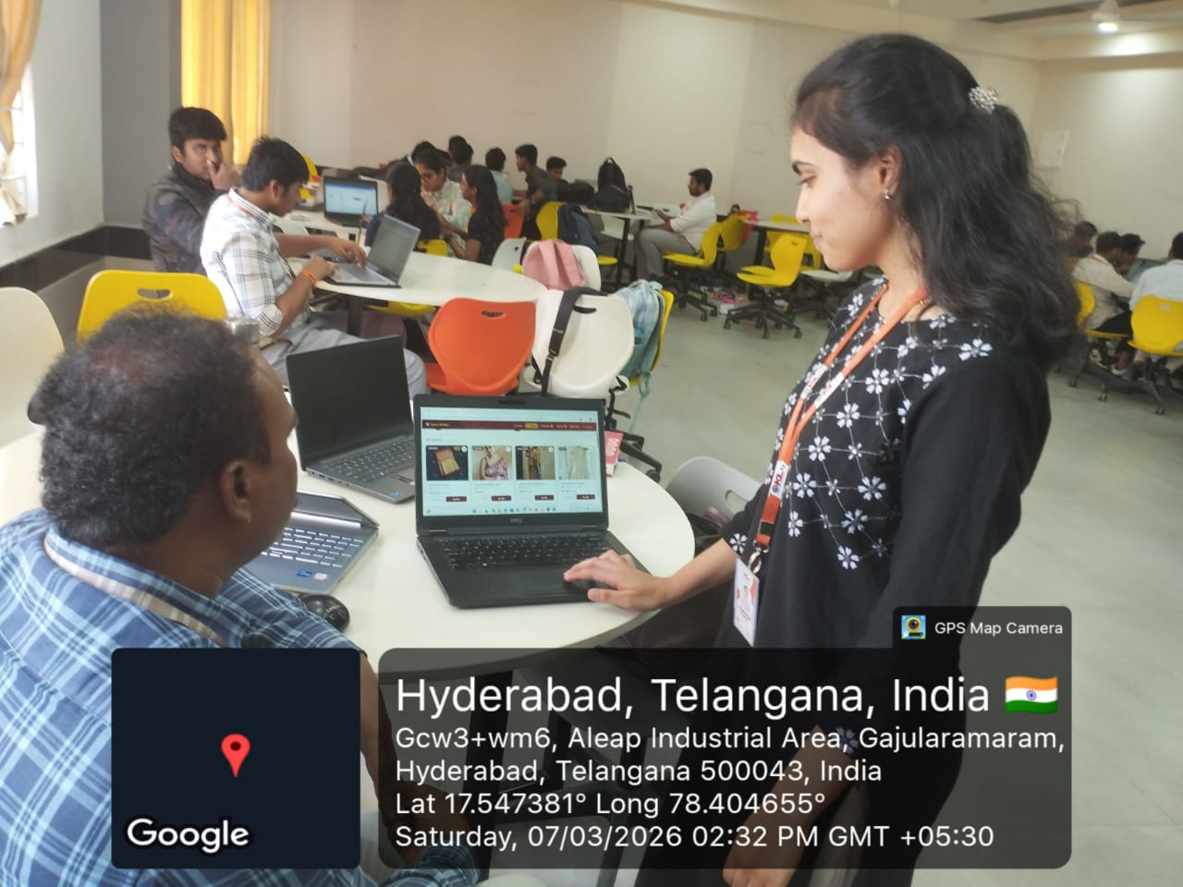

Slide 37
References
MDN Web Docs – HTML5, CSS3, and JavaScript Documentation: https://developer.mozilla.org
W3Schools – HTML, CSS, JavaScript and Web Development Tutorials: https://www.w3schools.com
JavaScript.info – JavaScript Learning Guide: https://javascript.info
GeeksforGeeks – Data Structures and Algorithms Concepts: https://www.geeksforgeeks.org
Programiz – Data Structures and Algorithms Tutorials: https://www.programiz.com
Project README – PreSareeFinder Documentation (Internal Reference)

Slide 38
THANK YOU

