Slide 1
Analysis of CSP monitoring Defect
The analysis is done based on the thickness occurrences of 5 different defects:
ECL (Edge Crack Longitudinal)
MC (M crack / Transverse crack)
TE (Telescopic coil)
ZZ (ZigZag)
TC (Thermal Crack)
BY: Govind G Krishnan

Slide 2
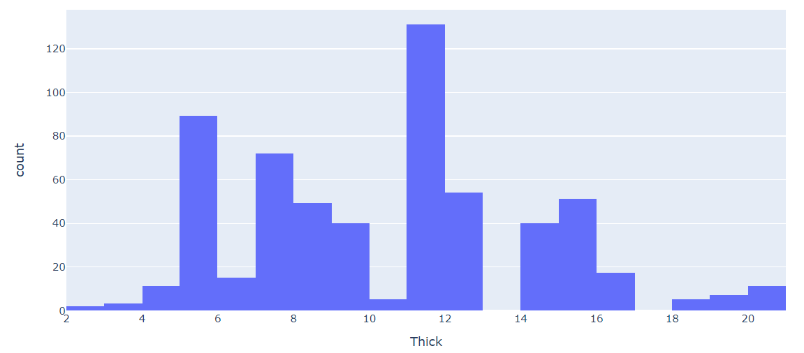
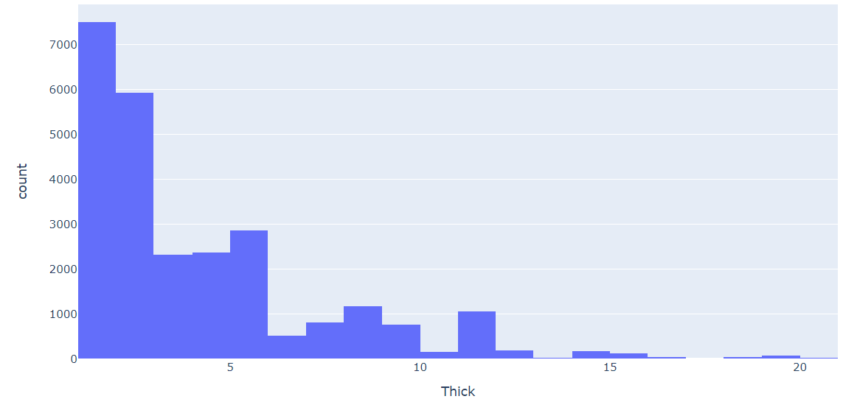
MC Defect Thickness Occurrences
Total Production
Point to Note: No coil exists between width 13-14mm and 17-18 mm.
Observations
Defect is present in 2.31 % of the total coil productions.
Thickness at which MC defect maximum occurs :11.5 mm -12 mm (21.7%).

Slide 3
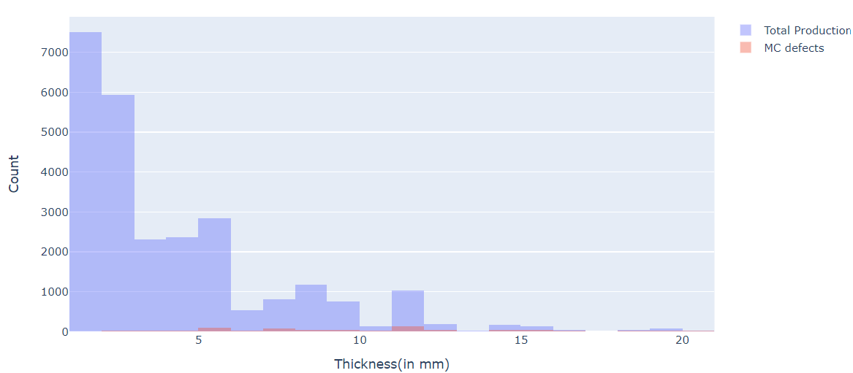
MC Defect Thickness Occurrences
Statistics | Values
count | 602.000000
mean | 10.648424
std | 3.796758
min | 2.900000
25% | 7.898516
50% | 11.799789
75% | 12.700000
max | 20.010000
MC defect is rare in between 0-4 mm and after 17 mm.

Slide 4
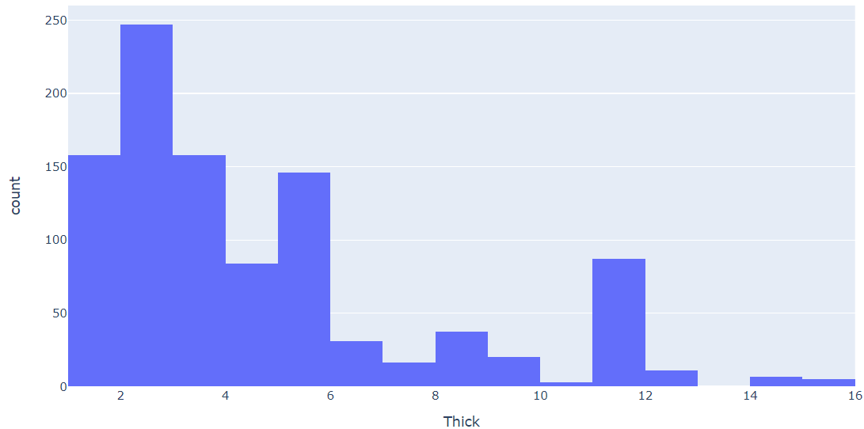
ECL Defect Thickness Occurrences
Total Production
Observations
Present in 3.88 % of the total coil productions.
Thickness at which ECL defect maximum occurs: 2 mm-3 mm (23.46%).

Slide 5
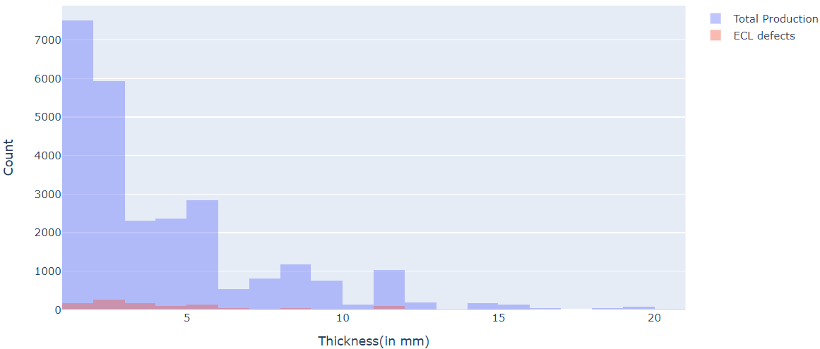
ECL Defect Thickness Occurrences
Statistics | Values
count | 1010.00
mean | 4.83
std | 3.22
min | 1.20
25% | 2.40
50% | 3.80
75% | 5.80
max | 15.81
ECL defect decreases significantly 6.0 mm.

Slide 6
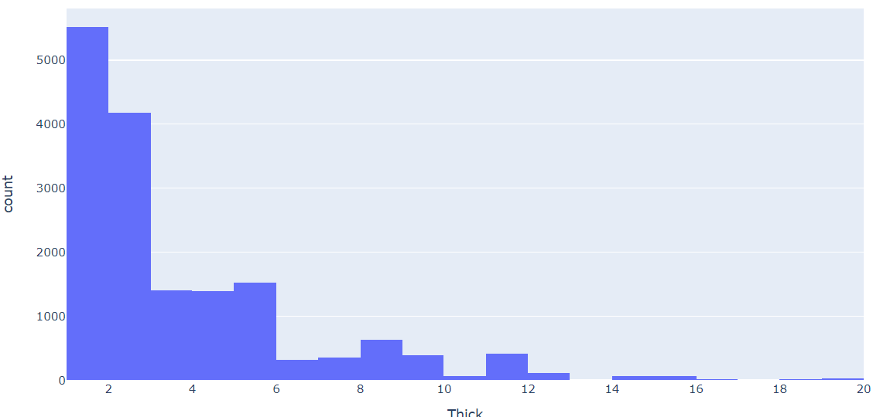
TE Defect Thickness Occurrences
Total Production
Observations
TE defect is present in 63.25 % of the total coil productions.
The thickness at which TE defect maximum occurs is in between 1.5-2 mm.

Slide 7
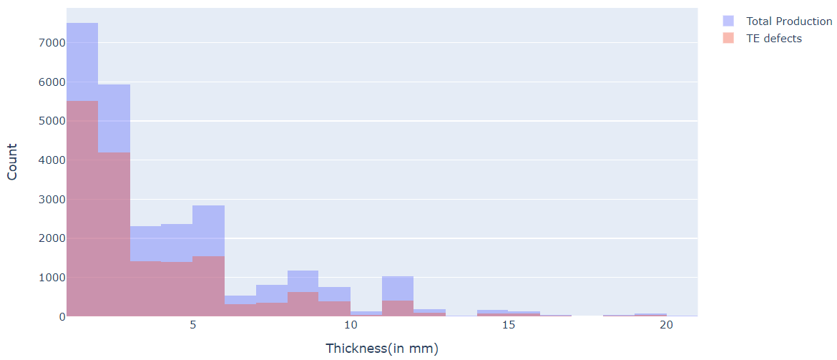
TE Defect Thickness Occurrences
Statistics | Values
count | 16435.00
mean | 3.81
std | 2.87
min | 1.18
25% | 1.90
50% | 2.80
75% | 4.80
max | 19.72
TE defect is uniformly present over the overall coil production.

Slide 8
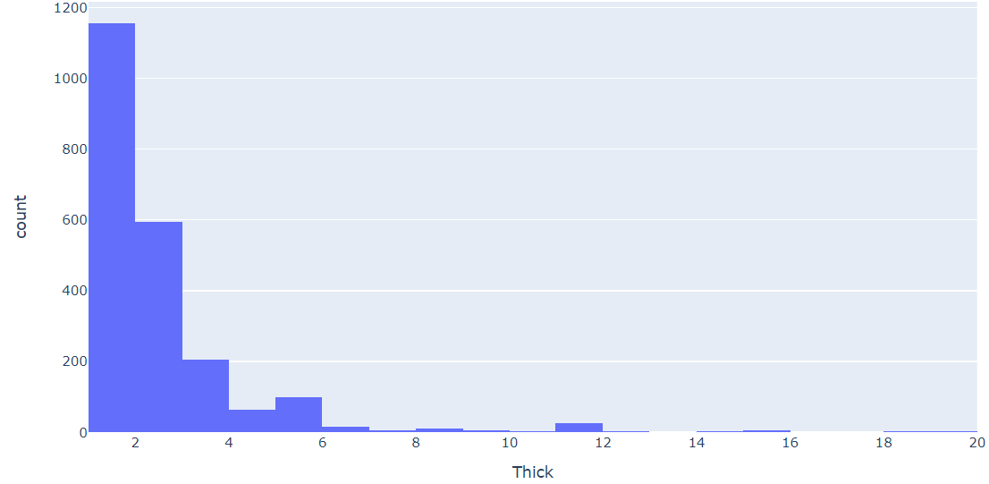
ZZ Defect Thickness Occurrences
Total Production
Observations
ZZ defect is present in 8.45 % of the total coil productions
The thickness at which ZZ defect maximum occurs is in between 0-2 mm(52.57%).

Slide 9
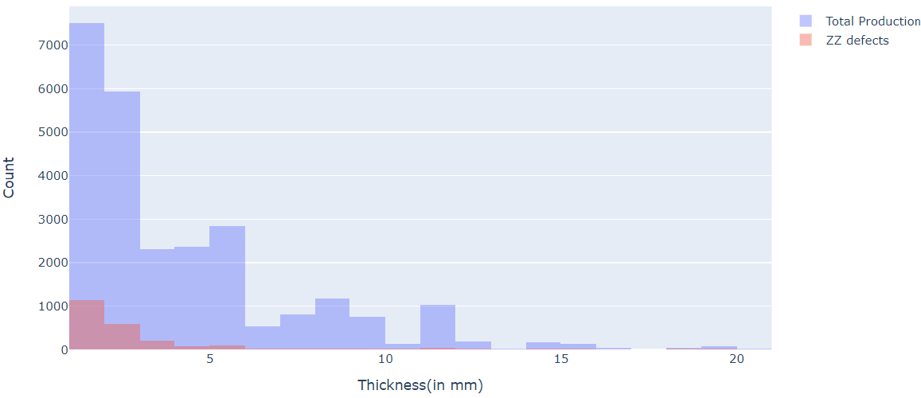
ZZ Defect Thickness Occurrences
Statistics | Values
count | 2197.00
mean | 2.61
std | 1.98
min | 1.18
25% | 1.51
50% | 1.91
75% | 2.90
max | 19.71
ZZ defect decreases significantly after 6 mm.

Slide 10
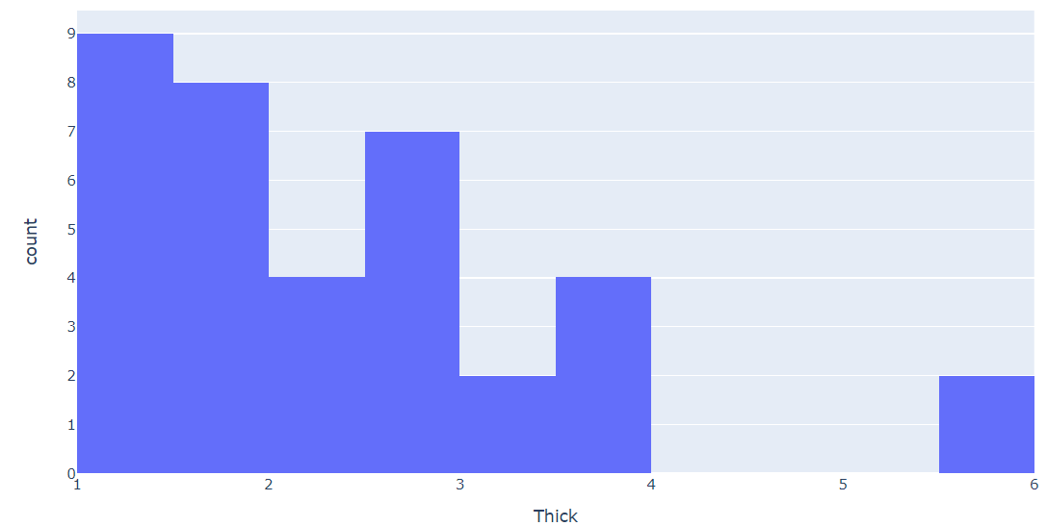
TC Defect Thickness Occurrences
Total Production
Observations
TC defect is present in 0.1 % of the total coil productions.
The thickness at which TC defect maximum occurs is in between 0-2 mm(47.22%).

Slide 11
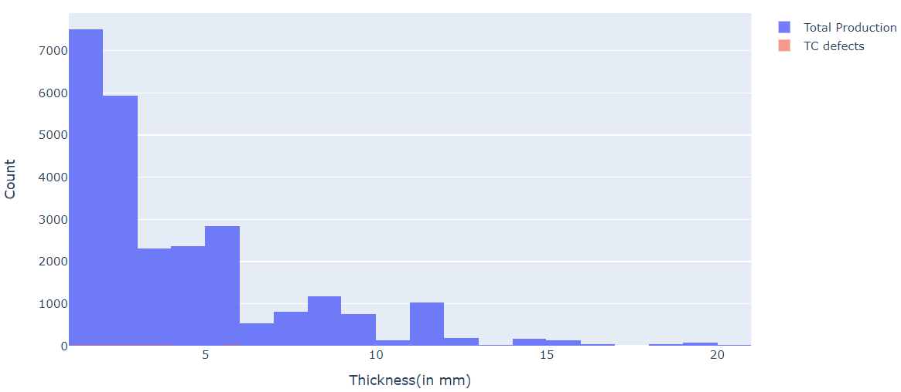
TC Defect Thickness Occurrences
Statistics | Values
count | 36.00
mean | 2.43
std | 1.16
min | 1.31
25% | 1.48
50% | 2.08
75% | 2.91
max | 5.80
TC defect stops occurring after 6mm .

Slide 12
Key Observations
Overall around 78% of the total produced coils have some sort of defect.
TE defect has the highest occurrence among all the defects (63.25%).
The highest frequency of overall defect is found in thickness 1-2mm (33.77%) followed by 2-3mm(24.84%).
Coils having less thickness (1-3mm) have higher probability of having TE,ECL or ZZ defect.

