Slide 1
Module -3
Convolution layers,
max pool layers,
ELU Gradient Decent,
training CNN-initialization,
CNN architectures
VGG, Google Net, ResNet,
dropout, normalization,
rules update,
data augmentation, transfer learning,

Slide 2
VGG-16

Slide 3
VGG Architecture
The full name of VGG is the Visual Geometry Group, which belongs to the Department of Science and Engineering of Oxford University.
It has released a series of convolutional network models beginning with VGG, which can be applied to face recognition and image classification, from VGG16 to VGG19.
The original purpose of VGG's research on the depth of convolutional networks is to understand how the depth of convolutional networks affects the accuracy and accuracy of large-scale image classification and recognition.
-Deep-16 CNN), in order to deepen the number of network layers and to avoid too many parameters, a small 3x3 convolution kernel is used in all layers.

Slide 4
Network Structure
The input of VGG is set to an RGB image of 224x244 size.
The average RGB value is calculated for all images on the training set image, and then the image is input as an input to the VGG convolution network.
A 3x3 or 1x1 filter is used, and the convolution step is fixed.
There are 3 VGG fully connected layers, which can vary from VGG11 to VGG19 according to the total number of convolutional layers + fully connected layers.
The minimum VGG11 has 8 convolutional layers and 3 fully connected layers.
The maximum VGG19 has 16 convolutional layers. +3 fully connected layers.
In addition, the VGG network is not followed by a pooling layer behind each convolutional layer, or a total of 5 pooling layers distributed under different convolutional layers.

Slide 5
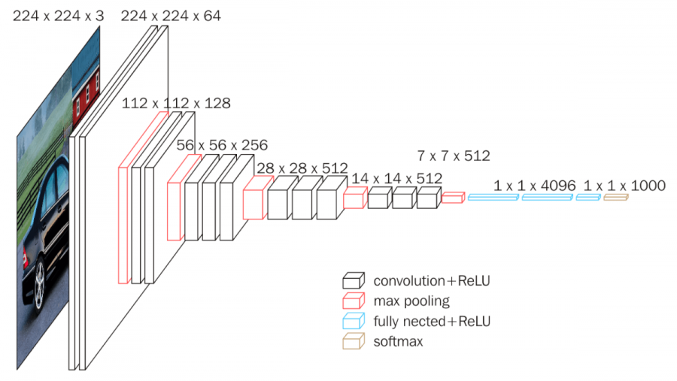

Slide 6
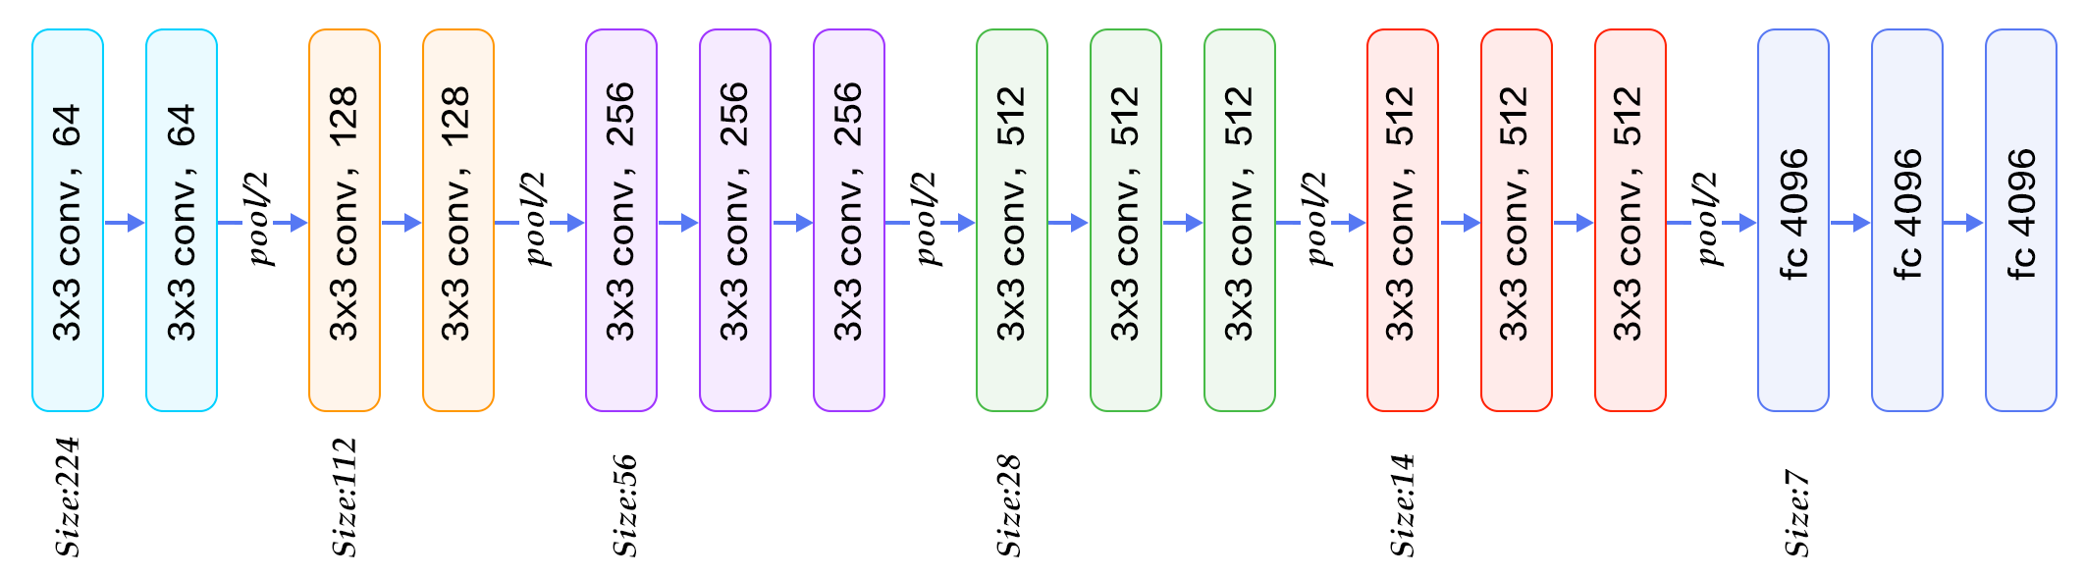

Slide 7
VGG16 contains 16 layers and VGG19 contains 19 layers.
A series of VGGs are exactly the same in the last three fully connected layers.
The overall structure includes 5 sets of convolutional layers, followed by a MaxPool.
The difference is that more and more cascaded convolutional layers are included in the five sets of convolutional layers .

Slide 8
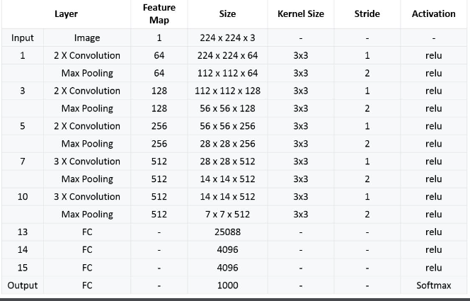

Slide 9
Special features
Input—VGGNet receives a 224×224 image input. In the ImageNet competition, the model’s creators kept the image input size constant by cropping a 224×224 section from the center of each image.
all the VGG network’s hidden layers use ReLU
A pooling layer follows several convolutional layers—this helps reduce the dimensionality and the number of parameters of the feature maps created by each convolution step. Pooling is crucial given the rapid growth of the number of available filters from 64 to 128, 256, and eventually 512 in the final layers.
VGGNet includes three fully connected layers. The first two layers each have 4096 channels, and the third layer has 1000 channels, one for every class.

Slide 10
Advantages
VGG can extract more information from the network as it deals multiple parameters. Since we are using RELU activation function, there won’t be a problem of Vanishing Gradient problem.
VGG have a general architecture where convolution layers and pooling occur in a systematic way.

