Slide 1
Module-6
Variational Autoencoders, Generative Adversarial Networks, Multi-task Deep Learning, Multi-view Deep Learning. Various Applications - speech, text, image and video

Slide 2
Introduction
Generative Adversarial Networks (GANs) were introduced in 2014 by Ian J. Goodfellow and co-authors.
GANs perform unsupervised learning tasks in machine learning.
GANs introduce the concept of adversarial learning, as they lie in the rivalry between two neural networks.
These techniques have enabled researchers to create realistic-looking but entirely computer generated photos of people’s faces.
They have also allowed the creation of controversial “deepfake” videos.
Actually, GANs can be used to imitate any data distribution (image, text, sound, etc.).

Slide 3
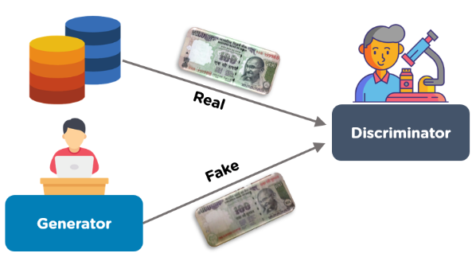
It consists of 2 models that automatically discover and learn the patterns in input data.
The two models are known as Generator and Discriminator.
GANs can be used to generate new examples that possibly could have been drawn from the original dataset.

Slide 4
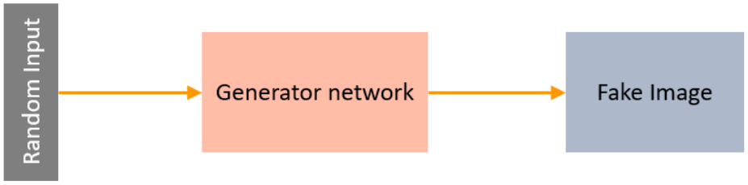
Generator
A Generator in GANs is a neural network that creates fake data to be trained on the discriminator.
It learns to generate possible data.
The generated examples/instances become negative training examples for the discriminator.
It takes a fixed-length random vector carrying noise as input and generates a sample.

Slide 5
The main aim of the Generator is to make the discriminator classify its output as real.
The part of the GAN that trains the Generator includes:
noisy input vector
generator network, which transforms the random input into a data instance
discriminator network, which classifies the generated data
generator loss, which penalizes the Generator for failing to dolt the discriminator
The backpropagation method is used to adjust each weight in the right direction by calculating the weight's impact on the output.
It is also used to obtain gradients and these gradients can help change the generator weights.

Slide 6
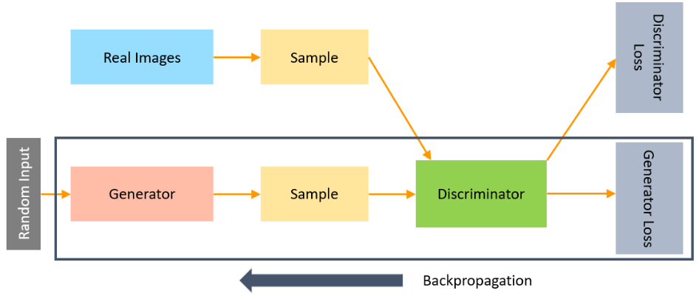

Slide 7


Slide 8
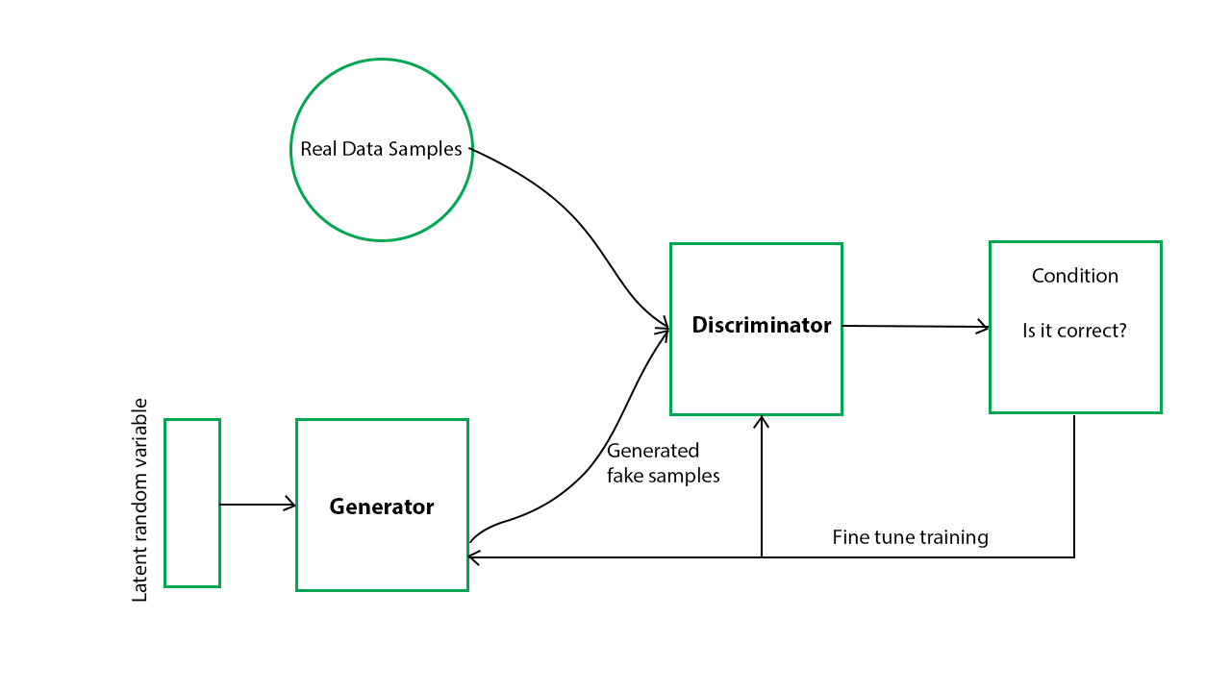
Its aim is to generate the fake image based on feedback and make the discriminator fool that it cannot predict a fake image.
And when the discriminator is made a fool by the generator, the training stops and we can say that a generalized GAN model is created.

Slide 9
Generative model captures the distribution of data and is trained in such a manner to generate the new sample that tries to maximize the probability of the discriminator to make a mistake(maximize discriminator loss).
The discriminator on other hand is based on a model that estimates the probability that the sample it receives is from training data not from the generator and tries to classify it accurately and minimize the GAN accuracy.
Hence the GAN network is formulated as a minimax game where the Discriminator is trying to minimize its reward V(D, G) and the generator is trying to maximize the Discriminator loss.
Generator output is directly connected to the input of the discriminator.
And discriminator predicts it and through backpropagation, the generator receives a feedback signal to update weights and improve performance.
The discriminator is a feed-forward neural network.

Slide 10
Training & Prediction of Generative Adversarial Networks (GANs)
Step-1) Define a Problem
Step-2) Select Architecture of GAN
Step-3) Train Discriminator on Real Dataset
Discriminator is trained on a real dataset.
It is only having a forward path, no backpropagation is there in the training of the Discriminator in n epochs.
And the Data you are providing is without Noise and only contains real images, and for fake images, Discriminator uses instances created by the generator as negative output.
It classifies both real and fake data.
The discriminator loss helps improve its performance and penalize it when it misclassifies real as fake or vice-versa.
weights of the discriminator are updated through discriminator loss.

Slide 11
Step-4) Train Generator
Provide some Fake inputs for the generator(Noise) and It will use some random noise and generate some fake outputs.
When Generator is trained, Discriminator is Idle and when Discriminator is trained, Generator is Idle.
During generator training through any random noise as input, it tries to transform it into meaningful data. to get meaningful output from the generator takes time and runs under many epochs.
Steps to train a generator
get random noise and produce a generator output on noise sample
predict generator output from discriminator as original or fake.
we calculate discriminator loss.
perform backpropagation through discriminator, and generator both to calculate gradients.
Use gradients to update generator weights.

Slide 12
Step-5) Train Discriminator on Fake Data
The samples which are generated by Generator will pass to Discriminator and It will predict the data passed to it is Fake or real and provide feedback to Generator again.
Step-6) Train Generator with the output of Discriminator
Generator will be trained on the feedback given by Discriminator and try to improve performance.
This is an iterative process and continues running until the Generator is not successful in making the discriminator fool.

Slide 13
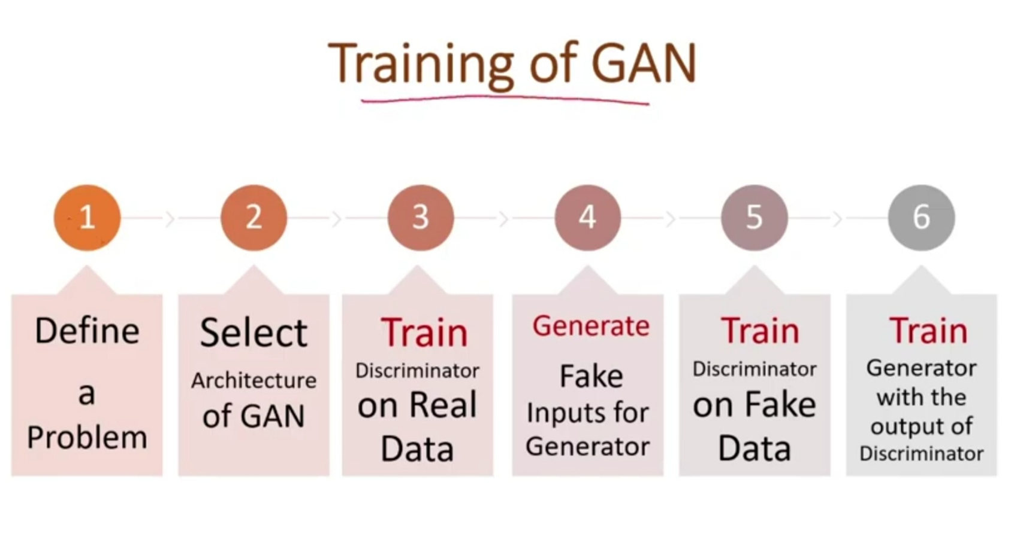

Slide 14
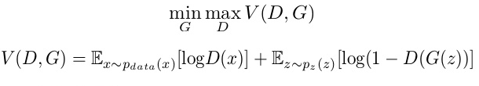
Generative Adversarial Networks (GANs) Loss Function
The generator tries to minimize the following loss function while the discriminator tries to maximize it. It is the same as a minimax game if you have ever played.

Slide 15
D(x) is the discriminator’s estimate of the probability that real data instance x is real.
E_{x} is the expected value over all real data instances.
G(z) is the generator’s output when given noise z.
D(G(z)) is the discriminator’s estimate of the probability that a fake instance is real.
E_{z} is the expected value over all random inputs to the generator (in effect, the expected value over all generated fake instances G(z)).
The formula is derived from cross-entropy between

Slide 16
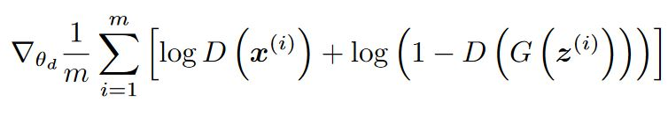
Discriminator loss
While the discriminator is trained, it classifies both the real data and the fake data from the generator.
It penalizes itself for misclassifying a real instance as fake, or a fake instance (created by the generator) as real, by maximizing the below function.
log(D(x)) refers to the probability that the generator is rightly classifying the real image,
maximizing log(1-D(G(z))) would help it to correctly label the fake image that comes from the generator.

Slide 17

Generator loss
While the generator is trained, it samples random noise and produces an output from that noise. The output then goes through the discriminator and gets classified as either “Real” or “Fake” based on the ability of the discriminator to tell one from the other.
The generator loss is then calculated from the discriminator’s classification – it gets rewarded if it successfully fools the discriminator, and gets penalized otherwise.
The following equation is minimized to training the generator:

Slide 18
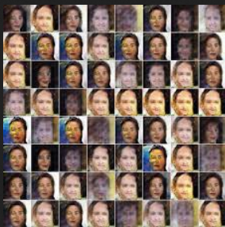
Challenges of GAN
Mode Collapse
we would want our GAN to produce a range of outputs. We would expect, for example, another face for every random input to the face generator that we design.
Instead, through subsequent training, the network learns to model a particular distribution of data, which gives us a monotonous output

Slide 19
In the process of training, the generator is always trying to find the one output that seems most plausible to the discriminator.
Because of that, the discriminator’s best strategy is always to reject the output of the generator.
But if the next generation of discriminator gets stuck in a local minimum and doesn’t find its way out by getting its weights even more optimized, it’d get easy for the next generator iteration to find the most plausible output for the current discriminator.

Slide 20
Vanishing Gradients
This phenomenon happens when the discriminator performs significantly better than the generator. Either the updates to the discriminator are inaccurate, or they disappear.
One of the proposed reasons for this is that the generator gets heavily penalized, which leads to saturation in the value post-activation function, and the eventual gradient vanishing.

Slide 21
Wasserstein Generative Adversarial Network (WGAN)
This is one of the most powerful alternatives to the original GAN loss. It tackles the problem of Mode Collapse and Vanishing Gradient.
In this implementation, the activation of the output layer of the discriminator is changed from sigmoid to a linear one. This simple change influences the discriminator to give out a score instead of a probability associated with data distribution, so the output does not have to be in the range of 0 to 1.
Here, the discriminator is called critique instead, because it doesn’t actually classify the data strictly as real or fake, it simply gives them a rating.
Following loss functions are used to train the critique and the generator, respectively.
The output of the critique and the generator is not in probabilistic terms (between 0 and 1), so the absolute difference between critique and generator outputs is maximized while training the critique network.
Similarly, the absolute value of the generator function is maximized while training the generator network.

Slide 22
CycleGAN
StyleGAN
pixelRNN
text-2-image
DiscoGAN
lsGAN
SRGAN
InfoGAN

Slide 23
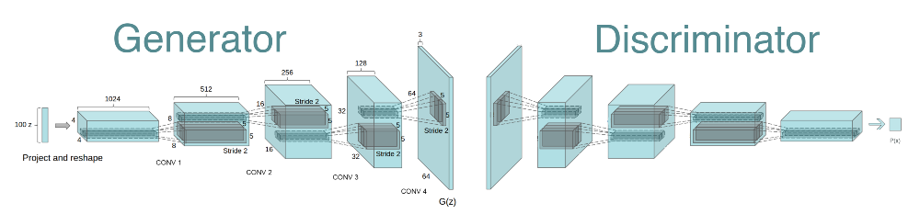
Deep Convolutional GAN
DCGANs are an improvement of GANs that use convolutional neural nets.
CNNs are good for extracting important features and representation from the data, making them more stable and enabling them to generate higher quality images.

Slide 24
Conditional GAN
Conditional GANs train on a labeled data set and let you specify the label for each generated instance. For example, an unconditional MNIST GAN would produce random digits, while a conditional MNIST GAN would let you specify which digit the GAN should generate.
Instead of modeling the joint probability P(X, Y), conditional GANs model the conditional probability P(X | Y).
Application:
Image-to-image translation
Text-to-image synthesis
Video generation

Slide 25
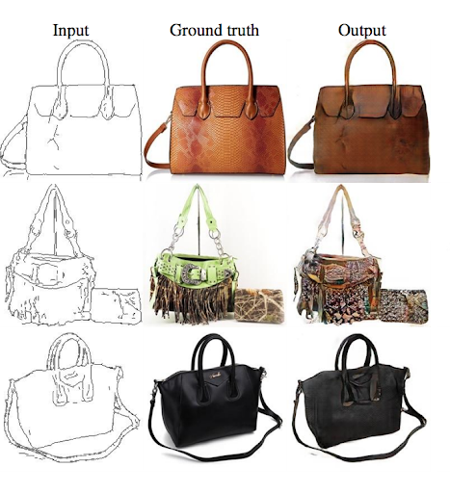
Image-to-Image Translation(Pix2Pix GAN)
Image-to-Image translation GANs take an image as input and map it to a generated output image with different properties. For example, we can take a mask image with blob of color in the shape of a car, and the GAN can fill in the shape with photorealistic car details.
Similarly, you can train an image-to-image GAN to take sketches of handbags and turn them into photorealistic images of handbags.
loss is a weighted combination of the usual discriminator-based loss and a pixel-wise loss that penalizes the generator for departing from the source image.

Slide 26
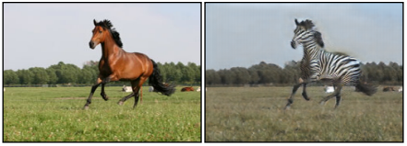
CycleGAN
CycleGANs learn to transform images from one set into images that could plausibly belong to another set. For example, a CycleGAN produced the righthand image below when given the lefthand image as input. It took an image of a horse and turned it into an image of a zebra.
The training data for the CycleGAN is simply two sets of images (in this case, a set of horse images and a set of zebra images). The system requires no labels or pairwise correspondences between images.

Slide 27
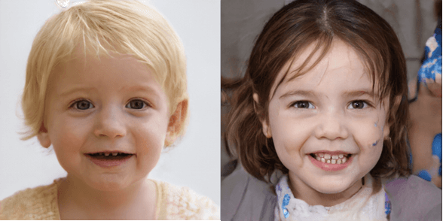
StyleGAN
The idea is to build a stack of layers where initial layers are capable of generating low-resolution images (starting from 2*2) and further layers gradually increase the resolution.
The easiest way for GAN to generate high-resolution images is to remember images from the training dataset and while generating new images it can add random noise to an existing image.
In reality, StyleGAN doesn’t do that rather it learn features regarding human face and generates a new image of the human face that doesn’t exist in reality.

Slide 28
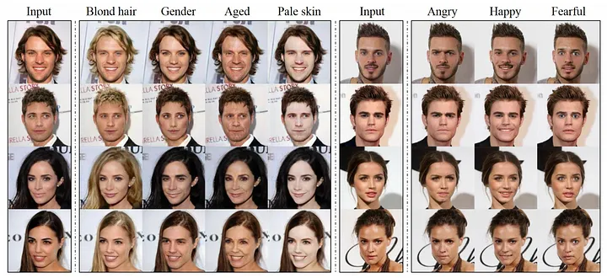
StarGAN

Slide 29
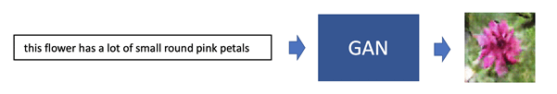
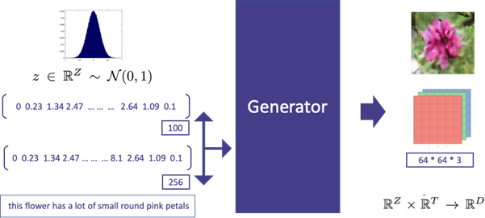
text-2-image
Instead of giving only noise as input to the Generator, the textual description is first transformed into a text embedding, concatenated with noise vector and then given as input to the Generator.

Slide 30
For the Discriminator, instead of having the only image as input, a pair of image and text embedding are sent as input.
Output signals are either 0 or 1. Earlier the Discriminator’s responsibility was just to predict whether a given image is real or fake.
Now, the Discriminator has one more additional responsibility.
Along with identifying the given image is read or fake, it also predicts the likelihood of whether the given image and text aligned with each other.
This formulation force the Generator to not only generate images that look real but also to generate images that are aligned with the input textual description.

Slide 31
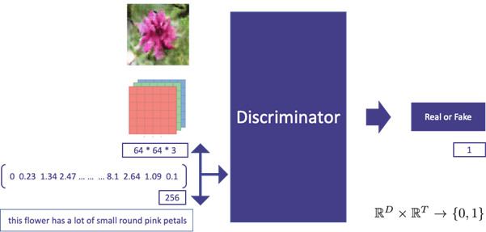

Slide 32
To fulfill the purpose of the 2-fold responsibility of the Discriminator, during training time, a series of different (image, text) pairs are given as input to the model which are as follows:
Pair of (Real Image, Real Caption) as input and target variable is set to 1
Pair of (Wrong Image, Real Caption) as input and target variable is set to 0
Pair of (Fake Image, Real Caption) as input and target variable is set to 0
The pair of Real Image and Real Caption are given so that the model learns whether a given image and text pair are aligned with each other.
The wrong Image, Read Caption means the image is not as described in the caption.
In this case, the target variable is set to 0 so that the model learns that the given image and caption are not aligned.
Here Fake Image means an image generated by the Generator, in this case, the target variable is set to 0 so that the Discriminator model can distinguish between real and fake images.

Slide 33
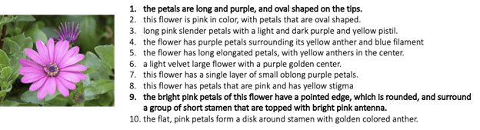
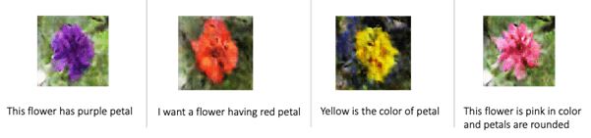
The training dataset used for the training has image along with 10 different textual description that describes properties of the image.

Slide 34
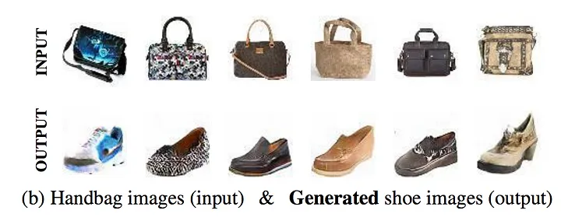
DiscoGAN
given images of two different domains, a human can figure out how they are related to each other.
As an example, in the following figure, we have images from 2 different domains and just by one glance at these images, we can figure out very easily that they are related by the nature of their exterior color.
The primary difference between DiscoGAN and CycleGAN is that DiscoGAN uses two reconstruction loss, one for both the domain whereas CycleGAN uses single cycle-consistency loss.

Slide 35
Generate New Human Poses
GANs can generate images of people in new poses, such as difficult or impossible for humans to achieve. It can be used to create new content or to augment existing image datasets.
Photos to Emojis
GANs can be used to convert photographs of people into emojis, creating a more personalized and expressive form of communication.
Photograph Editing
GANs can be used to edit photographs in various ways, such as changing the background, adding or removing objects, or altering the appearance of people or animals in the image.
Face Aging
GANs can be used to generate images of people at different ages, allowing users to visualize how they might look in the future or to see what they might have looked like in the past.

Slide 36
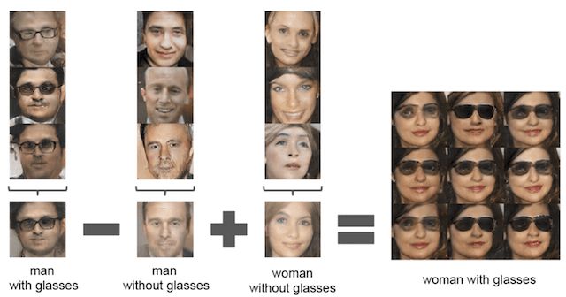

Slide 37
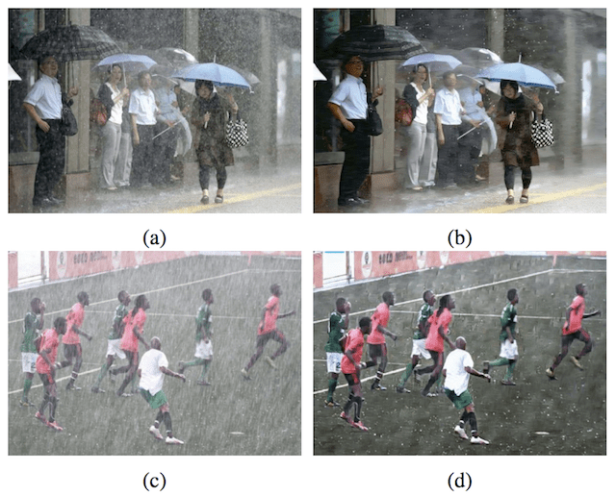
CGAN

Slide 38
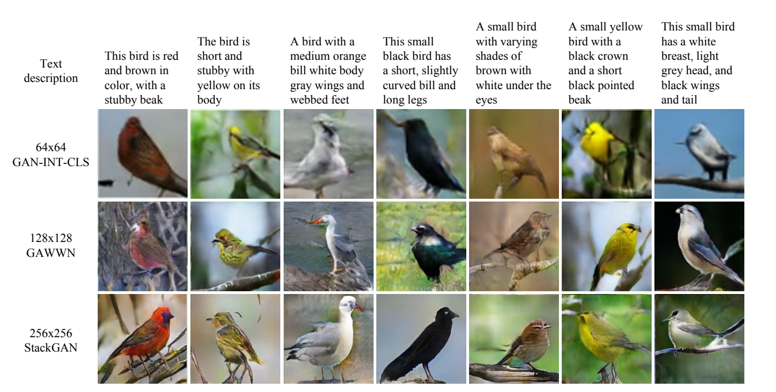
StackedGAN
Stacked Generative Adversarial Networks (StackGAN) can generate images conditioned on text descriptions.

Slide 39
The architecture comprises a stacked series of text and image GAN models.
It’s again a class of conditional GANs. It has two GANs, also known as stage-I GAN and stage-II GAN.
StackGAN uses a sketch-refinement process where the first level generator, Stage-I GAN, is conditioned on text and generates a low-resolution image, i.e. the primitive shape and colors of the descriptive text.
The second level generator, Stage-II GAN, is conditioned both on the text and on the low-resolution image, which takes the stage-I results and adds compelling detail.

Slide 40
LIMITATIONS
One issue is that GANs can be notoriously difficult to train. This is because the two networks in a GAN (the generator and the discriminator) are constantly competing against others, which can make training unstable and slow.
Additionally, GANs often require a large amount of training data in order to produce good results. This can be a problem if the dataset is not readily available or if it is too small.
Finally, GANs can be vulnerable to mode collapse, which is when the generator only produces a limited number of outputs instead of the variety that is desired.

Slide 41
Density Estimation, we still cannot predict the accuracy of the density of the evaluated model and state that this image is denser enough to move forward with. These metrices of the data generated are still deciding manually.
GANs are the elegant mechanism of Data Generation but due to Unstable Training and unsupervised leanring method it becomes harder to train and generate output.

