Slide 1

RAJIV GANDHI UNIVERSITY OF KNOWLEDGE TECHNOLOGIES - BASAR
DEPARTMENT OF COMPUTER SCIENCE AND ENGINEERING
MINI PROJECT
NEWS APP
TEAM:
K.VIJAY KUMAR - B201557
P.PRANAY KUMAR - B201140
K.NARESH - B200951
GUIDED BY :
MR G.RANJITH KUMAR SIR

Slide 2
Problem Statement :
Users struggle to find personalized and organized news from multiple sources. A centralized app is needed to aggregate real-time news, filter it by user preferences, and deliver a seamless, clutter-free reading experience..
Objective : To develop a user-friendly news app that aggregates real-time news from multiple sources, categorizes it intelligently, and delivers personalized content based on user interests and preferences..
The app should ensure easy navigation, and effective management to provide a goo experience.

Slide 3
INDEX :
Description
Technologies Used
Flowchart
Conclusion

Slide 4
Description
The News App is an all-in-one digital platform that curates and delivers the latest news from multiple trusted sources, ensuring users have access to accurate and up-to-date information. It leverages intelligent algorithms to categorize articles into sections such as politics, business, health, science, sports, and entertainment.
.

Slide 5
What is API’s?: An API, or Application Programming Interface, is a set of rules that allows different software applications to communicate with each other. In the context of news apps, APIs enable the retrieval of news articles and data from various sources seamlessl .
Importance of API Keys in News Apps: API keys are essential for authenticating requests made to APIs, ensuring that only authorized users can access the data. They help maintain security and track usage, which is crucial for news apps that rely on third-party content .
Overview of Popular News API’s : There are several popular news APIs available, such as NewsAPI, GNews, and Currents, each offering unique features and data sources. These APIs allow developers to integrate news content into their applications easily and efficiently.

Slide 6
*How to Integrate APIs into a News App ?: Integrating APIs into a news app allows developers to fetch real-time news articles and updates from various sources. By utilizing RESTful APIs, developers can streamline the process of displaying news content dynamically within the app.
*Challenges and Solutions in API Integration : API integration can present challenges such as data inconsistency and latency issues. To overcome these, developers can implement caching strategies and error handling mechanisms to enhance the user experience in news apps.

Slide 7
*Features of NEWS APP:
*Real-time News Updates :-
Get the latest news as it happens from multiple trusted sources.
*Personalized News Feed:-
News tailored to user interests, selected categories, and regions.
*Category-wise Browsing:-
Easily browse news by categories like Politics, Sports, Technology, Entertainment, Health, etc.
*User-friendly Interface:-
Clean, responsive, and intuitive design for seamless browsing.
*Trending News Section:-
Highlights the most-read or trending articles globally or locally.

Slide 8
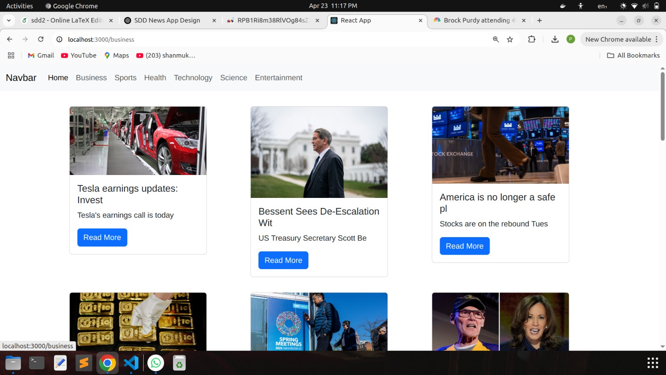
NEWS APP :
paste

Slide 9
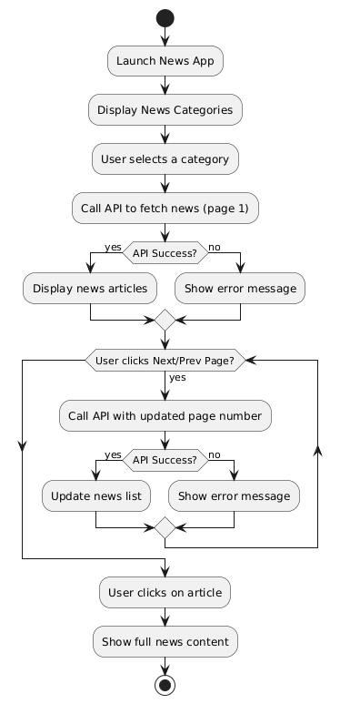
Flow
chart

Slide 10
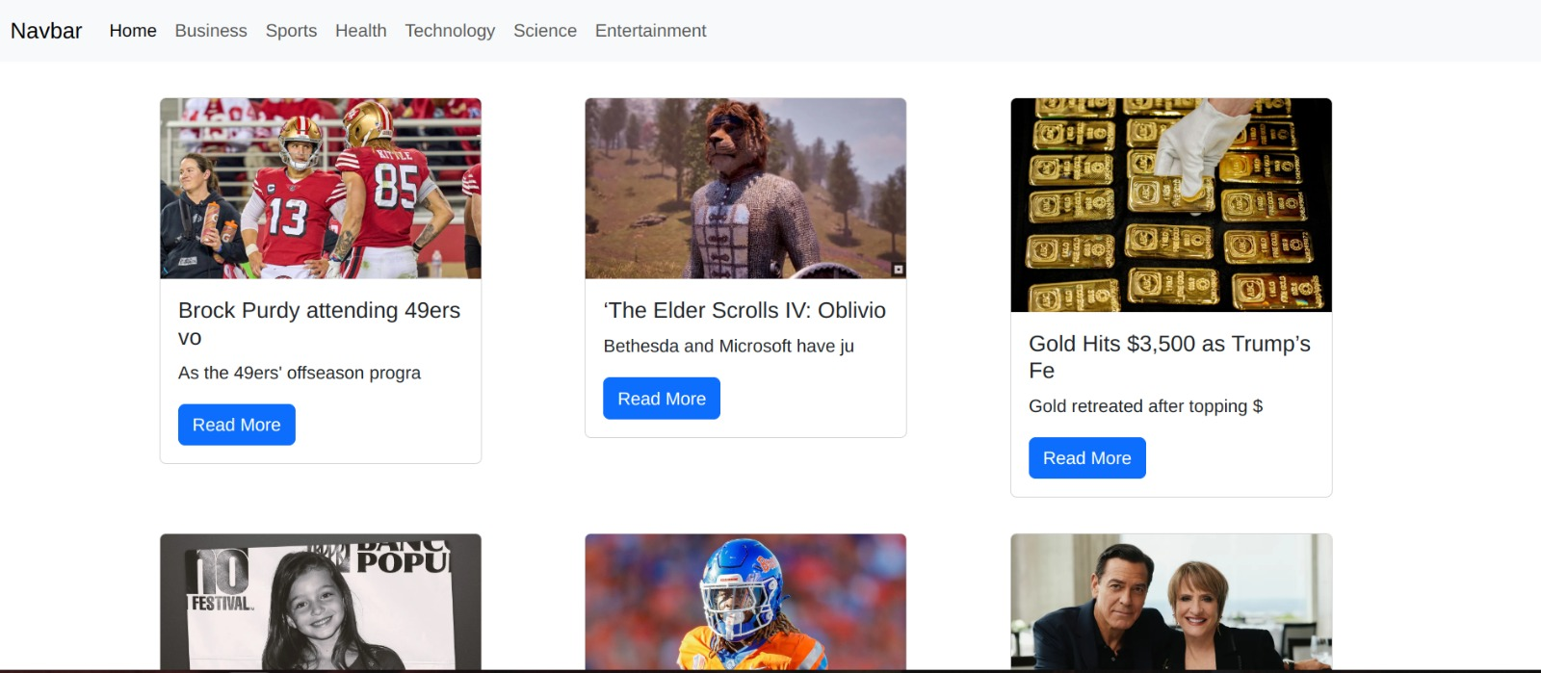
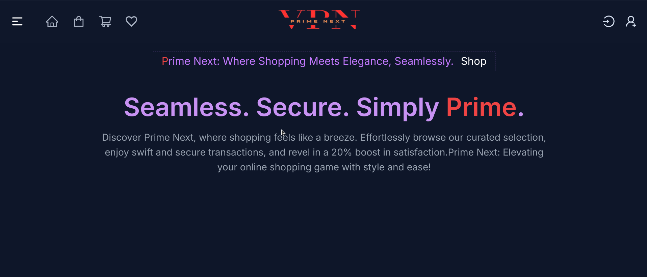
Home Page:

Slide 11

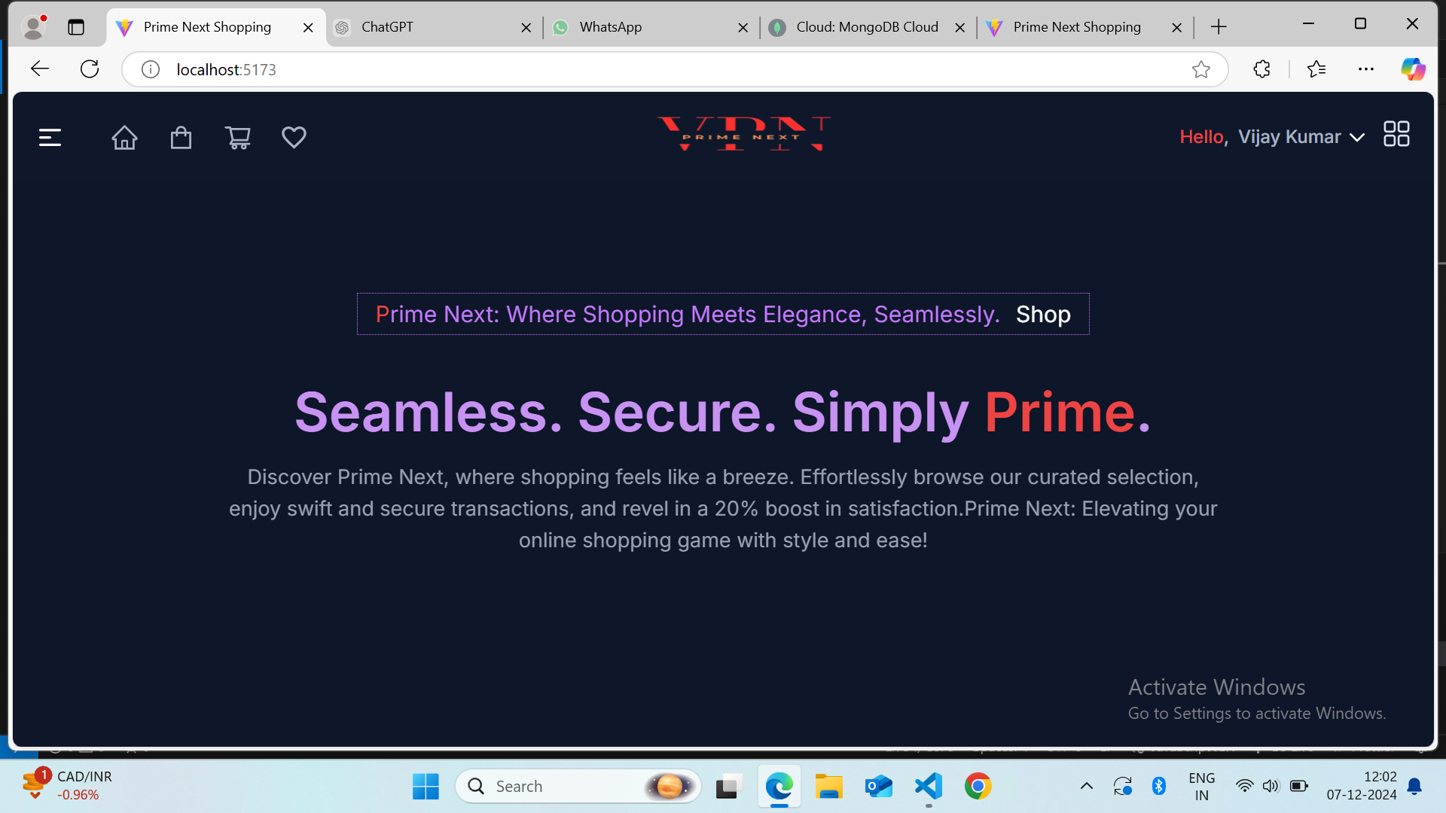
News content:

Slide 12
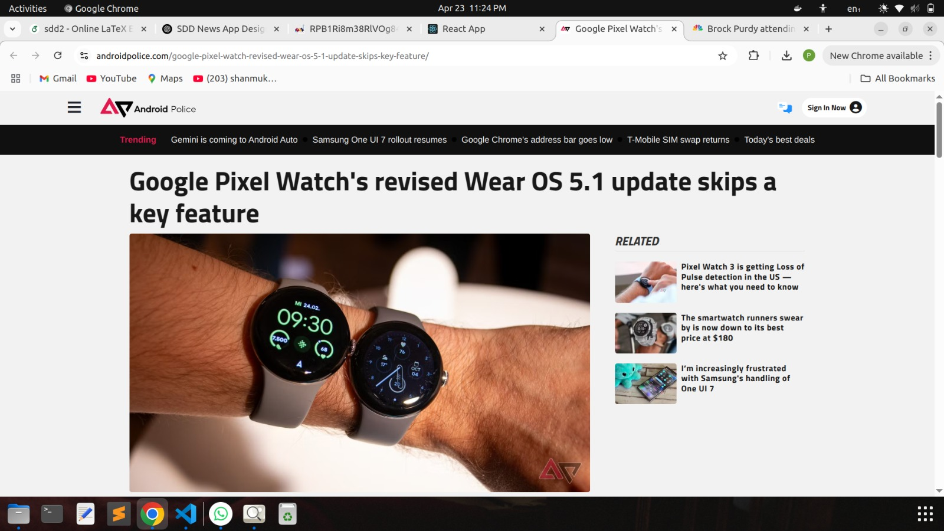

Slide 13
📌 Frontend
** React.js **
- JavaScript library for building user interfaces using a component-based architecture.
- Enables dynamic rendering of news content based on user interactions.
** Axios **
- Promise-based HTTP client used for fetching data from external news APIs.
- Simplifies GET and POST requests to REST APIs.
** Tailwind CSS / CSS Modules **
- Utility-first CSS framework (Tailwind) or modular CSS approach for styling.
- Helps in designing responsive and modern UIs with minimal code. i

Slide 14
🌐 APIs
** NewsAPI.org **
- Primary API used to fetch real-time news articles.
- Provides endpoints for top headlines, everything (search), and sources.
** RapidAPI (Alternative) **
-Platform for accessing multiple news APIs like ContextualWeb, Bing News, e etc., under one key.

Slide 15
Conclusion :
* The News App aims to revolutionize how users consume news by providing a personalized, efficient, and organized platform. With real-time updates, it ensures users are always informed about the latest events across the globe. By offering features like category-based browsing, offline reading, and intelligent push notifications, it makes news consumption seamless and user-centric.
* React is a JavaScript library for building interactive UIs. It communicates with a backend through REST APIs using HTTP methods like GET, POST, PUT, and DELETE. This allows React to fetch and update data dynamically without reloading the page. Tools like Axios or the native fetch API are used to make requests to the server, ensuring a smooth and responsive user experience.

Slide 16


