Slide 1

MLBD-Project
Courses Recommendation
Based on XuetangX MOOC
Zhijie Song; Chenkai Wang; Kang Fu
EPFL
May. 2021
Notes:
Hello, welcome to our final presentation. The topic we focused on is the courses recommendation based on XuetangX MOOC platform.

Slide 2
Overview
Online courses have become much more popular in recent years with the advantage of convenient long-distance education. To conduct our project, we adopted XuetangX, a massive open online course (MOOC) platform that offers online courses in multiple disciplines and certificate and degree programs. And it’s meaningful to explore users’ behaviors. We get our original dataset from the official website of MOOC Data.
And our potential target audience are online course platform, who intends to perfect their course recommendation system.
Notes:
Online courses have been much more popular in recent years with the advantage of convenient long-distance education. To conduct our project, we adopted XuetangX, a MOOC platform. And our potential target audience are online course platform, who intends to perfect their course recommendation system.

Slide 3
Research questions
Our goal is to predict the next course to recommend to each student, based on their needs or interests.
•Non-Personalized Recommendation Model: (baseline)
•Bayesian Personal Ranking (BPR) Model[1]: based on matrix factorization.
•The Self-attentive Sequential Recommendation Model (SASRec): In 2017, a new sequential model Transformer in Natural language processing achieved remarkable performance and efficiency for machine translation tasks. Based on Wang[2], we apply the self-attention mechanisms to sequential recommendation problems.
Then we analyze their outputs and compare the performance of the models. HitRate@10 and NDCG@10 are adopted to compare different evaluation metrics.
[1] S. Rendle, C. Freudenthaler, Z. Gantner, L. Schmidt-Thieme - Bayesian Personalized Ranking from Implicit Feedback
[2] Kang, W. C. , & Mcauley, J. . (2018). Self-Attentive Sequential Recommendation. 2018 IEEE International Conference on Data Mining (ICDM). IEEE.
Notes:
From a macro perspective, our goal is to predict and recommend the next course to each student, based on their needs or interests. Here we use students’ past selection as their interests.
To narrow down our research goal, we built three models for our course recommendation task. These models and why we choose them are as follows.
•The first one is Non-Personalized Recommendation Model: This is our baseline model that recommends courses based on their popularity. Since it is non-personalized, all the students will receive the same course recommendations.
•The second one is the BPR Model: BPR is a classic method for learning personalized rankings from implicit feedback, based on matrix factorization.
•The last one is our SASRec model. In 2017, a new sequential model Transformer achieved remarkable performance and efficiency for machine translation tasks. Inspired by this method, we follow the experimental steps from Wang[1]. The paper is attached below.
Then we analyze their outputs and compare the performance of these models. HitRate@10 and NDCG@10 are adopted to compare different evaluation metrics.

Slide 4
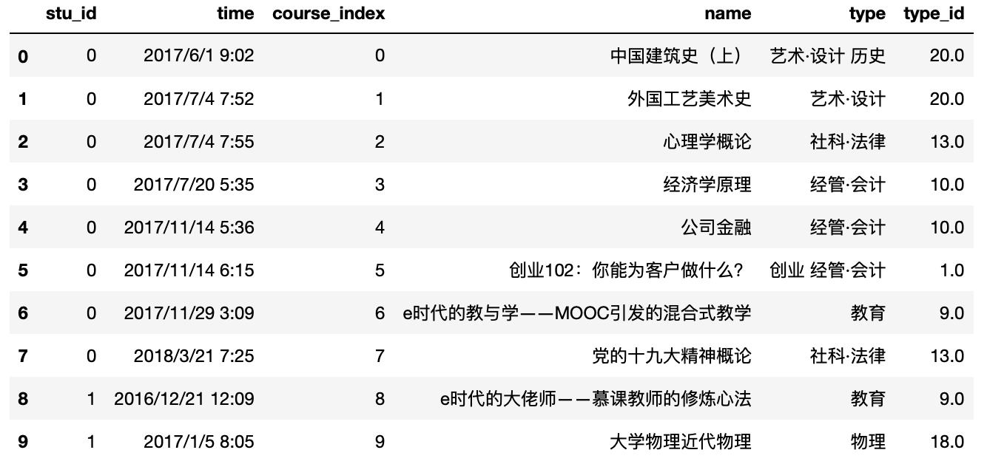
Dataset and exploratory analysis
The original dataset is acquired from MOOCData, with the following format. There are 82536 students and 1303 courses in total. And the types of courses are 79, with 23 type IDs.
Notes:
The original dataset is acquired from MOOCData, with the following format. As shown in the Figure, the dataset has 6 subjects. There are more than 82 thousand students and 1 thousand and 3 hundred courses in total. And the types of courses are 79, with 23 type ID. The reason is the Type_id only represents the ID number of the first class type.

Slide 5
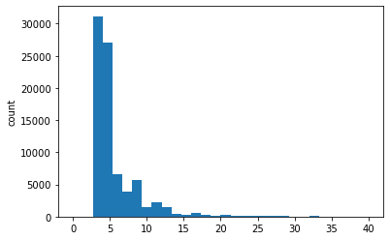
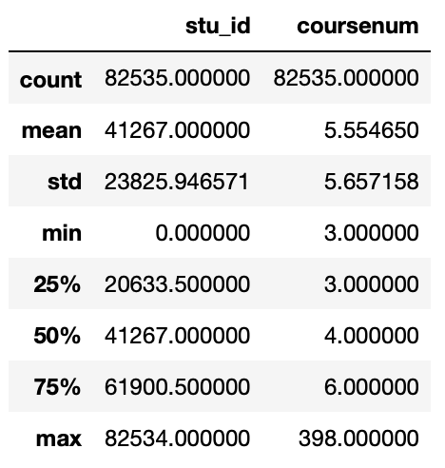
Dataset and exploratory analysis
the total length of users' chosen courses:
The average length is 5.55. The minimum is 3, and the maximum is 398. Additionally, the upper quartile is 6.
Notes:
We compute the length of users' chosen courses. And the result is shown below. The average length is 5.55. The minimum is 3, and the maximum is 398. Additionally, the upper quartile is 6. So when the course's length is 10, we can cover the majority of users' actions.

Slide 6
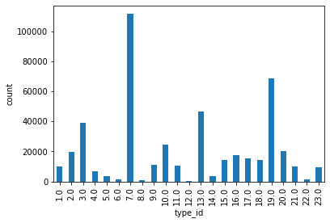
Rank | Type ID | Type name | Chosen times
1 | 7 | 计算机 Computer Science | 111542
2 | 19 | 医学·健康 Medical health | 68895
3 | 13 | 社科·法律 Law | 46372
4 | 3 | 工程 Engineering | 38911
5 | 10 | 经管·会计 Accounting | 24394
6 | 20 | 艺术·设计 Design | 20185
7 | 2 | 电子 Electrics | 19840
8 | 16 | 外语 Foreign language | 17659
9 | 17 | 文学 Literature | 15163
10 | 18 | 物理 Physics | 14531
Dataset and exploratory analysis
the type_id of users' chosen courses:
Notes:
Then we compute the distribution of type_id. Computer Science has the most chosen times, which is more than 1 hundred and ten thousand. And the second type is medical health, which is more than 60 thousand.

Slide 7
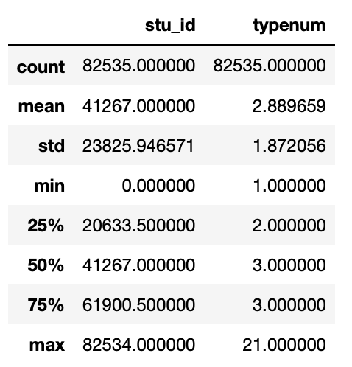
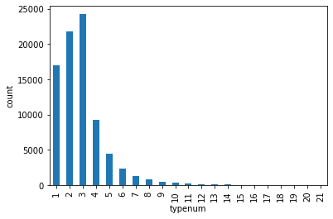
Dataset and exploratory analysis
The number of chosen types for each user:
Notes:
Similarly, we explore the type number of different users. The average length is 2.89 with a standard variance of 1.87. This means on average each user chooses courses from nearly 3 types. The minimum is 1, and the maximum is 21.

Slide 8
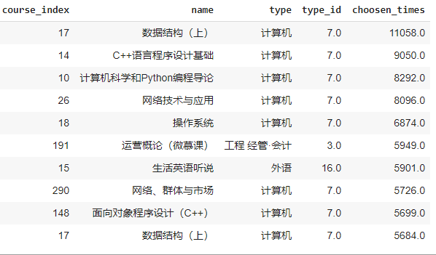
Non-Personalized Recommendation Model (Baseline)
The most basic form of recommendation system
Do not take the users' interest or preference into account
The selected indicator ------ the popularity of the courses
Already applied area:
Online community display (Reddit)

Slide 9
Bayesian Personal Ranking Model (BPR)
Personalized recommendation utilizing the users’ implicit behavior
BPR is based on Matrix Factorization
Applied area: Movie Recommendation
Online Shopping Recommendation
Relate example : Course Recommendations

Slide 10
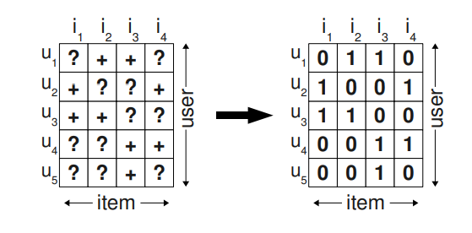
Method of BPR
the users’ implicit behavior : the past courses students have chosen
The chosen courses can be seen as positive datasets while the remaining courses can be a mixture of negative and missing values.
1 : course have been chosen
0 : course have not been chosen

Slide 11





Bayesian analysis
Likelihood function: p(i>u j|Θ)
(the individual probability that a user prefers item i over item j )
Prior probability: p(Θ)
Goal : maximise the posterior probability p(Θ|i>u j)
es
the difference between the predicted interaction between the item i and the item j
Model optimization: Stochastic gradient descent

Slide 12
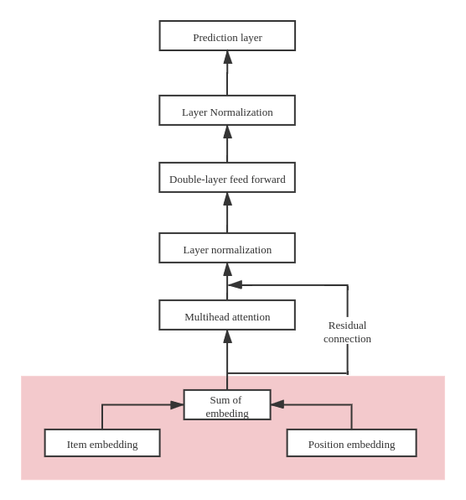
Self-Attentive Sequential Recommendation (SASRec)
Embedding
Item embedding: Embedding for course ID.
Position embedding: Embedding for the position of the course in the sequence.
Input = item embedding + position embedding
Notes:
Now, let me introduce the Self-attentive sequential recommendation model. It consists of 4 main parts. Embedding,Multihead attention, double-layer feed forward network, and finally the prediction layer.
Now, let’s begin with the embedding layer. First, we should create the embedding from the item sequence as the input to the model.
There are two embeddings we should create. The first one is item embedding, which is embedding for course ID. It is basically a linear transformation from the course ID to the embedding. And here comes an important hyperparameter, which is the dimensionality of the latent variable.
The second is the position embedding, which is the embedding for the position of the course in the sequence. We includes it to add the chronological information into the model.
At the end, we do the summation for the two embeddings and take it as the input.

Slide 13
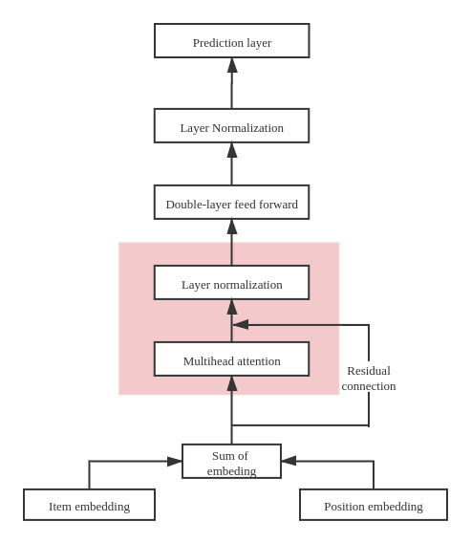


Self-Attentive Sequential Recommendation
2. Multi-head attention
The formula to calculate the attention:
Where are the the query, key, and values matrices;
Layer normalization: Normalize the inputs across all features; for the purpose of stabilizing and accelerating the training
Notes:
The second part of the model is the multi head attention. THe formula consists of three parts, query, key and value, they are all linear transformation of embedding matrix. For the output of the multihead attention, we should do the layer normalization.

Slide 14
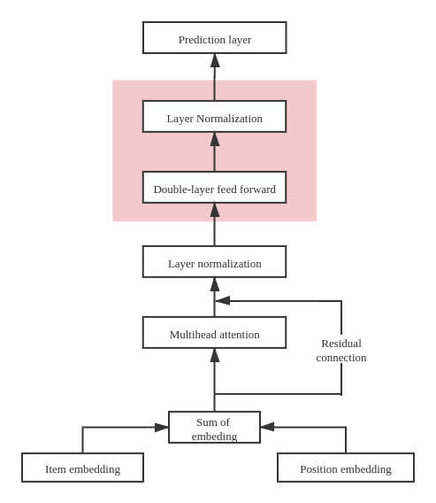
Self-Attentive Sequential Recommendation
3. Double-layer feed forward network
Since self-attentive layers aggregate the embeddings with the adaptive weights, which is essentially a linear model.
For adding nonlinearity into the model.
Notes:
The third part of the model is double-layer feed forward normalization. Since self-attentive layers aggregate the embeddings with the adaptive weights, which is essentially a linear model. We includes it for adding nonlinearity into the model.

Slide 15
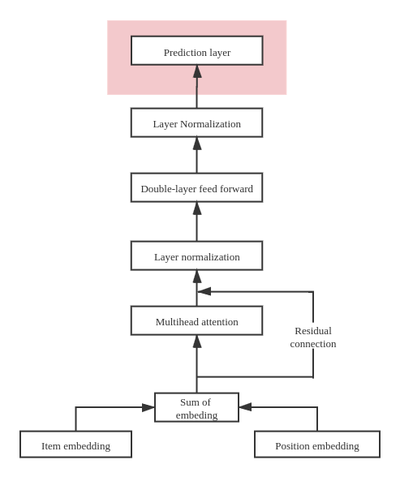
Self-Attentive Sequential Recommendation
4. Prediction layer
Product of the output and the embedding matrix of the items to obtain the score of each item.
The ranking of recommendations can be generated by sorting the scores in a descending order.
Notes:
The last part is the prediction layer. It is the product of the output of the last layer and the embedding matrix of the items to obtain the score of each item.
The ranking of recommendations can be generated by sorting them with a descending order of scores.

Slide 16
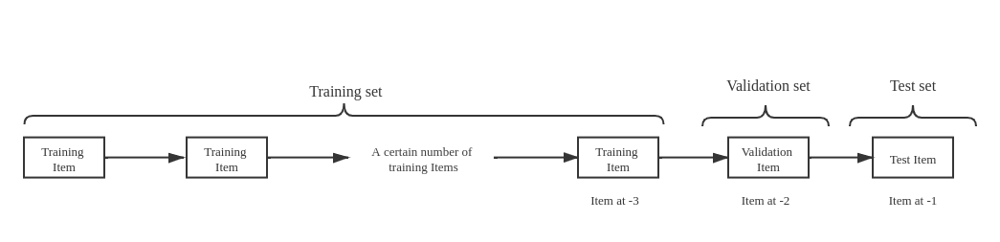

Model training of SASRec
Partitions: training set, validation set and test set.
To keep a fixed length N for each training sequence ,we prepend paddings (ItemId: 0) to the users who have selected less than N items.
Notes:
Next let me introduce the partition of the dataset for the model training. We split the sequence into three parts, the test set, the validation set and the training set. We use bootsratppping to train and validate the model.
To keep a fixed length N for each training sequence ,we prepend paddings to the users who have selected less than N. In our implementation, we denote the padding with itemid 0.

Slide 17

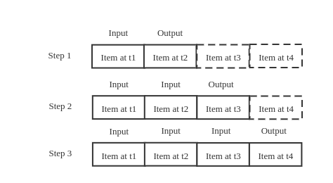
Model training of SASRec
Loss function: binary cross entropy with logit loss
Training steps:
Assume there are 4 items in the training set.
In the first step, the item at time 1 is taken into the model and used to train and predict the rating of the item at time 2.
We should prepare positive items(the ground-truth item) and negative items (randomly chosen from others)
We do the calculation at each step as time progresses until we reach the end of the training sequence.
Notes:
We adopt binary cross entropy with logit loss as our loss function.
And we train our model in an iterative way. In the first step, the item at time 1 is taken into the model and used to train and predict the rating of the item at time 2. For this purpose, we should prepare positive items(the ground-truth item) and negative items (randomly chosen from others), and calculate the loss.

Slide 18
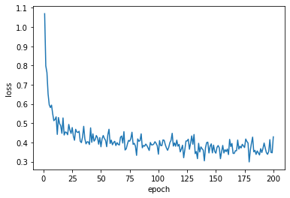
Discussion on SASRec
Learning curve
Batch size = 256
When epochs reach 50, the learning curve flattens and when epochs reach 150, the learning converges.
We adopt 50 epochs due to time constraint.
Notes:
Next it is some discussion about the SASRec model.
The first thing we want to present is the learning curve.
When epochs reach 50, the learning curve flattens and when epochs reach 150, the learning converges.
We adopt 50 epochs due to time constraint, we will update our result with 150 epochs later to finalize the report.

Slide 19
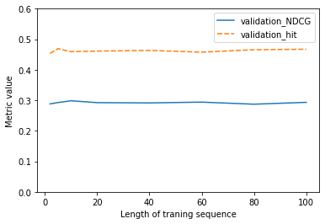
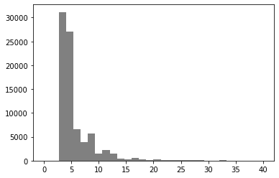
Discussion on SASRec
Experiment with various length of training sequence(maxlen)
When the sequence length is larger than 10, the model does not see improvement.
It is mainly because the mean length is 5.55, 75% quantile is 6.0.
Histogram of the sequence length for each user
Notes:
Also, we experimented the model with various length of training sequence. We can see that When the sequence length is larger than 10, the model does not see improvement.

Slide 20
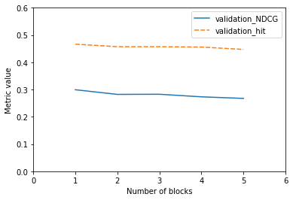
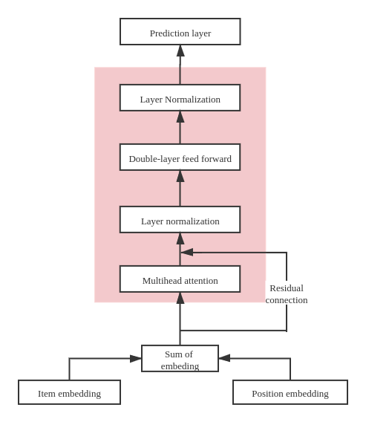
Discussion on SASRec
Experiment with various number of blocks
When the number of blocks increase, it show a slight decrease.
(one block = one self-attentive layer + one feed-forward network)
Notes:
Thirdly, we experimented the model with various numbers of blocks, the block is the pink rectangular, consists of one self-attentive layer and the subsequent feed-forward network. We can add more blocks to increase the complexity of the model.
When the number of blocks increase, it show a slight tendency to be over-fitting.

Slide 21
Evaluation metric for model comparison:
We adopted the following two metrics to evaluate the models.
Hit Rate
NDCG (Normalized discounted cumulative gain)
The cutoff is chosen as 10 for model evaluation. We will also compare the performance with different cutoff later in this presentation.
Notes:
直接念

Slide 22
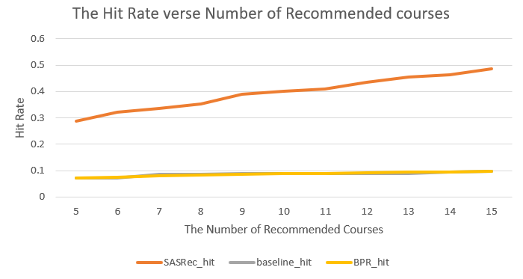
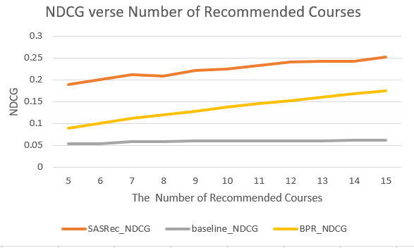
Comparison of the three models
Hit Rate
NDCG

Slide 23
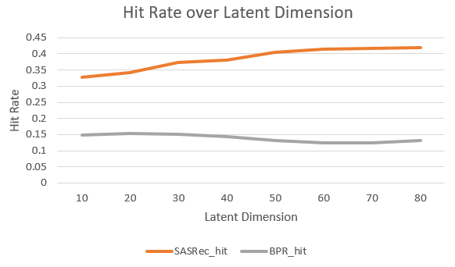
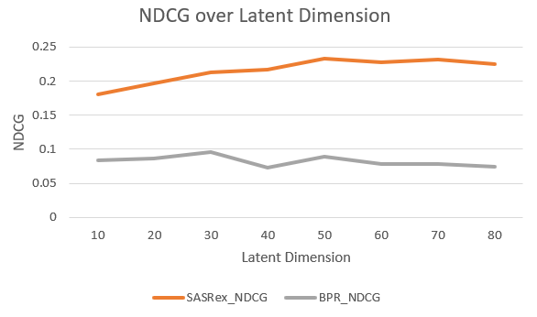
Comparison over Latent Dimension
Hit Rate
NDCG

Slide 24
Reflection
BPR model is hard to catch the time sequence factor into the model.
We could add more models based on RNN to compare the performance with SASRec.

