Slide 1
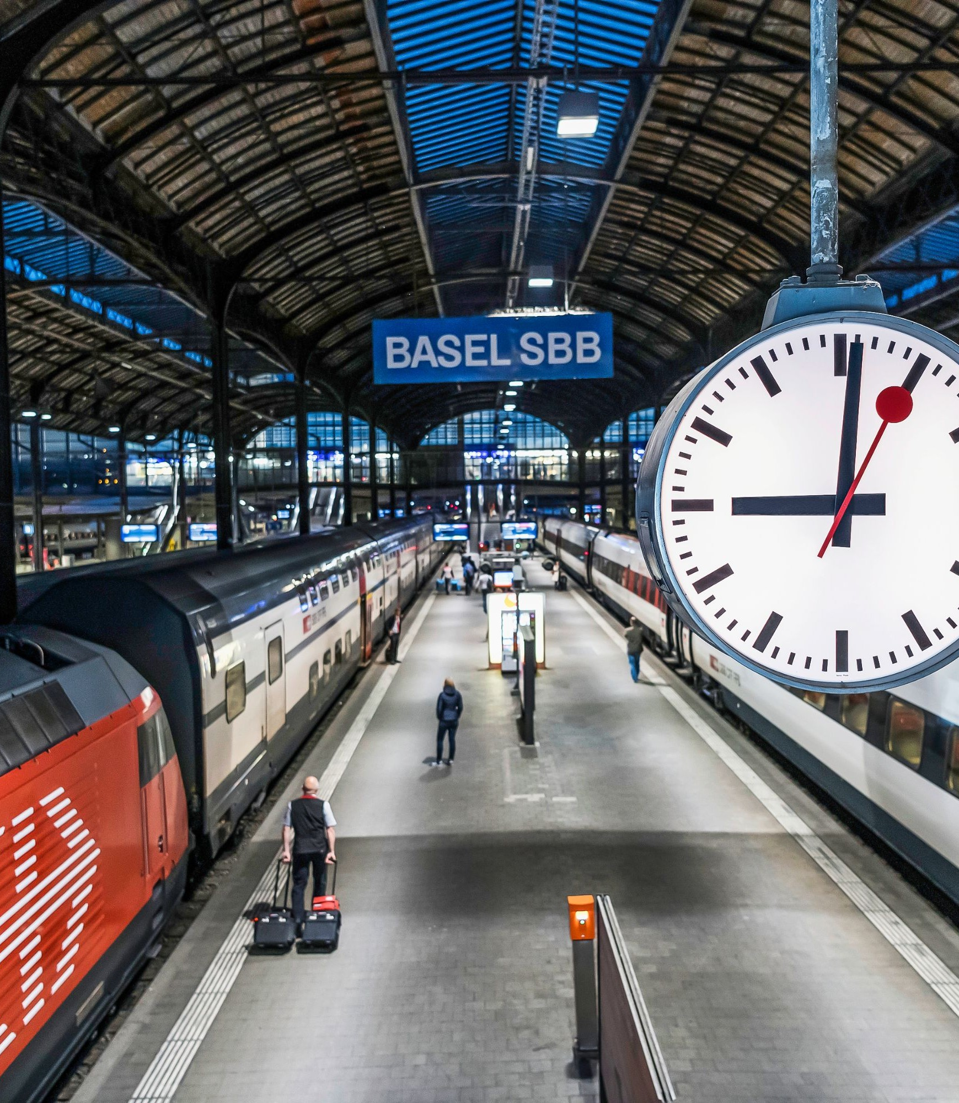
Lab in Data Science
--Final Project
Robust Journey Planning
team skr：
Kang Fu, Runke Zhou, Ruizhi Luo, Shanci Li

Slide 2
Motivation
Current route planning strategy :
1.leave as soon as possible
2.find the least time-consuming route
Risk of traditional route planning：
Probably miss a transition

Slide 3





Which one do you prefer?
Plan A :
50%
Plan B :
95%
Time

Slide 4
Robust journey planner
Planning strategy :
1. leave as late as possible
2. find the least risky route
Advantages:
1. fast and efficient route planning algorithm
2. predictive model from sbb delay history

Slide 5


Route planning algorithm
A
B
A
B

Slide 6

Find path
Search algorithm without time limit
all_simple_path()
Search depth
Maximum number of transfer
A
B
Too small
Better routes may not be selected
A
B
Too big
Useless paths & High Computational Complexity

Slide 7

Select route given arrive time
Backtrace method
A
B
C
D
Departure stop
Arrival stop
B
C
D
Backtrace Time
Arrival time
Departure time

Slide 8
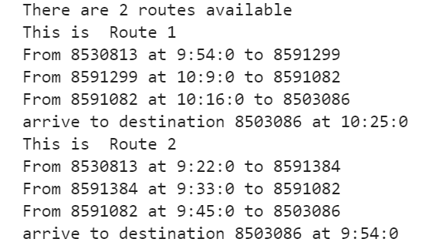
Final route
From 8530813 to 8503086 before 10:25:00"

Slide 9
Delay Model
Data: SBB data from 2018-2020
Assumptions:
1. Delay based on stops (based on stop_id)
2. Delay based on transport types (based on transport_type)
3. Delay may vary depends on different time periods
(morning, noon, afternoon)

Slide 10
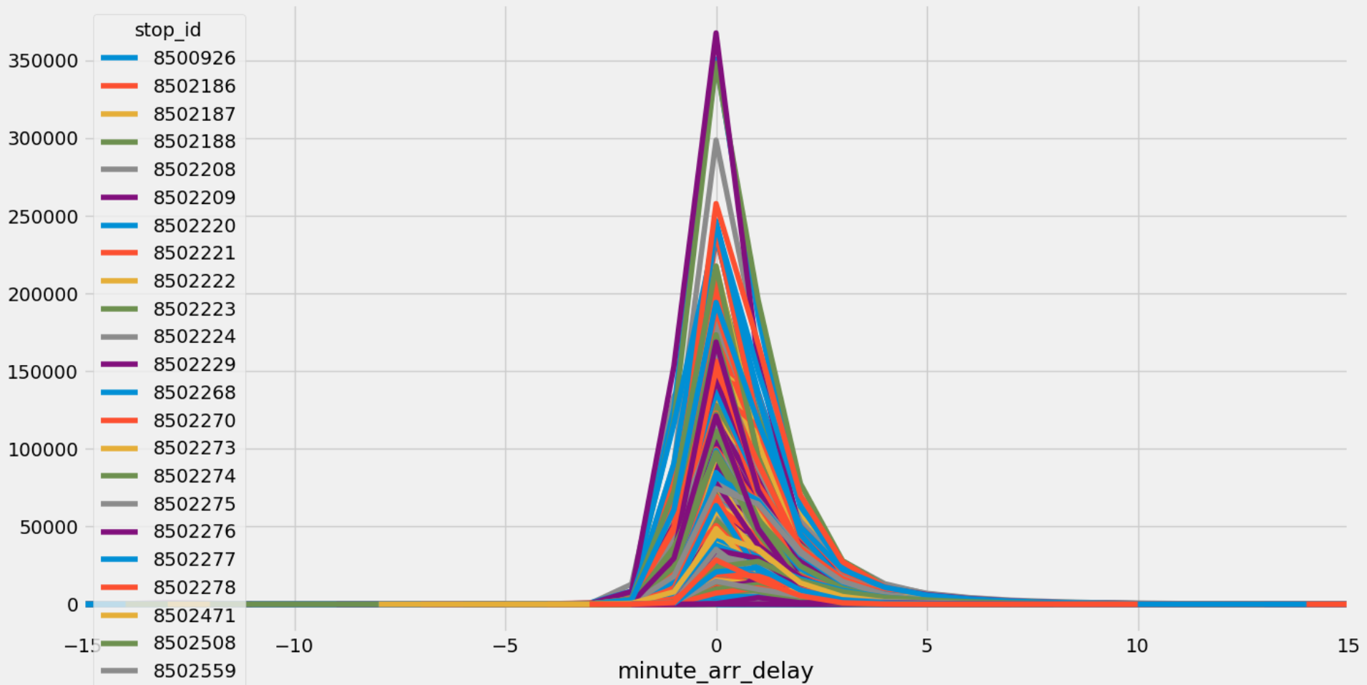
Delay Distribution of Stops
Normal Distribution

Slide 11
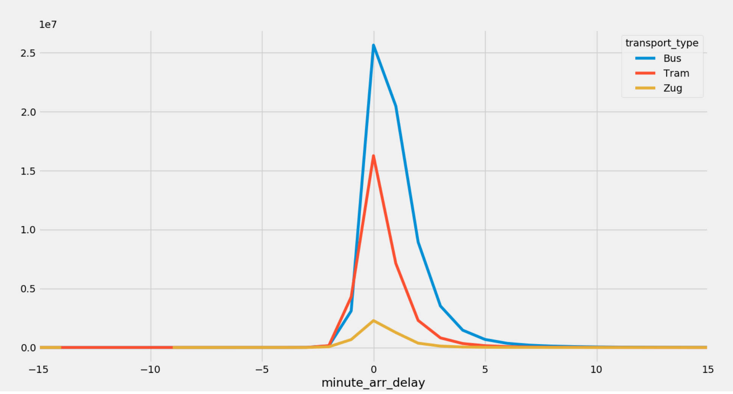
Delay Distribution of Transport Type
Normal Distribution

Slide 12
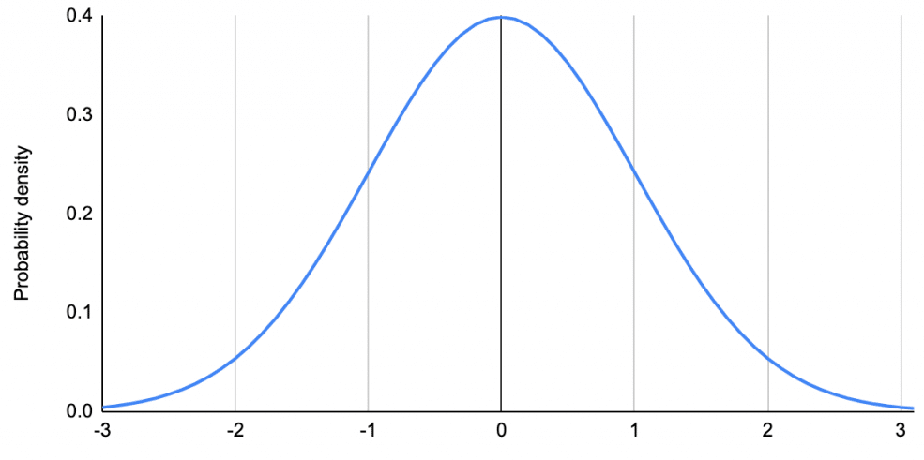
Success Probability Calculation
For each sub-route
Given stop_id,
transport_type,
time_period,
max-delay to catch next sub-route
Find the mean and standard deviation
Calculate the probability
cdf(1)
Max-delay

Slide 13
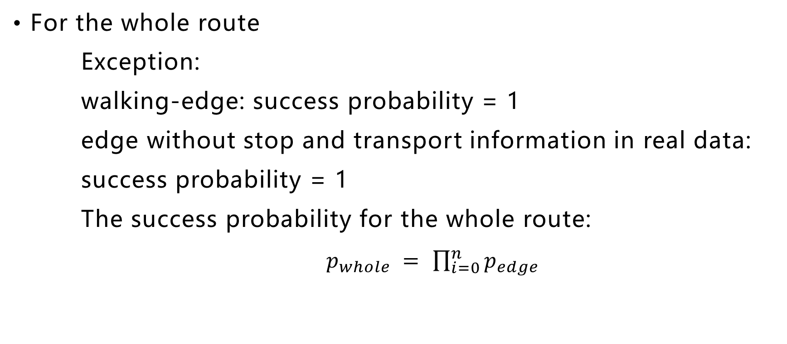
Success Probability Calculation
For the whole route
Exception:
walking-edge: success probability = 1
edge without stop and transport information in real data:
success probability = 1
The success probability for the whole route:
$p_{whole }= \prod_{i=0}^{n}{p_{edge}}$

Slide 14
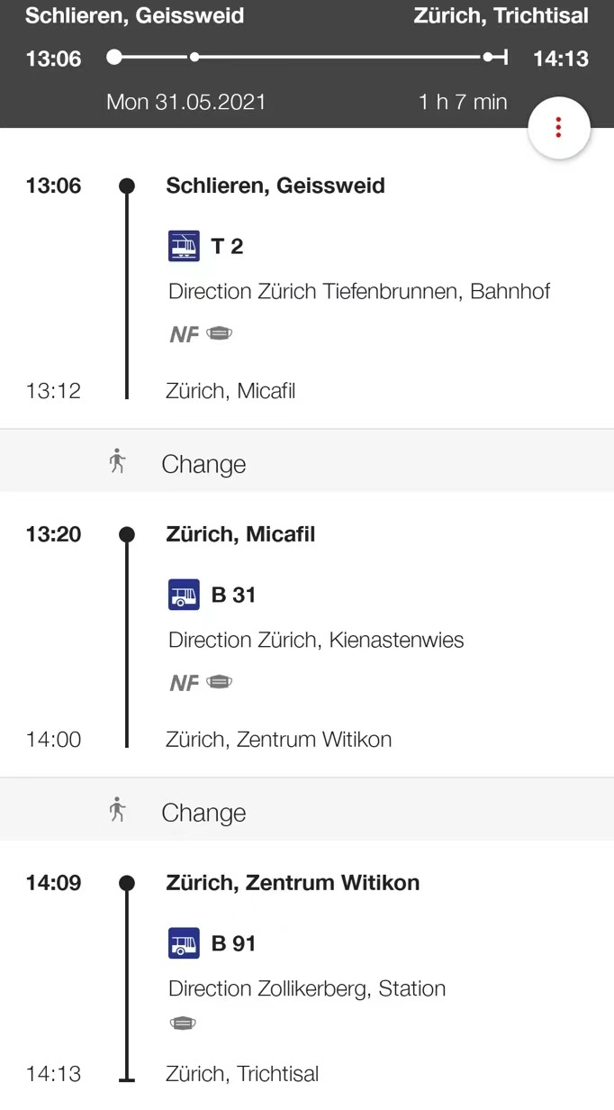
Validation
High Delay of two stops
From Schlieren, Geissweid walk to Schlieren, Zentrum at 13.17 probability 1
Then take Bus 31 to Zürich, Carl-Spitteler-Strasse at 14.07 probability 0.49
Then take Bus 91 to Zürich, Trichtisal at 14.13 probability 0.49
Total success probability 0.24

Slide 15
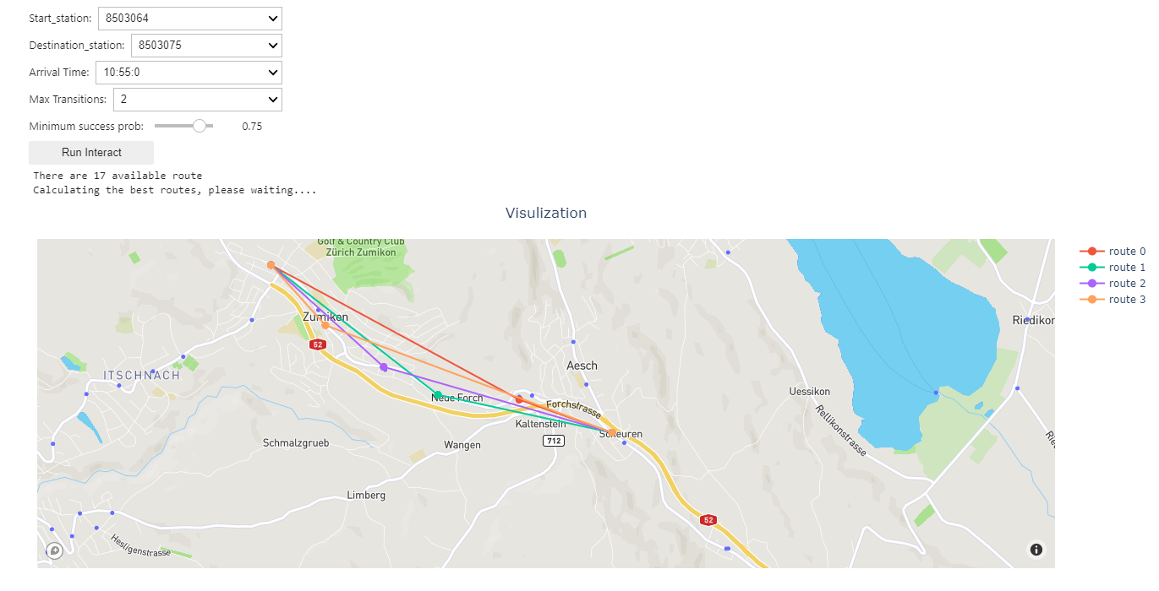
Visualization

Slide 16
Further we can do:
Use real-time data and streaming processing:
Delay model with dependence between stops
Leverage other related data:
Weather/traffic conditions
More accurate and vivid visualization:
Route fixed to real roads

