Slide 1
FINAL ACADEMIC PROJECT DEFENSE
Intelligent Multilingual Grievance Categorization &
Automated Dispatch Framework
for Central Government Portals
ARCHITECTURE
4-Tier Microservices (React, Express, FastAPI, Postgres)
MACHINE LEARNING
TF-IDF Vectorization + Calibrated Logistic Regression
EVALUATION DATASET
675 Academic Synthetic Samples (9 Categories)
VERIFICATION
99 Automated Tests Passing (34 Pytest, 65 Node Tests)

Slide 2
BACKGROUND & MOTIVATION
Problem Statement: Central Portal Triage Bottlenecks
Identified Operational Bottlenecks
Operational Impact & Target Focus
• High Complaint Latency: Central portals receive thousands of complaints daily; manual triage creates massive processing backlogs.
• Frequent Misrouting: Citizens manually select target departments from dropdown menus, leading to inter-department transfers.
• Unprioritized Safety Risks: Urgent infrastructure or public safety hazards wait in line behind routine inquiries.
• Multilingual Barrier: Citizens file complaints in diverse regional Indic scripts, creating language translation barriers for officers.
• Opaque Citizen Tracking: Lack of automated contextual status assistance leaves citizens unaware of complaint progress.
• Triage Latency: Manual sorting creates processing delays before complaints reach officer queues.
• Routing Accuracy: High frequency of inter-department misrouting when citizens select target departments manually.
• Emergency Escalation: Lack of automated keyword detection to escalate urgent leaks, power hazards, or contamination.
• Language Friction: Non-English regional complaints face severe processing delays due to manual script identification.

Slide 3
PROJECT GOALS
Project Objectives & Technical Scope
1. Automated AI Classification
2. Urgency & Priority Assessment
Implement statistical machine learning (TF-IDF + Logistic Regression) to classify raw complaint text into 9 primary government domains with confidence scores.
Analyze emergency keywords to predict complaint priority (LOW, MEDIUM, HIGH, CRITICAL) and assign SLA resolution deadlines.
3. Confidence-Based Human Review
4. Explainable AI (XAI) Transparency
Establish automated thresholding (75% confidence) to route uncertain AI predictions to administrators for human classification correction.
Extract exact TF-IDF token contribution weights for predictions, providing clear feature explanations for every assigned category.
5. Role-Based Governance
6. Intent-Based Conversational Chatbot
Build isolated web portals for Citizens (submit & track), Officers (department-locked queues & status updates), and Admins (analytics & overrides).
Provide a 24/7 multi-turn citizen assistant for status tracking, reference retrieval, filing guidance, and department inquiry.

Slide 4
SYSTEM COMPARISON
System Comparison: Existing Manual vs Proposed Framework
Feature / Dimension | Existing Conventional Portals | Proposed Intelligent Framework
Department Triage | Manual selection by citizen; high error rate. | Automated TF-IDF + Logistic Regression classification.
Priority & Urgency | First-in-first-out (FIFO); no emergency urgency flag. | Urgency term analysis assigning LOW to CRITICAL SLAs.
Uncertain Predictions | Accepted automatically or misrouted silently. | Confidence threshold check (75%) flagging human review.
Explainability (XAI) | Black-box or manual administrative decision. | Exact TF-IDF token contribution scores returned per class.
Citizen Support | Static FAQ pages or slow email queries. | 24/7 multi-turn intent-based chatbot for reference tracking.

Slide 5
SYSTEM ARCHITECTURE
Decoupled 4-Tier Microservices Architecture
1. React + TS Frontend UI
Port 80 (Nginx) / 5173
Single Page App (SPA), AuthContext, Axios API Client, Role-based Dashboards, Tailwind CSS
2. Node.js + Express Gateway
Port 5000
JWT Auth, RBAC Middleware, Workflow Logic, Prisma ORM, Notification Triggers
3. Python FastAPI AI Service
Port 8001
FastAPI, Scikit-learn ML Pipeline, Langdetect, Priority Predictor, Chatbot Engine
4. PostgreSQL 15 Database
Port 5432 / 5433
Relational persistence: Users, Departments, Grievances, Status History, Notifications

Slide 6
TECH STACK
Technology Stack & Core Dependencies
Frontend UI Layer
Backend Gateway Layer
• Framework: React 18 + TypeScript
• Build Tool: Vite
• Styling: Tailwind CSS
• Icons: Lucide React
• Runtime: Node.js v20+
• Framework: Express.js v4
• ORM: Prisma ORM v6
• Security: JWT + bcryptjs
AI Microservice Layer
Database & DevOps
• Language: Python 3.11 / 3.13
• Framework: FastAPI
• ML Toolkit: Scikit-learn + Joblib
• NLP: Langdetect
• Database: PostgreSQL 15
• Containerization: Docker & Docker Compose
• Testing: Pytest & Node --test
• Quality: ESLint & Vite Build

Slide 7
DATABASE SCHEMA
Database Design: Prisma Relational Schema Models
Model: User
Stores account credentials, role (CITIZEN, OFFICER, ADMIN), and optional department_id for officers.
Model: Department
Master catalog of 9 government departments (Water Supply, Electricity, PWD, Healthcare, etc.).
Model: Grievance
Central entity storing complaint text, status, priority, department, AI confidence, XAI terms, and human correction flags.
Model: GrievanceStatusHistory
Immutable audit trail capturing status transitions (SUBMITTED → UNDER_REVIEW → RESOLVED/REJECTED) and officer remarks.
Model: Notification
In-app citizen notification records triggered on workflow events (STATUS_CHANGED, REVIEW_FLAGGED).

Slide 8
WORKFLOW LIFECYCLE
End-to-End Grievance Processing & Resolution Workflow
1. Submission
2. Language & Prep
3. ML Inference
4. Urgency Analysis
Citizen enters complaint text (min 5 chars).
Langdetect checks script; text lowercased.
TF-IDF + LogReg predicts category & confidence.
Urgency keywords set priority & SLA hours.
5. Confidence Check
6. DB Persistence
7. Officer Review
8. Citizen Notice
Conf < 75% flags ai_review_required: true.
Saved in Postgres; reference GRV-2026-XXXX issued.
Department officer updates status + remarks.
In-app status change notification sent.

Slide 9
MACHINE LEARNING
AI/ML Methodology: TF-IDF + Logistic Regression
TF-IDF Feature Representation
Logistic Regression & XAI Explanations
• N-gram Range: ngram_range=(1, 2) (Unigrams & Bigrams)
• Max Features: max_features=5000 top informative terms
• Sublinear TF: sublinear_tf=True (1 + log(tf) scaling)
• Preprocessing: lowercase=True, stop-word & noise removal
• Mathematical TF-IDF: TF-IDF(t,d) = TF(t,d) x log(N / df_t)
• Inverse Reg Strength: C=2.5 (optimal fit / regularization balance)
• Solver & Iterations: solver='lbfgs', max_iter=1000, seed=42
• Softmax Multiclass: P(y=k|x) = exp(w_k.x + b_k) / Sum(exp(w_j.x + b_j))
• XAI Token Weights: Score(t) = TF-IDF(t) x w_predicted_class(t)
• Academic Disclaimer: Does NOT use Transformer models or LLMs

Slide 10
HUMAN-IN-THE-LOOP
Confidence Thresholding & Human Classification Review
HIGH Confidence (>= 0.75)
AUTOMATIC DISPATCH
ai_review_required: false. Complaint is routed directly to the predicted department queue.
Audit Trail: Admin correction updates category & department_id, preserving ai_original_category and setting is_human_corrected: true.
MEDIUM Confidence (0.50 - 0.74)
FLAGGED FOR HUMAN REVIEW
ai_review_required: true. Complaint is flagged in Admin dashboard for manual inspection.
Audit Trail: Admin correction updates category & department_id, preserving ai_original_category and setting is_human_corrected: true.
LOW Confidence (< 0.50)
ESCALATED HUMAN REVIEW
ai_review_required: true. Low-confidence or out-of-domain text assigned category 'Other'.
Audit Trail: Admin correction updates category & department_id, preserving ai_original_category and setting is_human_corrected: true.

Slide 11
MULTILINGUAL & CHATBOT
Multilingual Language Detection & Intent Chatbot
Multilingual Handling (Langdetect)
Intent-Based Citizen Chatbot (9 Intents)
• Language Detector: Uses langdetect library to identify ISO-639-1 language codes (en, hi, ta, te, mr, etc.).
• Script Preservation: Preserves original regional text in Postgres without altering citizen input.
• Keyword Fallback: Applies keyword rules for regional script domain terms.
• Honest Disclaimer: Does NOT perform IndicTrans2 neural translation; regional text preserved as-is.
• 9 Explicit Intents: GREETING, PRIORITY_INFO, PROCESS_INFO, TRACKING_GUIDANCE, SUBMIT_GUIDANCE, DEPT_INFO, HELP, GRIEVANCE_STATUS, UNKNOWN.
• Entity Extraction: Regex matches GRV-YYYY-XXXXXX reference tracking codes.
• Context Recall: Session context memory recalls last_grievance_number for pronouns ('it', 'this complaint').
• Data Privacy: Filters queries by authenticated user's grievances (user_id == req.user.id).

Slide 12
SECURITY & PRIVACY
Security Architecture & Role-Based Access Control
JWT Authentication
Password Security
Stateless 24-hour JSON Web Tokens passed in Authorization: Bearer header. Validated via authenticate middleware.
Salted bcrypt hashing (cost factor 10) applied to passwords prior to PostgreSQL persistence.
Role-Based Access Control
Citizen Ownership Isolation
requireRole('CITIZEN', 'OFFICER', 'ADMIN') middleware blocks unauthorized endpoint invocation with HTTP 403.
Grievance lookups strictly include where: { user_id: req.user.id }, preventing cross-user data access.
Officer Department Isolation
SQL Injection Protection
Officer queues filter by where: { department_id: req.user.department_id }, enforcing department boundaries.
Prisma ORM parameterizes all SQL database queries, eliminating raw SQL string injection risks.

Slide 13
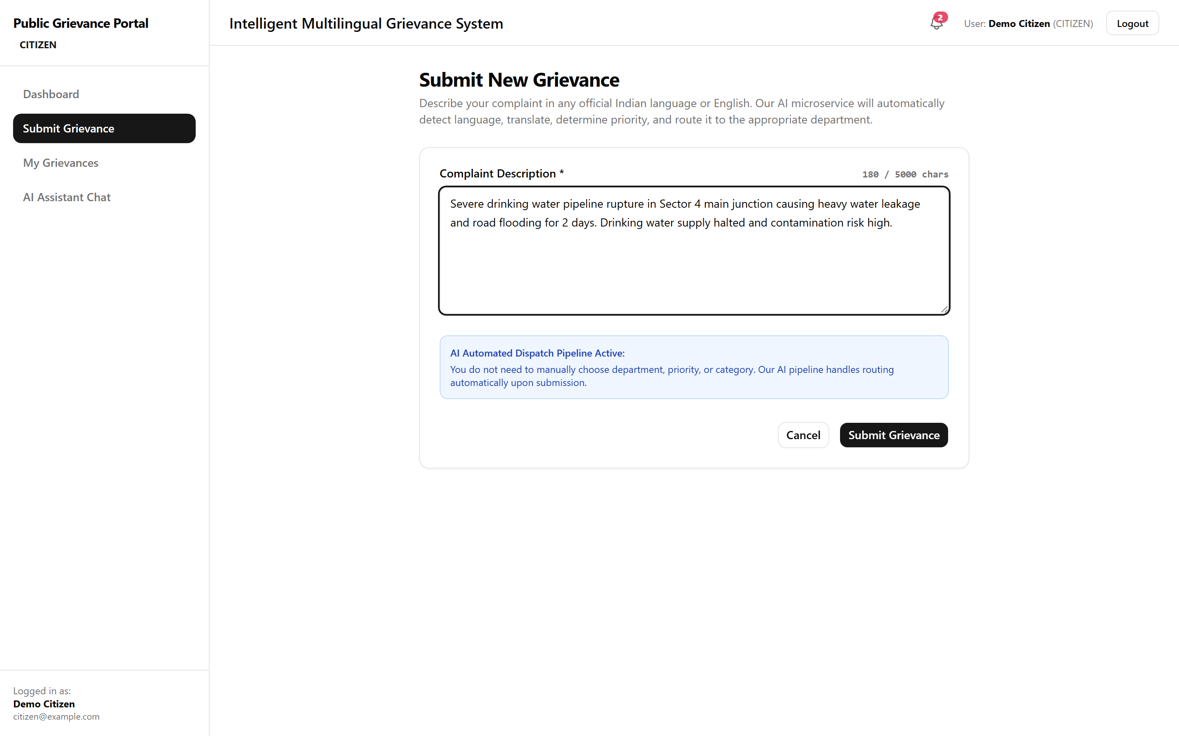
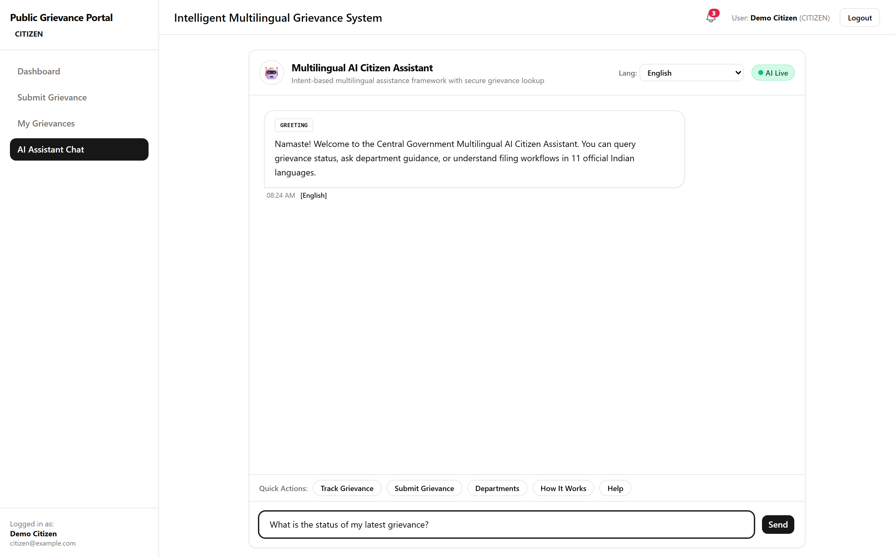
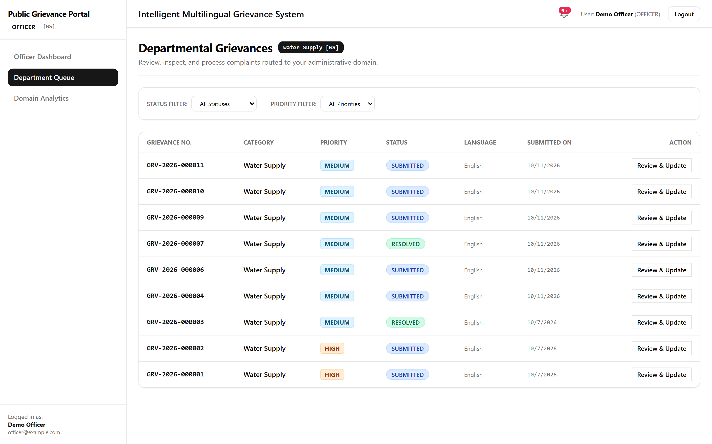
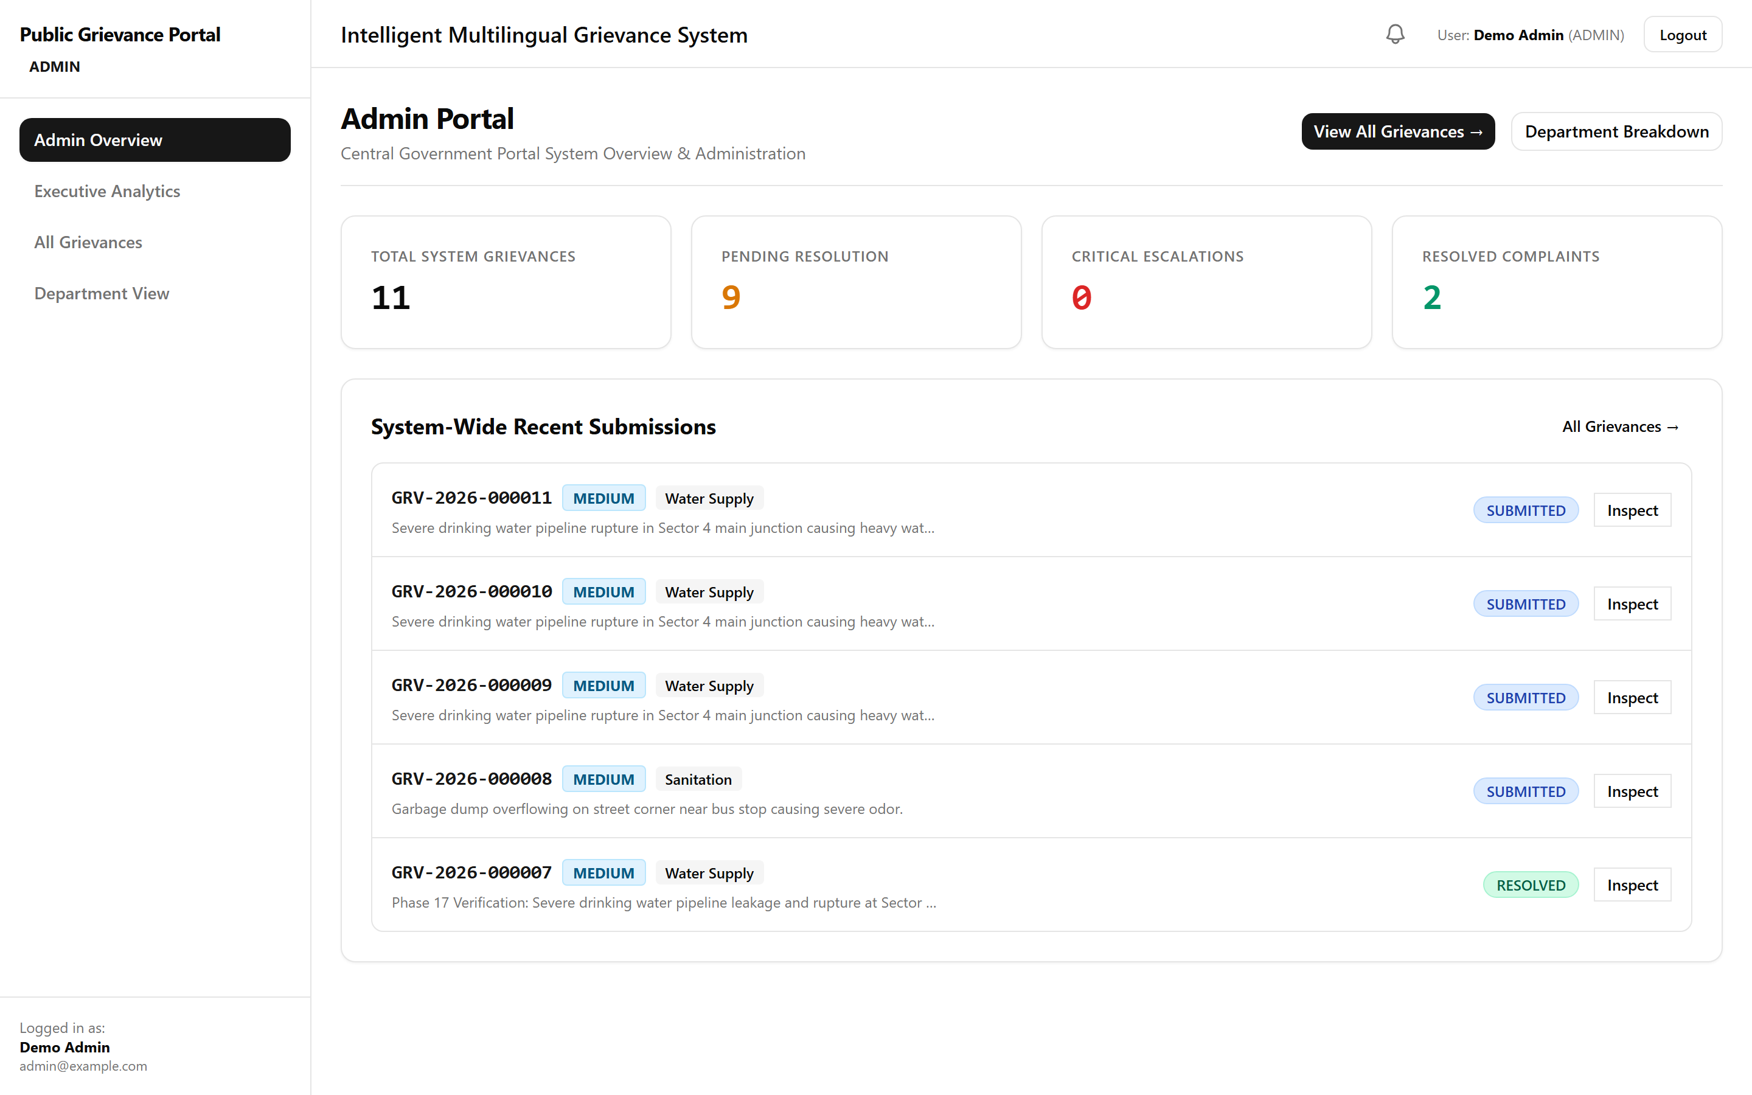
UI SHOWCASE
Application User Interface & Portal Demonstration
1. Citizen Submission
2. Multilingual Chatbot
3. Officer Queue
4. Admin Overview

Slide 14
TESTING RESULTS
Empirical Testing & Verification Metrics
34 / 34 Passed
Python Pytest AI Suite
65 / 65 Passed
Node Backend Suite
0 Errors
Frontend ESLint Quality
SUCCESS
Vite Production Build
Empirical ML Evaluation: Clean Benchmark vs Realistic Edge Cases
• Clean Benchmark Split: 675 synthetic samples split strictly into Train (472, 70%), Validation (101, 15%), and Test (102, 15%). Seed: 42.
• Clean Test Accuracy: 100.0% accuracy, precision, recall, and F1-score on clean held-out test split (102 samples) via evaluate_classifier.py.
• Realistic Edge-Case Test: 79.63% accuracy (86/108 correct) on 108 realistic validation cases with typos, slang, and multi-issue text via error_analysis.py.
• Human Review Safety Net: 88.9% (96/108) of ambiguous validation cases safely flagged for Human Review (confidence < 0.75), preventing automated misrouting.
• Academic Honesty: Synthetic templates achieve 100%, but noisy inputs reduce direct ML accuracy to ~80%, proving the necessity of confidence thresholding.

Slide 15
CONCLUSION & FUTURE SCOPE
Conclusion, Verified Limitations & Future Roadmap
Verified Technical Limitations
Future Technical Enhancements
• Classifier Scope: Uses TF-IDF + Logistic Regression (does NOT use BERT or deep Transformers).
• Language Limits: Language detection active; regional text preserved without neural IndicTrans2 translation.
• Chatbot Scope: Explicit intent matching schemas; not a generative LLM or RAG model.
• Synthetic Dataset: Evaluated on 675 synthetic samples; real-world government data required for production scale.
• IndicBERT Transformer: Fine-tune IndicBERT or mBERT embeddings for contextual Indic language understanding.
• Neural Translation: Integrate IndicTrans2 NMT model for 22 official Indian languages.
• Active Learning Pipeline: Collect admin human corrections to automatically retrain model weights.
• Telephony & SMS: Connect Twilio / NIC SMS & WhatsApp gateways for low-literacy populations.

