Slide 1

TDMA Schedule Planner
and EMANE Integration
Technical Project Presentation
PART 1
16-node TDMA
Candidate: Thamarai Kannan P
Part 1: TDMA Scheduling | Part 2: EMANE Integration
PART 2
EMANE approach
Technical explanation • documented results • implementation evidence
Notes:
Introduce the project in one sentence: first solve the 16-node TDMA scheduling problem, then carry that schedule into EMANE for integration and validation.

Slide 2
Project Objective
01
What the project is designed to achieve
Problem
Objective
• Allocate TDMA transmission slots to 16 nodes.
• Prevent modeled one-hop and two-hop conflicts.
• Reuse slots where nodes are non-conflicting.
• Carry the final schedule into an EMANE runtime.
• Build and verify a conflict graph.
• Generate a conflict-free TDMA assignment.
• Convert the mapping into an EMANE TDMA schedule.
• Validate schedule behavior with controlled tests.
INPUT
CORE OUTPUT
INTEGRATION
16-node topology
9-slot schedule
EMANE runtime
TDMA Schedule Planner and EMANE Integration
02
Notes:
Explain the problem first, then the expected technical flow. Avoid going into implementation details yet.

Slide 3
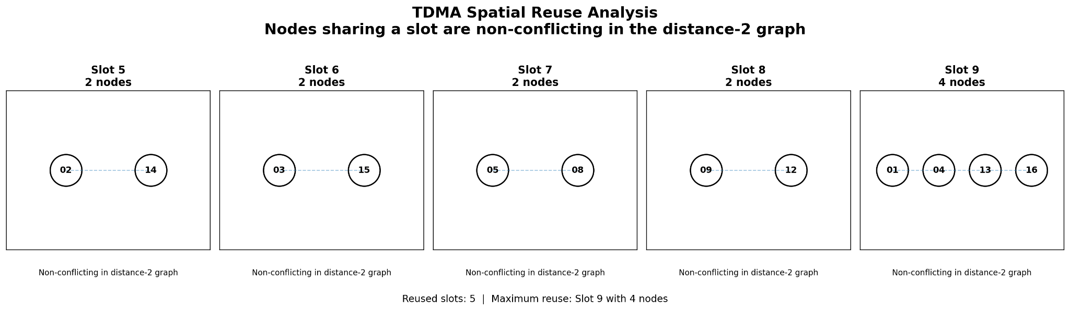
Network & Conflict Model
02
The scheduling constraint is represented as a distance-2 conflict graph
NODES
COMMUNICATION RANGE
DIRECT LINKS
DISTANCE-2 CONFLICT LINKS
16
500 m
42
90
How conflicts are defined
• The network is converted into a conflict graph.
• Conflicting nodes cannot be assigned the same slot.
• Distance-2 modeling includes direct and two-hop conflict relationships.
N
N
N
N
N
TDMA Schedule Planner and EMANE Integration
03
Notes:
State the documented network values. Then explain why the conflict graph is needed: TDMA slot sharing is decided by conflict relationships, not simply by node identity.

Slide 4
TDMA Scheduling Approach
03
From conflict graph to verified slot assignment
1. Build conflict graph
2. Apply graph coloring
3. Generate initial slots
4. Local optimization
5. Verify every conflict
Coloring strategies tested
SELECTION
Fewest-slot result among tested strategies
STRATEGY 1
Largest First (LF)
The selected coloring is followed by local optimization.
STRATEGY 2
Smallest Last (SL)
VERIFICATION
Conflict-free assignment
STRATEGY 3
Saturation Largest First (SLF)
Every edge in the distance-2 conflict graph is checked.
Heuristic result — not a proof of minimum slots
TDMA Schedule Planner and EMANE Integration
04
Notes:
Explain that graph coloring maps naturally to slot allocation: each color represents a TDMA slot. Mention the three tested strategies, local optimization, and explicit verification. State that the solution is heuristic.

Slide 5
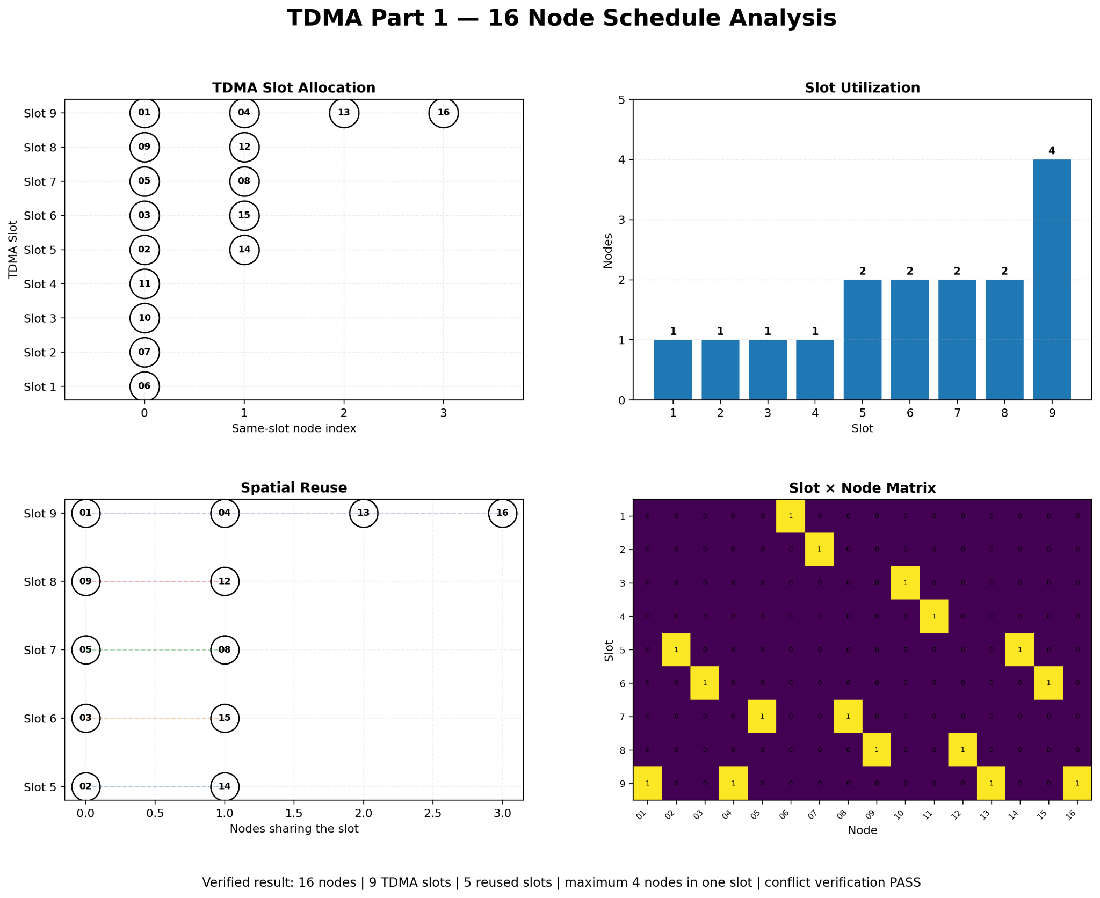
Final Schedule — Key Results
04
The verified output of Part 1
TDMA Schedule Planner and EMANE Integration
05
Notes:
Use the consolidated schedule analysis figure. Point out 16 nodes, 9 slots, 5 reused slots, maximum 4 nodes in one slot, and conflict verification PASS.

Slide 6
Node-to-Slot Mapping
04
Exact mapping used for the final schedule
Node | Slot | Node | Slot
Node_01 | 9 | Node_09 | 8
Node_02 | 5 | Node_10 | 3
Node_03 | 6 | Node_11 | 4
Node_04 | 9 | Node_12 | 8
Node_05 | 7 | Node_13 | 9
Node_06 | 1 | Node_14 | 5
Node_07 | 2 | Node_15 | 6
Node_08 | 7 | Node_16 | 9
SCHEDULE
9 slots
REUSE
5 slots
MAXIMUM
Slot 9 → 4 nodes
TDMA Schedule Planner and EMANE Integration
06
Notes:
Read the exact mapping. Highlight Node_01 = Slot 9 because it is used in the later EMANE enforcement test.

Slide 7
Spatial Reuse
04
Why multiple nodes can share the same TDMA slot
TDMA Schedule Planner and EMANE Integration
07
Notes:
Explain that Slots 5, 6, 7, 8 and 9 are reused. The nodes shown in each group are non-conflicting in the distance-2 graph, so the slot can be reused.

Slide 8
Python → EMANE Integration
05
The Part 1 schedule becomes the Part 2 runtime input
01
02
03
04
05
Node-to-Slot
Mapping
→
generate_emane_schedule.py
→
emane_tdma_schedule.xml
→
EMANE Event-TDMA
Schedule
→
16-NEM Runtime
PYTHON ROLE
EMANE ROLE
Schedule generation + XML conversion
Load schedule + runtime behavior
Uses the final Node-to-Slot mapping as the bridge input.
The generated event-TDMA schedule is loaded into the 16-NEM runtime.
Scheduler output → EMANE schedule → runtime validation
TDMA Schedule Planner and EMANE Integration
08
Notes:
This is the key Part 2 explanation. The important point is the interface: the Part 1 Node-to-Slot mapping is converted to an EMANE TDMA schedule.

Slide 9
EMANE Runtime Configuration & Validation
05
Documented runtime settings and acceptance checks
NEMS
SLOT DURATION
FRAMES
16
1 ms
1
TDMA SLOTS
FREQUENCY
BANDWIDTH
9
2.4 GHz
1 MHz
DATA RATE
SERVICE CLASS
SCHEDULEACCEPTFULL
1 Mbit/s
0
1 for NEMs 1–16
TESTED REJECTION COUNTERS
NEM SCHEDULE ACCEPTANCE
RUNTIME RESULT
0
16 / 16
ACCEPTED
TDMA Schedule Planner and EMANE Integration
09
Notes:
Explain the configuration values that matter to understanding the test, then state the documented acceptance result: all 16 NEMs accepted the regenerated schedule and tested rejection counters remained zero.

Slide 10
Packet-Level Enforcement Test
06
Controlled comparison of allowed and blocked transmission
NODE_01
→
EMANE INDEX
→
TX TEST
TDMA Slot 9
8 (zero-based)
controlled
ALLOWED CASE
BLOCKED CASE
50 frames → 17 packets
50 frames → 0 packets
NEM 1 has a TX opportunity in the corresponding TDMA slot.
The corresponding TX opportunity is removed in a clean run.
ENFORCEMENT RESULT: PASS
TDMA Schedule Planner and EMANE Integration
10
Notes:
Explain the mapping Node_01 → Slot 9 → EMANE zero-based index 8. Then compare the two clean test cases: allowed gives 17 upstream packets; blocked gives 0.

Slide 11
Implementation Structure
07
How the solution is organized in code
SCHEDULING
EMANE / VALIDATION
main.py
End-to-end Part 1 execution
generate_emane_schedule.py
Node-to-Slot → EMANE XML
graph_builder.py
Communication and distance-2 conflict graph
send_tdma_test.py
Raw Ethernet test
coloring.py
Graph-coloring strategies
validate_emane.py
Generated XML validation
scheduler.py
Slot numbering and local optimization
Part2_Enforcement_Evidence.txt
Allowed / blocked evidence
verifier.py
Conflict verification
TDMA Schedule Planner and EMANE Integration
11
Notes:
Briefly explain the module boundaries. Keep this slide focused on understanding the project structure, not on reading code.

Slide 12
Conclusion & Technical Takeaways
08
The complete project story in four points
SCHEDULE
VERIFICATION
INTEGRATION
ENFORCEMENT
16 nodes → 9 slots
Conflict verification → PASS
Python mapping → EMANE TDMA schedule
17 allowed → 0 blocked-case packets
What I should be able to explain
What the evidence shows
• Why graph coloring is used for TDMA slot assignment
• Why distance-2 conflicts are modeled
• Why the reused-slot nodes do not conflict
• Why 9 slots is a heuristic result, not a proven minimum
• The final schedule is verified
• The regenerated schedule was accepted by 16 NEMs
• Tested rejection counters remained zero
• The controlled allowed / blocked test changed packet behavior
TDMA Schedule Planner and EMANE Integration
12
Notes:
Conclude with the end-to-end story. Be ready to expand verbally on the four technical takeaways and the evidence.

Slide 13
THANK YOU

