Slide 1
Simulation of wdm using optism
PRESENTED BY- UNDER SUPERVISION OF
LAXMIKANT (214022) PROF. B.B. TIWARI
PRINCE PATEL(214025)
SANDEEP YADAV(214007)
SANJEEV KUMAR(214026)

Slide 2
CONTENTS
Foreword
Objective
Challenges before
Requisite
Operative
Pros
Conclusion

Slide 3
Foreword
In fiber-optic communications, wavelength-division multiplexing (WDM) is a technology which multiplexes a number of optical carrier signals onto a single optical fiber by using different wavelengths (i.e., colors) of laser light. This technique enables bidirectional communications over one strand of fiber, as the term wavelength-division multiplexing is commonly applied to an optical carrier, which is typically described by its wavelength, whereas frequency-division multiplexing typically applies to a radio carrier which is more often described by frequency.

Slide 4
Objective
ONE OF THE MOST PROMISING CONCEPTS FOR HIGH CAPACITY COMMUNICATION SYSTEMS IS WAVELENGTH DIVISION MULTIPLEXING (WDM).
EACH COMMUNICATION CHANNEL IS ALLOCATED TO A DIFFERENT FREQUENCY AND MULTIPLEXED ONTO A SINGLE FIBER. AT THE DESTINATION WAVELENGTHS ARE SPATIALLY SEPARATED TO DIFFERENT RECEIVER LOCATIONS..

Slide 5
Challenges before
Due to the rapid growth in telecommunication links, high capacity and faster data transmission rates over farther distances are required. To meet these demands, network managers are relying more and more on fiber optics.

Slide 6
Requisite
HARDWARE REQUIREMENTS
Processor : 2.0 GHZ AND above.
Memory : 2 GB RAM.
Hard Disk : 80 GB HDD.
Technology used
Front End : OPTISM
Back End : MySql.

Slide 7
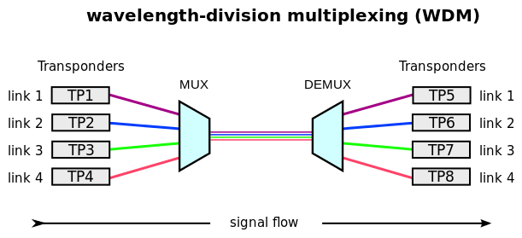
Operative

Slide 8
Pros
It increases the information carrying capacity of a fiber
It has greater transmission capacity
Duplex transmission
Easy system expansion
Lower cost

Slide 9
Conclusion
WDM works by combining and splitting signals in different systems ranging from telecommunications to imaging systems. There are many WDM products including CWDM MUX/DEMUX, DWDM MUX/DEMUX, CWDM & DWDM optical add-drop multiplexer, WDM filter and so on.

Slide 10
Thank you

