Slide 1
A Machine Learning Project on
Lung Cancer Prediction

Slide 2
Objective
Build a classification model that predicts the lung-cancer (classification model) based on symptomatic and lifestyle data
Refine the model and deploy in streamlit cloud

Slide 3
Methodology
Perform data cleaning
Explore and preprocess the data
Visualize the data
Build a preliminary model with logistic regression
Use RandomForest Classifier model and compare accuracy
Try with XGBOOST and compare the accuracy
Tune the best model using GridSearchCV
Deploy the the best trained model in streamlit cloud

Slide 4
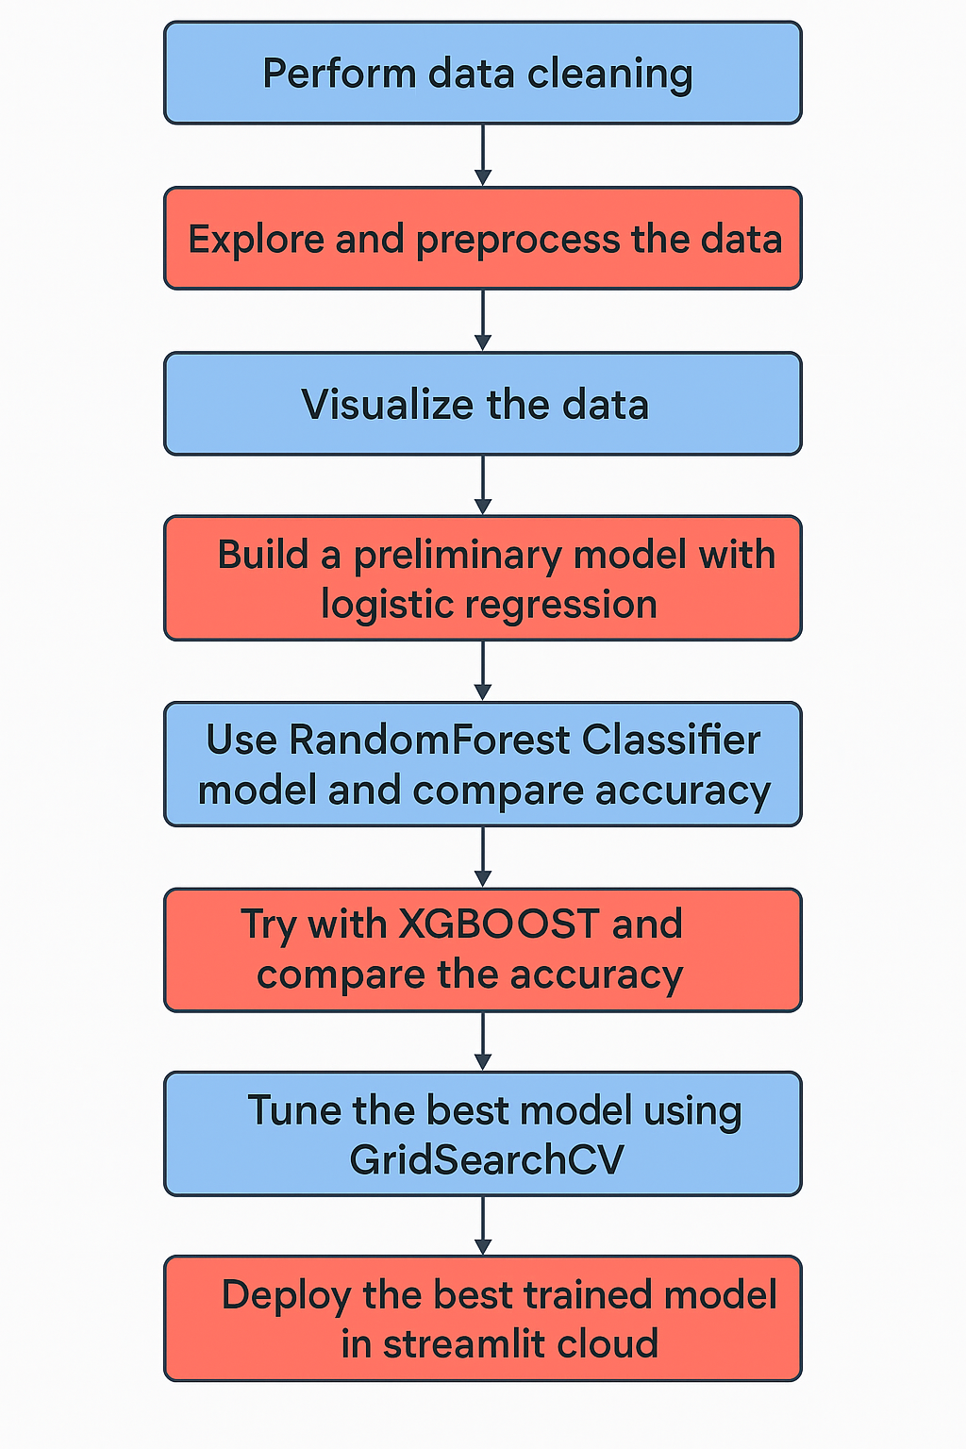
Methodology

Slide 5
SMOTE (Synthetic Minority Oversampling Technique)
Works only with numerical features
STEPS:
Identify the minority class in the target variable.
For each sample in the minority class:
Find its k-nearest neighbors (typically k=5) from the same class.
Randomly pick one or more neighbors.
Generate synthetic samples:
For each selected neighbor, generate a new sample by interpolating
between the original sample and its neighbor.

Slide 6
SMOTE-NC (SMOTE for Nominal and Continuous features)
Used when the dataset has a mix of numerical and categorical features
Steps:
Identify categorical and continuous columns:
You must tell SMOTENC which features are categorical (via categorical_features parameter).
For each minority class sample:
Compute nearest neighbors using only continuous features (numeric).
Generate synthetic samples:
For numerical features: Use the same interpolation method as SMOTE.
For categorical features:
Select the most frequent category among the k-nearest neighbors (mode), or randomly pick one of the neighbor’s categorical values.

Slide 7
Deployment Steps
Save the best trained model in .pkl format to the disc using joblib library
Create front end app.py python script file that integrates the front end code with trained model .pkl file to predict on the user input data
Create the requirements.txt file that mentions the dependencies
Upload the below mentioned files to GitHub public repository
1. app.py python script file
2. dataset .csv file
3. trained model .pkl file
4. requirements.txt file
Login to Streamlit cloud with GitHub details and launch the app

