Slide 1
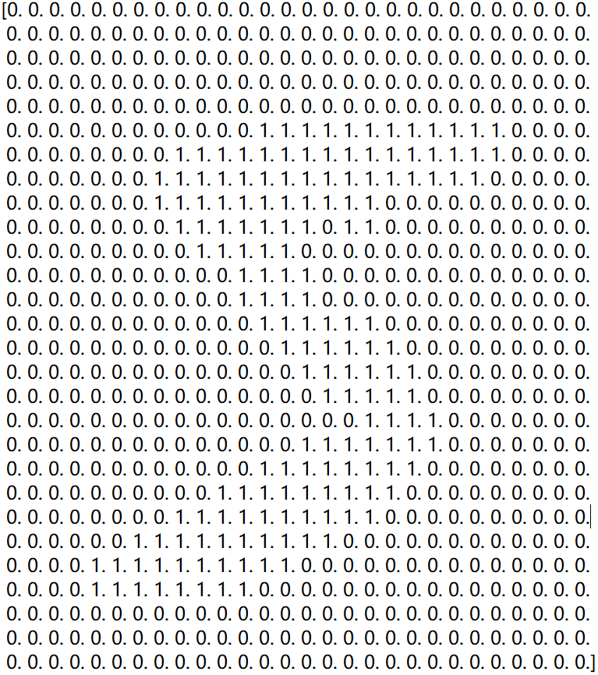
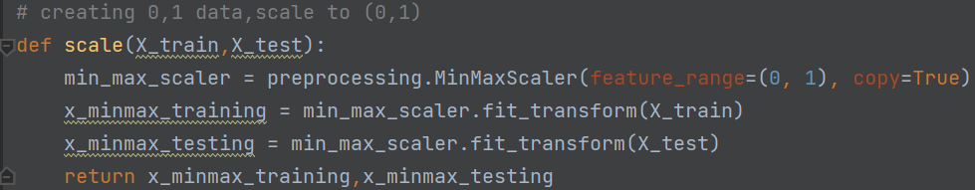
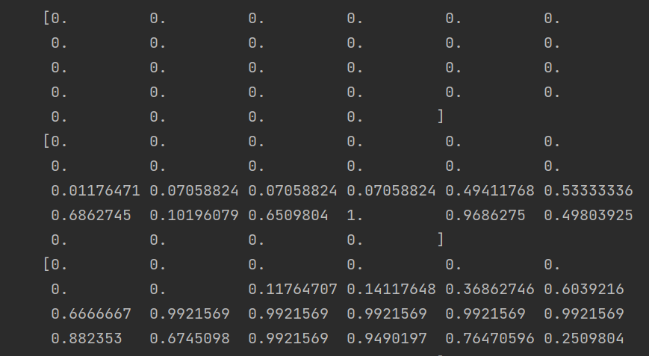
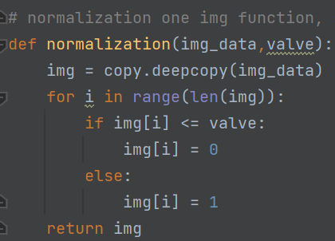

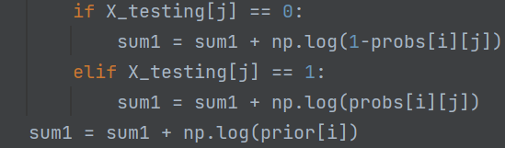
Naive Bayes
1.data-processing (dataset from http://yann.le-cun.com/exdb/mnist/)
i.Thresholding---->0/1 data
ii.Normalization---->data value in (0,1)
2. My-simple Bayes(Bernoulli)
special process:
1.Laplace Smoothing:
2.log calculation:

Slide 2
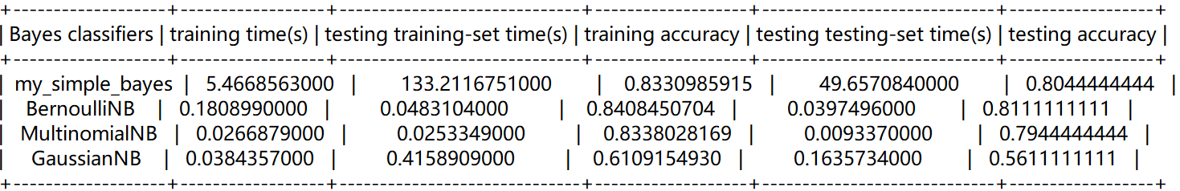
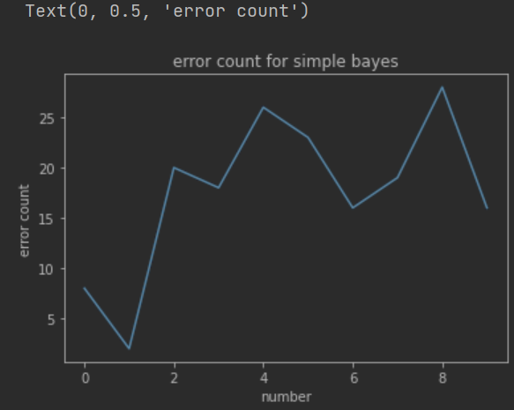
3.performances for 4 Navie_Bayes classifiers
performances Comparasion(sklearn ML package)
1. BernoulliNB and MultinomialNB run faster than other two
2. Bernoulli get the highset accuracy ( fit 0/1 data) , multinomial get middle(fit (0,1) data), Gaussian get the lowest( data doesn’t follow Gaussian distribution)
error count for BernoulliNB
’8’ has most error rate

Slide 3
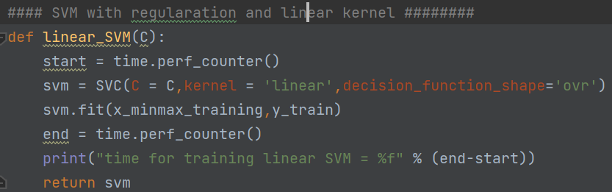
SVM
1.data-processing
Normalization---->data value in (0,1), same as before
2. model training and testing
Train 4 tpyes of SVM:
SVM with regularation C and linear kernel
SVM with regularation C and poly kernel
SVM with regularation C and rbf kernel
SVM with regularation C and gamma for rbf kernel
SVM with regularation and linear kernel
3. paramater setting
Using K-fold Cross-validation, 5 fold for training set, accuracy = mean value of 5 times accuracy
Using grid search method, find the best params in a given range

Slide 4
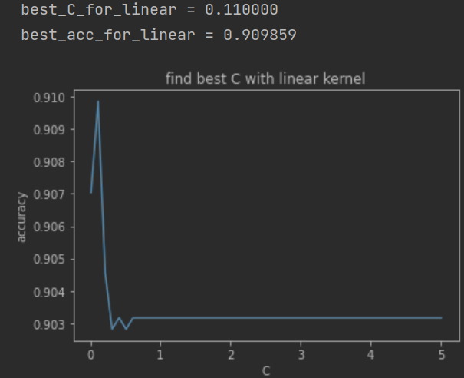
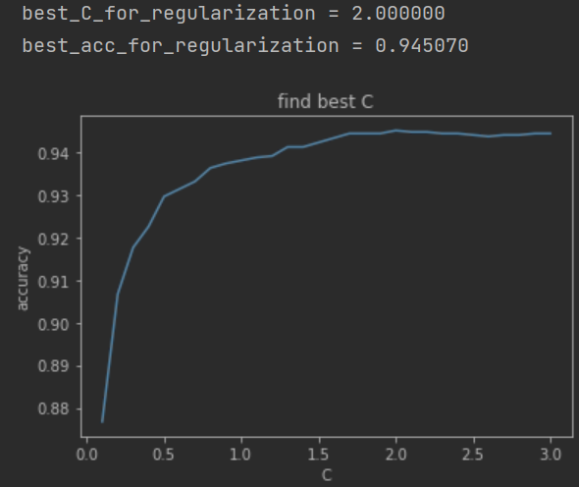

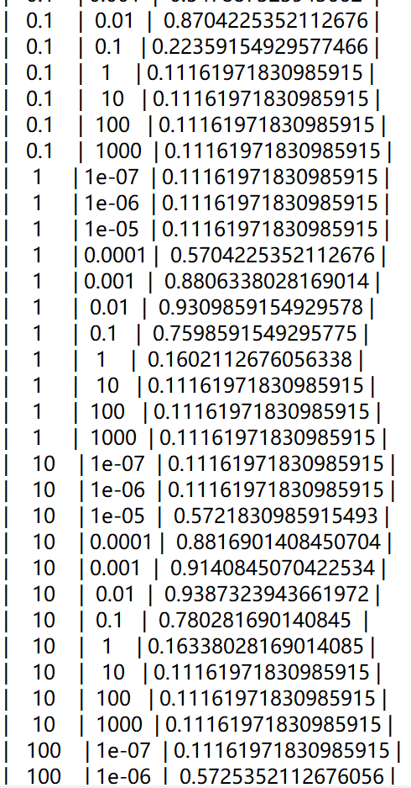
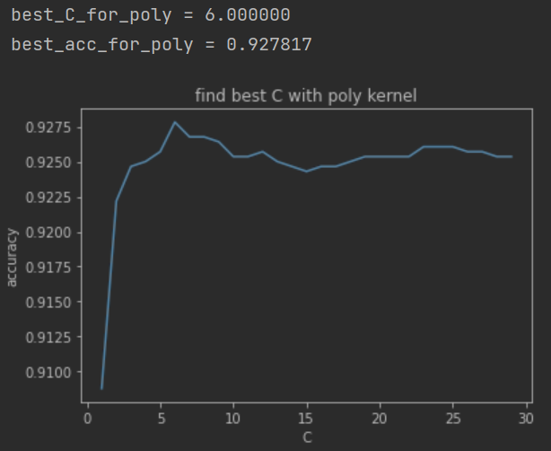
3. paramater setting
SVM with regularation C and linear kernel
SVM with regularation C and rbf kernel
SVM with regularation C and gamma for rbf kernel
SVM with regularation C and poly kernel

Slide 5
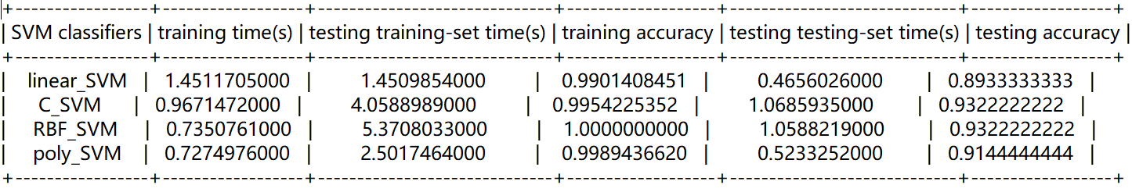
4.performance
1. Linear_SVM < poly_SVM < RBF_SVM
2. RBF_SVM will take more time

