Slide 1
Final view of Tablet user interface with map
Design 1

Slide 2
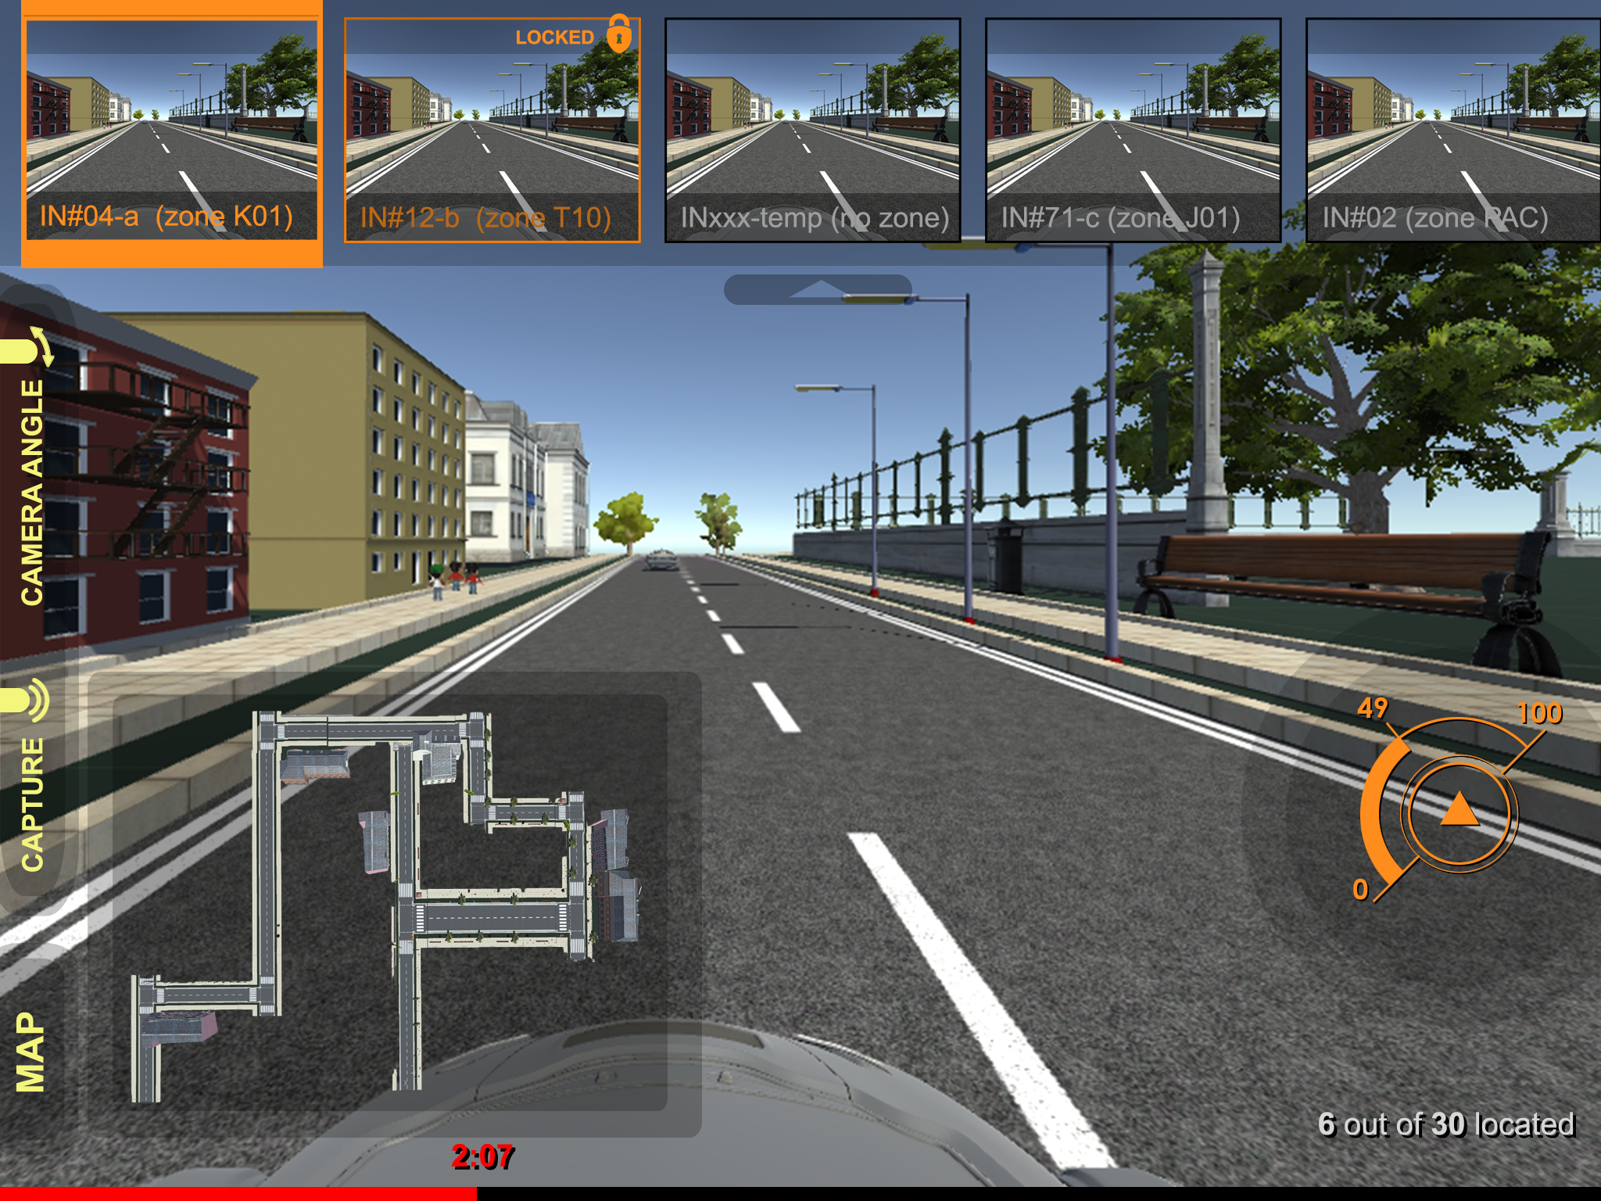

Slide 3
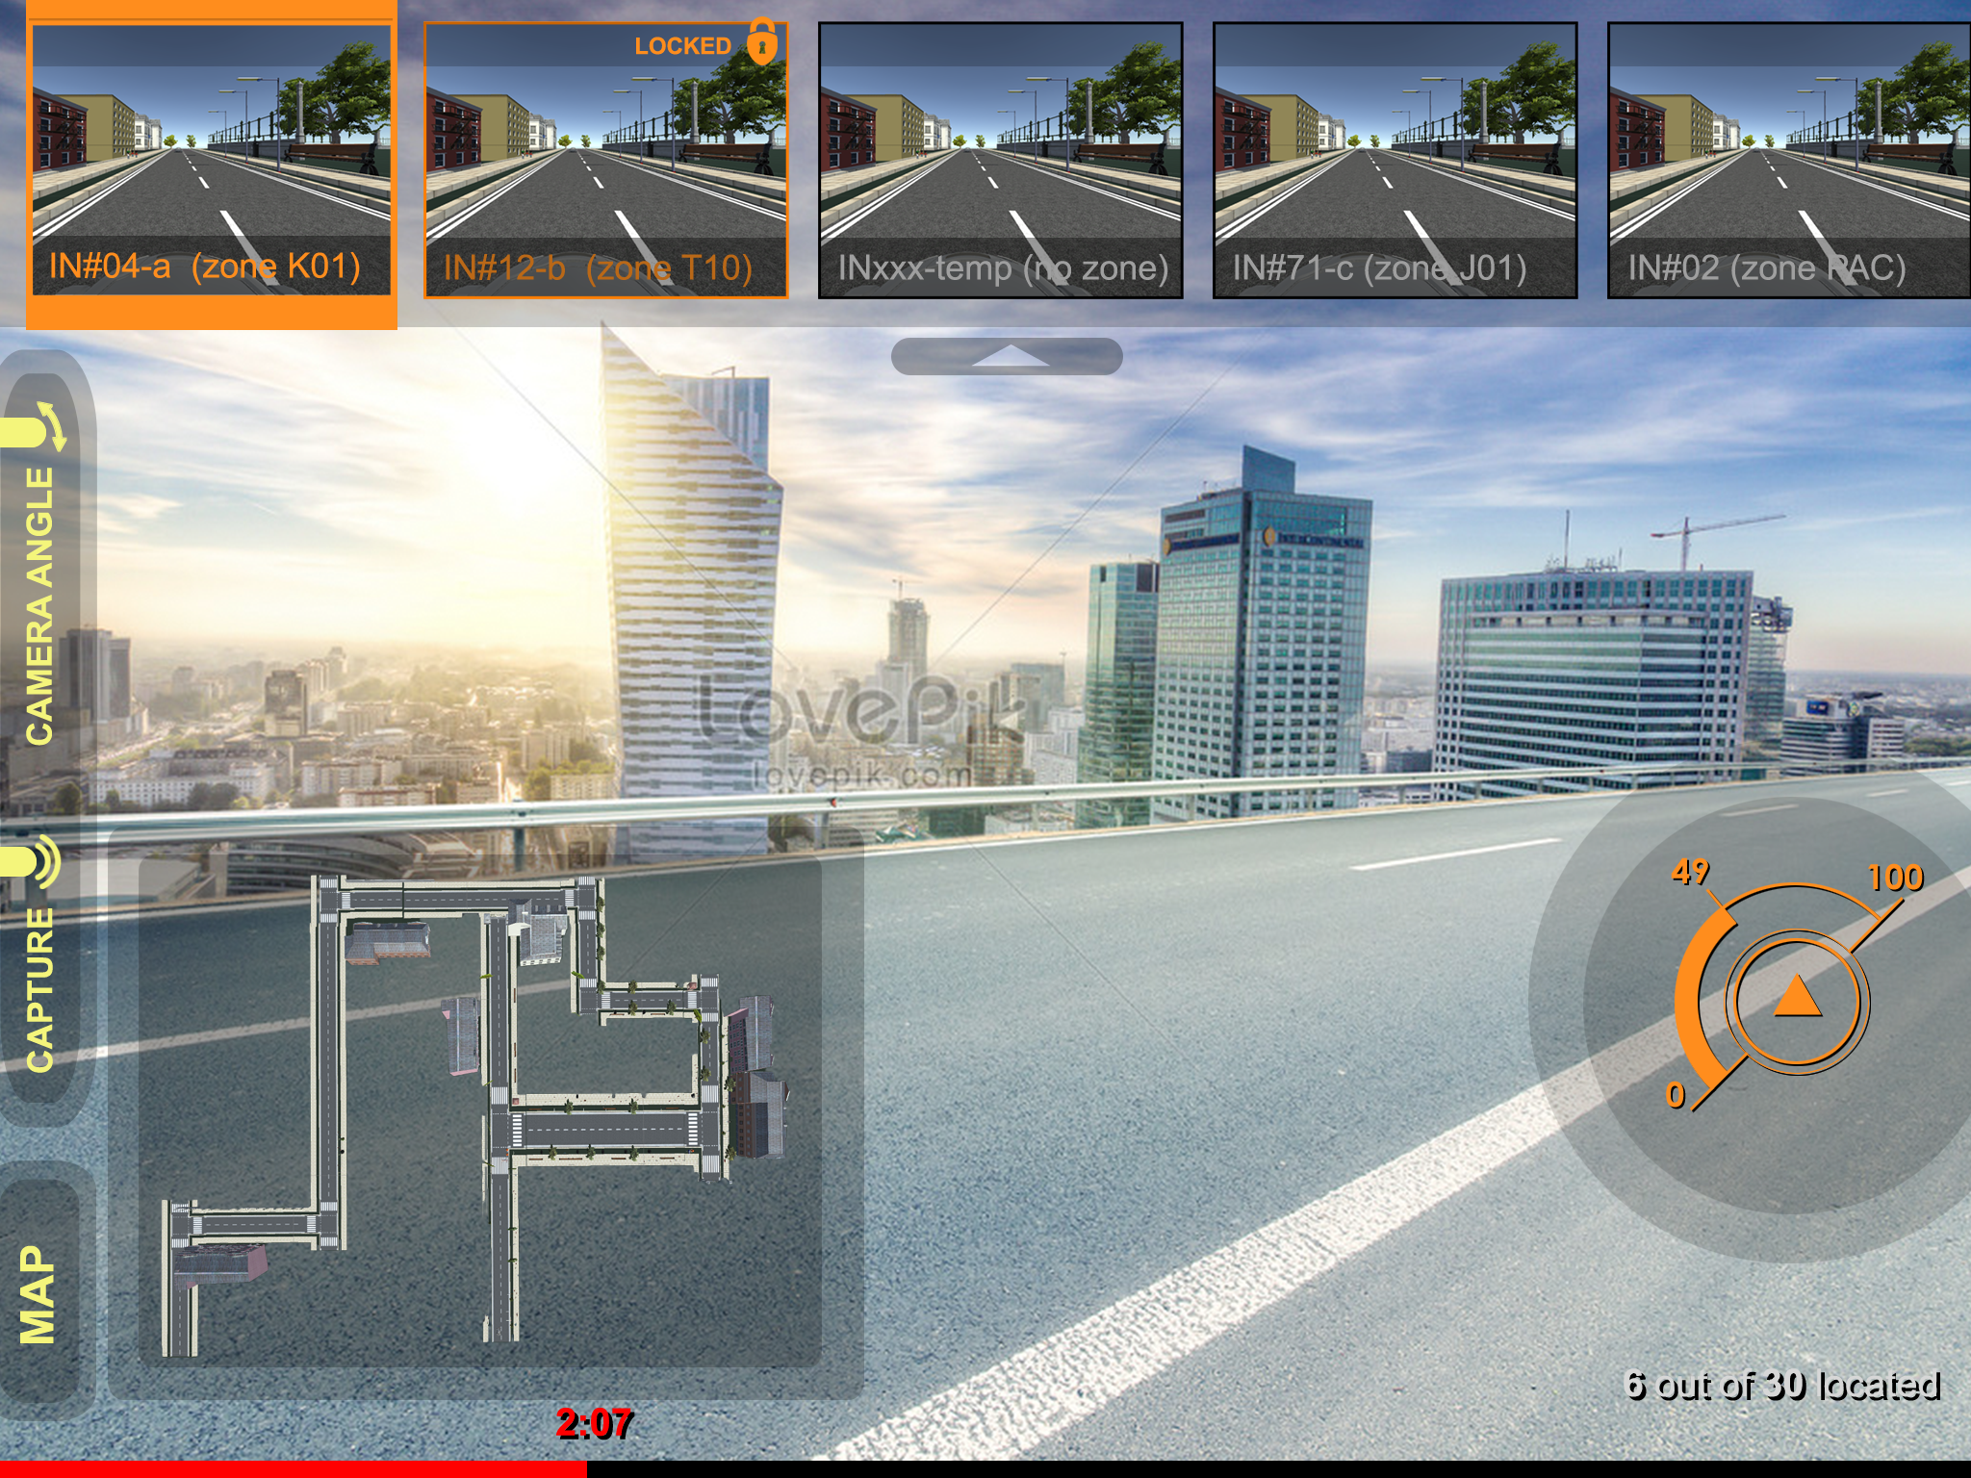
Bright background - still legible

Slide 4
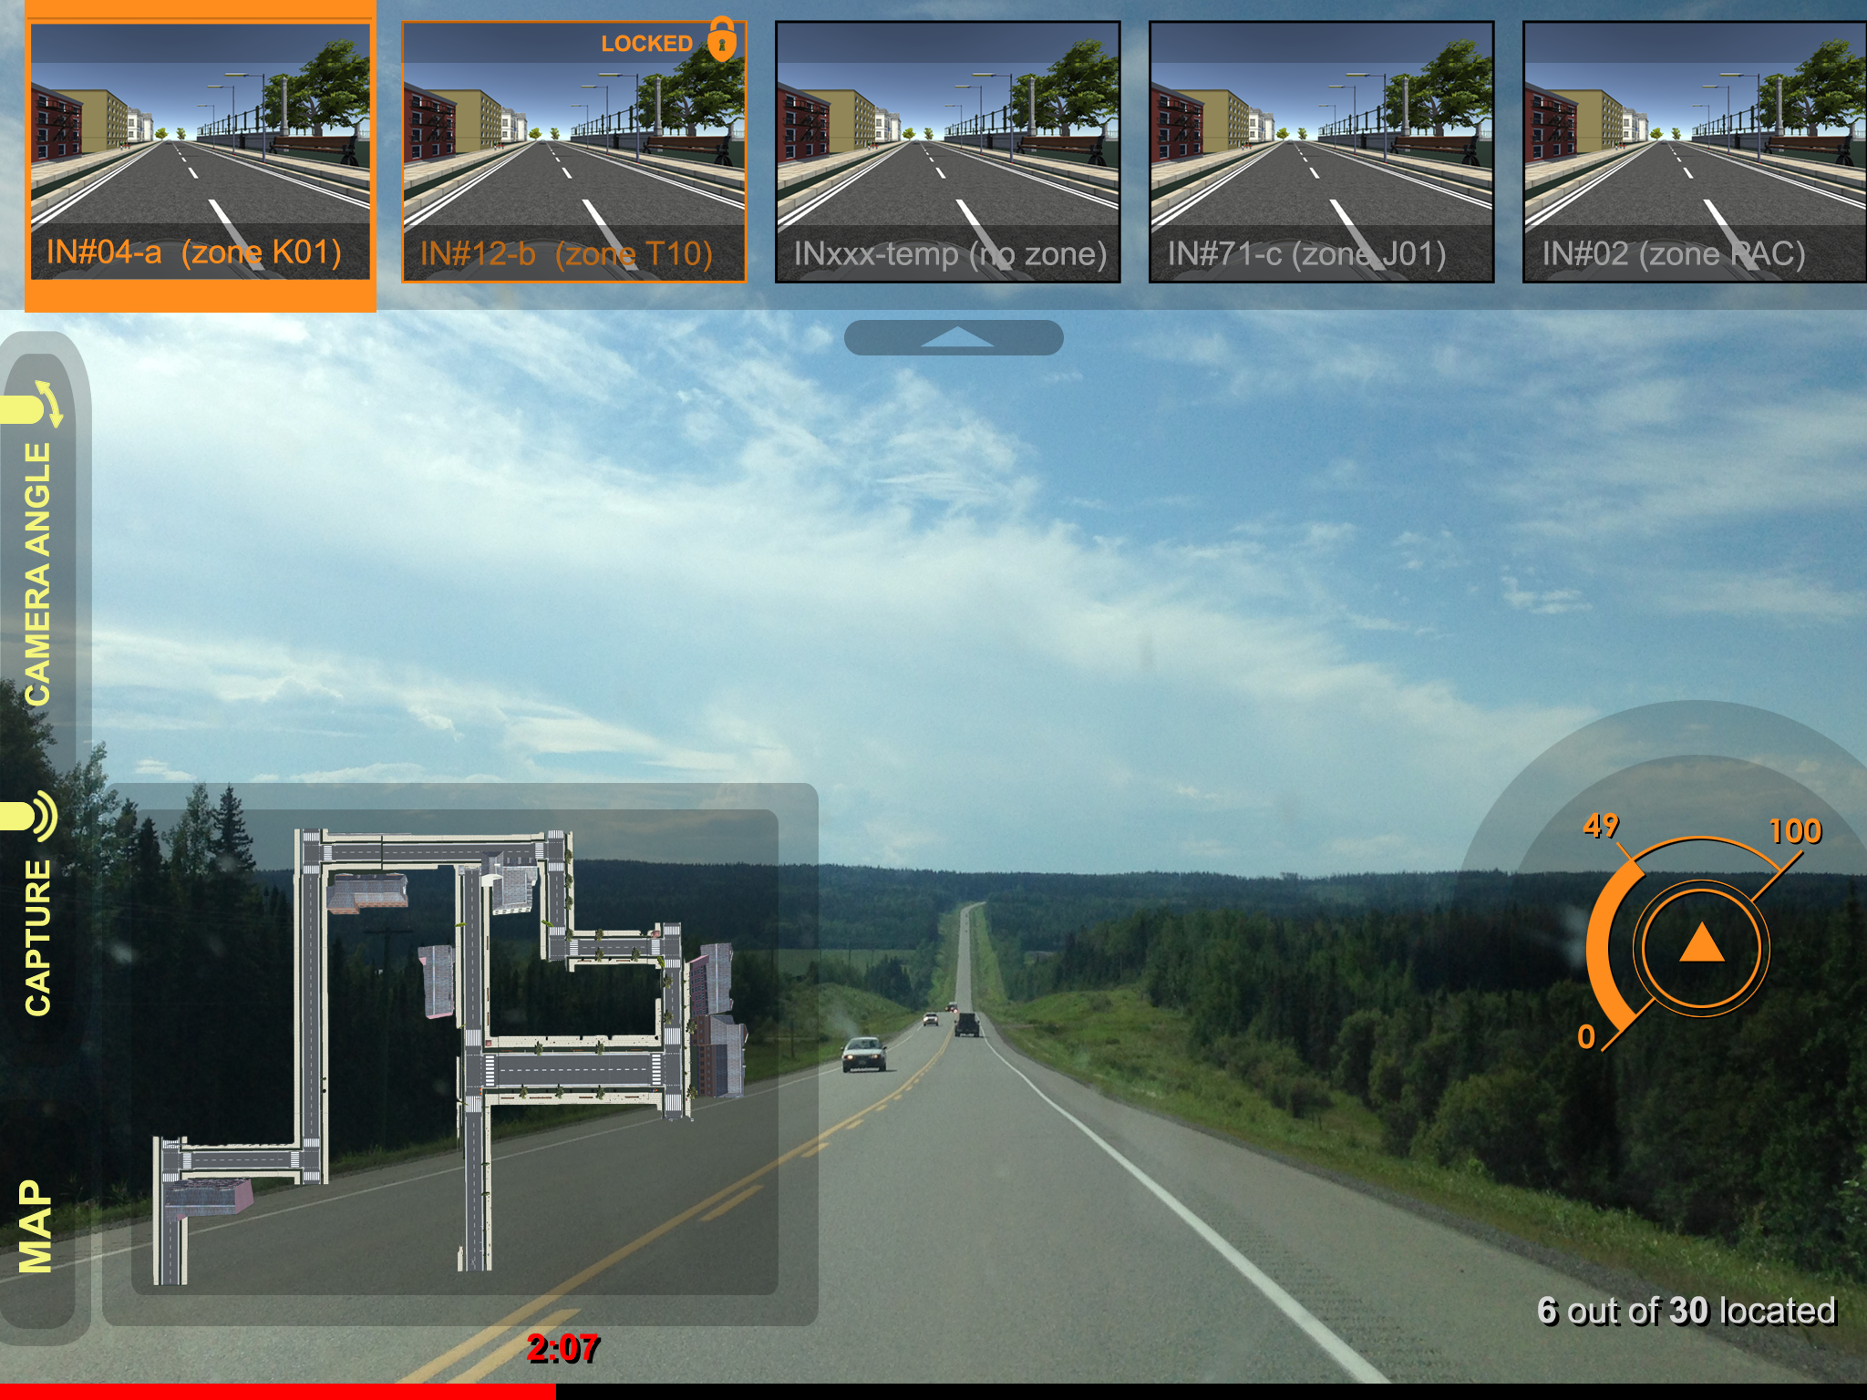
Dark background - still legible

