Slide 1
Final view of Tablet user interface
Full first design

Slide 2
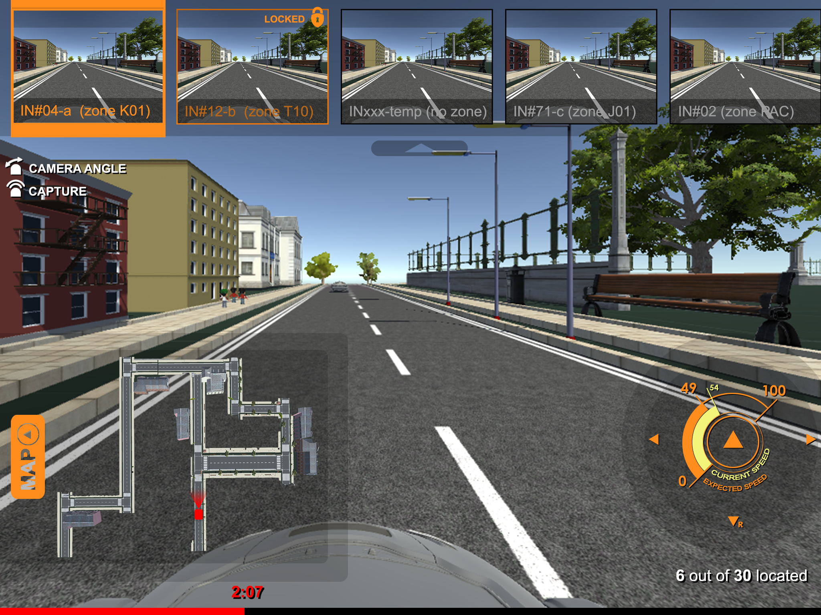
Other car view
Button to hide the other car view
Map Button
Controller
Localisation of the car
Time indication

Slide 3
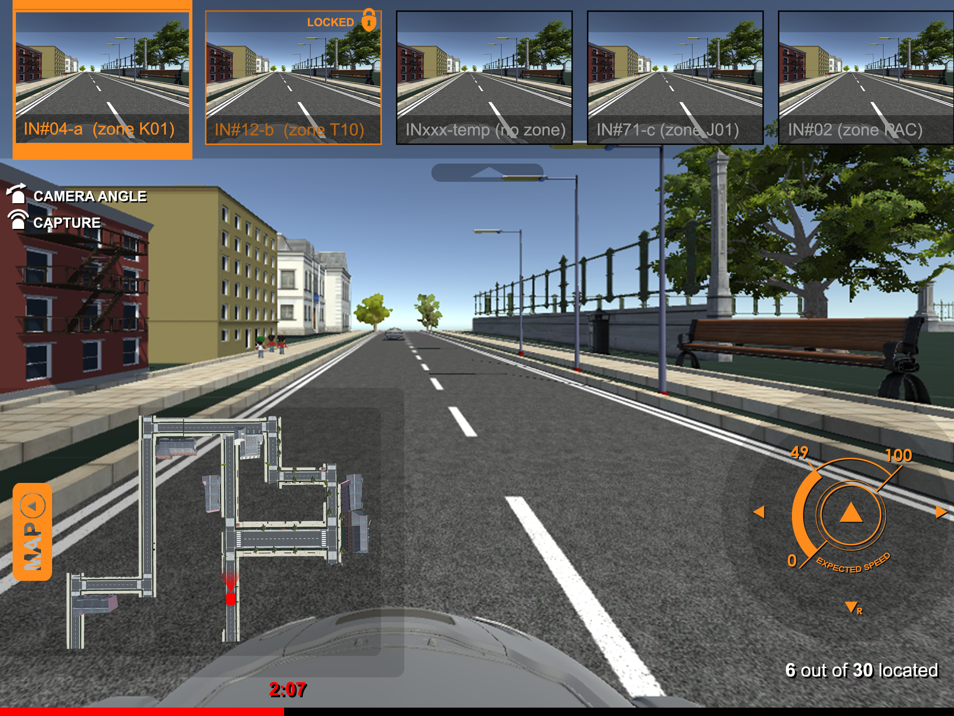
Controller when expected speed equals current speed

Slide 4
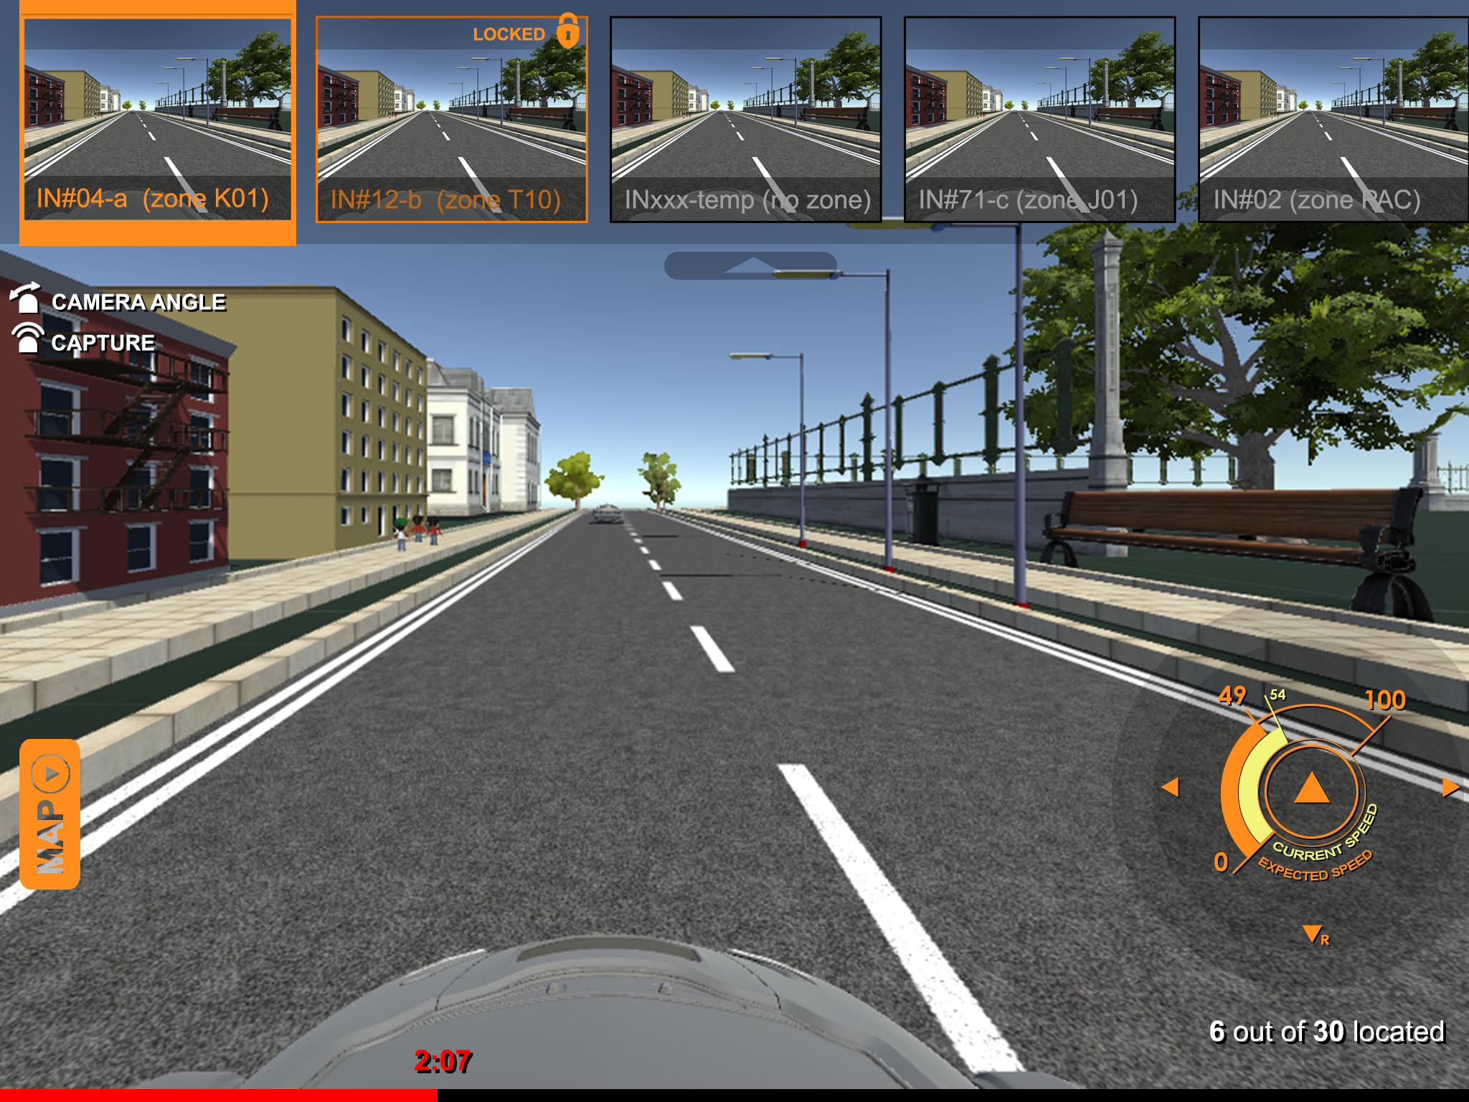
Map view hidden

Slide 5
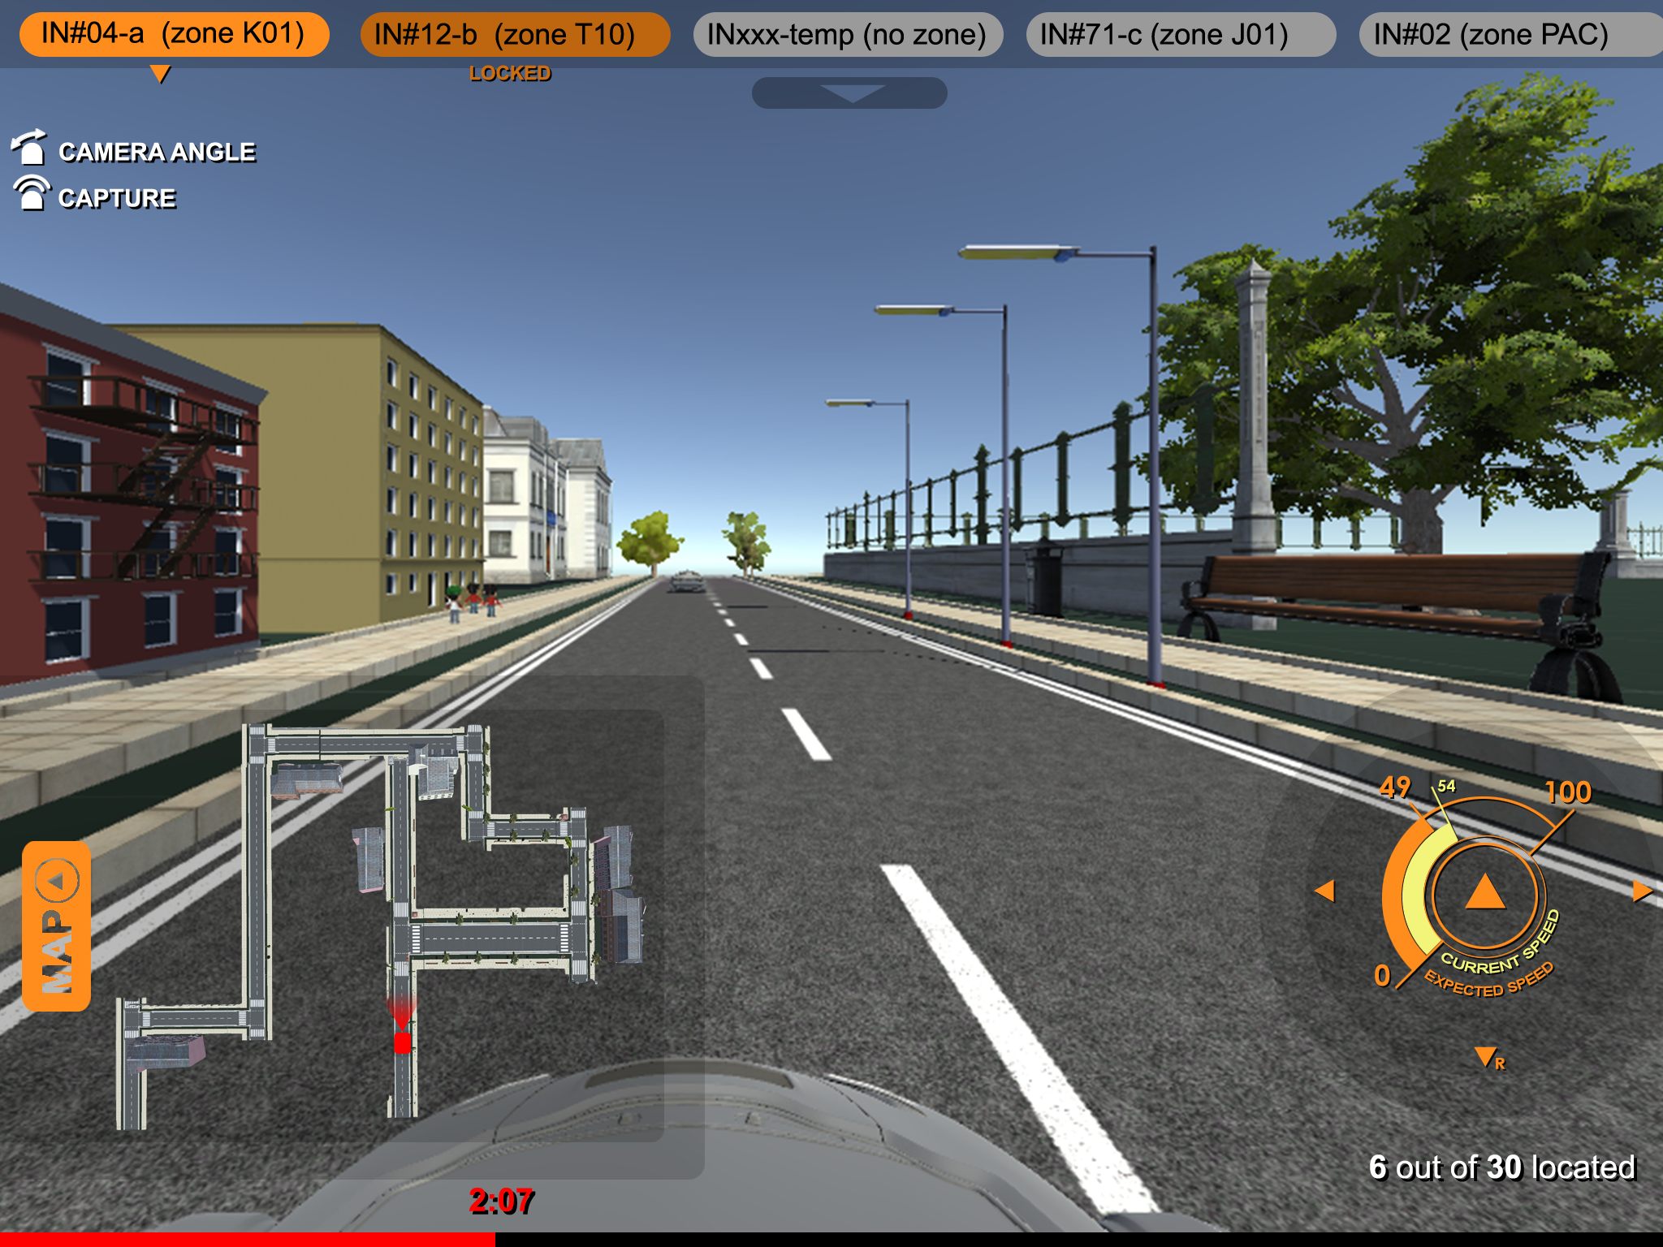
Other car view hidden

Slide 7
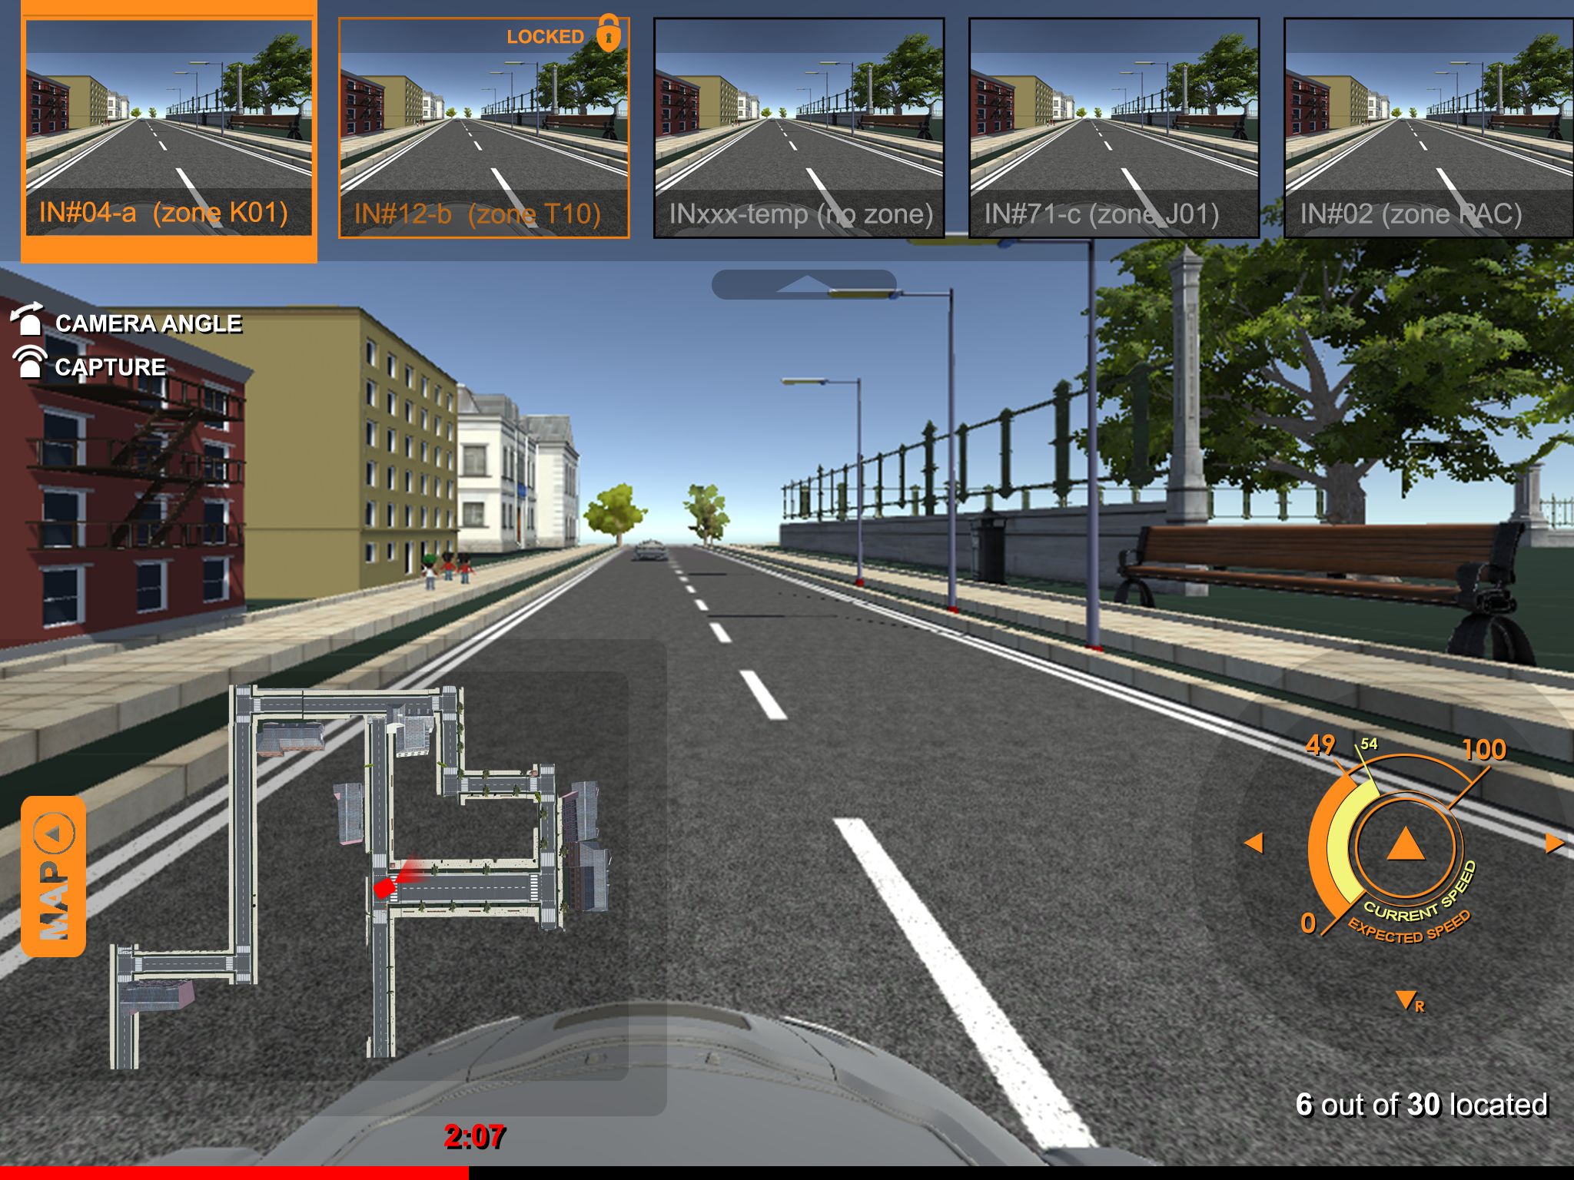

Slide 8


Slide 9


Slide 10
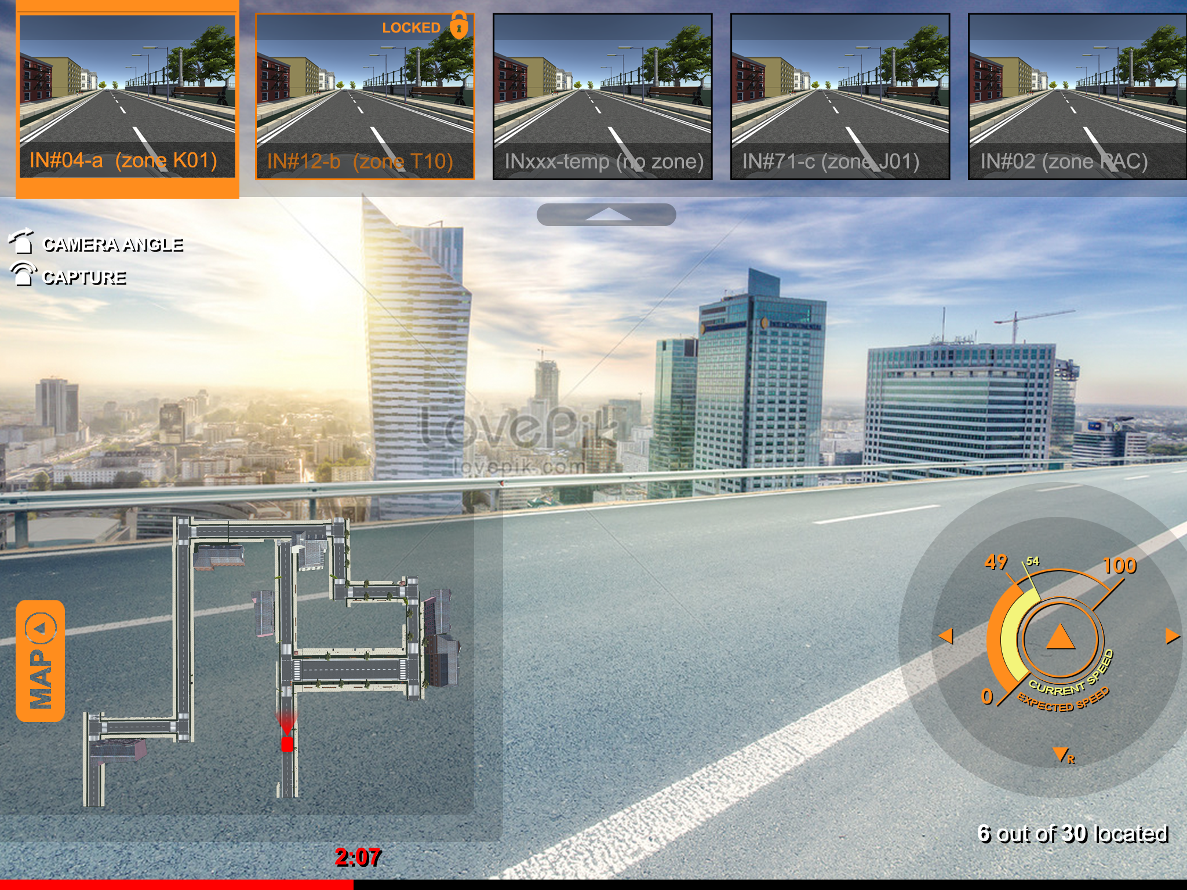
Bright background - still legible

Slide 11
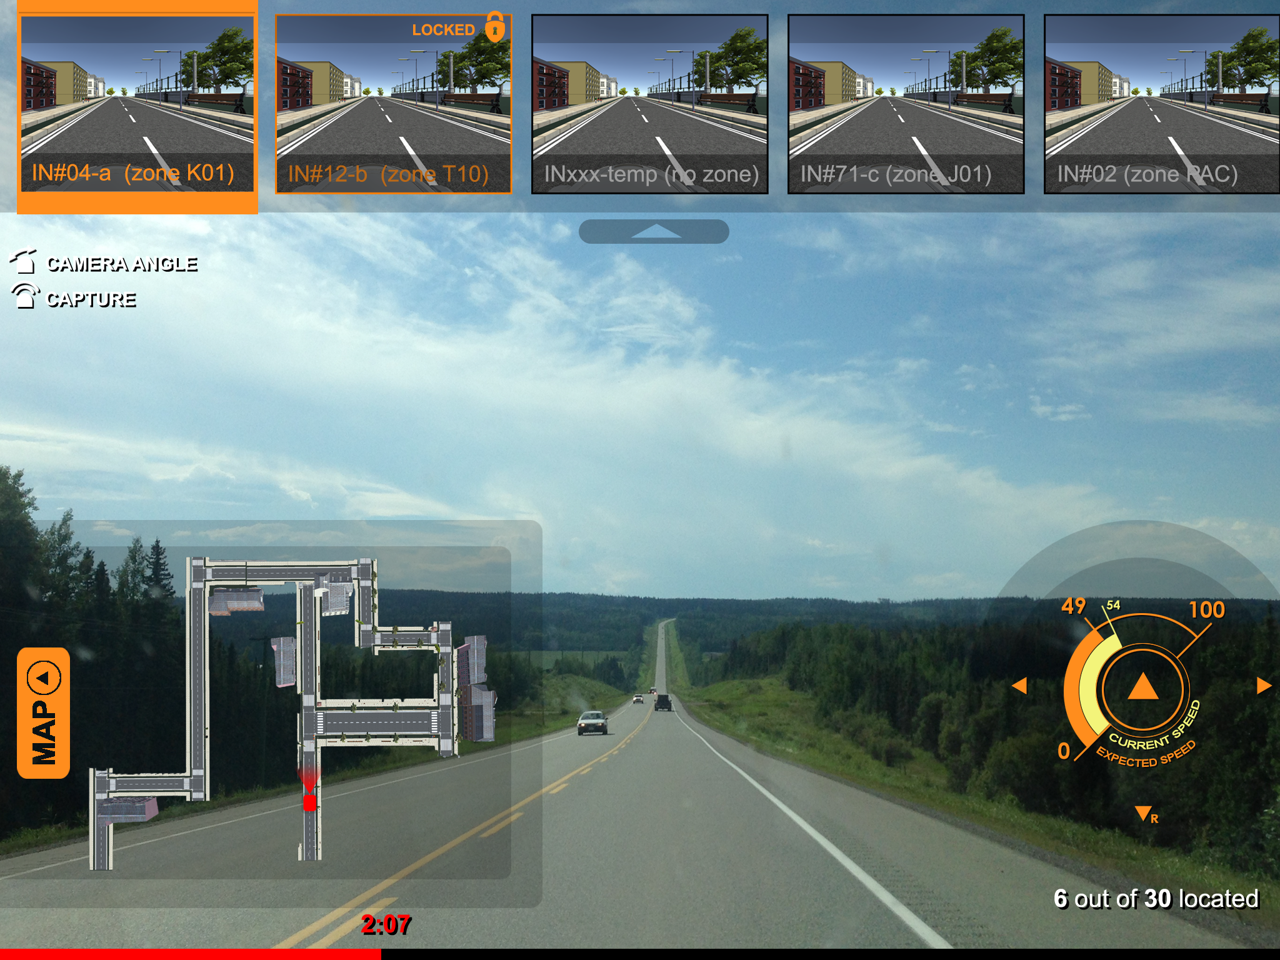
Dark background - still legible

