Slide 1
Game Update

Slide 2
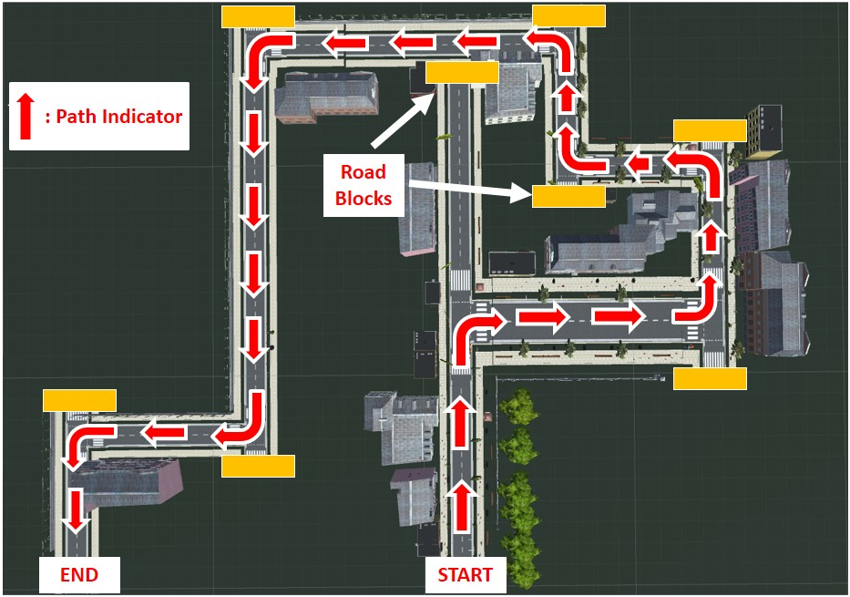
Orthographic View

Slide 3
Navigation
Autonomous
  Robot will be navigating following the line.
  Human direction (Left or Right) will be required in situations like, at a road junction, dead end, etc.
  The user can pause the motion to look for targets.
  Similarly, can continue back on the motion.
Manual
  Robot can move in 4 directions (Forward, Backward, Left and Right) based on user input.

Slide 4
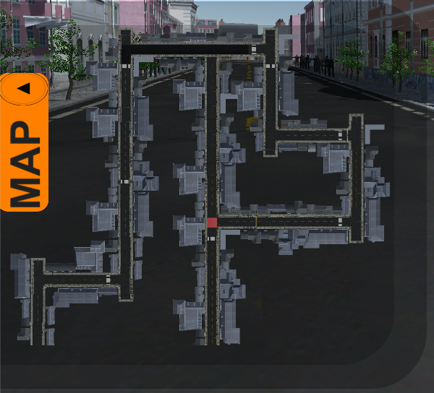
Localization
In both autonomous and manual mode of navigation, the user can always check for the current robot location from the map view shown at bottom left of the screen.

Slide 5
Navigation Controls
Mode | Control
Auto (Required at junctions, dead ends, etc.) | Keypress A → Rotate in Left Keypress D → Rotate in Right Keypress W → Go straight in the chosen direction
Manual | Keypress Up → Forward Motion Keypress Down → Backward Motion Keypress Left → Rotate in Left Keypress Right → Rotate in Right

Slide 6
Differential-Drive Velocity Specification
Mode | Speed (per second)
Auto-Translation | 10 m/s
Manual-Translation | 10 m/s
Auto-Rotation | 90º/sec
Manual-Rotation | 15º/sec
Frame rate of unity is variable, mostly around 30 fps.

Slide 7
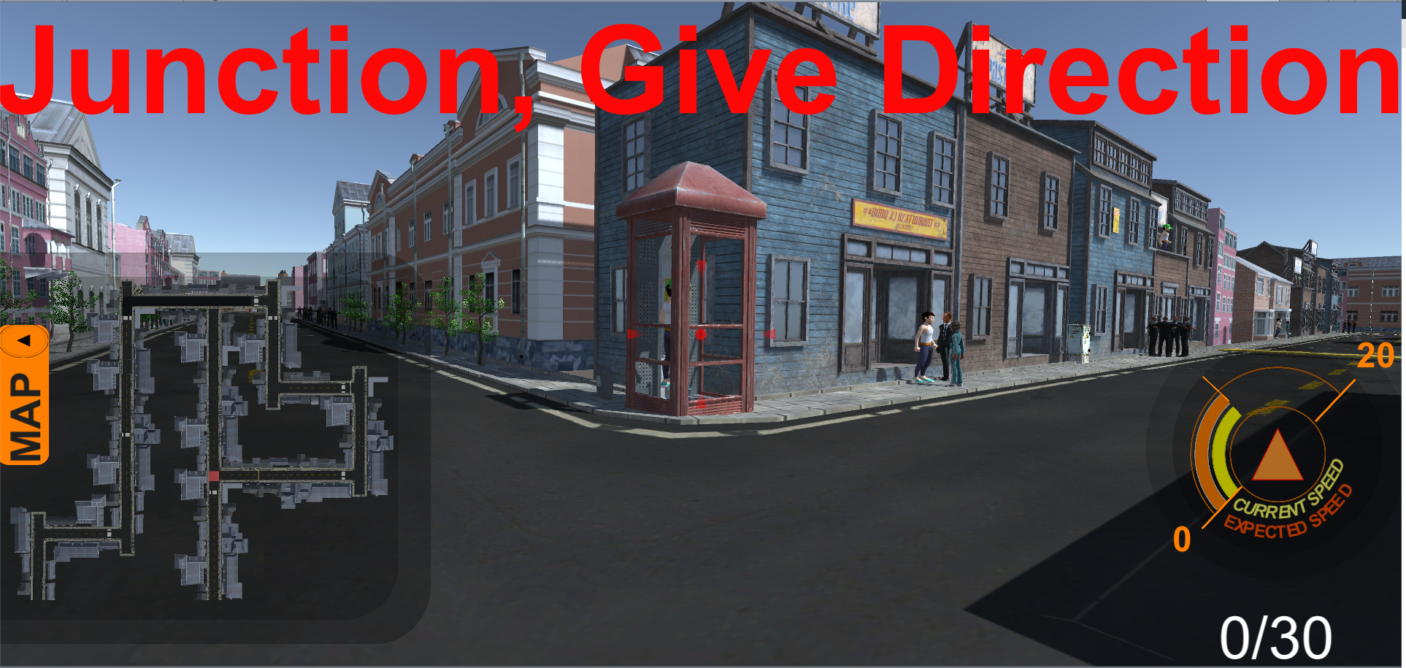
Junction: Command Required
10

Slide 8

Target Identification
Aiming the Surveillance Camera
  The surveillance camera attached on top of the robot can be rotated using the mouse.
  There is a red crosshair at the center of the surveillance view.
  User has to position the surveillance camera such that the crosshair is right on the face of the human wearing green cap.
This Photo by Unknown Author is licensed under CC BY-SA

Slide 9
Target Identification
Capturing the Target
  Once the aim has been set, the user can capture the target by pressing the spacebar on the keyboard.
  The user will be notified with a message on top of the screen “Target Captured” of successful identification and an increment in the score shown at the bottom-right corner of the screen.
Level of difficulty of Targets
  Low → When the target is clearly visible on the ground level.
  Medium → When the target is hidden behind the crowd or objects on the ground level.
  High → When the target is on top of a building.

Slide 10
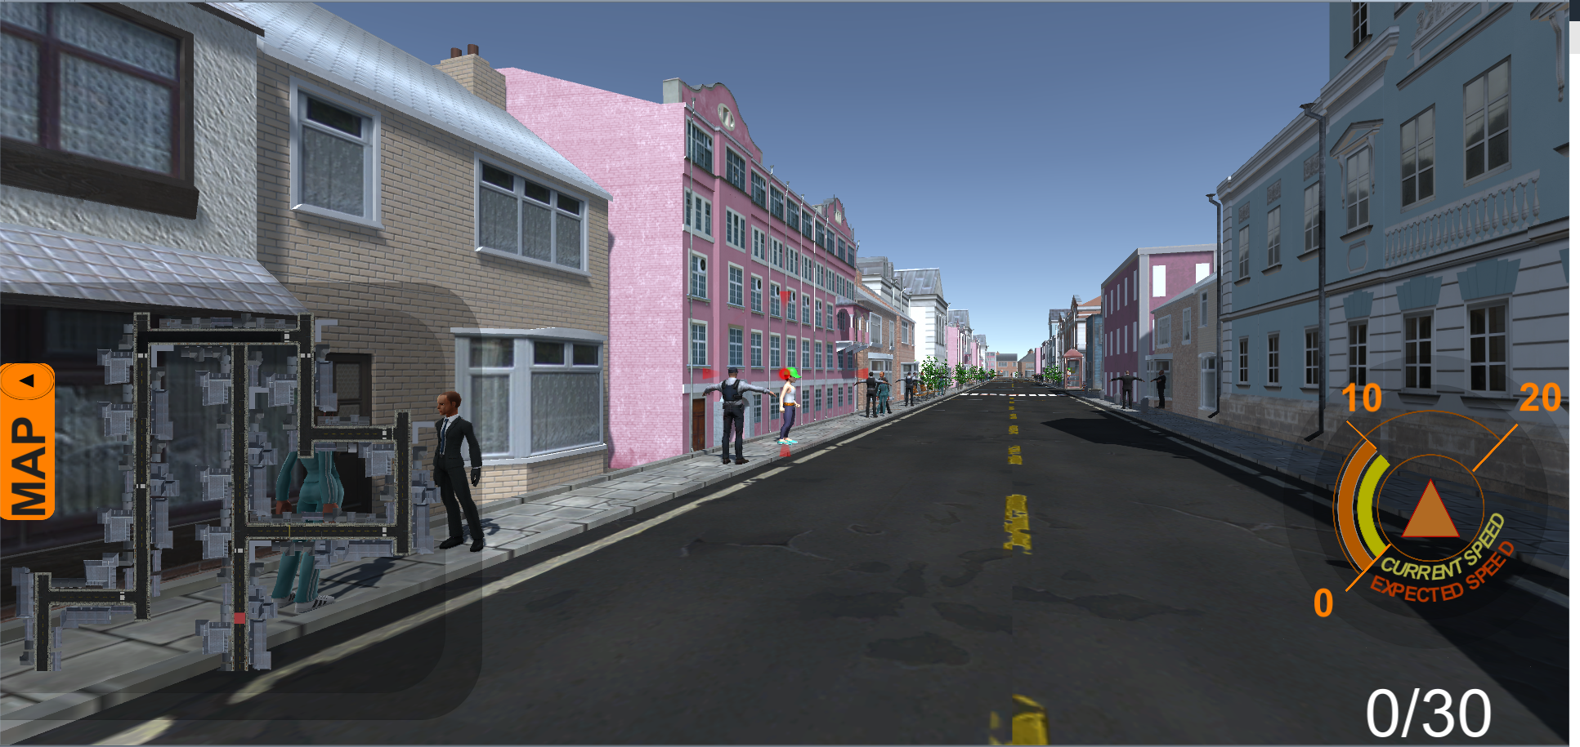
Target Identification
Low Difficulty
This Photo by Unknown Author is licensed under CC BY-SA

Slide 11
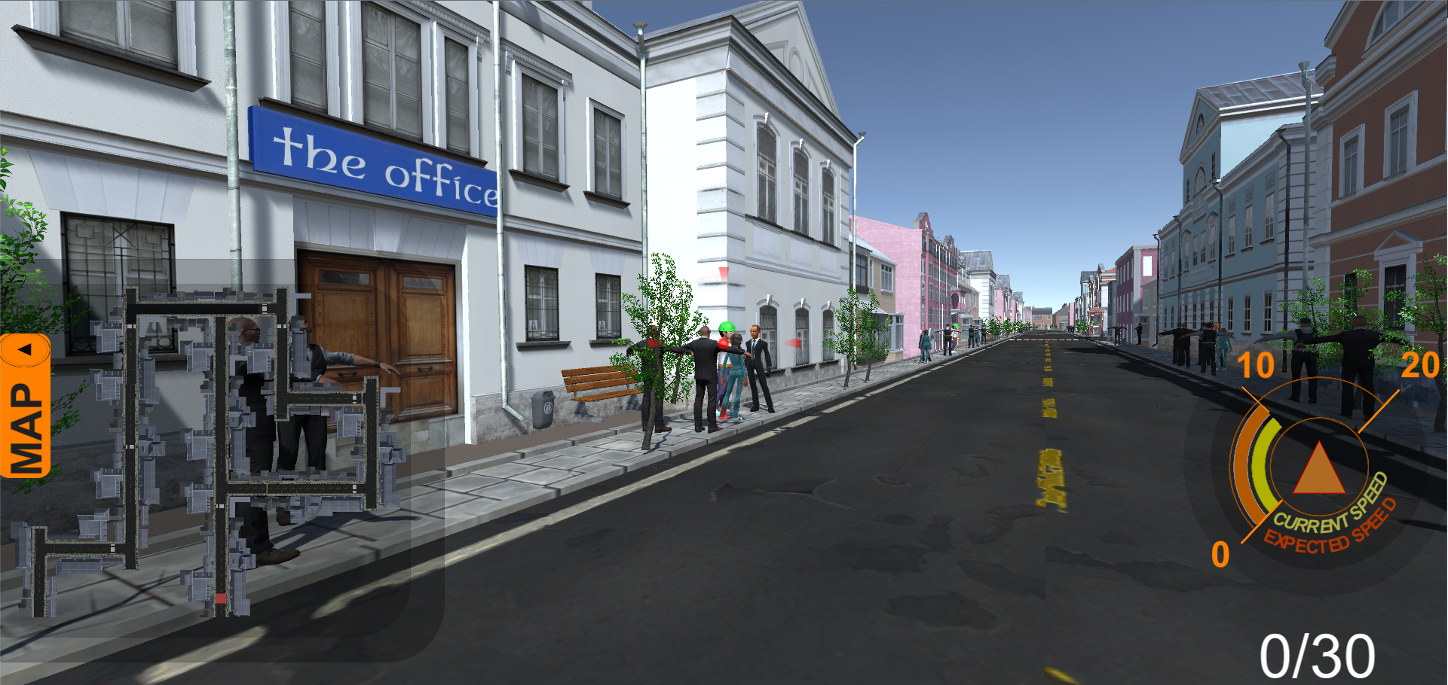
Target Identification
Medium Difficulty

Slide 12
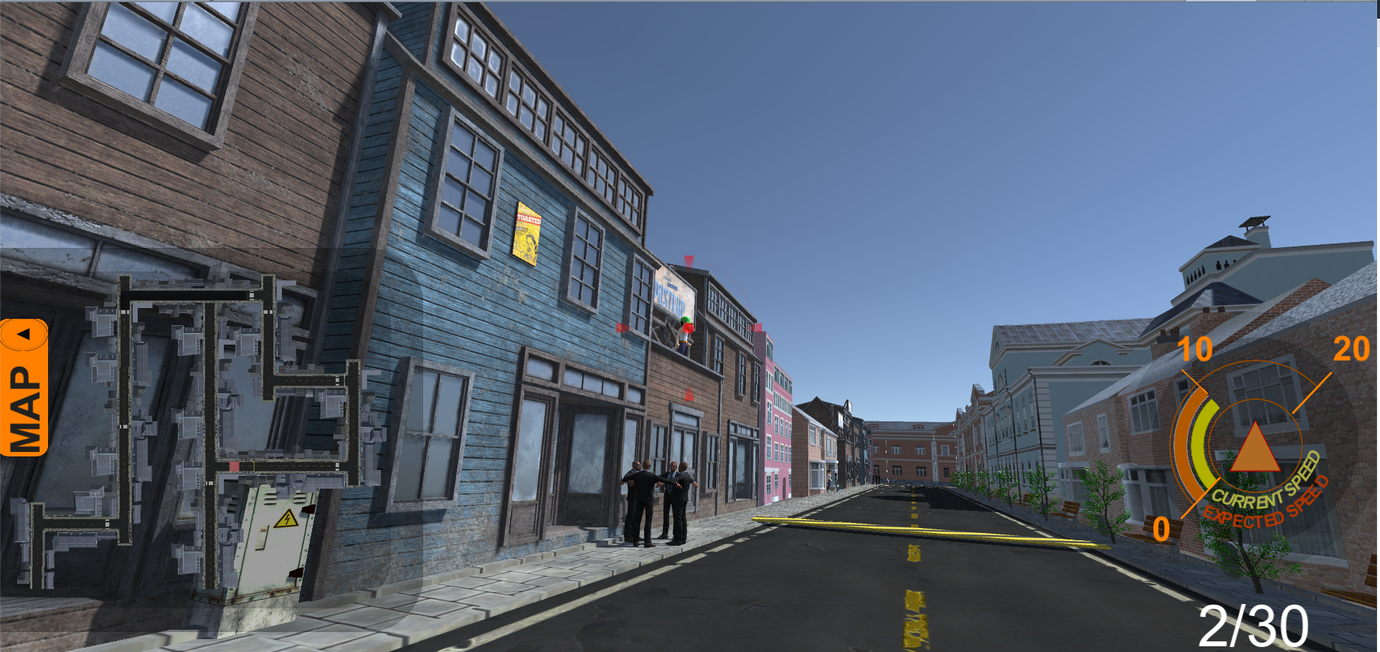
Target Identification
High Difficulty

Slide 13
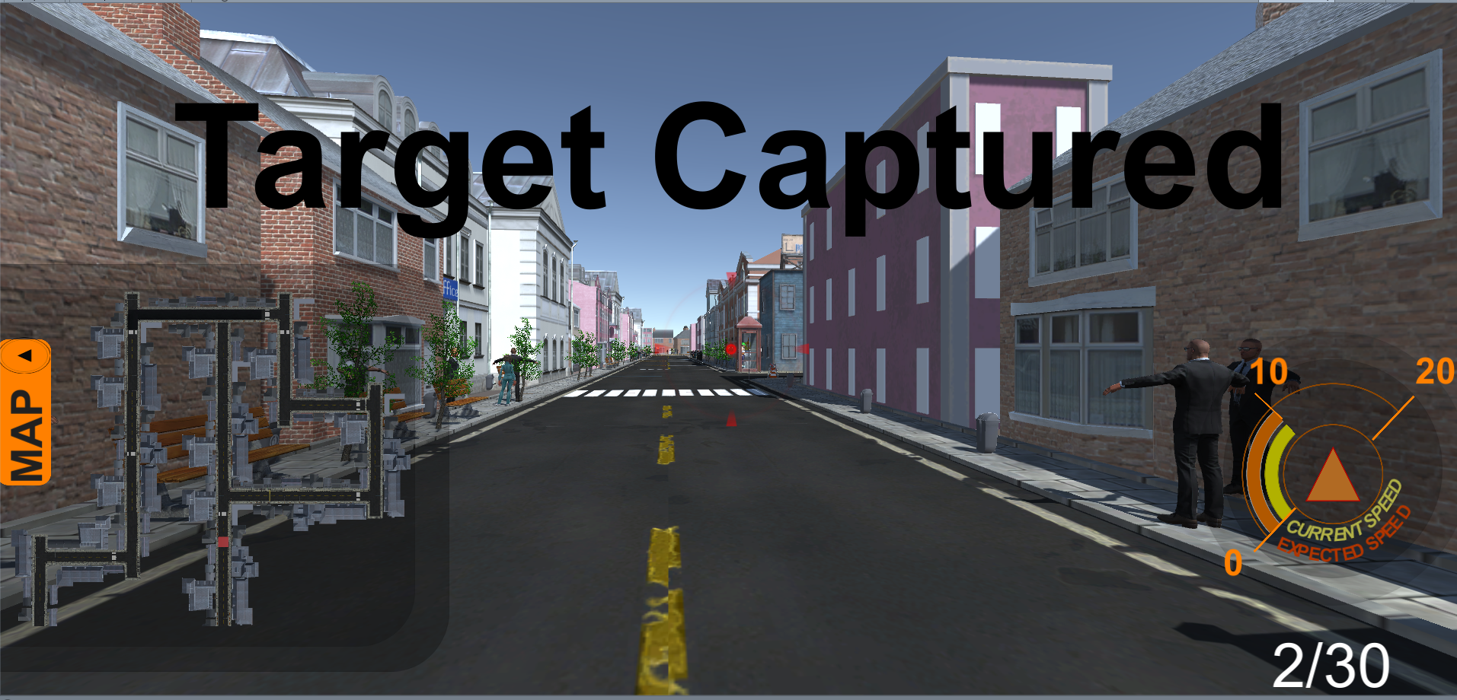
Target Capturing
Notification of successful identification
No. of objects detected/ total No. of objects

Slide 14
Surveillance Controls
Task | Control
Aiming | Mouse Movement
Capture | Keypress Spacebar
Pause the autonomous navigation of the robot | Keypress X
Resume the autonomous navigation of the robot | Keypress R
Home | Keypress H

Slide 15
Obstacle Detection
The obstacle detection system of the robot halts the navigation on detection of an obstacle.
Situation | Control
Ignore the object, and continue with the navigation | Keypress R
Choose a different route (E.g. Dead End) | Manual Mode Controls

Slide 16
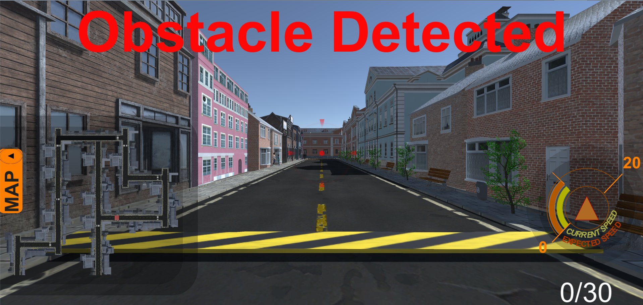
Obstacle Detected
10

