Slide 1
ON POLICY MULTI-AGENT REINFORCEMENT LEARNING
FOR 6G EDGE-CLOUD COMPUTING
Kan Ziyang
A0326643A
Supervisor: Prof. Tham Chen Khong
March 2026

Slide 2
Abstract
Task offloading in 6G edge-cloud systems must coordinate execution placement and wireless PRB reservation
Proposed MAPPO scheduler for joint task offloading and PRB allocation in LOCAL-EDGE-CLOUD architecture
MAPPO achieves 99.96% success rate vs 90.39% for best heuristic (ROUND_ROBIN)
PPO baseline reaches 99.94%, showing on-policy RL effectiveness
Adaptive PRB control is the dominant source of performance gain
MAPPO provides narrower reliability-oriented advantage over PPO

Slide 3
Research Questions
1. Can on-policy RL improve QoS and system efficiency over heuristic schedulers when destination and PRB are jointly optimized?
2. Is adaptive PRB allocation the dominant source of performance gain relative to other MAPPO design choices?
3. Does MAPPO provide meaningful advantage over shared-policy PPO baseline in deadline-sensitive reliability?

Slide 4
Main Contributions
Joint task-offloading and PRB-allocation formulated as Dec-POMDP
MAPPO framework with CTDE: per-device actors + centralized critic
Shared-policy PPO baseline under same environment interface
Extended PureEdgeSim with PRB-aware networking and Java-Python co-simulation
Comprehensive evaluation against heuristic and learning baselines

Slide 5
Background: 6G and Mobile Edge Computing
6G integrates intelligence, communication, and distributed computing
MEC reduces latency by moving computation closer to users
Radio-resource allocation is central to edge-cloud orchestration
Scheduler must jointly determine WHERE and HOW MUCH wireless resource
Without reasonable PRB allocation, attractive compute destination can produce poor outcome

Slide 6
Why Multi-Agent Reinforcement Learning?
RL improves through interaction rather than analytical model
Devices interact through shared PRBs, edge queues, and compute resources
One device's choice affects others - naturally multi-agent problem
MARL enables local decision-making while learning cooperative behavior
Partial observability + shared constraints + system trade-offs

Slide 7
Related Work Comparison

Slide 8
Related Work Comparison

Slide 9
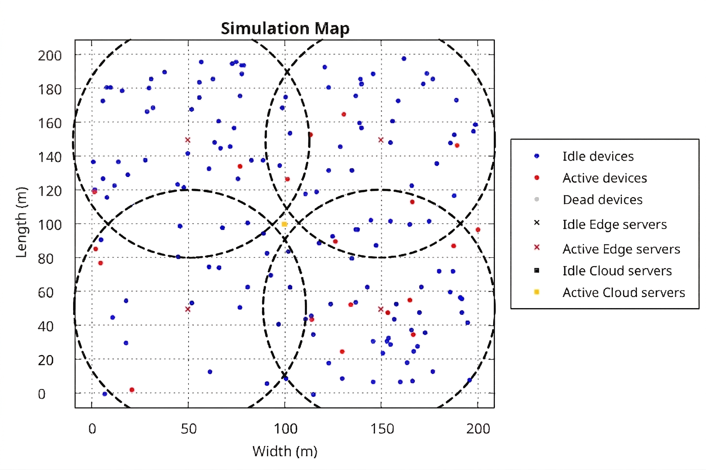
Three-Tier System Architecture
200m × 200m area with 160 devices, 4 edge data centers, 1 cloud node

Slide 10
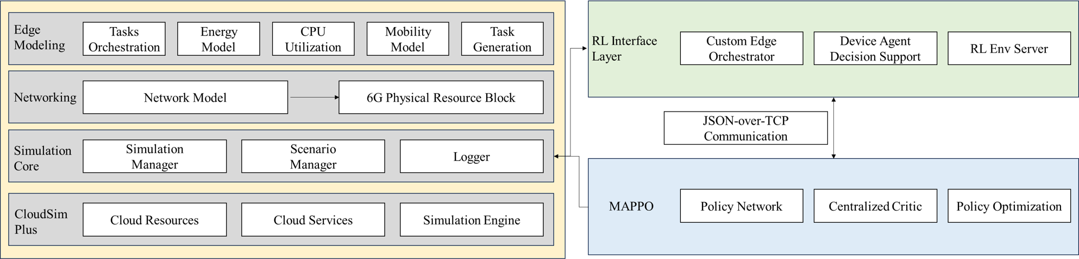
Extended PureEdgeSim Architecture
Four coordinated layers: simulator extensions, RL interface, runtime support, telemetry

Slide 11
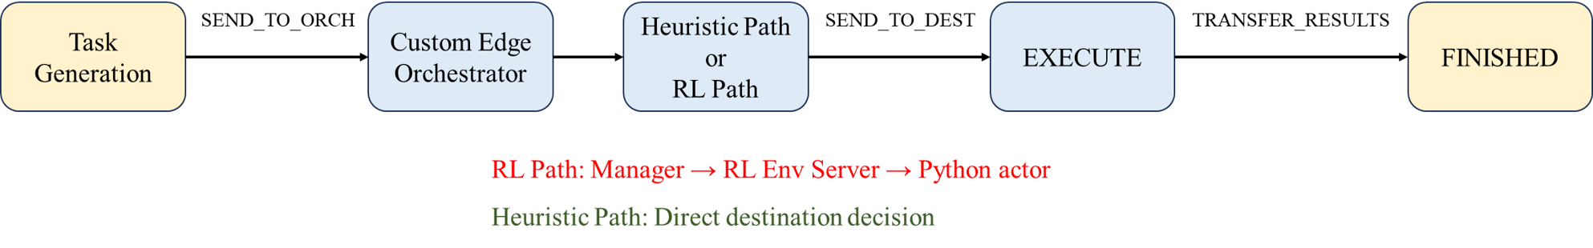
Event-Driven Task Lifecycle
Decisions triggered when tasks arrive, preserving event-driven semantics

Slide 12
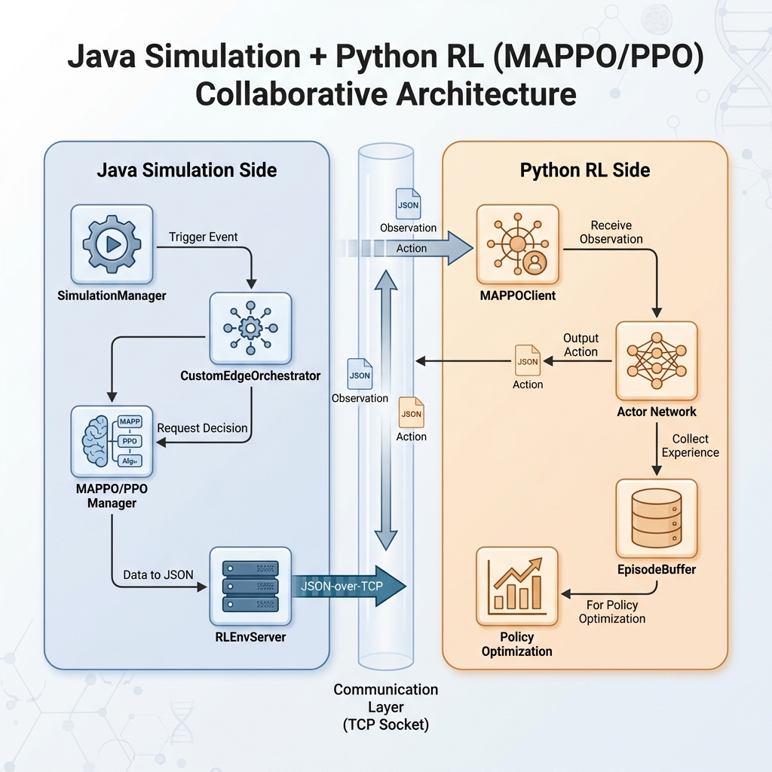
Java-Python Training Architecture
Training mode: Python launches Java, synchronous TCP JSON protocol

Slide 13
Simulation Configuration
• Area: 200m × 200m
• Devices: 160 (30% smartphone, 30% sensor)
• Simulation time: 30 minutes
• Mobile speed: 1.4 m/s
• Edge coverage: 120m
• Cloud distance: 160m
• WLAN bandwidth: 5000 Mbps
• Total PRB blocks: 5000
• Max PRBs per task: 50
• Reference distance d₀: 20m
• Distance exponent α: 0.5
• VM policy: SPACE_SHARED

Slide 14
PRB-Based Communication Model
Total capacity: 5000 Mbps discretized into 5000 PRB blocks
Bandwidth = (BW_WLAN / PRB_total) × blocks × min(1, (d₀/max(d,d₀))^α)
RL algorithms: fixed PRB reservation before transmission
8 discrete PRB bins: {0.02, 0.05, 0.10, 0.20, 0.40, 0.60, 0.80, 1.00}
Non-RL algorithms: dynamic PRB allocation by simulator
Cloud uses fixed equivalent distance of 160m

Slide 15
Energy Model
Wireless energy: EEZC protocol with free-space and multipath models
E_tx = E_elec·B + E_fs·B·d² (d ≤ d₀) or E_mp·B·d⁴ (d > d₀)
CPU energy: linear utilization model
ΔE_cpu = [P_idle + (P_max - P_idle)·u] / 3600 · Δt
Online standardization via EMA for RL reward stability
Total energy = CPU energy + wireless energy

Slide 16
Dec-POMDP Formulation
Agent set N: all task-generating devices
Observation o_i: task demand, device state, destination features, feasibility mask
Action a_i = (dest, prb): execution destination + PRB reservation level
Global state s: aggregated load, energy, PRB usage
Objective: minimize weighted cost of failures, latency, energy, PRB, fallback
Constraints: feasible destinations, PRB budget, deadline satisfaction

Slide 17
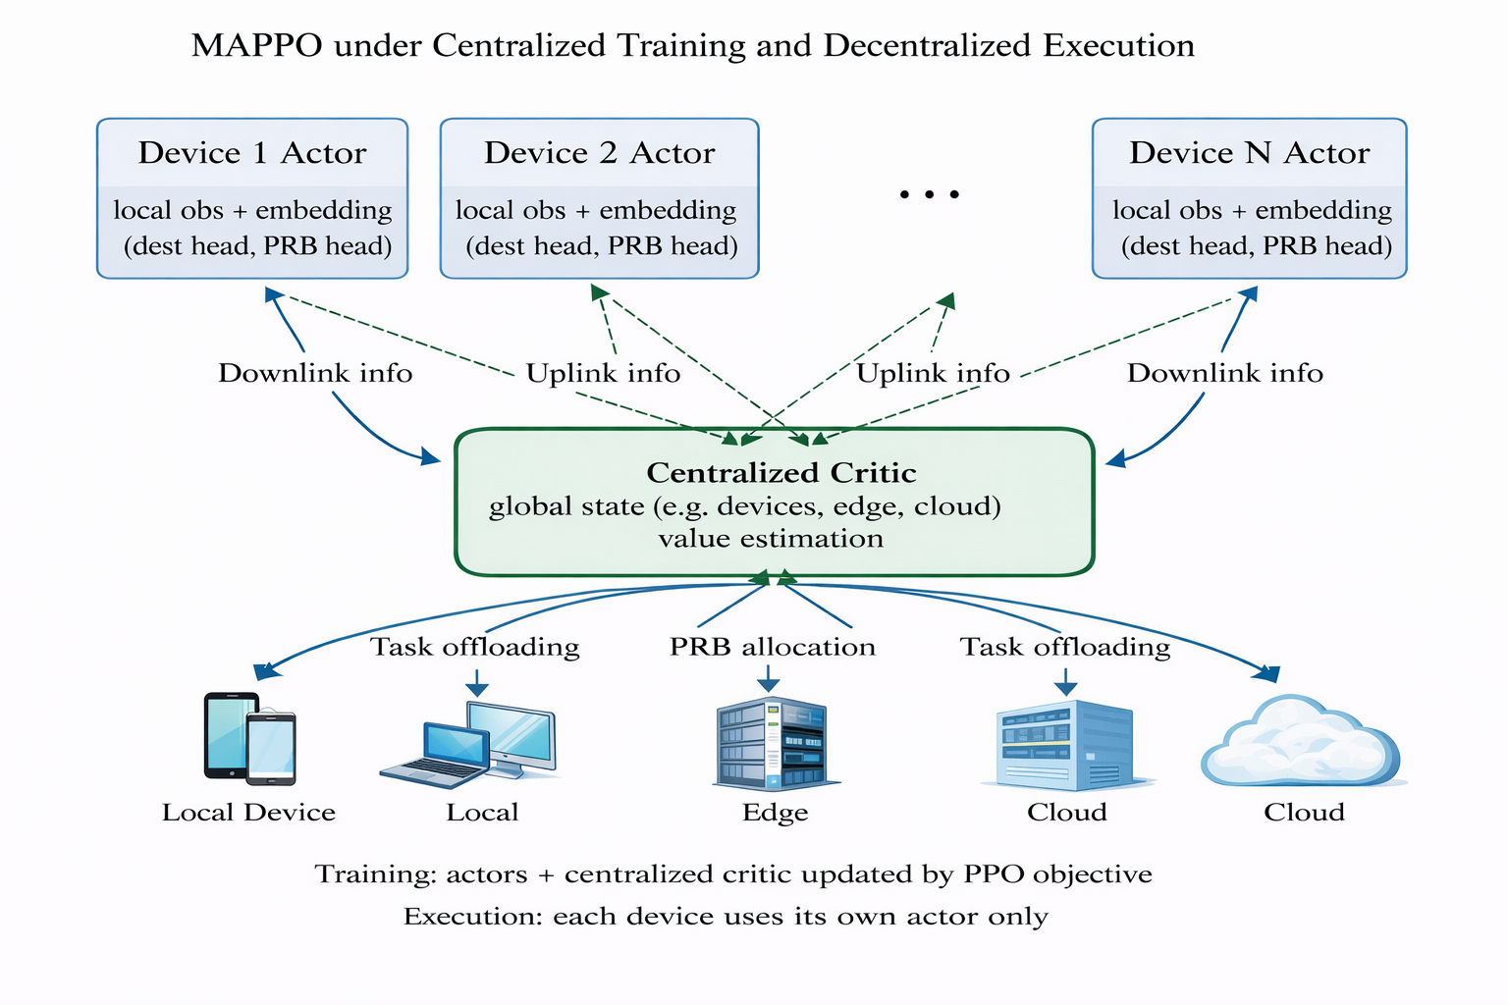
MAPPO CTDE Framework
Centralized training with decentralized execution

Slide 18
Observation and State Design
Agent observation (13D): task demand (5) + device state (4) + network context (4)
Destination features (11D per dest): load, capacity, delay, distance, tier indicators
Destination mask: suppresses infeasible destinations
PPO critic state (27D): agent obs + aggregated system statistics
MAPPO critic state (41D): base state + destination distribution + PRB distribution
All features normalized to [0,1] or [-2,2]

Slide 19
Action Space and Fallback
Composite action: (destination, PRB bin)
Destination: local(0) → edge DCs (sorted by ID) → cloud
PRB bins: 8 discrete levels mapping to {1, 2, 5, 10, 20, 30, 40, 50} blocks
Local execution forces PRB=0, log-prob and entropy zeroed
Destination fallback: if infeasible at execution, use shortest estimated completion
Fallback transitions excluded from PPO updates, penalized in reward

Slide 20
Reward Function Design
R = -5.0 if task fails
R = 5.0 - L̃ - 2.0Ẽ - 1.5B̃ - 1.5Z if task succeeds
L̃: latency ratio (realized / deadline), clipped to [0,2]
Ẽ: online-standardized energy via EMA (α=0.01)
B̃: normalized PRB cost (requested / max), clipped to [0,1]
Z: fallback indicator (1 if fallback triggered, 0 otherwise)
QoS-oriented: prioritizes success and timely completion

Slide 21
MAPPO Network Architecture
Agent embedding: 16D learnable per device (MAPPO only)
Agent encoder: 2-layer MLP (29→128→128) with tanh
Destination encoder: 2-layer MLP (139→128→128), shared across destinations
Destination head: linear projection (128→1), masked softmax
PRB head: 2-layer MLP (256→128→8), conditioned on selected destination
Centralized critic: 3-layer MLP (41→256→256→1) for MAPPO, (27→256→256→1) for PPO

Slide 22
Training Algorithm
PPO with clipped surrogate objective, ε=0.1
Immediate-return design: G_t = r_t, Â_t = r_t - V(s_t)
Entropy annealing: 0.02 → 0.002 over 40 episodes
Learning rate: 3×10⁻⁴ for both actor and critic
4 PPO epochs per update, minibatch size 1024
Fallback transitions excluded from updates
Training: 40 episodes, ~2.53 hours total

Slide 23
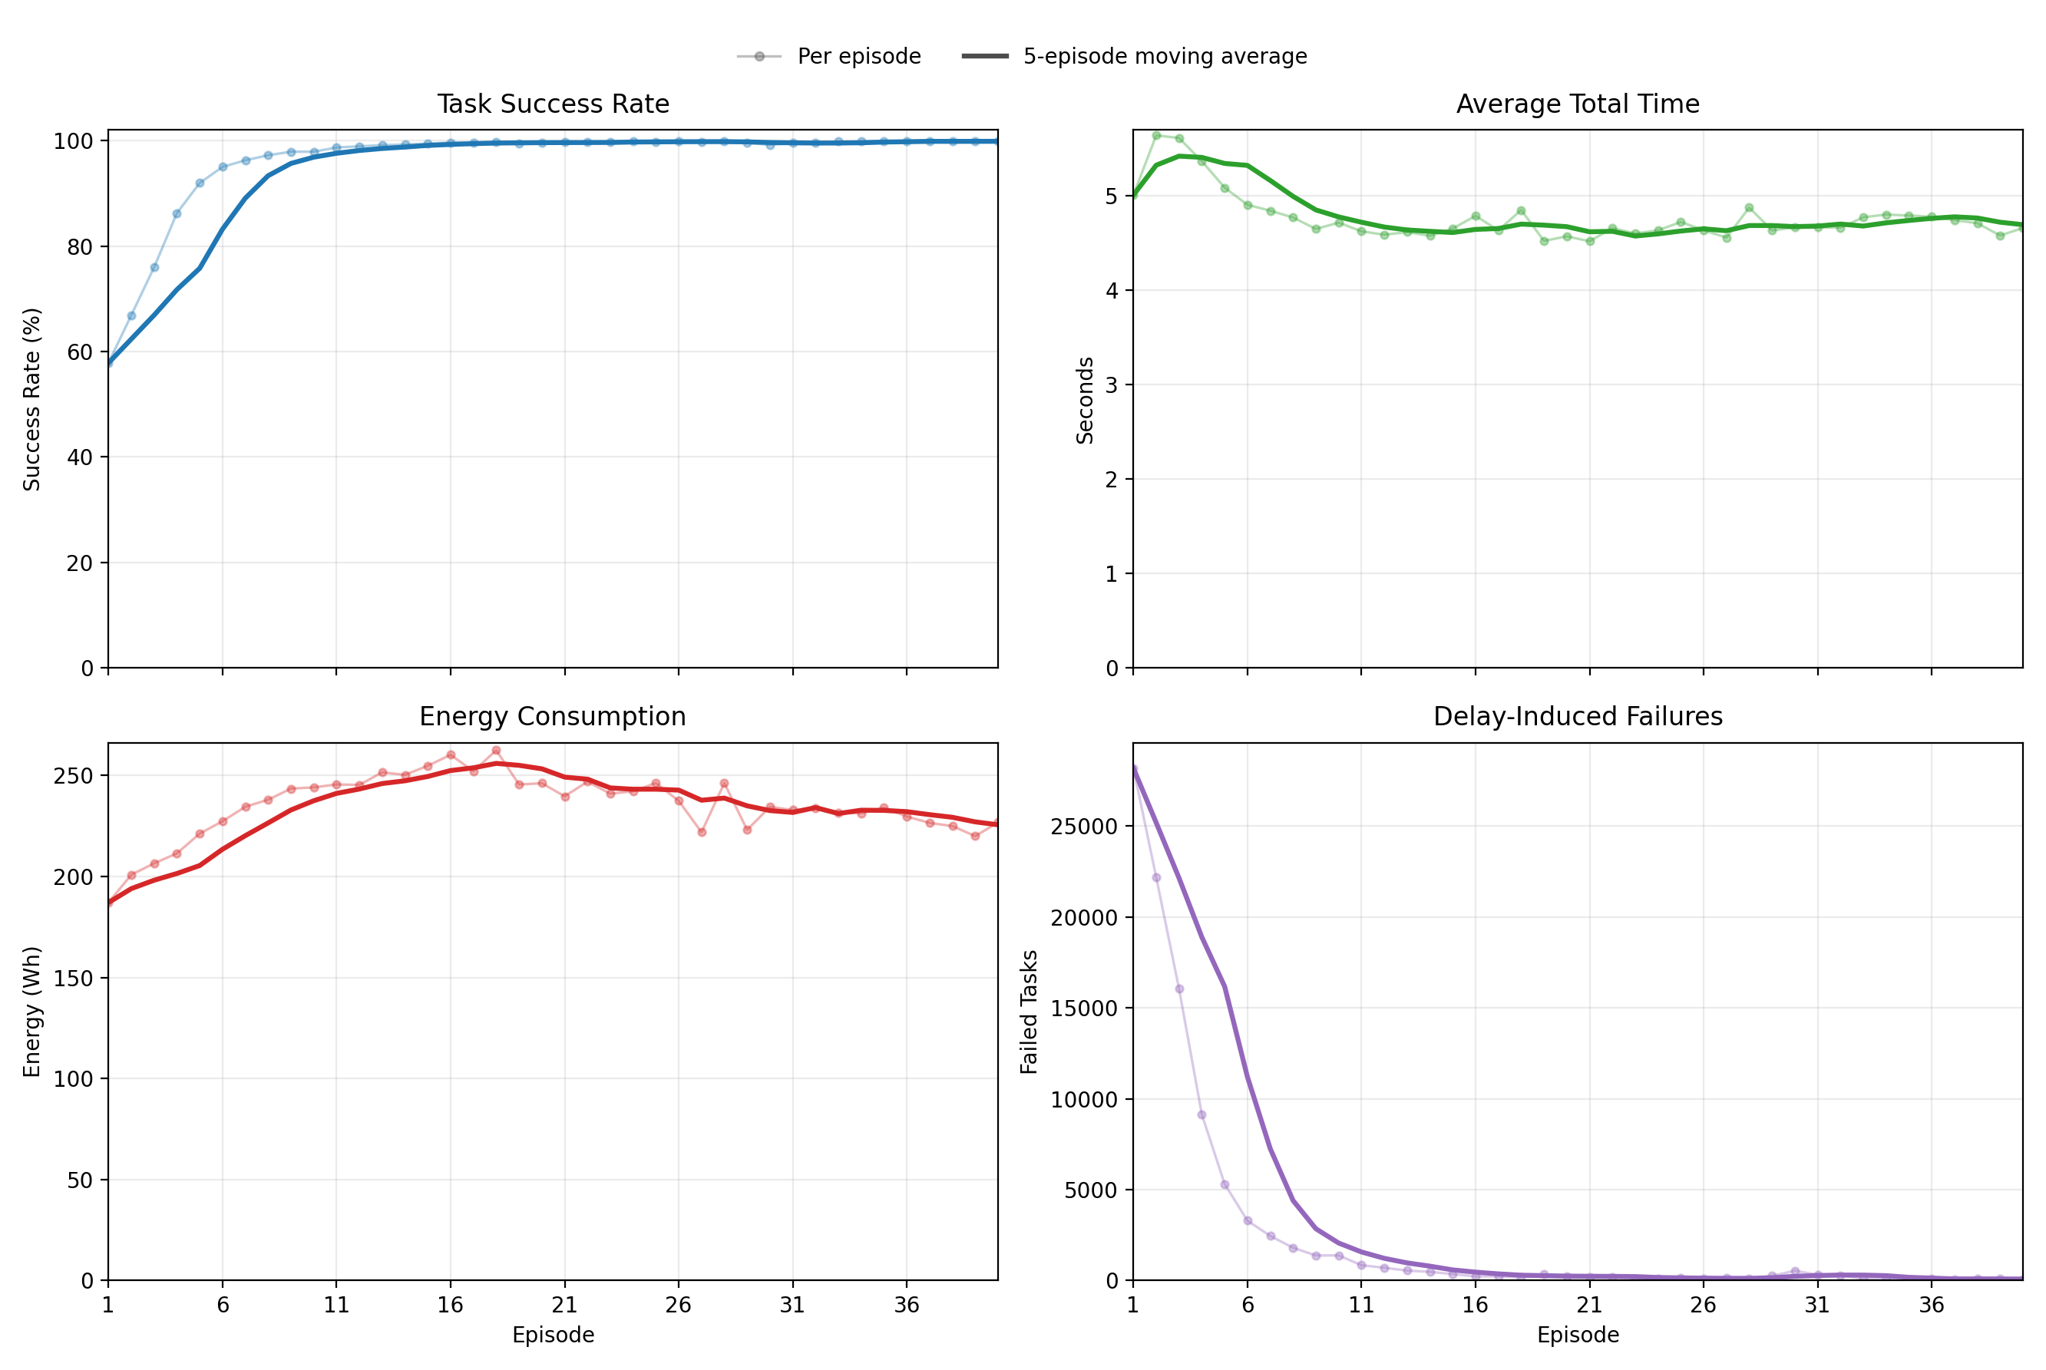
MAPPO Training Progress
Success rate: 57.85% (ep1) → 99.91% (ep40), stable plateau after ep13

Slide 24
MAPPO Three-Seed Evaluation
Seed 9001: 99.8901% success
Seed 9002: 99.9390% success
Seed 9003: 99.9421% success
Mean: 99.9237% ± 0.0238%
Avg total time: 4.5284s
Energy: 227.64 Wh
Strong cross-seed robustness
All three runs tightly clustered
No large deviations
Consistent generalization
Stable policy behavior

Slide 25
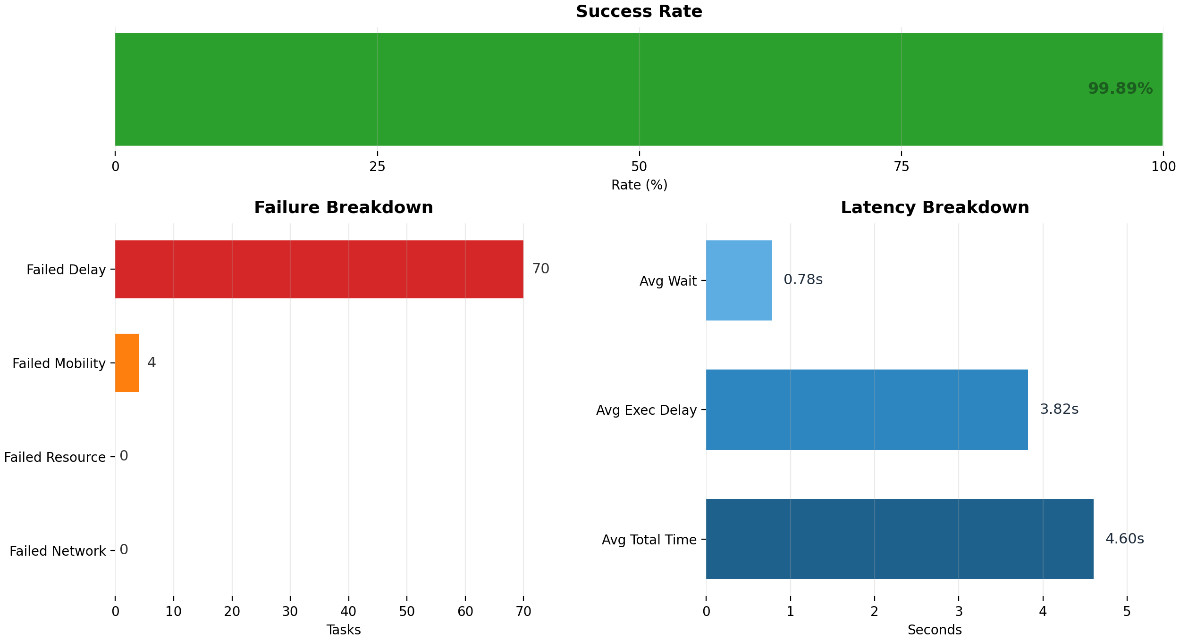
MAPPO Evaluation Overview (Seed 9001)
51.73% cloud, 19.81% local, 28.46% edge; PRB: 72.76% use 1-block

Slide 26
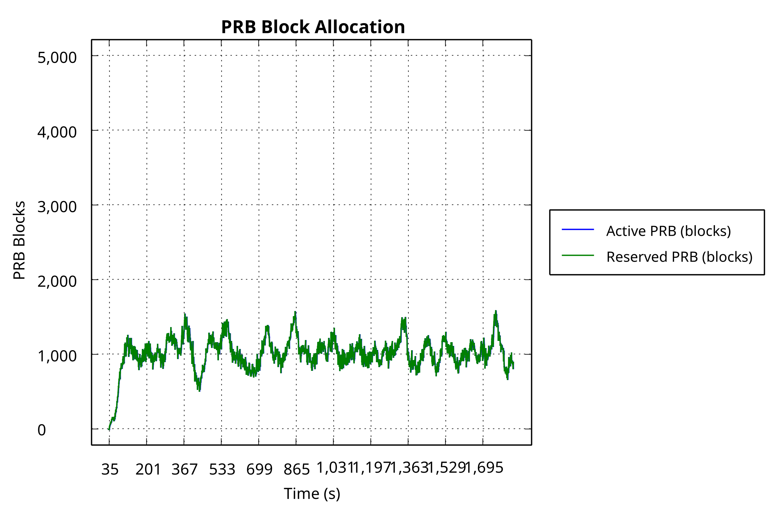
MAPPO Runtime Resource Dynamics
Moderate stable PRB reservation, balanced CPU utilization across tiers

Slide 27
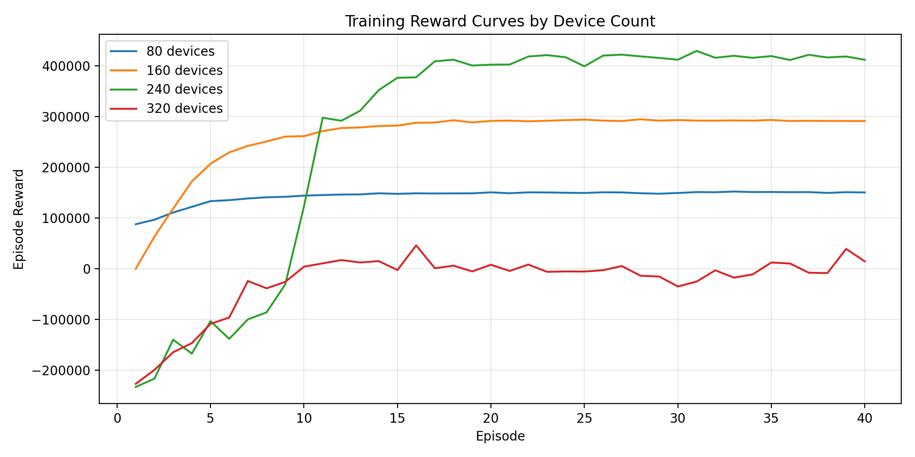
Device Count Scalability Study
80/160/240 devices converge; 320 devices fail due to infrastructure saturation

Slide 28
Device Count Evaluation Results
80 devices: 99.75% success
160 devices: 99.77% success
240 devices: 99.55% success
320 devices: 54.06% success
Graceful scaling 80→240
Sharp collapse at 320
Delay failures:
• 80: 86
• 160: 154
• 240: 451
• 320: 61,899 (137× jump)
Infrastructure saturation,
not optimization failure

Slide 29
Ablation Study: NoEmbedding vs FixedPRB
NoEmbedding:
• Success: 99.8148%
• Delay failures: 123
• Energy: 227.73 Wh
• Small controlled degradation
• Removes 16D agent embedding
• Slightly more aggressive PRB
FixedPRB (10 blocks):
• Success: 92.3822%
• Delay failures: 5127.67
• Energy: 309.26 Wh
• Structural failure
• Disables adaptive PRB
• Systematic mismatch

Slide 30
Ablation Study Conclusions
Adaptive PRB control is the DOMINANT contributor to performance
Removing PRB adaptation: 99.92% → 92.38% success, 7.5pp drop
Removing agent embedding: 99.92% → 99.81% success, 0.11pp drop
Agent embeddings provide smaller but consistent reliability refinement
MAPPO value = joint offloading-PRB learning + agent conditioning
FixedPRB shows systematic inability to manage compute-radio contention

Slide 31
Offline Baseline Comparison (Fixed Seed)
MAPPO: 99.96% | PPO: 99.94% | ROUND_ROBIN: 90.39% | CLOUD: 64.64% | LOCAL: 45.36%

Slide 32
Baseline Comparison Highlights
MAPPO: 99.96% success, 4.56s time, 231.26 Wh, 20 delay failures
PPO: 99.94% success, 4.49s time, 231.38 Wh, 36 delay failures
ROUND_ROBIN: 90.39% success, 5.83s time, 298.26 Wh, 6452 failures
RL policies: 9.58pp success gain, 1.28s faster, 67 Wh less energy
RL bandwidth: 4.07 Mbps vs RR: 77.26 Mbps (19× reduction)
Coordinated three-tier usage vs mechanical single-tier overload

Slide 33
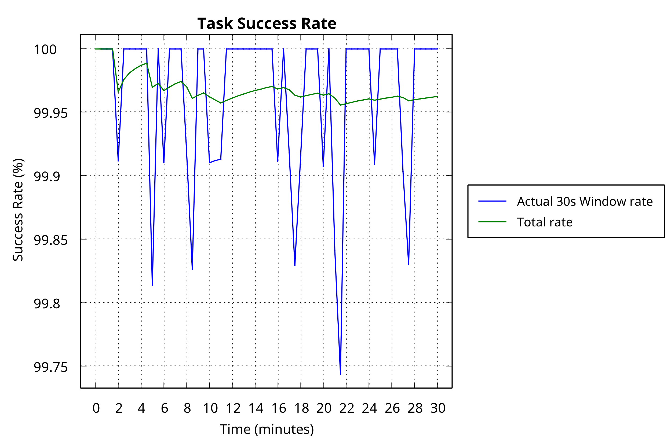
Runtime Success Trajectories
MAPPO/PPO: flat near 100%; ROUND_ROBIN: gradual decline to 90%

Slide 34
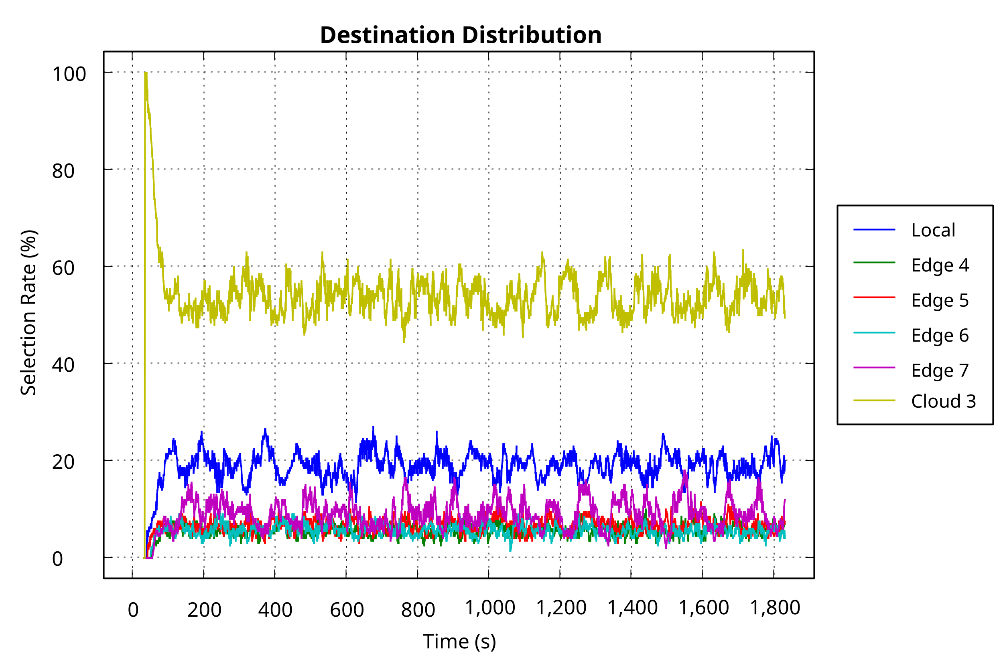
Runtime Destination Distribution
MAPPO/PPO: cloud-dominant three-tier; RR: larger local fraction, flatter edge split

Slide 35
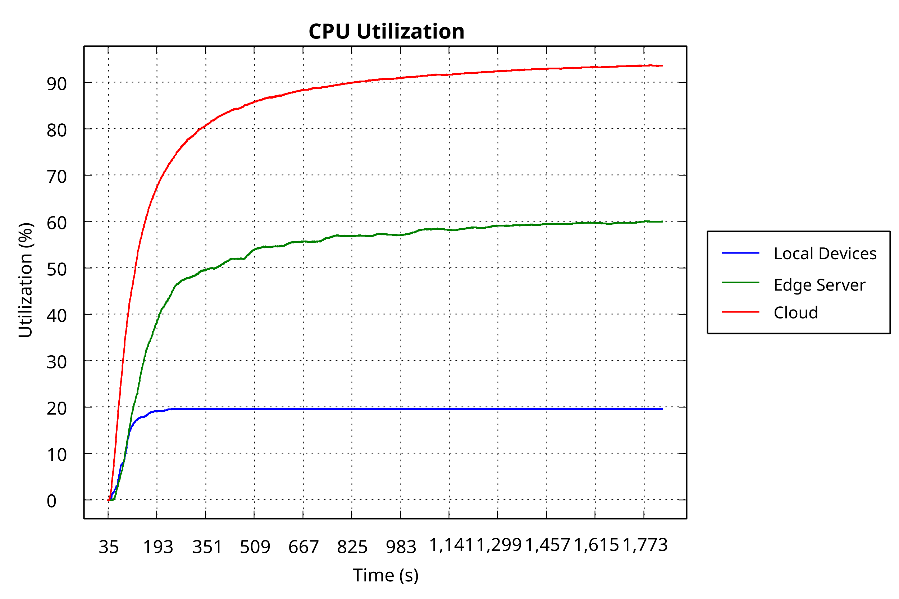
CPU Utilization Comparison
MAPPO/PPO: balanced loading; RR: edge near saturation causing queuing delays

Slide 36
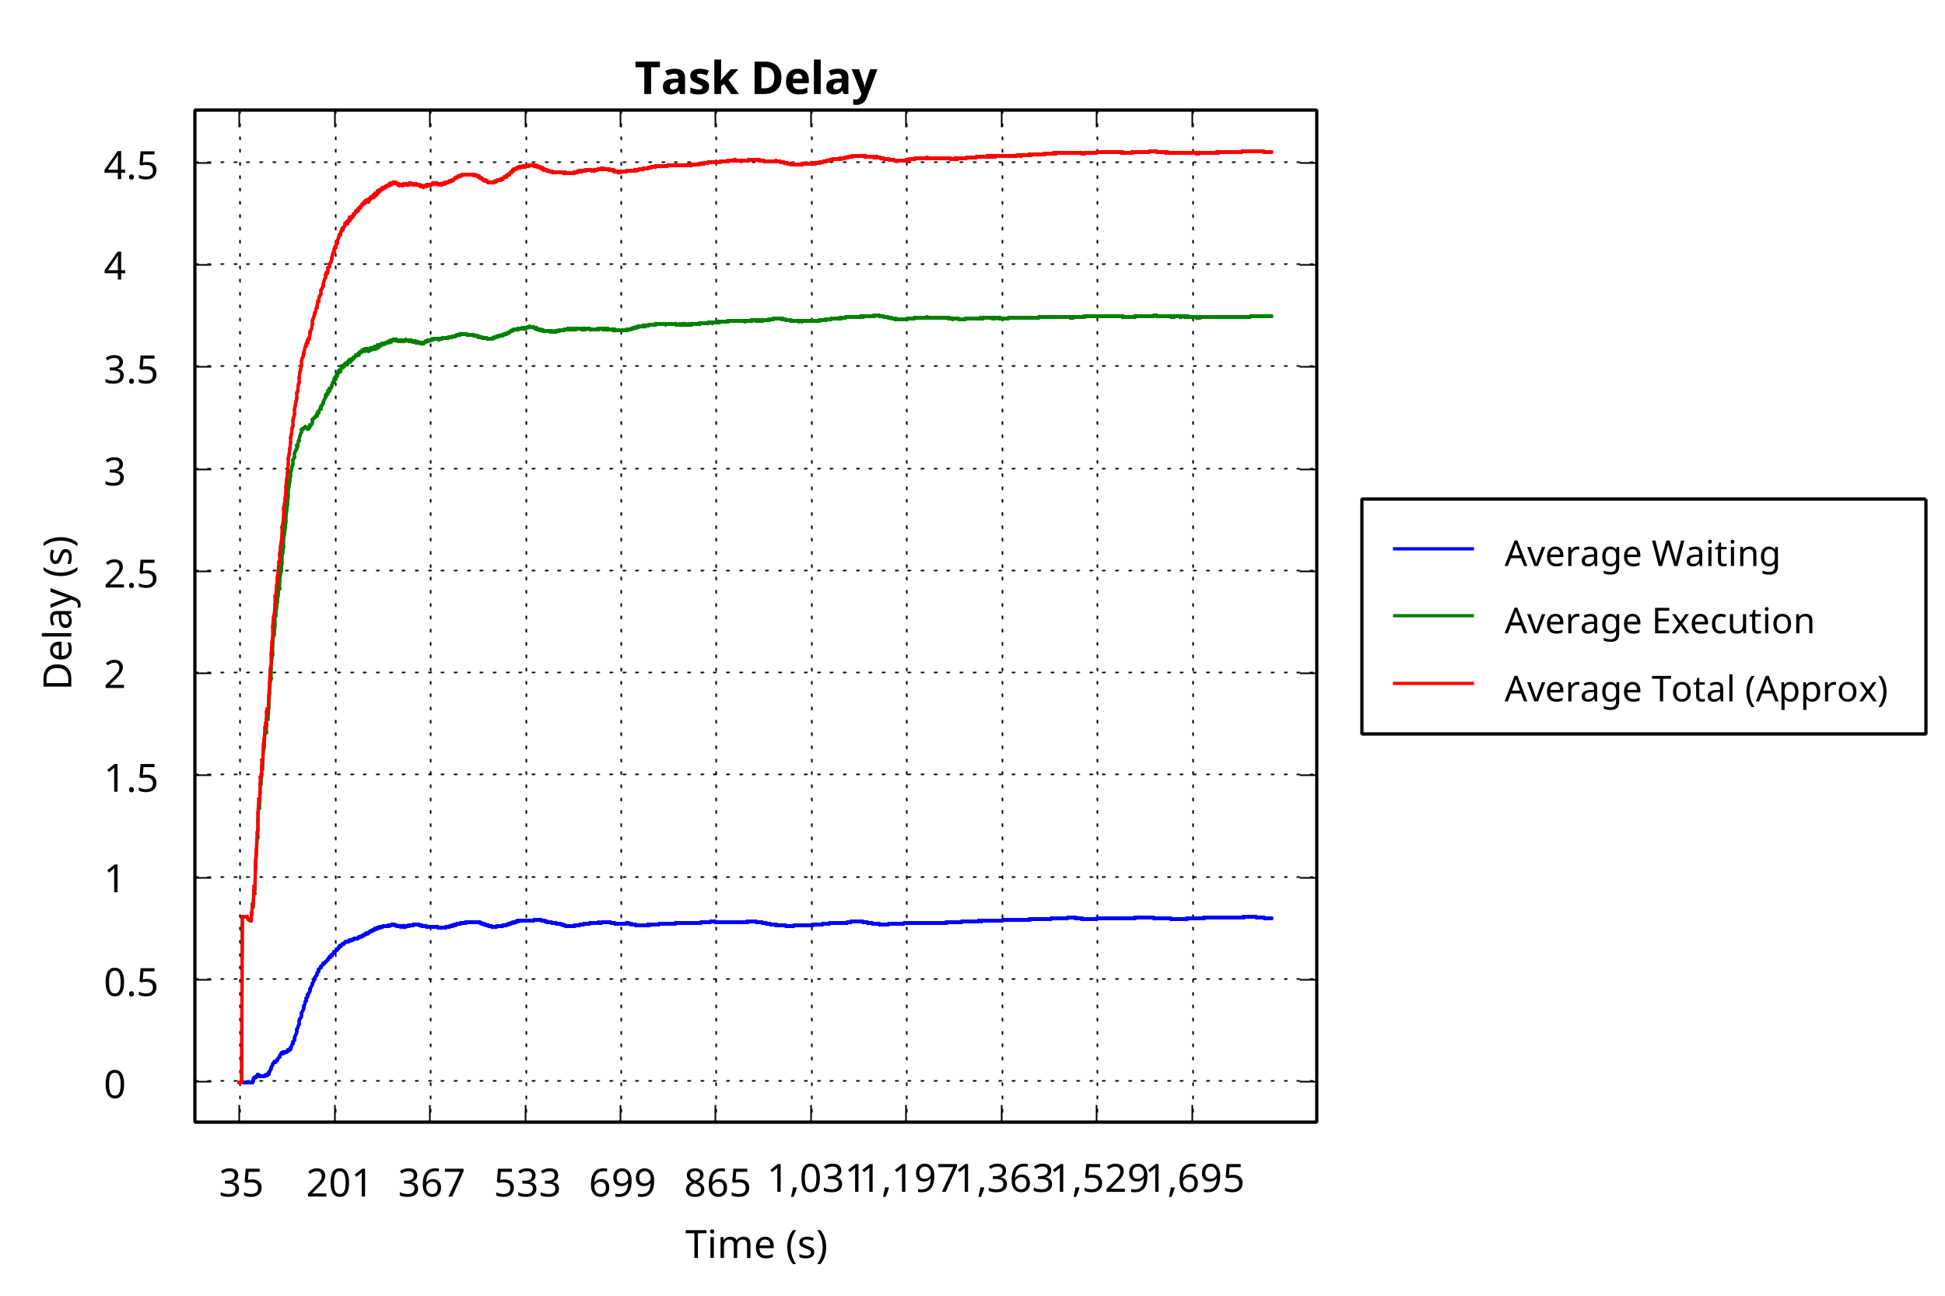
Delay Distribution Comparison
MAPPO/PPO: narrow band well below deadline; RR: wider spread with tail violations

Slide 37
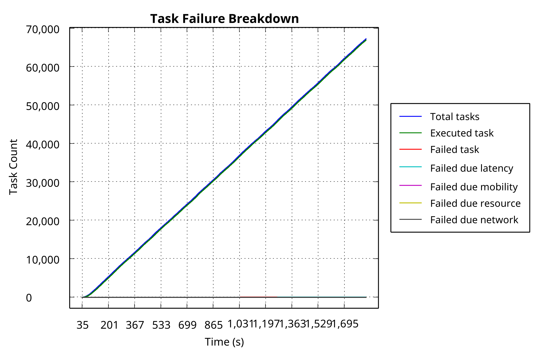
Task Failure Accumulation Over Time
MAPPO/PPO: flat curves (20/36 failures); RR: linear accumulation (6452 failures)

Slide 38
MAPPO vs PPO: Detailed Comparison
Three-seed means:
• MAPPO: 99.9237% ± 0.0238%
• PPO: 99.9436% ± 0.0137%
PPO marginally stronger on:
• Mean success rate
• Variance
• Mean total time
• Mean energy
MAPPO advantages:
• Fixed-seed: 20 vs 36 failures
• Better deadline reliability
• Structurally aligned
• Per-device formulation
MAPPO = methodologically
better-matched scheduler

Slide 39
Answer to Research Question 1
Q1: Can on-policy RL improve QoS and system efficiency over heuristics?
YES - Strong positive evidence:
• MAPPO/PPO: 99.9%+ success vs 90.39% best heuristic
• 9.58pp success gain, 1.28s faster, 67 Wh less energy
• 19× reduction in bandwidth occupation (4.07 vs 77.26 Mbps)
• Joint destination-PRB control improves both QoS and efficiency

Slide 40
Answer to Research Question 2
Q2: Is adaptive PRB allocation the dominant source of gain?
YES - Ablation evidence is clear:
• FixedPRB: 99.92% → 92.38% success (7.5pp drop)
• NoEmbedding: 99.92% → 99.81% success (0.11pp drop)
• Adaptive PRB control is 68× more important than agent embedding
• Joint offloading-PRB learning is the key principle

Slide 41
Answer to Research Question 3
Q3: Does MAPPO provide meaningful advantage over PPO?
QUALIFIED YES - Narrower reliability-oriented advantage:
• PPO marginally stronger on aggregate three-seed means
• MAPPO: fewer residual deadline failures (20 vs 36 fixed-seed)
• NoEmbedding ablation: agent conditioning improves reliability
• MAPPO = structurally better-matched per-device formulation
• Not universally superior, but methodologically aligned

Slide 42
Key Findings Summary
On-policy RL substantially outperforms heuristic schedulers
Adaptive PRB control is the dominant design factor
MAPPO provides reliability-oriented advantage over PPO
Graceful scaling 80→240 devices, collapse at 320 (infrastructure limit)
Joint communication-computation control is essential
MAPPO = methodologically aligned per-device scheduler

Slide 43
Limitations
Simulation-based evidence, gap to real 5G/6G deployment
Claims tied to tested workload range and infrastructure
320-device saturation shows capacity boundary, not infinite scalability
Full-task offloading only, no partial offloading
Limited to LOCAL-EDGE-CLOUD, no mist layer or device-to-device
PPO artifacts lack per-decision trajectory exports for symmetric comparison

Slide 44
Future Work
Map capacity boundary systematically across device density and infrastructure
Preserve symmetric behavioral artifacts for PPO and MAPPO
Extend to partial offloading with joint task partitioning
Expand architecture to include mist layer and neighboring-device execution
Reduce simulation-to-reality gap with realistic traces or hardware testbed
Broader robustness validation across seeds, traffic patterns, topologies

Slide 45
Conclusion
Joint task offloading and PRB allocation formulated as Dec-POMDP
MAPPO framework with CTDE achieves 99.96% success rate
Adaptive PRB control is the dominant contributor to performance
MAPPO provides reliability-oriented advantage, structurally aligned
On-policy RL is effective within tested capacity envelope
Extended PureEdgeSim provides end-to-end training/evaluation pipeline

Slide 46
Thank You
Questions?

