Slide 1
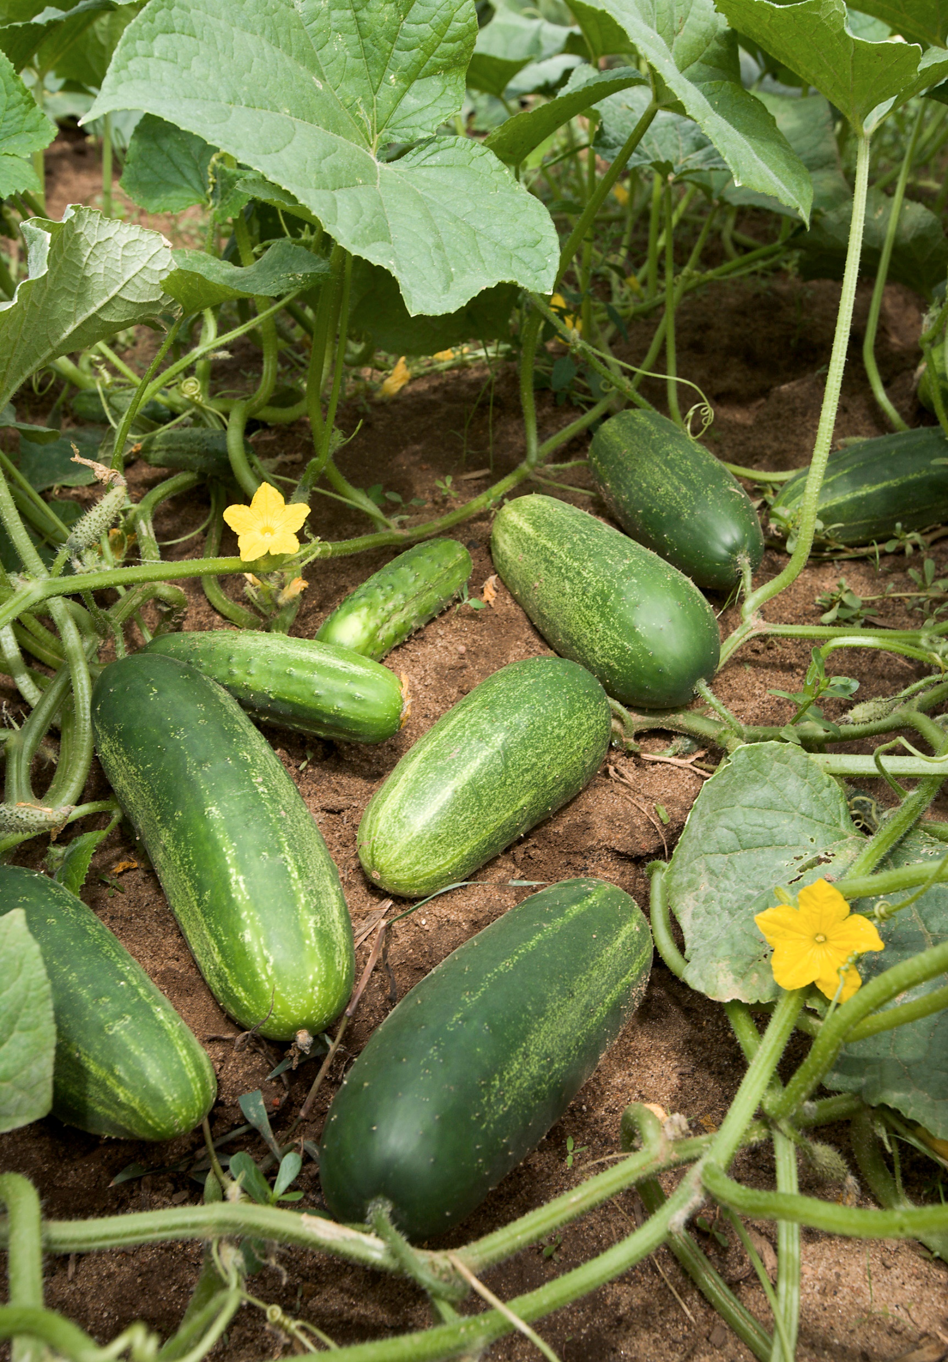
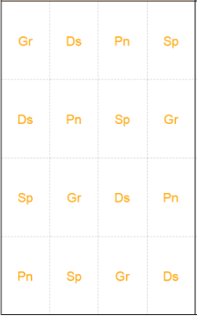
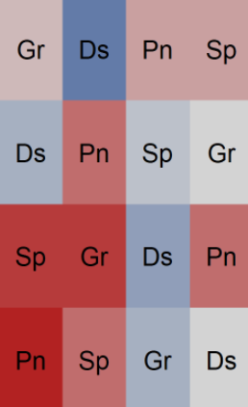
Multi-Environment Latin Square Design with Cucumbers
(Ausmus S 2007)
Experimental Design:
Multi-environment + Latin Square
Programming:
SQL, R, RMarkdown
Data:
Cleaning, manipulation, viz
Statistical tests:
Q-Q plot, Shapiro Wilk test, Levene’s test, ANOVA, two-way ANOVA, Fully Random Model, Mixed Effect Model

Slide 2
