Slide 1
Use of Digital Technology to calculate water footprint for different daily use items

Slide 2
Abstract
Motivation: rising water scarcity, depletion, and pollution; need consumer transparency.
Solution: software-only React web app computing blue/green/grey footprints and an optional scarcity-weighted indicator.
Stack: React + TypeScript frontend; Node/NestJS calculation API; PostgreSQL storage; Redis caching; optional FastAPI CV service.
Features: search and barcode/image scan (device camera only), regional factors, multi-language UI, explainability and alternatives.
Outcome: credible, fast, transparent results to drive everyday behavior change.

Slide 3
Literature Survey (1/2)
Hoekstra & Mekonnen (2012), PNAS — The water footprint of humanity: baseline patterns & virtual water trade.
Mekonnen & Hoekstra (2011), HESS — Crop-level blue/green/grey factors underpinning food item estimates.
ISO 14046 (2014) — Water footprint principles; shapes reporting & disclosure.
ISO 14044 (2006/2018) — LCA requirements; allocation & functional unit guidance.
Pfister et al. (2009), PNAS — Freshwater consumption in LCA; consumptive use framing.

Slide 4
Literature Survey (2/2)
Ridoutt & Pfister (2010), J. Industrial Ecology — Scarcity-oriented footprinting rationale.
Boulay et al. (2018), Int. J. LCA — AWARE model; regional characterization factors.
Kounina et al. (2013), Int. J. LCA — Methods review; pitfalls & harmonization.
Berger et al. (2014), Int. J. LCA — Progress & challenges; communication best practices.
Bayart et al. (2010), Int. J. LCA — Off-stream water use; grey WF framing.
Boulay et al. (2015), Environ. Sci. Technol. — Consensus on assessing water use impacts.
Hoekstra (2017) — Water Footprint Assessment: evolvement of the field.

Slide 5
Objectives
Implement ISO-aligned computation of WF_total = WF_blue + WF_green + WF_grey with transparent units & sources.
Provide an optional scarcity-weighted indicator using regional characterization factors (e.g., AWARE).
Deliver fast, accessible UX (target ≤ 1.5 s p95 after warm cache) with English + 2 Indian languages.
Enable product discovery via search & barcode/image scanning; show assumptions, region, data version.
Governance: dataset versioning, changelogs, integrity hashes; reproducible ETL.

Slide 6
Existing Methods – Drawbacks
Coarse global averages; limited regionalization and unclear data lineage.
Missing blue/green/grey breakdown and absent scarcity characterization view.
Weak provenance and transparency of assumptions and datasets.
Limited local-language support; little or no scanning capability.
Few actionable alternatives or “what-if” comparisons for users.

Slide 7
Proposed Method — Concepts & Formulae
Definitions:
WF_green: rainwater in soil used by crops.
WF_blue: surface/groundwater consumed (not returned same time/place/quality).
WF_grey: water needed to dilute pollutants to standards.
Formulae:
WF_total = WF_blue + WF_green + WF_grey
WF_grey = pollutant load / (C_max − C_nat)

Slide 8
Proposed Method — Workflow
1) Map product → ingredients → processes.
2) Normalize recipe quantities to functional unit (per 100 g / per serving).
3) Compute component sums (WF_blue / WF_green / WF_grey); add processing water if available.
4) Apply optional scarcity characterization using regional CFs (AWARE).
5) Explainability: charts, assumptions, data vintage, region, sources.
6) Recommendations: lower-footprint alternatives with rationale.

Slide 9
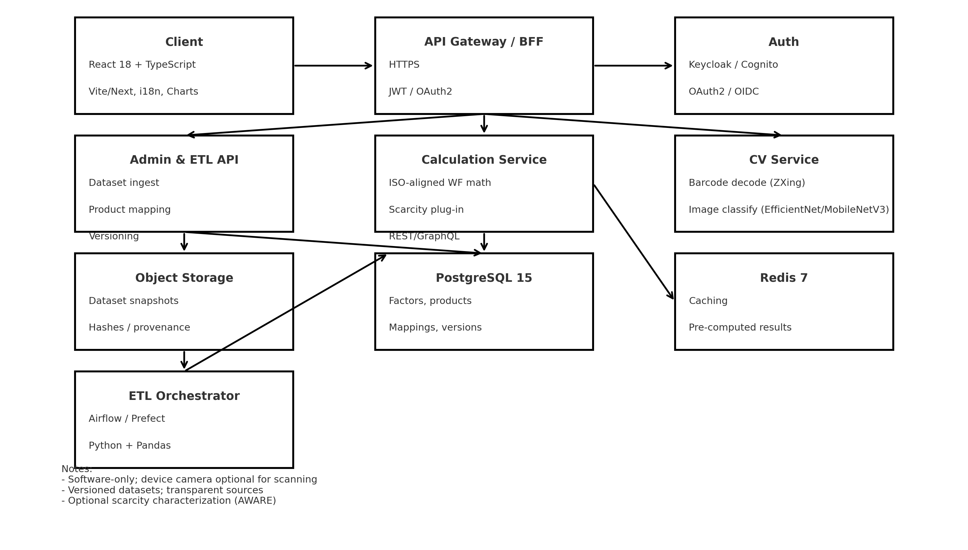
Architecture Diagram

Slide 10
Modules
Auth & Profiles — OAuth2/OIDC, saved items, privacy.
Catalog & Search — product taxonomy, filters, multilingual search.
Scan & Recognize — barcode decoding (ZXing) and optional image classifier.
Calculator Engine — ISO-aligned blue/green/grey computation with unit conversions and uncertainty flags.
Scarcity Characterization Plug-in — regional factors with safe fallbacks.
Explainability & Sources — charts, assumptions, dataset/version badges, glossary.
Recommendations — lower-footprint alternatives and serving-size comparisons.
Admin & ETL — dataset imports, product→ingredient mapping, review workflow.

Slide 11
Hardware & Software Details — Technologies & Tools
Frontend: React 18, TypeScript, Vite/Next, React Query, react-i18next, Chart.js/D3, TailwindCSS.
Backend: Node.js (NestJS/Express) for calc/admin APIs; FastAPI/Python for optional CV service.
Data: PostgreSQL 15 (primary store), Redis 7 (cache).
ETL/Orchestration: Python + Pandas, Airflow/Prefect.
AI/CV: PyTorch/TensorFlow Lite; ZXing for barcode.
Security: OAuth2/OIDC (Keycloak/Cognito), JWT; rate limiting; OpenAPI/Swagger.
DevOps: Docker, docker-compose, GitHub Actions (CI/CD), Jest/PyTest, ESLint/Prettier, ruff/mypy.
Observability: Sentry or OpenTelemetry + ELK.

Slide 12
Hardware & Software Details — Development PC
Minimum (per developer): 4‑core CPU; 16 GB RAM; 256 GB SSD; no GPU required; Windows/macOS/Linux; stable broadband.
Recommended: 6–8 cores; 32 GB RAM; 512 GB NVMe SSD; optional GPU only for local model training.

Slide 13
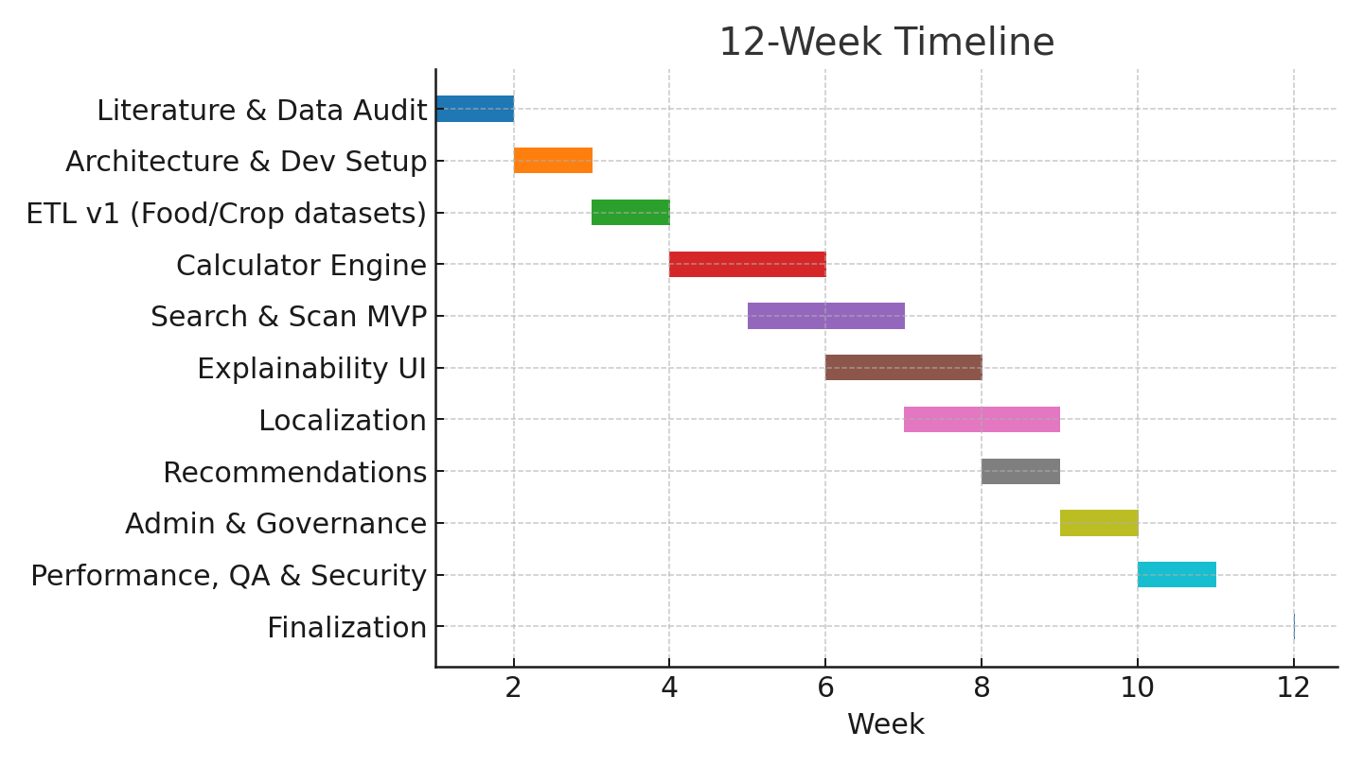
Time Line by Gantt Chart (12 Weeks)

Slide 14
Timeline — Milestones
Weeks 1–2: Literature & Data Audit — scope, dataset shortlist, schema, glossary.
Weeks 2–3: Architecture & Dev Setup — repos, Docker, CI, React shell, API skeleton, DB migrations.
Weeks 3–4: ETL v1 — ingest & normalize; validation; versioning baseline.
Weeks 4–6: Calculator Engine — component computation; Redis caching; tests; OpenAPI docs.
Weeks 5–7: Search & Scan MVP — catalog search; barcode decode; image classification prototype.
Weeks 6–8: Explainability UI — product detail, charts, assumptions/sources; accessibility review.
Weeks 7–9: Localization — i18n pipeline; add two Indian languages.
Weeks 8–9: Recommendations — alternatives & per‑serving comparisons.
Weeks 9–10: Admin & Governance — dataset import UI, mapping tool, version badges, optional hash snapshots.
Weeks 10–11: Performance/QA/Security — latency checks; auth hardening; integration tests.
Week 12: Finalization — deployed demo; user manual; final report & presentation.

Slide 15
Evaluation Metrics
Performance: p95 latency ≤ 1.5 s after cache warm-up.
Coverage: ≥ 95% items display sources; ≥ 70% unit/integration test coverage.
Localization: ≥ 2 languages at launch; accessibility checks (WCAG-friendly).
Usability: SUS ≥ 75 on pilot cohort.

Slide 16
Risk Analysis & Mitigations
Data gaps / proxies — Use nearest-region proxies with uncertainty badges; prioritize India-specific datasets.
User confusion (liters vs scarcity) — Dual view + tooltips + glossary.
Methodological debates (allocation rules) — Document choices; provide toggles where feasible.
Performance & cold starts — Redis caching; pre-compute common SKUs; CDN for assets.

Slide 17
Future Scope
Add more non-food categories and finer regionalization (state/catchment).
Crowdsourced validations with moderation and data quality checks.
Open APIs for research/education; classroom packs and exportable charts.

Slide 18
Conclusion
A credible, transparent, and fast React-based platform for water-footprint awareness.
ISO-aligned results plus optional scarcity context using regional characterization factors.
Actionable insights and alternatives to guide everyday choices.

Slide 19
References
Hoekstra, A.Y., Mekonnen, M.M. (2012). The water footprint of humanity. PNAS.
Mekonnen, M.M., Hoekstra, A.Y. (2011). Green, blue and grey water footprint of crops and derived crop products. Hydrology & Earth System Sciences.
ISO 14046 (2014). Environmental management — Water footprint — Principles, requirements and guidelines.
Ridoutt, B.G., Pfister, S. (2010). Revisiting water footprint to reflect water scarcity. Journal of Industrial Ecology.
Pfister, S., et al. (2009). Assessing the environmental impacts of freshwater consumption in LCA. PNAS.
Boulay, A.-M., et al. (2018). The WULCA consensus characterization model for water scarcity footprints (AWARE). International Journal of Life Cycle Assessment.
Kounina, A., et al. (2013). Review of methods addressing freshwater use in LCA. International Journal of Life Cycle Assessment.
Berger, M., et al. (2014). Water footprinting: progress, challenges, and prospects. International Journal of Life Cycle Assessment.
Bayart, J.-B., et al. (2010). A framework for assessing off-stream freshwater use in LCA. International Journal of Life Cycle Assessment.
Boulay, A.-M., et al. (2015). Building consensus on the assessment of water use impacts within LCA. Environmental Science & Technology.
Ercin, A.E., Hoekstra, A.Y. (2012/2014). Corporate water footprint accounting and reduction strategies (assorted works).
Hoekstra, A.Y. (2017). Water Footprint Assessment: Evolvement of a new research field.

