Slide 1
Types of storage classes in c
We have four different storage classes in a C program
1. auto
2. register
3. static
4. extern

Slide 2
auto
The auto storage class is the default storage class for all local variables.
example
int mount; // local variable
auto int month; // auto variable
By default, all local variables are auto variables
Note: local or auto variables stored in stack section

Slide 3
Scope of the auto variable
The scope of an auto variable is within the function block and cannot be accessed outside the function.
By default, the initial value of auto variables is garbage values.

Slide 4
Register
Variable declared with the keyword register are register variables.
The scope of register variables is within the function block.
Register variables are stored in the CPU register for an example auto variables are stack similarly.

Slide 5
Advantage of register variable
The frequently accessed variables are stored in the CPU register since the access time is less and makes our program run faster
Example:
register int var;

Slide 6
static
Static variables are declared with the keyword static. The static variable's lifetime is throughout the program.
The static variable declared inside the function cannot be accessed outside the function.
Static variables must be initialized before the program execution otherwise, the initial default value will be zero.

Slide 7
Static variables can be declared globally and accessed throughout the program.
Re-Initialisation is not possible in static variable.
Example:
Static int sum =1;
Note: static variables are stored in Data Section.

Slide 8
extern
External variables are declared with the keyword extern.
By default, all the global variables are external variables.
The scope of the variable is throughout the program.
External variables share the variables among the multiple C files.
External variables are stored in the memory, and their initial default value is assigned to zero.

Slide 9
Example program of Extern
//extern1.c
#include<stdio.h>
#include "extern2.c"
int Jd = 10;
void call_extern_function();
int main()
{
call_extern_function();
printf("Jd=%d\n", Jd);
}

Slide 10
// extern2.c
#include<stdio.h>
extern int Jd;
void call_extern_function()
{
printf("Jd=%d\n", Jd);
Jd =100;
}

Slide 11
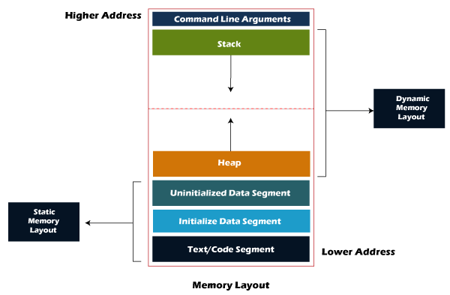
Memory Layout of C Programs

Slide 12
Types of Memory Segment
There are four types of memory segments
Code segment or Text segment
Data Segment
Heap Segment
Stack Segment

Slide 13
Code segment or Text segment
The text segment is also known as the code segment. When we compile any program it creates an executable file like a.out, .exe.
That gets stored in the text or code section of the RAM memory.
Text segment has read-only permission that prevents the program from accidental modifications.

Slide 14
Data Segment
Initialized data segment:
Initialized data segment, usually called simply the Data Segment.
It contains the global variables and static variables.
Examples
static int i=100;
int i = 100;
Both are stored in Initialized Data Segment

Slide 15
Uninitialized data segment (bss)
Uninitialized data segment often called the “bss(block started by symbol)” segment.
Uninitialized variable stored in BSS Section.
Example
static int i; and int i;
both are stored in Bss Section.

Slide 16
Heap Segment
Heap is used for memory allocation during the run time (dynamically allocated memory).
Heap Memory allocated with the help of malloc, calloc, free, realloc,
Note:
#include<stdlib.h> // should be included when use following functions //
malloc, calloc, free, realloc

Slide 17
Stack Segment
auto variables and local variables are stored stack section.
values are passing through function as an arguments and Instruction sets, return address also stored in stack.
The stack segment follows the LIFO (Last In First Out) structure and grows down to the lower address, but it depends on computer architecture.

Slide 18
Summaries
Types of storage classes.
Extern Programs in Details.
Types of Memory Layout.

