Slide 1
Introduction
Purpose:
This training covers understanding technologies and jobs details
How to get jobs in various domains what components skills really Needed
Learning what kind of activities Really ongoing in company side

Slide 2
Companies Expectation From Engineers
Good Communication
Programming Languages
Technologies
Confidents
Enthusiasm

Slide 3
Goals
Improve people skills
Everyone has to get Jobs Various Technologies and fields
People should learn lot and earn lot
People should refer others to help for them

Slide 4
List of technologies covering for Jobs
Embedded Systems
Computers
Wireless
CyberSecurity
Cloud Computing
Networking
Hardware Networking and Troubleshooting
Custom Application

Slide 5
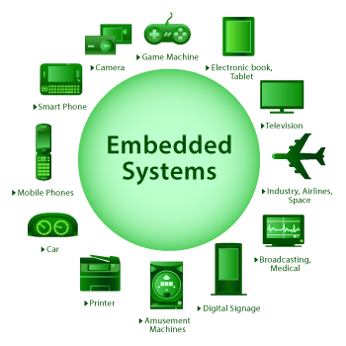
Embedded Systems

Slide 6

Computers

Slide 7
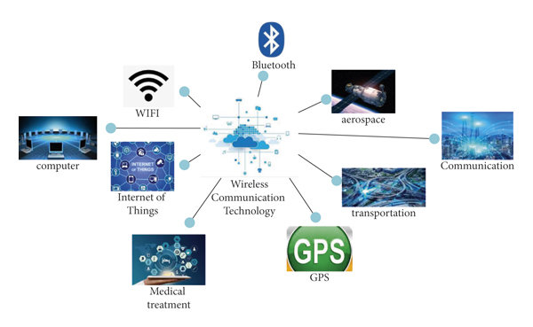
Wireless

Slide 8
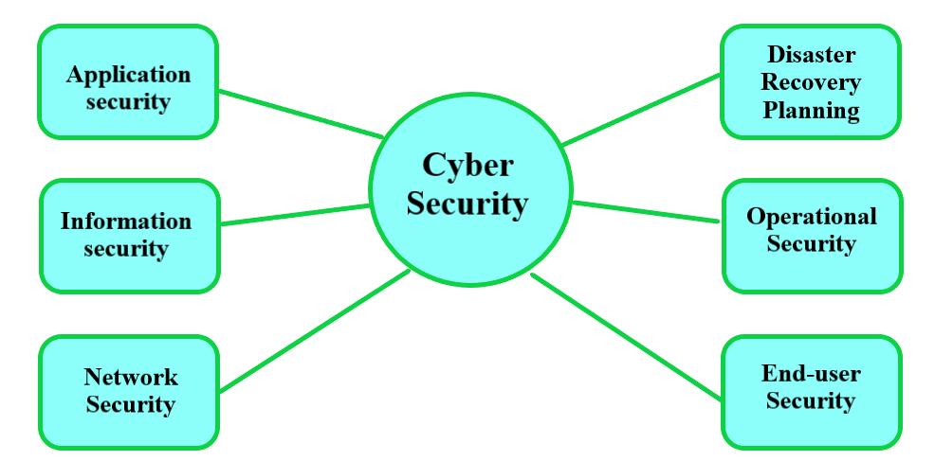
CyberSecurity

Slide 9
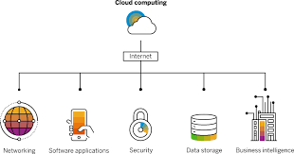
Cloud Computing

Slide 10
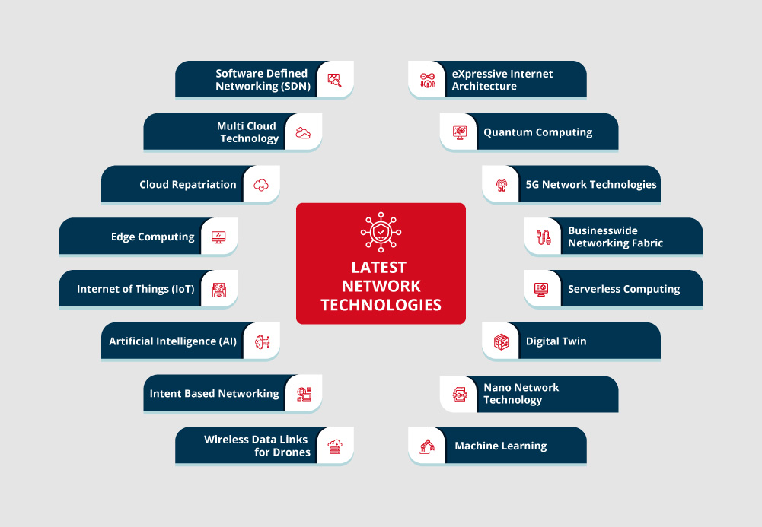
Networking

Slide 11
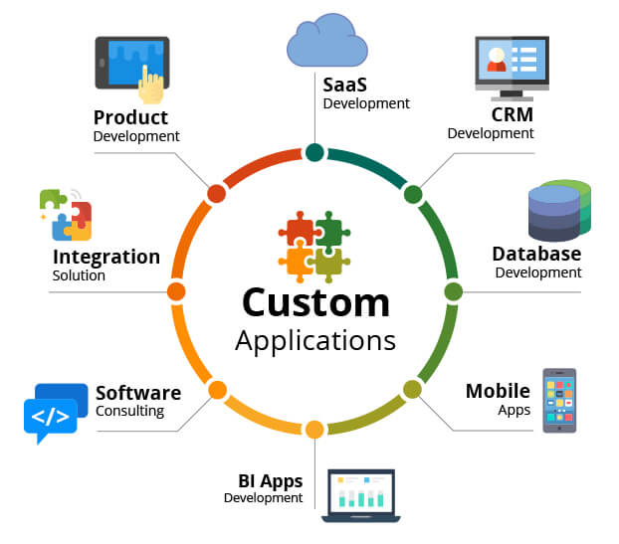
Custom Applications

Slide 12
Prerequisites of trainee
Basic Graduation
Bsc or Msc computer science
BCA and MCA
BE/ME

Slide 13
Summary
Goals
Companies Expectation From Engineers
List of technologies covering for Jobs
Prerequisites of trainees

