Slide 1
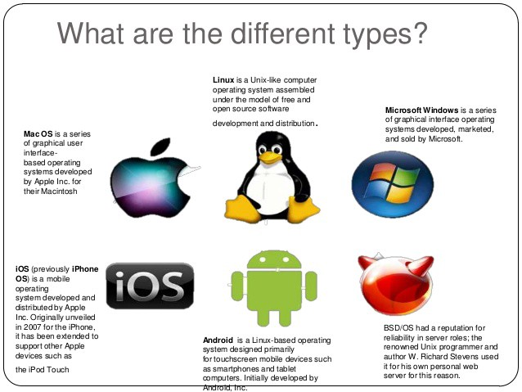
Types of Operating Systems

Slide 2
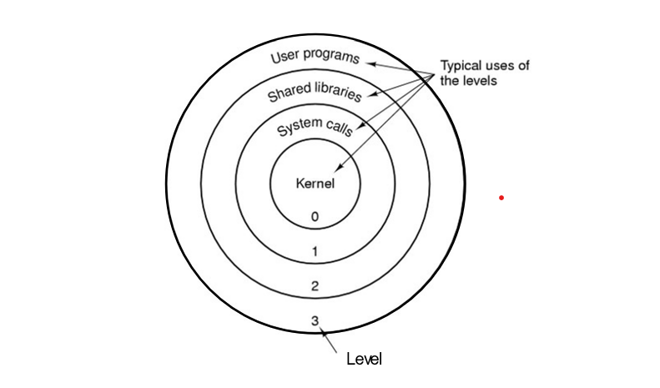
Internal Operations of Operating System

Slide 3
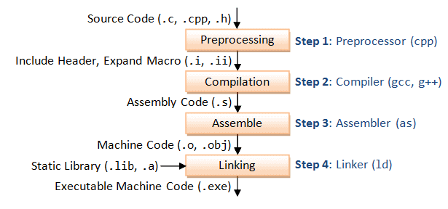
Compilation Process

Slide 4
Compilation Stages
Pre-processor
Compiler
Assembler
Linker

Slide 5
Pre-processor
Comments Removal
Macros Expansion
Header File inclusion

Slide 6
Compiler
The code which is expanded by the preprocessor is passed to the compiler.
The compiler converts this code into assembly code.
Assembler
Assembler is used to convert assembly code into object file.
The extension of the object file in DOS is '.obj,' and in UNIX, the extension is ‘o’.

Slide 7
Linker
Linker is used to link the library files with the object file to define the unknown statements.
It generates an executable file with .exe/.out extension i.e. a hello.exe/hello.out file.
Static linking
Dynamic linking

Slide 8
Commands for Compilation Stages
gcc -E code.c # generates pre-processed code
gcc -S code.c # generates assembly code
gcc -c code.c # generates object code
gcc code.c # generates linked object code

Slide 9
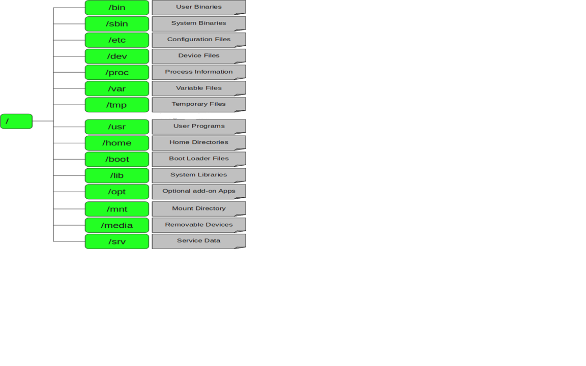
Linux File Systems

Slide 10
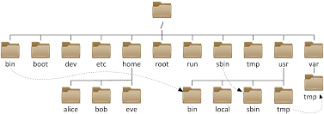
Files System Trees

Slide 11
Types of Linux Commands
Linux Directory Commands
Linux File Commands
Linux File Content Commands
Linux User Commands
Linux Filter Commands
Linux Utility Commands
Linux Networking Command

Slide 12
Linux Directory Commands
pwd Command
The pwd command is used to display the location of the current working directory.
Syntax:
Pwd

Slide 13
mkdir Command
The mkdir command is used to create a new directory under any directory.
Syntax:
mkdir <directory name>

Slide 14
rmdir Command
The rmdir command is used to delete a directory.
rmdir <directory name>

Slide 15
ls Command
The ls command is used to display a list of content of a directory.
Syntax:
ls

Slide 16
cd Command
The cd command is used to change the current directory.
Syntax:
cd <directory name>

Slide 17
Linux File Commands
touch Command
The touch command is used to create empty files. We can create multiple empty files by executing it once.
Syntax:
touch <file name>
touch <file1> <file2> ....

Slide 18
cat Command
The cat command is a multi-purpose utility in the Linux system.
It can be used to create a file, display content of the file.
Syntax:
cat > <file name>
cat <file name>

Slide 19
rm Command
The rm command is used to remove a file.
Syntax:
rm <file name>

Slide 20
cp Command
The cp command is used to copy a file or directory.
Syntax:
To copy in the same directory:
cp <existing file name> <new file name>
To copy in a different directory:
2. cp <existing file name> <directory name>

Slide 21
mv Command
The mv command is used to move a file or a directory form one location to another location.
Syntax:
mv <file name> <directory path>

Slide 22
Linux File Content Commands
head Command
The head command is used to display the content of a file. It displays the first 10 lines of a file.
Syntax:
head <file name>

Slide 23
tail Command
The tail command is similar to the head command. The difference between both commands is that it displays the last ten lines of the file content. It is useful for reading the error message.
Syntax:
tail <file name>

Slide 24
tac Command
The tac command is the reverse of cat command, as its name specified. It displays the file content in reverse order (from the last line).
Syntax:
tac <file name>

Slide 25
Linux User Commands
su Command
The su command provides administrative access to another user.
Syntax:
su <user name>

Slide 26
id Command
The id command is used to display the user ID (UID) and group ID (GID).
Syntax:
id
useradd Command
The useradd command is used to add a user on a Linux.
Syntax:
useradd username

Slide 27
passwd Command
The passwd command is used to create and change the password for a user.
Syntax:
passwd <username>
groupadd Command
The groupadd command is used to create a user group.
Syntax:
groupadd <group name>

Slide 28
Linux Filter Commands
grep Command
The grep is the most powerful and used filter in a Linux system.
The 'grep' stands for "global regular expression print." It is useful for searching the content from a file. Syntax:
command | grep <searchWord>

Slide 29
wc Command
The wc command is used to count the lines, words, and characters in a file.
Syntax:
wc <file name>

Slide 30
gzip Command
The gzip command is used to truncate the file size. It is a compressing tool. It replaces the original file by the compressed file having '.gz' extension.
Syntax:
gzip <file1> <file2> <file3>...

Slide 31
gunzip Command
The gunzip command is used to decompress a file. It is a reverse operation of gzip command.
Syntax:
gunzip <file1> <file2> <file3>. .

Slide 32
Linux Utility Commands
find Command
The find command is used to find a particular file within a directory. It also supports various options to find a file such as byname, by type, by date, and more.
Syntax:
find . -name "*.pdf"

Slide 33
locate Command
The locate command is used to search a file by file name. It searches the file in the database, whereas the find command searches in the file system. It is faster than the find command. To find the file with the locates command, keep your database updated.
Syntax:
locate <file name>

Slide 34
date Command
The date command is used to display date, time, time zone, and more.
Syntax:
date

Slide 35
cal Command
The cal command is used to display the current month's calendar with the current date highlighted.
Syntax:
cal

Slide 36
sleep Command
The sleep command is used to hold the terminal by the specified amount of time. By default, it takes time in seconds.
Syntax:
sleep <time>

Slide 37
df Command
The df command is used to display the disk space used in the file system. It displays the output as in the number of used blocks, available blocks, and the mounted directory.
Syntax:
df

Slide 38
clear Command
Linux clear command is used to clear the terminal screen.
Syntax:
clear

Slide 39
Linux Networking Commands
ip Command
Linux ip command is an updated version of the ipconfig command. It is used to assign an IP address, initialize an interface, disable an interface.
Syntax:
ip a or ip addr

Slide 40
ssh Command
Linux ssh command is used to create a remote connection through the ssh protocol.
Syntax:
ssh user_name@host(IP/Domain_name)</p>

Slide 41
ping Command
The ping command is used to check the connectivity between two nodes, that is whether the server is connected. It is a short form of "Packet Internet Groper."
Syntax:
ping <destination>

Slide 42
host Command
The host command is used to display the IP address for a given domain name and vice versa. It performs the DNS lookups for the DNS Query.
Syntax:
host <domain name> or <ip address>

Slide 43
summary
Types of Operating Systems
Compilation Process
Linux Commands and Usages

