Slide 1
Inter Process Communication
Inter-Process Communication (IPC) plays a vital role in the operating systems, enabling different processes to communicate and cooperate with each other.
IPC is crucial for multi-tasking, enabling processes to share data, synchronize their activities, and collaborate effectively. Number of processes are running concurrently.
The Need for IPC
Data Sharing: Processes often need to share data. For example, a text editor may need to pass data to a printer process to generate a hard copy.
Synchronization: Processes may need to synchronize their activities. For instance, in a multi-threaded environment, threads must coordinate to ensure data consistency.

Slide 2
Cont..
Communication: Processes might need to communicate for a variety of purposes, such as exchanging information, signaling, and error handling.
Resource Sharing: IPC helps manage and share resources, like file access, memory, or hardware devices among processes.
Methods of IPC
Message Passing: In message passing, processes exchange data by sending and receiving messages through a messaging system.
Shared Memory: Processes can communicate by sharing a common memory region. This method is efficient but requires synchronization mechanisms to avoid data inconsistencies.

Slide 3
Cont..
Sockets: Sockets are commonly used for IPC in networked systems. Processes can communicate over a network or on the same machine by reading and writing data through sockets.
Pipes and FIFOs: These are used for communication between related processes. Pipes are unidirectional, while FIFOs (named pipes) are bidirectional and can be used between unrelated processes.
Signals: Processes can send signals to each other to notify about events or requests. Signals are lightweight and are often used for process management and error handling.

Slide 4
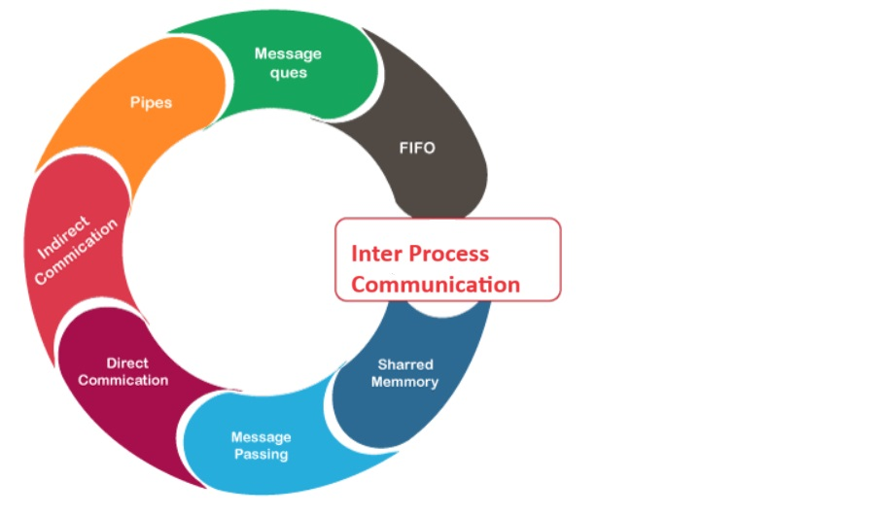
Cont..

Slide 5
Pipe()
pipe() creates a pipe, a unidirectional data channel that can be used for inter process communication.
There two process are used for send and receive data. On Success returns 0 and Errors returns -1.
Syntax
int pipe(int pipefd[2]);
Need to include following headers file
#include <unistd.h>
#include <fcntl.h>

Slide 6
Read and Write System Calls
write() - write to a file descriptor. writes up to count bytes from the buffer starting at buf to the file referred to by the file descriptor fd.
Syntax:
#include <unistd.h>
ssize_t write(int fd, const void buf[.count], size_t count);
read() - read from a file descriptor. attempts to read up to count bytes from file descriptor fd into the buffer starting at buf.
Syntax:
ssize_t read(int fd, void buf[.count], size_t count);

Slide 7
Cont..
Process w for Writing data into kernal and Process R for Reading Data from the Kernal.
Process R
Process W
Kernal

Slide 8
Program
#include<stdio.h>
#include<fcntl.h>
#include<unistd.h>
void main()
{
int fd[2];
char wr_buf[100];
char Rd_buf[100];
int status;
status=pipe(fd);

Slide 9
Cont..
if(fork()==0)
{
read(fd[0],Rd_buf,sizeof(Rd_buf));
printf("Display Data:%s\n", Rd_buf);
}
else
{
printf("Enter the Data:\n");
scanf("%s",wr_buf);
write(fd[1],wr_buf,sizeof(wr_buf));
}
close(fd[0]);
close(fd[1]);

Slide 10
Named Pipe or FIFO
A named pipe (also known as a FIFO) is one of the methods for inter-process communication.
A FIFO file is a special kind of file on the local storage which allows two or more processes to communicate with each other by reading/writing to/from this file.
A FIFO special file is entered into the filesystem by calling mkfifo() in C. Once we have created a FIFO special file in this way, any process can open it for reading or writing, in the same way as an ordinary file.
Syntax:
#include <sys/types.h>
#include <sys/stat.h>
int mkfifo(const char *pathname, mode_t mode);

Slide 11
Program for mkfifo1.c
#include<stdio.h>
#include<fcntl.h>
#include<unistd.h>
#include<sys/stat.h>
#include<string.h>
void main ()
{
int fd1,fd2;
char Rd_Buf[50];
char Wr_Buf[50];
bzero(Rd_Buf, sizeof(Rd_Buf));
bzero(Wr_Buf, sizeof(Wr_Buf));
mkfifo("pipe1",0664);
perror("mkfifo");

Slide 12
Cont..
mkfifo("pipe2",0664);
perror("mkfifo");
fd1=open("pipe1",O_RDWR);
fd2=open("pipe2",O_RDWR);
if(fork()==0)
{
while(1)
{
read(fd2,Rd_Buf,sizeof(Rd_Buf));
printf("%s\n",Rd_Buf);
}
}

Slide 13
Cont..
else
{
while(1)
{
printf("enter the data\n");
scanf("%s", Wr_Buf);
write(fd1,Wr_Buf,sizeof(Wr_Buf));
}
}
}

Slide 14
Program for mkfifo2.c
#include<stdio.h>
#include<fcntl.h>
#include<unistd.h>
#include<sys/stat.h>
#include<string.h>
void main ()
{
int fd1,fd2;
char Rd_Buf[50];
char Wr_Buf[50];
bzero(Wr_Buf, sizeof(Wr_Buf));
bzero(Rd_Buf, sizeof(Rd_Buf));
mkfifo("pipe1",0664);
perror("mkfifo");

Slide 15
Cont..
mkfifo("pipe2",0664);
perror("mkfifo");
fd1=open("pipe1",O_RDWR);
fd2=open("pipe2",O_RDWR);
if(fork()==0)
{
while(1)
{
read(fd1,Rd_Buf,sizeof(Rd_Buf));
printf("%s\n", Rd_Buf);
}
}

Slide 16
Cont..
else
{
while(1)
{
printf("enter the data\n");
scanf("%s",Wr_Buf);
write(fd2,Wr_Buf,sizeof(Wr_Buf));
}
}
}

Slide 17
Compilation
gcc mkfifo1.c –o P1
gcc mkfifo2.c –o P2
Need to open two terminal and do Execution

Slide 18
Summary
IPC Explanation
Pipe
Named pipe or FIFO

