Slide 1
Linux Process
A program/command when executed, a special instance is provided by the system to the process. This instance consists of all the services/resources that may be utilized by the process under execution.
Whenever a command is executed in Unix/Linux, it creates/starts a new process.
For example, when pwd executed It will show list of current directory.
Each Process It has Unique ID that is called ProcessId if we terminate particular process following command has to use $ kill -9 PID

Slide 2
Types of Processes in Linux
Foreground process
Every process when started runs in foreground by default, receives input from the keyboard, and sends output to the screen.
When giving pwd command in console it would give output on the screen
When a process is running in the foreground it is taking a lot of time, no other processes started because the prompt would not be available until the Process will get finish

Slide 3
Cont..
Background Process
A process is running on the background that is called background process. When this process is executing at the same time other parallel process also running in the background.
Example
$ pwd &

Slide 4
Cont..
Parent and Child Process
A child process is a Linux process that is created by another process known as the parent process.
By using fork() system call we can create two process such as parent and child process.
Zombie and Orphan process
A zombie process is a Linux process that has finished its execution but still has an entry in the process table.
An orphan process is a process that continues to run even after the parent process has been completed or terminated. An orphan process can be intentionally or unintentionally created.

Slide 5
Cont..
Daemon process
Daemon processes are system-related background processes. These processes often run the permissions of root and service requests from other processes.
Daemon processes often run in the background, waiting for specified events or tasks to occur. Daemon processes, unlike regular processes, do not require a controlling terminal to operate.

Slide 6
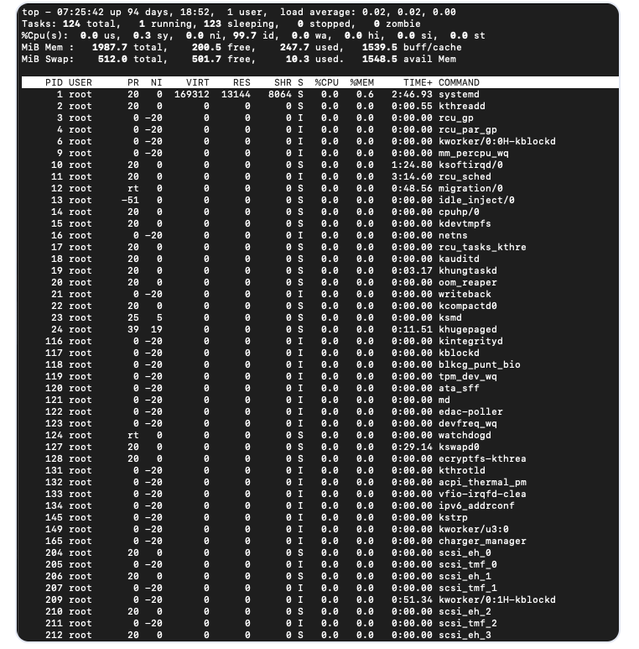
Commands for Process Management in Linux
There are two commands available in Linux to track running processes. These two commands are Top and Ps.
$ top

Slide 7
Cont..
PID: Unique Process ID given to each process.
User: Username of the process owner.
PR: Priority given to a process while scheduling.
NI: ‘nice’ value of a process.
VIRT: Amount of virtual memory used by a process.
RES: Amount of physical memory used by a process.
SHR: Amount of memory shared with other processes.
S: state of the process
‘D’ = uninterruptible sleep
‘R’ = running
‘S’ = sleeping
‘T’ = traced or stopped
‘Z’ = zombie
%CPU: Percentage of CPU used by the process.
%MEM; Percentage of RAM used by the process.
TIME+: Total CPU time consumed by the process.
Command: Command used to activate the process.

Slide 8
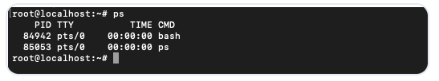
Cont..
$ ps
Process Id
TTY – Terminal Type
TIME – Total Time process is running
CMD – Name of the command launching Process

Slide 9
Stop Process
For Killing particular Process
$kill -9 [Pid]
Changing Priority of Process
The priority value for a process is called the ‘Niceness’ value. Niceness value can range from -20 to 19. 0 is the default value.
$ nice -n [value] [process name]

Slide 10
Process related system calls
fork()
System call fork() is used to create processes. It takes no arguments and returns a process ID.
The purpose of fork() is to create a new process, which becomes the child process of the caller. After a new child process is created, both processes will execute the next instruction following the fork() system call.
If fork() returns a negative value, the creation of a child process was unsuccessful.
fork() returns a zero to the newly created child process.
The parent Process returns Non Zero Positive value
fork() returns a positive value, the process ID of the child process, to the parent. The returned process ID is of type pid_t defined in sys/types.h.

Slide 11
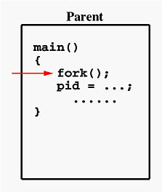
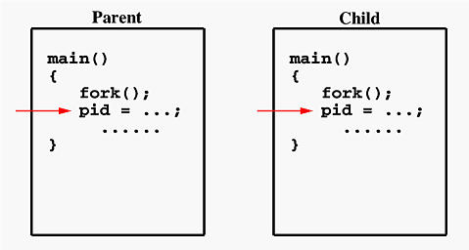
Cont..

Slide 12
Cont..
If the call to fork() is executed successfully
make two identical copies of address spaces, one for the parent and the other for the child.
Both processes will start their execution at the next statement following the fork() call. In this case, both processes will start their execution at the assignment statement as shown above.

Slide 13
Program
#include<stdio.h>
#include<sys/types.h>
#include<unitstd.h>
void CallChildProcess();
void CallParentProcess();
void main()
{
pid_t pid = fork();
if(pid==0)
{
CallChildProcess();
}
else
{
CallParentProcess();
printf(“Process Id:%d\n”, pid);
}

Slide 14
Cont..
}
void CallChildProcess()
{
printf("Child Process Called\n"); }
void CallParentProcess()
{
printf("Parent Process Called\n");
}

Slide 15
exec() System Call
The exec() family of functions These functions are used to execute a file, and they replace the current process image with a new process image once they are called.
int execl(const char *pathname, const char *arg, ... /*, (char *) NULL */);
int execlp(const char *file, const char *arg, ... /*, (char *) NULL */);
int execle(const char *pathname, const char *arg, .../*, (char *) NULL, char *const envp[] */);
int execv(const char *pathname, char *const argv[]);
int execvp(const char *file, char *const argv[]);
int execvpe(const char *file, char *const argv[], char *const envp[]);

Slide 16
execl() System Function
In execl() system function takes the path of the executable binary file (i.e. /bin/ls) as the first and second argument.
Then, the arguments (i.e. -lh, /home) that we want to pass to the executable followed by NULL
Then execl() system function runs the command and prints the output. If any error occurs, then execl() returns -1. Otherwise.
/bin/ls -lh /home - which is used to display list of files and folders inside the home directory
Syntax:
int execl(const char *pathname, const char *arg, ... /*, (char *) NULL */);

Slide 17
Program
#include <unistd.h>
int main(void)
{
char *BinPath = "/bin/ls";
char *arg1 = "-lh";
char *arg2 = "/home";
execl(BinPath, BinPath, arg1, arg2, NULL);
}

Slide 18
execlp() System Function
execlp() uses the PATH environment variable. So, if an executable file or command is available in the PATH then the command or the filename is enough to run it, the full path is not needed. then the command or the filename is enough to run it, the full path is not needed.
Syntax
int execlp(const char *file, const char *arg, …, NULL );

Slide 19
Program
#include <unistd.h>
int main(void)
{
char *programName = "ls";
char *arg1 = "-lh";
char *arg2 = "/home";
execlp(programName, programName, arg1, arg2, NULL);
}
Note: only passed the command name ls, not the full path /bin/ls

Slide 20
execv() System Function
In execv(), we can pass all the parameters in a NULL terminated array argv. The first element of the array should be the path of the executable file. The first element of the array should be the path of the executable file.
Syntax:
int execv(const char *path, char *const argv[]);

Slide 21
Program
#include <unistd.h>
int main(void)
{
char *binaryPath = "/bin/ls";
char *args[] = {binaryPath, "-lh", "/home", NULL};
execv(binaryPath, args);
}

Slide 22
execvp() System Function
The PATH environment variable is used. So, the full path of the executable file is not required.
Syntax:
int execvp(const char *file, char *const argv[]);
Program
#include <unistd.h>
int main(void)
{
char *programName = "ls";
char *args[] = {programName, "-lh", "/home", NULL};
execvp(programName, args);
}

Slide 23
execle() System Function
The environment variables are passed as an array envp. The last element of the envp array should be NULL. All the other elements contain the key-value pairs as string.
Syntax
int execle(const char *path, const char *arg, ..., NULL, char * const envp[] );
Program
#include <unistd.h>
int main(void)
{
char *binaryPath = "/bin/bash";
char *arg1 = "-c";

Slide 24
Cont..
char *arg2 = "echo Visit $HOSTNAME:$PORT from your browser.";
execle(binaryPath, binaryPath, arg1, arg2, NULL, env); }
passed two environment variables HOSTNAME and PORT to the execle() function. We can access them from the executable /bin/bash.

Slide 25
execve() System Function
Syntax
int execve(const char *file, char *const argv[], char *const envp[]);
Program
#include <unistd.h>
int main(void)
{
char *binaryPath = "/bin/bash";
char *const args[] = {binaryPath, "-c", "echo Visit $HOSTNAME:$PORT from your browser.", NULL};
char *const env[] = {"HOSTNAME=www.linuxhint.com", "PORT=8080", NULL};
execve(binaryPath, args, env); }

Slide 26
system function
The system() function is used to invoke an operating system command from a C/C++ program.
For example, we can call system(“dir”) on Windows and system(“ls”) in a Unix-like environment to list the contents of a directory.
It is a standard library function defined in <stdlib.h> header in C
Syntax
int system(const char *command);

Slide 27
Cont..
#include<stdio.h>
#include<stdlib.h>
int main()
{
system("ls"); }

Slide 28
Summary
Process and Types
Fork() and exec() system call
Exec() System Call Families
Few Linux Process oriented Commands

