Slide 1
System Calls
System calls are interfaces provisioned by the operating system to allow user-level applications to interact with low-level hardware components & make use of all the services provided by the kernel,
The kernal is a core component and the heart of an operating system that manages all the hardware and the services provided by the OS.
These system calls are essential for every process to interact with the kernel and User Level Program.

Slide 2
Types of System Calls
System calls are classified into the following categories
1. File Management
2. Process Control
3. Memory Management
4. Inter Process Communication
5. Device Management

Slide 3
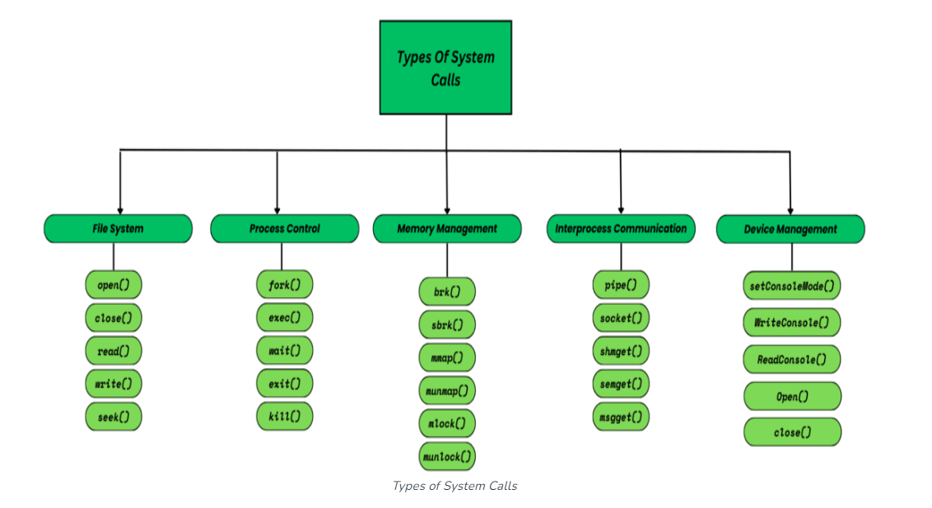
Cont..

Slide 4
File Management
System calls are working with files in OS, File manipulation operations such as creation, deletion, termination etc.
open() - Opens a file for reading or writing. A file could be of any type like text file, audio file etc.
read() - Reads data from a file after the file is opened through open() system call. if some process want to read the data from a file, then it will make a read() system call.
write() -Writes data to a file. Whenever the user makes any kind of modification in a file and saves when it is called.
close() - Closes a previously opened file.
seek() - Moves the file pointer within a file. This call is typically made when we the user tries to read the data from a specific position in a file. For example, read from line – 47. Than the file pointer will move from line 1 or wherever it was previously to line-47.

Slide 5
Process Control
System calls deal with process creation, process termination, process allocation, deallocation etc. It manages all the process that are a part of OS.
fork(): Creates a new process (child) by duplicating the current process (parent). This call is made when a process makes a copy of itself and the parent process is halted temporarily until the child process finishes its execution.
exec(): Loads and runs a new program/commands in the current process and replaces the current process with a new process. All the data such as stack, register, heap memory everything is replaced by a new process and this is known as overlay.
wait(): The primary purpose of this call is to ensure that the parent process doesn’t proceed further with its execution until all its child processes have finished their execution. This call is made when one or more child processes are forked.

Slide 6
Cont..
exit(): It simply terminates the current process.
kill(): This call sends a signal to a specific process and It has various purpose including requesting it to quit voluntarily, or force quit, or reload configuration.

Slide 7
Memory Management
System calls deals with memory allocation, deallocation & dynamically changing the size of a memory allocated to a process.
brk(): Changes the data segment size for a process in HEAP Memory. It takes an address as argument to define the end of the heap and explicitly sets the size of HEAP.
sbrk(): This call is also for memory management in heap, it also takes an argument as an integer (+ve or -ve) specifying whether to increase or decrease the size respectively.
mmap(): Memory Map basically maps a file or device into main memory and further into a process’s address space for performing operations.

Slide 8
Cont..
munmap(): Unmaps a memory-mapped file from a process’s address space and out of main memory
mlock(): memory lock defines a mechanism through which certain pages stay in memory. This could be done to avoid page faults.
unlock(): Memory unlock is the opposite of lock it releases the lock previously acquired on pages.

Slide 9
IPC (Inter Process Communication)
When two or more process are required to communicate, and various IPC mechanism are used by the OS.
pipe(): Creates a unidirectional communication channel between processes.
For example, A parent process may communicate to its child process through a pipe making a parent process as input source of its child process.
socket(): Creates a network socket for communication. Processes in same or other networks can communicate through this socket, provided that they have necessary network permissions granted.
shmget(): It is short for – ‘shared-memory-get’. It allows one or more processes to share a portion of memory and achieve interprocess communication.

Slide 10
Cont..
semget(): It is short for – ‘semaphore-get’. This call typically manages the coordination of multiple processes while accessing a shared resource.
msgget(): It is short for – ‘message-get’. IPC mechanism has one of the fundamental concept called ‘message queue’ which is a queue data structure inside memory through which various processes communicate with each other.
This message queue is allocated through this call allowing other processes a structured way of communication for data exchange purpose.

Slide 11
Device Management
The device management system calls are used to interact with various peripheral devices attached to the PC or even the management of the current device.
SetConsoleMode(): This call is made to set the mode of console (input or output). It allows a process to control various console modes In windows, it is used to control the behavior of command line.
WriteConsole(): It allows us to write data on console screen.
ReadConsole(): It allows us to read data from console screen (if any arguments are provided).
open(): This call is made whenever a device or a file is opened. A unique file descriptor is created to maintain the control access to the opened file or device.
close(): This call is made when the system or the user closes the file or device.

Slide 12
Linux File Permissions System
Every file and directory on your Unix/Linux system is assigned 3 types of owners.
User
A user is the owner of the file. By default, the person who created a file becomes its owner.
Group
A user- group can contain multiple users. All users belonging to a group will have the same Linux group permissions access to the file. Suppose we have a project here, a number of people require access to a file Instead of manually assigning permissions to each user, we can add all users to a group, and assign group permission to file.

Slide 13
Cont..
Other
Any other user who has access to a file. That person has neither created the file, nor he belongs to a user group who could own the file.
Linux File Permissions
Every file and directory in your UNIX/Linux system has following 3 permissions
Read: This permission give you the authority to open and read a file.
Write: The write permission gives authority to modify the contents of a file. The write permission on a directory gives you the authority to add, remove and rename files stored in the directory
Execute: In Windows, an executable program usually has an extension “.exe” which can easily run. In Unix/Linux, we cannot run a program unless the execute permission is set.

Slide 14
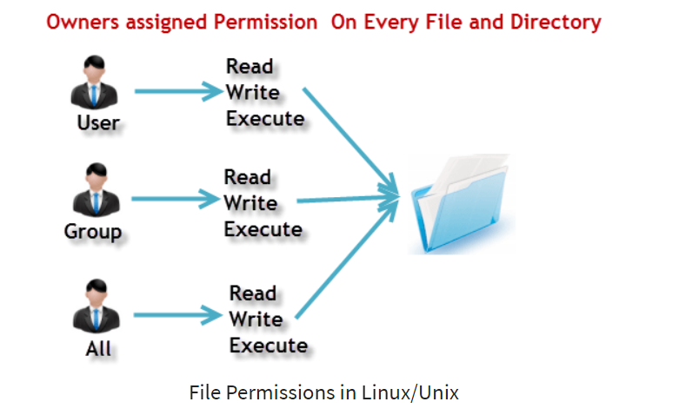
Cont..

Slide 15
Cont..
U
G
O

Slide 16
Cont..
r = read permission
w = write permission
x = execute permission
– = no permission

Slide 17
The table for all permissions types
Number | Permission Type | Symbol
0 | No Permission | -
1 | Execute | -x-
2 | Write | -w-
3 | Execute + Write | -wx
4 | Read | r--
5 | Read + Execute | r-x
6 | Read +Write | rw-
7 | Read + Write +Execute | rwx

Slide 18
File Access Flags
Flag Name | Description
O_RDONLY | Open for read-only.
O_WRONLY | Open for write-only.
O_RDWR | Open for read and write.
O_CREAT | Create the file if it doesn’t exist.
O_TRUNC | Truncate the file to zero length if it exists.
O_APPEND | Append data to the end of the file.
O_EXCL | Used with O_CREAT , returns an error if the file already exists.

Slide 19
Umask Values and Permission
Permissions | Octal Value | Binary Value | Description
--- | 0 | 000 | No Permission
--x | 1 | 001 | only permission to execute
-w- | 2 | 010 | only permission to write
-wx | 3 | 011 | permission to write and execute
r-- | 4 | 100 | only permission to read
r-x | 5 | 101 | permission to read and execute
rw- | 6 | 110 | permission to read and write
rwx | 7 | 111 | permission to do all three, i.e. read, write and execute

Slide 20
Summarize
System Calls and Types
File Management
Process control
Memory Management
IPC(Inter Process Communication)
Device Management
File Permission
File Access Flags
Umask Permission

