Slide 1
Agenda
OSI Layer Model in Detail
TCP/IP Model
TCP Protocol
UDP Protocol

Slide 2
OSI (Open Systems Interconnection) Layer Model
The OSI (Open Systems Interconnection) model is a conceptual framework used to understand how different networking protocols and technologies interact within a network.
The OSI reference model was developed by ISO – ‘International Organization for Standard’ in the year 1984.It consists of seven layers, each responsible for specific functions.
1. Physical Layer
2. Data Link Layer
3. Network Layer
4. Transport Layer
5. Session Layer

Slide 3
Cont..
6. Presentation Layer
7. Application Layer
Sender/Receiver
Application
Application
Presentation
Presentation
Session Layer
Session Layer
Transport Layer
Transport Layer
Network Layer
Network Layer
Data Link Layer
Data Link Layer
Physical Layer
Physical Layer

Slide 4
Physical Layer - Layer 1
The lowest layer of the OSI reference model is the physical layer. It is responsible for the actual physical connection between the devices.
The physical layer contains information in the form of bits. It is responsible for transmitting individual bits from one node to another. When receiving data, this layer will get the signal received and convert it into 0s and 1s and send them to the Data Link Layer.
Raw Bits
1100
1011
1110

Slide 5
Functions of the Physical Layer
Bit synchronization
The physical layer provides the synchronization of the bits by providing a clock. This clock controls both sender and receiver thus providing synchronization at the bit level.
Bit rate control
The Physical layer also defines the transmission rate i.e. the number of bits sent per second.
Physical topologies
Physical layer specifies how the different, devices/nodes are arranged in a network i.e. bus, star, or mesh topology.

Slide 6
Cont..
Transmission mode
Physical layer also defines how the data flows between the two connected devices. The various transmission modes possible are Simplex, half-duplex and full-duplex.
Involving Network Devices
Hub, Repeater, Modem, and Cables are Physical Layer devices.

Slide 7
Data Link Layer (DLL) – Layer 2
The data link layer is responsible for the node-to-node delivery of the message. The main function of this layer is to make sure data transfer is error-free from one node to another, over the physical layer.
When a packet arrives in a network, it is the responsibility of the DLL to transmit it to the specific computer using its MAC address. (08:00:27:7c:6d:50)
ARP(Address Resolution Protocol) - This Protocol is to Map the which MAC Address corresponds to particular Ip Address.
The Data Link Layer is divided into two sublayers
Logical Link Control (LLC)
Media Access Control (MAC)

Slide 8
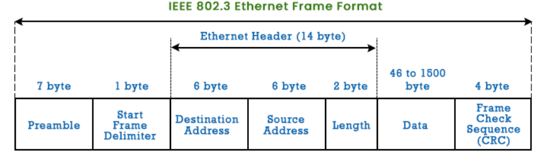
Functions of the Data Link Layer
Framing - Framing is the process to make some meaningful following content
Physical addressing - After creating frames, the Data link layer adds physical addresses (MAC addresses) of the sender and/or receiver in the header of each frame.

Slide 9
Cont..
Error control - The data link layer provides the mechanism of error control in which it detects and retransmits damaged or lost frames.
Flow Control - The data rate must be constant on both sides else the data may get corrupted thus, flow control coordinates the amount of data that can be sent before receiving an acknowledgment.
Access control - When a single communication channel is shared by multiple devices, the MAC sub-layer of the data link layer helps to determine which device has control over the channel at a given time.

Slide 10
Cont..
Important Points of MAC Layer
Packet in the Data Link layer is referred to as Frame.
Data Link layer is handled by the NIC (Network Interface Card) and device drivers of host machines.
Switch & Bridge are Data Link Layer devices.

Slide 11
Network Layer - Layer 3
The network layer works for the transmission of data from one node to the other located in different networks. It also takes care of packet routing i.e. selection of the shortest path to transmit the packet, from the number of routes available.
The sender & receiver’s IP addresses are placed in the header by the network layer.
Functions of the Network Layer
Routing - The network layer protocols determine which route is suitable from source to destination. This function of the network layer is known as routing.
Logical Addressing - The sender & receiver’s IP addresses are placed in the header by the network layer. Such an address distinguishes each device uniquely and universally.

Slide 12
Cont..
Important Points of Network Layer
Segment in the Network layer is referred to as Packet.
Network layer is implemented by networking devices such as routers and switches.

Slide 13
Transport Layer - Layer 4
The data in the transport layer is referred to as Segments. It is responsible for the end-to-end delivery of the complete message.
The transport layer also provides the acknowledgment of the successful data transmission and re-transmits the data if an error is found.
The Transport Layer adds Source and Destination port numbers in its header and forwards the segmented data to the Network Layer. The sender needs to know the port number associated with the receiver’s application.
At the Sender Side
The sender needs to know the port number associated with the receiver’s application. For example, when a web application requests a web server, it typically uses port number 80.

Slide 14
Cont..
At the receiver’s side
Transport Layer reads the port number from its header and forwards the Data which it has received to the respective application. It also performs sequencing and reassembling of the segmented data.
Functions of the Transport Layer
Segmentation and Reassembly - This layer accepts the message from the (session) layer, and breaks the message into smaller units. Each of the segments has associated header.
Service Point Addressing - To deliver the message to the correct process, the transport layer header includes a type of address called service Access point address or port address.

Slide 15
Cont..
Services Provided by Transport Layer
1. Connection-Oriented Service
2. Connectionless Service
1. Connection-Oriented Service - It is a three-phase process that includes
Connection Establishment
Data Transfer
Termination/disconnection

Slide 16
Cont..
In this type of transmission, the receiving device sends an acknowledgment, back to the source after a packet or group of packets is received. This type of transmission is reliable and secure.
2. Connectionless service - It is one of the process and includes Data Transfer. In this type of transmission, the receiver does not acknowledge received packet. This approach allows for much faster communication between devices. Connection-oriented service is more reliable than connectionless Service.

Slide 17
Cont..
Important Points of Transport Layer
Data in the Transport Layer is called Segments.
Transport layer is operated by the Operating System. It is also a part of the OS and communicates with the Application Layer by making system calls.
The transport layer is called as Heart of the OSI model.
Protocol Used : TCP, UDP NetBIOS, PPTP

Slide 18
Session Layer - Layer 5
This layer is responsible for the establishment of connection, maintenance of sessions, and authentication, and also ensures security.
Functions of the Session Layer
Session establishment, maintenance, and termination: The layer allows the two processes to establish, use, and terminate a connection.
Dialog Controller: The session layer allows two systems to start communication with each other in half-duplex or full -duplex.
Important Points of Session Layer
Protocol Use : NetBIOS, PPTP.

Slide 19
Presentation Layer - Layer 6
The presentation layer is also called the Translation layer. The data from the application layer is extracted here and manipulated as per the required format to transmit over the network.
Functions of the Presentation Layer
Encryption/ Decryption - Data encryption translates the data into another form or code. The encrypted data is known as the ciphertext and the decrypted data is known as plain text. A key value is used for encrypting as well as decrypting data.
Compression - Reduces the number of bits that need to be transmitted on the network.
Important Points of Transport Layer - Protocol Use JPEG, MPEG, GIF.

Slide 20
Application Layer - Layer 7
At the very top of the OSI Reference Model stack of layers, we find the Application layer which is implemented by the network applications.
These applications produce the data to be transferred over the network. This layer also serves as a window for the application services to access the network and for displaying the received information to the user.
Example - Application Browsers, Skype Messenger, etc.

Slide 21
TCP/IP Model
TCP/IP was designed and developed by the Department of Defense (DoD) in the 1960s and is based on standard protocols. It stands for Transmission Control Protocol/Internet Protocol. It contains four layers such as,
Application Layer
Transport Layer(TCP/UDP)
Network/Internet Layer(IP)
Data Link Layer (MAC)
Physical Layer

Slide 22
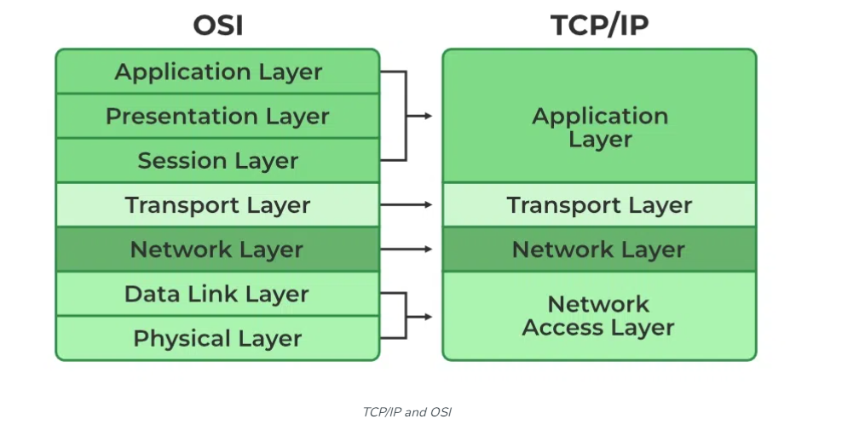
Cont..
The diagrammatic comparison of the TCP/IP and OSI model

Slide 23
Cont..
What is the Difference between TCP and IP?
TCP and IP are different protocols of Computer Networks. The basic difference between TCP (Transmission Control Protocol) and IP (Internet Protocol) is in the transmission of data.
For example IP finds the destination of the mail and TCP has the work to send and receive the mail.
UDP is another protocol, which does not require IP to communicate with another computer. IP is required by only TCP.
Internet Layer
It defines the protocols which are responsible for the logical transmission of data over the entire network. The main protocols residing at this layer are as follows

Slide 24
Cont..
The Internet Layer is responsible for routing packets of data from one device to another across a network. It does this by assigning each device a unique IP address, which is used to identify the device and determine the route that packets.
Example - Imagine that you are using a computer to send an email to a friend. When you click “send,” the email is broken down into smaller packets of data, which are then sent to the Internet Layer for routing. The Internet Layer assigns an IP address to each packet and uses routing tables to determine the best route for the packet to take to reach its destination. The packet is then forwarded to the next hop on its route until it reaches its destination.

Slide 25
Cont..
IP - stands for Internet Protocol and it is responsible for delivering packets from the source to the destination by looking at the IP addresses in the packet headers. IP has 2 versions IPv4 and IPv6. IPv4 is the one that most websites are using currently. But IPv6 is growing as the number of IPv4 addresses.
ICMP - stands for Internet Control Message Protocol. It is encapsulated within IP datagrams and is responsible for providing hosts with information about network problems.
ARP - stands for Address Resolution Protocol. Its job is to find the hardware address of a host from a known IP address. ARP has several types: Reverse ARP, Proxy ARP, Gratuitous ARP, and Inverse ARP.

Slide 26
Transport Layer
The TCP/IP transport layer protocols exchange data receipt acknowledgments and retransmit missing packets to ensure that packets arrive in order and without error.
End-to-end communication is referred to as such. Transmission Control Protocol (TCP) and User Datagram Protocol are transport layer protocols at this level (UDP).
TCP transmits data in a way that resembles character-by-character transmission rather than separate packets. A starting point that establishes the connection, the whole transmission in byte order.
UDP - The datagram delivery service is provided by UDP, the other transport layer protocol. Connections between receiving and sending hosts are not verified by UDP.

Slide 27
Application Layer
It is responsible for end-to-end communication and error-free delivery of data. It shields the upper-layer applications from the complexities of data. The three main protocols present in this layer are such as,
HTTP and HTTPS
HTTP stands for Hypertext transfer protocol. It is used by the World Wide Web to manage communications between web browsers and servers. HTTPS stands for HTTP-Secure. It is a combination of HTTP with SSL(Secure Socket Layer) for Security Purpose.
SSH - stands for Secure Shell. It is a terminal emulations software similar to Telnet. The reason SSH is preferred is because of its ability to maintain the encrypted connection. It sets up a secure session over a TCP/IP connection.

Slide 28
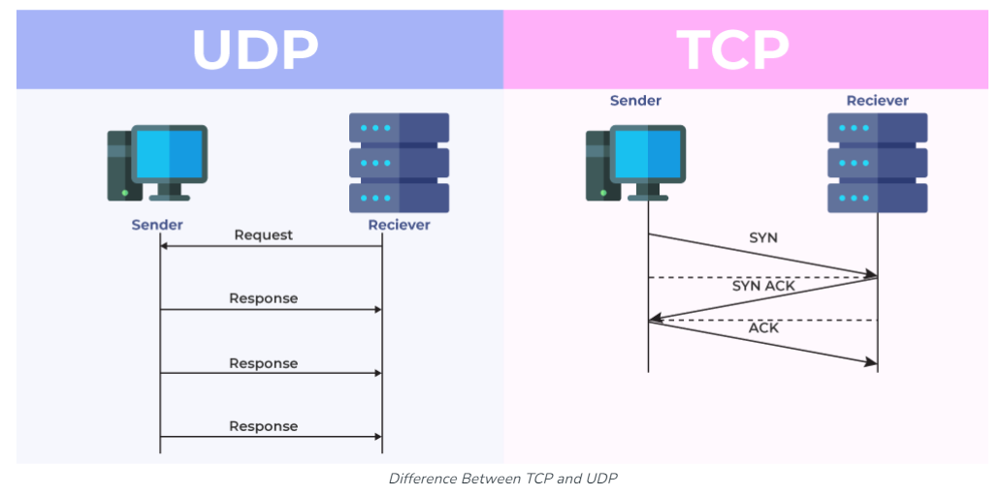
Difference Between TCP and UDP

Slide 29
Cont..
TCP is Used for?
Sending Emails
Transferring Files
Web Browsing
UDP is Used for?
Gaming
Video Streaming
Online Video Chats

Slide 30
Cont..
TCP(Transmission Control Protocol) | UDP(User DataGram Protocol)
TCP is a connection-oriented protocol means connection path already established before transmitting data. | UDP is a Connection less Protocol means no connection would be established.
TCP is reliable as it guarantees the delivery of data to the destination. | The delivery of data to the destination cannot be guaranteed in UDP.
The TCP has an Acknowledgement. | The UDP has no acknowledgment segment.
The TCP is comparatively slower than UDP | The UDP is faster, simpler, and more efficient than TCP.

Slide 31
Cont..
TCP has Handshaking Techniques such as SYN, ACK, SYN-ACK | It’s a connectionless protocol i.e. No handshake
The TCP doesn’t support Broadcasting. | The UDP supports Broadcasting.
TCP used protocols are HTTP, HTTPs, FTP, SMTP and Telnet. | UDP used protocols are DNS, DHCP, TFTP, SNMP, RIP, and VoIP.
The TCP connection is a byte stream. | The UDP connection is a message stream.

Slide 32
Summarize
OSI Layer Model
TCP/IP Model
Difference Between TCP and UDP
Network Devices and Protocols of Each Layer

