Slide 1
TCP(Transmission Control Protocol)
The Transmission Control Protocol is the most common transport layer protocol. It works together with IP and provides a reliable transport service between processes using the network layer.
The data is sent and received as a stream of bytes. TCP groups a number of bytes together into a segment and adds a header to each of these segments and then delivers these segments to the network layer. In network layer, each of these segments is encapsulated in an IP packet for transmission.

Slide 2
Handshake Mechanism
Two types of Handshake Mechanism are used in TCP Protocol
1. Three Way Handshake - It is used for Connection Establishment time.
2. Four Way Handshake - It is used for Connection Termination time.
Three Way Handshake
  In the first step, on the one side, either client or the server initiates the connection establishment by sending “synchronize” or an SYN flag to the other side. In this step, the client’s initial sequence number will be sent to the server to create a connection.
  In return for the SYN flag, the TCP server will send an “Acknowledgement” or ACK flag along with its initial sequence number for the connection establishment.

Slide 3
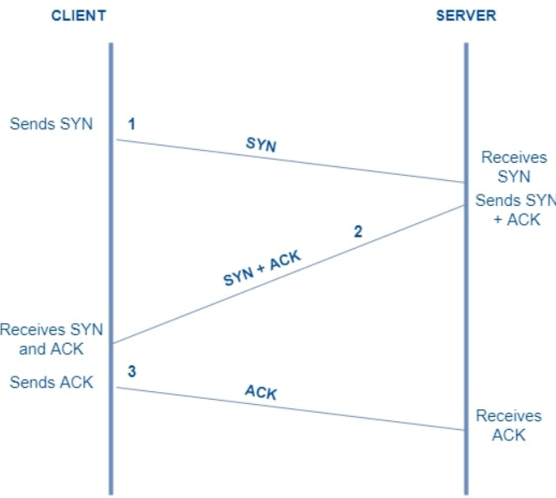
Cont..
Finally with the client’s confirmation through the ACK flag, in return to the server’s SYN flag, The connection establishment will be activated.

Slide 4
Cont..
Four Way Handshake
  This mechanism is used to terminate the connection in between Client and Server. In one side of the connection, either from the client or the server the FIN flag will be sent as the request for the termination of the connection.
  Who receives the FIN flag then will be sending an ACK flag as the acknowledgment for the closing request to the other side.
  The server will also send a FIN flag as the closing signal to the other side. The final step, the TCP, who received the final FIN flag, will be sending an ACK flag as the final Acknowledgement for the suggested connection closing.

Slide 5
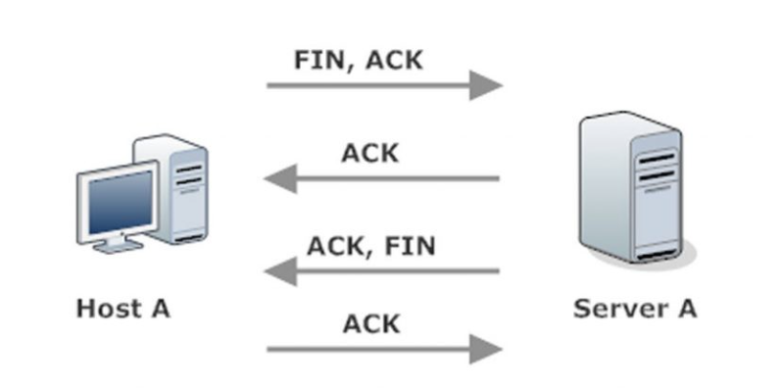
Cont..

Slide 6
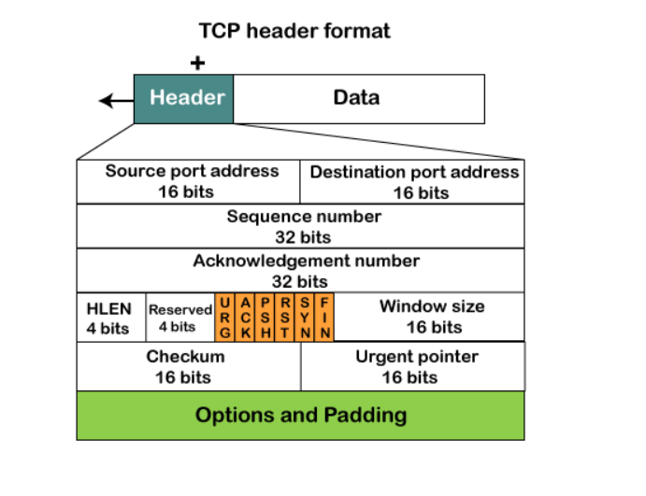
TCP Header Format

Slide 7
Explanation
Source port - It defines the port of the application, which is sending the data. So, this field contains the source port address, which is 16 bits.
Destination port - It defines the port of the application on the receiving side. So, this field contains the destination port address, which is 16 bits.
Sequence number - This field contains the sequence number of data bytes in a particular session.
Acknowledgment number - When the ACK flag is set, then this contains the next sequence number of the data byte and works as an acknowledgment for the previous data received. For example, if the receiver receives the segment number 'x', then it responds 'x+1' as an acknowledgment number.

Slide 8
Cont..
HLEN - It specifies the length of the header indicated by the 4-byte words in the header. The size of the header lies between 20 and 60 bytes. Therefore, the value of this field would lie between 5 and 15.
Reserved - It is a 4-bit field reserved for future use, and by default, all are set to zero.
Flags - There are six control bits or flags are there.
  URG - It represents an urgent pointer. If it is set, then the data is processed urgently.
  ACK - If the ACK is set to 0, then it means that the data packet does not contain an acknowledgment.
  PSH -If this field is set, then it requests the receiving device to push the data to the receiving application without buffering.
  RST - If it is set, then it requests to restart a connection.
  SYN - It is used to establish a connection between the hosts.

Slide 9
Cont..
FIN - It is used to release a connection, and no further data exchange will happen.
Window size - It is a 16-bit field. It contains the size of data that the receiver can accept. This field is used for the flow control between the sender and receiver and also determines the amount of buffer allocated by the receiver for a segment. The value of this field is determined by the receiver.
Checksum - It is a 16-bit field. This field is optional in UDP, but in the case of TCP/IP, this field is mandatory.
Urgent Pointer - It is a pointer that points to the urgent data byte if the URG flag is set to 1. It defines a value that will be added to the sequence number to get the sequence number of the last urgent byte.
Options - It provides additional options. The optional field is represented in 32-bits. If this field contains the data less than 32-bit, then padding is required to obtain the remaining bits.

Slide 10
Socket Programming
System Calls
  socket()
  bind()
  listen()
  accept()
  connect()
  socket() – creates an endpoint for communication and returns a file descriptor that refers to that endpoint.

Slide 11
Cont..
Syntax
  #include <sys/socket.h>
  int socket(int domain, int type, int protocol);
bind() - assigns the address specified by addr to the socket referred to by the file descriptor sockfd.
  Syntax
    int bind(int sockfd, const struct sockaddr *addr, socklen_t addrlen);

Slide 12
Cont..
listen()- listen for connections on a socket On success, zero is returned On error, -1 is returned.
  Syntax:-
  int listen(int sockfd, int backlog);
accept() - accept a connection on a socket.
  Syntax:-
  int accept(int sockfd, struct sockaddr *_Nullable restrict addr, socklen_t *_Nullable restrict addrlen);

Slide 13
Cont..
connect() - initiate a connection on a socket.
Syntax:
  int connect(int sockfd, const struct sockaddr *addr, socklen_t addrlen);
Important Flags
  SOCK_STREAM - Provides sequenced, reliable, two-way, connection-based byte streams. which is used for TCP Protocol Communication.
  SOCK_DGRAM - Supports datagrams (connectionless, unreliable messages of a fixed maximum length). which is used for UDP Protocol Communication.
  AF_INET - IPv4 Internet protocols
  AF_INET6 - IPv6 Internet Protocols

Slide 14
Program for Server.c
#include<stdio.h>
#include<sys/types.h>
#include<sys/socket.h>
#include<netinet/in.h>
#include<unistd.h>
#include<string.h>
#include<arpa/inet.h>
void main ()
{
int fd, newfd;
char rd_buf[128];
char wr_buf[128];
struct sockaddr_in server, client;
fd=socket(AF_INET,SOCK_STREAM,0);

Slide 15
Cont..
if(fd<0)
{
perror("socket");
return;
}
server.sin_family=AF_INET;
server.sin_port=htons(2002);
server.sin_addr.s_addr=inet_addr("0.0.0.0");
if(bind(fd,(struct sockaddr*)&server, sizeof(server))==0)
printf("bind: success\n");
else
{
perror("bind");
return;
}

Slide 16
Cont..
listen(fd,1);
int len = sizeof(client);
newfd=accept(fd,(struct sockaddr*)&client, &len);
if(newfd<0)
{
perror("accept");
return;
}
if(fork()==0)
{
while(1)
{
bzero(rd_buf,128);

Slide 17
Cont..
read(newfd,rd_buf,128);
printf("%s\n", rd_buf);
}
}
else
{
while(1)
{
printf("enter the data\n");
scanf("%s", wr_buf);
write(newfd,wr_buf,128);
}
}
}

Slide 18
Program for Client.c
#include<stdio.h>
#include<sys/types.h>
#include<sys/socket.h>
#include<netinet/in.h>
#include<unistd.h>
#include<string.h>
void main ()
{
int fd;
char wr_buf[128];
char rd_buf[128];
struct sockaddr_in client;
fd=socket(AF_INET,SOCK_STREAM,0);

Slide 19
Cont..
if(fd<0)
{
perror("socket");
return;
}
client.sin_family=AF_INET;
client.sin_port=htons(2002);
client.sin_addr.s_addr=htonl(INADDR_LOOPBACK);
if(connect(fd,(struct sockaddr*)&client, sizeof(client))==0)
printf("connected\n");
else
{
perror("connect");
return;
}

Slide 20
Cont..
if(fork()==0)
{
while(1)
{
bzero(rd_buf,128);
read(fd,rd_buf,128);
printf("%s\n", rd_buf);
}
}
else
{
while(1)
{
printf("enter the data\n");

Slide 21
Cont..
scanf("%s", wr_buf);
write(newfd,wr_buf,128);
}
}
}
Compilation Steps for Client and Server
  gcc client.c -o Client
  gcc server.c -o Server

Slide 22
Summarize
TCP Protocol
Handshake Mechanism and Types
TCP Header Format
Socket Programming

