Slide 1



Thyroid Disease Classification using Machine Learning Algorithms
PRESENTED BY
KARINGU RAVI (21TP1A6725) THATI AMULYA (21TP1A6750)
SAPATI JYOSHNA(21TP1A6743) SOHAIL SHAIKH(21TP1A6746)
KADITHAYALA HANISH (21TP1A6724)
UNDER THE GUIDENCE OF
Mr. KLSDT Keerthi Vardhan
HOD CSE(DS), SIET

Slide 2
CONTENTS
ABSTRACT
INTRODUCTION
OBJECTIVE
EXISTING SYSTEM
PROPOSED SYSTEM
SYSTEM REQUIREMENTS
SYSTEM ARCHITECTURE
MODULES
SYSTEM DESIGN
IMPLEMENTATION
TESTING
OUTPUT SCREENSHOTS
CONCLUSION
FUTURE ENHANCEMENT
REFERENCES

Slide 3
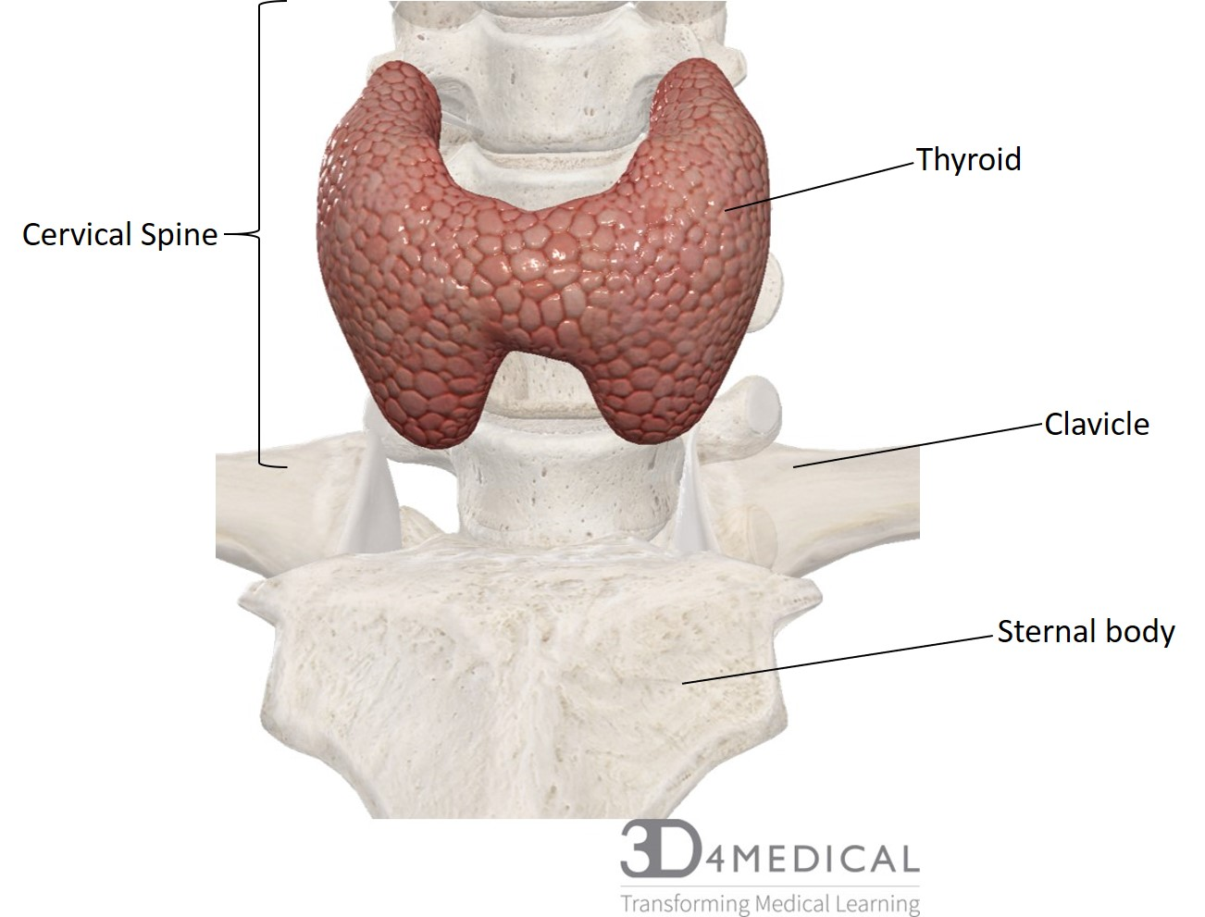
ABSTRACT
With the vast amount of data and information difficult to deal with, especially in the health system, machine learning algorithms have an important role in dealing with data. In our study, we used machine learning algorithms with thyroid disease. The goal of this study is to categorize thyroid disease into three categories: hyperthyroidism, hypothyroidism, and normal, so we worked on this study using data from Iraqi people, some of whom have an overactive thyroid gland and others who have hypothyroidism, so we used of the algorithms. Support vector machines, random forest, decision tree, multilayer perceptron (MLP) to classification of thyroid disease.

Slide 4
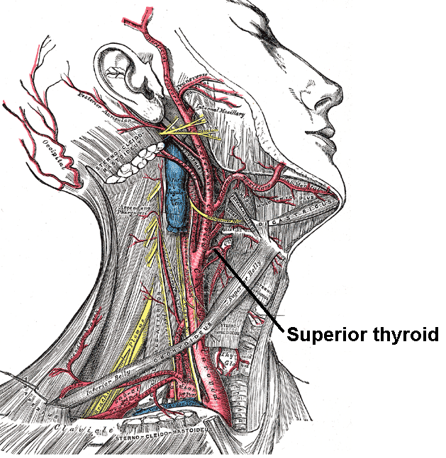
INTRODUCTION
Thyroid disease is a subset of endocrinology which is one of the most misunderstood and undiagnosed diseases. Thyroid gland diseases are among the most prevalent endocrine disorders in the world, second only to diabetes, according to the World Health Organization. Hyper function hyperthyroidism and hypothyroidism affect about 2% and 1% of individuals, respectively. Men have about a tenth of the prevalence of women. Hyperthyroidism and hypothyroidism may be caused by thyroid gland dysfunction, secondary to pituitary gland failure, or tertiary to hypothalamic malfunction.

Slide 5
OBJECTIVE
This study investigates the classification of thyroid disease (hyperthyroidism, hypothyroidism, normal) using various machine learning algorithms, including SVM, Random Forest, Decision Tree, MLP. The goal is to evaluate the effectiveness of these algorithms in accurately classifying thyroid disease and potentially improve diagnostic accuracy.

Slide 6
EXISTING SYSTEM
At present, diseases have become dangerous and rapidly spread, and their exploration and diagnosis require a great deal of time and effort. The correct and accurate diagnosis of the disease early has become one of the problems that the health system suffers from it. The critical role of early and correct diagnosis of the disease, including thyroid disease, is vital because it increases patient treatment opportunities and reduces mortality. Among the vast amount of clinical data, early diagnosis is a challenging task.
Disadvantage
Low accuracy
high-power computing

Slide 7
PROPOSED SYSTEM
In this paper author employing various machine learning algorithms such as SVM, Decision Tree and MLP to predict thyroid disease. Each algorithm gets trained on thyroid dataset which contains 3 different classes such Normal, Hyperthyroid and Hypothyroid. All algorithms performance is evaluated in terms of accuracy, precision, recall, FSCORE and confusion matrix and in all algorithms Random Forest and Decision Tree giving best accuracy.
Advantage
1. access to a significant amount of data
2. risk factors influence disease progression
3. more accurate

Slide 8
SYSTEM REQUIREMENTS
Software Requirements
Hardware Requirements
Operating system : Windows family.
Programming Languages : Python
Frameworks/Libraries : tkinter, sklearn, numpy, pandas, seaborn
Development Tools : PyCharm or Visual Studio
Processor : intel i3 or above
Storage : 128 SSD
RAM : 4 GB

Slide 9
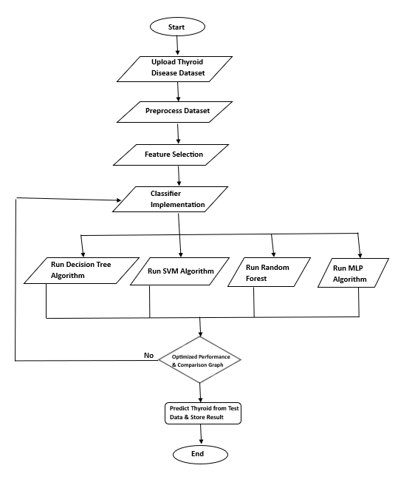
SYSTEM ARCHITECTURE
Upload Thyroid Disease Dataset:
Upload thyroid dataset & Explore and visualize class label distribution.
Preprocess Dataset:
Preprocess data (e.g., handle missing values, convert to numeric, normalize).
Split data into training (80%) and testing (20%) sets.
Feature Selection:
Feature selection selects the most relevant input features to improve model accuracy.
Classifier Implementation:
Train and evaluate Algorithms: Decision Tree, SVM, Random Forest, MLP.
Optimized Performance & Comparison Graph:
Plot comparison graphs of model performances and Select Best Model for Classification.
Prediction Result:
we will upload test data and then algorithm will predict weather test data is normal or contains thyroid.

Slide 10
SYSTEM DESIGN
Class Diagram
A class diagram is a key tool in object-oriented modeling. It visually represents classes, their attributes, and methods. Classes are depicted as boxes with three compartments: the class name, attributes, and methods.

Slide 11
Use Case Diagram
A use case diagram at its simplest is a representation of a user's interaction with the system and depicting the specifications of a use case. A use case diagram can portray the different types of users of a system and the various ways that they interact with the system. This type of diagram is typically used in conjunction with the textual use case and will often be accompanied by other types of diagrams as well.

Slide 12
Sequence Diagram
A sequence diagram illustrates how objects interact over time. It shows objects, their lifelines, and the messages exchanged between them. Sequence diagrams are often used to visualize the flow of control in a use case scenario.

Slide 13
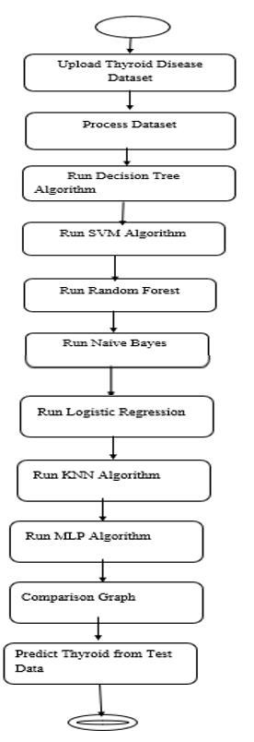
Activity Diagram
Activity diagram is another important diagram in UML to describe dynamic aspects of the system. It is basically a flow chart to represent the flow form one activity to another activity. The activity can be described as an operation of the system. So, the control flow is drawn from one operation to another. This flow can be sequential, branched or concurrent

Slide 14
Deployment Diagram
A deployment diagram visualizes the physical deployment of software artifacts on hardware nodes. It shows how components are distributed across servers and how they communicate. Nodes are represented as boxes, and artifacts as rectangles within them. A node can represent multiple physical nodes, like a cluster.

Slide 15
Component Diagram
A component diagram illustrates the structure of a system by showing how components are connected. Components are represented as rectangles with ports for interfaces. Assembly connectors link the interfaces of different components, representing the service provider-consumer relationship.

Slide 16
Collaboration Diagram
A collaboration diagram describes interactions among objects in terms of sequenced messages. Collaboration diagrams represent a combination of information taken from class, sequence, and use case diagrams describing both the static structure and dynamic behavior of a system.

Slide 17
Data Flow Diagram
Data Flow Diagrams (DFDs) illustrate how data moves through a system. They can be used to visualize complex processes in a simple way. DFDs use symbols to represent processes, data flows, data stores, and external entities. By breaking down processes into smaller components, DFDs help in understanding and analyzing information systems.
User
1. Upload Thyroid Disease Dataset 2. Successfully Upload Thyroid Disease Dataset
3. Preprocess Dataset 4. Successfully Preprocess Dataset
5. Run Decision Tree Algorithm 6. Successfully Run Decision Tree Algorithm
7. Run SVM Algorithm 8. Successfully Run SVM Algorithm
9. Run Random Forest 10. Successfully Run Random Forest
11. Run Naive Bayes 12. Successfully Run Naive Bayes
13. Run Logistic Regression 14. Successfully Run Logistic Regression
15. Run KNN Algorithm 16. Successfully Run KNN Algorithm
17. Run MLP Algorithm 18. Successfully Run MLP Algorithm
19. Comparison Graph 20. Successfully Comparison Graph
21. Predict Thyroid from Test Data 22. Successfully Predict Thyroid from Test Data
System

Slide 18
IMPLEMENTATION
PYTHON:
Python is a versatile, beginner-friendly language known for readability, extensive libraries, and cross-platform compatibility. Widely used in web development, data science, and machine learning, its open-source nature and strong community support make it highly popular.
Features of Python:
A simple language which is easier to learn
Free and open-source, Portability
Extensible and Embeddable
A high-level
Interpreted language
Object-oriented

Slide 19
IMPLEMENTATION
Libraries
Algorithms
NumPy
Scikit-learn
pandas
TensorFlow
Matplotlib
Seaborn
Decision Tree: Builds a tree-like model to make predictions based on a series of questions about the data. Easy to interpret.
SVM: Finds the best boundary to separate data points. Effective for high-dimensional data.
Random Forest: Combines multiple decision trees to improve accuracy and reduce overfitting.
MLP: A type of neural network that can learn complex relationships in the data.

Slide 20
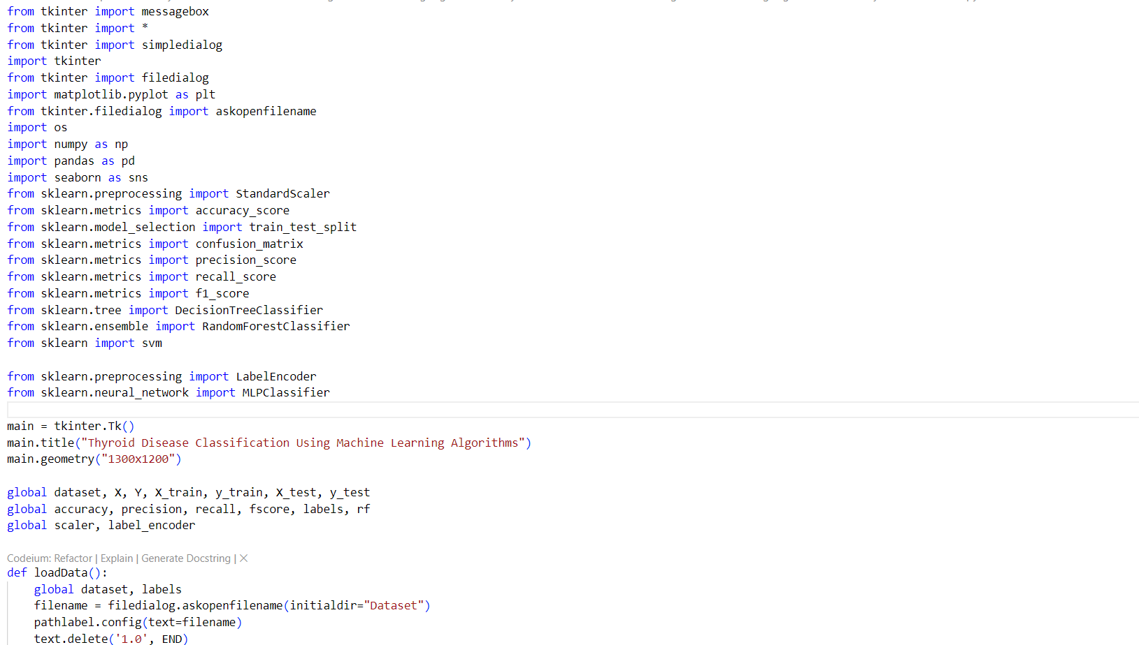
IMPLEMENTATION

Slide 21
TESTING
Individual modules are first tested with prepared data. The integrated system is then tested with diverse scenarios and real-world data to ensure functionality and effectiveness.
System Evaluation Testing ensures software quality by identifying and fixing defects to improve functionality and reliability.
Module Testing Modules are tested independently to ensure functionality and accuracy.
Integration Testing
Modules are connected and tested to resolve interconnection issues and ensure proper functioning.
Acceptance Testing
A final acceptance test verifies that the system meets its original goals and requirements. This eliminates the need for time-consuming user acceptance testing.

Slide 22
TESTING
Test Case Id | Test Case Name | Test Case Desc. | Test Steps |  |  | Test Case Status | Test Priority
 |  |  | Step | Expected | Actual
01 | Upload Dataset | Test whether the dataset is uploaded or not | If the Dataset is not uploaded | we cannot do further operations | If Dataset is uploaded we will do further operations | High | High
02 | Preprocess Dataset | Verify the Dataset is Preprocessed or not | If the Dataset is not preprocessed | We cannot do further operations | If Dataset is Preprocessed We Can do further operations | High | High
03 | Run Decision Tree Algorithm | Verify whether Decision Tree runned or not | Without Running Decision Tree | we cannot do further operations | If Decision Tree Algorithm Runned We can do further operations | High | High

Slide 23
04 | Run SVM | Verify whether SVM runned or not | Without Running SVM | we cannot do further operations | If SVM Algorithm Runned we can do further operations | High | High
05 | Run Random Forest Algorithm | Verify whether Random Forest AlgorithmRunned or not | Without Running Random Forest Algorithm | We cannot do further operations | If Random Forest Algorithm Runned We can do further operations | High | High
09 | Run MLP Algorithm | Verify whether MLP Runned or not | Without Running MLP Algorithm | We cannot do further operations | If MLP Runned we can do further operations | High | High
10 | Comparison Graph | Verify Graph obtained or not | Without Graph | We cannot do further operations | If Graph is Obtained, we can do further operations | High | High
11. | Predict Thyroid | Verify Thyroid predicted or not | Without Thyroid | We cannot do further operations | If Thyroid predicted we can do further operations | High | High

Slide 24
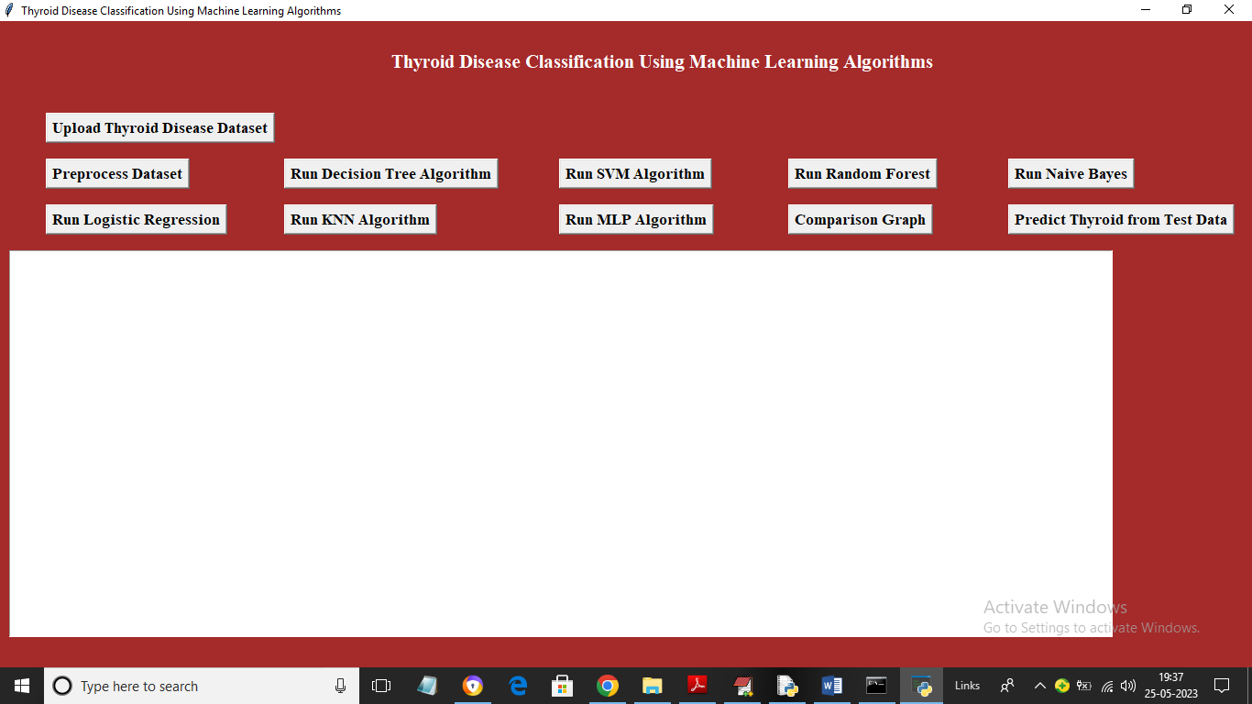
OUTPUT SCREENSHOTS
UI Screen before Uploading Dataset

Slide 25
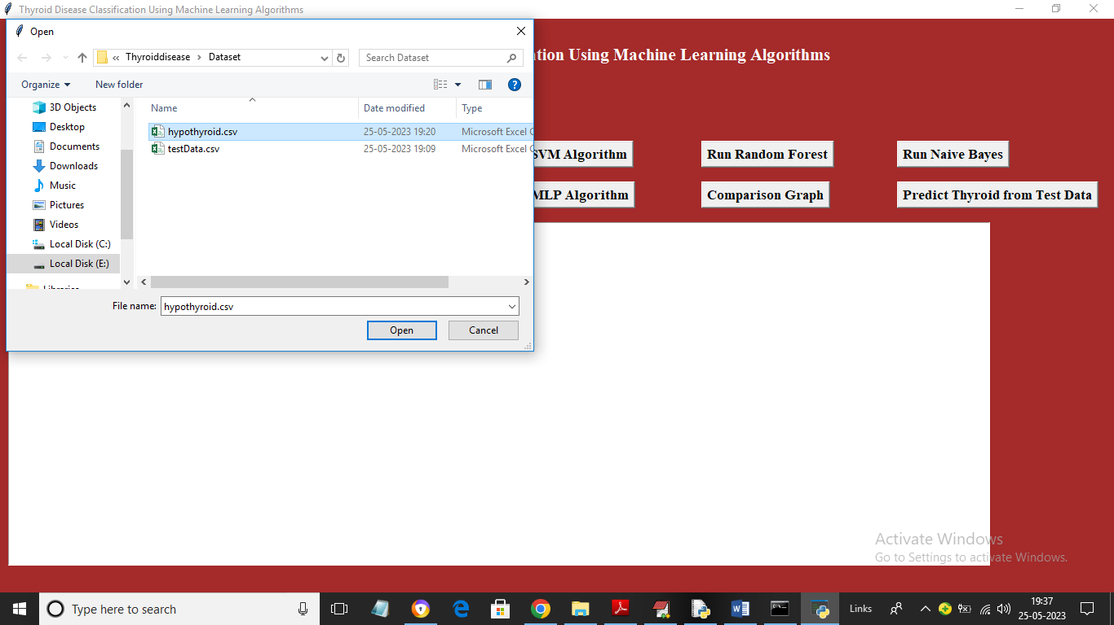
In above screen click on ‘Upload Thyroid Disease Dataset’ button to upload dataset and get below screen

Slide 26
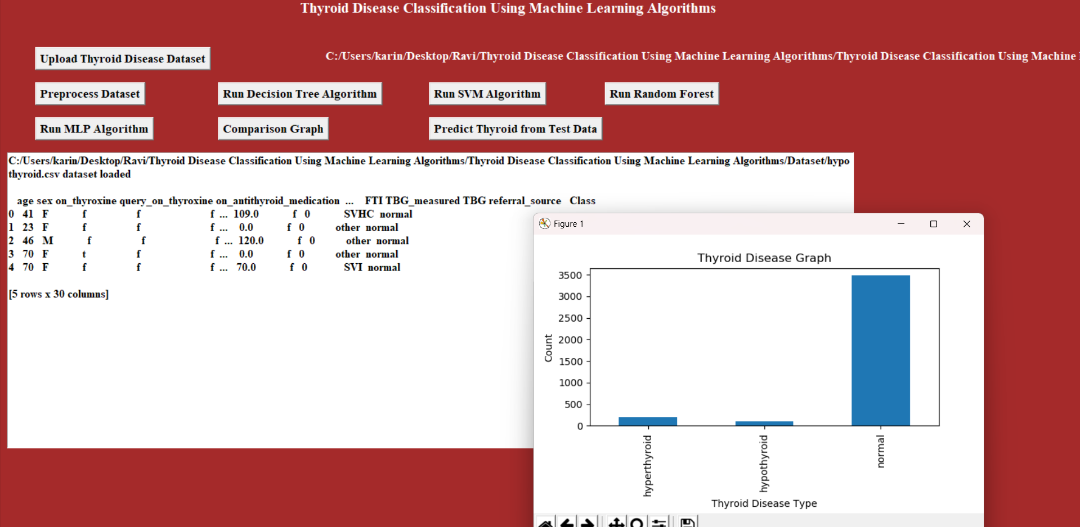
In above screen selecting and uploading dataset file and then click on ‘Open’ button to load dataset and get below output

Slide 27
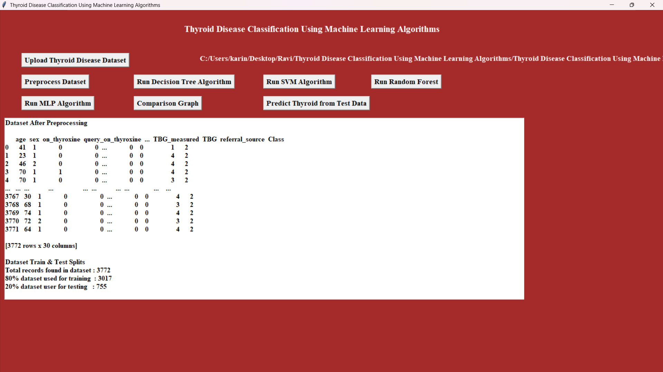
In above screen dataset loaded and we can see dataset contains some numeric and some non-numeric values so by applying Processing technique we can clean above data. Now close above graph and then click on ‘Preprocess Dataset’ button to process dataset and get below output

Slide 28
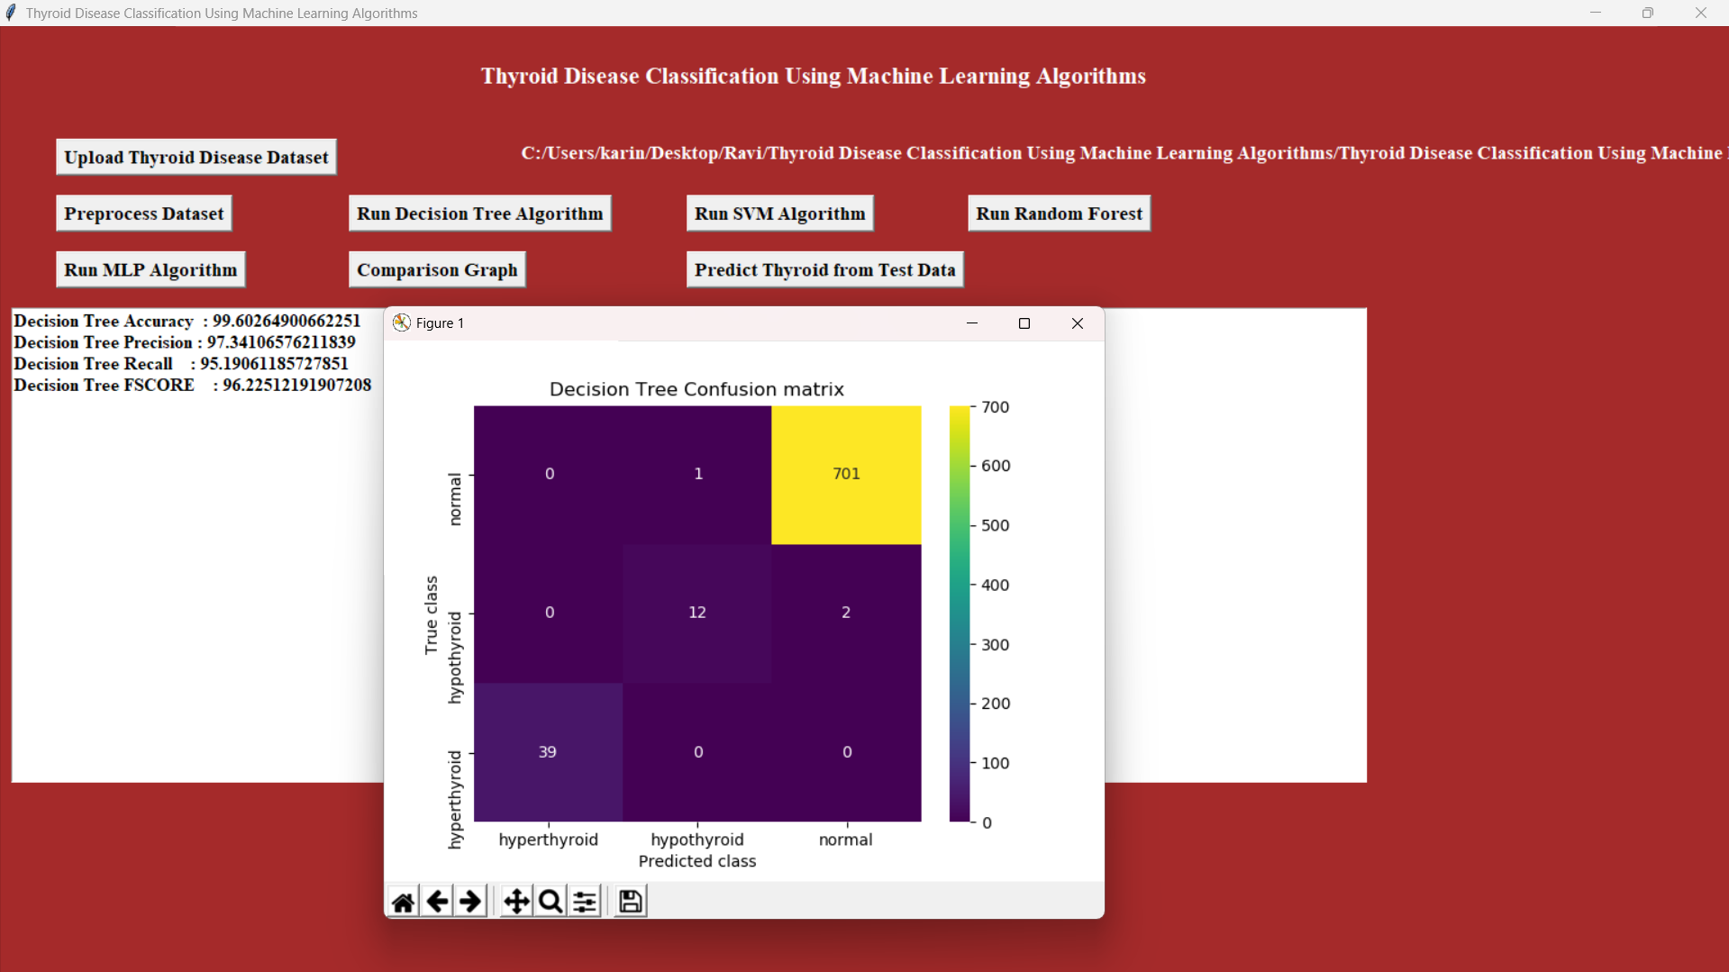
In above screen we can see entire dataset is now converted to numeric values and in last line we can see size of dataset and train and test split details. Now click on ‘Run Decision Tree Algorithm’ button to train decision Tree and get below output

Slide 29
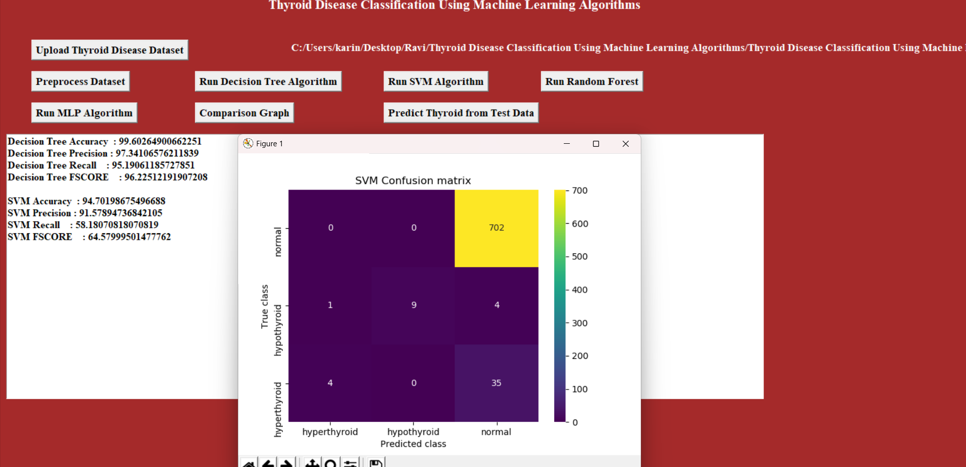
Now close above graph and then click on ‘Run SVM Algorithm’ button to get below output

Slide 30
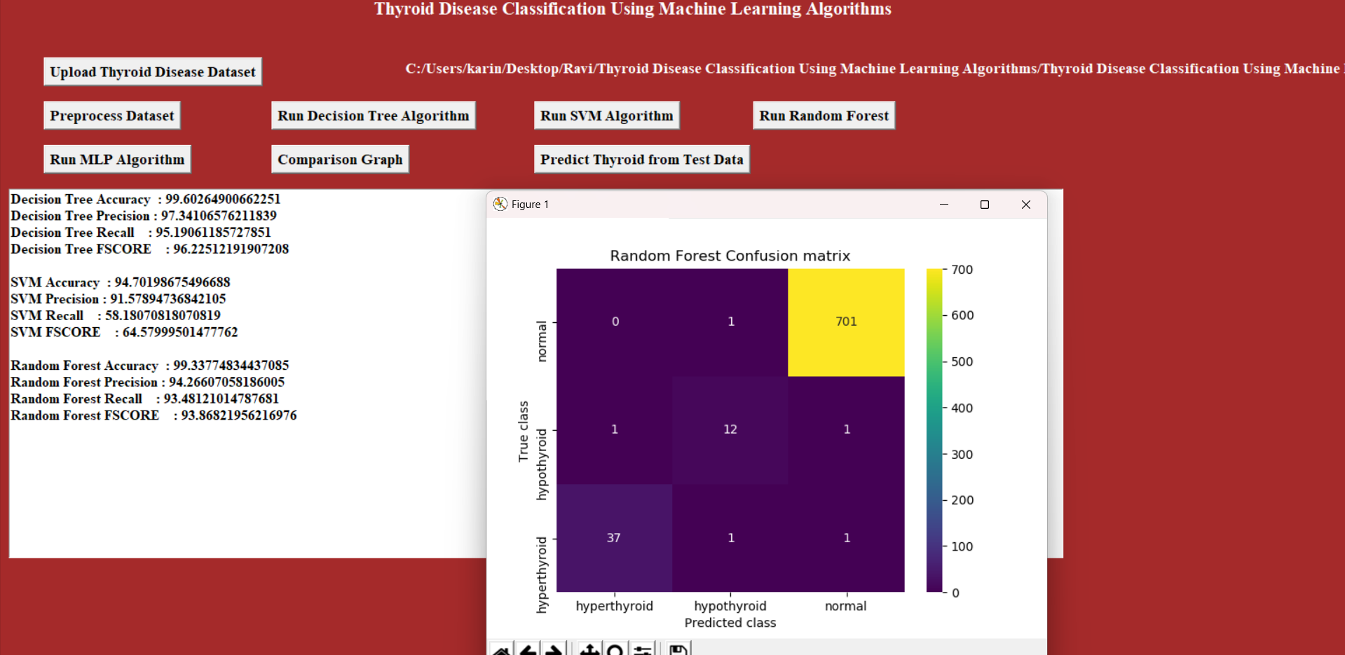
In above screen with SVM we got 95% accuracy and we can see other metrics and confusion matrix graph. Now click on ‘Run Random Forest Algorithm’ button to train Random Forest and get below output

Slide 31
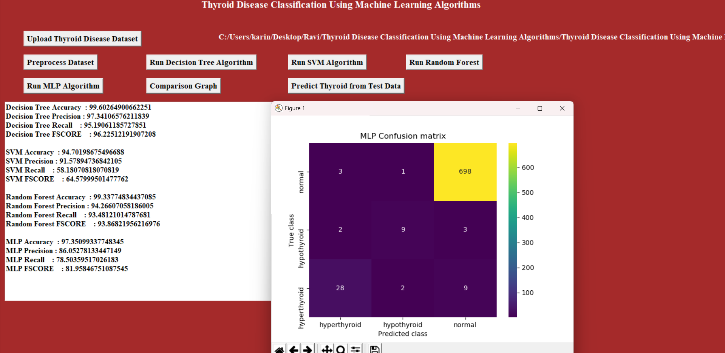
In below screen MLP got 97% accuracy

Slide 32
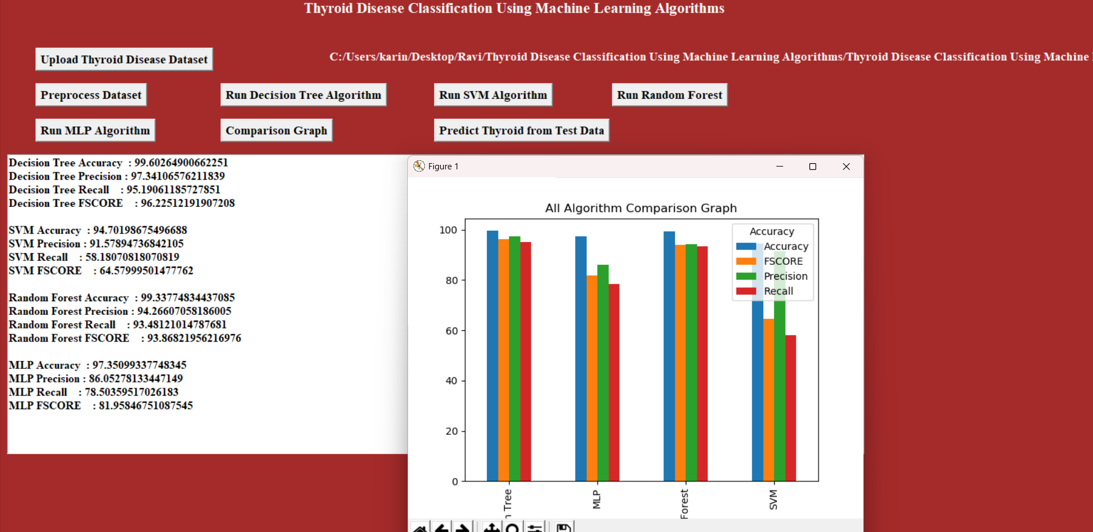
In above screen click on ‘Comparison Graph’ button to get below graph

Slide 33
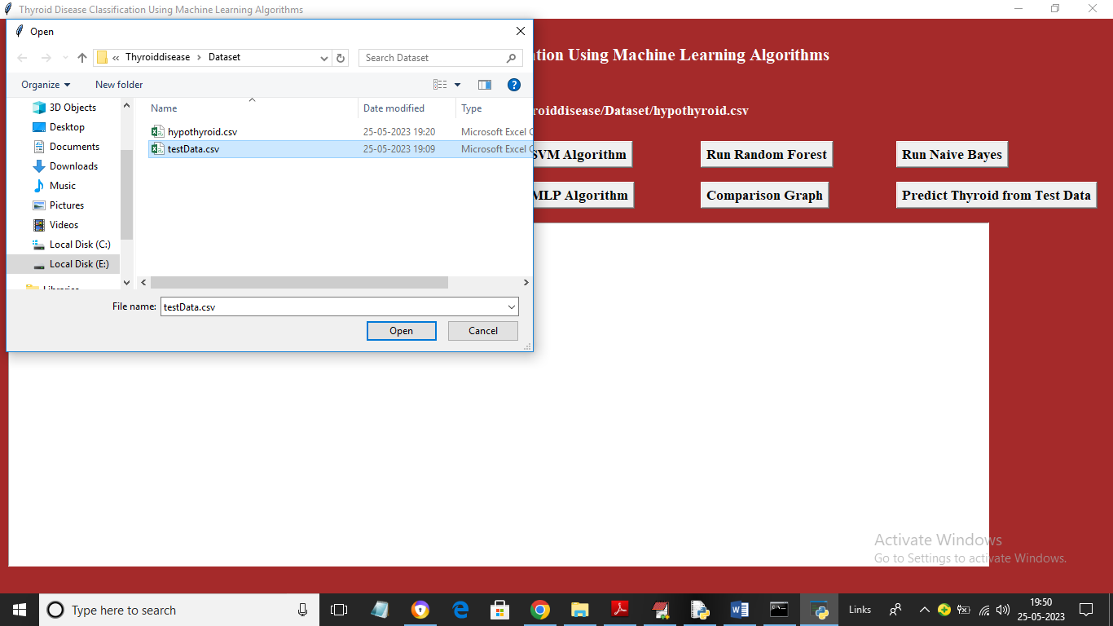
close above graph and then click on ‘Predict Thyroid from Test Data’ button to upload test data and get prediction output

Slide 34
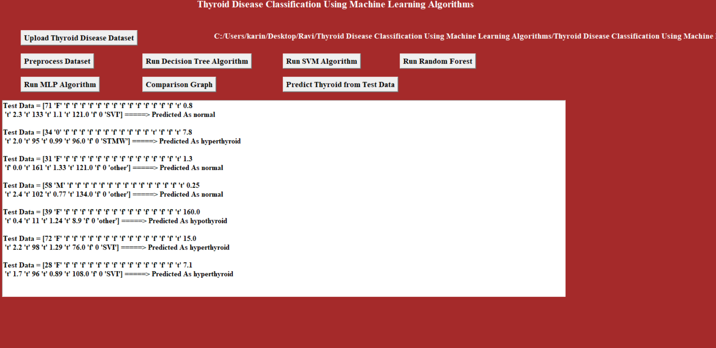
In above screen selecting and uploading ‘Test Data’ file and then click on ‘Open’ button to get below output

Slide 35
CONCLUSION
Thyroid disease is a prevalent health issue. This study focuses on classifying thyroid disorders into hyperthyroidism, hypothyroidism and Normal using machine learning algorithms model is developed:
Model : Utilized all input features and achieved a highest accuracy of 98.93% with the Random Forest algorithm.
Overall, the study demonstrates the potential of machine learning in accurately classifying thyroid disorders.

Slide 36
FUTURE ENHANCEMENT
Future enhancements for thyroid disease classification include integrating IoT devices for real-time health monitoring, using advanced deep learning models like CNNs for improved accuracy, and providing personalized treatment recommendations. Deploying the system on cloud platforms can enable remote access and telemedicine services, while expanding it to diagnose other related diseases increases its utility. Additionally, implementing Explainable AI ensures transparency and trust in the predictions.

Slide 37
REFERENCES
Research Papers:
Jadhav, S., & Tambade, P. (2017). "Thyroid Disease Prediction using Machine Learning Algorithms." International Journal of Engineering Research & Technology (IJERT).
UCI Machine Learning Repository. "Thyroid Disease Dataset."
Books:
Dr. Srinivasan B, Pavia K “Diagnosis of Thyroid Disease: A Study” International Research Journal of Engineering and Technology Volume: 03 Issue:
Chantel, Khushboo, et al. "A comparative study on thyroid disease detection using K-nearest neighbor and Naive Bayes classification techniques." CSI transactions on ICT 4.2-4 (2016)
Healthcare Articles:
MedlinePlus. "Thyroid Disease Overview." https://medlineplus.gov/thyroiddiseases.html
Sandhya, Mrs. K. "EFFECTIVE PREDICTION OF HYPOTHYROID USING VARIOUS DATA MINING TECHNIQUES."

Slide 38
Thank you

