Slide 1
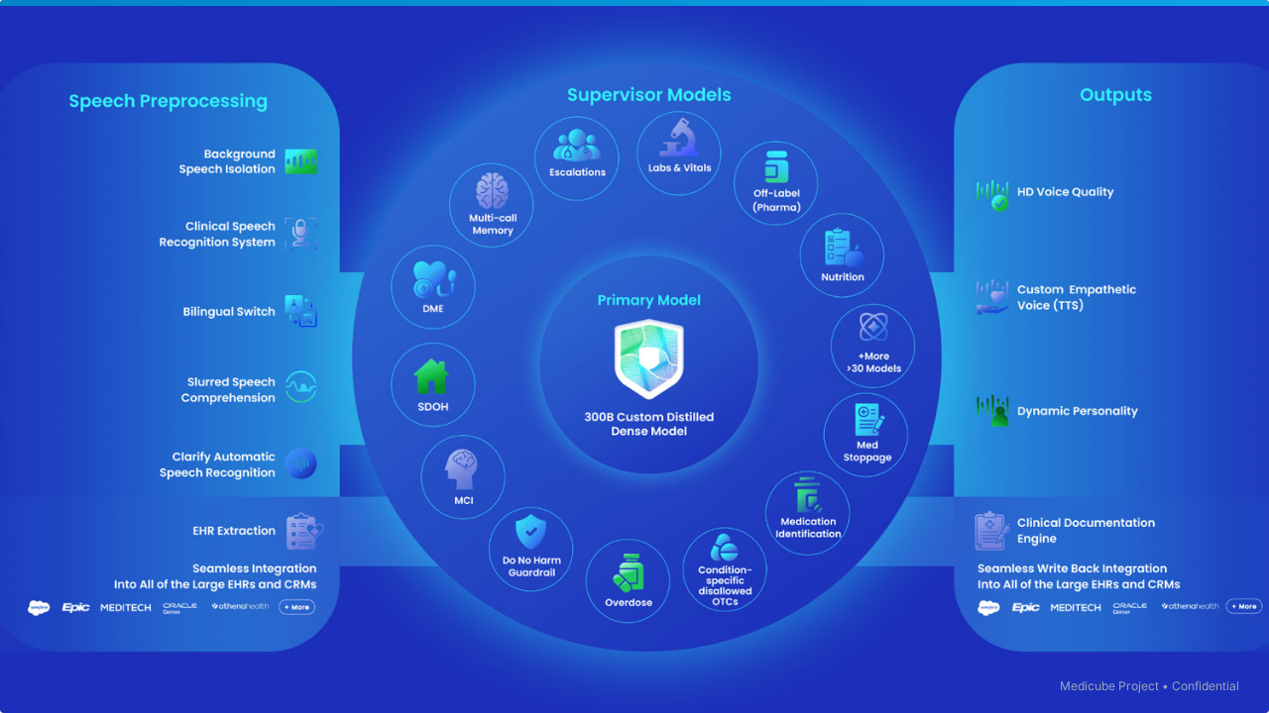


Multi-Model AI Agent for Automated Health Diagnostics
Infosys Springboard Virtual Internship
Chepuri Rishivardhan

Slide 2



Problem Statement & Motivation
•
Complex Analysis: Manual interpretation of blood reports is time-consuming and error-prone due to varying formats.
•
LLM Risks: Direct LLM diagnosis is dangerous due to hallucinations and lack of grounding.
•
Black Box Issue: Medical AI requires absolute explainability and auditability, not just "magic" answers.
•
The Gap: Need for a system that combines deterministic accuracy with narrative clarity.

Slide 3


High-Level System Architecture
End-to-End Pipeline: From Raw Data to Validated Explanation
Input
Extractor
Model-2
Model-3
UI / Chat
LLMEvals
PDF/Images
User Context
OCR &
Normalization
Deterministic
Reasoning
LLM Narrative
Synthesis
Streamlit App
& Chatbot
Validation
& Safety

Slide 4






Functional Capabilities
Flexible Ingestion
Context Awareness
Multi-View Reporting
Supports single PDF report upload or ZIP batch processing. Handles varying report layouts and noise via advanced OCR preprocessing.
Integrates user-specific metadata (age, gender, lifestyle, symptoms) to tailor risk scoring and reference ranges dynamically.
Generates a unified final report while allowing inspection of individual model outputs (raw JSON, reasoning logs, narrative text).

Slide 5
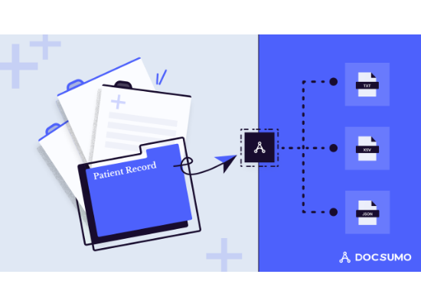
Module 1: Extractor & Normalization
Deterministic Data Extraction
•
OCR Engine: Converts PDF/Images to structured text, handling noise and artifacts.
•
Parameter Extraction: Identifies key biomarkers (e.g., Hemoglobin, Cholesterol) using regex and fuzzy matching.
•
Clinical Normalization: Maps raw values to standard units and classifies states (Low / Normal / High) based on reference ranges.
•
Safety: This stage is 100% deterministic. No "guessing" by AI models.

Slide 6
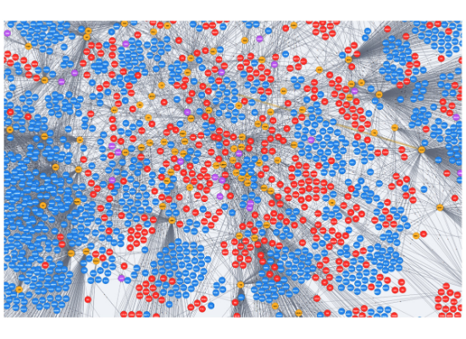
Module 2: Deterministic Reasoning Engine
The Ground Truth Layer
•
Pattern Detection: identifying logical clusters (e.g., Low Iron + Low Hb = Anemia Risk).
•
Knowledge Graph: Uses a hard-coded medical rule set to establish causal links between parameters.
•
Risk Scoring: Calculates numerical confidence scores for potential conditions.
•
Role: Serves as the immutable "fact sheet" that the LLM must adhere to in the next stage.

Slide 7
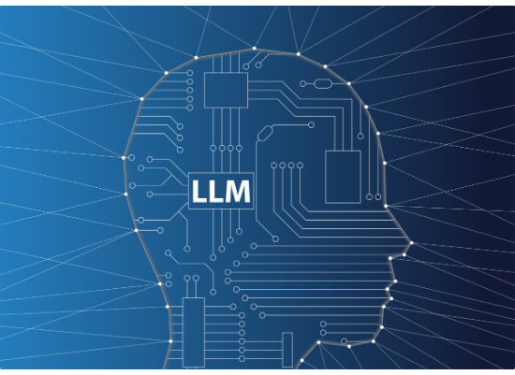
Module 3: LLM Narrative Synthesis
Safe Explanation, Not Diagnosis
•
Prompt Grounding: The LLM is fed strictly the facts from Model-2. It cannot invent symptoms or values.
•
Strict JSON Schema: Output is forced into a structured format to prevent rambling.
•
Guardrails: Hallucination checks compare output against Model-2 facts.
•
Gemini API: Chosen for its high adherence to system instructions and JSON reliability.

Slide 8


Model-3 Output Structure
Executive Summary
Possible Explanations
A concise, non-alarmist overview of the patient's health status derived strictly from the reasoning engine's findings.
Contextualizes abnormal values using layman's terms (e.g., "Low Vitamin D can cause fatigue") without confirming a disease.
Lifestyle Guidance
Doctor Consultation
Suggests general wellness improvements (diet, sleep, exercise) relevant to the findings, avoiding specific drug prescriptions.
Explicit flags indicating when professional medical advice is strictly necessary based on risk thresholds.

Slide 9

Chatbot: Exploratory Assistant
Exploration, No Prescription
•
Purpose: Allows users to ask "Should I worry?" or "What does this mean?" in a conversational manner.
•
RAG-Style Context: Responses are bounded by the specific patient report data.
•
Safety Refusal: Hard-coded logic blocks questions asking for medication or definitive diagnosis.
•
Fallback: Reverts to deterministic "Standard of Care" responses if the LLM is uncertain.

Slide 10
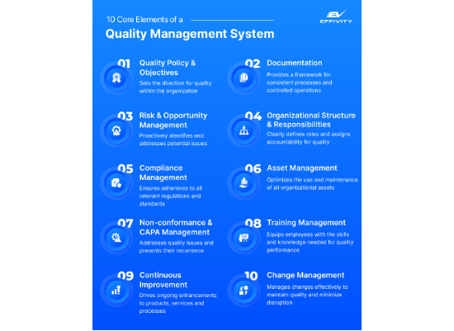
LLMEVALS: Independent Validation
The "Judge" Model
•
Independent Layer: Separated from the main pipeline to ensure unbiased auditing.
•
Pairwise Comparison: Compares Model-2 (Facts) vs. Model-3 (Narrative) to detect discrepancies.
•
Metrics: specifically checks for hallucinations, missing signals, and tone appropriateness.
•
Groq API: Utilized for high-speed inference, allowing rapid iterative testing of prompts.

Slide 11

Unified Interface
Streamlit-Based Dashboard
The UI is designed for transparency. Users see the "Final Report" by default but can toggle tabs to inspect the raw data from Model-1 and the reasoning logic of Model-2.
Audit Trail: Every step of the pipeline is logged and visible, building trust with technical users and clinicians.

Slide 12



Orchestration (app.py)
Module Integration
Data Flow
Session State
Connects Python modules for Extractor, Reasoning, and Synthesis into a coherent synchronous pipeline.
Manages I/O operations, passing JSON artifacts between stages and saving outputs to the local file system.
Maintains user context and report data across UI re-renders in Streamlit, ensuring a smooth UX.

Slide 13

Dockerization & Deployment
Isolation & Reproducibility
•
Per-Module Dockerfiles: Ensures dependencies for OCR (Tesseract) and LLM libraries do not conflict.
•
Unified UI Container: Dockerfile.ui orchestrates the frontend presentation layer.
•
Scalability: Modular containerization allows individual components to be scaled or updated independently.
•
Deployment: Ready for cloud deployment on AWS ECS or similar container services.

Slide 14


Safety, Ethics & Guardrails
No Diagnosis
Deterministic Truth
Full Auditability
System is strictly framed as a decision support tool. It never claims to replace a doctor's diagnosis.
Core reasoning is rule-based. The AI explains the rules; it does not invent them.
Every claim in the final report can be traced back to a specific line in the raw blood report data.

Slide 15

Conclusion & Key Takeaways
Differentiation: Combines the safety of rule-based systems with the accessibility of LLMs.
Safety First: Architecture prevents "black box" failure modes common in end-to-end AI.
Relevance: A realistic template for regulatory-compliant medical AI deployment.

