Slide 1

Fake Profile Identification In Social Network Using Machine Learning & NLP
Sir CR Reddy College of Engineering
Department of Information Technology
Under the Guidance of:
N Durga Prasanna
Team Members:
J Janaki Lakshmi(20B81A1243)
K Teja(21B85A1206)
A Lohika(20B81A1206)
G Deepu Venkata Swaroop(20B81A1228)

Slide 2
AGENDA
Abstract
Introduction
Requirement Specification
Existing System
Drawbacks of Existing System
Proposed System
Methodology
Implementation
Result

Slide 3
Abstract
Now-a-days people are using social media by creating their unique profiles for Communication with Friends & Family. But, there are some threats on user’s Privacy and Security.To know who are creating those threats, we classify the each user’s Individual profile by using Machine Learning and Natural Language Processing Techniques .Here we identify the fake profile using Machine Learning models.This project proposes a classification approach to distinguish genuine and fake profiles, addressing security challenges in the prevalent realm of social network platforms.

Slide 4

Introduction
In today's world, almost everyone is using social media every day. People create profiles and connect with each other, no matter where they are. While social media has its benefits, it also brings up security concerns, especially about our personal information. Figuring out who might be causing problems on social media requires us to sort through user profiles. The ways we currently do this work pretty well, but we want to make them even better. So, in this presentation, we suggest using smarter techniques like Machine Learning and Natural Language Processing. We'll use these techniques to get better at spotting fake profiles and make online spaces safer for everyone.​

Slide 5
Requirement Specification
Software Requirements
• Web Interface:Streamlit
• Language: Python
• Machine Learning Libraries
• Editor: Visual Studio Code
Hardware Requirements
• Hard Disk:20GB
• Processor: Intel Core i5 and above
• RAM: 4GB

Slide 6
Existing System
The existing model for fake profile detection likely employs a Random Forest approach.​
Random forest is a supervised learning algorithm. The “forest” it builds is an ensemble of decision trees, usually trained with the bagging method. The general idea of the bagging method is that a combination of learning models increases the overall result.​
While the existing model may incorporate basic machine learning algorithms, it might not leverage more advanced techniques like deep learning or sophisticated natural language processing. ​

Slide 7
Drawbacks of Existing System
Interpretability: Random Forests, being an ensemble of multiple decision trees, can be challenging to interpret compared to a single decision tree.​
Computational Complexity: Training a large number of decision trees in a Random Forest can be computationally expensive and time-consuming.​
Handling Noisy Data: Struggles with outliers or noisy data.

Slide 8
Proposed System
The proposed model introduces Machine Learning and Natural Language Processing (NLP) techniques like SVM, KNN, Naive Bayes ,Lemmatization , Stop Word, Stemming.​
The aim is to enhance the accuracy rate of fake profile detection in social networks.
The proposed model seeks to address the limitations of Random Forest methods and improve the overall effectiveness of fake profile detection.​

Slide 9
Methodology
Data Collection and Preprocessing
Model training and testing
Model Evaluation and Persistence
Streamlit Interface

Slide 10
Data Collection and Preprocessing
Identify sources of training data, including text and image datasets. Some common sources are like public datasets,web scraping,government databases and many more.
Implement data collection processes to gather diverse and representative samples. Gather information from a wide range of people and places to make sure it represents everyone fairly and accurately. Use different methods like surveys or interviews to collect this information in a respectful and careful way.
Apply preprocessing steps, such as text tokenization, feature extraction.

Slide 11
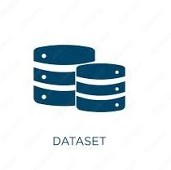
Dataset Description
A "fake/genuine profiles dataset" is a collection of information about online accounts on social media or other platforms. It includes details about profiles that are either real (genuine) or fake (created with false information). This dataset helps developers study the characteristics of fake and genuine profiles, understand how they differ, and develop methods to identify and distinguish between them.

Slide 12
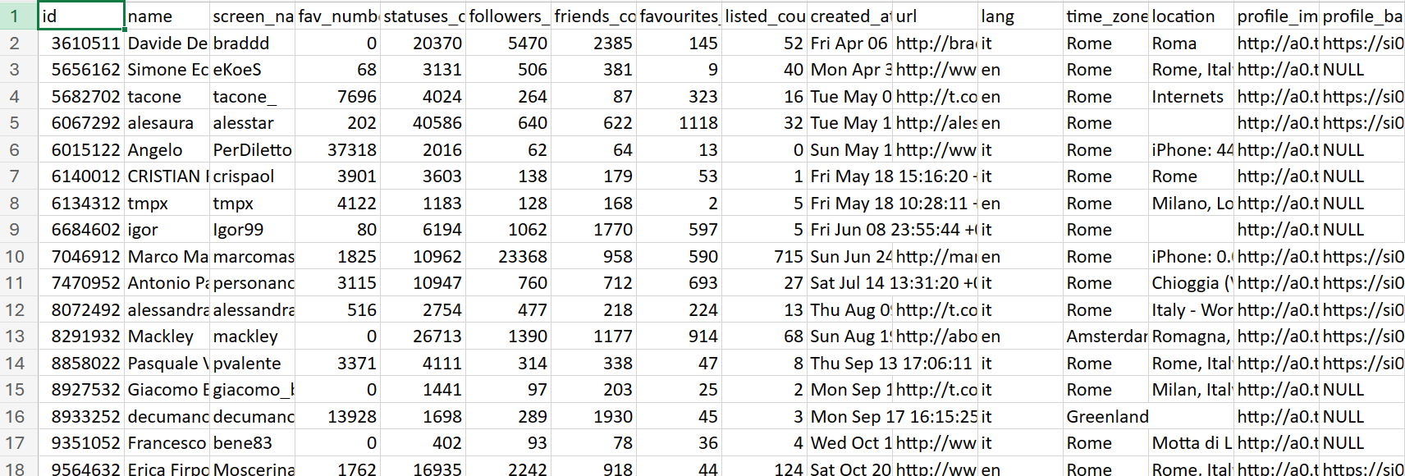
Dataset

Slide 13
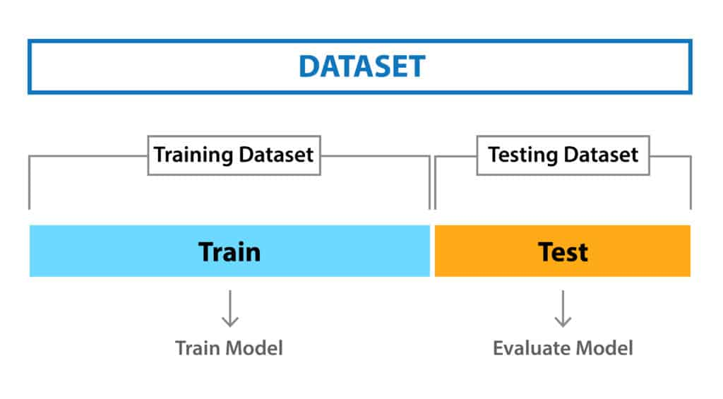
Model Training and Testing
The code trains multiple classifiers including Support Vector Machine (SVM), Naive Bayes, and K-Nearest Neighbors using the preprocessed and transformed features.
These classifiers are trained on the training dataset.
Evaluate the trained models on the testing set to assess their performance using metrics such as accuracy, precision, recall, and F1-score.

Slide 14
Model Evaluation and Persistence
After predicting the labels for the testing set, calculate and print out evaluation metrics to assess the models' performance.
Trained models (vectorizer, SVM, Naive Bayes, KNN, and PCA) are saved using joblib for future use.

Slide 15

Streamlit Interface
The Streamlit application interface allows users to input profile details including name, followers count, friends count, location, and profile description.
Upon clicking the "Predict" button, the entered details are preprocessed, vectorized, and passed through the trained SVM classifier for prediction.
The predicted result (whether the profile is fake or genuine) is displayed to the user.

Slide 16
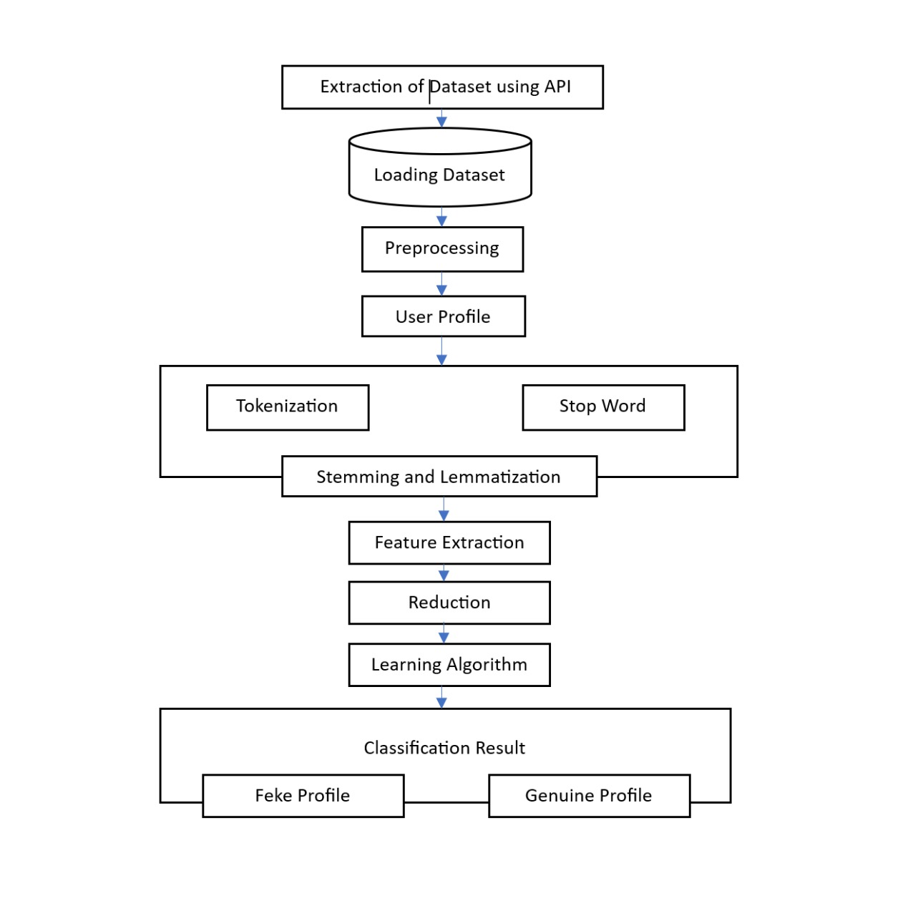
Design Architecture

Slide 17
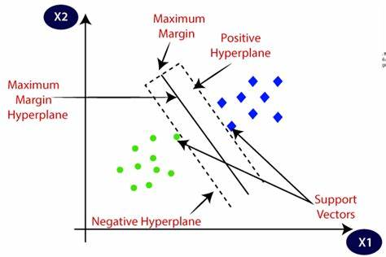
Algorithms
Support Vector Machine (SVM)
SVM is a supervised learning algorithm used for classification tasks. It aims to find the hyperplane that best separates different classes in the feature space. In this code, a linear SVM classifier (SVC) is employed for binary classification of fake and genuine profiles.
Usage: SVM is particularly effective when the number of features is relatively high compared to the number of samples.

Slide 18
Naive Bayes
Naive Bayes is a probabilistic classifier based on Bayes' theorem with the assumption of feature independence. Despite its simplicity, it often performs well in text classification and other tasks where the independence assumption holds reasonably well.
Usage: In the code, the Multinomial Naive Bayes classifier (MultinomialNB) is utilized for text classification based on preprocessed profile descriptions.

Slide 19
K-Nearest Neighbors (KNN)
KNN is a simple, instance-based learning algorithm used for classification and regression tasks. It classifies data points based on the majority class among their k nearest neighbors.
Usage: In the code, the K-Nearest Neighbors Classifier (KNeighborsClassifier) is used for classification. KNN is suitable for small to medium-sized datasets and can work well with non-linear data.
Each algorithm in the code serves the purpose of classifying profiles into fake or genuine categories based on various features extracted from the profile descriptions and associated attributes. The choice of algorithms allows for exploring different approaches and comparing their performance in profile identification.

Slide 20
Implementation
Importing Libraries:
The necessary libraries are imported at the beginning, including pandas for data manipulation, Streamlit for building the web application, scikit-learn for machine learning tasks, NLTK for natural language processing, and joblib for saving models.
Data Loading and Preprocessing:
The dataset is loaded from a CSV file.
Missing values in certain columns are filled with empty strings.
Features like name, follower count, friend count, location, and description are combined into a single feature called combined_features.
Text preprocessing is performed on the combined features. This includes tokenization, removing stopwords, punctuation, and applying lemmatization.

Slide 21
Text Vectorization (TF-IDF): The preprocessed text is vectorized using the TF-IDF (Term Frequency-Inverse Document Frequency) method. This helps in converting text data into numerical format for machine learning algorithms to process. Dimensionality Reduction (PCA): PCA (Principal Component Analysis) is applied to reduce the dimensionality of the TF-IDF vectorized data. This is useful for reducing computational complexity and noise in the data. Splitting Data: The dataset is split into training and testing sets.

Slide 22
Model Training:
Several classifiers are trained including SVM (Support Vector Machine), Naive Bayes, Random Forest, and K-Nearest Neighbors.
Each classifier is trained on the preprocessed and dimensionality-reduced data.
Evaluation Metrics Calculation:
Accuracy, precision, recall, and F1-score are calculated for each classifier using the testing data.

Slide 23
Saving Models:
Trained models along with the vectorizer and PCA instances are saved using joblib for future use.
Streamlit Application:
The Streamlit application is defined where users can input profile details.
Upon clicking the 'Predict' button, the input details are preprocessed, vectorized, transformed using PCA, and fed into the SVM classifier for prediction.
The predicted label (Fake Profile or Genuine Profile) is displayed to the user.

Slide 24
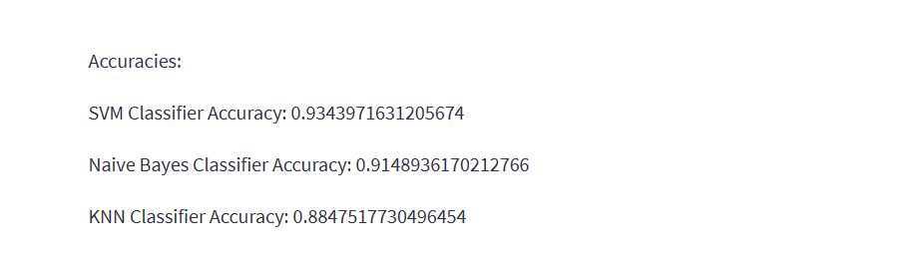
Result
Accuracy Results of 4 Classification models

Slide 25
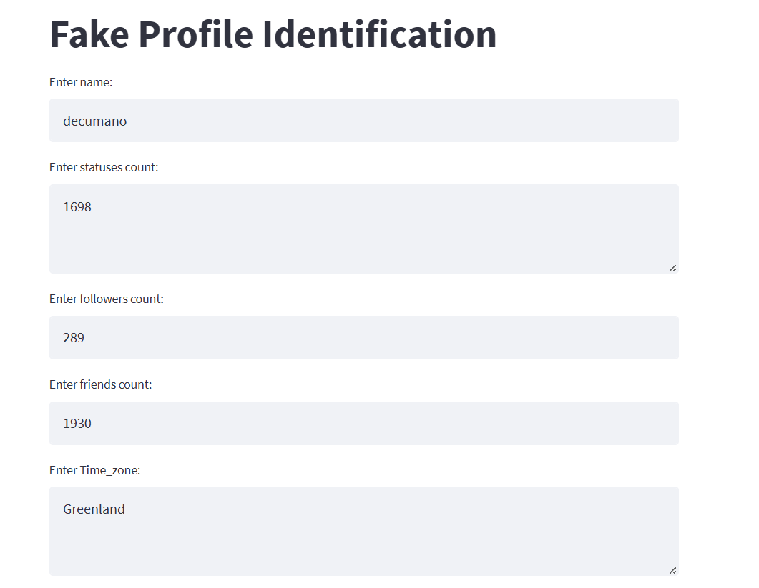
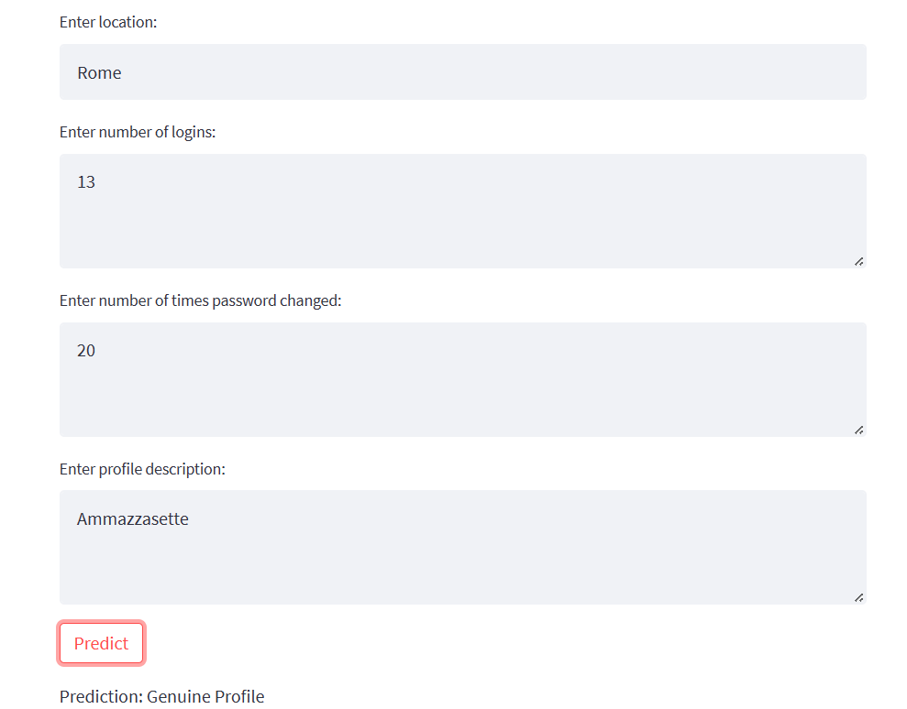
Output Screens

Slide 26
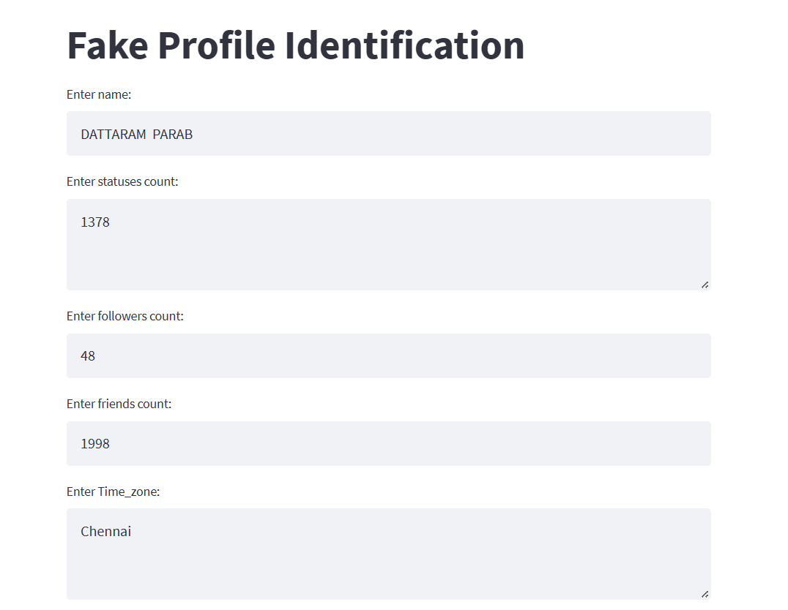
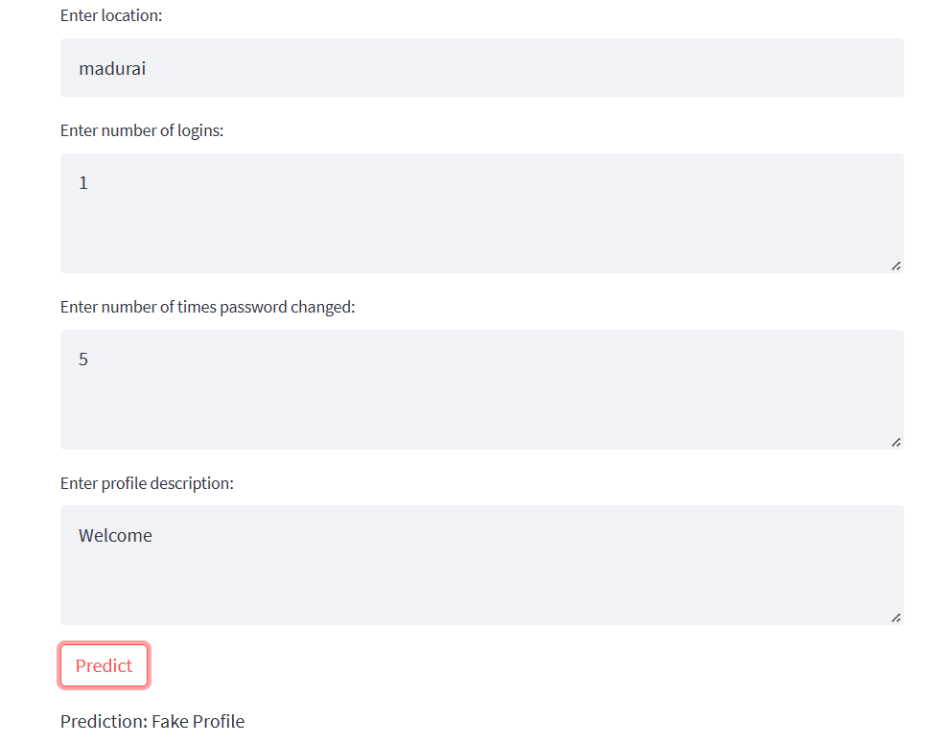

Slide 27
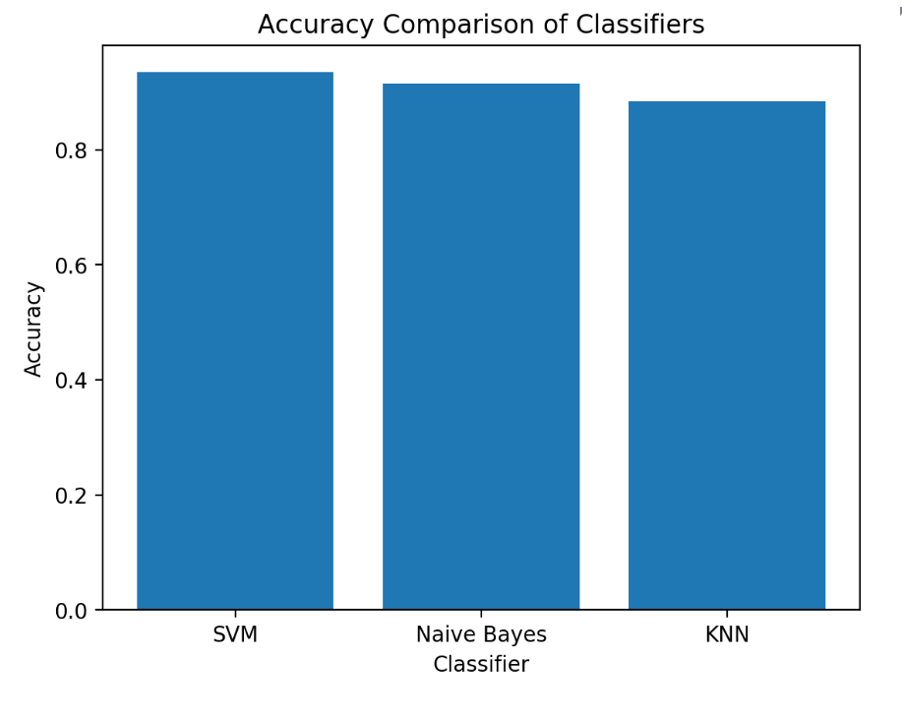

Slide 28
Conclusion
This project focuses on detecting fake profiles on social networks by using advanced computer techniques like machine learning and natural language processing (NLP). We trained algorithms such as Support Vector Machines (SVM), Naive Bayes, and K-Nearest Neighbors (KNN) on a dataset containing real and fake profiles' features. The algorithms learned to identify patterns that distinguish fake from genuine profiles.
Our project significantly improved the ability to detect fake profiles on social media. This is crucial for ensuring trust and honesty in online communities, as it helps prevent deceptive practices and maintains a safe and authentic environment for users.

Slide 29
THANK YOU

