Slide 1

AI Chatbot for Forensic Analysis of Telecom and Digital Forensics Data
Turning Raw Telecom Data into Actionable Intelligence

Slide 2

Telecom Investigations Are Data-Heavy but Insight-Poor
Massive CDR, IPDR, Tower Dump datasets overwhelm analysts
Manual cross-analysis consumes critical hours or days
Hidden behavioral patterns frequently go unnoticed
Delays severely impact investigative outcomes
In intelligence, speed defines success.

Slide 3

Current System Limitations
Static Dashboards
No AI Reasoning Layer
Limited to basic data display without dynamic interaction.
Lacks automated cognitive analysis and inference capabilities.
No Behavioral Pattern Detection
Data Visualization Without Insight Extraction
Inability to identify complex or subtle behavioral anomalies.
Presents data but fails to deliver actionable intelligence.

Slide 4


An AI Investigator — Not Just a Dashboard
TeleIntel transforms raw telecom data into actionable intelligence through a sophisticated AI reasoning layer.
Raw Telecom Data
AI Behavioral Reasoning
Call logs, CDRs, metadata
Infer patterns and intent
Backend Processing
Investigative Intelligence
Normalize, enrich, aggregate
Actionable leads and context

Slide 5








Core Features: TeleIntel at a Glance
AI Investigator
Multi-Dataset Analysis
Behavioral Pattern Detection Engine
Risk Scoring System
Human-like intelligence briefings.
CDR, IPDR, Tower Dumps, and more.
Quantified threat assessment.
Uncover hidden links and anomalies.
Timeline Reconstruction
Network Relationship Mapping
Quick Scan & Deep Investigation Modes
Structured Intelligence Report Generation
Visualize events in chronological order.
Dynamic visualization of connections.
Adaptive analysis depth.
Automated, comprehensive reporting.

Slide 6

Live AI Report Sample
Executive Summary
Overview of key findings and their implications.
Key Observations
Critical data points identified by AI.
Suspicious Indicators
Flags for anomalous activities.
Recommended Actions
Prescriptive steps for next phase.
Risk Score: 8.4 / 10
Threat Level: High

Slide 7






Robust Technology Stack
Frontend: React.js
AI UI: Antigravity
Dynamic, responsive UI.
Rapid AI prototyping.
Backend: Node.js
Database: Supabase
Scalable server-side logic.
Secure PostgreSQL backend.
AI Layer: LLM Integration
Infrastructure: Cloud-based
Prompt-engineered intelligence.
Secure, elastic deployment.

Slide 8
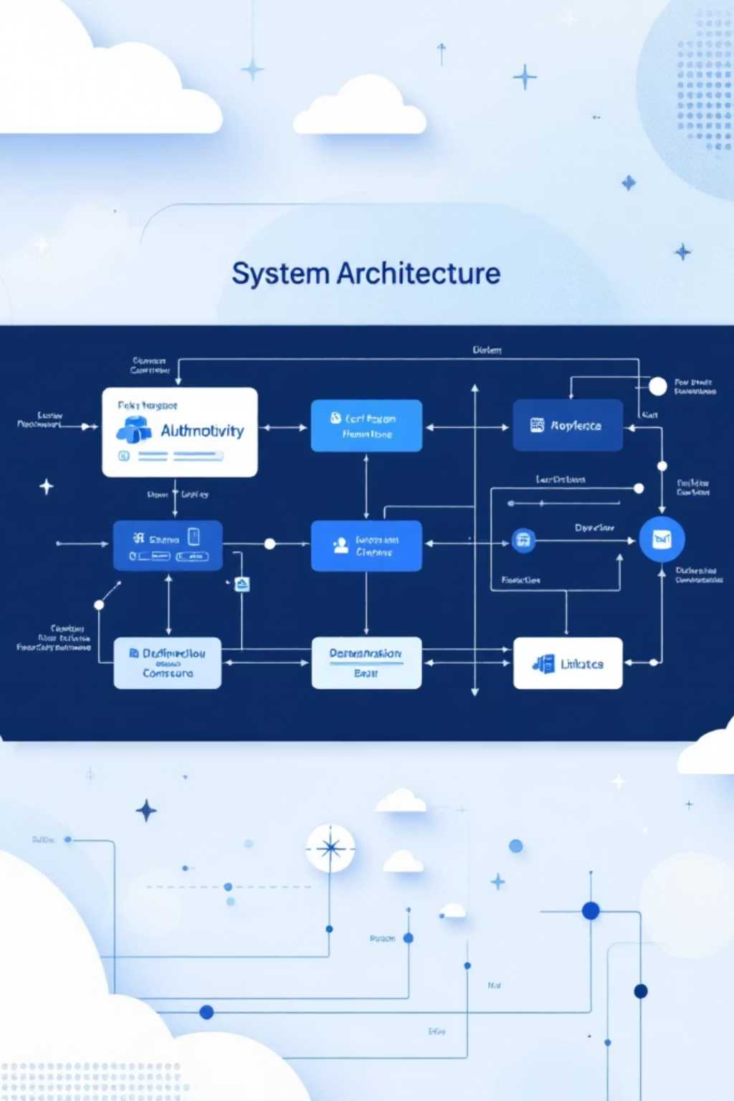

System Architecture
User Interface
API Layer
Data Engine
Supabase + AI

Slide 9

Innovation Factor
Conversational Forensic Analysis: Interact with data intuitively.
Human-like Structured Intelligence Reporting: AI-generated, high-quality reports.
AI-Assisted Anomaly Detection: Pinpoint deviations with precision.
Quantified Risk Scoring: Objective threat assessment.
Decision-Oriented Output: Clear, actionable recommendations.

Slide 10

Impact: Redefining Intelligence Operations
Reduces Investigation Time Significantly: From days to minutes.
Accelerates Pattern Detection: Uncover hidden threats faster.
Minimizes Manual Workload: Automate tedious data analysis.
Enhances Decision-Making Accuracy: Data-driven insights for critical choices.

Slide 11
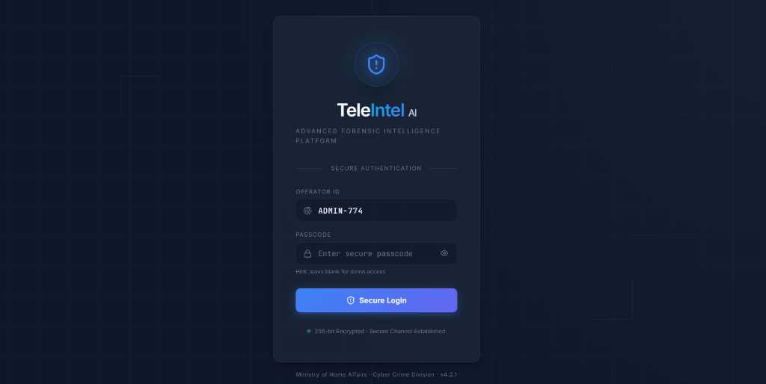
Screenshots of the project
1. Login page

Slide 12
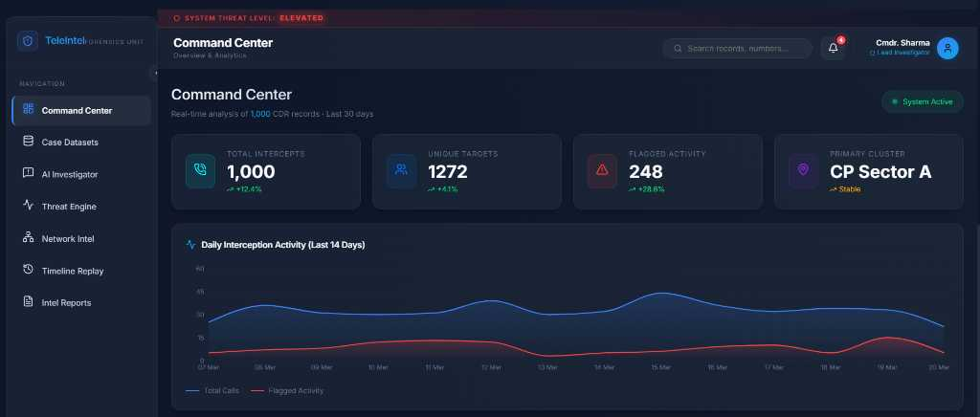
2. Command center dashboard

Slide 13
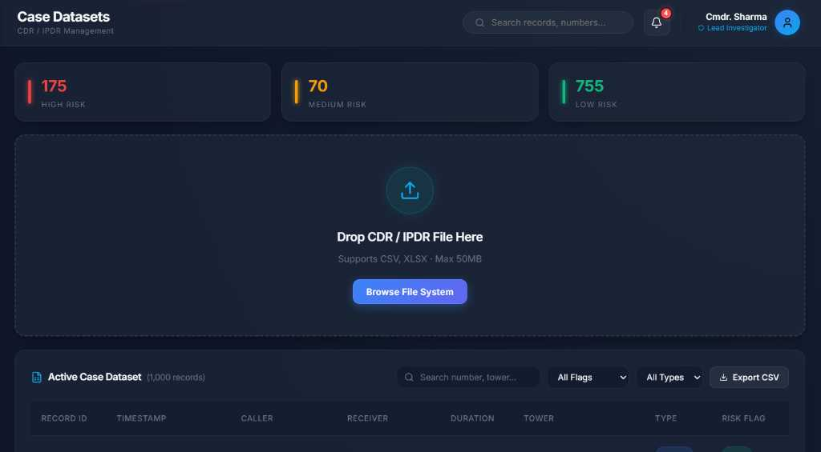
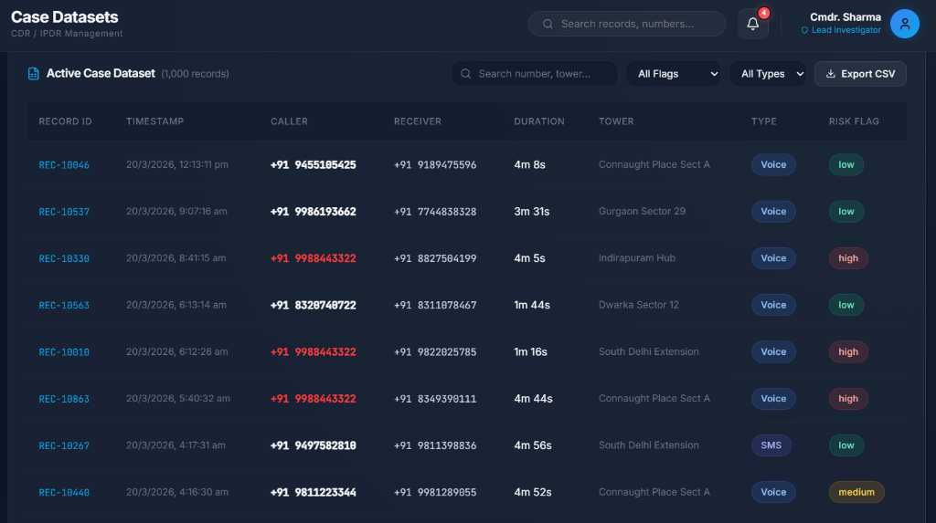
3. Case Datasets

Slide 14
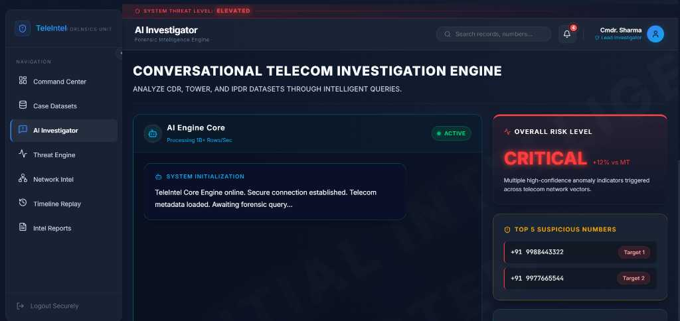
4. AI Chatbot (Main)

Slide 15
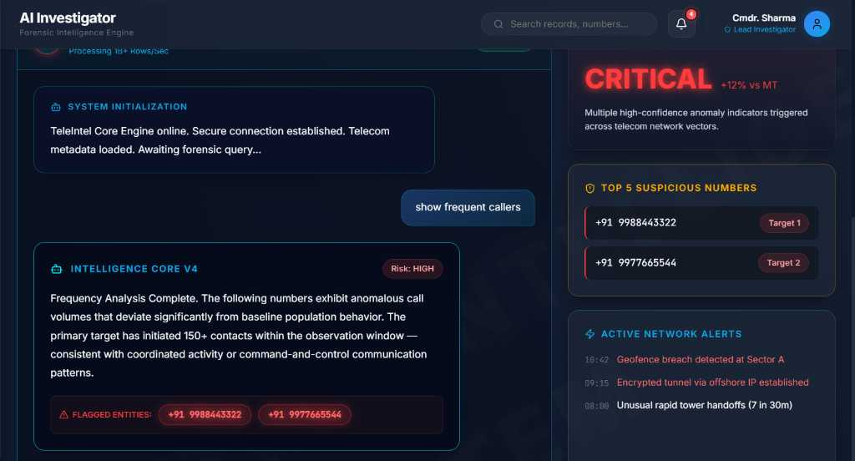
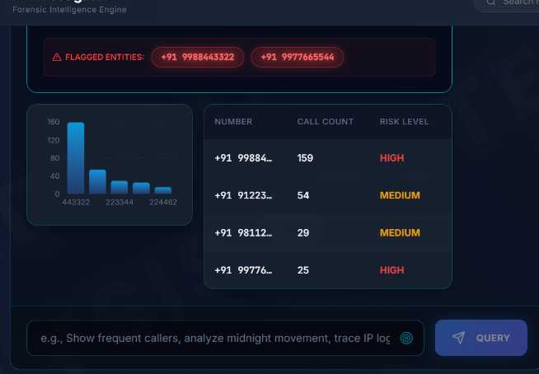
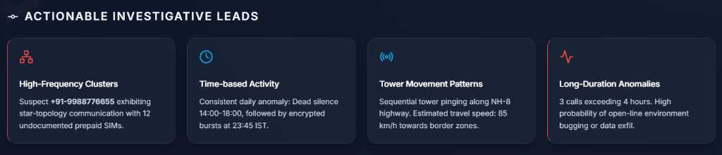

Slide 16
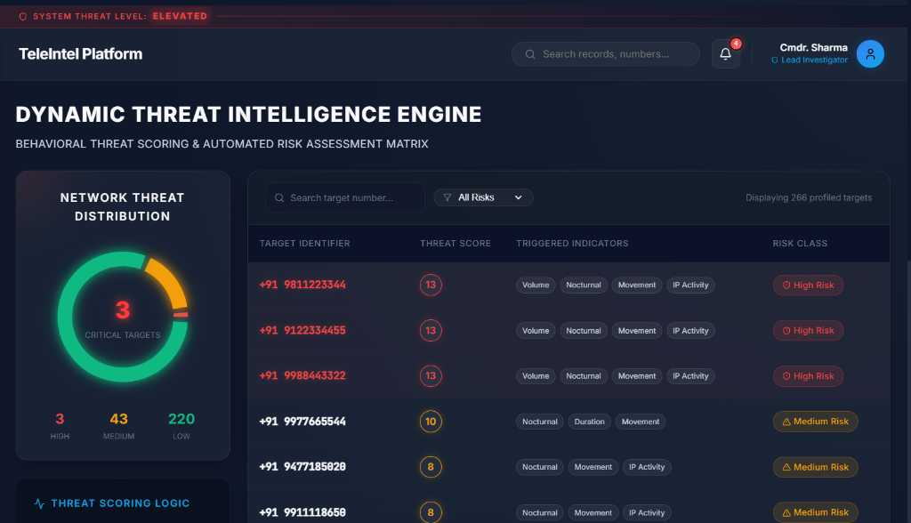
5. Threat Engine

Slide 17
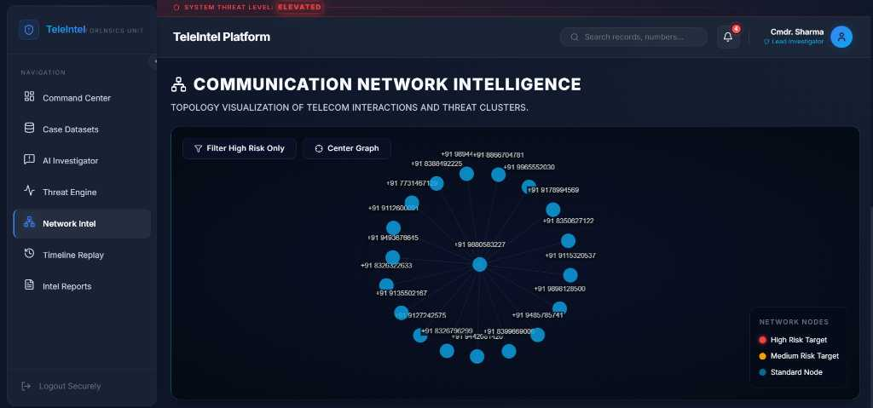
6. Network Intel

Slide 18
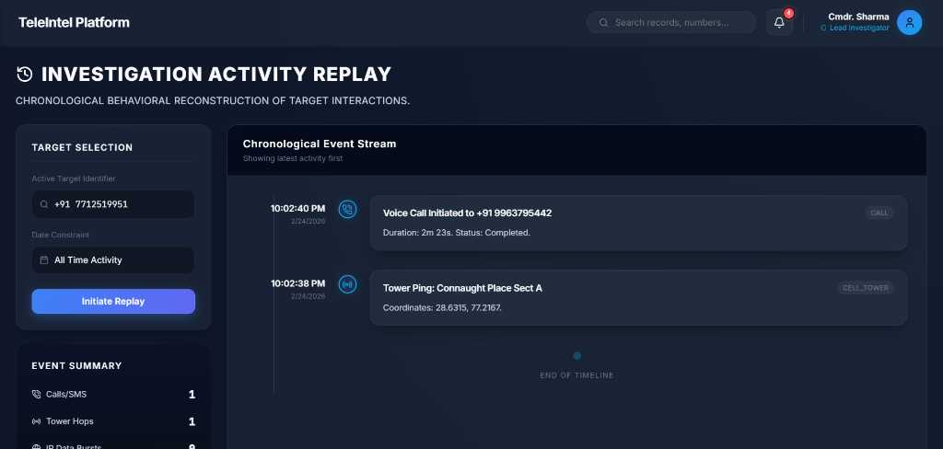
7. Timeline Replay

Slide 19
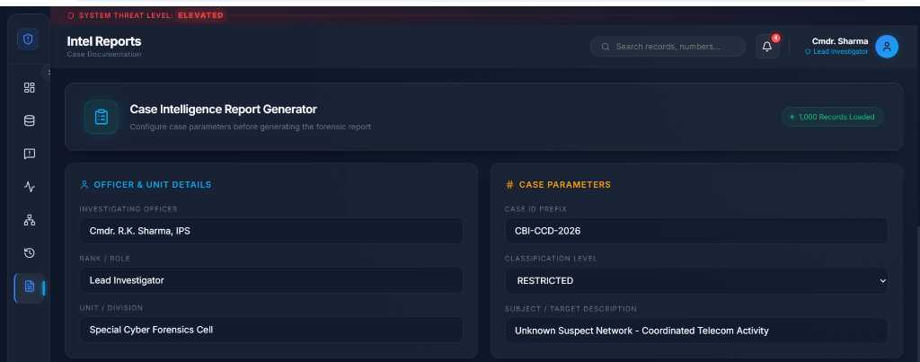
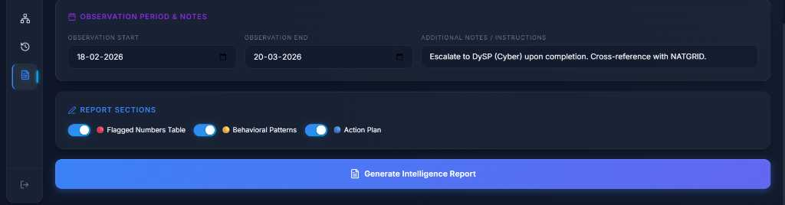
8. Intel Reports

Slide 20
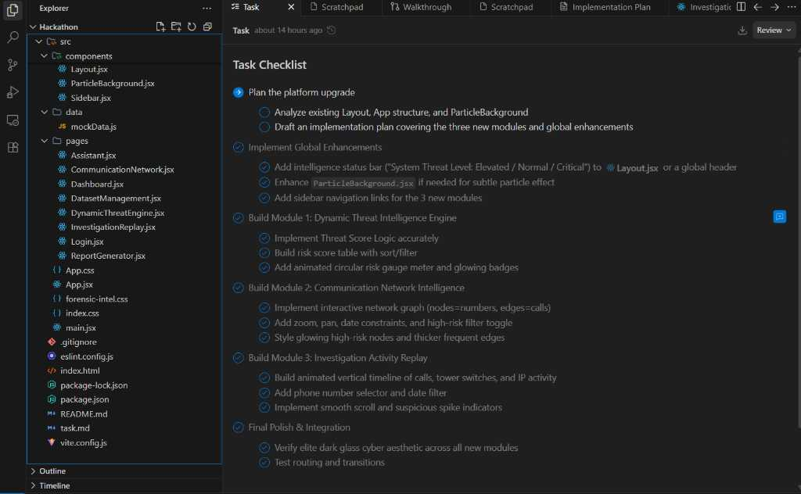
Application Development Snapshot

Slide 21
Thank You

