Slide 1
Design and Analysis of a Telescopic OTA
Daivik I Vinayaka Karthik K Prasad
4NI23EC023 4NI23EC039
Department of Electronics and Communication Engineering National Institute of Engineering, Mysuru

Slide 2
Introduction
A Telescopic CMOS Operational Transconductance Amplifier (OTA) is a high-gain, single-stage analog amplifier topology widely used in low-power and high-speed analog circuit applications. It belongs to the family of cascode amplifiers, where transistors are stacked vertically to enhance output resistance and gain, resembling the structure of a telescope—hence the name "telescopic."

Slide 3
Objectives
Parameter
Value
Supply Voltage DC Gain
Transconductance (g_{m}) Unity Gain Bandwidth Phase Margin
Power Consumption
3.0 V
50–70 dB
Set by I_{BIAS}
Determined by g_{m}/C_{f}
> 60◦
^{10mA}
Table: Target specifications for the OTA design.

Slide 4
Design specifications
DC Gain: 20 dB
UGB: 1.2 GHz
Phase Margin: ~60°
Load Capacitance: 1 pF
Supply Voltage: ±1.8 V
Power Consumption: ~300 µW
Technology: 180 nm CMOS
1
2

Slide 5
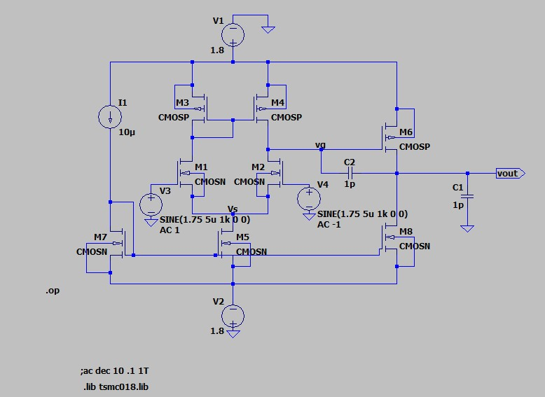
Circuit Diagram
Figure: Circuit diagram of the two-stage CMOS OTA.
Differential input to single-ended output conversion. Miller capacitor connects intermediate node to output.

Slide 6
Working Principle
Differential Input Pair
Current Steering
Cascoding for Gain Boosting
High Output Impedance and Gain

Slide 7
Design
2(VDD - |Vov7| - |Vov5| - Vov3 - Vov1 - Vov9
(W/L)9 = 400
(W/L)1-4 = 1250
(W/L)5-8 = 1111.1
Av = gm1,2[gm3ro3.ro1||gm5ro5.ro7]
gm1-4 = 15mA/V
ro1-4 = 6.66k
gm5-8 = 10mA/V
ro5-8 = 3.33k

Slide 8
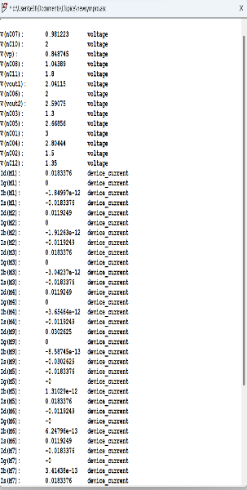
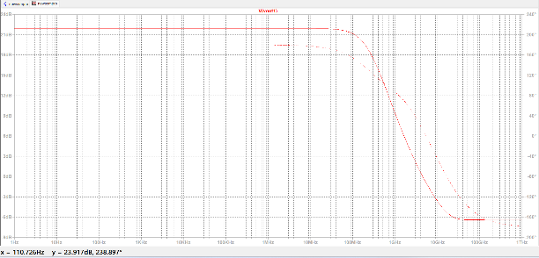
Results
The tail current source (I1) supplies a bias current of 10 μA, which is symmetrically split across the differential pair transistors M1 and M2, each drawing approximately 5.05 μA, confirming balanced operation. The common-source node of the differential pair (M5 drain) sits at a potential of 1.251 V. The drain current of M6 is 10.27 μA, showing that it carries the entire signal path current through the load branch.
The small-signal AC analysis of the fully differential amplifier reveals a 3 dB gain of approximately 54.01 dB, corresponding to a voltage gain of 501. The 3 dB bandwidth occurs beyond 43.19 kHz, indicating that the amplifier maintains a high gain up to this frequency.
The observed roll-off rate beyond the cutoff frequency is approximately −20 dB/decade.

Slide 9
Applications
Switched-capacitor filters Comparator Preamplifiers
Phase-Locked Loops (PLLs) and Frequency Synthesizers
Low-Power Analog Signal Processing

Slide 10
Conclusion
The Telescopic CMOS OTA is a compact, high-gain, and low-power amplifier ideal for analog applications where speed and efficiency are critical. While it offers excellent gain and bandwidth due to its cascode structure, its use is best suited to designs where limited output swing and common-mode range are acceptable. Overall, it remains a powerful choice in integrated analog design for low-voltage, high-performance systems.

